Slide 1
SPEA-V-202
Contemporary Economic Issues in Public Affairs
Market Equilibrium
Luis Navarro

Slide 2


Outline for Today
Market Equilibrium
Conditions for equilibrium
Economic Intuition and Willingness to sell/buy
Examples
Market Changes and Market Equilibrium
Shifts in supply and demand
Role of elasticities
Market Size
Empirical Considerations

Slide 3




Introduction
Demand Curve
Law of Demand: if ↑P then ↓Q
Negatively sloped.
Willingness to Pay (WTP) curve.
Supply Curve
Law of Supply: if ↑P then ↑ Q
Positively sloped.
Willingness to Sell (WTS) curve.
$$P$$
Question
What does it mean that supply equals demand ?
$$Supply$$
$$Demand$$
$$Q$$

Slide 4
Introduction
$$P$$
Assumptions for Equilibrium
Sellers and buyers can sell (and buy) as much as they want, so long they are willing to.
Price received equals price paid. Can only buy and sell at an agreed price.
At equilibrium: marginal benefit equals marginal cost.
$$Supply$$
$$Demand$$
$$Q$$

Slide 5
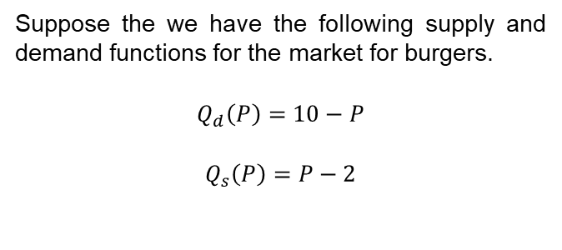
An Example
Some Lessons:
Recall these are curves of willingness to buy and sell.
If price is below 2, then there is no market. No burger place is willing to sell a burger.
If the price is above 10, then there is no market. Consumers won’t buy. Burgers too expensive.
For example, for p=4, consumers are willing to buy up to 6 burgers, but suppliers are only willing to sell 2 burgers. Willingness to buy is larger than the willingness to sell.
Now, for p=8 suppliers are willing sell 6 burgers, but consumers are only willing to buy 2. Willingness to buy is lower than the willingness to sell.
At p=6, both consumers and suppliers are willing to buy and sell 4 burgers. Willingness to buy = willingness to sell.
Suppose the we have the following supply and demand functions for the market for burgers.
$$Q_{d}\left(P\right)=10−P$$
$$Q_{s}\left(P\right)=P−2$$
Price
0
2
4
6
8
10
Demand
10
8
6
4
2
0
Supply
-
0
2
4
6
8
Dem - Supp
-
+8
+4
0
-4
-8

Slide 6








An Example: Visual Representation
Suppose the we have the following supply and demand functions for the market for burgers.
$$Q_{d}\left(P\right)=10−P$$
$$Q_{s}\left(P\right)=P−2$$
Market for Burgers
$$P$$
$$10$$
$$Supply$$
Price
0
2
4
6
8
10
Demand
10
8
6
4
2
0
Supply
-
0
2
4
6
8
Dem - Supp
-
+8
+4
0
-4
-8
P=6 is the market clearing price. At such price, quantity demanded equals quantity supplied.
$$6$$
$$2$$
$$Demand$$
$$Q$$
$$4$$

Slide 7





What’s the fuzz about equilibrium ?
Market for Burgers
Market equilibrium it is when consumer’s willingness to pay (WTP) equals producer’s willingness to sell (WTS). In simple words, when supply equals demand.
How do we reach market equilibrium?
Adam Smith: the invisible hand and market forces.
For prices below 6, WTP > WTS.
Consumers could be better-off because there is unsatisfied demand. But there are no incentives to produce enough burgers at such prices.
For prices above 6, WTP < WTS.
Suppliers are willing to sell more burgers, but there is not enough demand to buy them.
$$P$$
$$10$$
$$Supply$$
$$6$$
$$2$$
$$Demand$$
$$Q$$
$$4$$

Slide 8
What’s the fuzz about equilibrium ?
Market for Burgers
$$P$$
Economists like equilibrium because it is efficient.
Market forces lead to the case where consumer surplus and producer surplus are maximized.
This is the main argument for laissez-faire economics.
Let the markets work and we’ll get and efficient allocation of resources in the economy.
Marginal benefit of buying = marginal cost of producing.
$$10$$
$$Supply$$
$$6$$
$$2$$
$$Demand$$
$$Q$$
$$4$$

Slide 9
What’s the fuzz about equilibrium ?
Market for Burgers
$$P$$
Economists like equilibrium because it is stable.
Given preferences, technology and all other factors influencing market’s supply and demand:
There are no incentives to produce more units by suppliers, and
No incentives from consumers to buy another unit.
In the absence of changes on supply and demand, we expect the market to remain in equilibrium.
When there are changes, the market will adjust to a new equilibrium.
$$10$$
$$Supply$$
$$6$$
$$2$$
$$Demand$$
$$Q$$
$$4$$

Slide 10




Market Adjustment
Market for Burgers
What happens if price is above the equilibrium price? How does the market adjust back to the equilibrium price.
Suppose p=8. At p=8, firms know people are not willing to buy the number of burgers they are willing to produce.
Quantity supplied is larger than quantity demanded.
Firms can cut the price to 7. With that, quantity demanded increases and quantity supplied falls.
Still, there is room to make profits (i.e. there is some producer and consumer surplus left on the table).
Firms will cut the price until reaching 6, where supply equals demand and the market for burgers clears.
$$P$$
$$10$$
$$Supply$$
$$8$$
$$7$$
$$6$$
$$2$$
$$Demand$$
$$Q$$
$$q_{d}$$
$$4$$
$$q_{s}$$

Slide 11





Excess Supply and Excess Demand
Market for Burgers
$$P$$
Whenever markets are not clearing, there is either excess supply or excess demand.
Excess Supply: happens when price is above its equilibrium level. Quantity supplied exceeds quantity demanded.
Excess Demand: happens when price is below its equilibrium level. Quantity demanded exceeds quantity supplied.
Market Equilibrium happens when there is neither excess supply nor excess demand.
$$10$$
Excess Supply
$$Supply$$
$$q_{d}$$
$$q_{s}$$
$$8$$
$$6$$
$$q_{s}$$
$$q_{d}$$
$$4$$
Excess Demand
$$2$$
$$Demand$$
$$Q$$
$$4$$

Slide 12





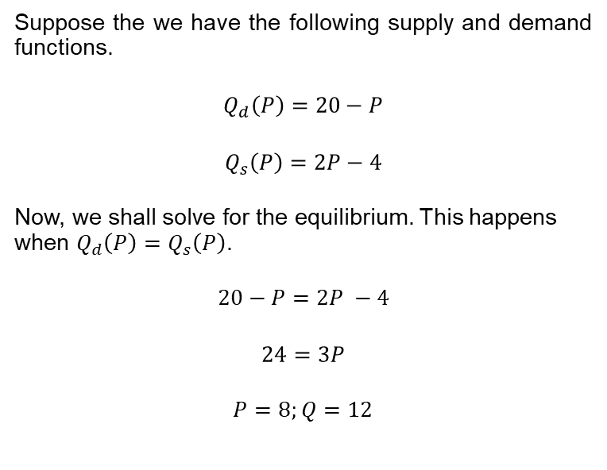


Example: supply and demand together
Suppose the we have the following supply and demand functions.
$$Q_{d}\left(P\right)=20−P$$
$$Q_{s}\left(P\right)=2P−4$$
Now, we shall solve for the equilibrium. This happens when $Q_{d}\left(P\right)=$ $Q_{s}\left(P\right)$.
$20−P=2P −4$
$$24=3P$$
$P=8;Q=12$
Market for Burgers
$$P$$
$$20$$
$$Supply$$
$$8$$
$$2$$
$$Demand$$
$$Q$$
$$12$$
$$20$$

Slide 13
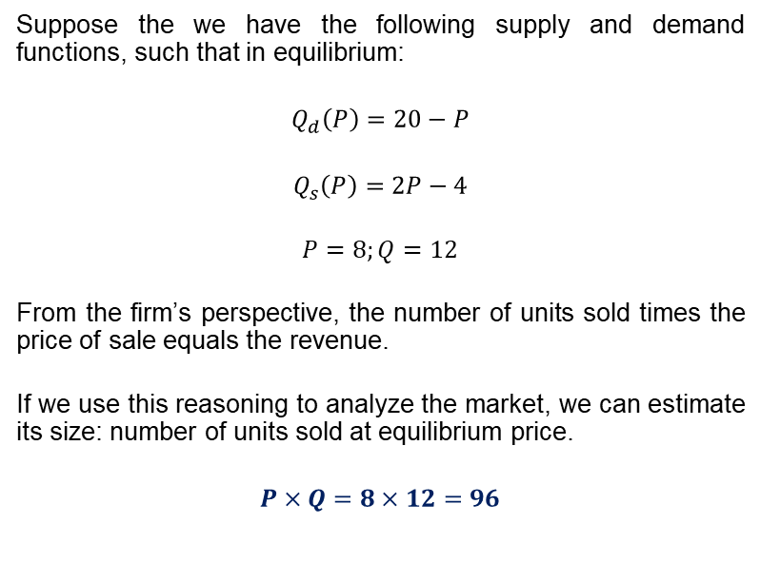
Market Size
Suppose the we have the following supply and demand functions, such that in equilibrium:
$$Q_{d}\left(P\right)=20−P$$
$$Q_{s}\left(P\right)=2P−4$$
$P=8;Q=12$
From the firm’s perspective, the number of units sold times the price of sale equals the revenue.
If we use this reasoning to analyze the market, we can estimate its size: number of units sold at equilibrium price.
$$P×Q=8×12=96$$
Market for Burgers
$$P$$
$$20$$
$$Supply$$
$$8$$
$$2$$
$$Demand$$
$$Q$$
$$12$$
$$20$$

Slide 14






Shifts in Demand
Market for Burgers
$$P$$
Suppose the market is at equilibrium? What happens if there is a shift in demand?
Demand decrease (shift to the left)
Both equilibrium price and quantity fall.
Demand increase (shift to the right)
Both equilibrium price and quantity rise.
Change in price and quantity follow the same direction.
Supply is constant: movements happen along the supply curve. Thus, elasticity of supply determines the new equilibrium.
$$Supply$$
$$p_{2}$$
$$p^{∗}$$
$$p_{1}$$
$$Demand$$
$$q_{2}$$
$$Q$$
$$q_{1}$$
$$q^{∗}$$

Slide 15





Shifts in Supply
Market for Burgers
$$P$$
Suppose the market is at equilibrium? What happens if there is a shift in supply?
Supply decrease (shift to the left)
Equilibrium price increases, but quantity falls.
Supply increase (shift to the right)
Equilibrium price drops and quantity rise.
Change in price and quantity follow opposite directions.
Demand is constant: movements happen along the demand curve. Thus, elasticity of demand determines the new equilibrium.
$$Supply$$
$$p_{1}$$
$$p^{∗}$$
$$p_{2}$$
$$Demand$$
$$Q$$
$$q_{1}$$
$$q_{2}$$
$$q^{∗}$$

Slide 16















Shifts in Supply and Demand
What happens if there are shifts in both supply and demand? There will be new equilibrium prices and quantities.
How do we know whether this new equilibrium will lead to higher/lower prices or quantities ? Depends on the shift. Example: Supply and Demand Increase (2 cases) [Tip: compare large vs small changes]
Case 1
Case 2
$$P$$
$$S_{0}$$
$$P$$
$$S_{0}$$
$$S_{1}$$
$$S_{1}$$
$$p_{1}$$
$$p^{∗}$$
$$p^{∗}$$
Effect on prices is ambiguous.
$$p_{1}$$
$$D_{1}$$
$$D_{0}$$
$$D_{1}$$
$$q^{∗}$$
$$q_{1}$$
$$Q$$
$$q^{∗}$$
$$q_{1}$$
$$D_{0}$$
$$Q$$

Slide 17



Class Example.
Take the market for burgers. Suppose there is a supply increase because there is a new restaurant in town and at the same time there is a decrease in demand due to a reduction in the price of chicken (substitute for beef).
Think-Pair-Share: make a prediction about the new equilibrium. Will it derive in higher/lower prices and/or quantities ? Take 2 minutes and discuss your predictions with the person beside you.
Case 1
Case 2
$$P$$
$$S_{0}$$
$$P$$
$$S_{0}$$
$$S_{1}$$
$$S_{1}$$
Effect on quantities is ambiguous, but prices will be lower.
$$p^{∗}$$
$$p^{∗}$$
$$p_{1}$$
$$p_{1}$$
$$D_{1}$$
$$D_{0}$$
$$D_{1}$$
$$q_{1}$$
$$q^{∗}$$
$$Q$$
$$q^{∗}$$
$$q_{1}$$
$$D_{0}$$
$$Q$$

Slide 18
Shifts in Supply and Demand: Effects on Prices
What happens if there are shifts in both supply and demand? There are four possibilities.
If demand shifts, then the effect on price and quantity has the same direction.
If supply shifts, quantity follows but price moves in the opposite direction.
If demand falls and supply increases, then we know that the new equilibrium will definitively have a lower equilibrium price.
If demand rises and supply drops, then we know that the new equilibrium will definitively have a higher equilibrium price.
For both joint decreases/increases in supply and demand, the effect on prices is uncertain. Depends on both supply and demand’s shift magnitude.
Effect on Price | Supply ↑ | Supply ↓
Demand ↑ | (d=↑, s=↓) | (d=↑, s=↑)
Demand ↓ | (d=↓, s=↓) | (d=↓, s=↑)

Slide 19
Shifts in Supply and Demand: Effects on Quantities
What happens if there are shifts in both supply and demand? There are four possibilities.
If demand shifts, then the effect on price and quantity has the same direction.
If supply shifts, quantity follows but price moves in the opposite direction.
For both joint decreases/increases in supply and demand, we know for sure the effect on equilibrium quantity: it will move with the direction of the change.
If demand falls and supply increases, or viceversa, then the effect on the new equilibrium quantity is uncertain. Depends on both supply and demand’s shift magnitude.
Effect on Quantity | Supply ↑ | Supply ↓
Demand ↑ | (d=↑, s=↑) | (d=↑, s=↓)
Demand ↓ | (d=↓, s=↑) | (d=↓, s=↓)

Slide 20
Market Size
Recall our example: supply increase and demand decrease at the same time.
In the first case, the market’s size will be lower.
For the second case, however, it is not clear whether the market’s size will rise or drop. It is ambiguous.
Case 1
Case 2
$$P$$
$$S_{0}$$
$$P$$
$$S_{0}$$
$$S_{1}$$
$$S_{1}$$
$$p^{∗}$$
$$p^{∗}$$
$$p_{1}$$
$$p_{1}$$
$$D_{1}$$
$$D_{0}$$
$$D_{1}$$
$$q_{1}$$
$$q^{∗}$$
$$Q$$
$$q^{∗}$$
$$q_{1}$$
$$D_{0}$$
$$Q$$

Slide 21












Elasticities of Supply and Demand
Suppose we have two consumers: Bob and Sandy. Both are consuming at the same equilibrium point. The only difference is that Sandy’s demand for burgers is more inelastic.
$$P$$
$$S_{0}$$
Now suppose there is an increase in supply.
For both consumers: equilibrium price drops and quantity consumed increases.
Magnitudes of the changes differ. Depend on the elasticities of demand.
Bob (Elastic): change in price is smaller, but change in the quantity is larger.
Sandy (Inelastic): change in price is larger, but change in the quantity is smaller.
$$D_{S}$$
$$S_{1}$$
$$p^{∗}$$
$$p_{B}$$
$$p_{S}$$
$$D_{B}$$
$$q^{∗}$$
$$q_{s}$$
$$q_{B}$$
$$Q$$

Slide 22








Elasticities of Supply and Demand
Suppose we have two firms: Apple and Samsung. Both are producing at the same equilibrium point. The only difference is that Samsung’s supply for cellphones is more inelastic.
$$P$$
$$S_{S}$$
Now suppose there is an increase in demand.
For both suppliers: equilibrium price and quantity produced increases.
Magnitudes of the changes differ. Depend on the elasticities of supply.
Apple (Elastic): change in price is smaller, but change in the quantity is larger.
Samsung (Inelastic): change in price is larger, but change in the quantity is smaller.
$$S_{A}$$
$$p_{S}$$
$$p_{A}$$
$$p^{∗}$$
$$D_{1}$$
$$D_{0}$$
$$q_{s}$$
$$q^{∗}$$
$$q_{A}$$
$$Q$$

Slide 23
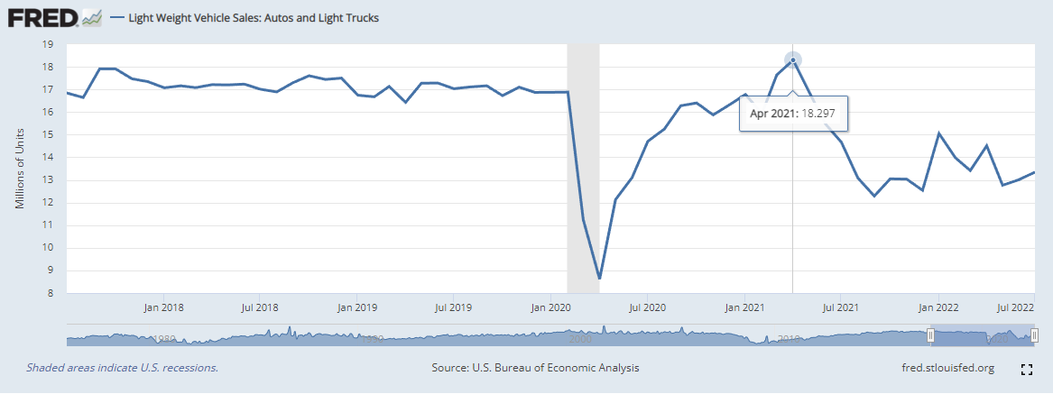
Empirical Considerations
When we look at data, what can we infer about the market?
How does this chart….
…relates to this chart?
Light Weight Vehicles Market
$$P$$
$$S_{0}$$
$$p^{∗}$$
$$D_{0}$$
$$q^{∗}$$
$$Q$$

Slide 24
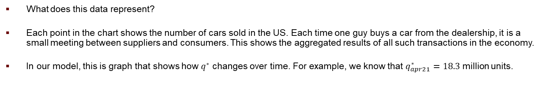
Empirical Considerations
What does this data represent?
Each point in the chart shows the number of cars sold in the US. Each time one guy buys a car from the dealership, it is a small meeting between suppliers and consumers. This shows the aggregated results of all such transactions in the economy.
In our model, this is graph that shows how $q^{∗}$ changes over time. For example, we know that $q_{apr21}^{∗}=18.3$ million units.

Slide 25
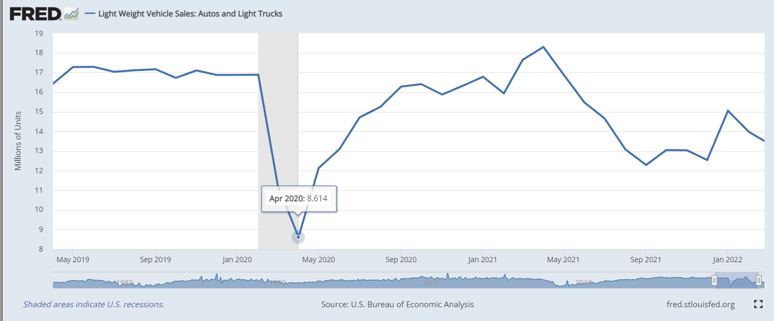
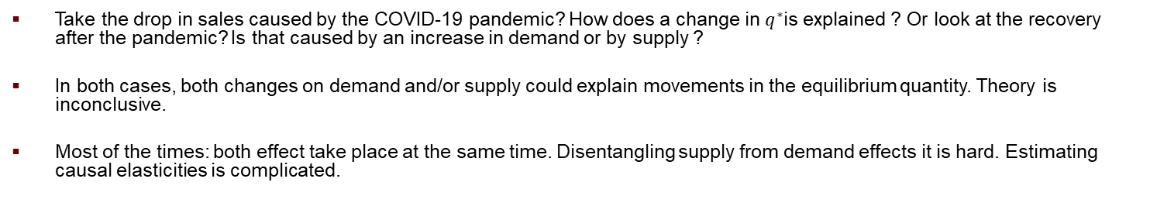
Empirical Considerations
Take the drop in sales caused by the COVID-19 pandemic? How does a change in $q^{∗}$is explained ? Or look at the recovery after the pandemic? Is that caused by an increase in demand or by supply ?
In both cases, both changes on demand and/or supply could explain movements in the equilibrium quantity. Theory is inconclusive.
Most of the times: both effect take place at the same time. Disentangling supply from demand effects it is hard. Estimating causal elasticities is complicated.

Slide 26
For Next Class
Readings: Mankiw 6 & 7, Stiglitz & Rosengard 4, Gruber 2. Optional (Winston)
Assignment: A1 is out.
Discussion Forum: is out.

Slide 27
SPEA-V-202
Contemporary Economic Issues in Public Affairs
Market Equilibrium
Luis Navarro

