Slide 1
SPEA-V-202
Contemporary Economic Issues in Public Affairs
Market Failure and Government Intervention
Luis Navarro

Slide 2


Outline for Today
Economic Efficiency
Measurements of Economic Well-being
Total Surplus and Economic Efficiency
Free-market Exchange and Efficiency
Market Failure
Departures from efficiency
Types of market failures
Examples

Slide 3




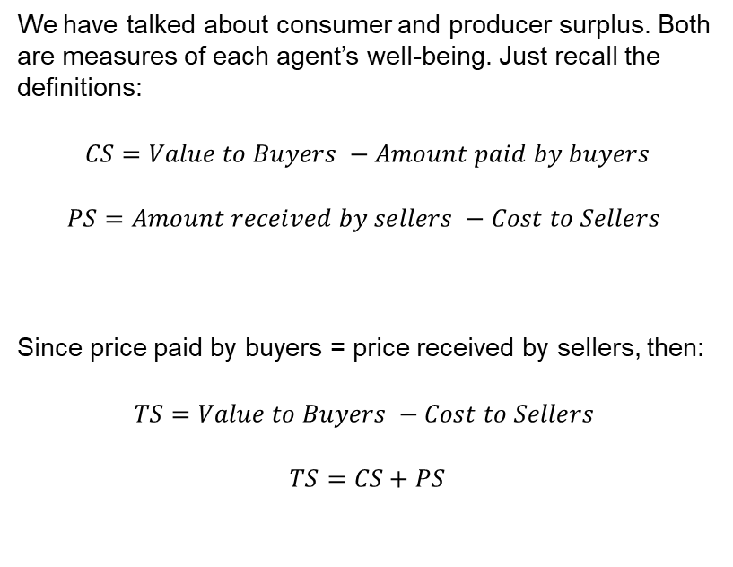




Measurements of Economic Well-Being
Market for Burgers
We have talked about consumer and producer surplus. Both are measures of each agent’s well-being. Just recall the definitions:
$$CS=Value to Buyers −Amount paid by buyers$$
$$PS=Amount received by sellers −Cost to Sellers$$
Since price paid by buyers = price received by sellers, then:
$$TS=Value to Buyers −Cost to Sellers$$
$$TS=CS+PS$$
$$P$$
$$10$$
$$Supply$$
$$6$$
$$2$$
$$Demand$$
$$Q$$
$$4$$
$$10$$

Slide 4



Measurements of Economic Well-Being
Market for Burgers
Total surplus measures the aggregated well-being of producers and consumers.
What’s the ideal? = Maximize Total Surplus.
Let’s look how TS changes across different prices.
$$P$$
$$10$$
$$Supply$$
A
$$8$$
P | CS | PS | TS
2 | - | - | -
4 | A+B+D | F | A+B+D+F
6 | A+B+C | D+E+F | A+B+C+D+E+F
8 | A | B+D+F | A+B+D+F
10 | - | - | -
B
C
$$6$$
D
E
MAX
$$4$$
F
$$2$$
$$Demand$$
$$Q$$
$$2$$
$$4$$
$$10$$

Slide 5
Measurements of Economic Well-Being
Market for Burgers
Numeric example. Given our supply and demand equations you can check that (Homework):
B=D=4
A=F=C=E=2
$$P$$
$$10$$
$$Supply$$
2
$$8$$
P | CS | PS | TS
2 | - | - | -
4 | 10 | 2 | 12
6 | 8 | 8 | 16
8 | 2 | 10 | 12
10 | - | - | -
4
2
$$6$$
4
2
MAX
$$4$$
2
$$2$$
$$Demand$$
$$Q$$
$$2$$
$$4$$
$$10$$

Slide 6
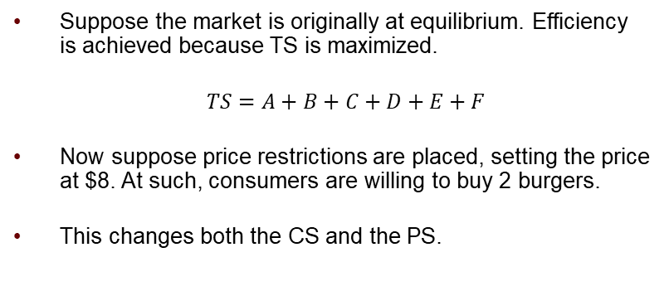
Efficiency and departures from it
Market for Burgers
Suppose the market is originally at equilibrium. Efficiency is achieved because TS is maximized.
$TS=A+B+C+D+E+F$
Now suppose price restrictions are placed, setting the price at $8. At such, consumers are willing to buy 2 burgers.
This changes both the CS and the PS.
$$P$$
$$10$$
$$Supply$$
A
$$8$$
B
C
Welfare loss (Deadweight loss)
C+E
$$6$$
Scenario | CS | PS | TS
Original | A+B+C | D+E+F | A+B+C+D+E+F
After | A | B+D+F | A+B+D+F
Difference | B+C | B+E | C+E
D
E
$$4$$
F
$$2$$
$$Demand$$
$$Q$$
$$2$$
$$4$$
$$10$$

Slide 7

Free Market Economy and Efficiency
We have established that people are the best they can when total surplus is maximized. The economy achieves an efficient allocation of resources.
Why does having a larger CS or PS means that people are better-off?
Definition (Pareto Efficiency): you cannot make one agent better-off, without making the other worse-off.
Definition (Pareto Improvement): when the welfare of at least one agent increased, without reducing welfare of the other agents.
Note: you reach Pareto efficiency, when there is no room for Pareto improvements.

Slide 8
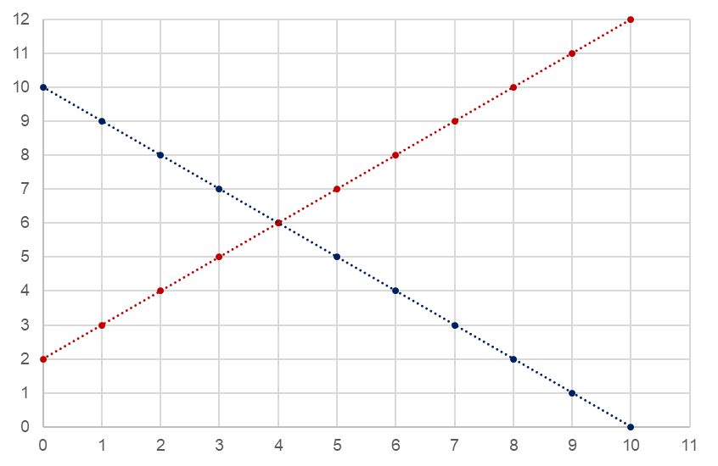
Efficiency and Pareto Improvements
Suppose we are in a scenario where the price is set exogenously at p=4. What are the CS, PS and TS?
Suppose the government implements a policy that leads to p=5? Is this a Pareto Improvement?
a=2
Welfare | Baseline (p=4) | Policy (p = 5) | Change
CS | a+b+c+d = 10 | a+b+c+f+g = 10.5 | +f+g-d= +0.5
PS | e = 2 | d+e+h = 4.5 | +h+d = +2.5
TS | a+b+c+d+e =12 | a+b+c+d+e+f+g+h = 15 | +f+g+h =+3
DWL | f+g+h+i= 4 | i = 1 | -(f+g+h) = -3
b=2
f=0.5
c=4
g=2
i=1
d=2
h=0.5
e=2
Yes!, We had ↑CS and ↑PS. Thus, ↑TS.
Takeaway: as the prices approaches its equilibrium level, it enhances efficiency. Note that if ↑TS then by definition ↓DWL.

Slide 9





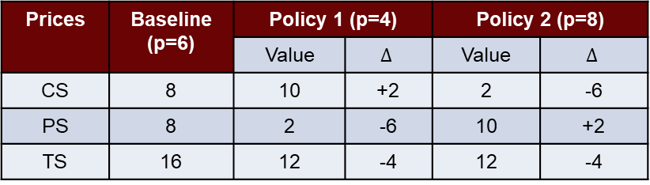







Free Market Economy and Efficiency
Pareto Efficiency: you cannot make one agent better-off, without making the other worse-off.
$$P$$
Suppose this market at equilibrium (p*=6). Let’s analyze deviations from this allocation. Policy 1 will set p=8, while Policy 2 leads to p = 4.
$$10$$
$$Supply$$
2
$$8$$
Prices | Baseline (p=6) | Policy 1 (p=4) |  | Policy 2 (p=8)
 |  | Value | $$Δ$$ | Value | $$Δ$$
CS | 8 | 10 | +2 | 2 | -6
PS | 8 | 2 | -6 | 10 | +2
TS | 16 | 12 | -4 | 12 | -4
4
2
$$6$$
4
2
$$4$$
2
$$2$$
$$Demand$$
$$Q$$
Policy 1: consumers are better-off (↑CS), but at the expense of suppliers (↓PS). Not a Pareto Improvement.
Policy 2: suppliers are better-off (↑PS), but at the expense of consumers (↓CS). Not a Pareto Improvement.
$$2$$
$$4$$
$$10$$
Takeaway: the allocation where p*=6 is the only one where there is no room for Pareto improvements.

Slide 10
Maximize Welfare and Pareto Efficiency
Economist’s story: the social planner or the benevolent dictator
Suppose there is one agent that knows perfectly the demand and supply curves, and also knows the conditions under which exchange is taking place. But most important, it can determine the price at which goods should be exchanged.
If this planner is benevolent, then it will choose the prices that maximize total surplus.
Hence, the planner must choose p*=6 such that q*=4 and TS*=16.
Why is this useful?
Normative analysis: allows for a benchmark of the social optimum.
By definition: the outcome chosen by the planner is Pareto efficient.

Slide 11
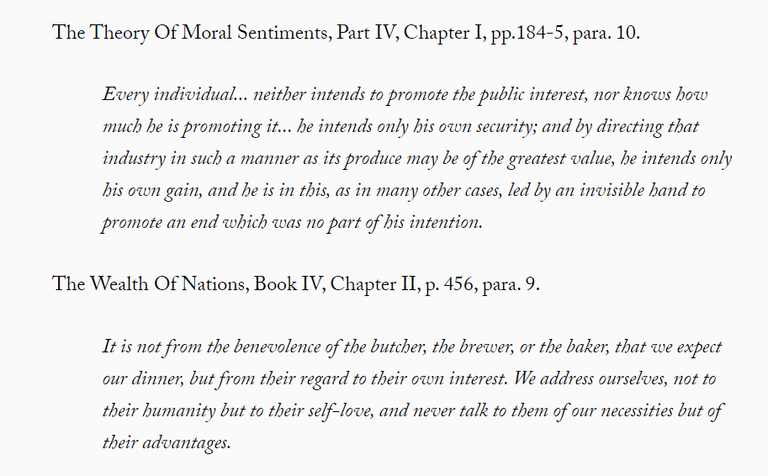
Free Market Economy and the Invisible Hand
Adam Smith and the Invisible Hand metaphor

Slide 12








Free Market Economy and the Invisible Hand
Adam Smith and the Invisible Hand metaphor
Individuals are driven by self-interest.
What does this mean for our supply-demand world?
Consumers: look to maximize consumer surplus.
Producers: look to maximize producer surplus.
The invisible hand = individual’s self-interest.
Intuition: if people engage in free exchange looking for their own interests, then total surplus is maximized.
Free Market Exchange leads to Pareto Efficiency!!
Market for Burgers
$$P$$
$$10$$
$$Supply$$
$$6$$
$$2$$
$$Demand$$
$$Q$$
$$4$$

Slide 13
Free Market Economy: How does it really works?
Free Market Exchange leads to Pareto Efficiency!
This is one of the biggest results in economic theory. (First Welfare Theorem)
Main argument for laissez-faire economics: leave the markets to operate alone and they will reach an efficient allocation of resources in the economy.
No need for government intervention.
Of course, this is a theoretical result. In real life, there are tons of examples where free market exchange leads to inefficient outcomes (TS is not maximized).
Why is the case? For this result to be true, the assumptions behind the competitive equilibrium model we are using need to hold.

Slide 14
Free Market Economy: How does it really works?
Conditions required to get Pareto Efficiency through free-market exchange
Institutions: Existence of an authority that defines property rights and enforces contracts.
Free Exchange: Buyers and sellers can buy/sell as many units as they want.
Perfect Competition: consumers and producers are price-takers. Neither can directly influence the equilibrium price with their actions. Large number of consumers/producers.
Perfect Information: consumers and producers have access to the same information about the goods being exchanged.
Main Result of Welfare Economics
If markets operate properly. That is, these four assumptions are met, then free market exchange leads to an efficient allocation of resources in the economy.

Slide 15
Market Failure
We say markets are competitive (operate properly) when these conditions hold. What happens when they do not?
Market Failure: when free-market exchange does not lead to an efficient outcome.
Why do we observe market failures? These conditions are hard to met (alone, and all at once).
Institutions: definition of property rights might be complicated. Institutions might not be strong enough to enforce all contracts properly. Rule of Law.
Public goods: under free-market exchange, some goods either will not be supplied or, if supplied, will be at an inefficient quantity. Free rider problem.
Imperfect Competition: some markets might have only one supplier/consumer. Market power is not distributed equally. Monopolies.
Imperfect Information: information is costly. People have incentives to lie/hide information. Information asymmetries, adverse selection, moral hazard.

Slide 16
Government Intervention
Market Failure: when free-market exchange does not lead to an efficient outcome.
Market failures derive in cases where demand/supply does not reflect true WTP/WTS for some goods.
What can we do about them?
If we know the type of failure, then the government could implement some policy to address it.
Example: imperfect competition. What can we do about it?
Potential Solutions: enact antitrust regulation preventing the formation of monopolies.
Motivation for government intervention: make sure the assumptions required for markets to work are met.
Get markets as close to optimal as we can.
Depending on the failure, the optimal solution to it. Market-based (through prices) vs regulation-based (rules).

Slide 17
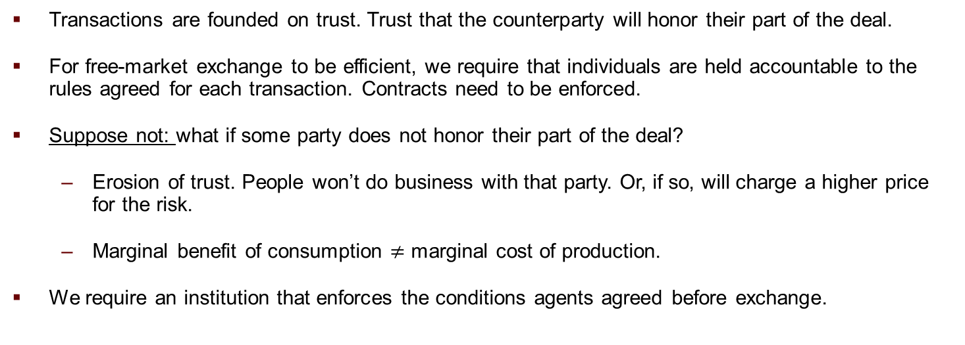
Institutions and Economic Efficiency
Institutions: Existence of an authority that defines property rights and enforces contracts.
Transactions are founded on trust. Trust that the counterparty will honor their part of the deal.
For free-market exchange to be efficient, we require that individuals are held accountable to the rules agreed for each transaction. Contracts need to be enforced.
Suppose not: what if some party does not honor their part of the deal?
Erosion of trust. People won’t do business with that party. Or, if so, will charge a higher price for the risk.
Marginal benefit of consumption $≠$ marginal cost of production.
We require an institution that enforces the conditions agents agreed before exchange.

Slide 18
Institutions and Economic Efficiency
Standard Solution: the government is the ultimate authority that defines property rights and enforces contracts.
It does not need to be the government all the time.
Example: little brothers exchange toys. Who is the authority enforcing the terms of the transaction? Who determines the property rights?
Market Failure: supply/demand curve does not capture all the marginal benefits/costs of producing/consuming the good.
This is the case of externalities. Actions of one agent influence the outcome of the other, outside the price mechanism.
Externalities = unintended consequences of free-market exchange.

Slide 19
Public Goods and Economic Efficiency
Recall the importance of scarcity. Scarcity allows that marginal benefits of consumption = marginal costs of production.
Scarcity and property rights are closely related. If you own a burger, you have the right to eat it. If you eat it, there is one burger less in the economy (and one consumer satisfied).
For some goods defining who can derive benefits from the consumption might be hard.
Example: the lighthouse.
Everyone benefits from the light. Hard or impossible to exclude consumption.
Free rider problem: once one buys it, the rest have no incentives to buy or contribute to buying one.
Market Failure: Private sector benefits of providing the good are lower than the marginal benefits of consumption.

Slide 20
Perfect Competition and Economic Efficiency
Perfect Competition: there are enough consumers and producers in the economy such that no one can directly influence the market equilibrium. This is price-taking behavior.
Imperfect Competition: monopolies, oligopolies, monoposony.
Example: Microsoft in the 1990s. Only supplier for certain computer parts and computer software. They can set the price.
Example: OPEC (Organization of Petroleum Exporting Countries), just a bunch of countries produce and export oil, but all countries buy oil and/or oil-derived products.
Market Failure: Private sector benefits of providing the good might not equal the marginal benefits of consumption.

Slide 21
Perfect Information and Economic Efficiency
Perfect Information: consumers and producers have access to the same information about the goods being exchanged.
Imperfect Information: some market agents possess information about the good exchanged that other parties do not, and have incentives to use this information to benefit from the transaction.
Information is costly. People might have incentives to lie.
Information is fundamental to ensure demand/supply curves reflect accurately the WTP/WTS goods and services.
Example: FDA. What happens with your WTP for some drug if it is not FDA approved?
Information provides signals about quality.
Market Failure: demand/supply curves do not reflect accurately WTP/WTS.

Slide 22
Another Type of Failure
Incomplete Markets: whenever private markets fail to provide a good or service even though the cost of provision is less than individual’s WTP.
Similar to the public goods problem in the sense of underprovision.
Key difference: in this case, the private sector is actually providing some of the good. As we will discuss, pure public goods are usually provided/procured by the government.
Example: Insurance Markets: insurance companies might not (enough) sell contracts to cover for certain events.
Example: Credit Markets: not enough loans for every student. Credit rationing. People are willing and able to get loans. Banks are not willing to provide them.

Slide 23
For Next Class
Further Reading for this session: Stiglitz and Rosengard 4.
On the Next Episode: Tax Policy.
Readings: Mankiw 8. Gruber 18. Stiglitz and Rosengard 1 and 2.

Slide 24
SPEA-V-202
Contemporary Economic Issues in Public Affairs
Market Failure and Government Intervention
Luis Navarro

