Slide 1
SPEA-V-202
Contemporary Economic Issues in Public Affairs
Midterm Exam Review
Luis Navarro
Fall 2022

Slide 2
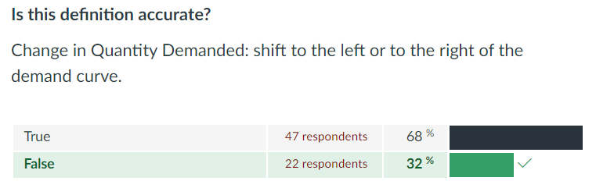
False: change in quantity demanded is a movement along the demand curve. A change in demand when the demand curve shifts either to the left or to the right.
This is the definition of a change in demand.

Slide 3
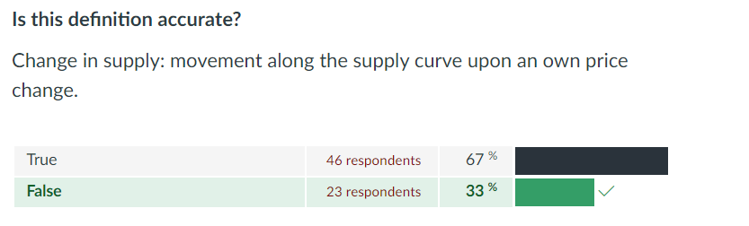
Same issue here. Change in the supply is when the curve shifts, not a movement along it.

Slide 4
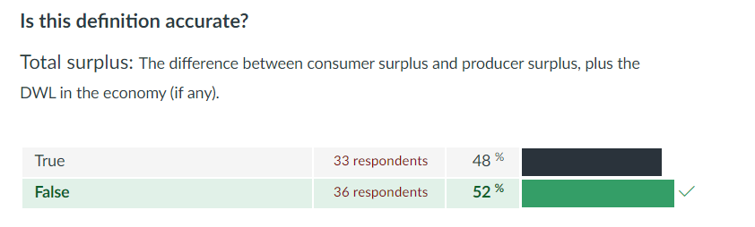
False: Total surplus is the sum (not the difference) of consumer surplus and producer surplus, minus (not plus) any DWL if any.

Slide 5
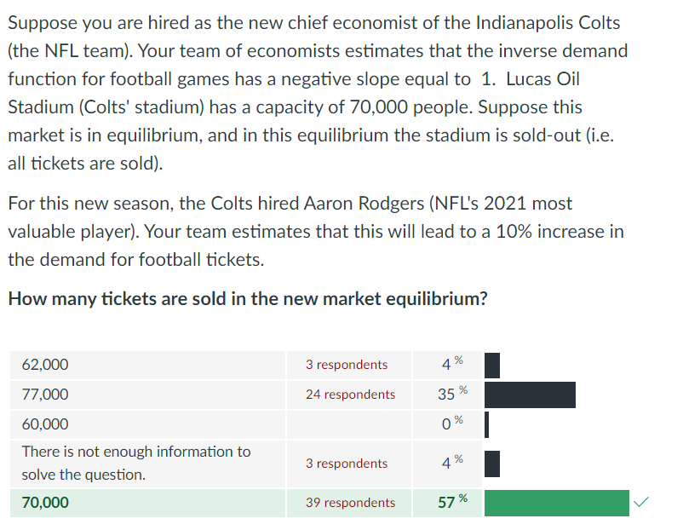








The prompt is describing the supply of football tickets. This is constrained by the number of seats in the stadium.
Perfectly Inelastic Supply!
Intuition: some good was sold-out at current demand, and suddenly there is an increase in demand. Is there an increase in the quantity exchanged?
No! Tickets were already sold out. Shift in demand only increases the price consumers face.
$$P$$
$$S$$
$$p_{1}$$
$$p_{0}$$
$$D_{1}$$
$$D_{0}$$
$$70K$$
$$Q$$

Slide 6
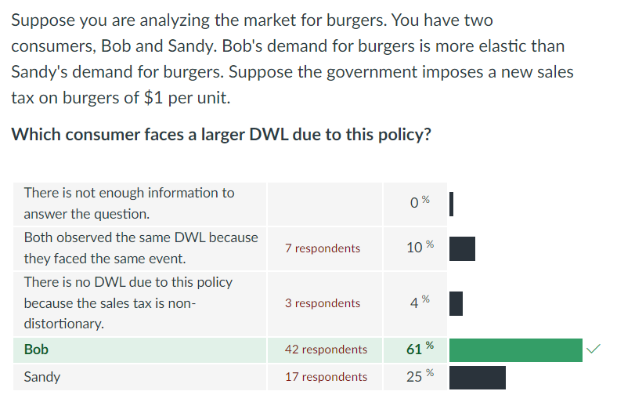




Compare the size of DWL between two demands: one is more elastic than the other.
Short Answer: Mankiw Ch 8 Fig 5
Intuitive answer: elastic means a larger response in Q upon a change in P. Both face the same change in P (i.e. the tax), the one that will decrease his consumption more is Bob.
$$P$$
$$D_{B}$$
$$D_{S}$$
$$Q$$

Slide 7
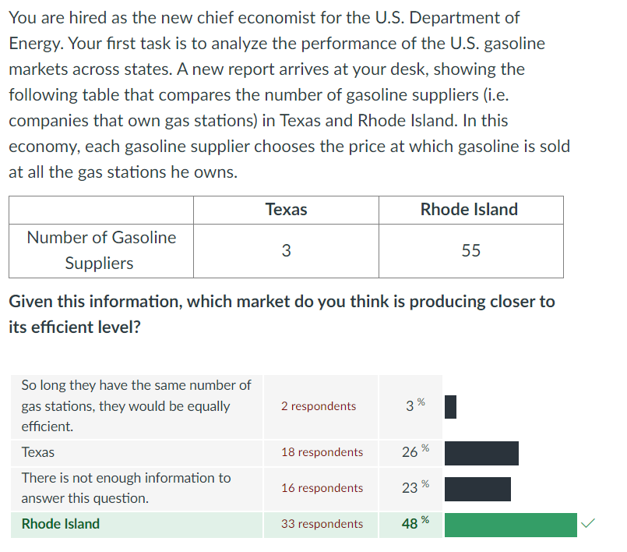
This was a question about market competition, market failure, and economic efficiency.
We know from theory that imperfect competition (i.e. having a small number of providers could lead to DWL).
In theory, as the number of suppliers increases, then market imperfection decreases.
Hence, Rhode Island should be a more competitive market and it should be producing at a more efficient level.

Slide 8
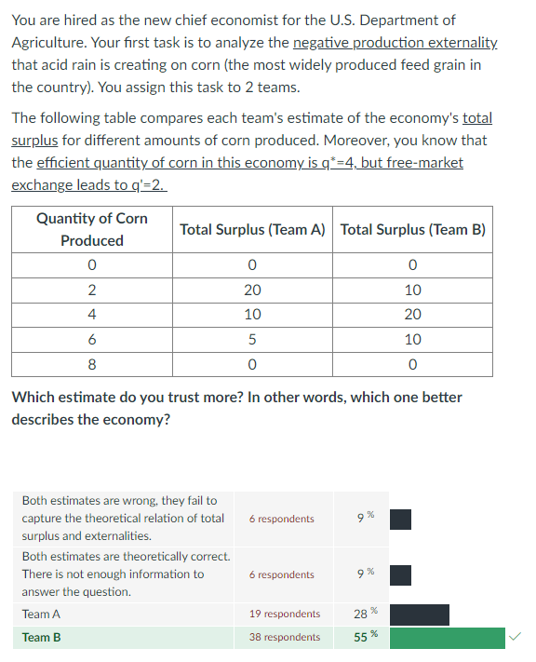
This is a question about efficiency and externalities. It says there is an externality in the market, and we have some information about the social optima (efficient q*).
We know that q*=4 maximizes TS, but free market exchange leads to corn underprovision at q’=2.
Team A is just wrong by saying that TS(q=2) > TS(q=4). We know there is underprovision. Hence, if there is more corn in the economy people should be better-off.
Team B, on the other hand, reflects this more accurately. Their table suggests TS(q=4) is the highest.
The lesson here is that even with the externality, the social planner chooses the q that makes everyone better-off (maximizes TS).
Therefore, Team’s B estimate is better describing the economy.

Slide 9
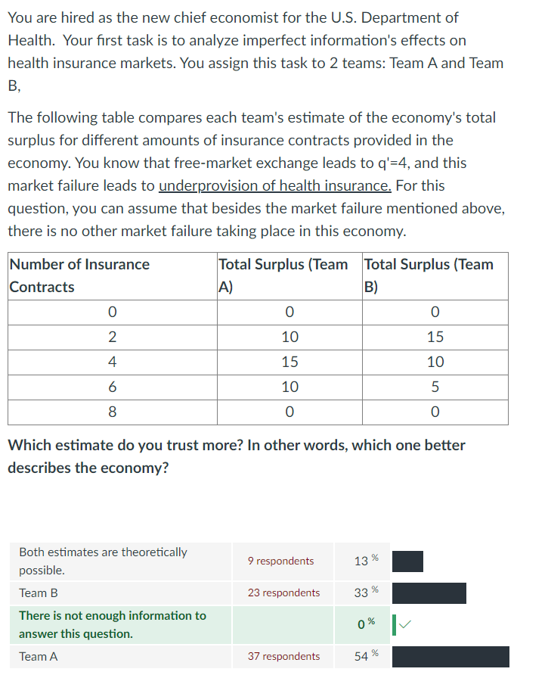
Ok. This was a tricky question. You need to read carefully.
It says there is a market failure: imperfect information that leads to underprovision of health insurance and you know that free-market exchange leads to q’=4.
If there is underprovision, then free-market exchange is leading to something lower than q*. Therefore, q* should be larger than 4.
Key fact: at the optimal level TS is maximized. So, any deviation from this scenario leads to a decrease in it (DWL).
Team B is just wrong by saying that TS(q=2) > TS(q=4). Free market exchange is leading to underprovision. So, it could not be the case that reducing the number of contracts below q’ is welfare-improving.
Team A is also wrong because q’=4 is not the social optima. This market failure leads to underprovision. For their estimates to be correct they need to be TS(q=6) > TS(q=4), which is not the case.
Therefore, the information is not enough to determine which one is better.

Slide 10
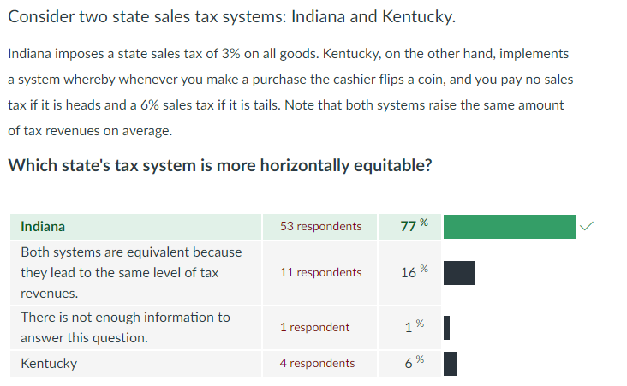
While most of you had no problem in this question, the answer is subtle. So, I want to go through it.
Horizontal equity refers to the treatment the tax system gives to 2 individuals based on their economic decisions. Not their income.
Quick dumb example: suppose you enter the store to buy a bag of chips. The cashier flips the coin and lands heads, so no sales tax for you. t=0.
But you forgot to buy milk and eggs. You return to the store and now the coin toss lands tails. So you pay taxes.
Literally the same individual, but in one case has higher taxes and in the other lower. This does not improve horizontal equity.
Indiana’s flat sales tax rate does. It applies to everyone the same, regardless of their decisions or characteristics.

Slide 11
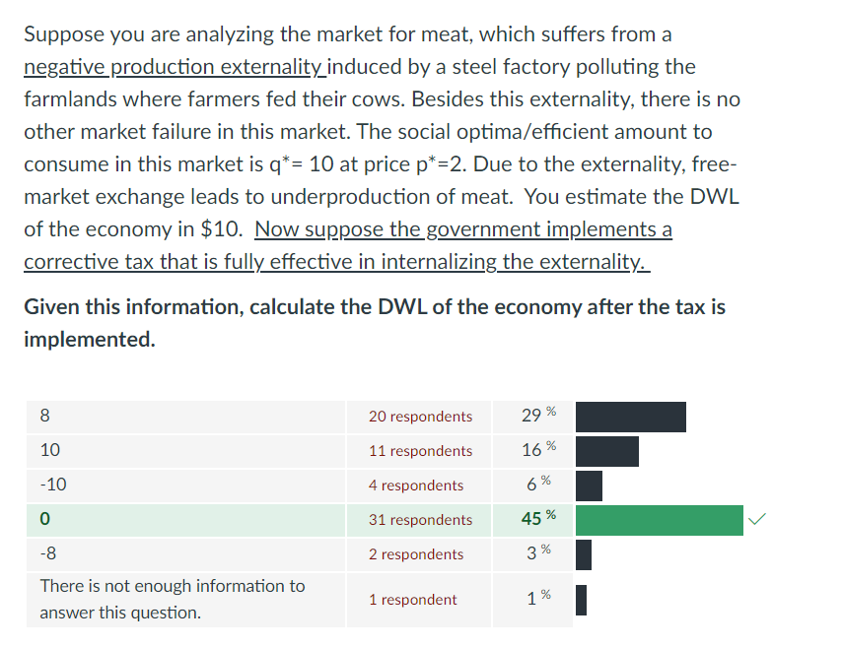
The answer to this question is given at the prompt. You just need to read carefully.
There are a bunch of facts about q* and p* and DWL. Yeah, none of those matter for the solution.
At the end it is underlined that the government implements a corrective tax that is fully effective internalizing the externality.
What does this mean?
Before the tax: there was some DWL due to the externality.
After the tax: the externality is corrected, and the economy is operating at its efficient level.
Hence, what is the new DWL?
Zero!!! The government solved the externality.

Slide 12
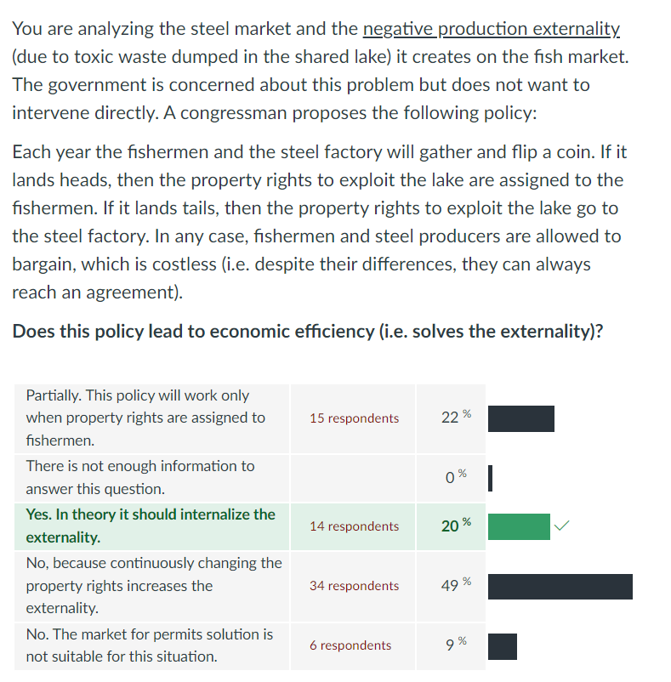
Recall Coasian solutions and the market for permits.
The whole point of the market for permits solution is that it does not matter who gets the property rights, if both parties are allowed to bargain (exchange) and such bargaining (exchange) is costless, then the market for permits corrects the externality.
The fact that they are tossing a coin each year is irrelevant.
In this market, each year a market for permits will be created at no cost.
This solution should work.

Slide 13
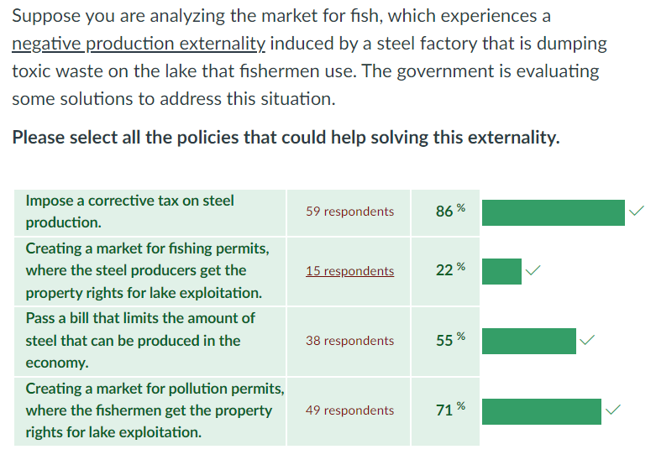
This question describes all the solutions for an externality.
Taxation, regulation, and a market for permits.
Recall that in the market for permits solution it does not matters who gets the property rights.
All answers are correct.

Slide 14
For Next Class
Next class: Labor Markets.

Slide 15
SPEA-V-202
Contemporary Economic Issues in Public Affairs
Midterm Exam Review
Luis Navarro
Fall 2022

