Slide 1
SPEA-V-202
Contemporary Economic Issues in Public Affairs
Labor Markets
Luis Navarro

Slide 2


Outline for Today
Economic Theory of Labor
Labor Supply
Labor Demand
Market Equilibrium
Labor Prices
Equilibrium Wage
Labor Productivity and Wage
Examples

Slide 3
Introduction
To talk about labor, we need to talk about the opportunity cost of your time.
Consider the following scenario.
You have two job offers. Both offers pay $50 per hour. The difference: full-time vs part-time: Job A requires to work for at least 40 hours a week, while Job B only 20.
How would you choose between the two? What is the opportunity cost of choosing B over A?
Opportunity cost: whatever you do with the other 20 hours!
Example: if you choose part-time, you can work on a side gig. Which criterion would you use to choose?
The wage it offers! You should only choose part-time so long your side gig pays at least $50 per hour.

Slide 4
Introduction
Sometimes the opportunity cost of your time is not revealed clearly.
Consider the following two job offers. For simplicity suppose this is after-tax annual income.
Private Consulting: $110K.
Budget Analyst: $90K.
The catch: in consulting you will work 60 hours a week, while as a budget analyst you will work 40 hours a week. How would you choose between the two? What is the opportunity cost here?
Let’s try to calculate it. The year has 52 weeks.
Job | Annual Income | Total Hours Worked | Average Hourly Wage
Private Consulting | $110 K | 3,120 | 35.25
Budget Analyst | $90 K | 2,080 | 37.50

Slide 5
Introduction
Job | Annual Income | Total Hours Worked | Average Hourly Wage
Private Consulting | $110 K | 3,120 | 35.25
Budget Analyst | $90 K | 2,080 | 37.50
The budget analyst job pays a higher hourly wage. It compensates you better for your time and effort.
Opportunity cost: $2.25 per hour. That seems low, but it means you will work an extra 720 hours each year.
720 hours = 1 month! → Is 1 month of your free-time worth the additional $20K a year?
Lesson: the opportunity cost of time is determined by what you do with it!
It is not only about money, but also leisure. How much do you value your free time?

Slide 6
Labor Market Structure
Question: you want a job after college, right? Does that mean that you “demand” a job?
You have a demand for goods and services. A job is not any of those.
People work to satisfy their needs.
People supply labor! You are willing to give hours from your life to be able to buy stuff. To satisfy your demand.
Hence, organizations demand labor. Firms, government agencies, non-profits. All these organizations require people to meet their goals.
They are willing to compensate people in exchange for their time (and skills!).

Slide 7
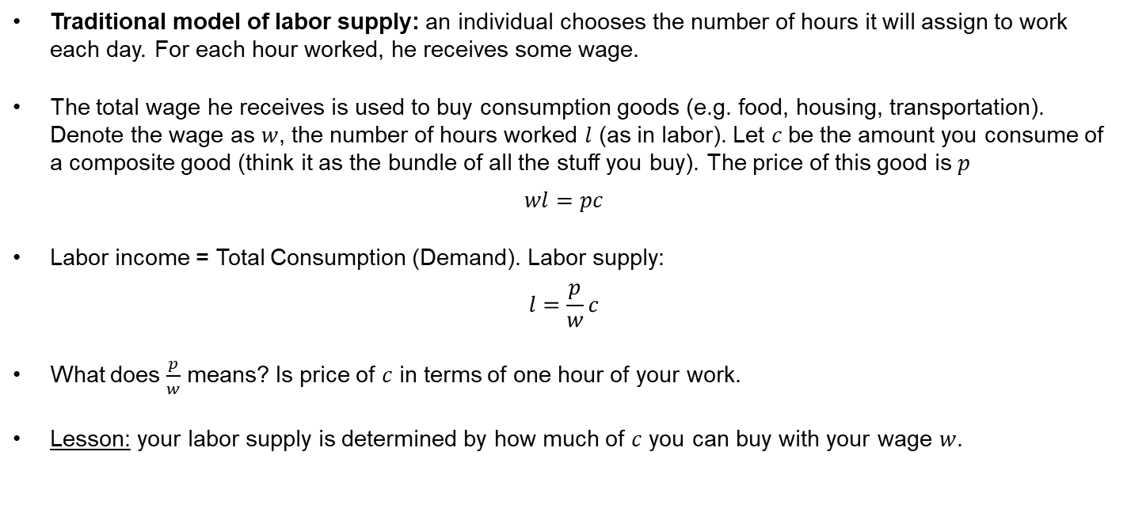
Theory of Labor Supply
Traditional model of labor supply: an individual chooses the number of hours it will assign to work each day. For each hour worked, he receives some wage.
The total wage he receives is used to buy consumption goods (e.g. food, housing, transportation). Denote the wage as $w$, the number of hours worked $l$ (as in labor). Let $c$be the amount you consume of a composite good (think it as the bundle of all the stuff you buy). The price of this good is $p$
$$wl=pc$$
Labor income = Total Consumption (Demand). Labor supply:
$$l=\frac{p}{w}c$$
What does $\frac{p}{w}$ means? Is price of $c$ in terms of one hour of your work.
Lesson: your labor supply is determined by how much of $c$ you can buy with your wage $w$.

Slide 8
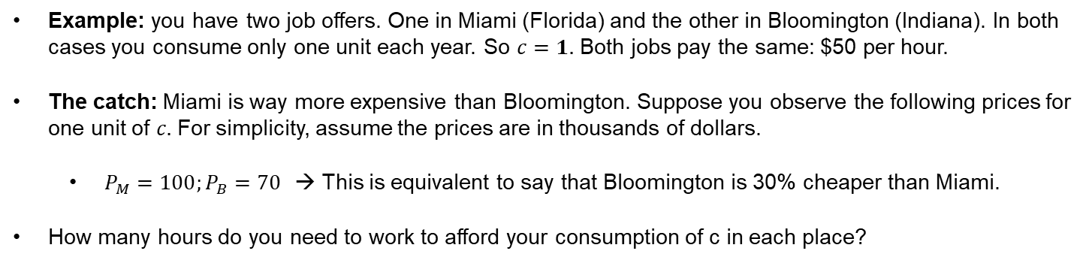
Theory of Labor Supply
Example: you have two job offers. One in Miami (Florida) and the other in Bloomington (Indiana). In both cases you consume only one unit each year. So $c=1.$ Both jobs pay the same: $50 per hour.
The catch: Miami is way more expensive than Bloomington. Suppose you observe the following prices for one unit of $c.$ For simplicity, assume the prices are in thousands of dollars.
$P_{M}=100;P_{B}=70$ → This is equivalent to say that Bloomington is 30% cheaper than Miami.
How many hours do you need to work to afford your consumption of c in each place?
Job | Price of Consumption (Living) | Hourly Wage | # of Hours Worked
Miami | $100 K | $50 | 2,000 (38.46 hours per week)
Bloomington | $70 K | $50 | 1,400 (26.9 hours per week)

Slide 9
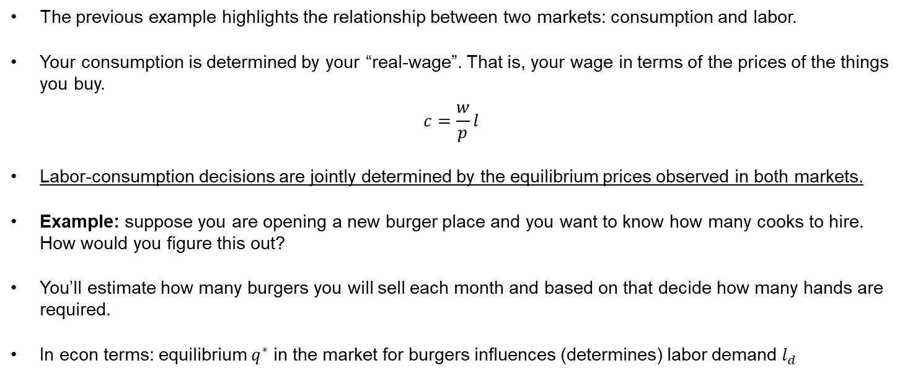
Theory of Labor Supply
The previous example highlights the relationship between two markets: consumption and labor.
Your consumption is determined by your “real-wage”. That is, your wage in terms of the prices of the things you buy.
$$c=\frac{w}{p}l$$
Labor-consumption decisions are jointly determined by the equilibrium prices observed in both markets.
Example: suppose you are opening a new burger place and you want to know how many cooks to hire. How would you figure this out?
You’ll estimate how many burgers you will sell each month and based on that decide how many hands are required.
In econ terms: equilibrium $q^{∗}$ in the market for burgers influences (determines) labor demand $l_{d}$

Slide 10
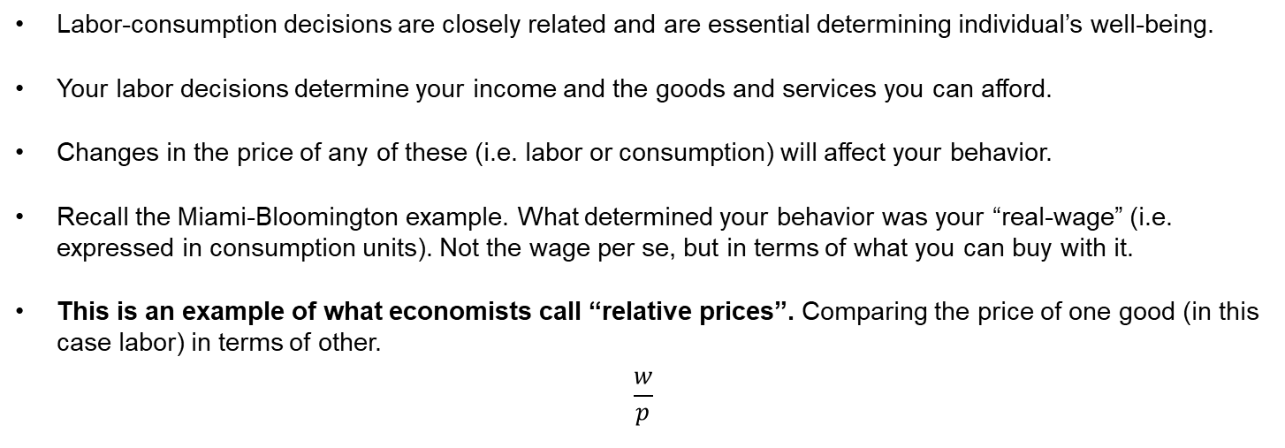
Theory of Labor Supply
Labor-consumption decisions are closely related and are essential determining individual’s well-being.
Your labor decisions determine your income and the goods and services you can afford.
Changes in the price of any of these (i.e. labor or consumption) will affect your behavior.
Recall the Miami-Bloomington example. What determined your behavior was your “real-wage” (i.e. expressed in consumption units). Not the wage per se, but in terms of what you can buy with it.
This is an example of what economists call “relative prices”. Comparing the price of one good (in this case labor) in terms of other.
$$\frac{w}{p}$$

Slide 11
Income and Substitution Effects
What happen when there is change in w?
Example: your job pays $30 per hour. Now, suppose your boss gives a raise to all employees, which increases your wage to $50. This change in the price of labor induces two effects on your behavior.
Substitution Effect: for each extra hour worked you earn an extra $20. Extra money allows you to buy more of everything. Hence, your willingness to supply labor increases.
Income Effect: if you work more then you have less time for leisure (i.e. less time to hang-out with your friends/family). Less time for leisure makes you sad. You are not necessarily able to enjoy the extra income. Opportunity cost of c increases. So, your willingness to supply labor decreases.
In practice, these opposing effects complicate how to make predictions about the effect of wages on labor supply. In theory, it depends on everyone's preferences for labor and leisure. Although, for the most part evidence suggests substitution effect > income effect.
So, how does the labor supply curve look like?

Slide 12
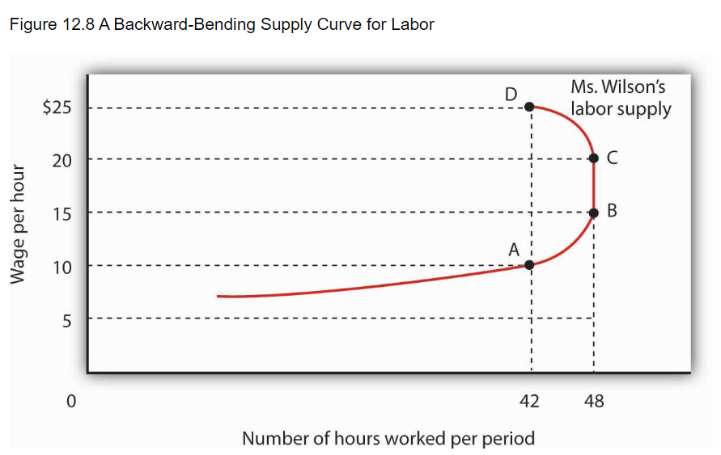
Theory of Labor Supply
For this class, we will assume the substitution effect dominates the income effect.
Why? To avoid backward-bending labor supply curves.
In this example, for labor < 48, the substitution effect dominates the income effect. If they offer you more money, you are willing to work more.
However, there is diminishing marginal benefits from the extra income. Each additional dollar compensates less for the time you spend working.
For labor > 48 hours, income effect dominates the substitution effect, and the supply curve starts to bend backwards.
Source: https://open.lib.umn.edu/principleseconomics/chapter/12-2-the-supply-of-labor/#rittenecon-ch12_s03_s02_f01

Slide 13


Theory of Labor Supply
For the model we will use to analyze the labor market, we will assume the inverse labor supply curve is always positively sloped at all points. No backward-bending analysis for this class.
$$w$$
Law of supply holds.
An increase in wages leads to an increase in labor supply.
This is equivalent to saying that if there is some backward-bending, our analysis is not for that part of the labor market.
$$l$$

Slide 14
Theory of Labor Demand
We said organizations demand labor. Firms, government agencies, non-profits, and small businesses.
Production of goods requires people too. Labor is segmented by sector/industry.
To understand labor demand, we need to understand firm’s behavior.
Economic theory looks at firm’s behavior through the lens of a production function or technology. How through some production inputs firms provide goods and services as output.

Slide 15
Theory of Labor Demand
Example: you run a burger place and you want to know how many burgers the place is able to make for each additional cook hired.
Assumptions: all cooks are equally skilled and there is only one kitchen.
Let’s look at the numbers closely and listen to their story.
The first cook hired gets everything up and running. Alone he can make 10 burgers.
The second cook provides an extra pair of hands, but they need to share the grill. So together they can cook 18 burgers.
When the third cook arrives, the grill starts to feel crowded. While production increased to 24, it was in a lower number: 6 instead of 8.
Same phenomenon with cooks 4 and 5.
What’s the key assumption explaining this data?
# of cooks | Burgers
1 | 10
2 | 18
3 | 24
4 | 28
5 | 30

Slide 16
Theory of Labor Demand
The previous example underlines a key factor for labor demand: marginal productivity!
Think like an economist: how many additional burgers each cook provides?
This is an example of diminishing marginal returns on labor.
Intuition: the marginal benefit of hiring an additional cook decreases as the number of people in the kitchen increases.
Key assumption here: technology is fixed (there is only one kitchen)
We will keep this assumption for the analysis.
# of cooks | Burgers | Marginal Productivity
1 | 10 | 10
2 | 18 | 8
3 | 24 | 6
4 | 28 | 4
5 | 30 | 2

Slide 17
Theory of Labor Demand
Marginal Productivity of Labor and Wages
Suppose you compare the production of burgers by 2 cooks in one day: Bob and Sandy.
Bob cooked 100 burgers, while Sandy cooked 80 burgers.
If you were to hire only one, who would you choose? Why?
Suppose both already work at your place, and you want to give someone a raise. Who would you choose?
What’s the magnitude of that raise?
Lesson: in theory, wages reflect worker’s productivity.
Intuition: firm’s WTP for your time and effort is larger if you are skilled.

Slide 18
Theory of Labor Demand
Marginal Productivity of Labor and Wages
Firm’s WTP for labor depends on worker’s skills. Skilled workers are more valuable.
Quick caveat: education is an investment to increase your skills. Then, what is the relation between your tuition and your expected wage?
Firm’s value skills because they derive in more profits!!
Suppose you compare the wage of a nurse and a lawyer. On average, the lawyer earns more.
Does this mean that the lawyer is more productive? Not necessarily. It only means the market prices at the legal services market might be higher than the prices at the nursing services market.
The equilibrium prices on each sectorial market determine equilibrium wages in that sector’s labor market.

Slide 19


Theory of Labor Demand
Suppose we hold skills constant. In average, workers have the same skills.
Recall the kitchen example. When technology is fixed, labor faces diminishing marginal returns. Each additional worker increases in a lower magnitude the output.
What is the firm’s WTP for labor? Depends on the marginal revenue produced by each worker. Which translates to the incremental number of burgers produced by each cook.
# of cooks (l) | Burgers | Marginal Productivity (w)
1 | 10 | 10
2 | 18 | 8
3 | 24 | 6
4 | 28 | 4
5 | 30 | 2
$$w$$
$$l$$

Slide 20


Equilibrium in the Labor Market
Like any other market, we have a negatively sloped inverse demand curve and a positively sloped inverse supply curve.
Equilibrium analysis is done the same way: where supply meets demand.
All the tools we have covered apply here: elasticities, taxation, externalities.
$$w$$
$$l$$

Slide 21









Quick Policy Evaluation Examples
You are analyzing the labor market for nurses. A new hospital was built in town. What is the prediction from our standard supply and demand model?
$$w$$
Which curve is shifting?
Labor demand
On which direction?
Shifts to the right.
Everything else constant, equilibrium wage for nurses increases, and the number of nurses hired increases as well.
$$L_{s}$$
$$w_{1}$$
$$w_{0}$$
$$L_{d1}$$
$$L_{d0}$$
$$l$$
$$l_{0}$$
$$l_{1}$$

Slide 22






Quick Policy Evaluation Examples
You are analyzing the labor market for actors/actresses. With the rise of social media, there was an increase of content creators that are trying to make it in the movie business. What is the prediction from our standard supply and demand model?
$$w$$
$$L_{s_{0}}$$
Which curve is shifting?
Labor supply
On which direction?
Shifts to the right.
Everything else constant, equilibrium wage for actors decreases, and the number of people hired in this market increases.
$$L_{s_{1}}$$
$$w_{0}$$
$$w_{1}$$
$$L_{d0}$$
$$l_{0}$$
$$l$$
$$l_{1}$$

Slide 23
Quick Policy Evaluation Examples
There is a negative externality in the market for fish due to pollution in the river. We know this means there is fish underproduction (i.e. free-market exchange leads to a quantity lower than the efficient one).
What are this policy's effects on fishermen's labor market?
Labor and output are always positively related.
If firms are producing below their optimal level, that means they are also hiring below their optimal level.
Hence, fishermen’s labor supply is below its efficient level.
If the government intervenes and solves the externality, what happens to the number of fishermen hired in equilibrium?
It increases! If the externality is solved, then more fish is required. Thus, there is an increase in the demand for fishermen, which leads to a larger number of people hired in the economy.

Slide 24






Unemployment
Labor Market
$$w$$
Unemployment means that there are people willing and able to work that are not being hired.
In its most basic version, it means there is excess supply. The quantity of labor supplied is larger than the quantity of labor demanded.
We can address excess supply by either: i) decreasing labor supply; ii) increasing labor demand.
Most government policies work through the second channel: fostering firm’s willingness to hire at competitive wages.
Unemployment
$$Supply$$
$$l_{d}$$
$$l_{s}$$
$$Demand$$
$$l$$

Slide 25
For Next Class
Next class: More on labor markets. Read Mankiw and review tax readings on income taxation.

Slide 26
SPEA-V-202
Contemporary Economic Issues in Public Affairs
Labor Markets
Luis Navarro

