Slide 1
SPEA-V-202
Contemporary Economic Issues in Public Affairs
Labor Markets II
Luis Navarro

Slide 2


Outline for Today
Labor Markets in Action
Technology and Innovation
Labor Taxation
Description of the US Labor Market
Government Policies
Unemployment
Minimum Wage
Relevant concepts around labor markets.

Slide 3






Labor Market
We can analyze the labor market as we do with any other market. Just keep in mind: people supply and organizations demand labor.
$$w$$
$$L_{s}$$
$$w_{0}$$
$$L_{d}$$
$$l$$
$$l_{0}$$

Slide 4

Labor Market
Last class we mentioned there are labor markets for each sector/occupation (e.g. nurses, lawyers). Each market observes a different level of equilibrium wage $w^{∗}$, and labor $l^{∗}$.
$$w$$
Equilibrium in the labor market is reached when individuals’ willingness to supply one extra hour (unit) of labor equals firms’ willingness to pay for it.
Wages reflect the marginal productivity of labor.
Differences in the wages perceived across occupations also reflect differences in productivity.
Remember: productivity in this case is measured in terms of the market value of the output produced.
$$L_{s}$$
$$w_{0}$$
$$L_{d}$$
$$l$$
$$l_{0}$$

Slide 5
Labor and Technological Innovation
Labor is a production input. Technology (capital investments) are also part of the production process.
Economists use the term capital to refer to production inputs other than labor. Capital because it is associated with investments.
Examples: the grill from Bob’s kitchen and his utensils. Machinery and equipment in general. Computers, trucks, factories.
Textbook example: the pencil factory needs both the machinery and the people working there to produce pencils.
Intensity (dependence) of each factor on production differs across sectors (e.g. farmer vs data scientist).
Capital and labor could be either complements or substitutes in the production function.
Complements: upgrading the machinery allows workers to produce more pencils per hour.
Substitutes: robots might steal your job!

Slide 6

Labor and Technological Innovation
Labor is a production input. Technology (capital investments) are also part of the production process.
Example: suppose we discover a way to produce quantum computers cheaply. That makes robots widely available in the economy.
What is the effect of this discovery on the labor market?
If technology is a substitute, then it reduces the demand for labor. Why? It is cheaper to buy a robot than to hire Bob.
If technology is a complement, then it increases the demand for labor. Why? To scale their production firms, require more labor that can exploit the productivity increase.
$$w$$
$$L_{s}$$
$$w_{0}$$
$$L_{d}$$
$$l$$
$$l_{0}$$

Slide 7
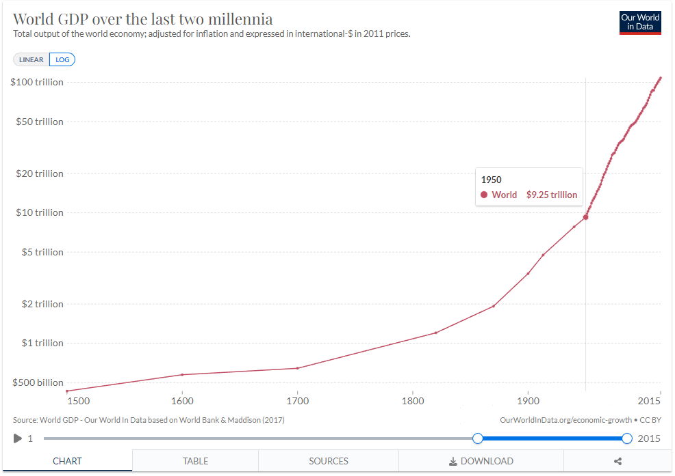
Labor and Technological Innovation
If technology is a complement, then technological improvements lead to higher labor productivity.
Each big technological improvement has led to an increase in the total productivity of the economy.
The last big example: the internet. The internet changed the game of how things are produced and sold in the economy.
https://ourworldindata.org/grapher/world-gdp-over-the-last-two-millennia?yScale=log&time=1000..2015

Slide 8
Labor and Technological Innovation
Labor productivity is also related to workers’ abilities to exploit technology.
Example: suppose you are looking to hire one new policy analyst for your team. You have two candidates that just got out of college (same degree).
The catch: one candidate is proficient in programming, so she knows how to write programs that automatically create policy reports.
If you measure their productivity by number of policy reports generated each month, who should you hire?
Some skills are useful across industries. Recall firm’s WTP depends on worker’s skills.
Silicon Valley example: why do workers in high-tech firms perceive such high wages? High-tech companies can produce large quantities of output with few staff. Moreover, the goods being produced observe a relatively large price in their own market.

Slide 9



Labor Taxation
Labor is one of the most heavily taxed goods in the economy, and one of the main revenue sources for the government.
Type of taxes directly influencing labor supply: income and payroll taxes.
How does this look in the supply-demand diagram?
Same as we had for other taxes! The wage perceived by workers is not the same paid by organizations. The difference is given by the size of the tax. It decreases the incentives to work, so employment in equilibrium is lower.
Same analytical considerations: there is a DWL, and its magnitude depends on the elasticities of supply and demand. In terms of economic efficiency, it does not matter who has the statutory incidence of the tax.
$$w$$
$$L_{s}$$
$$w_{d}$$
$$w_{s}$$
$$L_{d}$$
$$l$$
$$l_{1}$$
$$l_{0}$$

Slide 10





Equilibrium Wage and Consumption
Key question: is the equilibrium wage enough to satisfy your basic human needs?
$$w$$
Last class we discussed that what matters for that question is the real-wage.
That is, your wage in terms of units of consumption.
Differences in the equilibrium wage across occupations and prices derive in different real wages.
Let’s look at some data from the US.
$$L_{s}$$
$$w_{0}$$
$$L_{d}$$
$$l$$
$$l_{0}$$

Slide 11
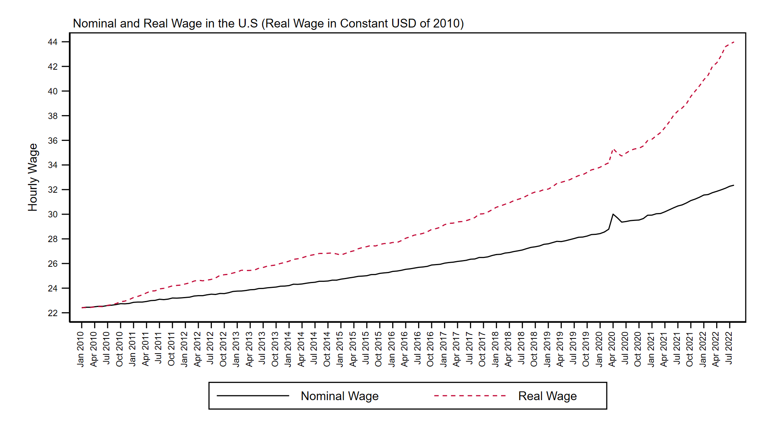
Nominal vs Real Wage
If we fix prices at the level observed in 2010, we can see that real wages in the US (on average) had increased in the last 12 years.

Slide 12
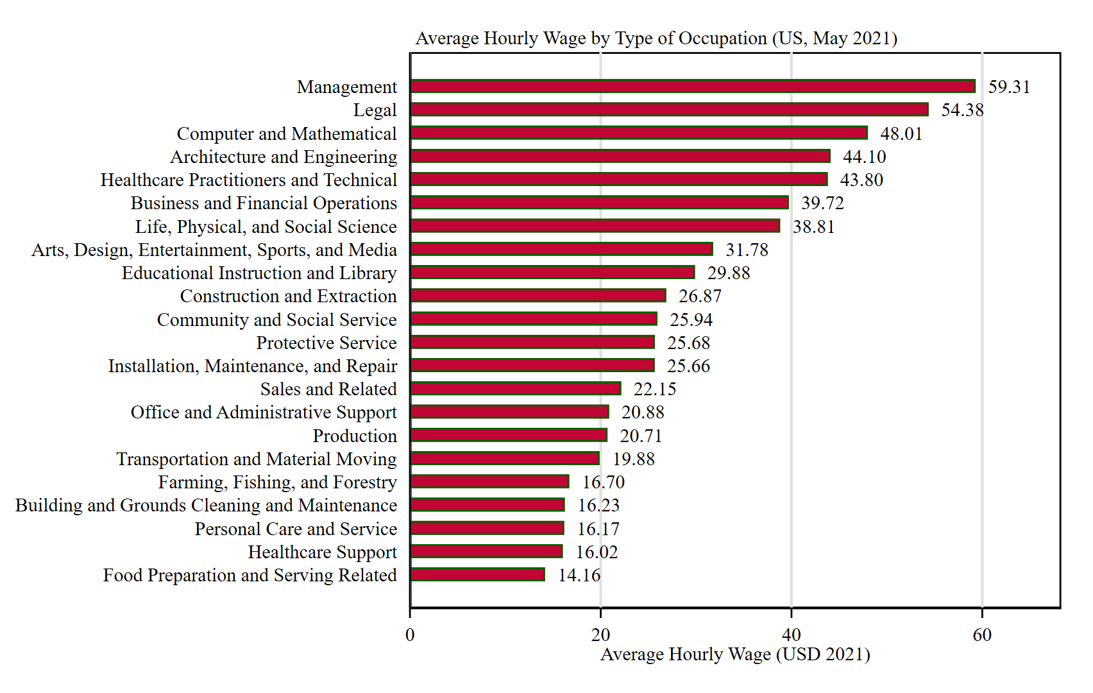
Labor Market in the US: a glimpse
This graph shows the average hourly wage for different occupations in the United States.
For example, occupations in the legal sector perceive an hourly wage that is 280% higher than the average wage perceived by workers in food preparation and serving-related occupations.
Source: U.S. Bureau of Labor Statistics
https://www.bls.gov/oes/current/oes_nat.htm#00-0000

Slide 13
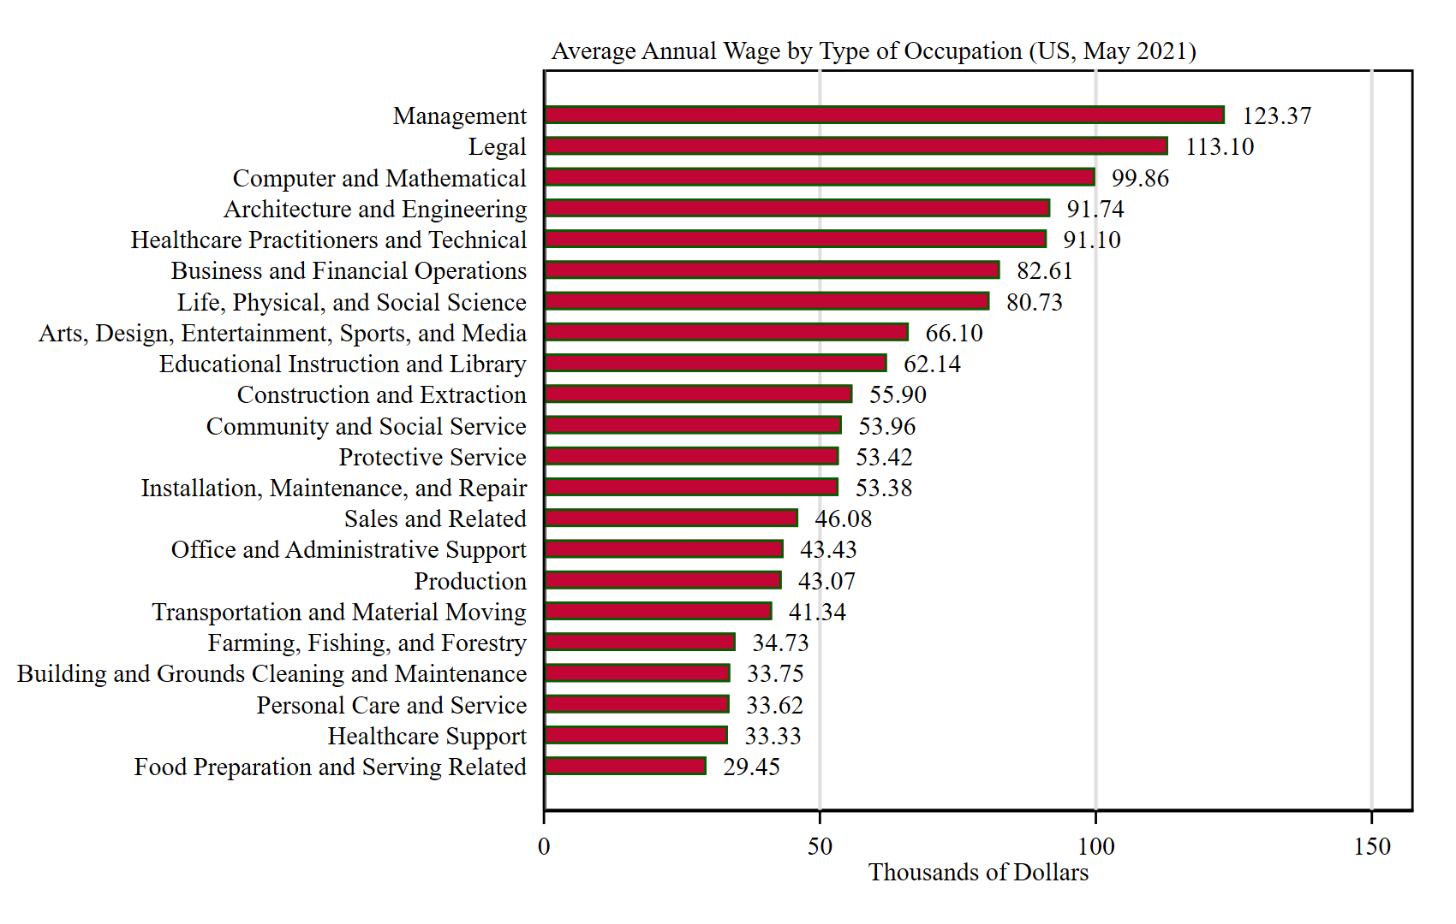
Labor Market in the US: a glimpse
However, when we account for how many hours are supplied in a year, differences are quite remarkable.
Same example: differences in the hourly wage across occupations in the legal sector and food-preparation and serving-related services, translates into an annual difference of $83K.
Source: U.S. Bureau of Labor Statistics
https://www.bls.gov/oes/current/oes_nat.htm#00-0000

Slide 14
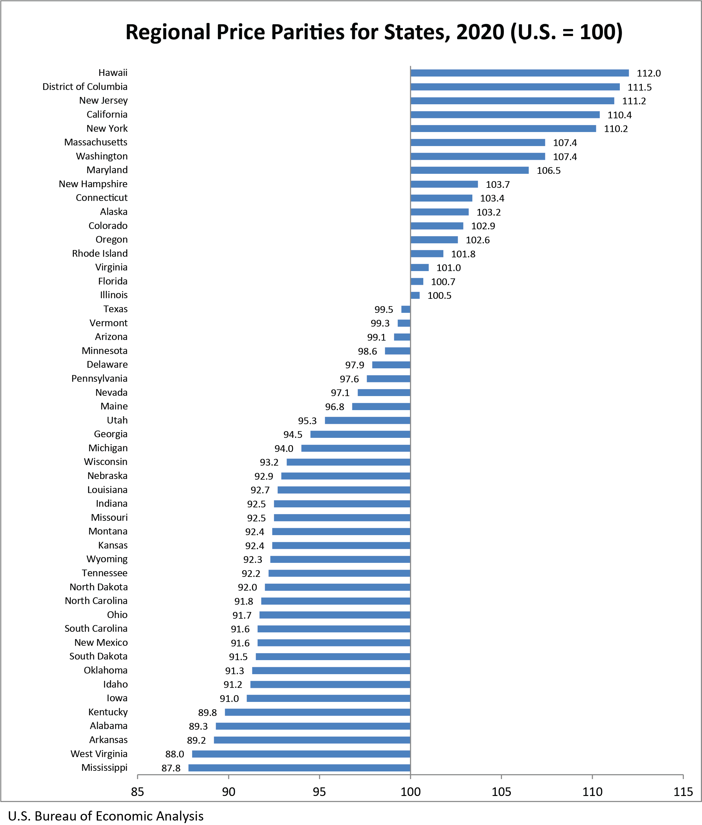
Differences in Consumer Prices
Recall the Miami-Bloomington example. Relative prices across localities matter.
This graph shows price parities for states. This is an index variable. If the state > 100, it means it is above the average observed for the United States, by the difference between the index and 100 percent.
Hawaii and DC are, on average, 12% and 11% more expensive than the average state in the US.
West Virginia and Mississippi are, on average, 12% less expensive than the average state in the US.
Source: U.S. Bureau of Economic Analysis
https://www.bea.gov/news/2021/real-personal-consumption-expenditures-and-personal-income-state-2020

Slide 15
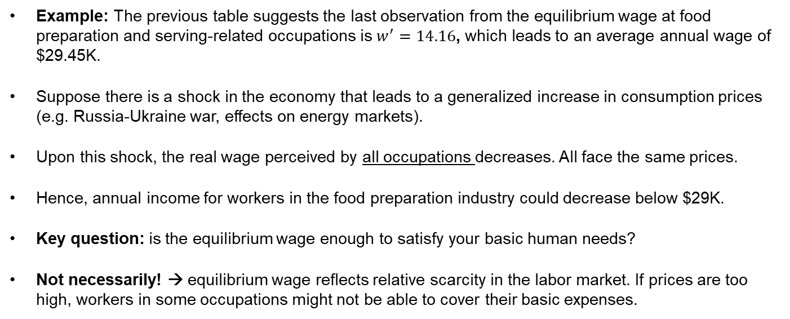
Labor Market
The previous tables together highlight the lesson behind the Miami-Bloomington example: the opportunity cost of labor varies by occupation and depends on the consumption prices faced by workers.
Example: The previous table suggests the last observation from the equilibrium wage at food preparation and serving-related occupations is $w^{′}=14.16$, which leads to an average annual wage of $29.45K.
Suppose there is a shock in the economy that leads to a generalized increase in consumption prices (e.g. Russia-Ukraine war, effects on energy markets).
Upon this shock, the real wage perceived by all occupations decreases. All face the same prices.
Hence, annual income for workers in the food preparation industry could decrease below $29K.
Key question: is the equilibrium wage enough to satisfy your basic human needs?
Not necessarily! → equilibrium wage reflects relative scarcity in the labor market. If prices are too high, workers in some occupations might not be able to cover their basic expenses.

Slide 16






Government Intervention in Labor Markets
Labor Market
The previous example motivates one of the most widely used policies on labor markets. The Minimum Wage.
The Minimum Wage is a regulation-based policy that establishes a minimum level at which people should be compensated for their labor supply.
In economic terms, the minimum wage is a price floor. It limits the value the equilibrium price could take.
Usually, the minimum wage is estimated to guarantee that all workers have enough income to satisfy their basic human needs.
$$w$$
$$Supply$$
$$w_{m}$$
$$w^{′}$$
$$Demand$$
$$l$$

Slide 17









Minimum Wage
Example: suppose the government considers that equilibrium wage $w_{0}$is not enough to satisfy basic human needs, so it imposes a minimum wage of $w_{m}$. What is the prediction of our model?
For wages above the equilibrium level, the willingness to supply labor is larger than the willingness to demand labor.
Excess supply = Unemployment.
Moreover, it induces a DWL.
Unemployment (losing your job) and/or underemployment (working fewer hours than your actual willingness to supply labor).
Question: what happens if the minimum wage is set below the equilibrium wage?
Is not binding! No distortions and no DWL.
$$w$$
$$L_{s}$$
Unemployment
$$w_{m}$$
$$w_{0}$$
$$L_{d}$$
$$l$$
$$l_{m}^{d}$$
$$l_{0}$$
$$l_{m}^{s}$$

Slide 18







Minimum Wage: Real Life Example
There is a policy proposal that aims to increase the federal minimum wage in the United States.
$$w$$
What is our theoretical prediction of this policy?
First, let’s assume it is binding. Minimum wage is above its free-market exchange equilibrium. Hence, in the current scenario, there is some unemployment.
Raising the minimum wage raises the labor costs faced by organizations, thus reducing their willingness to hire.
At the same time, it increase individual’s willingness to supply labor. So excess supply increases in the market.
In other words, unemployment rises! Increasing the DWL in the economy.
$$L_{s}$$
Unemployment
$$w_{m1}$$
$$w_{m0}$$
$$w^{′}$$
$$L_{d}$$
$$l$$

Slide 19
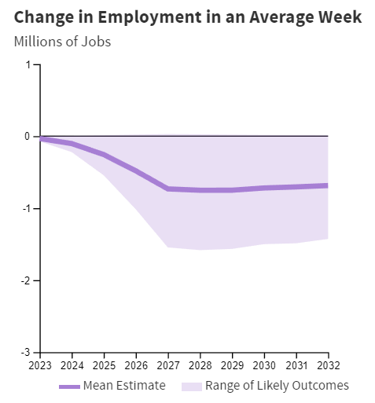
Minimum Wage: Real Life Example
Let’s take a quick look to this report from the Congressional Budget Office that estimates the effect of an increase in the federal minimum wage from $7.25 hour to $15, with a gradual implementation until 2027.
Their report predicts a gradual decrease in employment of 100K jobs in the first year, until reaching 750K in 2027.
Intuition: raising the minimum wage would increase the cost of employing low-wage workers. Thus, they might decrease labor demand for workers in these occupations.

Slide 20
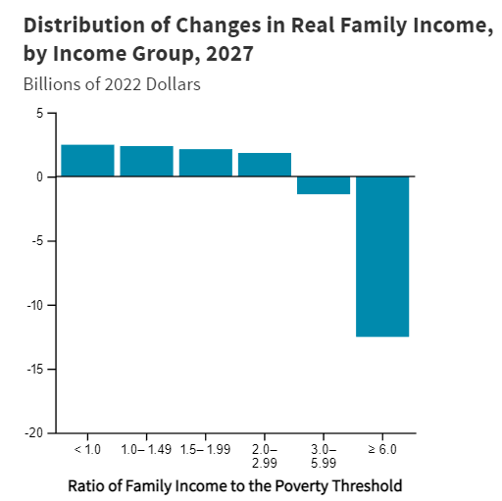
Minimum Wage: Real Life Example
If minimum wage leads to unemployment, then why is it a good idea?
The minimum wage affects people with low wages. However, each sectorial market has specific labor demands (i.e. their elasticities differ). Employment adjustments differ in magnitude.
On one hand, conditional on keeping your job, the raise boosts the income of low-wage workers.
On the other hand, some people will exit the labor market (or be underemployed) due to this policy.
The report from the CBO shows that, overall, income for families near to the poverty threshold increases with the policy.
Thinking like an economist: how would you determine whether this policy should be implemented or not?
Source: https://www.cbo.gov/publication/55681#:~:text=By%20boosting%20the%20income%20of,those%20families%20out%20of%20poverty

Slide 21
Other relevant aspects of labor markets
Some key concepts to keep in mind while studying the labor market.
Informal labor: labor that escapes the overview of the government. Includes labor activities that do not pay taxes (evasion). Also, workers that are not part of government benefits conditional on employment (social security).
While this problem is more common in developing countries, the US still observes some informal labor. Particularly, among individuals without legal immigration status.
Shadow labor: refers to unpaid work. Examples include housework and labor inherent to parenting.
Example: what is the opportunity cost of a mother that stays at home raising her children, instead of returning to the labor force?
Labor discrimination and wage gaps: wages perceived by individuals do not reflect accurately their productivity due to some systematic bias from employers. It also relates to equity concerns about access to education and labor opportunities.

Slide 22
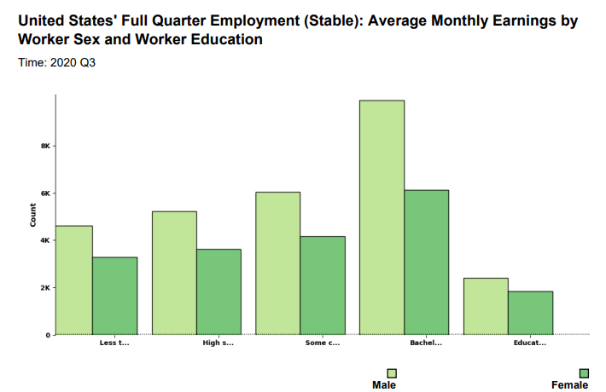
Example: Wage Differences by Gender
Let’s look at the last measurement from the Census.
Data from the Quarterly Workforce Indicators (QWI) from the Census shows that, on average, males observe higher monthly earnings.
Descriptive statistics from this table suggest the gender wage gap widens as females increase their education level!
 | Male | Female | % Difference
Less than HS | 4,613 | 3,281 | -29%
HS or equivalent no college | 5,223 | 3,621 | -31%
Some College or Associate Degree | 6,050 | 4,159 | -31%
BA or Advanced Degree | 9,926 | 6,137 | -38%
Educational Attainment NA | 2,403 | 1,842 | -23%
https://www.census.gov/library/stories/2022/01/gender-pay-gap-widens-as-women-age.html

Slide 23
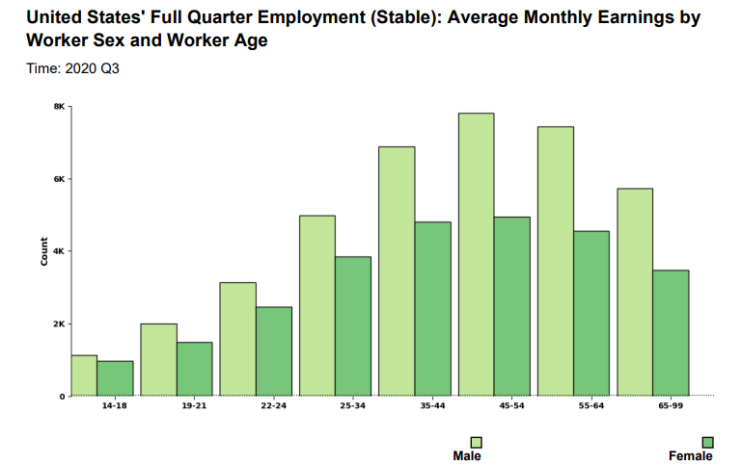
Wage Differences by Gender
Moreover, the gap increases along with age.
In other words, wage differentials between males and females are lower among younger individuals.
Age Group | Male | Female | % Difference
14-18 | 1,129 | 972 | -14%
19-21 | 2,009 | 1,489 | -26%
22-24 | 3,147 | 2,468 | -22%
25-34 | 4,992 | 3,842 | -23%
35-44 | 6,885 | 4,801 | -30%
45-54 | 7,812 | 4,952 | -37%
55-64 | 7,445 | 4,568 | -39%
65-99 | 5,729 | 3,479 | -39%
https://www.census.gov/library/stories/2022/01/gender-pay-gap-widens-as-women-age.html

Slide 24
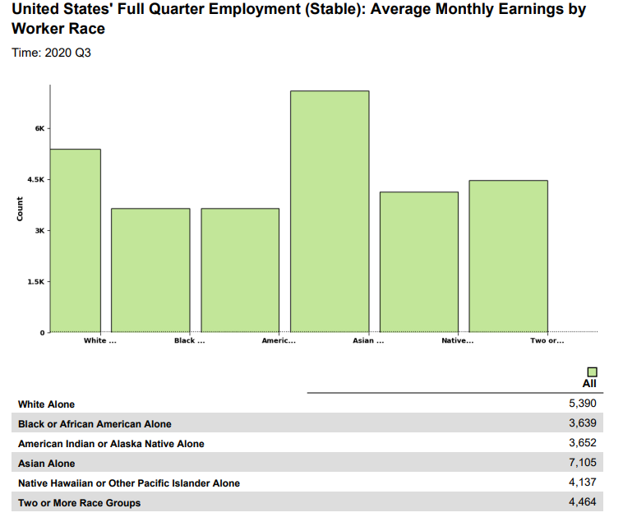
Wage Differences by Race
When looking at differences by race, we observe that, in average, the Asian population perceives a higher wage, relative to individuals from other races.
Black or African American, and American Indian or Alaska Native populations observe lower monthly earnings relative to other groups.
Important: read all these tables with a grain of salt. These are just average differences, not causal estimations of wage gaps.
https://www.census.gov/library/stories/2022/01/gender-pay-gap-widens-as-women-age.html

Slide 25
Other relevant aspects of labor markets
We could spend an entire semester looking at the relation of labor with other relevant policy areas.
Education Policy: education improves your skills in the labor market, thus leading to higher levels of average income.
Example: Scholarships based on household income improve the distribution of skills across the income distribution.
Immigration Policy: foreign labor, like technology, could be either a complement or substitute for domestic labor. Foreign policy shapes the outcome in the labor market.
Example: Setting a maximum number of work visas caps the foreign labor supply. It is a cap on the number of foreign people you can hire, so it induces some DWL (try drawing the diagram).
Justice enforcement: places with high unemployment rates often observe large crime rates/ violence. Fostering the development of labor markets is a natural way to attack the roots of criminal behavior.

Slide 26
For Next Class
Next class: poverty and transfer programs.
Readings: Mankiw Ch 20. Stiglitz & Rosengard Ch 15.

Slide 27
SPEA-V-202
Contemporary Economic Issues in Public Affairs
Labor Markets II
Luis Navarro

