Slide 1
SPEA-V-202
Contemporary Economic Issues in Public Affairs
Income Inequality and Poverty
Luis Navarro

Slide 2


Outline for Today
Income Inequality and Poverty
Definition
Measurement
Gini Coefficient & Poverty Line
Economic Mobility
Empirical Evidence
Regional Differences in the US
Demographic Composition
Historical Trends

Slide 3
Efficiency vs Equity
So far, our discussion has been focused on economic efficiency: maximizing total surplus (minimizing DWL). This has to do with the allocation of resources in the economy.
We also explored how market failures derive in deviations from economic efficiency (DWL > 0).
Recall the example of wage gaps and discrimination in the labor market. Is discrimination a market failure?
Sadly, no. In our framework, discrimination means that a firm’s willingness to hire individuals systematically differs across some characteristic (e.g. gender, race) that does not necessarily reflect an individual’s skills or preferences.
Does this mean it is desirable? Obviously, no!
It means that economic efficiency is not the right criterion to analyze this problem.
Change of hats: to analyze income inequality we need to think about equity.

Slide 4
Introduction
In general, there are two ways to think about the distribution of income.
Relative Income Inequality
The amount of income the poor have relative to the rich.
Absolute deprivation
The amount of income the poor have relative to some measure of minimally acceptable income.
Equity in the income distribution
Poverty Measurement

Slide 5
Income Distribution
We have discussed how labor market outcomes determine an individual’s income. Some occupations observe higher real wages relative to others.
Income Distribution: suppose you have data on the income observed by all individuals in the economy, so you can rank them across their income level.
This graph shows the latest measure of income distribution in the US.
How do we read this graph?
It says that 9.3% of households in the US observed an annual income lower than 15K a year. 15.9% of total households earned between 100-150K.
How do we know whether this income distribution is an “equitable” outcome?

Slide 6
Income Distribution
Suppose we are analyzing an economy comprised of 5 people with the following income levels.
Individual | Income | % of Total Income
Anne | 100 | 33%
Bill | 80 | 27%
Cady | 60 | 20%
Dan | 40 | 13%
Emily | 20 | 7%
Total | 300 | 100%
Aggregated income (wealth) in the economy equals the sum of the income of everyone. In this case, $300.
If we divide how much everyone has by the total amount of resources in the economy, we get how much each person has relative to the size of the economy.
In this example, Anne has one-third of the total resources in the economy, while Emily only has 7%.
How do we measure equity in the income distribution? A simplistic approach is to consider the scenario where everybody gets the same amount of money. In other words, perfect income equality.
In this case, everybody gets $60 so everyone has an equal share (20%) of the total amount of resources in the economy. By definition, there is no income inequality.

Slide 7
Income Inequality
How can we measure inequality in the income distribution? Intuitively, we can do the following:
Individual | Observed Distribution |  | No Income Inequality |  | Deviation from Perfect Equality
 | Income | % Total Income | Income | % Total Income | Absolute Deviation | % Total Income
Anne | 100 | 33% | 60 | 20% | 40 | 13%
Bill | 80 | 27% | 60 | 20% | 20 | 7%
Cady | 60 | 20% | 60 | 20% | 0 | 0%
Dan | 40 | 13% | 60 | 20% | 20 | 7%
Emily | 20 | 7% | 60 | 20% | 40 | 13%
Total | 300 | 100% | 300 | 100% | 120 | 40%
Take the absolute difference between the observed income and the theoretical income when there is no income inequality. Why the absolute difference? We want to consider deviations above and below perfect equity (i.e. whether you have more/less compared to the case without inequality).
Then compare the sum of absolute deviations with the total resources in the economy. Result: the first distribution derives in 40% of the resources of the economy being assigned unequally.
Caveat: don’t take to seriously the formulation per-se. Keep the intuition of how inequality is measured as a deviation from perfect equality in the income distribution.

Slide 8
Income Inequality: Measurement
In practice, one of the most common ways to measure income inequality is the Gini Coefficient.
The formulation is like the one used in the previous example but more complex (and accurate). If you are interested in how it is calculated, you can read this.
In a nutshell, the Gini Coefficient takes the differences between the observed income distribution and the distribution with no income inequality and builds a variable that takes values from 0 to 1.
If Gini = 0, then there is no income inequality. If Gini = 1, then it means perfect income inequality (e.g. one person holds all the resources in the economy).
Individual | Perfect Inequality (Gini = 1) |  | Perfect Equality (Gini = 0)
 | Income | % Total Income | Income | % Total Income
Anne | 300 | 100% | 60 | 20%
Bill | 0 | 0% | 60 | 20%
Cady | 0 | 0% | 60 | 20%
Dan | 0 | 0% | 60 | 20%
Emily | 0 | 0% | 60 | 20%
Total | 300 | 100% | 300 | 100%

Slide 9
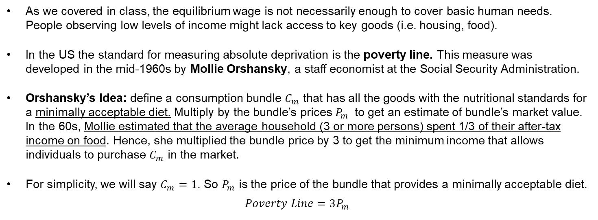
Absolute Deprivation and Poverty
Absolute deprivation: the amount of income the poor have relative to some measure of minimally acceptable income.
As we covered in class, the equilibrium wage is not necessarily enough to cover basic human needs. People observing low levels of income might lack access to key goods (i.e. housing, food).
In the US the standard for measuring absolute deprivation is the poverty line. This measure was developed in the mid-1960s by Mollie Orshansky, a staff economist at the Social Security Administration.
Orshansky’s Idea: define a consumption bundle $C_{m}$ that has all the goods with the nutritional standards for a minimally acceptable diet. Multiply by the bundle’s prices $P_{m}$ to get an estimate of bundle’s market value. In the 60s, Mollie estimated that the average household (3 or more persons) spent 1/3 of their after-tax income on food. Hence, she multiplied the bundle price by 3 to get the minimum income that allows individuals to purchase $C_{m}$ in the market.
For simplicity, we will say $C_{m}=1$. So $P_{m}$ is the price of the bundle that provides a minimally acceptable diet.
$$Poverty Line=3P_{m}$$

Slide 10
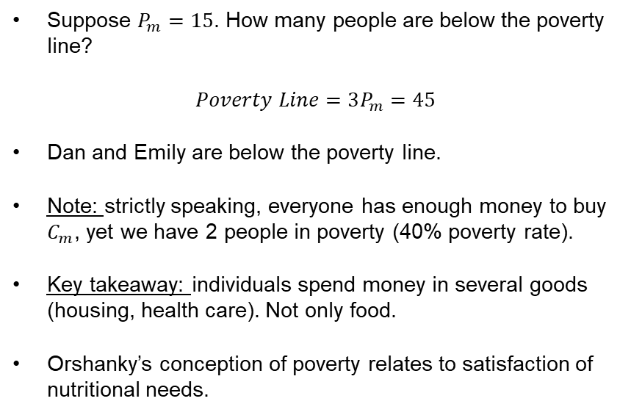
Absolute Deprivation and Poverty
Recall the income distribution from our previous example.
Suppose $P_{m}=15$. How many people are below the poverty line?
$Poverty Line=3P_{m}=45$
Dan and Emily are below the poverty line.
Note: strictly speaking, everyone has enough money to buy $C_{m}$, yet we have 2 people in poverty (40% poverty rate).
Key takeaway: individuals spend money in several goods (housing, health care). Not only food.
Orshanky’s conception of poverty relates to satisfaction of nutritional needs.
Individual | Income | % of Total Income
Anne | 100 | 33%
Bill | 80 | 27%
Cady | 60 | 20%
Dan | 40 | 13%
Emily | 20 | 7%
Total | 300 | 100%

Slide 11
Absolute Deprivation and Poverty
Example: suppose we experience an inflationary shock such that $P_{m}=25 .$ Hence, the poverty line = 75.
Individual | Income
Anne | 100
Bill | 80
Cady | 60
Dan | 40
Emily | 20
Total | 300
With the new prices, Cady’s income is now below the poverty line.
Now we have 3 people in poverty (poverty rate = 60%). Poverty rate is just the number of people in poverty divide by the total population.
This shock derived in a poverty increase of 20 percentage points (pp).
Government Response: suppose the government implements a program that gives everyone a check for $20.
After the policy Cady is pulled above the poverty line. She is no longer poor.
This policy offset the inflationary shock and reduced the poverty rate in 20 percentage points (pp).
Individual | Income 0 | Income 1
Anne | 100 | 120
Bill | 80 | 100
Cady | 60 | 80
Dan | 40 | 60
Emily | 20 | 40
Total | 300 | 400

Slide 12
Absolute Deprivation and Poverty
Example: suppose the government implements a redistributional fiscal policy that taxes Anne with $20 and transfers $10 to Dan and Emily. Suppose $P_{m}=15$ so the poverty line = 45.
Individual | Before the Policy |  |  | After the Policy
 | Income | Absolute Deviation | Abs Dev (% Income) | Income | Absolute Deviation | Abs Dev (% Income)
Anne | 100 | 40 | 13% | 80 | 20 | 7%
Bill | 80 | 20 | 7% | 80 | 20 | 7%
Cady | 60 | 0 | 0% | 60 | 0 | 0%
Dan | 40 | 20 | 7% | 50 | 10 | 3%
Emily | 20 | 40 | 13% | 30 | 30 | 10%
Total | 300 | 120 | 40% | 0% | 80 | 27%
This policy pulled Dan above the poverty line, but not Emily. It reduced poverty by 20 percentage points but did not eliminate it.
Moreover, this policy reduced income inequality! The resources in the economy that were distributed unequally decreased by 13 pp. Intuition: progressivity in the tax system reduces income inequality.

Slide 13
Poverty Line
The poverty line remains the way the US government measures poverty. However, it has some shortcomings.
Bundle changes: the share of food in family consumption has fallen over time relative to other goods like clothing, shelter, medical care. By 1998, the 33% estimated by Mollie was only 16%. Hence, multiplying by 3 seems to be inaccurate.
Regional differences are overlooked: the poverty line is a nation-wide statistic. It takes the average across states. What is the inherent problem of this? Recall the Miami-Bloomington example. Prices differ!
Income definition is incomplete: the poverty line only considers “cash-income”. It ignores non-cash transfers (e.g. Medicaid).
There has been a long discussion about potential improvements to this measure. Currently, the Census Bureau measures poverty using poverty thresholds. It has also improved the way income is measured.
Still, the current version follows the basic intuition of Orshansky’s poverty line.

Slide 14
Poverty Measurement in the US: Poverty Thresholds
The current methodology estimates different poverty lines (thresholds) that depend on household’s characteristics like family size and composition. If a family’s total income is less than the family’s threshold, then the family is considered in poverty.
Poverty Thresholds by Size of Family and Number of Related Children Under 18 Years Old: 2021 (thousands of $)
Size of family unit | Related children under 18 years
 | None | One | Two | Three | Four | Five | Six | Seven | Eight or more
One person (unrelated individual): | - | - | - | - | - | - | - | - | -
....Under age 65 | 14.10 | - | - | - | - | - | - | - | -
....Aged 65 and older | 13.00 | - | - | - | - | - | - | - | -
Two people: | - | - | - | - | - | - | - | - | -
....Householder under age 65 | 18.15 | 18.68 | - | - | - | - | - | - | -
....Householder aged 65 and over | 16.38 | 18.61 | - | - | - | - | - | - | -
Three people | 21.20 | 21.81 | 21.83 | - | - | - | - | - | -
Four people | 27.95 | 28.41 | 27.48 | 27.58 | - | - | - | - | -
Five people | 33.71 | 34.20 | 33.15 | 32.34 | 31.84 | - | - | - | -
Six people | 38.77 | 38.92 | 38.12 | 37.35 | 36.21 | 35.53 | - | - | -
Seven people | 44.61 | 44.89 | 43.93 | 43.26 | 42.01 | 40.55 | 38.96 | - | -
Eight people | 49.89 | 50.33 | 49.42 | 48.63 | 47.50 | 46.07 | 44.59 | 44.21 | -
Nine or more people | 60.01 | 60.30 | 59.50 | 58.83 | 57.72 | 56.20 | 54.83 | 54.49 | 52.39
Limitation: thresholds do not vary geographically. However, they are updated yearly for inflation.
Source: US Census

Slide 15
Economic Mobility
The previous example shows how through policy people can move across the income distribution.
Economic Mobility refers to the movement of people across the income distribution. This is particularly relevant from an intergenerational standpoint.
Intergenerational Mobility refers to the probability of rising (climbing) the income distribution conditional on the income level to which you were born.
Recall the so-called “American Dream”. Let’s see Oxford’s Dictionary definition:
American Dream: the belief that America offers the opportunity to everyone of a good and successful life achieved through hard work.
The American Dream highlights a key concept in development economics: equality of opportunity is not the same as equality of outcome.

Slide 16
Equality of Opportunity vs Equality of Outcome
Two alternative views of income mobility:
Equality of Opportunity: everybody has the same chance to climb the income ladder.
Equality of Outcome: people’s outcomes should be similar, regardless of their economic decisions.
The American Dream refers to equality of opportunity, not outcome.
Equality of opportunity, however, hinges on a strong implicit assumption. Which one?
No systematic discrimination!

Slide 17

Economic Mobility and Income Inequality
Example: suppose two identical babies are born (same skills). The difference: one baby is born in a country with low income inequality, while the second is born in a country with high inequality. If we measure the average income of these two people when they turn 40, who is likely to have a higher income?
Think about the income distribution as a literal ladder. Each step is an income bracket. Climbing from 15K to 30K. Rising across quintiles (ranking).
Note: If there is high income inequality, it means the distance between the steps is larger.
Income Ranking | Distribution 1 |  |  | Distribution 2
 | Income | Step | Abs Dev (% Income) | Income | Step | Abs Dev (% Income)
Top 20% | 100 | 20 | 13% | 120 | 40 | 20%
2nd quintile | 80 | 20 | 7% | 80 | 30 | 7%
3rd quintile | 60 | 20 | 0% | 50 | 20 | 3%
4th quintile | 40 | 20 | 7% | 30 | 10 | 10%
Bottom 20% | 20 |  | 13% | 20 |  | 13%
Total | 300 |  | 40% | 300 |  | 53%

Slide 18
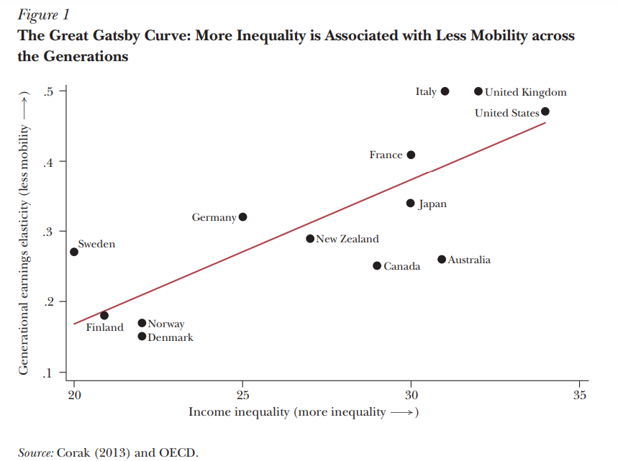
Economic Mobility and Income Inequality
Corak (2013) estimated an intergenerational income elasticity. (the effect your parent’s income has on your expected income) and compared it with the Gini coefficient, across a panel of several countries.
His study finds that more inequality is associated with less mobility across the generations.
Corak, Miles. 2013. "Income Inequality, Equality of Opportunity, and Intergenerational Mobility." Journal of Economic Perspectives, 27 (3): 79-102

Slide 19
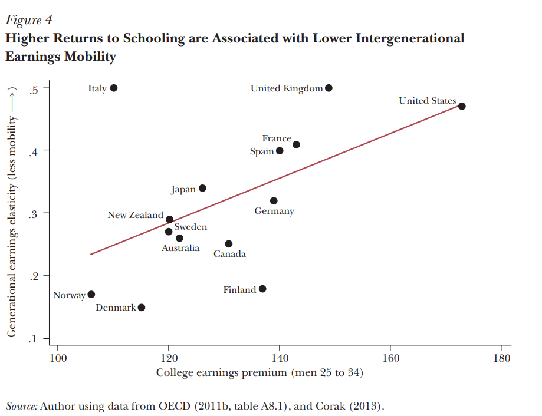
Economic Mobility and Returns to Schooling
Corak (2013) also finds that countries with higher returns to schooling (i.e the incremental effect of college on the average income) are associated with lower intergenerational mobility.
In other words, going to college helps you “climb the ladder”.
Corak, Miles. 2013. "Income Inequality, Equality of Opportunity, and Intergenerational Mobility." Journal of Economic Perspectives, 27 (3): 79-102

Slide 20
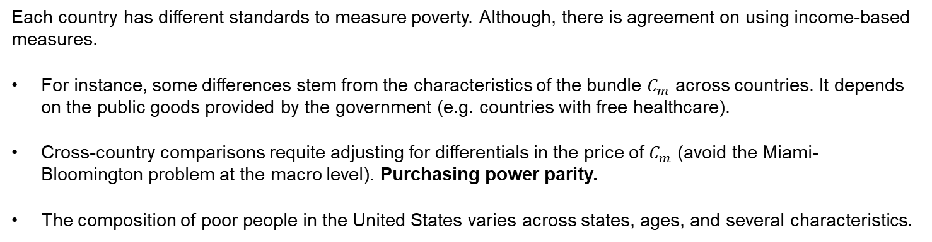
Other relevant aspects of poverty measurement
Each country has different standards to measure poverty. Although, there is agreement on using income-based measures.
For instance, some differences stem from the characteristics of the bundle $C_{m}$ across countries. It depends on the public goods provided by the government (e.g. countries with free healthcare).
Cross-country comparisons requite adjusting for differentials in the price of $C_{m}$ (avoid the Miami-Bloomington problem at the macro level). Purchasing power parity.
The composition of poor people in the United States varies across states, ages, and several characteristics.

Slide 21
Poverty Across States
The following graph shows differences in the poverty rate observed at each state, relative to the national average. In sum, states with positive bars are poorer than the average.
Source: US Census.

Slide 22
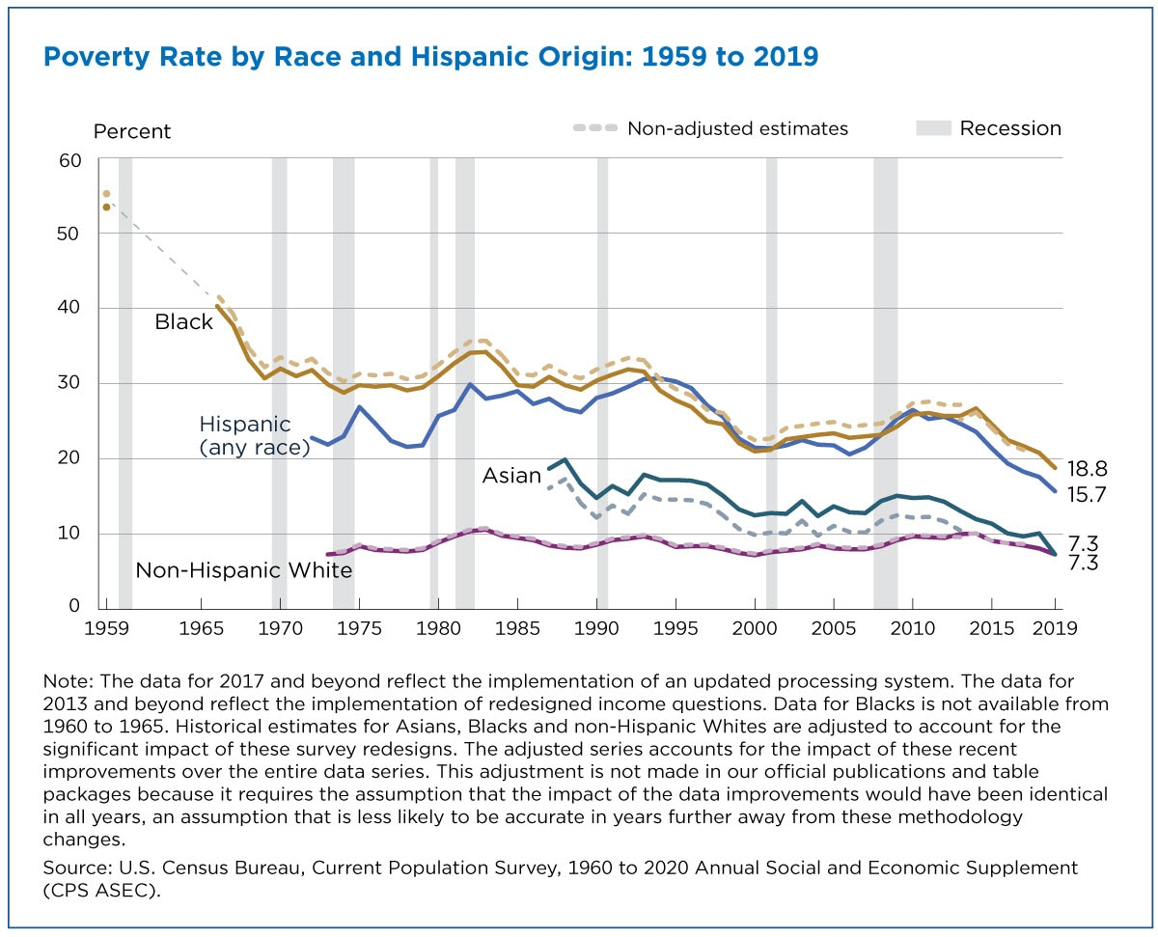
Poverty by Race and Age
Poverty rates had decreased significantly over time across Black, Hispanic, and Asian population.
However, inequalities across race and age persist in the United States.
Source: US Census.

Slide 23
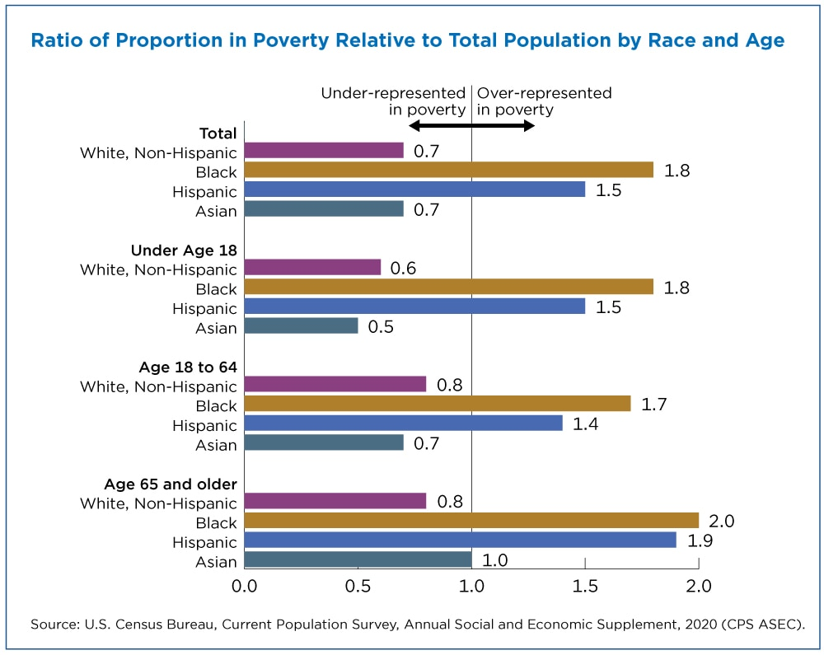
Poverty by Race and Age
This figure shows the ratio of people in poverty by race or Hispanic origin group to each group’s share of the total population.
If the poverty population is perfectly proportional to the total population, the ratio equals 1.
If a group is over-represented in poverty, the ratio will be greater than 1.0. If the ratio is less than 1.0, the group is under-represented in poverty.
Source: US Census.

Slide 24
For Next Class
Next class: Transfer Programs
Readings: Mankiw Ch 20. Stiglitz & Rosengard Ch 15. Gruber Ch 17.
Weekly Discussion is out!
Assignment 4: will be released on Monday, October 24, and is due Monday, October 31. It will cover labor markets, income inequality, poverty and transfer programs. .

Slide 25
SPEA-V-202
Contemporary Economic Issues in Public Affairs
Income Inequality and Poverty
Luis Navarro

