Slide 1
SPEA-V-202
Contemporary Economic Issues in Public Affairs
Income Inequality and Poverty II
Luis Navarro

Slide 2


Outline for Today
Stylized Facts Around Poverty
Poverty, Income Inequality and Economic well-being
Poverty line and some limitations
Rationale for Welfare Programs
Welfare Policy in the United States
Types of policies and benefits
Main Welfare Programs in the US
Economic Theory of Welfare Programs

Slide 3
Alternative Poverty Measurements: Mexico’s case
Measuring poverty accurately matters. What can be measured, can be improved.
An individual is poor if her income is below the poverty line and if she experiences at least one social deprivation.
Takeaway: is not only about the money.
Social deprivations = lack of basic human rights.
Mexico’s case: education, health services, social security, housing, and housing services, nutrition.
There are several paths to poverty.
Do you think of any other human right that should be included in poverty measurement?

Slide 4
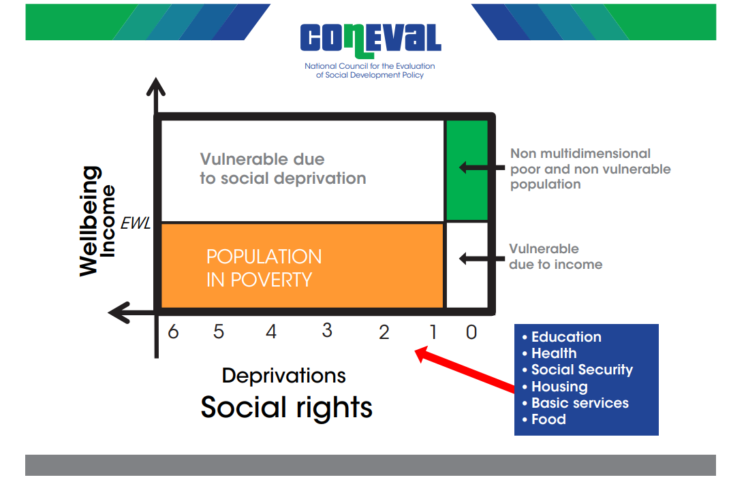
Alternative Poverty Measurements: Mexico’s case
Vulnerable due to income: an individual could be below the poverty line, and not be in poverty. How? If he does not experience any social deprivations, he is not poor under this definition.
Vulnerable due to social deprivation: an individual could lack access to 1 (or all) human rights, but if his income is above the poverty line, he is not poor under this definition.
Takeaway: identifying “vulnerable population” allows policymakers to improve policy targeting.

Slide 5
Poverty Line Approach: Some Problems
Contrasting Mexico’s and the US’s poverty measurement methodology highlights some of the main concerns economists have with income-based approaches to measuring poverty.
Poverty rate could be understated: some costs are not included in the measurement (e.g. healthcare, education, childcare, services on the dwelling).
Poverty rate could be overstated: poverty is experienced differently in developed economies (e.g. US) than in developing economies.
Americans in poverty experience a high standard of living relative to the rest of the world.
The measure only counts income, not wealth. Nearly a million poor people own homes worth more than $150K.

Slide 6
Why should we care about income inequality and poverty?
These two characteristics are highly correlated with economic well-being.
Provide a framework to assess the effectiveness of social policies.
For example, empirical evidence suggests that low-income inequality is associated with.
Low GDP per capita (income per capita).
Low economic growth.
High poverty rates.
Let’s look at some 2019 data.

Slide 7
Income Inequality: Macro Evidence
The World Bank estimates Gini coefficients for several countries. This allows to compare the income distribution
While the United States has an income distribution that is more equitable compared to the one observed in countries like Brazil and Peru, it is still less equitable than the one observed in places like Spain, Denmark, or Belgium.
Source: World Bank.

Slide 8
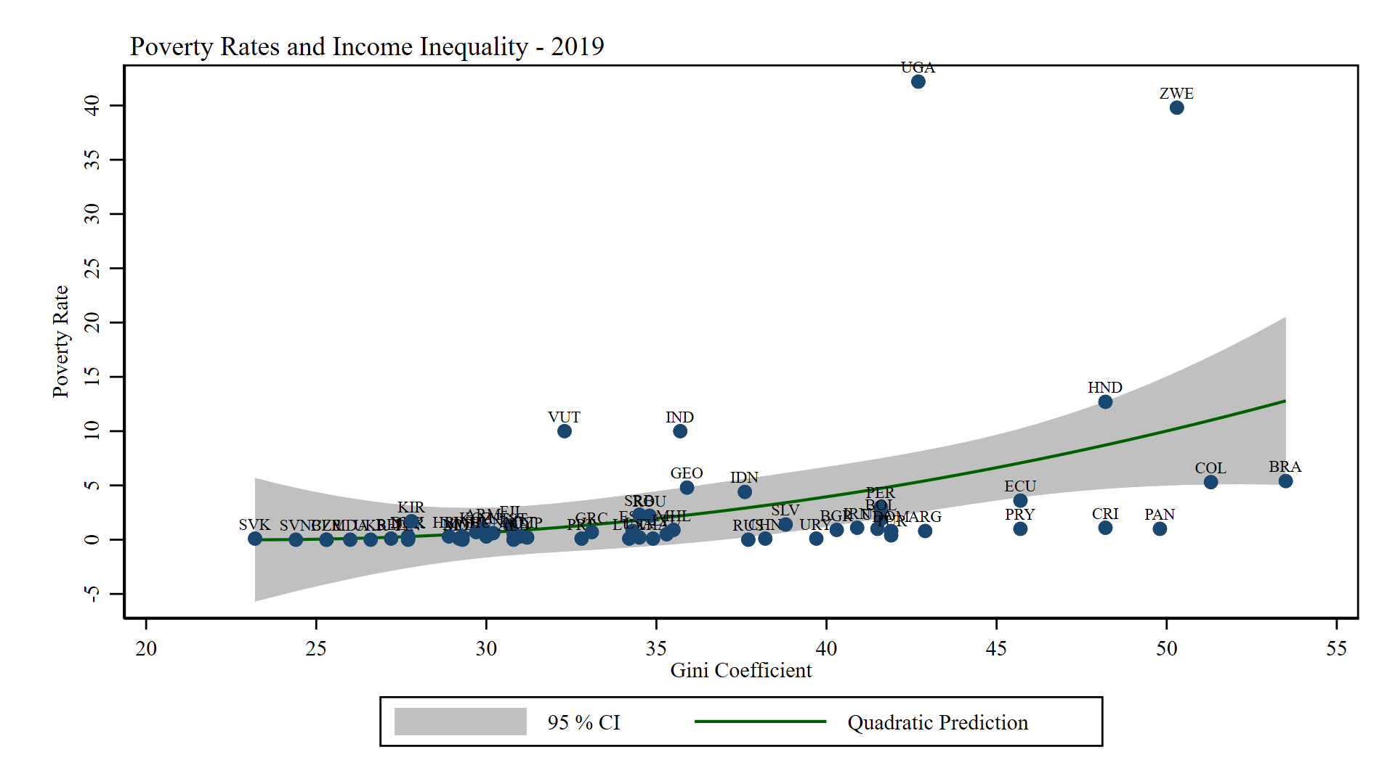
Poverty and Income Inequality
Poverty and income inequality are positively correlated.
Source: World Bank.

Slide 9
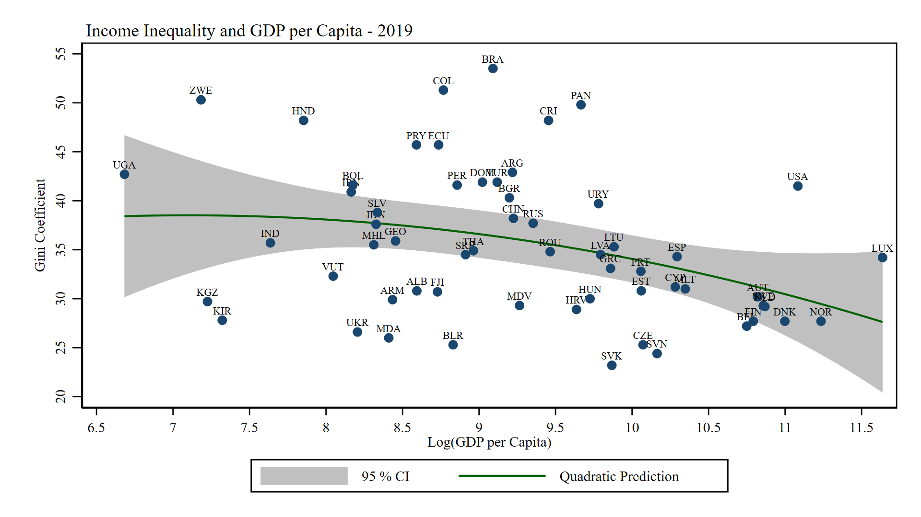
Income Inequality and GDP per Capita
Countries with lower income per capita observe higher levels of income inequality.
Source: World Bank.

Slide 10
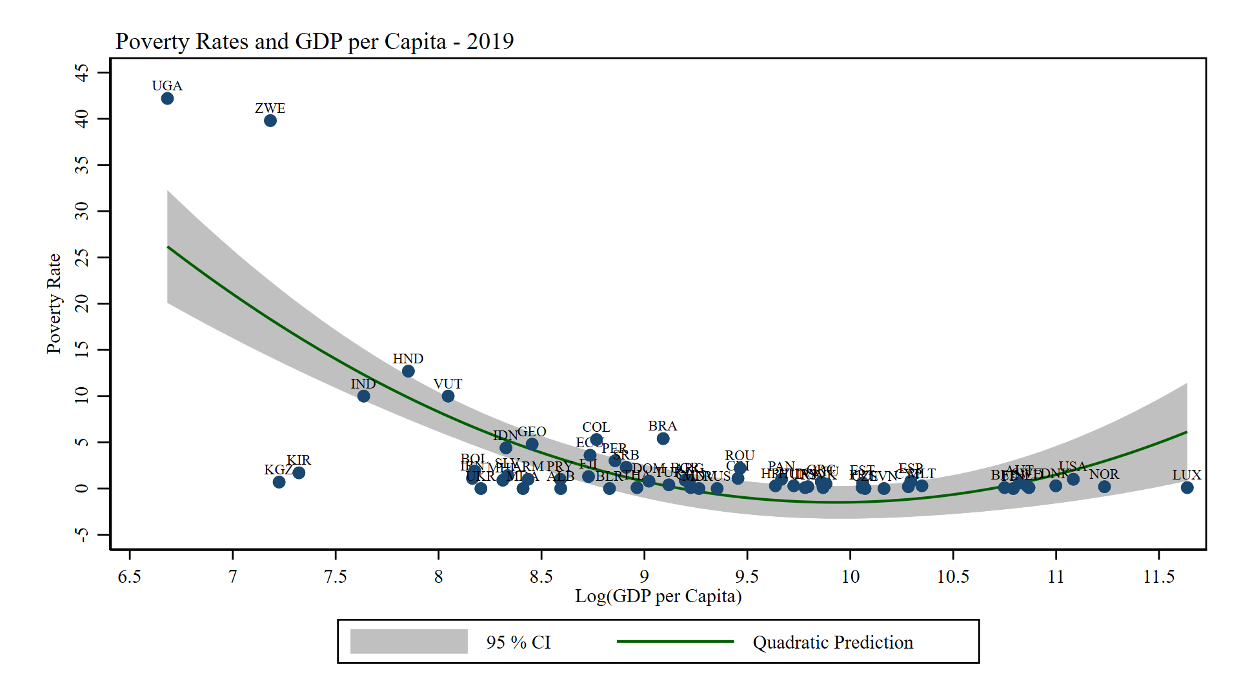
Poverty and GDP per Capita
Same phenomenon with poverty and income per capita.
Source: World Bank.

Slide 11
Rationale For Government Welfare Programs
Even if markets operate efficiently (i.e. without market failures), they do not necessarily produce a distribution of income that is socially acceptable.
Welfare Programs focus on one aspect of the income distribution: those at the very bottom.
These programs are often viewed as safety net programs.
Also viewed as a form of social insurance (more on this later!).

Slide 12
General Aspects of US Welfare Policy
Key Components of Welfare Policy
Eligibility/Targeting: who should receive the benefits?
Aid type: how should the government assist welfare beneficiaries (cash vs in-kind)?
Generosity: what is the optimal amount of aid beneficiaries must receive?
Duration: how long should individuals be eligible for the program?
General Aspects of US Welfare Policies
Family structure and household composition determine eligibility and degree of “generosity” of the welfare program. Special attention to children experiencing poverty.
Programs are designed to “graduate” beneficiaries. The goal is to pull out people of poverty. Move them from welfare to the labor market. Hence, for most programs as income rises, benefits reduce.

Slide 13
Cash Welfare and Labor Supply
Example: suppose we have the following means-tested cash transfer program. All individuals whose income is below $30K will receive a check from the government for $5K.
Your current job pays $29K, so you qualify for the program. After the check, your net income is $34K.
You have a job offer that pays $32K. Would you take it?
If you do, your income decreases because the increase in your wage does not compensate for losing the benefits from the program. If you are rational, you should not take the offer.
Takeaway: the threshold for eligibility creates a jump (cliff) in your earnings, creating a distortion in your behavior if you are supplying at the margin.
The more “generous” the program (higher benefits), the cliff rises.

Slide 14









Welfare and Labor Supply
The previous example highlights the argument of how welfare reduces incentives for labor supply.
Note the example is equivalent to the effect of an increase in non-labor income on labor supply.
Hence, the theory predicts the program will derive in a decrease in the labor force.
This is problematic if the goal is to “graduate” people from the program into the labor market.
Since eligibility is determined by income, the opportunity cost of being enrolled in the program is determined by the size of the transfer (program’s generosity)
Question: what’s the relation between the change in the intercept and the program’s generosity?
Labor Market
$$w$$
$$Supply (Program)$$
$$Supply$$
$$w_{p}$$
$$w^{′}$$
$$Demand$$
$$l$$
$$l_{p}$$
$$l^{′}$$

Slide 15
Welfare Policy in the United States
Welfare policy could be categorized by the type of benefit it provides and the eligibility criterion to receive such benefits.
Type of Benefit
 | Cash | In-Kind
Categorical | Cash benefits restricted by some demographic characteristic. Example: SSI | In-kind benefits restricted by some demographic characteristic. Example: Medicare
Means-Tested | Cash benefits restricted by income or wealth. Example: TANF | In-kind benefits restricted by income or wealth. Example: SNAP, Medicaid
Eligibility
Note: some policies implement combinations of these. For example, programs could have components both categorical and mean-tested (e.g single mothers below the poverty line).

Slide 16
Examples of Eligibility for Welfare Programs
Assistance is conditional on the recipient not working
Supplemental Security Income (SSI)
Unemployment Insurance (UI)
Assistance is conditional on the recipient’s income below the threshold
Earlier version of TANF (AFDC)
Assistance is conditional on the recipient’s income below the threshold and working
Temporary Assistance of Needy Families (TANF)
Earned Income Tax Credit (EITC)
Supplemental Nutrition Assistance Program (SNAP)

Slide 17
In-Kind Programs: SNAP
SNAP: Supplemental Nutrition Assistance Program
First introduced in 1964, as the Food Stamps Program. The main objective was to assist individuals to buy food.
Means-tested: eligibility and benefits depend on the level of income. In-kind: stamps are coupons for food, not money.
2008 reform changed the name to SNAP to counter the stigma associated with the previous name.
Currently is operated through benefit cards (instead of coupons/stamps).
Labor requirement: working-age adults without children cannot receive SNAP benefits for more than 3 months in a 36-month period if they have not worked 20 hours a week, completed a job training program, or participated in a workfare program.

Slide 18
Cash Welfare Programs: TANF
TANF: Temporary Assistance for Needy Families.
Provides assistance to low-income families with children in which one biological parent is absent.
Means-tested: income determines eligibility.
Time limits: individuals cannot receive benefits for more than 60 months (5 years).
Work requirement: recipients should be active in the labor force at most 2 years after enrollment (i.e. they cannot remain outside the labor market).

Slide 19
In-Kind Programs: Medicaid
Established in 1966, this program provides medical assistance to the poor. Special attention is given to poor children, the population with disabilities, and the elderly.
Means-tested: eligibility is determined by an income threshold: if your income is above, you are not eligible. In-kind: medical services are not fungible.
Medicaid provides a nice example to analyze the effects of in-kind transfers on labor supply.
Medical services are expensive. Not having insurance and facing an accident could bankrupt households.
Example: suppose you have two job offers. One has medical insurance, while the other one does not. Which income level would leave you indifferent between the two? (We will examine this deeply later on).
In general, for you to be indifferent the wage of the job without insurance should be large enough to cover your medical bill. Since medical services are expensive, this creates the so-called “benefit-cliff”.

Slide 20







Benefit Cliffs
The basic intuition behind the cliff is that the market value of some government benefits is large relative to the beneficiary’s income.
Example: suppose a program that provides benefits for $10K for all people above the poverty line.
Thinking like an economist: Each extra hour worked derives in additional income until you reach the poverty line.
After this threshold, the benefit of working an extra hour might not compensate for losing the $10K in benefits.
How can we deal with these incentives? Let’s see one way to “smooth” these adverse effects.
$$Earnings \$$$
$$Earnings+Benefits$$
$$Earnings$$
$$Cliff$$
$$Poverty Line$$
$$10K$$
$$Benefits$$
$$l$$

Slide 21
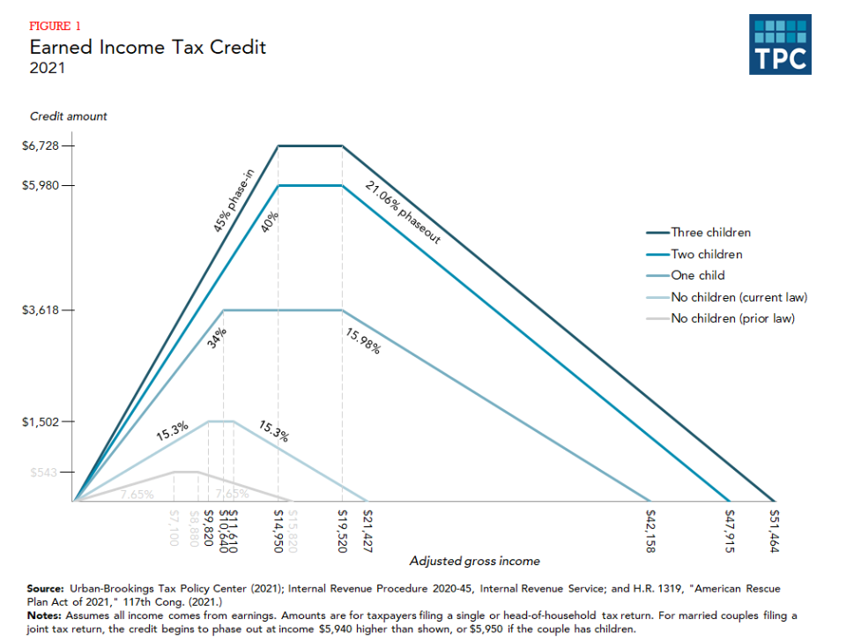
Cash Welfare Programs: EITC
EITC: Earned Income Tax Credit
Program that supplements the income of low-income families with children by an amount that depends on both income and number of children.
The EITC gradually increases as earned income rises, plateaus at the maximum level, and then is phased out as income continues to rise.
Phase-in and phase-out structures aim to “smooth” labor market responses.
This is an example of how programs “graduate” beneficiaries.
https://www.taxpolicycenter.org/briefing-book/what-earned-income-tax-credit

Slide 22
Cash vs In-Kind Transfers
Suppose you are designing a welfare program and you want to decide whether it should provide cash or in-kind benefits. How would you choose?
Cash is fungible. The main argument for cash programs is that people in need know best what could improve their well-being. Recipients could use it to buy whatever they need the most.
Critiques of in-kind policies often label them as “paternalistic”. The government is “choosing for you” what you should buy. In some cases, however, it could be beneficiary.
Evidence suggests many people (particularly those with limited income and education) may not be fully cognizant of the effect on themselves and their children of inadequate nutrition or preventive health care.
In-kind programs are a way of ensuring everyone has the access to a minimal level of consumption for specific goods (e.g. healthcare, food, housing).
The catch: in-kind programs observe higher administrative costs and create larger distortions in behavior.

Slide 23
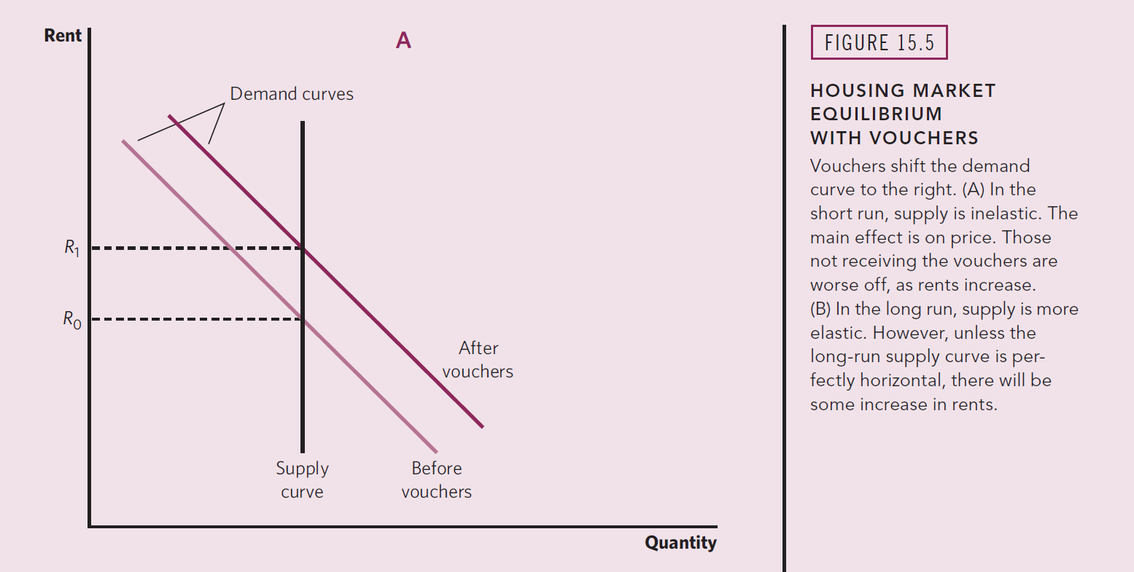
Externalities of Welfare Programs

Slide 24
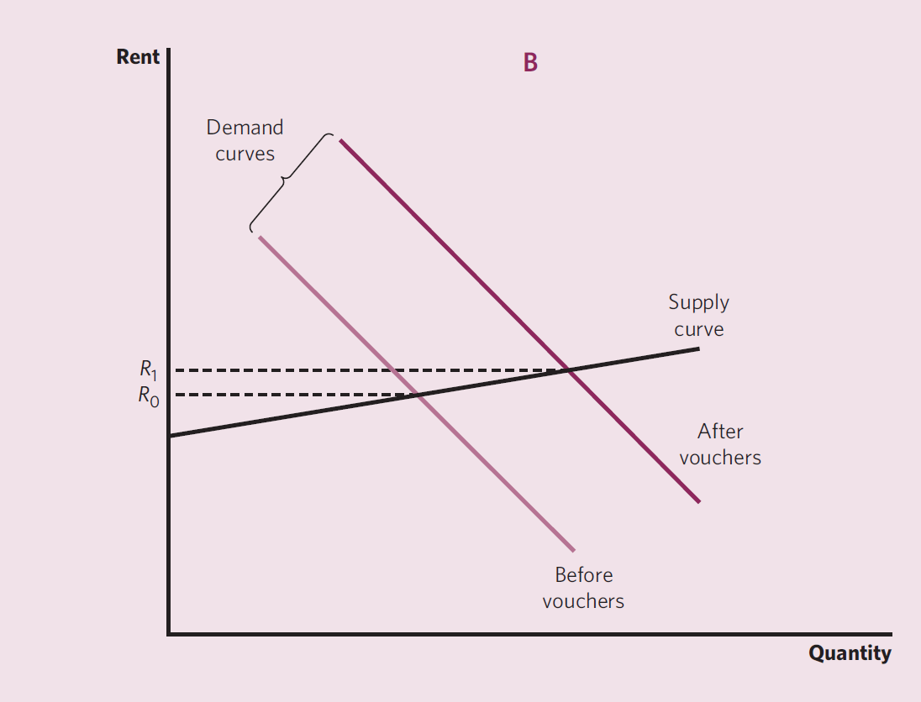
Externalities of Welfare Programs

Slide 25
For Next Class
Next class: Health Care
Readings: Mankiw Ch 20. Stiglitz & Rosengard Ch 15. Gruber Ch 17.
Assignment 4: due Sunday.
Weekly Discussion: due Sunday.

Slide 26
SPEA-V-202
Contemporary Economic Issues in Public Affairs
Income Inequality and Poverty II
Luis Navarro

