Slide 1
SPEA-V-202
Contemporary Economic Issues in Public Affairs
Trade Policy
Luis Navarro

Slide 2


Outline for Today
Determinants of Trade
Opportunity Cost
Comparative Advantage
Gains from trade
Equilibrium Analysis and Trade Policy
Welfare effects of Trade
Tariffs and Quotas
Trade Policy

Slide 3
Introduction – Production Possibilities
To think about trade, we need to examine differences in productivity between economic agents.
Productivity: how many units of output you can produce, given a fixed amount of inputs.
Recall Bob and Sandy’s example of the number of burgers cooked in one hour.
We will look at productivity slightly differently: the opportunity cost of doing another activity.
Example: suppose you have 1 hour to either: i) solve economics exercises or ii) do readings for your management class.
Suppose you can solve 5 economics exercises in 30 minutes and do a management reading in 12 minutes.
How can we look at all the possible combinations of output (econ exercises, management readings) you can do in one hour?
This has a nice visual representation.

Slide 4
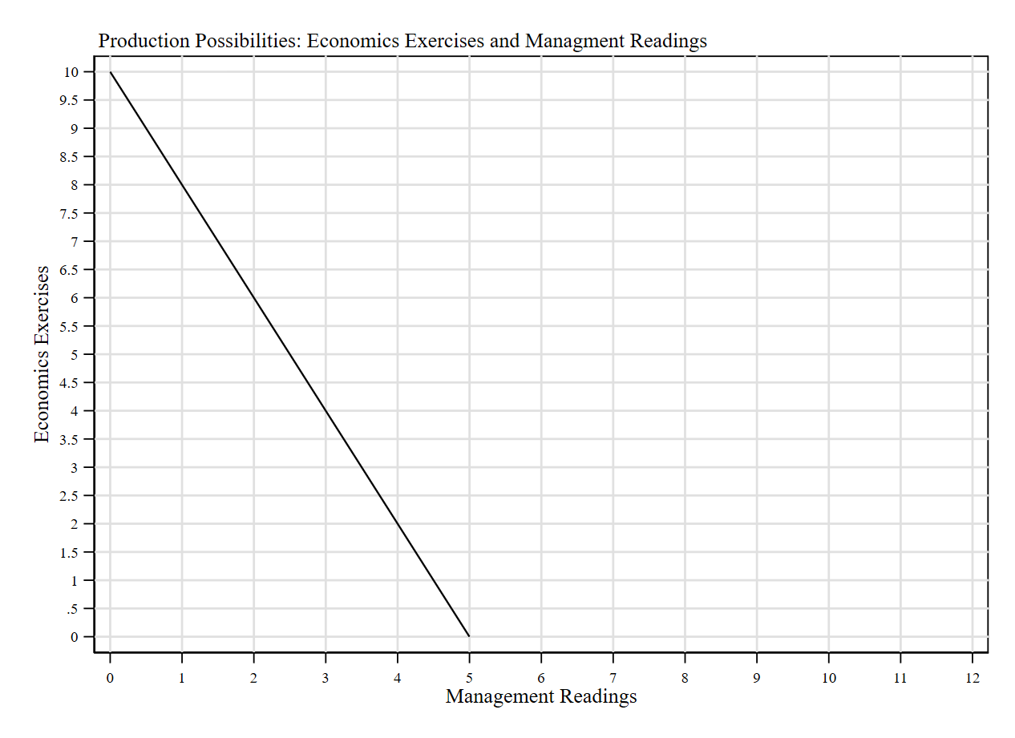
Introduction – Production Possibilities
If you allocate all your time to economics, you can solve up to 10 exercises. (Point A)
If you allocate all your time to management, you can do up to 5 readings. (Point B)
If you allocate 30 mins each, you can do 5 exercises and 2.5 readings. (Point C)
What if you don’t use all your time? Say 30 mins to econ and 12 minutes to management. Then you do 5 exercises and just one reading. (Point D)
Takeaway: the line delimits what you can produce. Points below the line are attainable but imply you are not using all the resources in the economy. In general, that is not optimal.
A
A=(0,10)
B=(5,0)
C=(2.5,5)
D=(1,5)
D
C
B

Slide 5
Introduction – Opportunity Cost
The Production Possibility Frontier (PPF) gives an intuitive representation of the opportunity cost: units of one good you give up in order to produce more of the other.
Example: to do an additional management reading, you need to decrease the number of econ exercises by 2.
Opportunity cost of 1 management reading = 2 econ exercises.
Opportunity cost of 1 econ exercise = 0.5 management readings.
Takeaway: the slope of the PPF represents the opportunity cost of producing (consuming) an additional unit of one good, in terms of the other.

Slide 6
Introduction
Example: consider an economy conformed of 2 people that live on a desert island: Bob and Sandy. Bob is skilled at collecting apples, while Sandy excels at fishing. Both have the same time to either collect apples or fish. Suppose that in one day they can collect/fish according to the following table:
 | Apples | Fish
Bob | 10 | 5
Sandy | 5 | 10
Just like before, we can find their production possibility frontier (PPF) by drawing a line that represents the trade-off (opportunity cost) of allocating resources (in this case time) to each activity.

Slide 7
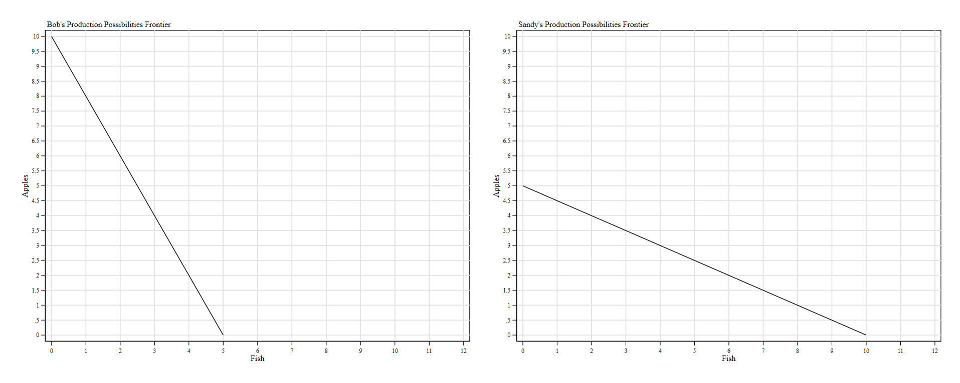
Production Possibilities Frontier without Exchange
Suppose they are not allowed to exchange (trade). They’ll consume a combination of apples and fish that lies at their individual PPFs. Since they like to smooth consumption, suppose both will consume right in the middle.
Bob | Apples | Fish
Consumption | 5 | 2.5
Sandy | Apples | Fish
Consumption | 2.5 | 5

Slide 8
Exchange
Now suppose they are allowed to exchange with each other. How can this improve their welfare?
Let’s look at the extreme cases. Suppose both Sandy and Bob allocate all their time to the activity in which they excel.
Then Bob collects 10 apples and Sandy 10 fish.
For simplicity, suppose there are no prices and that both Bob and Sandy have the same preferences (i.e. demand curve) for apples and fish.
If they are allowed to trade, Bob can exchange 5 apples for 5 of Sandy’s fish.
If they trade, both Bob and Sandy will be consuming 5 apples and 5 fish each.
How does this compare to the scenario without trade?

Slide 9
Production Possibilities Frontier with Exchange
If they exchange, both can attain a consumption bundle outside their production possibility frontier!
This means they are better-off in the equilibrium with exchange.
Bob | Apples | Fish
Without trade | 5 | 2.5
With trade | 5 | 5
Sandy | Apples | Fish
Without trade | 2.5 | 5
With trade | 5 | 5

Slide 10
Comparative Advantage
Why is it the case that exchange made them better-off? Both exploited their skills the best they could and maximized total output by trading.
Comparative Advantage: the ability to produce a good at a lower opportunity than another producer.
In our example:
Bob has a comparative advantage over Sandy in apples collection.
Bob’s opportunity cost of 1 apple (in terms of fish): 0.5 fish
Sandy’s opportunity cost of 1 apple (in terms of fish): 2 apples
Sandy has a comparative advantage over Bob in fishing.
Bob’s opportunity cost of 1 fish (in terms of apples): 2 apples
Sandy’s opportunity cost of 1 fish (in terms of apples): 0.5 apples

Slide 11
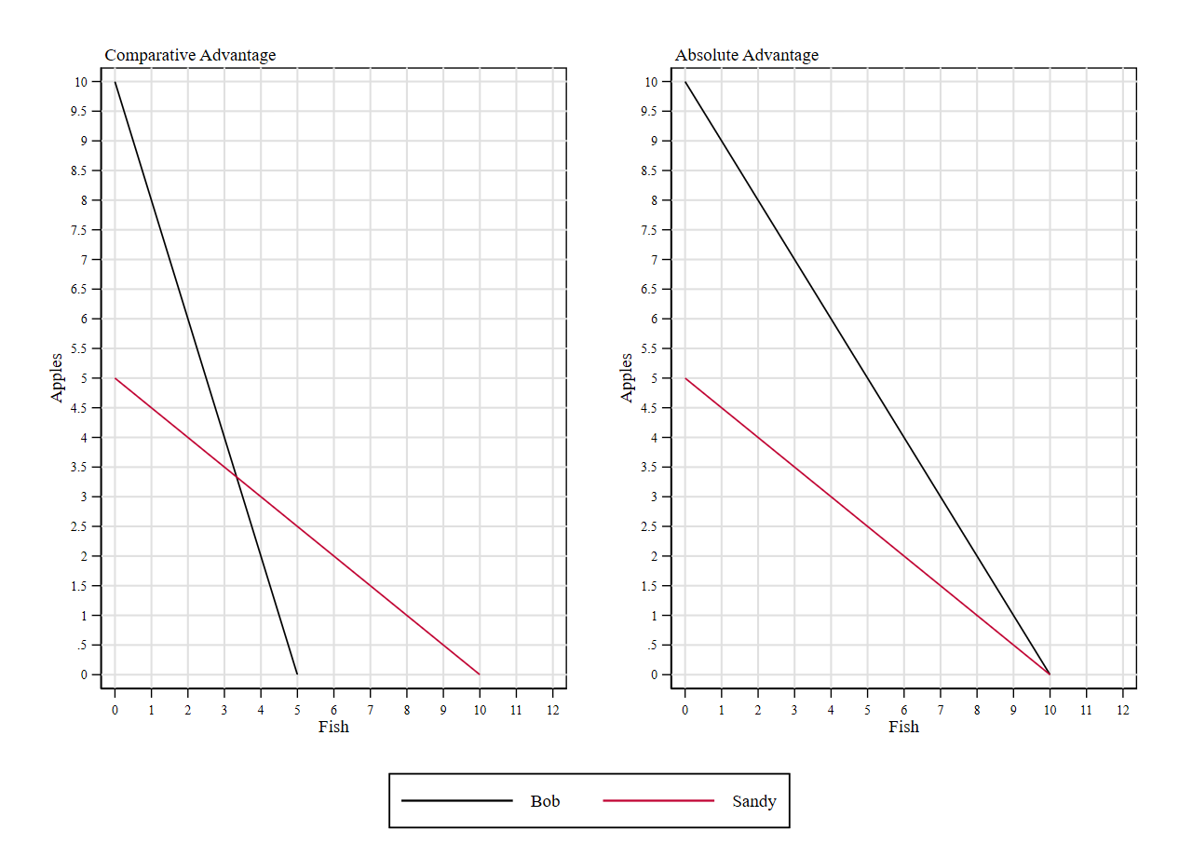
Absolute Advantage
Comparative Advantage PPFs intersect
Absolute Advantage
One PPF is above the other.
Suppose that Bob created a fishing rod that doubles his production of fish. Now he can capture 10 fish in one day. How does his PPF looks like after the change?
Absolute Advantage: the ability to produce both goods at a lower opportunity than another producer.
Is it still beneficial to trade?
Yes! Do the same exercise. If they trade, they can attain a consumption bundle outside their PPF.
Terms of trade might differ.

Slide 12
Some Remarks on Trade
In order to maximize output, the economy must be producing a combination of goods that lies at the production possibility frontier.
For trade to be beneficial, the agent’s opportunity cost must differ (i.e. there needs to be some comparative advantage).
Example: suppose both Bob and Sandy can produce the same number of apples and fish. Then the equilibrium with and without trade leads to the same consumption bundle.
Trade creates incentives for specialization in the activity in which each agent has a comparative advantage.
Example: countries with large farmlands and skilled farmers have incentives to specialize in agriculture.
The opportunity cost equals the terms of trade: units of one good you are willing to give up in exchange for units of another good.

Slide 13
Intuition behind trade
Example: US’s main export is refined petroleum, while its main import are cars.
Exports: goods sold to a business partner.
Imports: goods purchased from a business partner.
Why is one country willing to export/import one good?
Simple intuition: suppose quantity supplied > quantity demanded (i.e. excess supply), then you will be better-off by selling the excess to a business partner.
Similarly with imports. If quantity demanded > quantity supplied (i.e. excess demand), then you might be better-off by buying goods from another economic agent.
Remark: if the world price (i.e. the average price of the good in the world market) is higher than the domestic price, then the country could benefit from exporting some goods. Similarly, if the world price is below the domestic price, then the country could benefit from importing goods.

Slide 14
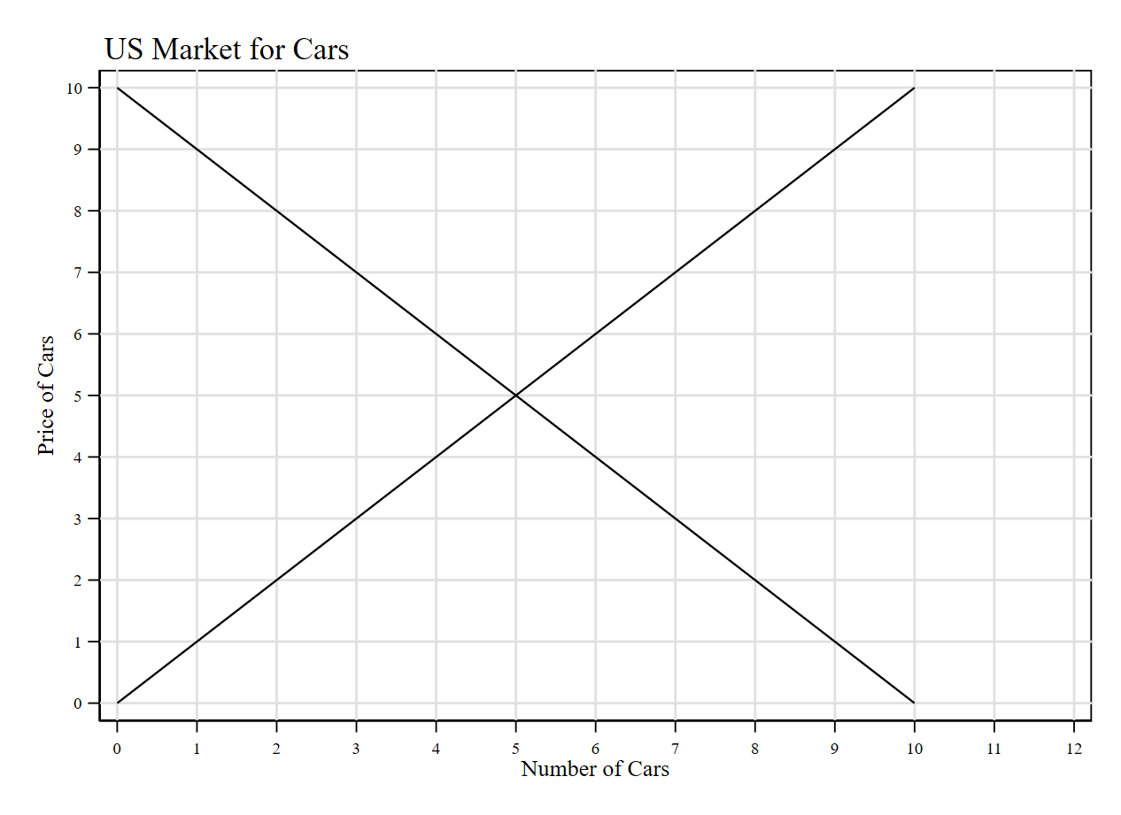
Gains from Trade: Autarky Equilibrium
Example: we have two countries, US and Rest of the World (RW, think it like the average of all the other countries). Each economy is described by inverse supply and demand functions for cars.
Suppose these two countries are not allowed to trade.
Hence, they can only consume what they produce.
Supply = Demand in each market.
We have the traditional analysis.
Economists often define autarky equilibrium as the market equilibrium without trade.
CS
PS

Slide 15


Gains from Trade: Equilibrium with Trade (Exports)
Example: suppose the world price of cars is higher than the price of cars in the US. Then, the US could benefit from exporting cars to the Rest of the World. Suppose both countries can trade.
United States | Before Trade | After Trade | Change
CS | A+B | A | -B
PS | C | B+C+D | +B+D
TS | A+B+C | A+B+C+D | +D
Exports
A
$$p_{rw}=7$$
B
D
Producers capture the increase in TS.
Producers benefit from selling at a higher price than in the US.
Consumers are worse-off because now they need to buy cars at the world price (i.e. p=7), which is higher.
$$p_{us}=5$$
C

Slide 16


Gains from Trade: Equilibrium with Trade (Imports)
Example: suppose it is the other way around: the world price of cars is lower than the price of cars in the US. Then, the US could benefit from importing cars from the Rest of the World.
United States | Before Trade | After Trade | Change
CS | A | A+B+D | +B+D
PS | B+C | C | -B
TS | A+B+C | A+B+C+D | +D
A
Consumers capture the increase in TS.
Consumers benefit from buying at a lower price. Imports reduce relative scarcity. Intuitively speaking, is like increasing the supply (i.e. it lowers the price)
Producers are worse-off because now they need to sell cars at lower price in the domestic market.
$$p_{us}=5$$
B
D
$$p_{rw}=3$$
C
Imports

Slide 17
Some Remarks on Trade
The previous example hinges on the assumption that, relative to the rest of the world, the US is a “small open economy”. In other words, its decisions cannot influence car’s price in the Rest of the World.
Sounds familiar? This is equivalent to saying that the US is a price-taker.
In practice, some developed economies (like the US) are not really price-takers. They have some market power.
Gains from trade could be analyzed even without this assumption. How?
If we know the market power the country has on the global market, we can “estimate” the markup it charges (i.e. deviation of the observed price to the marginal costs) and draw the triangles of CS, PS and Welfare Gain.
We won’t cover this, but the intuition of “winners and losers” from trade prevails.

Slide 18
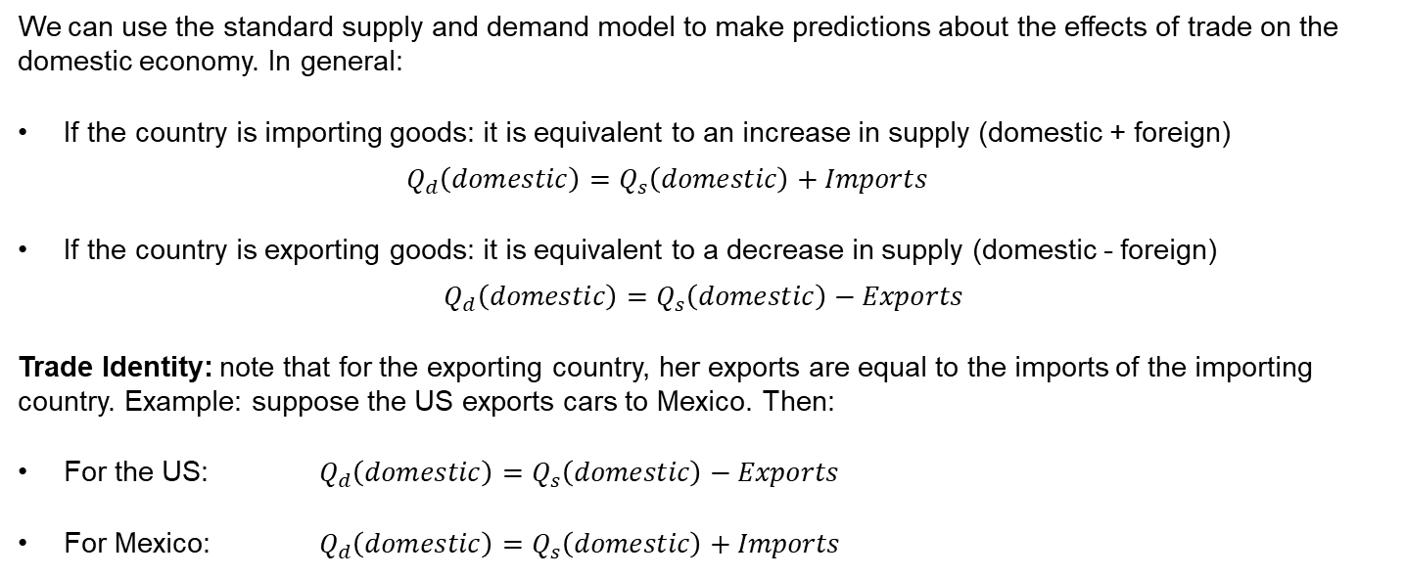
Some Remarks on Trade
We can use the standard supply and demand model to make predictions about the effects of trade on the domestic economy. In general:
If the country is importing goods: it is equivalent to an increase in supply (domestic + foreign)
$$Q_{d}\left(domestic\right)=Q_{s}\left(domestic\right)+Imports$$
If the country is exporting goods: it is equivalent to a decrease in supply (domestic - foreign)
$$Q_{d}\left(domestic\right)=Q_{s}\left(domestic\right)−Exports$$
Trade Identity: note that for the exporting country, her exports are equal to the imports of the importing country. Example: suppose the US exports cars to Mexico. Then:
For the US: $Q_{d}\left(domestic\right)=Q_{s}\left(domestic\right)−Exports$
For Mexico: $Q_{d}\left(domestic\right)=Q_{s}\left(domestic\right)+Imports$

Slide 19
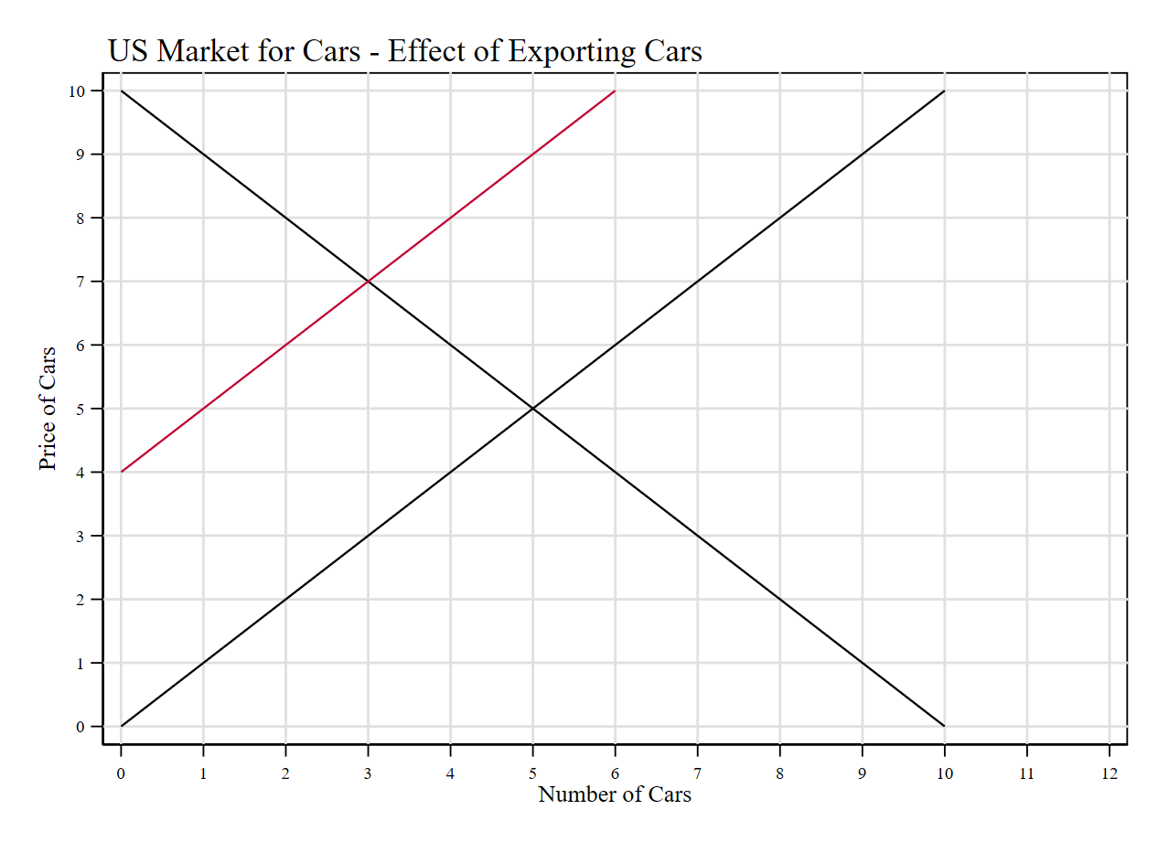




Gains from Trade: Equilibrium with Trade (Exports)
We can use the same diagram to analyze the market for the exporting country. Let ${(q}_{0},p_{0})$ be the equilibrium without trade and ${(q}_{1},p_{1})$ the equilibrium with trade.
Exporting goods means the domestic supply decreases (shifts to the left).
The magnitude is determined by the amount exported.
Analysis is straightforward. In equilibrium:
Price increases
Quantity decreases.
Supply
(with trade)
Supply (without trade)
$$p_{1}=7$$
Exports
$$p_{0}=5$$
$$q_{1}=3$$
$$q_{0}=5$$

Slide 20
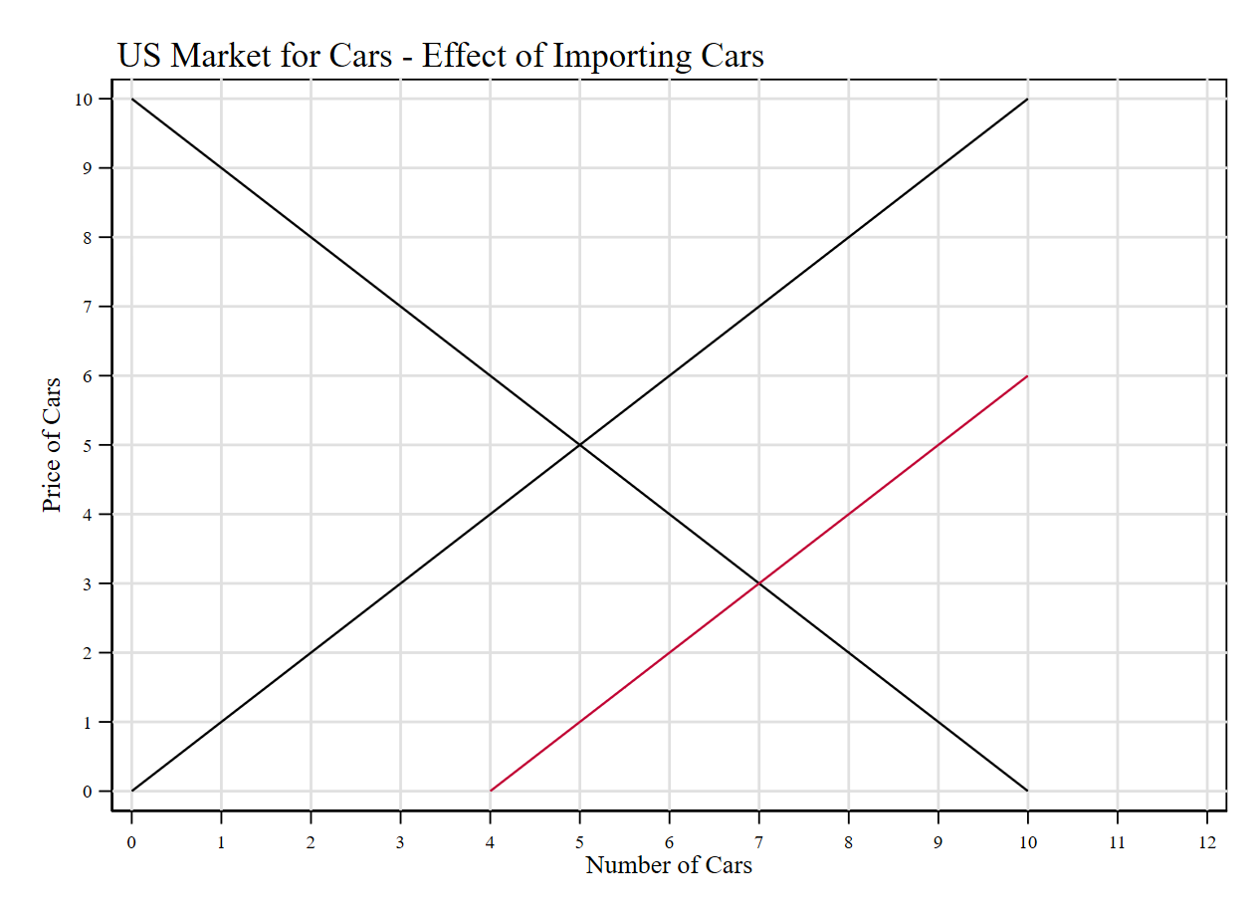


Gains from Trade: Equilibrium with Trade (Imports)
Same to analyze the effects of trade on an importing country. Let ${(q}_{0},p_{0})$ be the equilibrium without trade and ${(q}_{1},p_{1})$ the equilibrium with trade.
Supply (without trade)
Importing goods means the supply increases (shifts to the left) by the amount imported.
Analysis is straightforward. In equilibrium:
Price decreases
Quantity increases.
$$p_{0}=5$$
Supply
(with trade)
$$p_{1}=3$$
Imports
$$q_{1}=7$$
$$q_{0}=5$$

Slide 21
Trade Policy
In practice, in order to trade between countries sellers/buyers are often subject to quotas and/or tariffs. These are policies to influence the equilibrium in the domestic market, under the presence of trade.
Quotas: are just limits on the amount that could be imported.
Tariffs: taxes on goods produced abroad and sold domestically. Basically, taxes on imported goods.
Example: for the sugar market, the US government determines the amount of sugar that could be imported from each country at preferential tariffs. If a country wants to export more sugar than the one assigned at the quota, it needs to pay a higher tariff.
Welfare analysis of quotas and tariffs is the same as we did to analyze regulation-based limits (e.g. price ceilings) and taxes.
Since tariffs are taxes, the price paid by the exporting seller differs from the price faced by the importing consumer. Hence, inducing DWL in the economy. Same with quotas.

Slide 22


Equilibrium with Trade (Imports) and Tariffs
Same to analyze the effects of trade on an importing country, with and without a tariff.
US | Before Tariff | After Tariff | Change
CS | A+B+C+D+E+F | A+B | -(C+D+E+F)
PS | B+C | C | +C
TR | 0 | E | +E
TS | A+B+C | A+B+C+E+G | -(D+F)
A
B
$$p_{rw}(with tariff)$$
C
D
E
F
The tariff reduces the quantity of goods imported (because it raised the price).
DWL = D+F
$$p_{rw}(withour tariff)$$
G
Imports (with tariff)
Imports (without tariff)

Slide 23
Trade Policy
Gains from trade imply that consumers could access goods at lower prices. Countries would specialize in the sectors where they have comparative advantage and, if there is free-trade (no tariffs, low transaction costs) then we should all be better-off allowing for trade.
Why do governments put in place trade restrictions?
Opening the market to international trade, leads domestic prices to decrease. While this is good for consumers, it pressures producers.
In theory, low-productivity suppliers might exit the market under the presence of trade (consumers substitute them for a cheaper/better foreign option).
This leads to unemployment for the importing country. Protectionist measures (i.e. barriers to trade) usually aim to prevent this.
Thinking like an economist: so long the benefits from lower prices to consumers, outweigh the costs of lower producer surplus (which leads to unemployment in some sectors), then opening to trade leads to a welfare improvement.

Slide 24
Trade Policy
In practice, producers often lobby for trade protections.
Small producers might do it to ensure their survival. Some larger producers might do it to preserve market power.
Notice that opening the economy for international trade is implicitly increasing the number of suppliers/consumers available to domestic firms/buyers.
Example: with international trade, Apple can sell iPhones worldwide and US consumers can purchase BMWs.
Trade Balance: Total Exports – Total Imports. If Exports > Imports then the country has a trade surplus (i.e. it sends more goods than the ones it purchases abroad). If Imports > Exports, then it has a trade deficit.

Slide 25
Final Remarks
In practice, international trade is regulated by the standards set by the World Trade Organization (WTO).
Also, countries have international treaties/agreements that set special rules across signing members.
United States-Mexico-Canada Agreement (USMCA, previously NAFTA).
European Union.
There is nothing special about international trade. All the logic we covered here applies to inter-state trade as well.
Instead of country A and B, suppose we analyze Indiana and California on the import/exports of wine and corn.

Slide 26
For Next Class
Next class: Public Goods

Slide 27
SPEA-V-202
Contemporary Economic Issues in Public Affairs
Trade Policy
Luis Navarro

