Slide 1
SPEA-V-202
Contemporary Economic Issues in Public Affairs
Introduction
Luis Navarro

Slide 2

Welcome to V-202!
Instructor: Luis Navarro
Contact: lunavarr@iu.edu
Class Meeting: MW 4:45 – 6:00pm
Room: PV 169
Office Hours: MW 6:00 – 7:30 pm
Syllabus available at Canvas.

Slide 3

About Me:
Current: Doctoral Student at O’Neill. Public Finance Track.
Research: Local Tax Policy and Municipal Bond Market.
Education: BSc Economics (Finance Minor) – Class of 2016
Professional Background: economist at the federal government and financial advisor for government organizations (federal and local) and firms (investment banking).

Slide 4

Syllabus
Let’s read the syllabus and talk about:
Learning outcomes and expectations.
Ground rules.
Readings and course material.
Assignments, exams, and grades.

Slide 5
Economics: Intro
Economics is the social science that studies decision-making under scarcity.
Decision-making
All about incentives and the allocation of resources in the economy
Which cereal do you buy at the store?
How many hours do you work?
How much do you save?
Which program gets more funds from the federal budget?

Slide 6
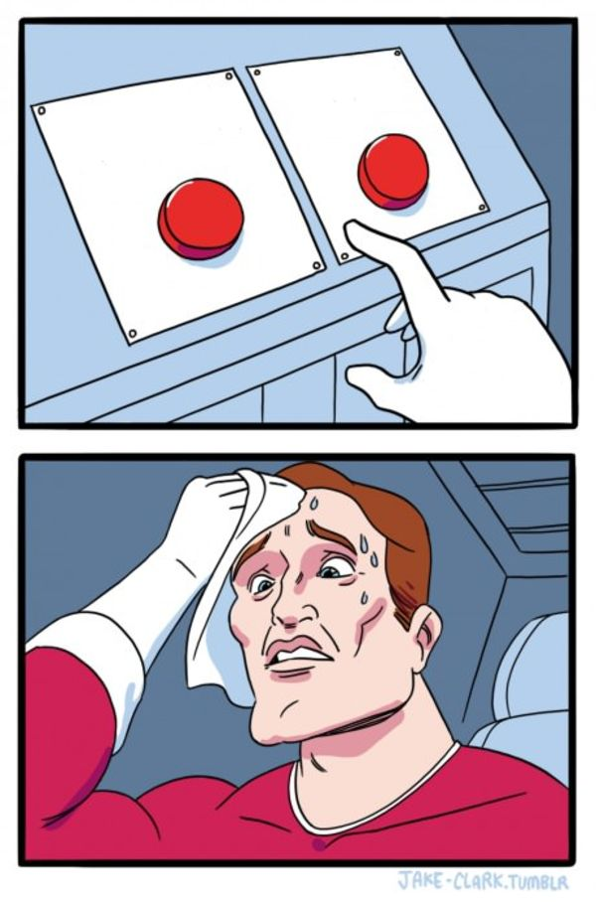

Key Concept: Opportunity Cost
“Two roads diverged in a yellow wood, and sorry I could not travel both…”
Robert Frost, The Road not Taken

Slide 7
Key Concept: Opportunity Cost
Decisions have trade-offs: every choice involves the sacrifice not choosing another alternative.
Pizza or sushi?
IU or Notre Dame?
Study or party?
Policy analyst or entrepreneur?
More or fewer taxes?
Increase or reduce CO2 emissions?
Opportunity cost is what you give up when you make your decision.
Opportunity Cost
The benefit of the second-best.

Slide 8



Key Concept: Opportunity Cost
Opportunity cost depends on each decision and on each individual.
What is the opportunity cost of allocating one hour of your time to play video games?
Student
Completing the readings for the next econ class.
Worker
Stop earning one hour of salary.
The President
Stop drafting America’s next big policy.

Slide 9
Economics: Intro
Economics is the social science that studies decision-making under scarcity.
Scarcity
Not enough to satisfy demand when accessible at no cost.
Economics deals with the allocation of scarce resources.
Allocation of resources is done through the combined decisions of individuals, firms, and governments.

Slide 10



Market Economy
Allocation of scarce resources takes place by the interaction of economic agents via market exchange.
Economic Agents
Households
Firms/
Organizations
Government
both suppliers and consumers in the market economy.
Market Exchange – Market Economy
consumers purchase goods and services from suppliers

Slide 11

Economics and the Government
Unlike households and businesses, the government has additional roles in the market economy.
Buy and sell goods and services.
Provides specific goods, not provided by private organizations.
Has the authority to pass and change regulations.
It can change the rules of the game.
It can impose taxes/subsidies and change people’s incentives towards buying/selling.
Our plan: use economic theory to examine the role of government intervention in the economy.

Slide 12
Economic Analysis of Public Policy
Key questions that we will be exploring along this course:
Why does the government implement some policies over others?
Are we better off with the implemented policy, relative to the case of no intervention? What about relative to the case of a different policy?
What are the intended (and unintended) effects of government actions on human behavior? In particular, in key outcomes for society: education, health, security, economic growth, income inequality, pollution, etc.
What are the main economic concepts to keep in mind when analyzing public policy?
What are the limitations of economic theory to analyze public policy? What things remain unanswered?

Slide 13
Economic Models
We will use economic theory to try to answer such questions.
Models are representations of reality: a model is as good as it describes accurately the phenomenon of interest. Simplicity vs Realism.
Positive Analysis (what will happen): The model will provide some predictions about the effect of one economic variable on another one.
Upon an increase on the price of healthcare, mortality is likely to rise.
Normative Analysis (what should happen): The model could be used as benchmark to test to which extent policies depart from “the ideal scenario”.
Should government provide universal healthcare?
Economics provides only a partial answer. Some dimensions of reality escape the scope of economic models.

Slide 14
Thinking like an economist
Always think at the margin: what is the benefit of drinking one more beer? Increasing one percent the income tax rate?
Caeteris Paribus: markets have a lot of moving parts. To analyze the effect of one factor, we need to keep everything else constant. Caeteris Paribus == everything else held constant.
Our favorite answer: “it depends”. When asked about the effect of some policy we always need to ask: compared to what? Choose the counterfactual carefully.
Intended and unintended consequences: distinguish between the nature of policies’ effects on the economy.

Slide 15
For next class:
Readings: GS Appendix A.

Slide 16
SPEA-V-202
Contemporary Economic Issues in Public Affairs
Introduction
Luis Navarro

