Slide 1
SPEA-V-202
Contemporary Economic Issues in Public Affairs
Mathematics for Economic Analysis
Luis Navarro

Slide 2


Outline: Basic Math Concepts for Economics
Functions
Review definition
Table and graphical representation
Linear functions: slope and intercept
Functions as relations of variables.
Solving Systems of Equations
Conditions for solution
Methods for solving systems of equations
Examples

Slide 3

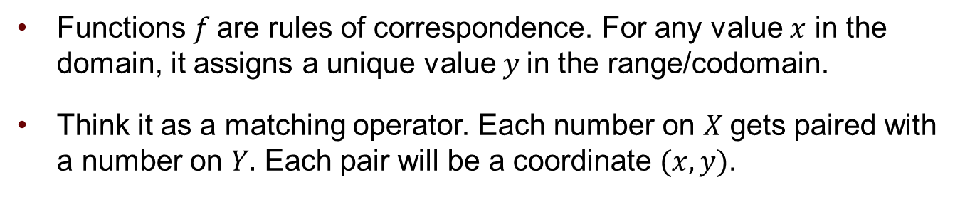
Functions: Introduction
Functions $f$are rules of correspondence. For any value $x$ in the domain, it assigns a unique value $y$in the range/codomain.
Think it as a matching operator. Each number on $X$gets paired with a number on $Y.$ Each pair will be a coordinate $(x,y)$.
$$Domain=X$$
$$Range=Y$$
$$f(x)$$
1
2
3
4
5
3
5
7
9
11

Slide 4
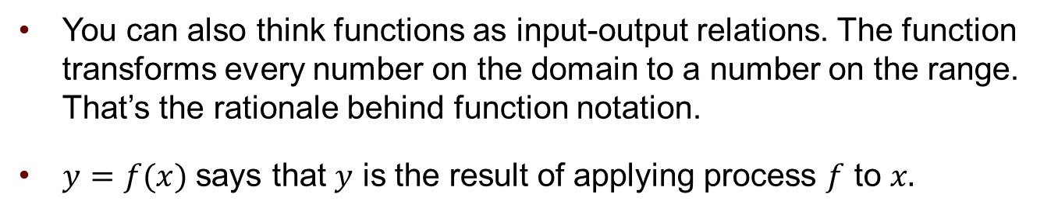
Functions: Intuition
You can also think functions as input-output relations. The function transforms every number on the domain to a number on the range. That’s the rationale behind function notation.
$y=f(x)$ says that $y$ is the result of applying process $f$ to $x.$
$$Domain=X$$
$$Range=Y$$
$$f(x)$$
1
2
3
4
5
3
5
7
9
11

Slide 5
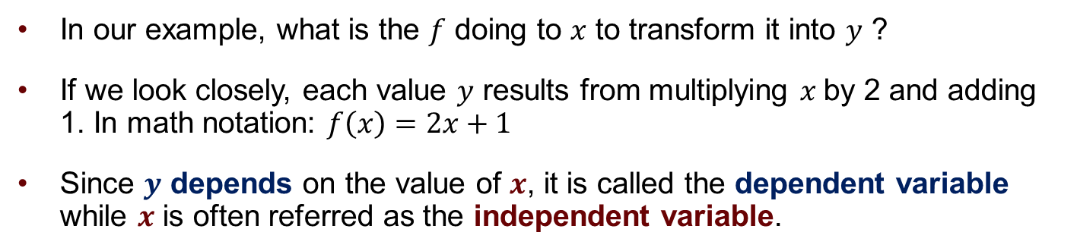
Functions: Example
In our example, what is the $f$ doing to $x$ to transform it into $y$ ?
If we look closely, each value $y$ results from multiplying $x$by 2 and adding 1. In math notation: $f\left(x\right)=2x+1$
Since $y$ depends on the value of $x$, it is called the dependent variable while $x$ is often referred as the independent variable.
$$Domain=X$$
$$Range=Y$$
$$f(x)$$
1
2
3
4
5
3
5
7
9
11

Slide 6
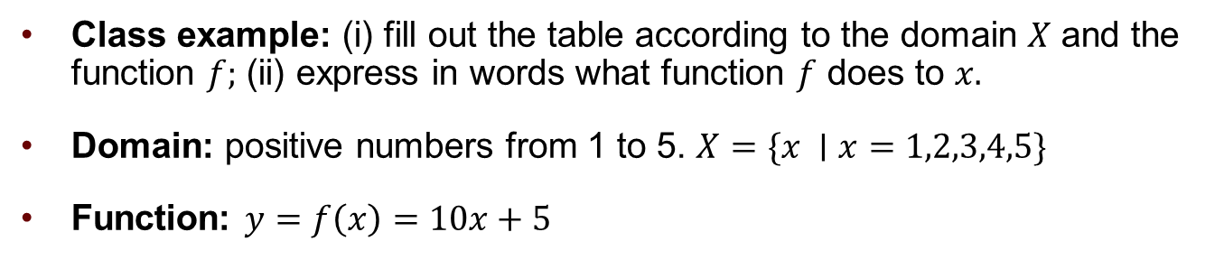
Functions: Example
Class example: (i) fill out the table according to the domain $X$ and the function $f;$ (ii) express in words what function $f$ does to $x.$
Domain: positive numbers from 1 to 5. $X=\{x ∣x=1,2,3,4,5\}$
Function: $y=f\left(x\right)=10x+5$
Domain X | Range Y
1
2
3
4
5

Slide 7
Functions: Example
Class example: (i) fill out the table according to the domain $X$ and the function $f;$ (ii) express in words what function $f$ does to $x.$
Domain: positive numbers from 1 to 5. $X=\{x ∣x=1,2,3,4,5\}$
Function: $y=f\left(x\right)=10x+5$
Domain X | Range Y
1 | 15
2 | 25
3 | 35
4 | 45
5 | 55

Slide 8








Functions: Graphical Representation
Both domain and range will be usually the positive part of the real line.
Hence, we can represent functions in the XY-coordinate plane.
$$y=f\left(x\right)=10x+5$$
$$y$$
Domain X
1
2
3
4
5
Range Y
15
25
35
45
55
$$\left(x,y\right)=(5,55)$$
$$\left(x,y\right)=(4,45)$$
$$\left(x,y\right)=(3,35)$$
$$\left(x,y\right)=(2,25)$$
$$\left(x,y\right)=(1,15)$$
$$x$$

Slide 9
Functions: Graphical Representation
Connecting the dots, we obtain the line representation of the function.
In this course, we will only work with linear functions (like this one).
$$y=f\left(x\right)=10x+5$$
$$y$$
Domain X
1
2
3
4
5
Range Y
15
25
35
45
55
$$\left(x,y\right)=(5,55)$$
$$\left(x,y\right)=(4,45)$$
$$\left(x,y\right)=(3,35)$$
$$\left(x,y\right)=(2,25)$$
$$\left(x,y\right)=(1,15)$$
$$x$$

Slide 10
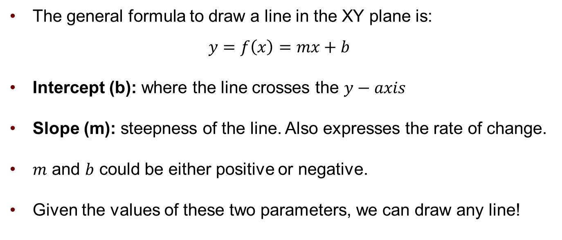
Linear Functions
The general formula to draw a line in the XY plane is:
$$y=f\left(x\right)=mx+b$$
Intercept (b): where the line crosses the $y−axis$
Slope (m): steepness of the line. Also expresses the rate of change.
$m$ and $b$ could be either positive or negative.
Given the values of these two parameters, we can draw any line!

Slide 11


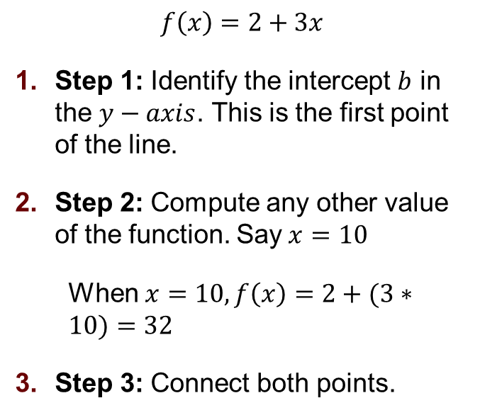


Linear Functions: Steps to Draw the Line
$$f\left(x\right)=2+3x$$
Step 1: Identify the intercept $b$ in the $y−axis$. This is the first point of the line.
Step 2: Compute any other value of the function. Say$x=10$
When $x=10,f\left(x\right)=2+(3∗10)=32$
Step 3: Connect both points.
$$y$$
$$32$$
2
$$x$$
$$10$$

Slide 12
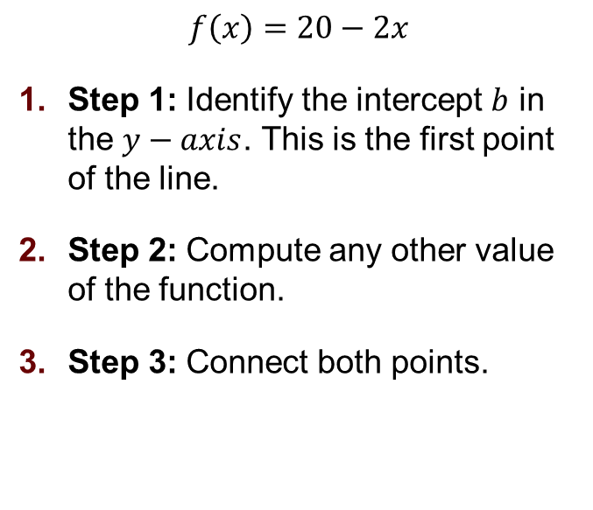
Linear Functions: An Example
$$f\left(x\right)=20−2x$$
Step 1: Identify the intercept $b$ in the $y−axis$. This is the first point of the line.
Step 2: Compute any other value of the function.
Step 3: Connect both points.

Slide 13


Linear Functions: An Example
$$f\left(x\right)=20−2x$$
Step 1: Identify the intercept $b$ in the $y−axis$. This is the first point of the line.
Step 2: Compute any other value of the function.
Step 3: Connect both points.
$$y$$
$$20$$
$$x$$
$$10$$

Slide 14



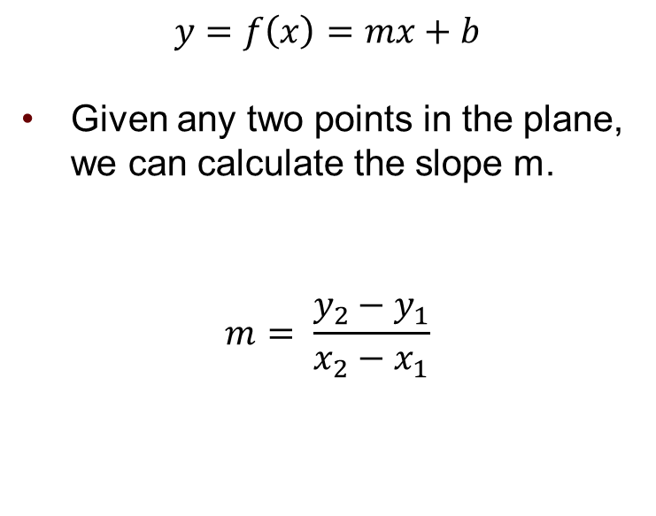





Linear Functions: Slope
$$y=f\left(x\right)=mx+b$$
Given any two points in the plane, we can calculate the slope m.
$$m= \frac{y_{2}−y_{1}}{x_{2}−x_{1}}$$
$$y$$
$${(x}_{2},y_{2})$$
$$y_{2}$$
$$y_{2}−y_{1}$$
$${(x}_{1},y_{1})$$
$$y_{1}$$
$$x_{2}−x_{1}$$
$$x$$
$$x_{1}$$
$$x_{2}$$

Slide 15
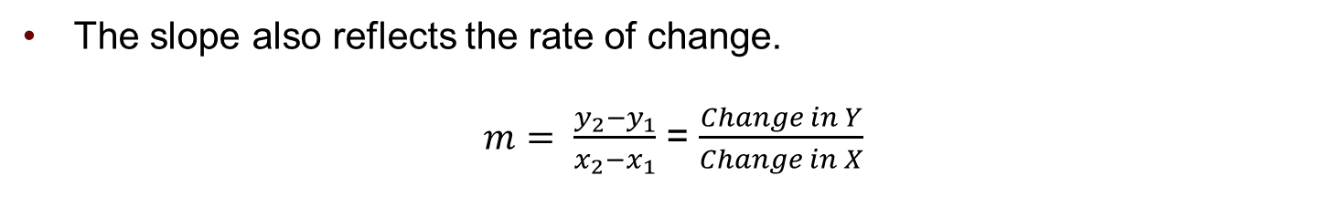
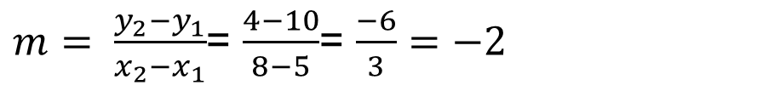
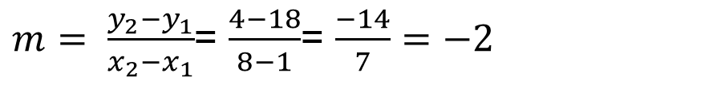
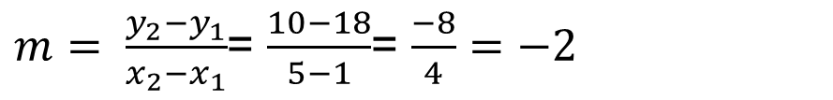
Linear Functions: Slope
The slope also reflects the rate of change.
$m= \frac{y_{2}−y_{1}}{x_{2}−x_{1}}$ = $\frac{Change in Y}{Change in X}$
$$f\left(x\right)=20−2x$$
$m= \frac{y_{2}−y_{1}}{x_{2}−x_{1}}$= $\frac{10−18}{5−1}$= $\frac{−8}{4}=−2$
x | f(x)
1 | 20-(2*1) = 18
5 | 20-(2*5) = 10
8 | 20-(2*8) = 4
$m= \frac{y_{2}−y_{1}}{x_{2}−x_{1}}$= $\frac{4−18}{8−1}$= $\frac{−14}{7}=−2$
$m= \frac{y_{2}−y_{1}}{x_{2}−x_{1}}$= $\frac{4−10}{8−5}$= $\frac{−6}{3}=−2$

Slide 16


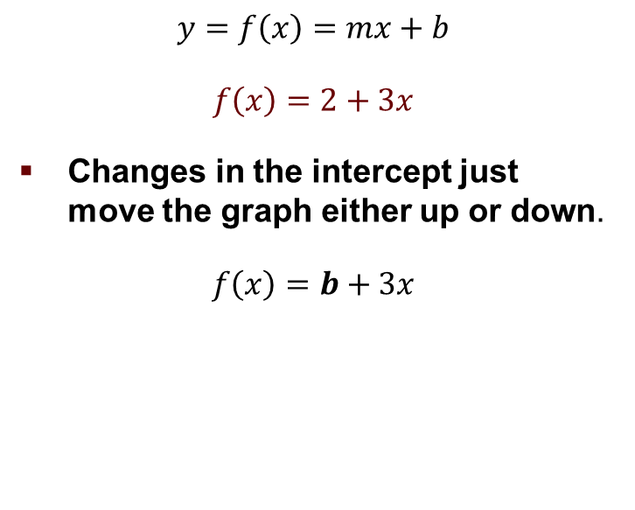

Linear Functions: Shifting a Graph
$$f\left(x\right)=3+3x$$
$$y=f\left(x\right)=mx+b$$
$$f\left(x\right)=2+3x$$
Changes in the intercept just move the graph either up or down.
$$f\left(x\right)=b+3x$$
$$y$$
$$f\left(x\right)=2+3x$$
$$f\left(x\right)=3x$$
$$3$$
2
$$x$$

Slide 17


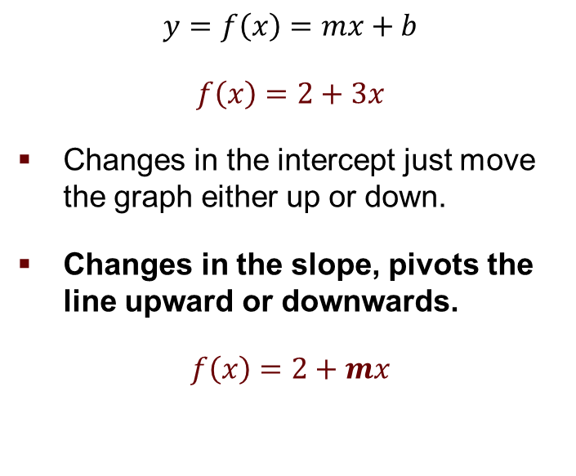
Linear Functions: Shifting a Graph
$$f\left(x\right)=2+6x$$
$$y=f\left(x\right)=mx+b$$
$$f\left(x\right)=2+3x$$
Changes in the intercept just move the graph either up or down.
Changes in the slope, pivots the line upward or downwards.
$$f\left(x\right)=2+mx$$
$$y$$
$$f\left(x\right)=2+3x$$
$$f\left(x\right)=2+1.5x$$
2
$$x$$

Slide 18
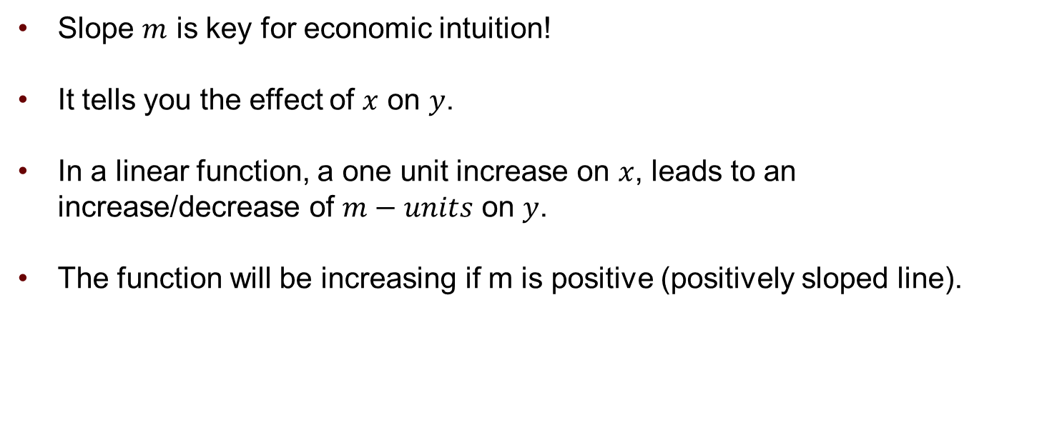
Linear Functions: Slope
Slope $m$ is key for economic intuition!
It tells you the effect of $x$ on $y$.
In a linear function, a one unit increase on $x$, leads to an increase/decrease of $m−units$ on $y$.
The function will be increasing if m is positive (positively sloped line).

Slide 19
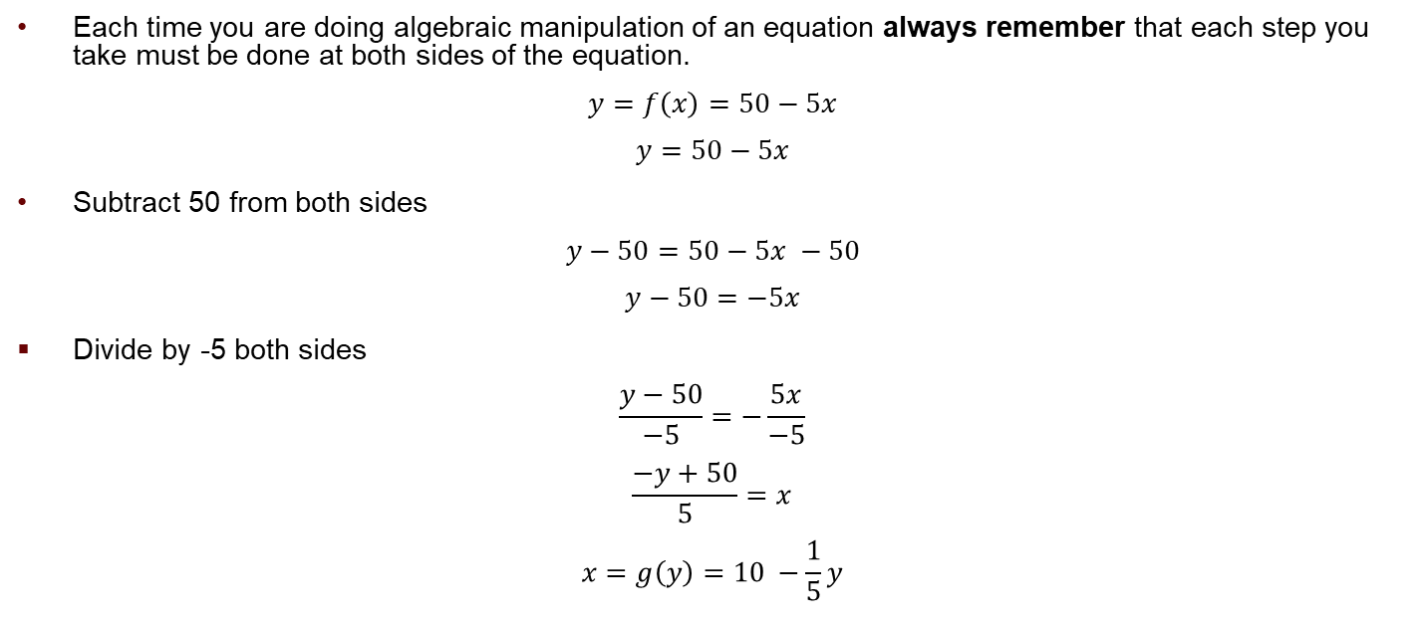
Algebraic Tip
Each time you are doing algebraic manipulation of an equation always remember that each step you take must be done at both sides of the equation.
$$y=f\left(x\right)=50−5x$$
$$y=50−5x$$
Subtract 50 from both sides
$$y−50=50−5x −50$$
$$y−50=−5x$$
Divide by -5 both sides
$$\frac{y−50}{−5}=−\frac{5x}{−5}$$
$$\frac{−y+50}{5}=x$$
$$x=g\left(y\right)=10 −\frac{1}{5}y$$

Slide 20
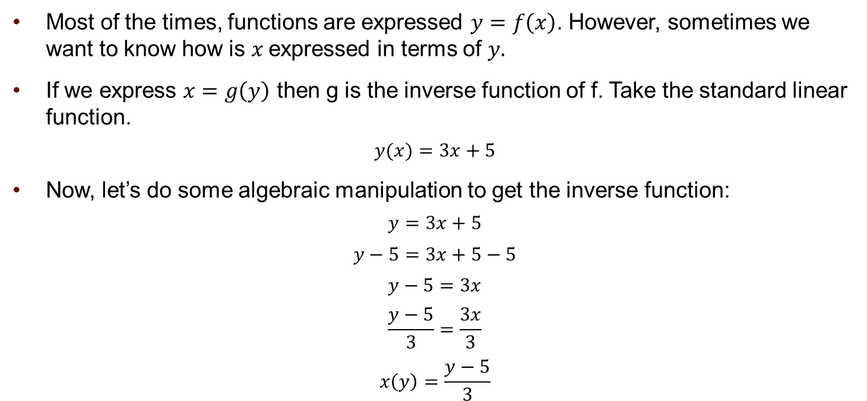
Inverse Functions
Most of the times, functions are expressed $y=f\left(x\right)$. However, sometimes we want to know how is $x$ expressed in terms of $y.$
If we express $x=g\left(y\right)$ then g is the inverse function of f. Take the standard linear function.
$$y(x)=3x+5$$
Now, let’s do some algebraic manipulation to get the inverse function:
$$y=3x+5$$
$$y−5=3x+5−5$$
$$y−5=3x$$
$$\frac{y−5}{3}=\frac{3x}{3}$$
$$x\left(y\right)=\frac{y−5}{3}$$

Slide 21
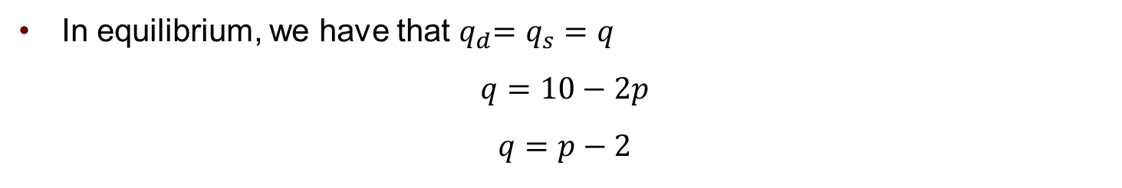
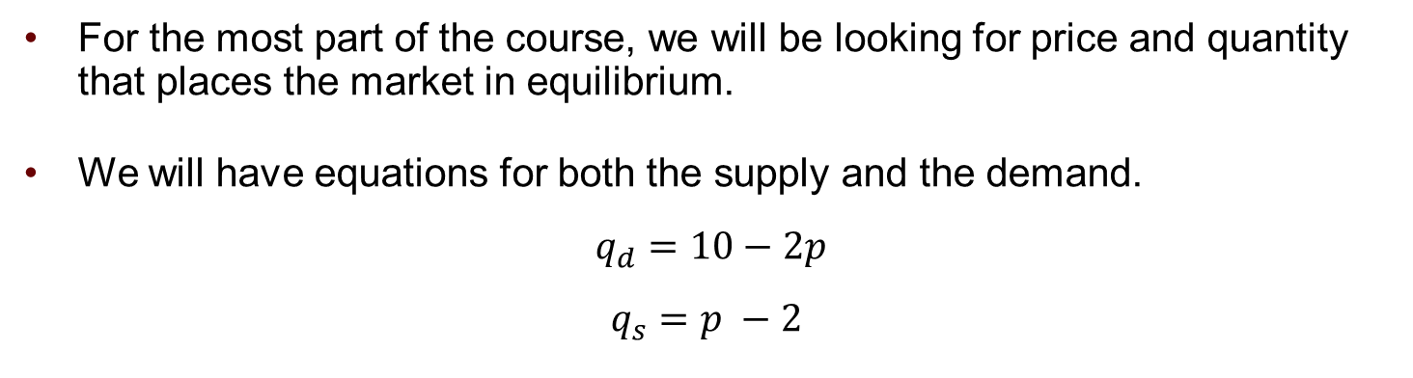
Solving Linear Equations
For the most part of the course, we will be looking for price and quantity that places the market in equilibrium.
We will have equations for both the supply and the demand.
$$q_{d}=10−2p$$
$$q_{s}=p −2$$
In equilibrium, we have that $q_{d}$= $q_{s}=q$
$$q=10−2p$$
$$q=p−2$$

Slide 22
Solving Linear Equations
Conditions for solution: for a system to have a solution we require to have at least one equation for each unknown variable.
In order words, the number of equations and variables should be the same.
For the most part we will work with systems of:
2 equations (supply and demand) and
2 unknowns (price and quantity).

Slide 23
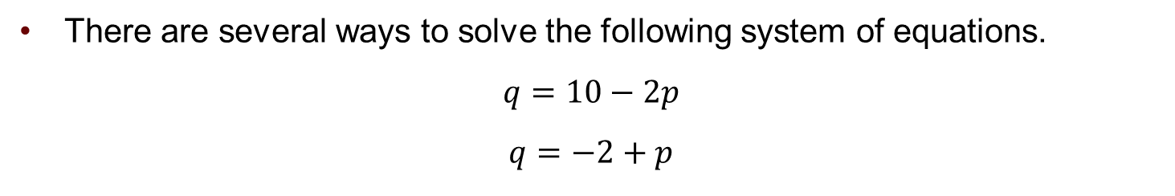
Solving Linear Equations: Substitution
There are several ways to solve the following system of equations.
$$q=10−2p$$
$$q=−2+p$$
Substitution Method: rearrange the terms of one equation such that you can plug it into the second equation.

Slide 24
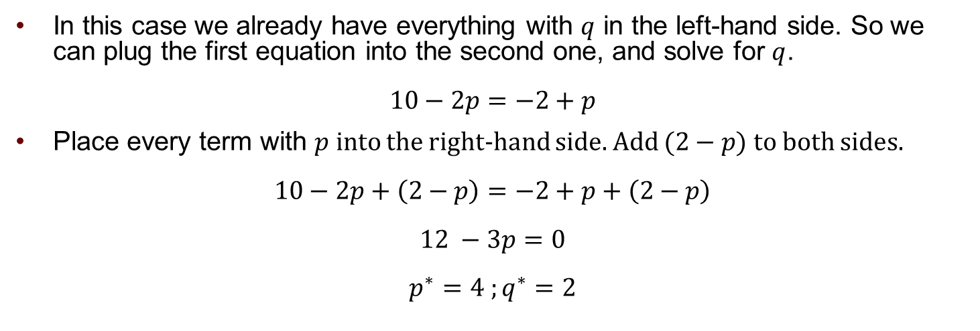
Solving Linear Equations: Substitution
In this case we already have everything with $q$ in the left-hand side. So we can plug the first equation into the second one, and solve for $q$.
$$10−2p=−2+p$$
Place every term with $p$ into the right-hand side. Add $(2−p)$ to both sides.
$$10−2p+\left(2−p\right)=−2+p+\left(2−p\right)$$
$$12 −3p=0$$
$$p^{∗}=4 ;q^{∗}=2$$
Notation Remark: we will denote the solutions to the system of equations with a star * as a superscript.

Slide 25

Solving Linear Equations: Elimination
There are several ways to solve the following system of equations.
$$q=10−2p$$
$$q=−2+p$$
Elimination Method: multiply one equation by one number such that when they are added, you get rid of the of the variables.

Slide 26
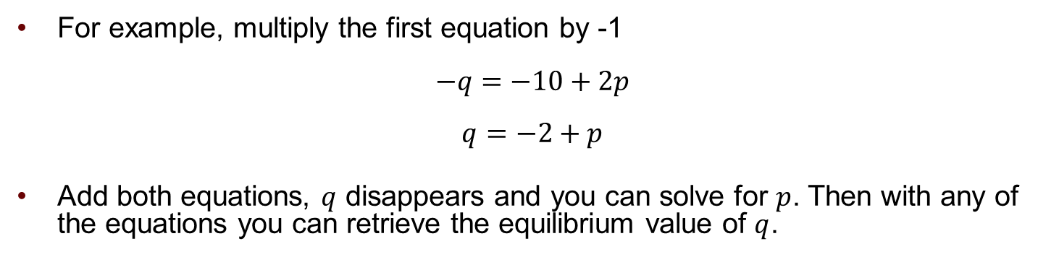

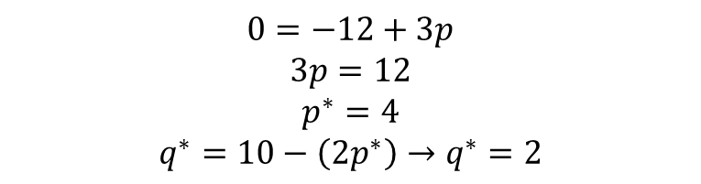
Solving Linear Equations: Elimination
$$q=10−2p$$
$$q=−2+p$$
For example, multiply the first equation by -1
$$−q=−10+2p$$
$$q=−2+p$$
Add both equations, $q$ disappears and you can solve for $p$. Then with any of the equations you can retrieve the equilibrium value of $q$.
$$0=−12+3p$$
$$3p=12$$
$$p^{∗}=4$$
$$q^{∗}=10−\left(2p^{∗}\right)→q^{∗}=2$$

Slide 27
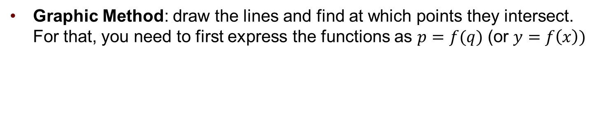

Solving Linear Equations: Graphic
There are several ways to solve the following system of equations.
$$q=10−2p$$
$$q=−2+p$$
Graphic Method: draw the lines and find at which points they intersect. For that, you need to first express the functions as $p=f(q)$ (or $y=f\left(x\right))$
$$p=5−0.5q$$
$$p=2+q$$

Slide 28








Solving Linear Equations: Graphic
If the functions are pretty and you draw them carefully, the graphic method is perhaps the easiest.
For some systems, the exact solution requires doing the math.
$$p$$
$$p=5−0.5q$$
$$p=2+q$$
$$5$$
$$p^{∗}=4$$
$$2$$
$$q$$
$q^{∗}$=2
$$10$$

Slide 29
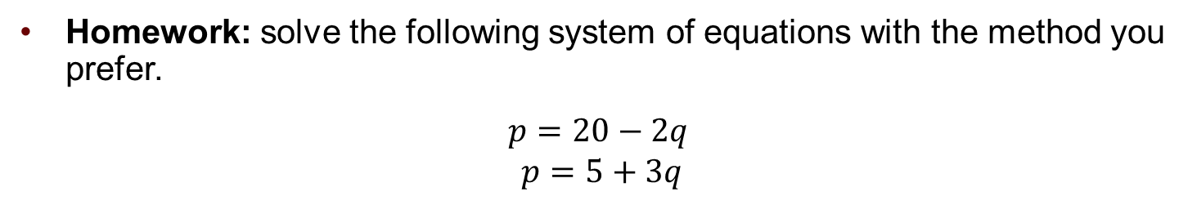
Solving Linear Equations: Example
Homework: solve the following system of equations with the method you prefer.
$$p=20−2q$$
$$p=5+3q$$
Verify the solution is given by q=3 and p = 14.

Slide 30
For next class:
Homework: Solve practice exercises from Assignment 0.
Complete this week’s discussion forum.
Readings: Mankiw Chapters 4 and 5.
Next Episode: Demand Curve

Slide 31
SPEA-V-202
Contemporary Economic Issues in Public Affairs
Mathematics for Economic Analysis
Luis Navarro

Slide 32
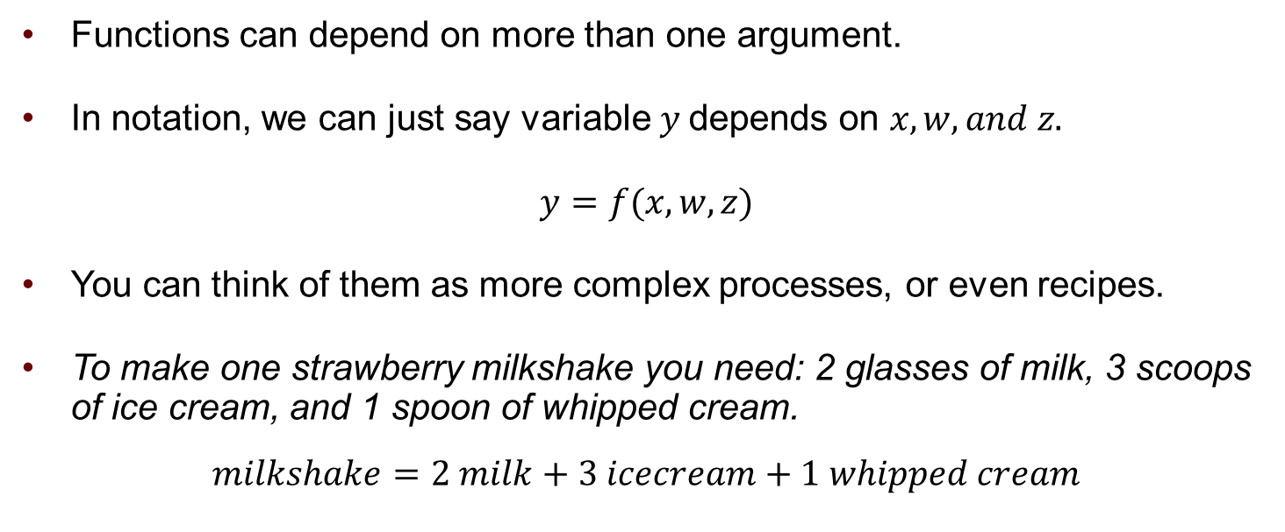
Multivariate Functions
Functions can depend on more than one argument.
In notation, we can just say variable $y$ depends on $x,w, and z.$
$y=f(x,w,z)$
You can think of them as more complex processes, or even recipes.
To make one strawberry milkshake you need: 2 glasses of milk, 3 scoops of ice cream, and 1 spoon of whipped cream.
$$milkshake=2 milk+3 icecream+1 whipped cream$$

Slide 33
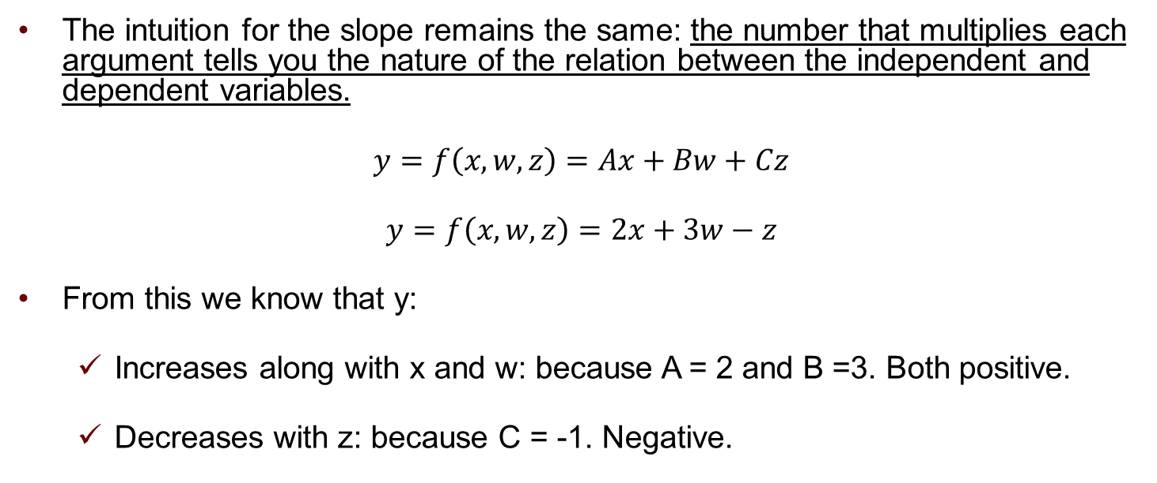
Multivariate Functions
The intuition for the slope remains the same: the number that multiplies each argument tells you the nature of the relation between the independent and dependent variables.
$y=f\left(x,w,z\right)=Ax+Bw+Cz$
$y=f\left(x,w,z\right)=2x+3w−z$
From this we know that y:
Increases along with x and w: because A = 2 and B =3. Both positive.
Decreases with z: because C = -1. Negative.

Slide 34
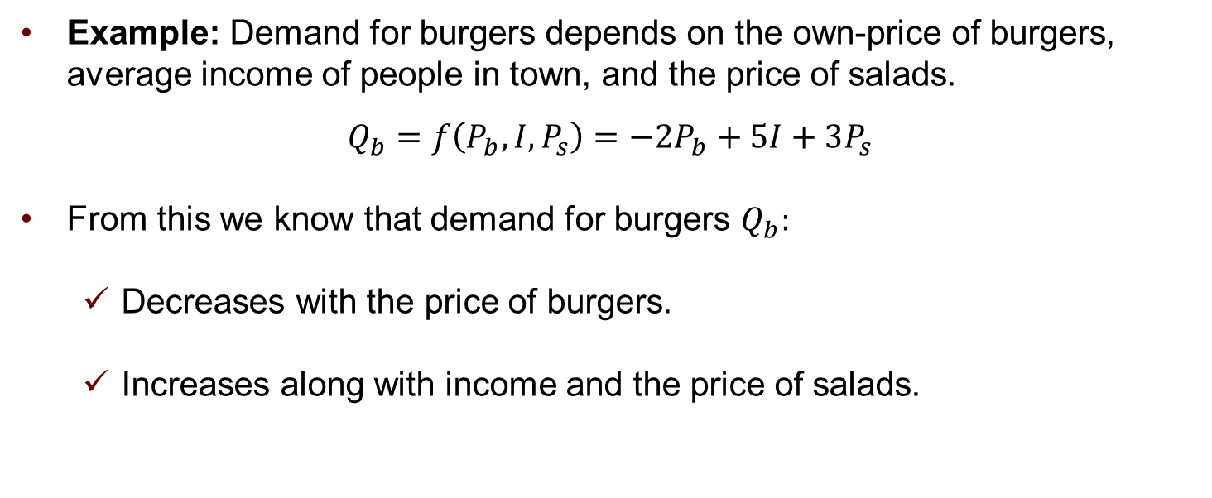
Multivariate Functions
Example: Demand for burgers depends on the own-price of burgers, average income of people in town, and the price of salads.
$$Q_{b}=f\left(P_{b},I,P_{s}\right)=−2P_{b}+5I+3P_{s}$$
From this we know that demand for burgers $Q_{b}:$
Decreases with the price of burgers.
Increases along with income and the price of salads.

Slide 35
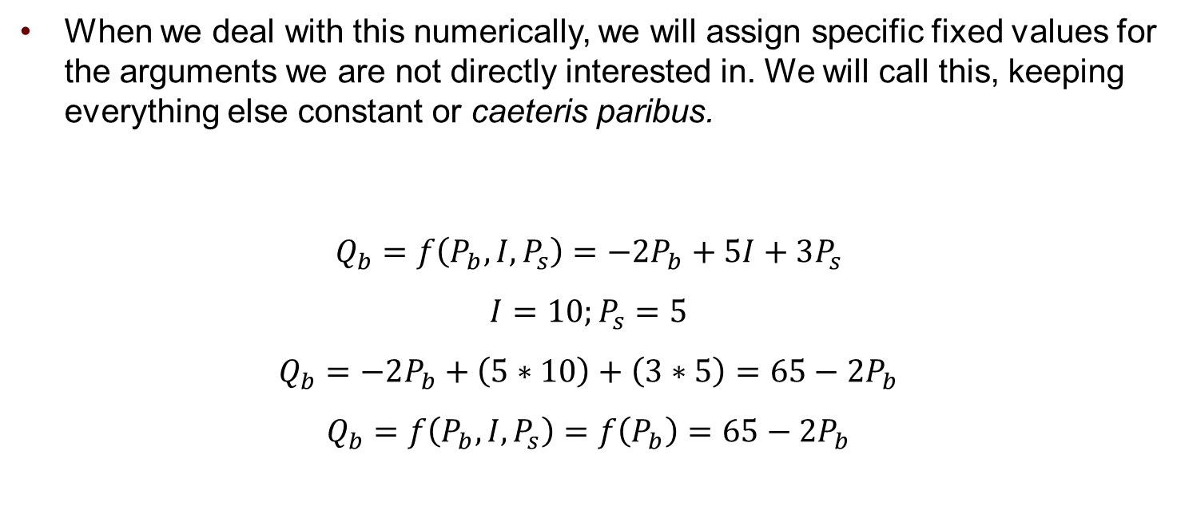
Multivariate Functions
When we deal with this numerically, we will assign specific fixed values for the arguments we are not directly interested in. We will call this, keeping everything else constant or caeteris paribus.
$$Q_{b}=f\left(P_{b},I,P_{s}\right)=−2P_{b}+5I+3P_{s}$$
$$I=10;P_{s}=5$$
$$Q_{b}=−2P_{b}+\left(5∗10\right)+\left(3∗5\right)=65−2P_{b}$$
$$Q_{b}=f\left(P_{b},I,P_{s}\right)=f\left(P_{b}\right)=65−2P_{b}$$

