Slide 1
SPEA-V-202
Contemporary Economic Issues in Public Affairs
Supply Curve
Luis Navarro
Fall 2022

Slide 2


Outline for Today
Producer Theory and the Supply Curve
Basics of firm decision-making.
Profit Maximization and Marginal Costs.
Supply Curves.
Properties of Supply Functions
Law of Supply
Willingness to Sell
Producer Surplus
Shifts in Supply
Elasticities

Slide 3

Producer Theory
Suppose Bob wants to open a burger restaurant. What things does he requires to do that ?
Ensure Operation
Rent/buy a place and set utilities contracts (water, electricity).
Hire workers and buy equipment to cook burgers.
Buy all the ingredients.
Ensure it is a Good Idea
Check the competition. Location, quality, prices. Does Bob has some advantage over his competitors?
Economic Rationality: if there is chance for Bob to sell burgers for economic profit, then he should open the restaurant (enter the market).

Slide 4
Producer Theory
How does Bob’s burger place make profits ?
Revenue, Costs and Profits
Revenue: the sum of all the burgers sold.
Costs: sum of all costs (fixed and variable) required to sold the burgers.
Profits: Revenue – Costs
Thinking like an economist
Bob’s objective is to maximize restaurant’s economic profits.
Economic Rationality: Bob will operate so long he is making profits.

Slide 5


Intuition behind profit maximization
Costs
Marginal Cost: the cost of producing one additional unit.
Economies of scale: the more units you produce, average cost (i.e. cost per unit) decreases.
Reservation price: lowest price at which Bob is willing to sell burgers. This is determined by his marginal cost.
Revenues-Benefits
Bob will offer his burgers at a price that covers his costs and allows him to have some profit.
Profit Maximization: sell as much burgers as you can.
Law of Supply: as the price increases, firm’s willingness to supply goods (quantity produced) increases as well.

Slide 6
Supply Curve
If we assume firms behave like Bob’s burger place (maximizing profits), then we can represent their production process through a supply curve or supply function.
This function reflects firm’s willingness and ability to sell.
Willingness to sell: an additional unit sold still derives in profits.
Ability to produce and sell: firm is covering its production costs.
Law of Supply: the higher the price, the higher the quantity supplied.
All things constant, as the price people is willing to buy goods rises, firm’s incentives to sell such good increase.
Key implication: the inverse supply function is positively sloped.

Slide 7








Supply Curve
$$P$$
$$P\left(Q\right)$$
$$6$$
Law of Supply
As the price increased from 5 to 6, the quantity supplied jumped from 4 to 7.
$$5$$
$$3$$
Reservation Price
Below $3, Bob is not willing to sell burgers.
$$Q$$
$$4$$
$$7$$

Slide 8
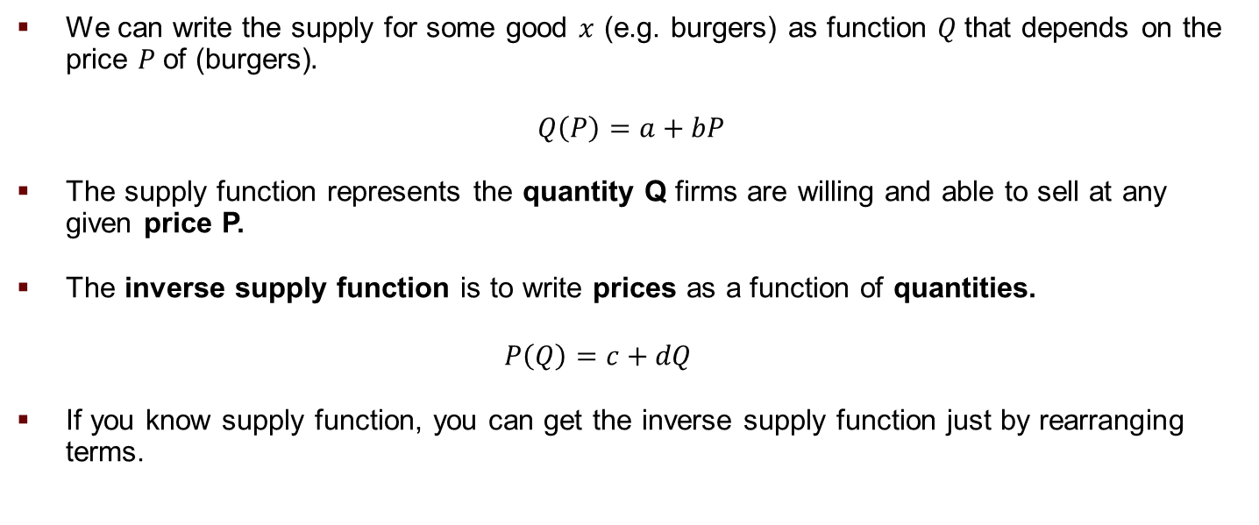
Supply Function
We can write the supply for some good $x$ (e.g. burgers) as function $Q$that depends on the price $P$of (burgers).
$$Q\left(P\right)=a+bP$$
The supply function represents the quantity Q firms are willing and able to sell at any given price P.
The inverse supply function is to write prices as a function of quantities.
$$P\left(Q\right)=c+dQ$$
If you know supply function, you can get the inverse supply function just by rearranging terms.

Slide 9
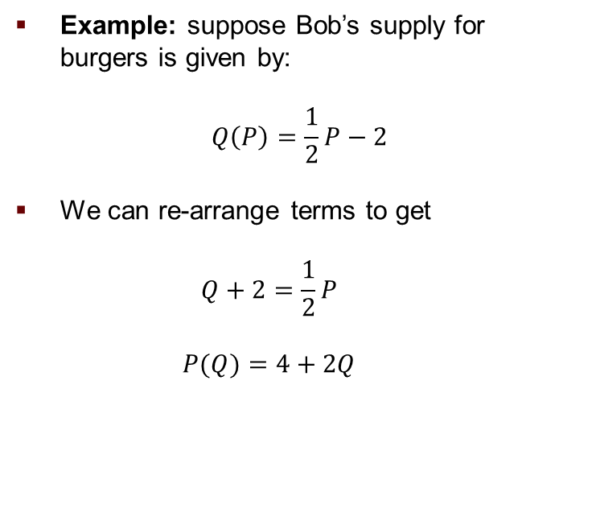
Supply Function
Example: suppose Bob’s supply for burgers is given by:
$$Q\left(P\right)=\frac{1}{2}P−2$$
We can re-arrange terms to get
$$Q+2=\frac{1}{2}P$$
$$P(Q)=4+2Q$$
Price P
0
2
4
6
8
10
12
14
Quantity Supplied Q(P)
-
-
0
1
2
3
4
5

Slide 10
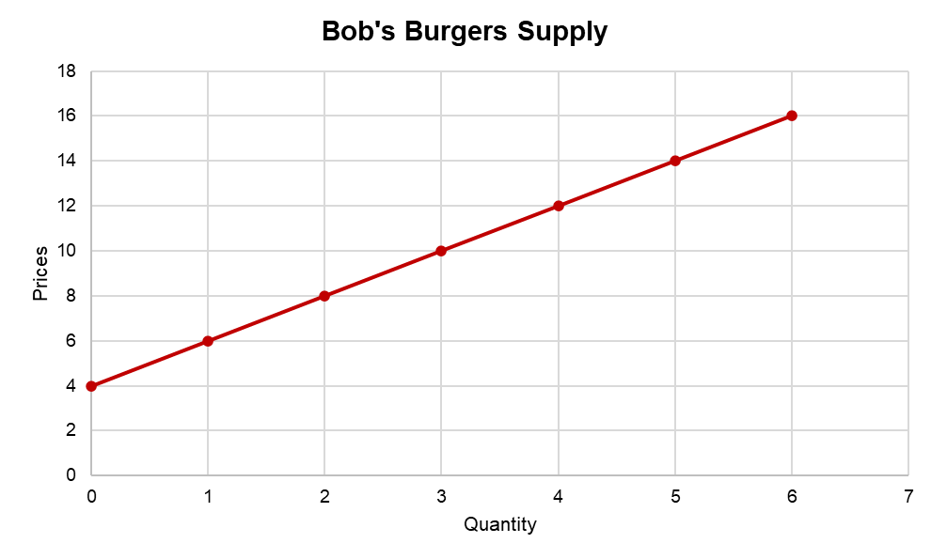

Supply as Function
Bob’s inverse supply for burgers is given by:
$$P(Q)=4+2Q$$
Price
0
2
4
6
8
10
12
14
Quantity Supplied
-
-
0
1
2
3
4
5

Slide 11













Willingness to Sell
The supply curve shows all the points at which Bob is willing and able to sell burgers.
The price at which he sells an additional burger, however, might be different from his willingness to sell such additional burger. Suppose Bob sells his burgers at $12 in the menu.
He is willing to sell the first unit for $6. He has a marginal revenue of $6 dollars for the first burger.
He is willing to sell the second burger for $8. He has a marginal revenue of $4.
For the 3rd burger, he is willing to sell that unit for $10, so he gets a marginal benefit of $2 for that third unit.
$$P$$
$$P\left(Q\right)=4+2Q$$
$$12$$
$$(4,12)$$
$$10$$
$$(3,10)$$
$$8$$
$$(2,8)$$
$$6$$
$$(1,6)$$
$$Q$$
$$1$$
$$2$$
$$3$$
$$4$$

Slide 12


Producer Surplus: Intuition
$$P$$
$$P\left(Q\right)=4+2Q$$
Producer Surplus (PS): the difference between a producer’s willingness to sell and the price at which the good is exchanged.
Producer surplus of selling 4 burgers is given by the sum of the marginal benefits obtained for selling each additional burger at price above the willingness to sell. In our example:
PS = (12-6) + (12-8) + (12-10) + (12-12) = 12
$$12$$
$$(4,12)$$
$$10$$
$$(3,10)$$
$$8$$
$$(2,8)$$
$$6$$
$$(1,6)$$
$$Q$$
$$1$$
$$2$$
$$3$$
$$4$$

Slide 13

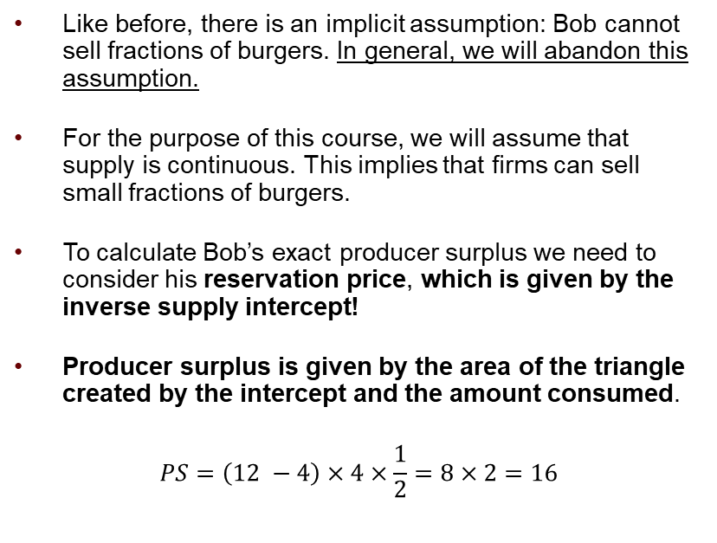
Producer Surplus: Exact Measure
$$P$$
Like before, there is an implicit assumption: Bob cannot sell fractions of burgers. In general, we will abandon this assumption.
For the purpose of this course, we will assume that supply is continuous. This implies that firms can sell small fractions of burgers.
To calculate Bob’s exact producer surplus we need to consider his reservation price, which is given by the inverse supply intercept!
Producer surplus is given by the area of the triangle created by the intercept and the amount consumed.
$$PS=\left(12 −4\right)×4×\frac{1}{2}=8×2=16$$
$$P\left(Q\right)=4+2Q$$
$$12$$
$$4$$
$$Q$$

Slide 14
Individual Supply vs Market Supply
So far, we have only studied Bob’s supply curve for burgers. But there are other burger places in town. To study all the market, we need to sum everyone’s supply. For simplicity suppose there are only two burger places in our economy: Bob’s burgers and Sandy’s burgers.
The market supply curve is the horizontal sum of individual supply curves.
Like in the individual case, it represents market’s willingness to sell.
If the two firms have different production processes or cost functions, then the slopes (elasticity) of their supply curve might be differ, and the market supply curve might have some kinks.
Still, it will satisfy the Law of Supply.

Slide 15


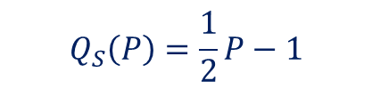









Individual Supply vs Market Supply
Example: Market supply for Burgers.
$$Q_{S}\left(P\right)=\frac{1}{2}P−1$$
$$P$$
$$Q_{B}\left(P\right)=P−4$$
$$8$$
WTP/Quantity Supplied by:
For prices below $2, there is no market. Supply = 0.
Bob is not willing to sell for prices below $4.
Prices between 2 and 4, then Sandy is the only burger place in town willing to sell.
Price
0
2
4
6
8
10
Bob
-
-
0
2
4
6
Sandy
-
0
1
2
3
4
Market
-
0
1
4
7
10
$$6$$
$$4$$
$$2$$
$$Q$$
$$2$$
$$4$$
$$7$$
$$1$$

Slide 16
Individual Supply vs Market Supply
Some Lessons:
Market supply is greater than individual supply, for all firms.
Greater quantity supplied at any price.
There are more sellers: 2 burger places in town.
Lower price for any quantity supplied: with more sellers, more units available with lower marginal cost.

Slide 17







Change in Supply vs Change in Quantity Supplied
$$P$$
Crucial difference: quantity supplied is not the same as the supply curve.
Quantity supplied refers to points on the supply curve. At p=6, supply for burgers equals q = 4.
Changes in quantity supplied occur upon price changes. We move along the curve.
Factors that influence firm’s willingness to sell lead to shifts on the supply curve.
It could increase/decrease or pivot.
$$P\left(Q\right)=2+Q$$
$$(8,10)$$
$$10$$
$$(4,6)$$
$$6$$
$$Q$$
$$4$$
$$8$$

Slide 18



Change in Supply vs Change in Quantity Supplied
$$P$$
Example: change in quantity supplied vs change in the supply curve.
Change in quantity supplied: price of burgers rises.
Change in supply curve (shift): Bob’s got a bigger place that allows him to increase the size of the kitchen and scale production up.
Change in supply curve (pivot): Bob’s got a new cook that is more efficient making burgers (i.e. cooks more burgers with the same inputs).
$$P\left(Q\right)=2+Q$$
$$(8,10)$$
$$10$$
$$(4,6)$$
$$6$$
$$Q$$
$$4$$
$$8$$

Slide 19

Shifts in Supply
Increase in supply: at all prices, firms are willing to sell more units.
Supply curve shifts to the right.
Decrease in supply: at all prices, firms are willing to sell less units.
Supply curve shifts to the left.
On the equation: slope remains the same, the change is on the intercept of the inverse demand function.
Intuition: changes in reservation prices.
$$P$$
$$P\left(Q\right)=a+bQ$$
$$Q$$

Slide 20

Shifts in Supply: Slope and Elasticity
$$P$$
Changes in the supply curve’s slope occur when there is a change in the marginal costs of the firm.
The slope measures how responsive (adjusting their production) are firms to changes in prices.
If the curve pivots to the right (i.e. the line becomes flatter), we say the supply is more responsive to price changes, or it is more elastic.
If the curve pivots to the left (i.e. the line becomes steeper), we say the supply is less responsive to price changes, or it is more inelastic.
On the equation: intercept remains the same, the change is on the slope of the inverse supply function.
$$P\left(Q\right)=a+bQ$$
$$Q$$

Slide 21


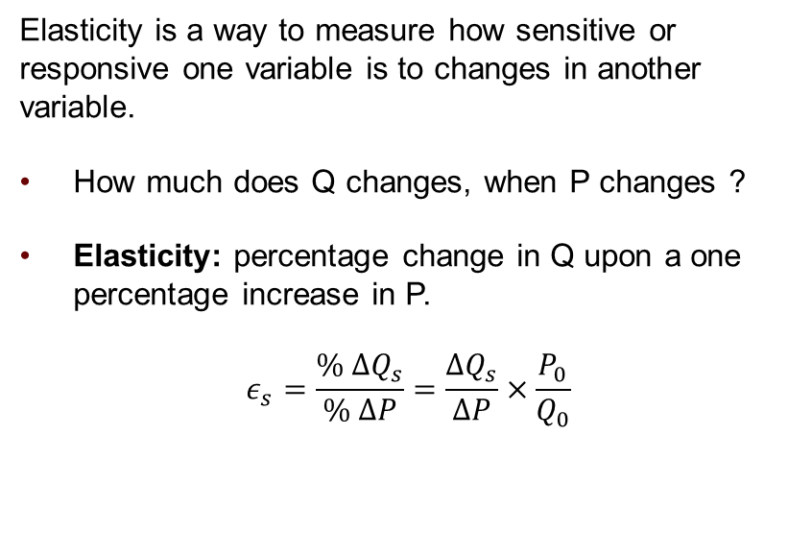


Price Elasticity of Supply
$$P$$
Elasticity is a way to measure how sensitive or responsive one variable is to changes in another variable.
How much does Q changes, when P changes ?
Elasticity: percentage change in Q upon a one percentage increase in P.
$$ε_{s}=\frac{\% ΔQ_{s}}{\% ΔP}=\frac{ΔQ_{s}}{ΔP}×\frac{P_{0}}{Q_{0}}$$
$$ΔP$$
$$ΔQ_{s}=Q_{after}−Q_{before}$$
$$ΔP=P_{after}−P_{before}$$
$$ΔQ$$
$$Q$$

Slide 22


Price Elasticity of Supply and Pivoting the Curve
$$P$$
As the supply becomes more elastic, the same change on prices, leads to higher adjustments in the quantity supplied.
Suppose a constant change in prices. Let’s see how the effect on quantity supplied changes across the elasticity of the supply curve.
Less elastic: the change in q is smaller.
More elastic: the change in q is larger.
Same lesson as with the demand curve.
$$Q$$

Slide 23






Elasticity of Supply: Extreme Cases
$$P$$
Perfectly Elastic Supply
$$P$$
Perfectly Inelastic Supply
$$p^{∗}$$
$$Q$$
$$q^{∗}$$
$$Q$$
Elasticity of supply=-∞
Firms are full responsive to price changes.
If price drops by any amount, quantity supplied falls to zero. If price rises by any amount, quantity supplied (willingness to sell) increases without limit.
Examples: uber drivers.
Elasticity of supply=0
Producers do not respond to price changes
Quantity supplied is the same at all prices.
Examples: stadium seats, Beatle’s songs.

Slide 24
Elasticity of Supply: Some Determinants
Elasticity of supply reflects firm’s responsiveness to price changes. Which factors could influence firm’s behavior for this matter?
Things affecting firm’s marginal costs: input prices. Price of labor and capital. In the case of Bob, burger’s ingredients.
Other options in the market: if there are more substitutes in the market, then Bob’s willingness to sell might decrease.

Slide 25
Elasticity of Supply: Short vs Long Run
Elasticity of supply reflects firm’s responsiveness to price changes. This also varies across time, and depends on the type of good.
In the short run, supply is often less elastic (more inelastic): price changes are hard to anticipate. Takes time to adjust production.
For some goods, supply is almost inelastic in the short-run (stocks are fixed). Examples: housing, agricultural goods.
For most goods, supply is more elastic in the long run: firms have more time to adapt for new technologies, new firms entering the market.

Slide 26
For next class:
On the Next Episode: Market Equilibrium
Readings: Mankiw Chapters 6 and 7.

Slide 27
SPEA-V-202
Contemporary Economic Issues in Public Affairs
Supply Curve
Luis Navarro
Fall 2022

