Slide 1
SPEA-V-202
Contemporary Economic Issues in Public Affairs
Tax Policy 1
Luis Navarro

Slide 2


Outline for Today
The Tax System in the US
How does the government tax?
Why does the government tax?
Example of government spending in the US.
Desired characteristics of the tax system
Equity
Efficiency
Regional tax heterogeneity.

Slide 3
Introduction
Rationale for government intervention
Market based
Taxes
Expenditures
How should it intervene?
Yes
Should the government intervene in the economy?
Regulation based
Restrictions on market exchange.
No
Why? Markets are working properly.

Slide 4

Introduction
In general, the government intervenes in the economy in two ways:
Types of Government Intervention (Policy Instruments)
Market-based: government’s actions have effects on incentives of suppliers and consumers.
Taxes: subtract resources from the economy.
Expenditures: inject resources into the economy.
Both cases, lead to changes in relative scarcity.
Regulation-based: government has the authority to set rules for market exchange.
Ban the exchange of certain goods (e.g. illegal activities).
Restrictions for market exchange (e.g. drinking age).

Slide 5
Market-based solutions: Taxes
Definition: taxes are mandatory contributions levied on individuals and corporations by a government entity.
Who has the power to tax?
Only governments have the authority to levy taxes on the population.
Governments across levels (federal, state, municipal, school districts) impose taxes.

Slide 6
How does the government tax?
Taxes take different forms.
Type of Taxes (by activity taxed)
Type of Tax | Description | Examples
Taxes on earnings | Levied on worker’s earnings. Tax on labor income. | Payroll tax.
Taxes on individual income | Levied on the income accrued during the year. Labor and non-labor income. | Federal and state individual income tax. Capital gains tax.
Taxes on corporate income | Levied on corporate earnings. | Corporate income tax.
Taxes on wealth | Taxes based on the value of assets held during the period. | Property tax and Estate tax.
Taxes on consumption | Taxes associated with buying and selling goods and services. | Sales tax and excise tax.

Slide 7
Why does the government impose taxes?
Definition: taxes are mandatory contributions levied on individuals and corporations by a government entity.
Why does the government impose taxes?
Sustain institutions and make sure the law is enforced. Finance government operation.
Provision of goods and services to the population.
Redistribution of wealth.
Modify behavior. Taxes change prices, thus inducing changes in supply/demand and equilibrium.

Slide 8

Why does the government impose taxes?
Sustain institutions and make sure the law is enforced. Finance government operation.
Government is an institution. An institution conformed of people.
Need to have offices, pay wages, equipment, etc.
There are costs of law enforcement.

Slide 9

Why does the government impose taxes?
Provision of goods and services to the population.
The government is also a market agent. It supplies some goods and demands others.
Supply of government-provided goods is determined by the size of government spending in the economy.
The government does not participate in all markets.
Government intervention: spending to correct market failures. Public expenditure is welfare improving (e.g. public goods, incomplete markets).
The budget provides a natural way to look at the presence of the government in the economy.

Slide 10
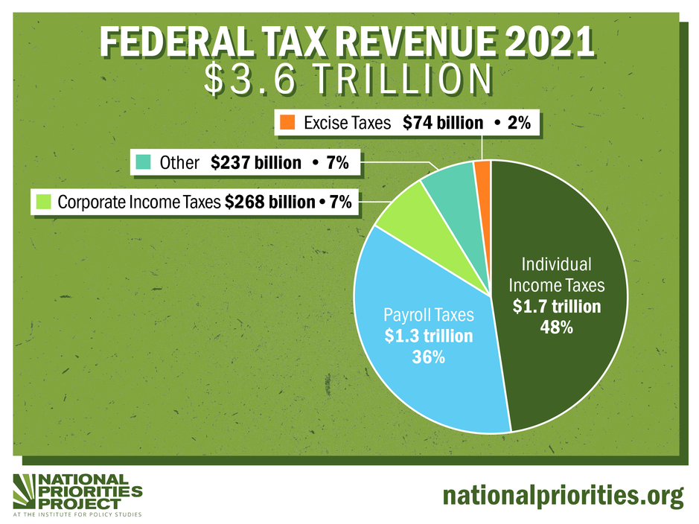
Example of Government Finance: US Government
Note: $1 trillion is one million million (12 zeros).

Slide 11


Example of Government Finance: US Government
For the fiscal year 2021, the federal government budgeted expenditures for $7 trillion.
Mandatory spending
Government spending required by law.
This includes programs such as Social Security, Medicare, and Medicaid.
Safety net spending is not subject to the budget process (politics).
Discretionary spending
Government spending approved by the Congress as part of the budget process.
This includes components of defense, education, and several other sectors and programs.
Note: US’s GDP is about $24 trillion. So, federal expenditures are approx 30% of the economy.

Slide 12
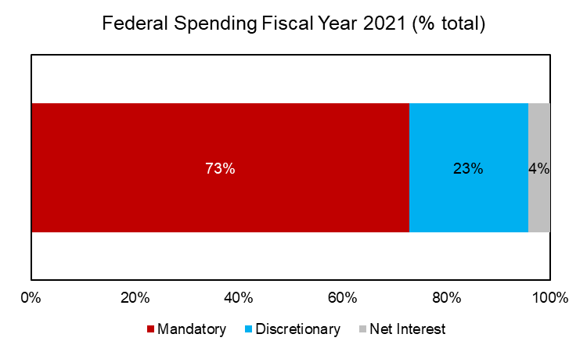
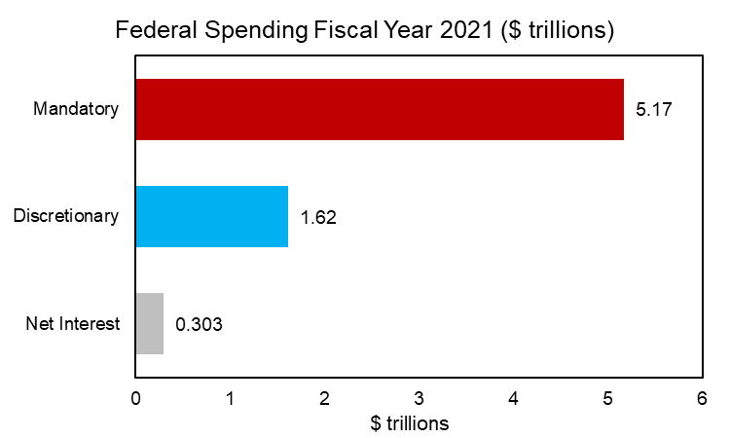
Example of Government Finance: US Government
For the fiscal year 2021, the federal government budgeted expenditures for $7 trillion.

Slide 13
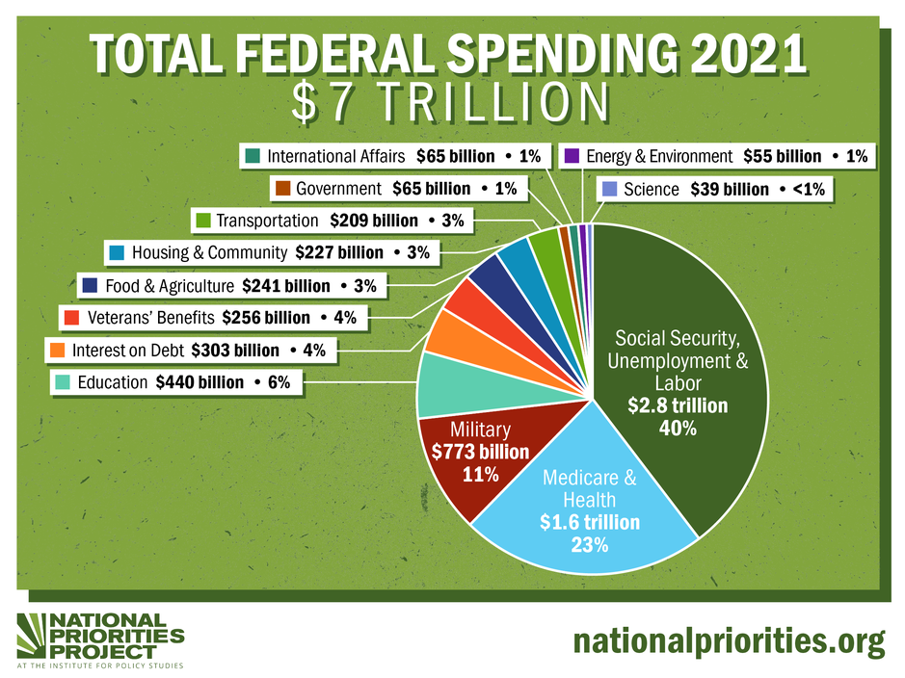
Example of Government Finance: US Government

Slide 14
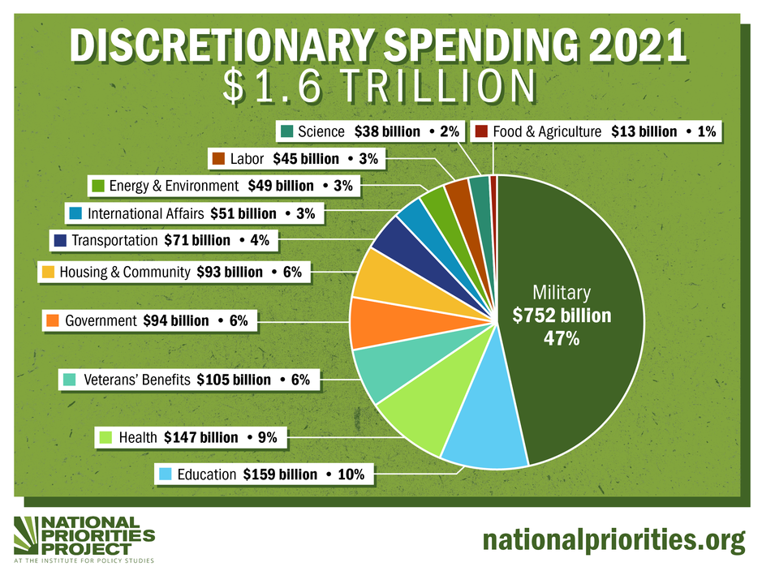
Example of Government Finance: US Government

Slide 15
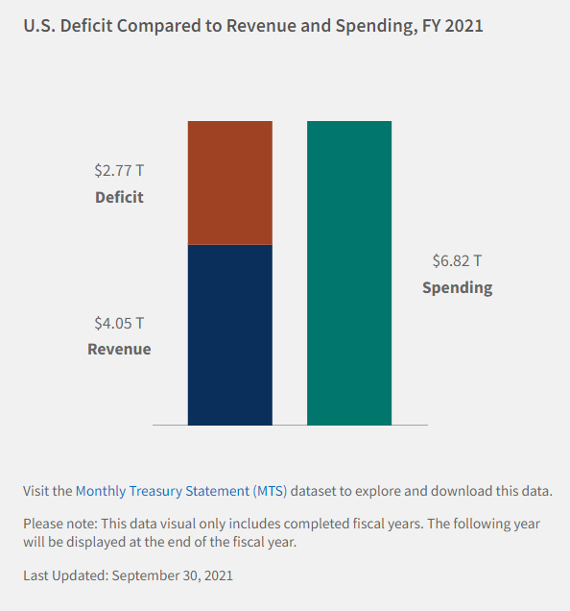
Example of Government Finance: US Government
But wait, government spending is way large than government revenues.
Where does the government get the extra money to spend?
In finance terms: it runs deficits (i.e. when expenditures are larger than revenues).
In simple terms: it borrows money (issues treasury bonds).
Who lends the money? Local and international investors, banks, households.

Slide 16
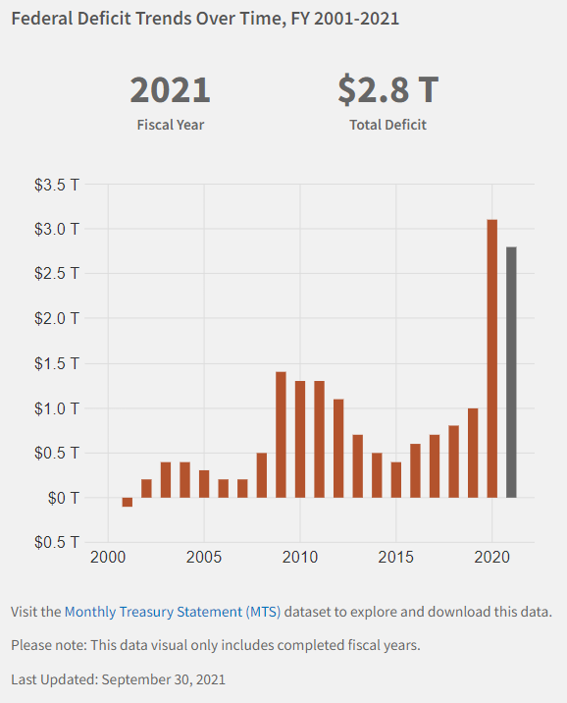
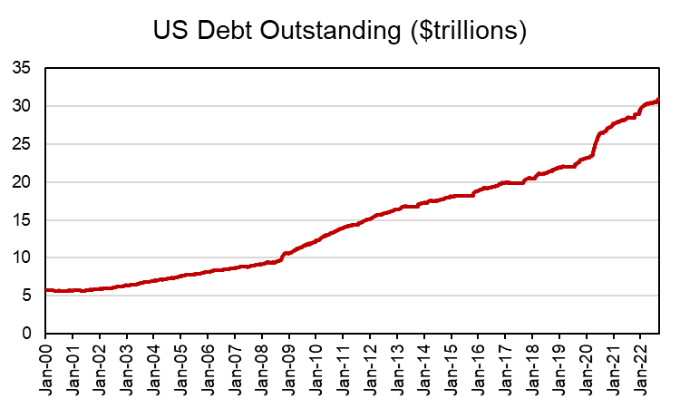
Example of Government Finance: US Government
Each time the government runs deficits, it increases the net amount of debt outstanding.

Slide 17
How does the government tax?
Taxes take different forms.
Type of Taxes (by level of government)
Type of Tax | Examples
Federal Taxes | Payroll tax, federal income tax, corporate income tax, capital gains tax.
State Taxes | State income tax, sales tax.
Municipal Taxes | Use and sales tax, excise tax, lodging tax. Property tax.

Slide 18
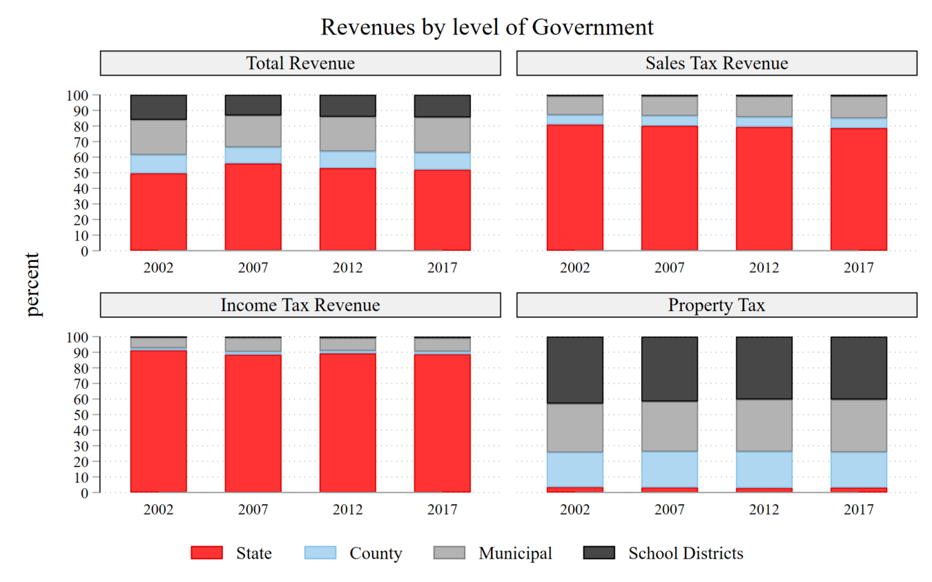
Subnational Governments Tax Policy

Slide 19
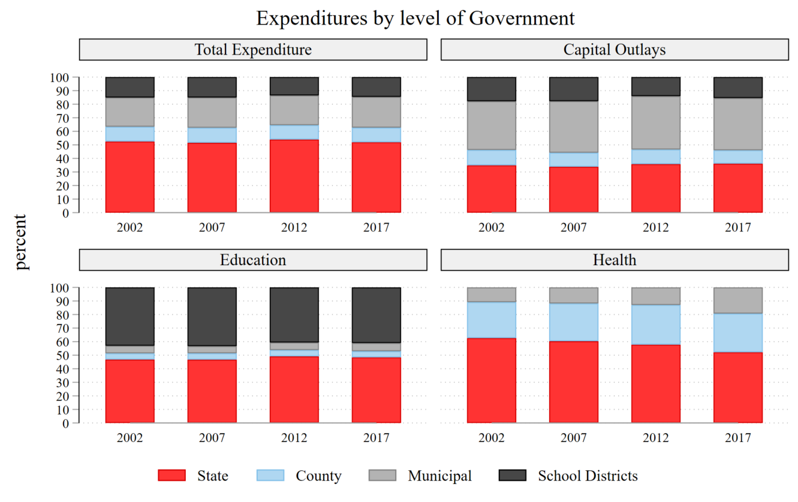
Subnational Governments Expenditure Policy

Slide 20
Why does the government impose taxes?
Redistribution of wealth.
Everyone faces different taxes. Taxes depend on which goods you consume, labor supply, and your income level.
The government might have wealth redistribution goals: use the tax system to transfer wealth from one group to another.
Wealth redistribution has two components: who is taxed and who is benefiting from public spending.
Who is taxed: higher tax rates for individuals with higher income.
Who benefits from public spending: low-income individuals are eligible for welfare programs.

Slide 21

Tax Systems: Desired Characteristics
Tax systems (set of all tax rates) have some desired characteristics.
Economic Efficiency: the tax system should not interfere with the efficient allocation of resources. Taxes should be non-distortionary.
Administrative Simplicity: tax system should have low administration and compliance costs. Promote self-compliance.
Flexibility: the tax system should be able to respond easily (even automatically) to changed economic circumstances.
Transparent Political Responsibility: individuals should be able to easily know what they are paying, and assess whether it reflects their preferences.
Fair (Equitable): the tax system should be fair, treating those in similar circumstances similarly, and imposing higher taxes on those who can better bear the burden of taxation.

Slide 22
Tax Systems: Equity
Fair (Equitable): the tax system should be fair, treating those in similar circumstances similarly, and imposing higher taxes on those who can better bear the burden of taxation.
Two types of equity
Horizontal Equity: the principle that similar individuals who make different economic choices should be treated similarly by the tax system.
Suppose two individuals earn the same income.
Individual 1: single, rents his apartment, owes 100K of student loan debt.
Individual 2: married, 4 kids, homeowner, owes 100K of mortgage debt.
Should these two individuals face the same effective income tax rate?
Depends on policy objectives and criteria to measure equity.

Slide 23
Tax Systems: Equity
Fair (Equitable): the tax system should be fair, treating those in similar circumstances similarly, and imposing higher taxes on those who can better bear the burden of taxation.
Two types of equity
Vertical Equity: the principle that groups with more resources should pay higher taxes than groups with fewer resources.
If the tax system has vertical equity, then it progressive.
If people with fewer resources pay more taxes, then the system is regressive.

Slide 24
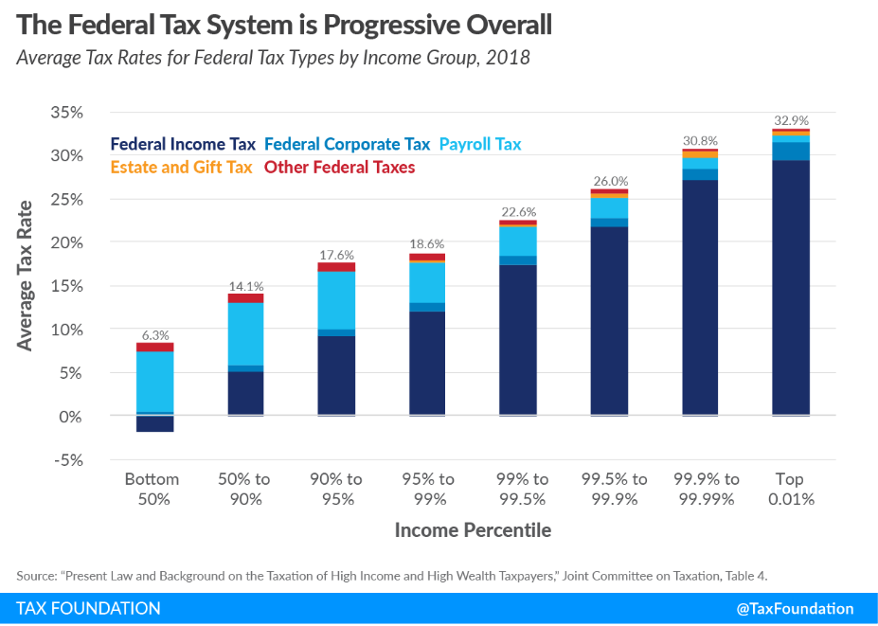
Tax Systems: Vertical Equity
Vertical Equity: If the tax system has vertical equity, then it progressive.

Slide 25
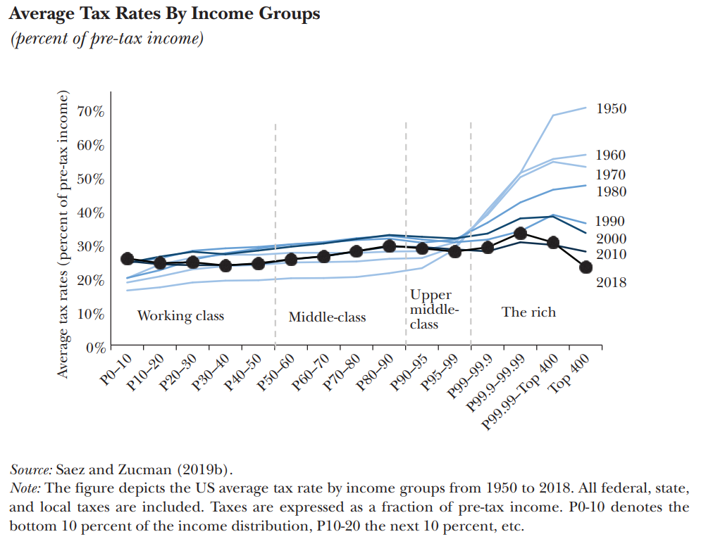
Tax Systems: Vertical Equity
While the federal tax system seems to be progressive, when accounting for state and local taxes evidence suggests has became more regressive.
This graph is from a recent paper by Saez and Zucman (2020) shows that progressivity in the US tax system has decreased over time.

Slide 26
Tax Systems: Efficiency
Efficient: if possible, taxes should be non-distortionary. Taxes should be used to make Pareto improvements (i.e. enhance efficiency in the economy).
Taxes affect prices hence they modify behavior.
Remember: the invisible hand should lead to the efficient allocation of resources. Taxation should interfere as less as possible with consumers’ and producers’ incentives.
In real life, market failures prevent the invisible hand to work properly.
Taxes (properly used) provide a tool to enhance efficiency in the economy.
Example: subsidies. Subsidies are negative taxes, they lower the price of some good for a specific group of people.

Slide 27
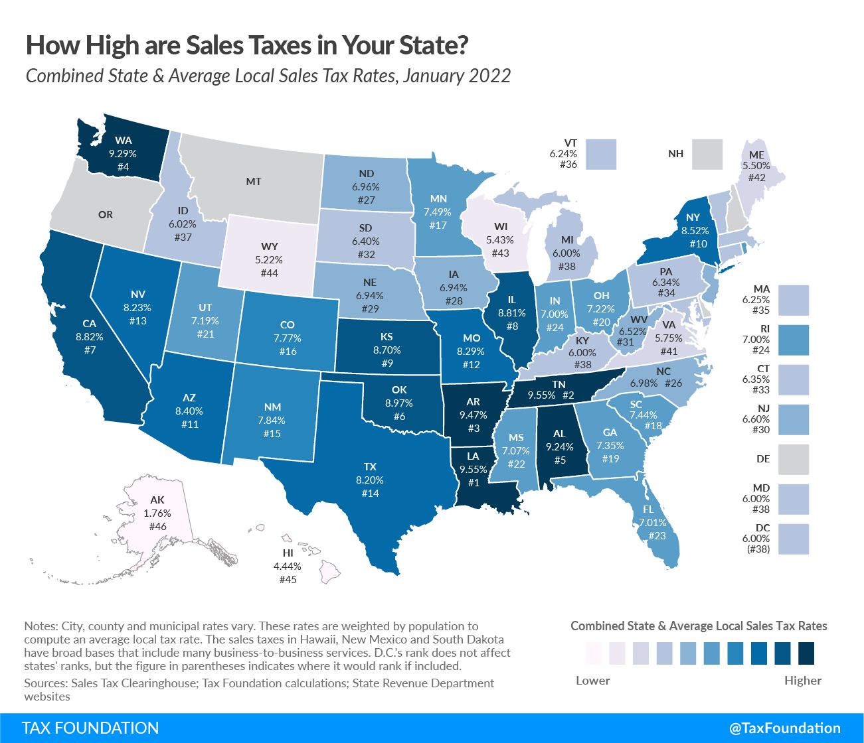
How does the government tax?
State and local taxes create heterogeneous conditions in the US economy.
Lower taxes → lower prices.
Regional market competition.
States with lower sales tax rates should observe higher consumption.
However, lower sales tax rates could be associated with lower revenues. Hence, less public goods (or with lower quality).
Remark: regional differences add complexity to the tax system.

Slide 28
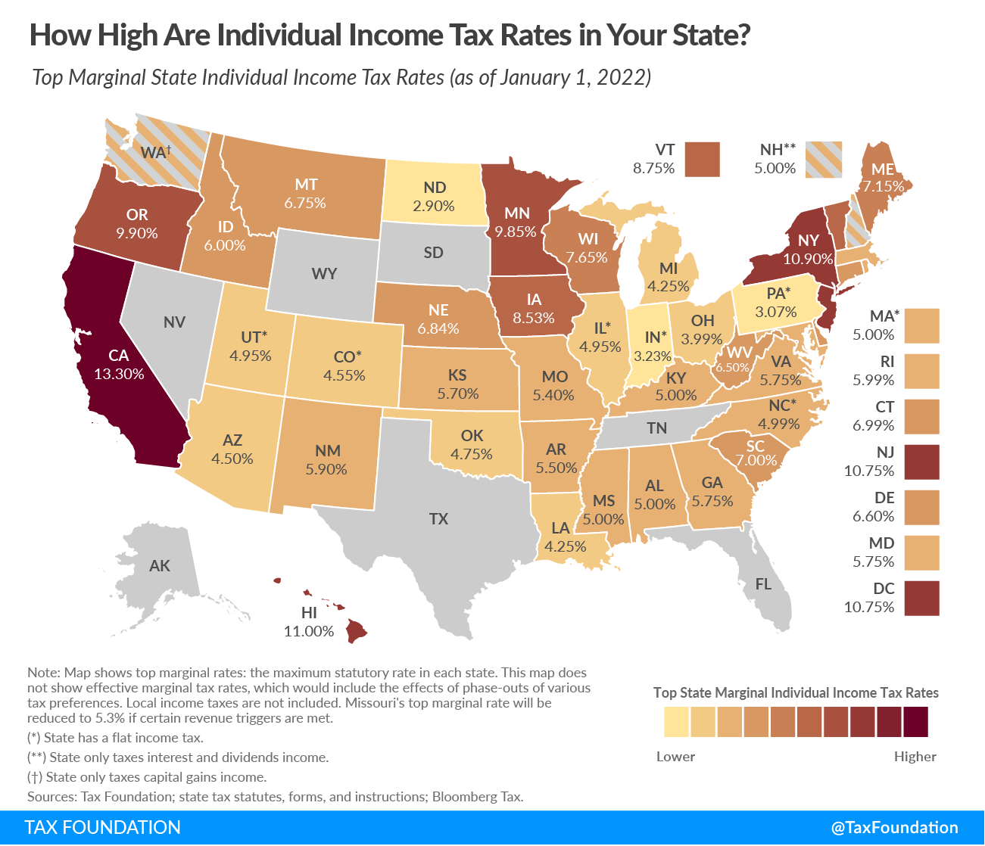
How does the government tax?
State and local taxes create heterogeneous conditions in the US economy.
Just like the sales tax, the income tax creates a distortion in its own market: the labor market.
States with lower income tax rates should observe higher labor supply.
Same dilemma. Low tax rates might lead to small revenues.
Remark: which other markets might be affected (indirectly) by this tax? Hint: if you were to relocate for a job, what would you need?

Slide 29
For Next Class
Reminder: Monday February 6th → No Class!
On the Next Episode: Tax Policy: Efficiency and Behavioral Effects.
Readings: Mankiw 8. Gruber 18. Stiglitz & Rosengard 18.
Discussion Forum: is out.

Slide 30
SPEA-V-202
Contemporary Economic Issues in Public Affairs
Tax Policy 1
Luis Navarro

