Slide 1
SPEA-V-202
Contemporary Economic Issues in Public Affairs
Externalities I
Luis Navarro

Slide 2


Outline for Today
Externalities
Definition and examples
Type of externalities
Positive and negative externalities
Intuition and visual representation
Examples
Environmental externalities
Environmental policy
Practical example of health policy

Slide 3
Externalities
Externality: an externality arises when a person engages in an activity that influences the well-being of a bystander but neither pays nor receives compensation for that effect.
Example: smoking in a closed room. Smokers create smoke with each cigarette they consume.
Exposure to smoke decreases the health of the non-smokers in the room.
Due to smoke exposure, non-smokers now will consume a higher amount of health care services.
Question: what is the non-smokers WTP for cigarettes?
Zero! They do not smoke because they do not derive benefit from it. Still, they bear some of the costs of smoking.
Is this efficient? Is this fair?

Slide 4














Introduction
Example: consider the market for burgers. Suppose that a pizza place opened right next to the only burger restaurant supplying this economy.
Opening the pizza place creates a market for pizza. Assumption: pizza and burgers are substitutes. What is the effect on the demand for burgers?
Is this an externality? (Hint: what is the market failure in this case? )
$$P_{z}$$
Pizza Market
$$P_{B}$$
Burgers Market
$$S_{w}$$
$$S_{z}$$
$$p_{z}^{∗}$$
$$p_{B}^{∗}$$
$$D_{B}$$
$$D_{z}$$
$$D_{B}^{′}$$
$$Q_{z}$$
$$q_{B}^{′}$$
$$q_{B}^{∗}$$
$$Q_{B}$$
$$q_{z}^{∗}$$

Slide 5


Pecuniary Externalities
There is no market failure! Opening the pizza place might be a response to demand for pizza. Markets are working as they should.
1. Pecuniary Externalities: externalities transmitted through the price system.
Opening the pizza place: increases the supply for pizza, decreases the demand for burgers. There is a negative effect on the burger’s market, but (in theory) it should be compensated by the benefit from having a pizza place. Hence, the DWL of both markets is zero. Actually, there could be a welfare gain.
$$P_{z}$$
Pizza Market
$$P_{B}$$
Burgers Market
$$S_{z}$$
$$S_{w}$$
$$p_{z}^{∗}$$
$$p_{B}^{∗}$$
$$DWL in the burgers market$$
$$D_{B}$$
$$D_{z}$$
$$D_{B}^{′}$$
$$Q_{z}$$
$$q_{B}^{′}$$
$$q_{B}^{∗}$$
$$Q_{B}$$
$$q_{z}^{∗}$$

Slide 6





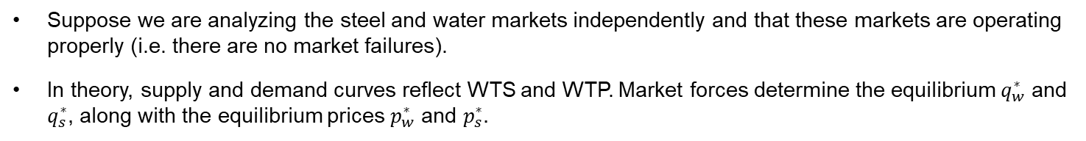







Introduction
Suppose we are analyzing the steel and water markets independently and that these markets are operating properly (i.e. there are no market failures).
In theory, supply and demand curves reflect WTS and WTP. Market forces determine the equilibrium $q_{w}^{∗}$ and $q_{s}^{∗}$, along with the equilibrium prices $p_{w}^{∗}$ and $p_{s}^{∗}.$
$$P_{s}$$
Steel Market
$$P_{w}$$
Water Market
$$S_{s}$$
$$S_{w}$$
$$p_{s}^{∗}$$
$$p_{w}^{∗}$$
$$D_{s}$$
$$D_{w}$$
$$Q_{s}$$
$$q_{w}^{∗}$$
$$Q_{w}$$
$$q_{s}^{∗}$$

Slide 7

An example
In this economy, the supplier is one steel factory, and the consumers are local businesses that use steel as input to produce final goods (e.g. car repair shops, construction).
Steel production requires several strong chemicals (acids) and creates toxic waste.
In other words, for each unit of steel produced some units of toxic waste are also produced.
Units of Steel Produced | Toxic Waste Created
10 tons | 500 pounds
20 tons | 1,000 pounds
30 tons | 1,500 pounds

Slide 8







An example
Suppose the steel factory disposes of the toxic waste on a nearby river, which converges with the river supplying water to the community.
What is the effect of this action on the water supply?
Reduction in the water supply. Less clean water is available. Price of water increases due to scarcity.
Takeaway: each unit of steel produced derives in a reduction of the water supply, which leads to higher prices for the community.

Slide 9


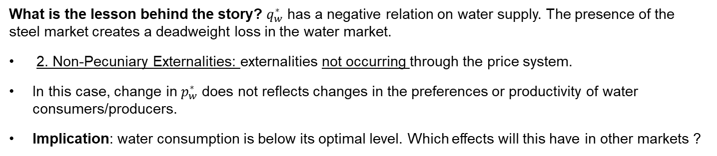




Non-Pecuniary Externalities
What is the lesson behind the story? $q_{w}^{∗}$ has a negative relation on water supply. The presence of the steel market creates a deadweight loss in the water market.
2. Non-Pecuniary Externalities: externalities not occurring through the price system.
In this case, change in $p_{w}^{∗}$ does not reflects changes in the preferences or productivity of water consumers/producers.
Implication: water consumption is below its optimal level. Which effects will this have in other markets ?
$$P_{s}$$
Steel Market
$$P_{w}$$
Water Market
$$S_{w}−Effect of Steel$$
$$S_{s}$$
$$S_{w}$$
$$p_{s}^{∗}$$
$$p_{w}^{∗}$$
$$DWL in the water market$$
$$D_{s}$$
$$D_{w}$$
$$Q_{s}$$
$$q_{w}^{′}$$
$$q_{w}^{∗}$$
$$Q_{w}$$
$$q_{s}^{∗}$$

Slide 10
Non-Pecuniary Externalities: Intuition
Intuitively: what is the imperfection in the economy? Why does free-exchange not lead to efficiency?
Supply of water is not fully capturing producer’s willingness to sell. Why is this the case?
Market failure: property rights are not well defined. Some of the costs of producing steel are borne by water suppliers (and consumers). Question: which is the market experiencing the market failure in our example?
$$P_{s}$$
Steel Market
$$P_{w}$$
Water Market
$$S_{w}−Effect of Steel$$
$$S_{s}$$
$$S_{w}$$
$$p_{s}^{∗}$$
$$p_{w}^{∗}$$
$$DWL in the water market$$
$$D_{s}$$
$$D_{w}$$
$$Q_{s}$$
$$q_{w}^{′}$$
$$q_{w}^{∗}$$
$$Q_{w}$$
$$q_{s}^{∗}$$

Slide 11
Non-Pecuniary Externalities: Intuition
In the absence of market failures: equilibrium happens when WTP = WTS → Private MB = Private MC
However, under the presence of externalities private MB/MC might differ from social MB/MC.
Private Marginal Cost: direct cost to producers of producing an additional unit of a good.
Private Marginal Benefit: direct benefit to consumers of consuming an additional unit of a good by the consumer.
Social Marginal Cost: private marginal cost + any costs associated with the production of such good that are imposed or borne by others.
Social Marginal Benefit: private marginal cost - any costs associated with consumption of such good that are imposed or borne by others.
The difference between private and social marginal benefit/cost is called Marginal Damage (in our example the marginal damage is the effect of steel on water supply).
Homework: see Mankiw’s Figures 5-3 and 5-4.

Slide 12
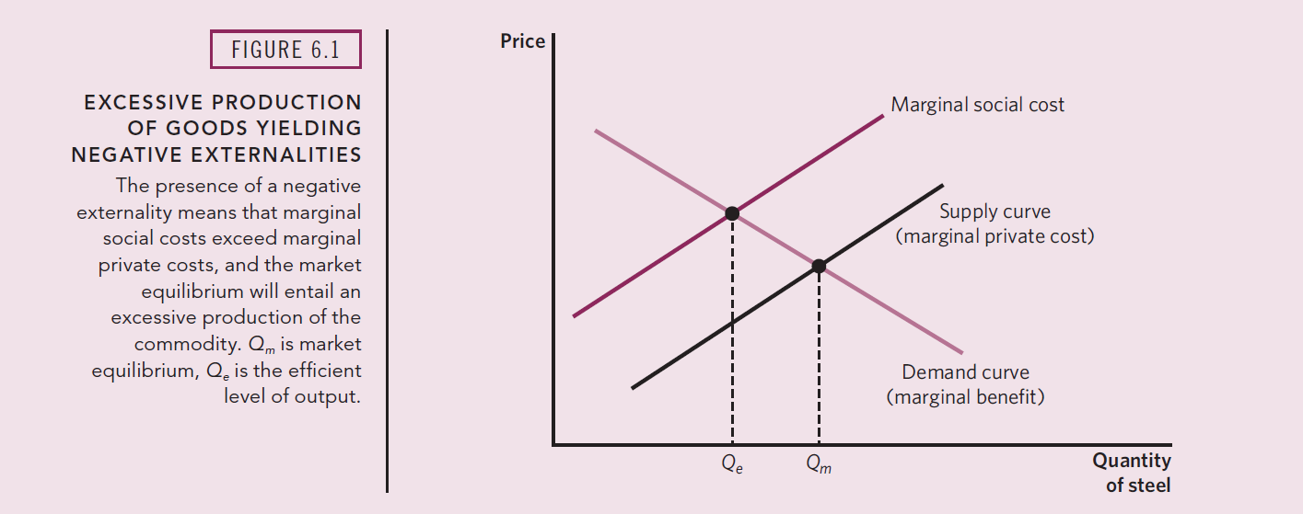
Externalities
Problem: private costs (only faced by suppliers) differ from social costs (faced by everyone). Recall the social planner. What would he do in this market?
Social planner: Social Marginal Benefit = Social Marginal Cost.
Free-market exchange: Private Marginal Benefit = Private Marginal Cost. If private ≠ social, then we have an externality.
Source Stliglitz and Rosengard Chapter 6

Slide 13
Externalities categorization
In general, we can categorize externalities in four main groups, defined by two sets of characteristics.
Direction of the unintended effect: this could be negative or positive.
Channel to the economy: externalities could be either on consumption (demand curve) or production (supply curve).
 | Negative | Positive
Production | Steel and water production. | Oil exploration.
Consumption | Roommate’s smoking habits and your healthcare. | Neighbor landscapes his garden, and your house benefits from the view.
For more details on the examples see Gruber Chapter 5.

Slide 14
Externalities
Question: if negative externalities lead to DWL, do positive externalities lead to welfare gains?
No! Even positive externalities are the result of market failure. Private marginal benefits/costs do not reflect social marginal benefits/costs.
Recall the social planner chooses the optimal level of production (i.e. to maximize total surplus, accounting for any market failure).
Negative externalities cause overproduction of the good in a competitive market. (i.e free market exchange leads to produce/consume the good above its optimal level)
Positive externalities cause underproduction of the good in a competitive market. (i.e free market exchange leads to produce/consume the good below its optimal level)
In both cases leading to a deadweight loss.

Slide 15
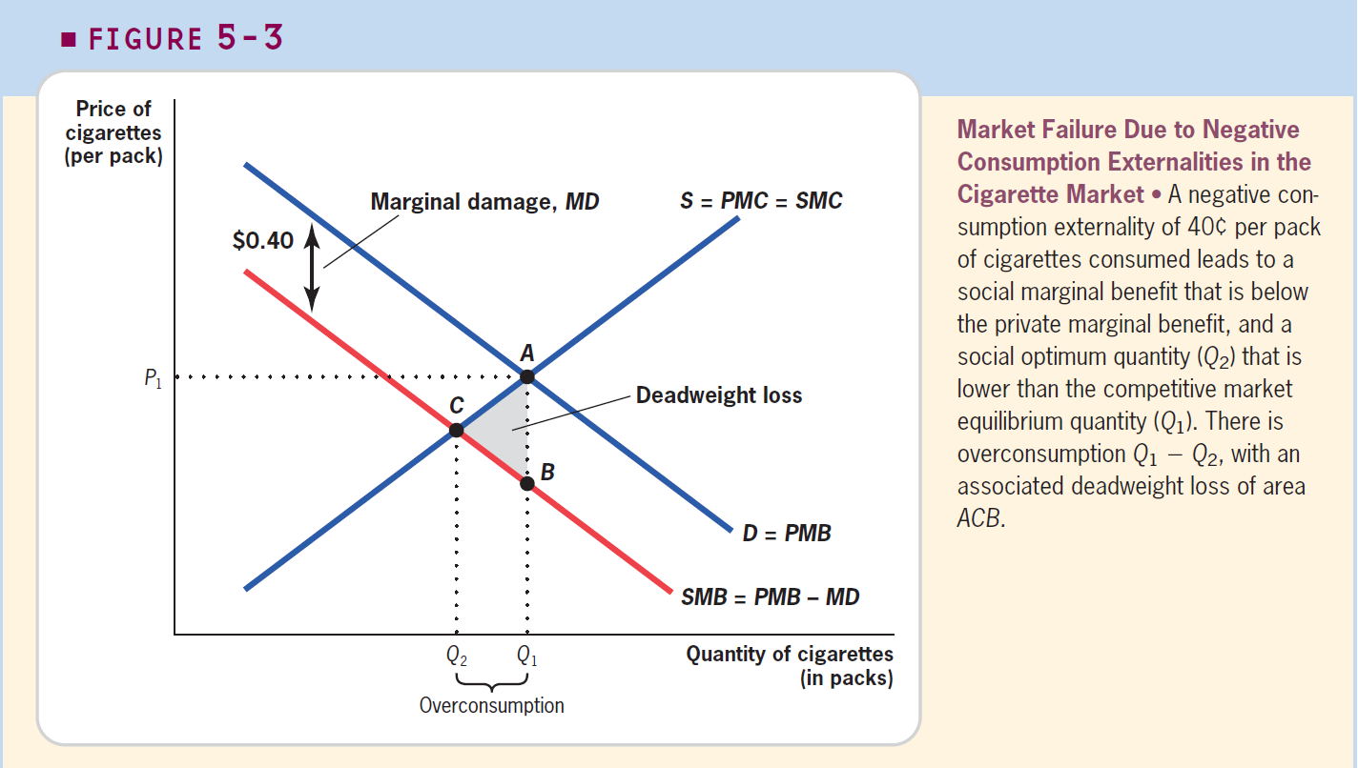
Externalities
Negative externalities cause overproduction of the good in a competitive market.
Source Gruber Chapter 5.

Slide 16
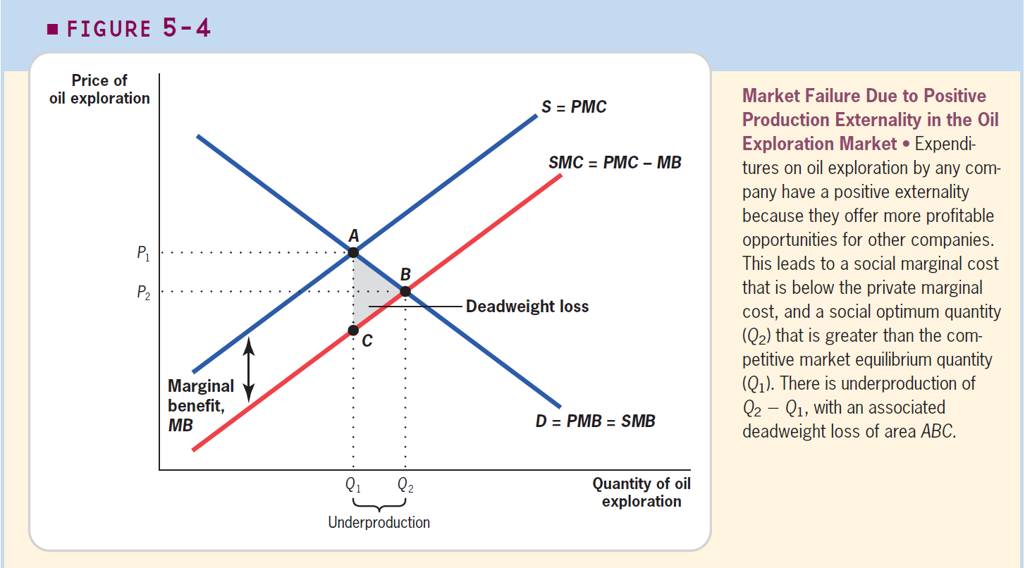
Externalities
Positive externalities cause underproduction of the good in a competitive market.
Source Gruber Chapter 5.

Slide 17
Example: Environmental Externalities
Economic activity involves in pollution. There is an unavoidable amount of pollution associated with the provision of goods and services in the economy.
Releasing pollutants to the environment creates consequences for all agents, regardless on whether they participate in the market or not.
Example: Global Warming. Greenhouse effect 101: the earth is heated by solar radiation that passes through the atmosphere. Most of the radiation is trapped by certain gases in the earth’s atmosphere.
The problem: economic activity increases the amount of carbon dioxide, methane and other gases to the atmosphere, trapping more radiation and, thus, increasing the temperature of the earth.
Consequences: melting poles, increasing sea level leads to higher probability of floods.

Slide 18
Example: Environmental Externalities
Another example: Acid rain. Acid rain occurs when sulfur dioxide and nitrogen oxides are released in to the atmosphere.
Damages of acid rain:
Forest erosion: death and slower growth for a variety of trees.
Property damage: corrosion of metals, paint, and several materials.
Reduced visibility in the air.

Slide 19
Regulation-based solutions to environmental externalities
1970 Clean Air Act: set maximum standards for atmospheric concentrations of various substances, including sulfur dioxide.
The catch: only new plants were subject to this cap. How could firms comply? Switch to coal with lower sulfur content.
Economic intuition: cap of emissions is basically a cap on quantity supplied.
Intended effects: total sulfur dioxide emissions declined by the early 1980s.
Was policy design optimal? What would you change/improve? (Hint: who is being targeted by the policy?)
Not applicable to current plants, only to new plants.
It created incentives for suppliers to run older, dirtier plants for longer than they should have.
1990 Amendments: mandated a reduction of more than 50% in the level of sulfur dioxide emissions nationwide, now including all plants. (More about this policy later).

Slide 20
Regulation-based solutions: a small caveat
One of the reasons for performance-based regulations is that they may induce innovations. That is, new ways of producing that generate less pollution or new techniques to fight pollution.
Ongoing debate on whether industries should be forced to innovate.
Example: suppose a policy that imposes a cap where all cars must get at least 40 miles per gallon, in terms of fuel consumption efficiency.
Thinking like an economist: what are the costs and benefits from this policy?
Costs: more expenditures on research and development. Might be a more expensive technology.
Benefits: reduction in gasoline consumption, and pollution associated to it.
Challenge: it is not clear that forcing innovation is welfare-improving. Finding feasible alternatives is hard.

Slide 21
Practical Example: Alpert, Powell & Pacula (2018)
Context: Opioid epidemic in the United States is health policy concern. More than 200K deaths due to opioid overdose.
Alpert, Powell & Pacula (2018): study the effect of the reformulation of OxyContin (one of the most widely abused opioids) on the mortality rates due to opioids and the consumption of other drugs.
In their paper, they analyze FDA’s 2010 policy that approved a reformulated version of OxyContin.
Policy objective: decrease the abuse of OxyContin.
Upgrade: make the pill harder to crush or dissolve (when is crushed, the consumption of Oxycontin is most dangerous, consumers are more likely to overdose).
Theory: this increases the costs of using OxyContin. Thus, consumer’s WTP for opioids should decrease.
Question: given these facts, do you think this policy was a good idea? Why?

Slide 22
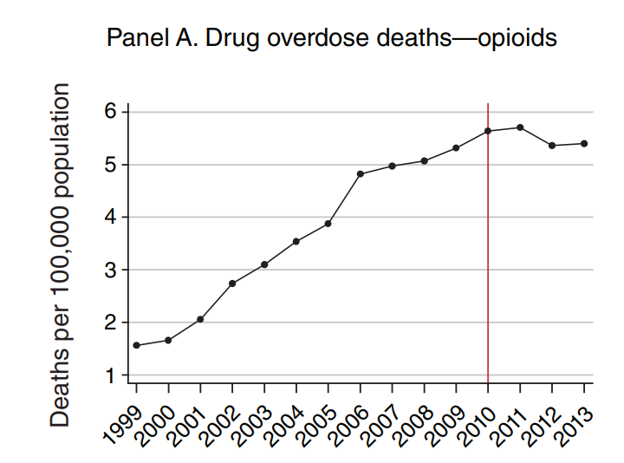
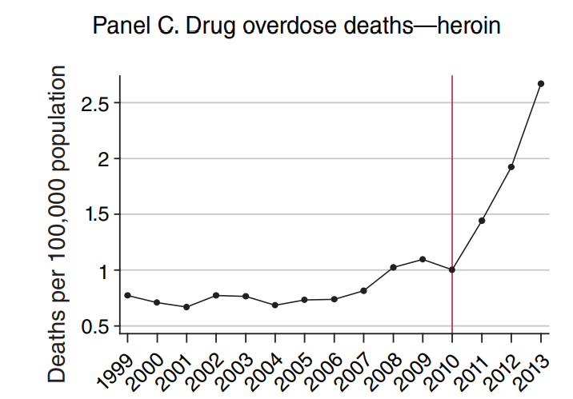
Practical Example: Alpert, Powell & Pacula (2018)
Unintended Consequence: raising the cost of OxyContin abuse lead to an unintended effect of increasing the abuse of substitute drugs, including more harmful ones like heroin.
If this substitution occurred, then it would undermine the benefits of the policy.
Source: Alpert, Powell & Pacula (2018)

Slide 23
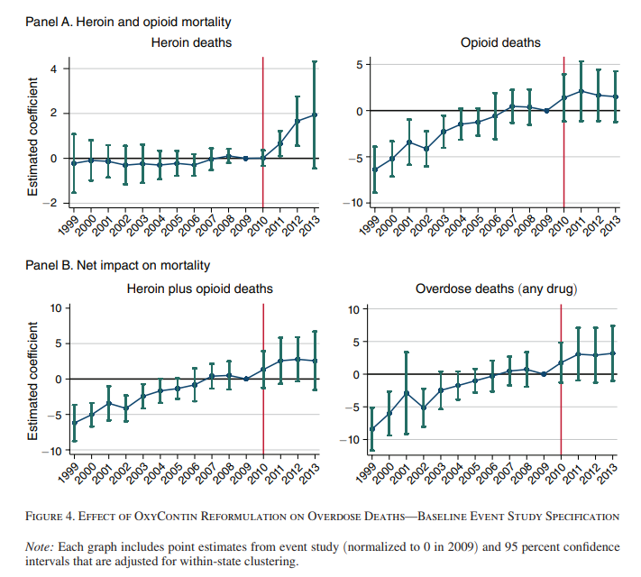
Practical Example: Alpert, Powell & Pacula (2018)
Results: after the reformulation, overdose deaths from prescription opioids decreased for the first time since 1990.
However, this drop coincided with an unprecedented rise in heroin overdoses. Heroin-related overdoses more than tripled between 2010 and 2014.
This evidence is consistent with the hypothesis that the reformulation lead to the substitution from OxyContin to heroin.
Source: Alpert, Powell & Pacula (2018)

Slide 24
Practical Example: Alpert, Powell & Pacula (2018)
Theoretical mechanism: the policy increased the price of OxyContin, thus decreasing consumer’s WTP for it. To satisfy their needs, they went to a substitute, a more dangerous one.
What are the (relevant) market failure(s) here? What of type of externality is this?
Market failure: imperfect information (e.g. opioids consumers might not be aware of the risks of heroin consumption).
Type of externality: non-pecuniary externality. Hint: there was no change on the heroin supply. It wasn’t the case that people substituted to heroin because it became cheaper, it was just easier.
Overall effect: increase in drug mortality.
Lesson: if you were the policymaker designing the policy, would you be able to anticipate this?

Slide 25
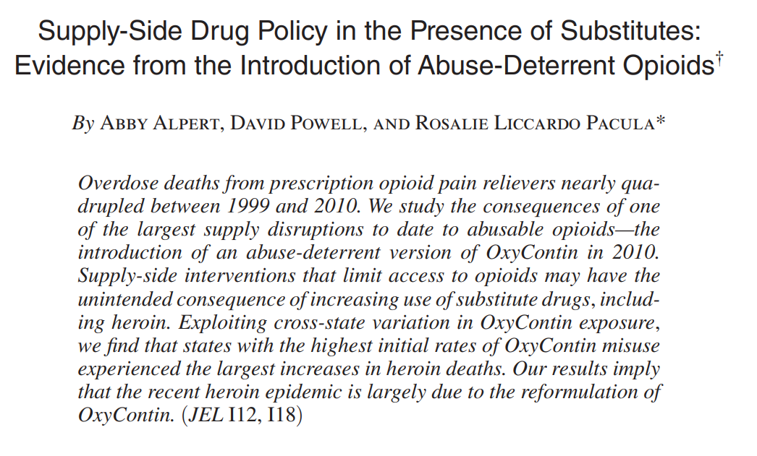

Practical Example: Unintended Effects of Health Policy

Slide 26
For Next Class
On the Next Episode: Externalities II.
Assignment 3: is out.
Readings: Mankiw 10. Gruber 5 and 6. Stiglitz & Rosengard 6
Review Class: Monday February 20th Come with questions!
Want some extra credit? Answer this survey by this Sunday! https://iu.instructure.com/courses/2126680/quizzes/3810364
Midterm Exam: Wednesday February 22th

Slide 27
SPEA-V-202
Contemporary Economic Issues in Public Affairs
Externalities I
Luis Navarro

