Slide 1
SPEA-V-202
Contemporary Economic Issues in Public Affairs
Externalities II
Luis Navarro

Slide 2


Outline for Today
Solutions to Externalities
Types of Solutions
Private Solutions
Government Intervention
Intuition and visual representation
Public Sector Remedies
Corrective Taxation
Regulation-based policies

Slide 3
Externalities
Externality: an externality arises when a person engages in an activity that influences the well-being of a bystander but neither pays nor receives compensation for that effect. Unintended consequences of free-market exchange. Effects not occurring through the price system.
Market failure: property rights are not well defined.
If markets operate properly, only the agents engaging in the exchange should experience the benefits/costs. Supply and demand reflect the willingness to sell/buy.
This type of failure implies that private and social willingness to sell/buy differ. There is some marginal damage experienced by third parties.
Free Market Exchange: private marginal benefit = private marginal cost.
Social Planner (Efficiency): social marginal benefit = social marginal cost.
Externalities: private ≠ social → there is DWL due to over/under consumption/production.

Slide 4
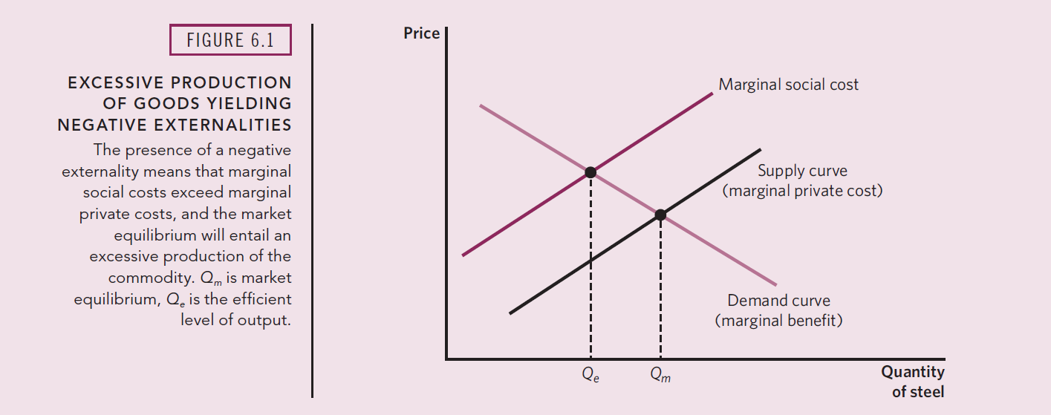
Externalities
Source Stliglitz and Rosengard Chapter 6

Slide 5

Solutions to Externalities
There are two types of solutions to address externalities:
Private-sector solutions:
Coasian solution: Market for marginal damages.
Government intervention:
Regulation-based solutions: production/consumption limits.
Market-based solutions: corrective (Pigovian) taxation and subsidies.

Slide 6
Private-Sector Solutions
Recall the example of the steel factory and the river. Steel suppliers create an externality on the water market by dumping toxic waste down the river, leading to a reduction in supply (hence, water underconsumption in equilibrium).
What is the basic problem in this example? Steel producers are affecting the way water is supplied by polluting the river.
Example: suppose that in equilibrium the steel market is producing 2 tons of steel, leading to 20 lb of toxic waste dumped into the river.
Units of Steel Produced | Toxic Waste Created
1 ton | 10 lb
2 tons | 20 lb
3 tons | 30 lb
The problem is not that toxic waste is created. The problem is that is being dumped into the river.
But what if we do something different with it?
Is there anyone willing to buy some units of toxic waste?

Slide 7


Private-Sector Solutions
Suppose there is some laboratory in town that could transform the toxic waste produced by the steel factory into usable chemical compounds that pharmaceutical companies are willing to buy.
In this case, this laboratory is willing to buy units of toxic waste from the steel factory (it can transform it and get some profit for it). There is some demand for toxic waste.
Arguably, the steel factory is also willing to sell such units of toxic waste (it was about to dump them anyway, better receive some money from it).
If the laboratory and the factory make a deal, then the toxic waste is not going to be dumped to the river.
This is a win-win scenario for everyone.
There is no damage on the water supply. Steel factory makes an additional profit, and the laboratory sells its products to other consumers.

Slide 8
Private-Sector Solutions
What is the lesson behind the last example?
The solution for the externality was to create a market for its marginal effects/damages.
A simpler example: can you think of another party that might be willing to buy some units of toxic waste?
The water supplier! He is better-off without the toxic waste on the river, so he might be willing to pay for that to stop. How much is the water supplier willing to pay?
Thinking like an economist: what are the marginal benefits for water suppliers of reducing the production of steel? In other words, at which price are they willing to buy the toxic waste produced?
A reduction of one unit of steel reduces the DWL in the water market, hence increasing the profits perceived by water producers. As steel production decreases, water suppliers’ revenue rises.
Suppliers are willing to buy the toxic waste so long the price of one unit of toxic waste is lower than the additional revenue induced by the reduction of such unit of toxic waste in the river.

Slide 9








Private-Sector Solutions
What is the nature of the problem in the previous example? Property rights are not well defined.
What do I mean by that?
Steel factory could use the river, which is the main input of the water supplier. This is what is inducing that the private and social marginal costs of production differ.
In this example, the steel factory has some property rights over the river (i.e. the water supplier cannot force him not to dump the toxic waste).
What if it was the other way around? What if the water supplier has the property rights over the use of the river?

Slide 10
Private-Sector Solutions
Suppose the water supplier has a license that says he controls the access to the river. Now, the water supplier has property rights over the river.
The steel factory still needs to dump the toxic waste somewhere and the river is the only feasible option. Hence, the steel factory now is willing to pay the water supplier some fee so it can dispose off the waste.
If you were the water supplier, at which price would you be willing to sell vouchers/permits to dump toxic waste on the river? (Hint: think like an economist, what is the opportunity cost?)
Units of Steel | Toxic Waste | Marginal Damage to Water Supplier | Total Damage to Water Supplier | WTS Permits for Pollution (Price for 1 lb of TW) | Marginal Revenue from Selling Permits | Total Revenue from Selling Permits
1 ton | 10 lb | $1000 | $1000 | $100 | $1000 | $1000
2 tons | 20 lb | $500 | $1500 | $50 | $500 | $1500
3 tons | 30 lb | $300 | $1800 | $30 | $300 | $1800

Slide 11
Private-Sector Solutions
Units of Steel | Toxic Waste | Marginal Damage to Water Supplier | Total Damage to Water Supplier | WTS Permits for Pollution (Price for 1 lb of TW) | Marginal Revenue from Selling Permits | Total Revenue from Selling Permits
1 ton | 10 lb | $1000 | $1000 | $100 | $1000 | $1000
2 tons | 20 lb | $500 | $1500 | $50 | $500 | $1500
3 tons | 30 lb | $300 | $1800 | $30 | $300 | $1800
Same logic! The price of the permits is proportional to the marginal damage induced by toxic waste.
For the water supplier to be indifferent between the case with and without pollution, the revenue he must receive from selling vouchers should be equal to the revenue lost due to the pollution.
Equilibrium in the permits market: Marginal revenue from selling permits = Marginal costs from pollution. The invisible hand solved this externality!

Slide 12
Private-Sector Solutions
Recap: the previous two cases are examples of Coasian solutions. Named after Ronald Coase (Nobel Prize, 1991)
His main contribution to the study of externalities is summarized by Coase’s theorem.
Coase Theorem: If property rights are well defined (and there is costless bargaining), then negotiations between the party creating the externality and the party affected by the externality can bring about the socially optimal market quantity.
Key Implication of the Theorem: The efficient solution to an externality does not depend on which party is assigned the property rights.
Recall our two examples. Regardless of whether the water supplier pays the steel factory to stop dumping waste, or the factory buys permits for pollution, in both cases creating a market for toxic waste led to socially optimal quantity.

Slide 13
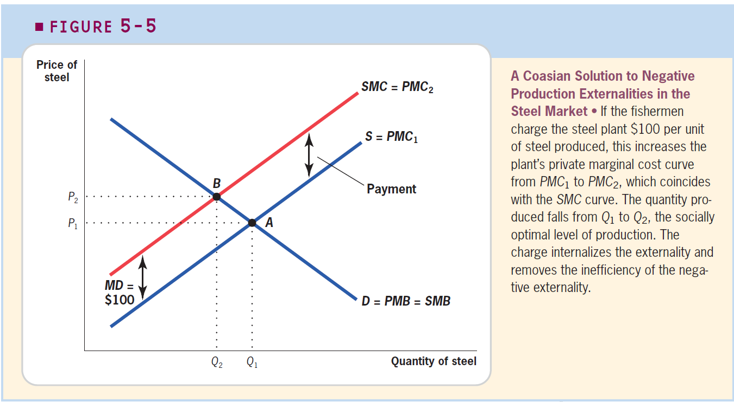
Private-Sector Solutions
Source Gruber Chapter 5.

Slide 14
Private-Sector Solutions: Some Limitations
Coasian solutions are market-based solutions that do not require the government. Why not use them all the time?
For this type of solution to work, property rights need to be well defined and assigned. Sometimes that is not trivial.
Assignment Problem: suppose we ask the water supplier what is the damage induced by toxic waste. During the bargaining process, he has incentives to overstate the damage, so he receives a larger compensation. Information asymmetries hide the true effects of the externality.
Transaction Costs: Coase’s theorem requires that transaction costs are low (costless bargaining). In most cases, this is not true. Creating a new market entails costs that could dissuade potential buyers.

Slide 15
Common Pool Resources: A caveat
A special type of externalities arise under the presence of common pool resources (CPR).
Common Pool Resources (CPR), as the name suggests, are goods shared by several market participants (could be both consumers and producers).
The river is a good example. Suppose that on top of the water supplier, there are fishermen also using the river for fishing, and other factories dumping waste.
The classic CPR example is a shared piece of land that farmers use to feed their cows. If one farmer brings an additional cow to the land, then it reduces the amount of grass that the cows from the rest of the farmers can eat. (More on this later!)
The actions of one farmer influence the outcomes of the others.
CPRs are associated with two main problems: the holdout problem and the free-rider problem.

Slide 16
Private-Sector Solutions: Some Limitations
Holdout Problem: suppose that instead of one water supplier, we have 10 identical firms using the river for water bottles production. Water suppliers own the property rights of the river. Hence, in order to produce, the steel factory needs to compensate first all water suppliers for the damages incurred.
The Coasian solution implies the factory needs to pay the same amount to all water suppliers in order to produce steel. The amount paid should be equivalent to the marginal damage experienced by each individual supplier. For simplicity, say such payment is set at $100.
Suppose 9 out of the 10 suppliers went to the factory and received their checks. Are the incentives of the 10th supplier the same?
No! He holds the fate of the market in his hands. If he says no to the payment, then the factory cannot produce steel at all. Hence, he could ask for $101 and the steel factory would arguably agree (because it has already paid $900 to the rest). Then, why not ask for more?
Holdout problem: shared ownership of property rights gives each owner power over all the others.

Slide 17
Private-Sector Solutions: Some Limitations
Let’s keep the same example. A simple solution for the holdout problem is to choose one out of the 10 water suppliers as a negotiator with the steel factory.
Nonetheless, this solution entails other complexities. Suppose now the steel factory has the property rights and it is selling vouchers for toxic waste reduction to water suppliers.
Like before, the Coasian solution implies water suppliers pay $100 each to the steel factory so it reduces the amount of waste dumped into the river.
Key implication: In this case, for each supplier it pays, the rest of them benefit from the induced pollution reduction.
Suppose 9 out of the 10 suppliers already made the payment. Are the incentives of the 10th supplier the same?
No! Now he has incentives to free-ride. Pollution is already down because the other 9 paid their share.
Free rider problem: when an investment has a personal cost, but common benefit. (More on this later!)

Slide 18
Private-Sector Solutions
Source Gruber Chapter 5.

Slide 19
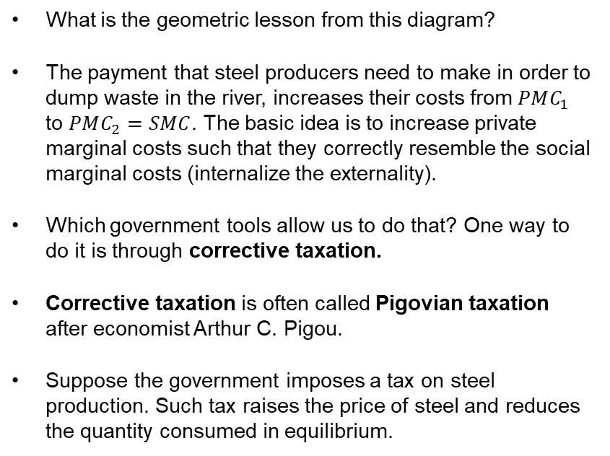
Public-Sector Remedies: Corrective Taxation
What is the geometric lesson from this diagram?
The payment that steel producers need to make in order to dump waste in the river, increases their costs from $PMC_{1}$ to $PMC_{2}=SMC$. The basic idea is to increase private marginal costs such that they correctly resemble the social marginal costs (internalize the externality).
Which government tools allow us to do that? One way to do it is through corrective taxation.
Corrective taxation is often called Pigovian taxation after economist Arthur C. Pigou.
Suppose the government imposes a tax on steel production. Such tax raises the price of steel and reduces the quantity consumed in equilibrium.
Source Gruber Chapter 5.

Slide 20

Public-Sector Remedies: Corrective Taxation
Question: which tax rate will the social planner choose?
The one that induces the optimal quantity in the market!
The basic idea is to set a tax per unit of steel produced equal to the marginal damage experienced by the water supplier.
This will shift the private marginal cost by MD for each unit of steel produced. This will result in a new private marginal cost curve, which is identical to the social marginal cost curve.
Hence, the result effectively internalizes the externality and leads to the socially optimal outcome.

Slide 21
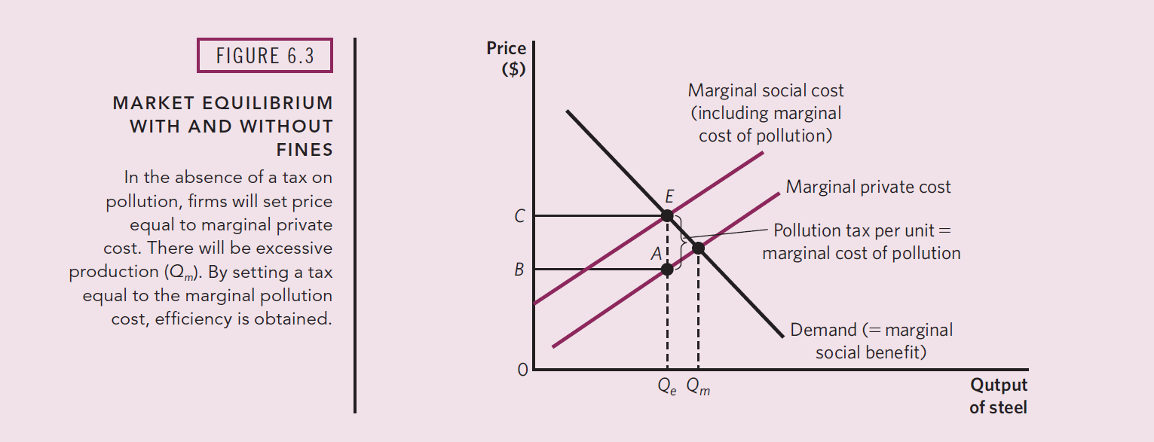
Corrective Taxation
We can think of tax as the difference between the marginal social and private costs of pollution.
Note: tax revenue from corrective taxation is determined by rectangle CBAE.
Source Stliglitz and Rosengard Chapter 6

Slide 22
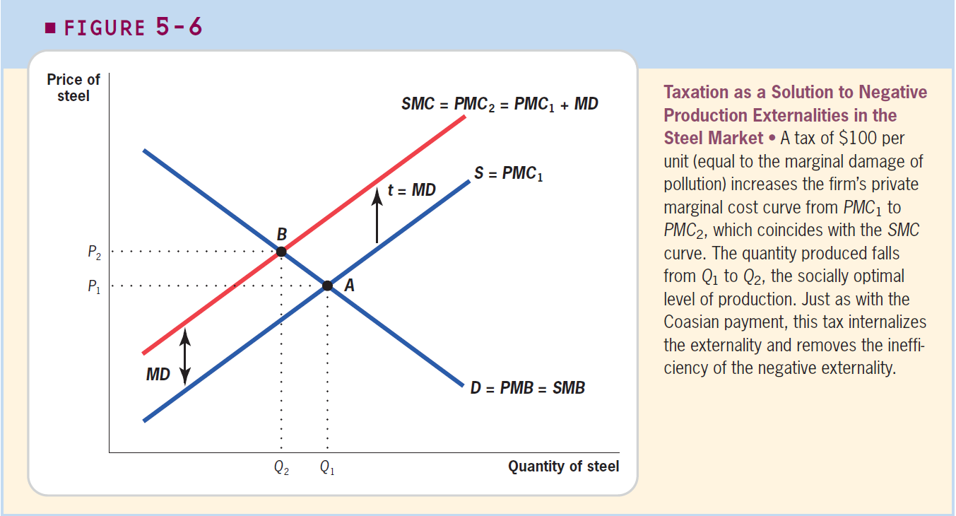
Corrective Taxation
Source Gruber Chapter 5.

Slide 23
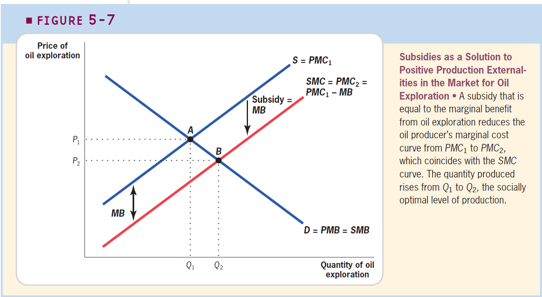
Corrective Taxation
Same logic applies to subsidies! The government ought to choose the subsidy that induces the optimal quantity in the market.
Source Gruber Chapter 5.

Slide 24
Public-Sector Remedies: Regulation
Production Cap
Another solution the government could implement is to enact some regulation. The simplest version of this consists of imposing limits on the production/consumption of the good creating the externality.
How does that look in our steel factory example?
The government determines a production limit equal to the social optimum quantity.
Source Stliglitz and Rosengard Chapter 6

Slide 25
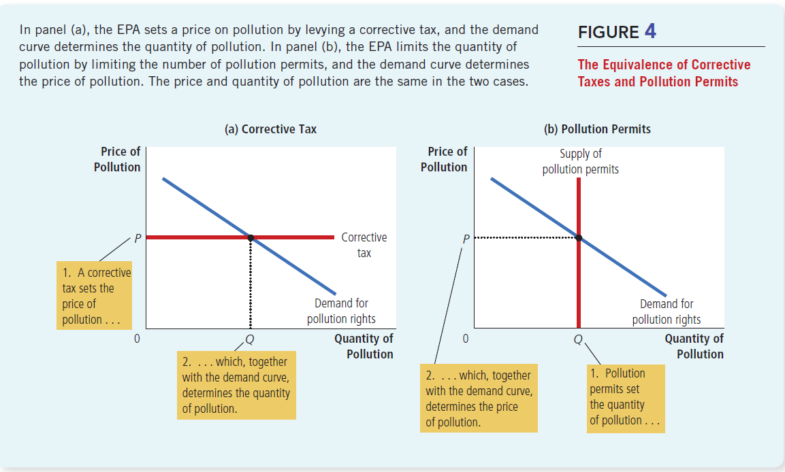
Public-Sector Remedies: Taxes vs Regulation
Both corrective taxation and regulation could lead to the socially desirable outcome, but they operate through different mechanisms.
Source Mankiw Chapter 10

Slide 26
Public-Sector Remedies: Regulation
Types of regulation-based solutions:
Performance-based: the amount paid by the steel factory is determined by the quantity of steel produced. To pollute more, it needs to buy more permits/vouchers.
Input-based regulations: the government could prohibit using some hazardous materials. Example: high-sulfur coal and the Clean Air Act.

Slide 27
Public-Sector Remedies: Summary
 | Description | Key Implications
Private Sector Solutions | Creating a market for marginal damages. Marketable permits. | Marketable permits provide more certainty about the amount of pollution produced. It is proportional to the number of permits sold. Marketable permits are subject to the assignment problem: who gets the property rights of the permits? Sometimes hard to determine.
Corrective Taxation | Government imposes taxes/fines that induce the social optimum | Create incentives to reduce pollution via increasing the price of polluting. Pollution effectively produced is uncertain. Remember in reality is hard to estimate supply/demand curves.
Regulation | Performance-based and input-based solutions. | Regulations provide strong incentives to comply with the law (not exceed the limit), but do not provide incentives to reduce pollution below such limit. Performance-based is more efficient when performance can be measured. Costs of monitoring inputs may be lower, though.

Slide 28
For Next Class
On the Next Episode: Pre-Midterm Review.
Assignment 3: due Sunday.
Weekly discussion: is out
Readings: Mankiw 10. Gruber 5 and 6. Stiglitz & Rosengard 6
Review Class: Monday February 20th Come with questions!
Want some extra credit? Answer this survey by this Sunday! https://iu.instructure.com/courses/2126680/quizzes/3810364
Midterm Exam: Wednesday February 22th

Slide 29
SPEA-V-202
Contemporary Economic Issues in Public Affairs
Externalities II
Luis Navarro

