Slide 1
SPEA-V-202
Contemporary Economic Issues in Public Affairs
Public Goods
Luis Navarro
Fall 2022

Slide 2


Outline for Today
Types of Goods
Public and Private Goods
Non-exclusion and Non-rivalry.
Common Pool Resources
Concepts around public goods
Free riding
Public goods and Lindahl pricing
Local public goods

Slide 3
Introduction
How well do markets work providing the goods people want? It depends on each good and its characteristics. Economic theory highlights two main criteria to categorize goods:
Excludability/Exclusion: can people be prevented from using the good and/or enjoying from the benefits from the good?
Rivalry in consumption: does one person’s use of the good reduce another person’s ability to use it?
 | Rival in Consumption = Yes | Rival in Consumption = No
Excludability = Yes | Private Goods | Club Goods
Excludability = No | Common Resources | Pure Public Goods

Slide 4
Four types of goods
 | Rival in Consumption = Yes | Rival in Consumption = No
Excludability = Yes | Private Goods | Club Goods
Excludability = No | Common Resources | Pure Public Goods
Private goods: are the regular goods we have studied so far. If you purchase the burger, you prevent me from eating it, and if you eat that burger, it lowers the number of burgers available for the rest.
Club goods: remember the name: “club”. There is an exclusion for consumption, but no rivalry. Only members of the club could consume as much as they want. These are type of natural monopoly.
Common Resources: these are goods with shared property rights. Everyone could consume, but there is rivalry. Each unit one individual consumes, is a unit less for the rest.
Pure public goods: non-rival and non-excludable. Everyone can benefit from consuming the good without affecting the quantity consumed by other agents in the economy.

Slide 5
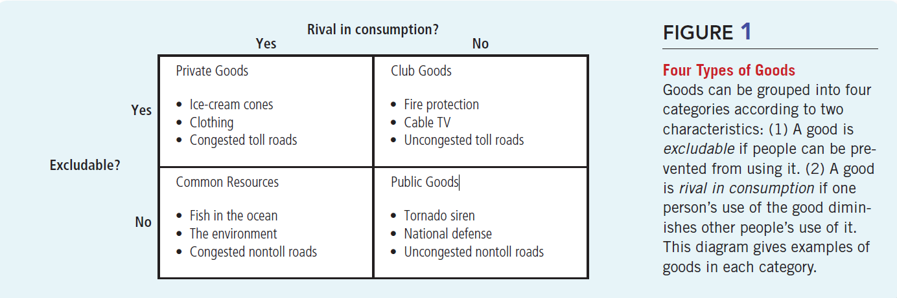
Four types of goods
Source Mankiw Chapter 11.

Slide 6


Common Pool Resources
Some refer to common pool resources as impure public goods. Why? Because they satisfy the two public good conditions (non-rivalry and non-excludability) to some extent, but not fully.
Example: Suppose you are a fisherman, and you go to Monroe lake to fish each weekend to catch the fish you’ll eat for that week.
Suppose this weekend you are the only fisherman there. Then you can catch as many fish as you want.
Word spreads out that Monroe lake has plenty of fish and more people start coming. For simplicity, suppose everyone behaves as you (i.e. their demand for fish is equal to 1).
The catch: Monroe lake has a limited supply of fish (i.e. perfectly inelastic in the short-run).
Monroe’s lake fish supply is enough to satisfy the demand of a finite number of people, say 50. What happens if at some point more people end up coming to the lake?

Slide 7
Common Pool Resources
Some refer to common pool resources as impure public goods. Why? Because they satisfy the two public good conditions (non-rivalry and non-excludability) to some extent, but not fully.
Take the 51th individual that enters the lake to fish. His entrance to the lake creates an externality to the others. What is the externality?
Negative consumption externality: now the first 50 individuals cannot consume as much as they want. There is one individual that will leave the lake without a fish (hence, there is some DWL relative to the previous weekend when there were only 50 people fishing).
What is the lesson here? For the first 50, the lake was a pure public good (non-rival and non-excludable). But when the 51th individual entered the market, the lake lost its non-rivalry. Now, any additional fishermen that enter increases the DWL because there is not enough fish for everyone.
Economic inefficiency: free market exchange leads to overconsumption (overfishing). Negative environmental effects.

Slide 8
Common Pool Resources
The previous example underlines the tragedy of the commons
What is the tragedy? When one person uses a common resource, she diminishes other’s people enjoyment of it. Self-driven individuals fail to acknowledge the externality they inflict on others.
The tragedy is also that, relative to the social optima, free-market exchange leads to the over-exploitation of the common resource.
Example: natural resources and long-term effects. It is not just the lake. Land, clean air.
Why is this happening? Which incentives drive this behavior?
Shared property rights: “everyone owns the lake, yet no one is responsible for it”.

Slide 9
User Fees and Congestion Pricing
Let’s think about more how to deal with common pool resources. A simple way to prevent the tragedy of the commons is to limit the access to the common pool resource. We can use any of the solutions we discussed last class.
Market for fishing permits. Impose a tax proportional to the number of fish caught or charge a fee to enter the lake. Cap the number of fishermen that could enter the lake.
Each solution entails its own complexities.
Take the fee solution, for instance. Suppose you need to pay $10 in order to enter the lake to fish.
Think like an economist: individuals whose benefits of consuming one fish are lower than $10, now will not go to the lake. Moreover, what is the optimal fee? The one what makes the quantity consumed socially optimal (i.e. internalizing the negative externality).
The problem: this solution is regressive. Affects individuals with low income. Only high-income individuals will be willing to pay.

Slide 10
Congestion Pricing: the case of toll roads
Congestion happens whenever a lot of people try to simultaneously consume the good, but there is not enough for everyone. In other words, congestion appears when consumption become rival.
Example: highways and the case of toll roads. The problem: people spend too much time stuck in traffic. In some sense, there is overconsumption of “traveling” because there are more people in the road relative to the level where everyone enjoys a smooth drive back home.
A simple solution: impose a user fee during times with high-traffic. Crowd-out from the market all the people that are not WTP to get “faster to home”.
The problems: same as before. Fees might be regressive. Low-income individuals are less willing to pay for them.
A concern: why individuals should pay extra to use the highway that was built using their taxpayer money? Is that fair?

Slide 11
Public Goods and Government Provided Goods
Non-excludability means that everyone can enjoy from the benefits of the good. This is the case for several goods and services provided by the government.
Examples: traffic lights, building roads, trash collection services, national defense.
However, there are some goods provided by the government that are rival in consumption (i.e. are prone to experience congestion).
Example: education. Education is publicly provided, yet if classrooms get crowded not all benefit from the same “quality” of education.
It could be also the case the government takes responsibility for the provision at no cost to the public. This depends on policy objectives in terms of which goods should benefit from non-excludability.
Example: healthcare is free in some countries and comes with a charge in others.
Subsidized goods lie in between. Private goods where the government pays part of the price to alleviate potential negative welfare effects of exclusion.

Slide 12
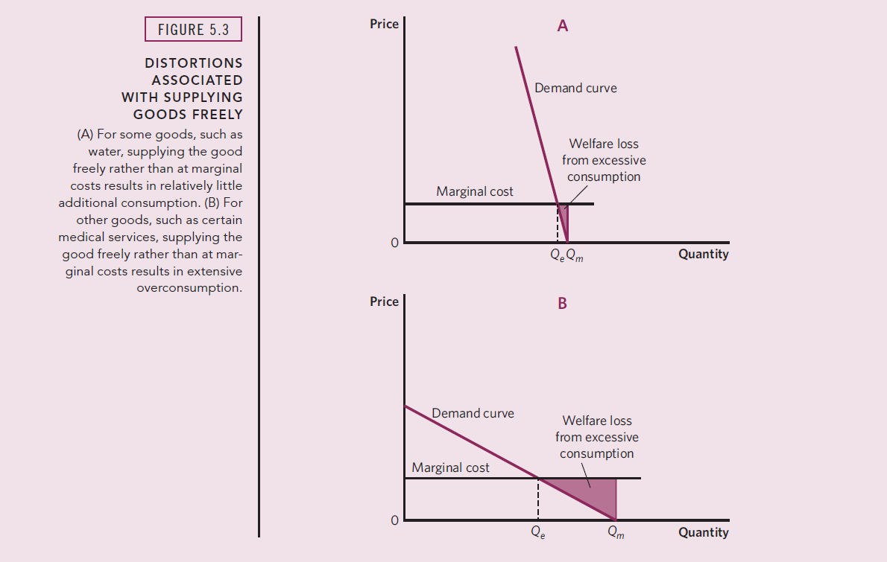
Public Goods and Government Provided Goods
If the good is provided freely by the government, then there are no seller revenues.
Still need to account for the cost of production faced by the government. Suppose it is constant (i.e. perfectly elastic supply).
This means that the marginal cost of providing the good to an additional individual does not increases (e.g. economies of scale).
Inelastic demand leads to smaller DWL because satiation is reached faster.
As always, elasticity of demand plays a role on the size of the DWL induced by public goods overconsumption.
Source Stliglitz and Rosengard Chapter 5

Slide 13
Public Goods and the Free Rider Problem
Remember: just because it is provided by the government in a non-excludable way (e.g. clean water, education), it does not mean that good is “free”.
Public goods provided by the government are financed through tax revenues.
The catch: the government cannot exclude you from consuming public goods if you don’t pay taxes.
This creates the free rider problem.

Slide 14
Public Goods and the Free Rider Problem
Suppose the economy is comprised of 2 individuals. The government wants to build city lights for the neighborhood. Suppose building the lights costs $10. What can the government do?
Solution A: Set a tax of $5 per individual. The problem? Requires full tax compliance in order to provide the good. That is, if at least one individual has WTP for lights less than $5, then no one receives the good. This is a version of the holdout problem we discussed previously.
Solution B: Set a tax of $ 10 per household. Now, it only requires that 1 household pays the tax in order to build the city lights.
The catch: suppose the cost of lights is known by the households. Hence, both individuals know that so long the other pays, then both will benefit from the good.
The problem: if one household pays, then the other has incentives to free-ride.
Implications: public goods underprovision. People pay fewer taxes than they should (in the social optima) if such taxes are used to provide pure public goods.

Slide 15
Local Public Goods
Recall the idea of common pool resources. It describes well the negative externality created by shared property rights.
This applies to study the global environment (e.g. global warming).
But also, our example of overfishing at Monroe Lake.
Global public goods: consumption benefits accrue to anyone in the world.
Examples: global COVID-19 vaccination, global security and world peace, scientific knowledge.
Local public goods: consumption benefits accrue to some living in a specific community.
Examples: local policing, and trash collection services.

Slide 16
Local Public Goods
Lindahl pricing: your willingness to pay taxes reflects your preferences toward public goods.
Charles Tiebout in 1954 proposed a similar concept to examine how local public goods are provided.
His basic idea is that if people can move freely across government jurisdictions (e.g. states, counties, cities, school districts), then they will move to the place where government’s policies better reflect their preferences for public policy (particularly taxes and public goods provision).
This is often referred as “voting with your feet”: if you don’t like it, you will relocate to a place that has what you want.
Implication: there is market-type competition between local governments to attract citizens to their cities/states.
His main contribution was that this market-type competition induces efficiency in the provision of local public goods. Why does this work? They are local, not global.

Slide 17
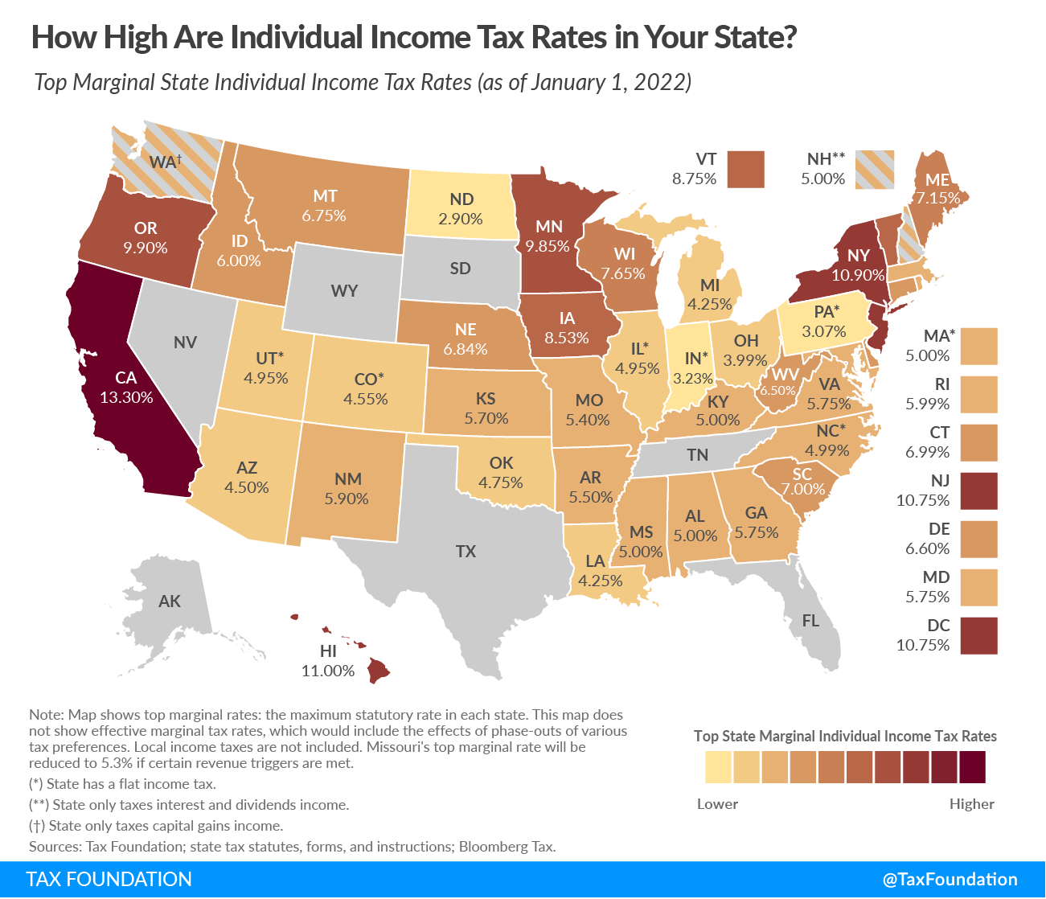
Local Public Goods
Some examples of Tiebout’s idea.
Property taxes: People might be willing to move to neighborhoods with higher property-taxes if their WTP for school is high enough. Remember that property-taxes finance most of education spending.
States with and without income tax. There are 9 states without a personal income tax. Suppose you live in the border between Texas and Oklahoma. Where would you choose to live?
Thinking like an economist: there is no free-lunch! If Texas does not collect an income tax, caeteris paribus, it could lead to lower public goods provision.
Is the marginal benefit of having an extra untaxed dollar greater than the marginal cost of having lower quality/quantity of public goods?

Slide 18
Some final remarks
For some goods these four characteristics are not fixed. There is some degree of publicness that depends on how the good is supplied and/or consumed.
Example: internet speed in the household. Internet, in general, is a club good. You pay to have internet in your apartment, but the amount of internet you consume (in general) does not affect how much internet others (say your neighbors) consume.
Is this always true? Think about the smallest economy comprised in this example: your own apartment. Your internet provider supplies you with a bandwidth that determines the speed of your connection.
As the number of devices that log into your network increases, the available speed for the rest decreases. Hence, there could be some number n of devices such that if n+1 devices tap into the wi-fi, then the internet becomes to slow to be enjoyed.
Lesson: while internet speed behaves as a club good in the “big picture”, for the economy comprised by all the people living in your household it behaves as a common pool resource. The key is to think when does relative scarcity begins to influence behavior.

Slide 19
For Next Class
Next class: Midterm Exam!
Review the practice questions, and all the assignments so far.
Study hard, rest well and good luck!

Slide 20
The Public Goods Game and the Free Rider Problem
An example of solution B: Set a tax of $ 10 per household. Now, it only requires that 1 household pays the tax in order to build the city lights. For simplicity, suppose both individuals have the same WTP for city lights ($12), so they get a marginal benefit of $2 for consuming lights. Each could choose to either contribute or not.
Benefits from consuming city lights WTP – Tax Payment |  | Household 2
 | (Benefit1, Benefit2) | Contribute | Not Contribute
Household 1 | Contribute | H1: 12-10 = 2 H2: 12-10 = 2 | H1: 12 – 10 = 2 H2: 12 – 0 = 12
 | Not Contribute | H1: 12 – 0 = 12 H2: 12 – 10 = 2 | H1: 0 – 0 = 0 H2: 0 – 0 = 0
If one household contributes, then the other has incentives to free-ride. But both households think the same way. Hence, in strategic equilibrium, there are no contributions and no lights are built. Yet, both would be better-off if both contributed to pay for the good. Public goods underprovision!

Slide 21
Public Goods and Lindahl Pricing
Remember: just because it is provided by the government in a non-excludable way (e.g. clean water, education), it does not mean that good is “free”.
Public goods provided by the government are financed through tax revenues.
Some economists argue taxes could be thought as the “price” we pay for public goods.
In other words, your willingness to pay taxes reflects your willingness to consume the public good.
This idea is called Lindahl pricing.
The basic intuition is that people are willing to pay taxes if they enjoy the goods provided by the government.
Lindahl pricing provides a natural framework to think about optimal provision of public goods. Why?

Slide 22
Public Goods and Lindahl Pricing
Lindahl Mechanism: take following fictional scenario. Suppose we have two individuals. Bob and Sandy.
The government announces the taxes that each individual will face. Say Bob pays a tax of $2 and Sandy a tax of $1.
After this announcement, the government asks both Bob and Sandy, how much of the public good they want, given the prices (taxes) they are paying. Basically, is asking their WTP for public goods.
Suppose the government repeats this process for different tax schedules, so it builds a demand schedule for each agent.
If you add Bob and Sandy’s WTP for the public good at each quantity provided, you get the social marginal benefit curve. With that, you can just SMB = SMC and get the optimal q* for any public good!
I will not go deep on how to do this, but instead of doing horizontal summation (like we did for a private good), public goods’ demand curve is estimated by doing vertical summation (see Gruber Chapter 9)

Slide 23
Public Goods and Lindahl Pricing
Cool feature: this mechanism leads to optimal public goods provision. Why? It induces that the social marginal benefit = social marginal cost.
Problems: in practice, this theoretical solution is unlikely to work.
Preference revelation problem: people have incentives to lie about their willingness to pay. They might strategically pretend their WTP is lower, so they get charged lower taxes. This leads to underprovision.
Preference knowledge problem: even if they are not willing to lie, they might have no idea of what that valuation actually is?
What is your willingness to pay for national defense? There is no private market for reference.
Preference aggregation problem: even if people are being honest and know the right valuation, how does the government aggregates their demands for public goods?
The previous example assumes both Sandy and Bob have the same “weight” in the social welfare function of the government. Gets more complicated with more people in the economy.

Slide 24
SPEA-V-202
Contemporary Economic Issues in Public Affairs
Public Goods
Luis Navarro
Fall 2022

