Slide 1

Intelligent Decision and Control
Electricity Fraud Detection
Group 3
Luís Borges, 78349
Luís Sá Couto, 79078
Cláudio Correia, 81959

Slide 2
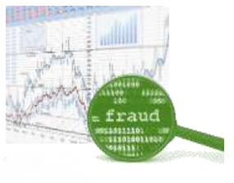
Our task
Applying intelligent methods for the task of detecting electricity frauds based on a dataset
A consumer may be committing no fraud, a simple fraud or a complex fraud, based on the data he/she provides

Slide 3
The dataset
60,360 data points, labelled with:
0 – consumer committed no fraud
1 – consumer committed simple fraud
2 – consumer committed complex fraud
Highly imbalanced!
~ 83% of the data is labelled as 0…

Slide 4
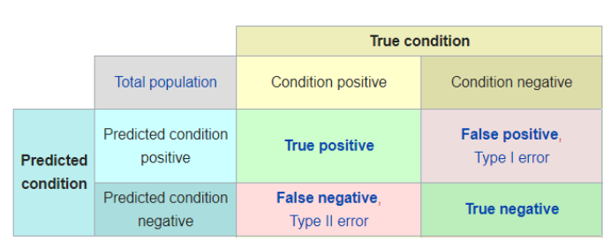
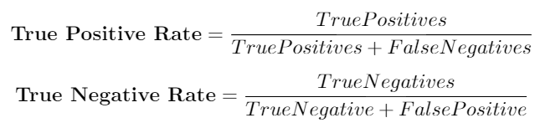
The dataset (cont.)
Accuracy is not the best measure to use…
A model outputting only the label 0 will achieve 83%

Slide 5
The dataset (cont.)
Data points measure 6 features:
I₁ - ratio between the consumption of the last day and the last five days
I₂^{d} - relates the hourly pattern of a day with the mean hourly pattern of the five days before, based on the euclidian distance
I₂^{c} - another indicator of hourly consumption patter change, this time using the Pearson correlation
I₃ - compares the mean consumption of the last five days to the mean consumption for the same days for the consumers with the most similar characteristics
I₄^{d -} relates the mean hourly consumption of the last five days between tem consumers with the greatest Similarity.
I₄^{c -} indicator of the same type as I₄^{d} this time using the Pearson correlation

Slide 6
The dataset (cont.)
We use 10-fold cross validation for model training and testing
Split the dataset in 10 parts and repeat:
Train the model on 9 parts
Test on the remaining part (NOTE: the testing set is always balanced)
Change the part we’re using to test
We consider the average accuracy/TPR over the 10 test sets

Slide 7
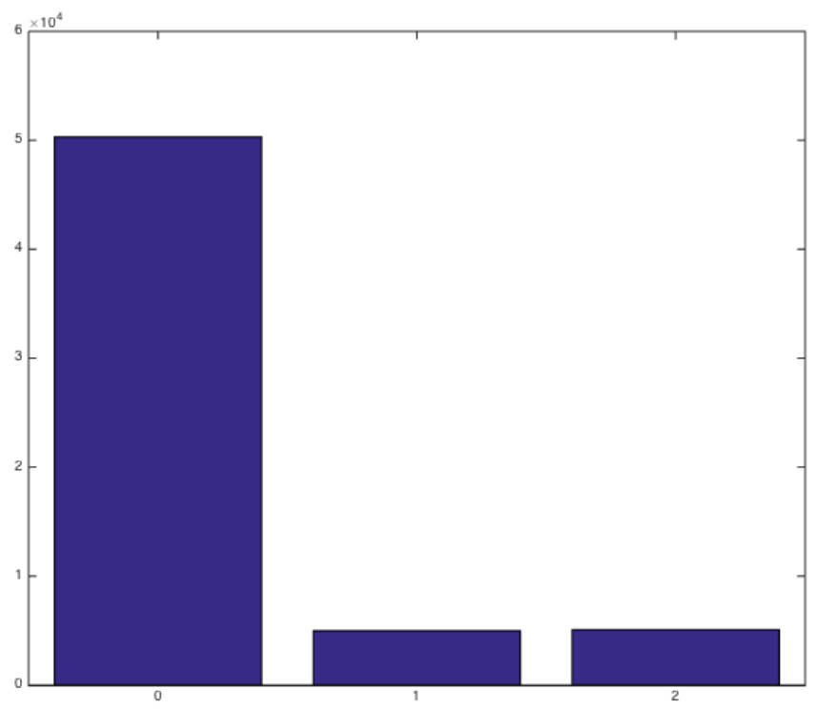
Dataset Problems
Dataset is really, really imbalanced…
~ 83% data labelled with 0
~ 17% more or less evenly divided between label 1 and label 2

Slide 8
Dataset Problems (cont.)
The dataset as is will generate models highly trained for legitimate consumer detection
Hypothesis: Models trained on a balanced subset of the original dataset will be better at detecting frauds, and models trained on a fraud subset will the better at distinguishing frauds
We considered 2 subsets of the original dataset:
Balanced dataset: equal % of class distribution
Fraud dataset: contains only labels 1 and 2

Slide 9

The Genetic Algorithm
A MATLAB library was used for an implementation of a genetic algorithm
Same idea as classical genetic algorithms:
Several generations of individuals reproducing in order to maximize a fitness function.
First generation of individuals chosen randomly
Keep choosing individuals for reproduction based on how fit they are
Fitness is the accuracy or the TPR on a test set
Termination when a number of generations is reached

Slide 10
The Neural Approach
We use a Multi-Layer Perceptron as a classifier for fraud detection.
How to select the optimal number of neurons, plus what features to feed the MLP with?
Genetic algorithms!
Every individual is a vector composed of 7 elements: the number of neurons, and six bits corresponding to the use (or not) of each feature for classification
The fitness function is the accuracy or the True Positive Rate over a balanced test dataset

Slide 11
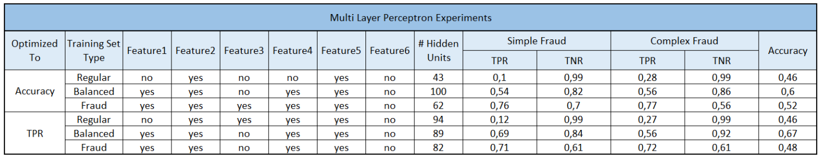
The Neural Approach (cont.)
Three different MLPs:
MLP trained on the general dataset
MLP trained on the balanced dataset
MLP trained on the fraud dataset

Slide 12
The Fuzzy Approach
We use a Takagi-Sugeno fuzzy model based on a fuzzy clustering algorithm (i.e. c-means clustering) for classification
How to once again choose the optimal number of clusters, plus the relevant features?
Genetic algorithms!
Every individual is a vector composed of 7 elements: the number of clusters, and six bits corresponding to the use (or not) of each feature for classification
The fitness function is the accuracy or the True Positive Rate over a balanced test dataset

Slide 13
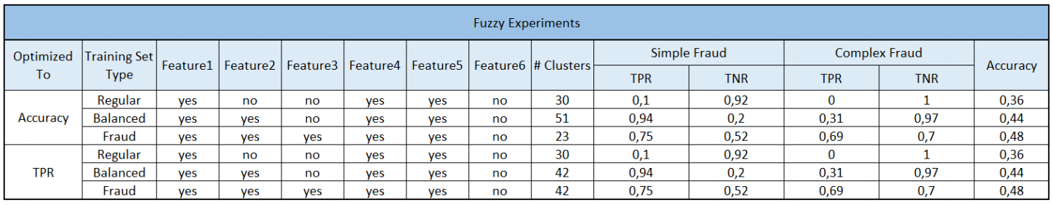
The Fuzzy Approach (cont.)
Three different Fuzzy models:
Fuzzy model trained on the general dataset
Fuzzy model trained on the balanced dataset
Fuzzy model trained on the fraud dataset

Slide 14
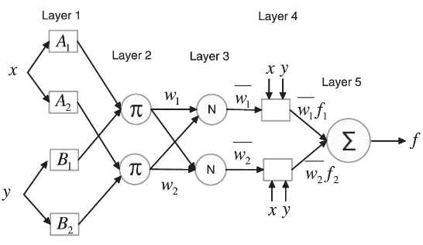
The Neuro-Fuzzy Approach
The best of both worlds: ANFIS
Feature selection once again performed with a genetic algorithm
Same conditions as the previous two approaches

Slide 15
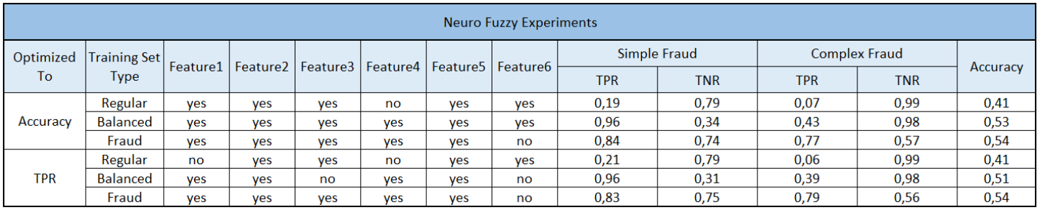
The Neuro-Fuzzy Approach (cont.)
Three different Neuro-Fuzzy models:
Neuro-Fuzzy model trained on the general dataset
Neuro-Fuzzy model trained on the balanced dataset
Neuro-Fuzzy model trained on the fraud dataset

Slide 16
Aggregating the nine models
How to leverage the outputs of these nine different models?
We experiment on 3 ensembles
The output of the ensembled models is the result of weighted voting between the nine sub-models
Genetic algorithms once again are used to choose the optimal weights
The ensembles can be optimized either for accuracy or TPR, just like the individual models that compose it

Slide 17
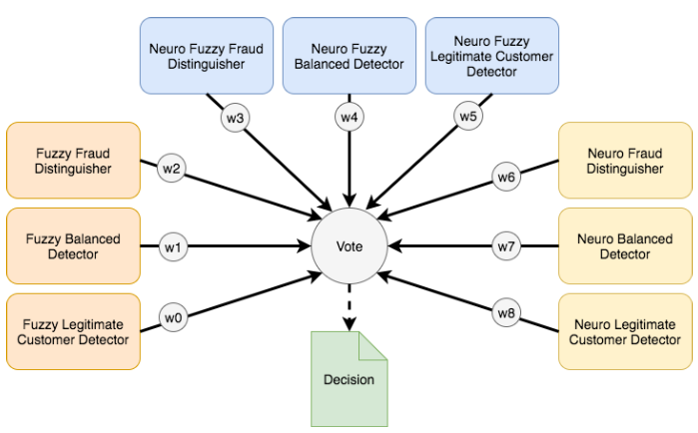
Normal Voting Ensemble

Slide 18
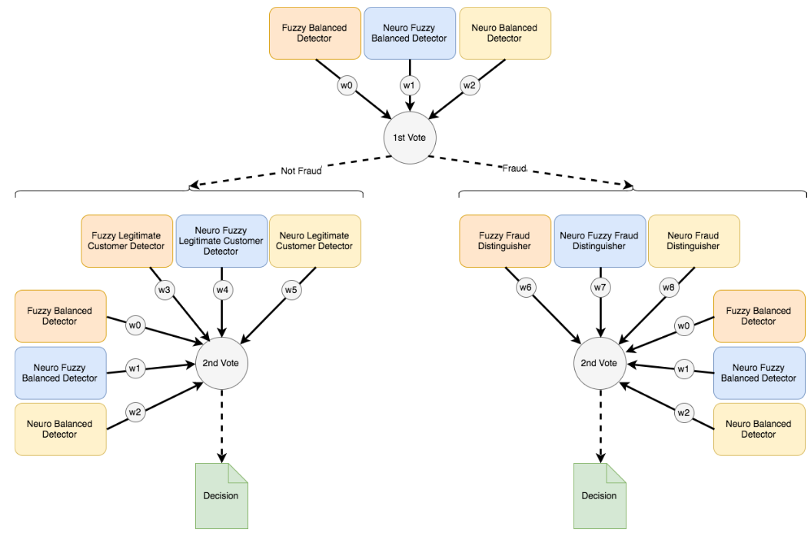
Hierarchic Voting Ensemble – Shared Weights

Slide 19
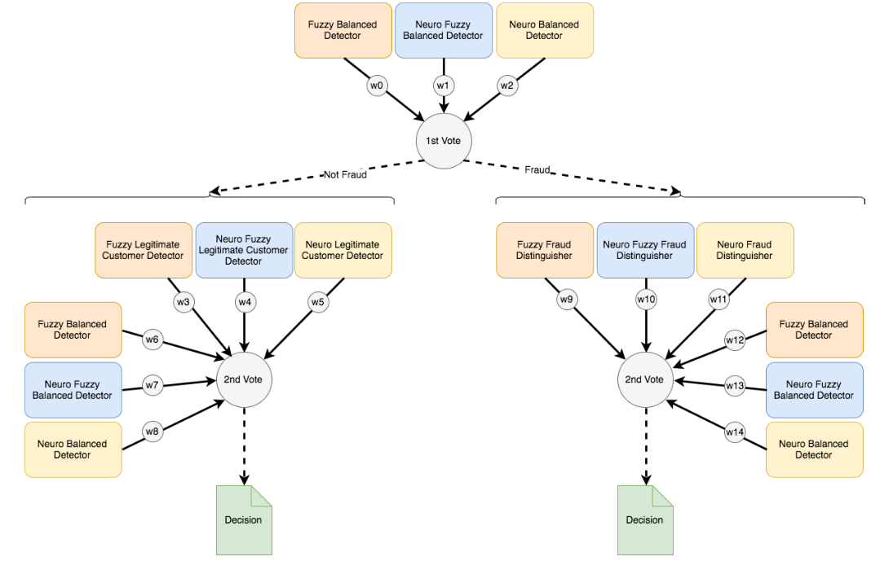
Hierarchic Voting Ensemble – Without Shared Weights

Slide 20
The Results
Our three “best” approaches are:
The Hierarchic Voting of Two Committees without Shared Voting Weights Ensemble Model, optimized for accuracy, composed of models also optimized for accuracy
The Hierarchic Voting of Two Committees without Shared Voting Weights Ensemble Model, optimized for TPR, composed of models also optimized for TPR
The Hierarchic Voting of Two Committees with Shared Voting Weights Ensemble Model, optimized for TPR, composed of models optimized for accuracy

Slide 21
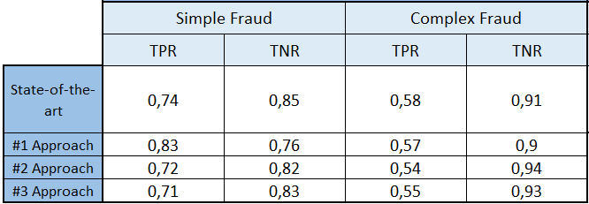
State-of-the-Art Comparison

Slide 22


