Slide 1

Machine Learning
Grupo 52
Dados e Aprendizagem Automática
Universidade do Minho,Mestrado em Engenharia Informática

Slide 2
1.
Previsão do fluxo de tráfego rodoviário
Competição ML @SBS/DAA
Edição 2021/2022

Slide 3
Train Dataset Tráfego Rodoviário
Column | Non-Null-Count | DType
city_name | 6812 | categorical
record_date | 6812 | datetime
AVERAGE_SPEED_DIFF | 6812 | categorical
AVERAGE_FREE_FLOW_SPEED | 6812 | float64
AVERAGE_TIME_DIFF | 6812 | float64
AVERAGE_FREE_FLOW_TIME | 6812 | float64
LUMINOSITY | 6812 | categorical
Features | Non-Null-Count | DType
AVERAGE_TEMPERATURE | 6812 | float64
AVERAGE_ATMOSP_PRESSURE | 6812 | float64
AVERAGE_HUMIDITY | 6812 | float64
AVERAGE_WIND_SPEED | 6812 | float64
AVERAGE_CLOUDINESS | 4130 | categorical
AVERAGE_PRECIPITATION | 6812 | float64
AVERAGE_RAIN | 563 | categorical
14 columns
6812 lines

Slide 4
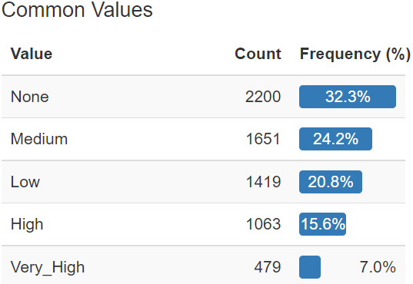
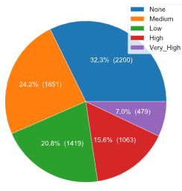
AVERAGE_SPEED_DIFF
Distribution

Slide 5
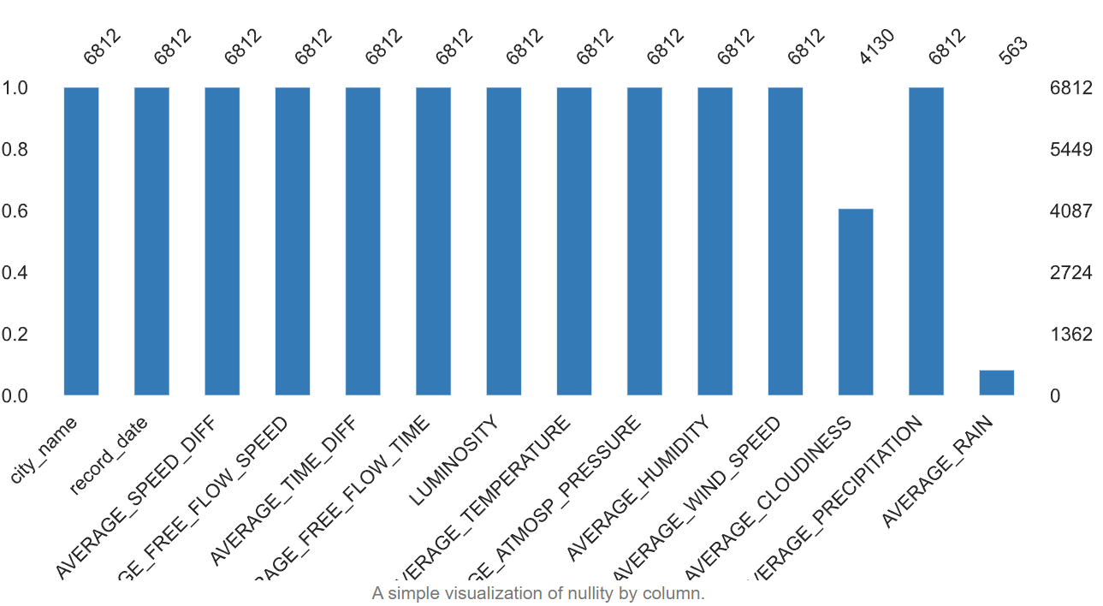
Pre-Processing
Constant / Missing
City_name – Constant “Porto”
AVERAGE_PRECIPITATION – Constant 0
AVERAGE_RAIN – 91.7% Miss
AVERAGE_CLOUDINESS – 39.4% Miss
Solution
Remove Constants
Analize Rain – ( O : No Rain, 1: Rain)
Apply Mode or Prediction to CLOUDINESS
Clean LUMINOSITY and CLOUDINESS

Slide 6
Pre-Processing Extended Features
From record_date
Hour
Day
Weekday
Is_Weekend
Month
Year
From speed=distance/time
AVERAGE_TIME
AVERAGE_SPEED
AVERAGE_SPEED_DIFF_Num

Slide 7
Pre-Processing One-Hot Encoding and Tranformations
CyclicalTransformer
Hour
Day
Weekday
Month
Year
Sin and Cos columns
One-Hot Encoding
LUMINOSITY
AVERAGE_CLOUDINESS
One new column per label
Values 0 or 1

Slide 8
Training
Sampling
RandomOverSampler
SMOTE
SMOTE-Borderline
SVMSMOTE
SMOTEENN
SMOTETomek
NearMiss + SMOTE
Classifier + Tuning
LogisticRegression
RandomForestClassifier
KNeighborsClassifier
DecisionTreeClassifier
AdaBoostClassifier
SVC
XGBClassifier
RidgeClassifier
RandomizedSearchCV
GridSearchCV
Validation
80% Train
20% Test
10 StratifiedKFold
Cross_val_score
Test Score
Feature Importance
Confusion Matrix

Slide 9
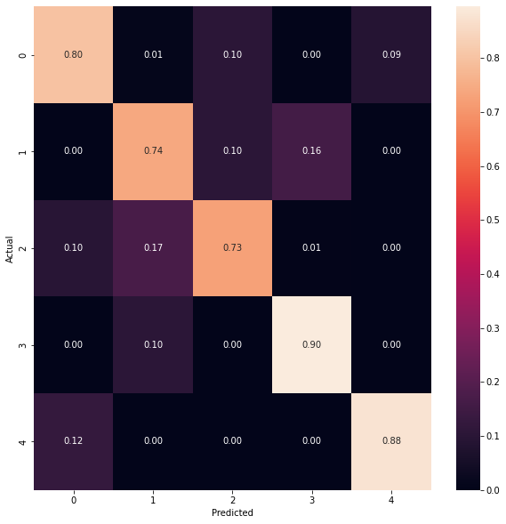
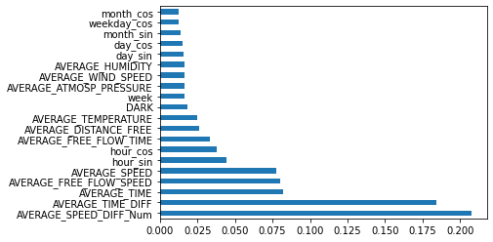
Training
Confusion Matrix + Feature Importance RF

Slide 10


Pycaret Training
Open Source
Low Code
Automated Machine Learning
Normalization
Oversampling Selection
K-fold validation
Auto Tuning

Slide 11
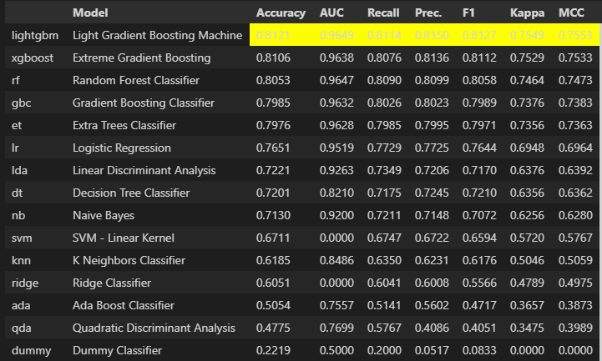
Pycaret Training
Model Training

Slide 12
Neural Network Training
Sampling
Endoding Label
MinMax Scaler 0,1
Tuning
Sequential
Keras Tuner
Nodes and Layers
DropOut Rate
Learning Rate
RandomSearch
Validation
80% Train
20% Test
Class Weight
Categorical Accuracy
Loss
Confusion Matrix

Slide 13
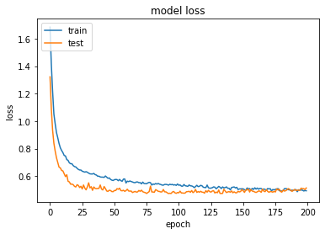
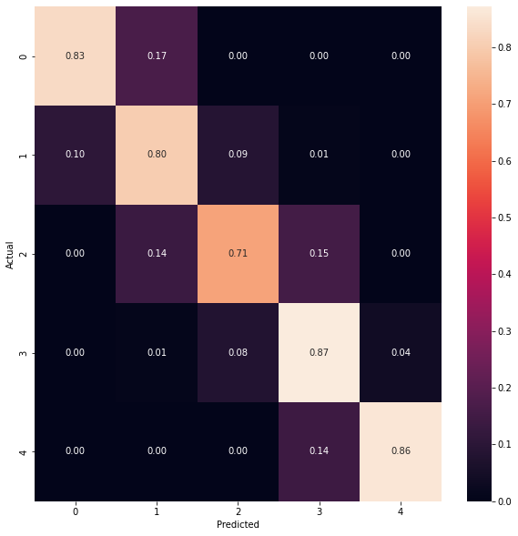
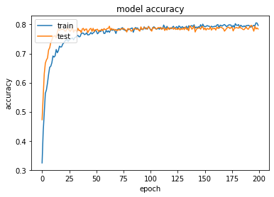
Neural Network Training
Confusion Matrix + Accuracy + Loss

Slide 14
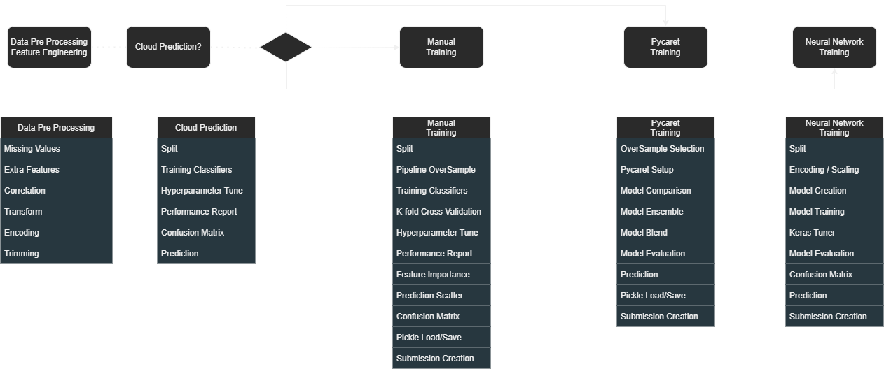
Traffic WorkFlow

Slide 15
2.
Disease Prediction
Kaggle Dataset
2019

Slide 16
Train Dataset Disease Prediction
Column | Non-Null-Count | DType
prognosis | 4920 | Categorical
itching | 4920 | Categorical binary
skin_rash | 4920 | Categorical binary
continuous_sneezing | 4920 | Categorical binary
shivering | 4920 | Categorical binary
stomach_pain | 4920 | Categorical binary
Unnamed: 133 | 0 | Missing
134 columns
4920 lines

Slide 17
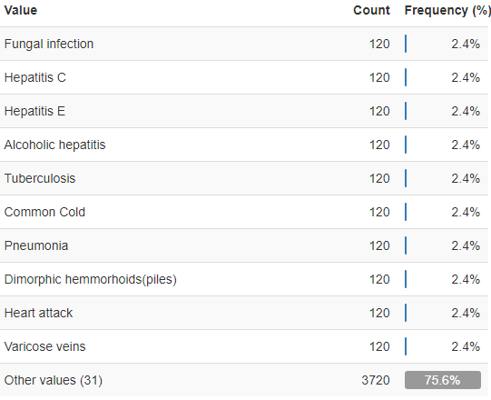
Pre-Processing
Constant / Missing
'Unnamed: 133’ – 100% Miss
fluid_overload – Constant 0
Solution
Remove Constant and Missing column

Slide 18
Training
Sampling
No Oversampling Needed
Classifier + Tuning
LogisticRegression
RandomForestClassifier
KNeighborsClassifier
DecisionTreeClassifier
AdaBoostClassifier
SVC
XGBClassifier
RidgeClassifier
Validation
80% Train
20% Test
10 StratifiedKFold
Cross_val_score
Test Score
Feature Importance
Confusion Matrix

Slide 19
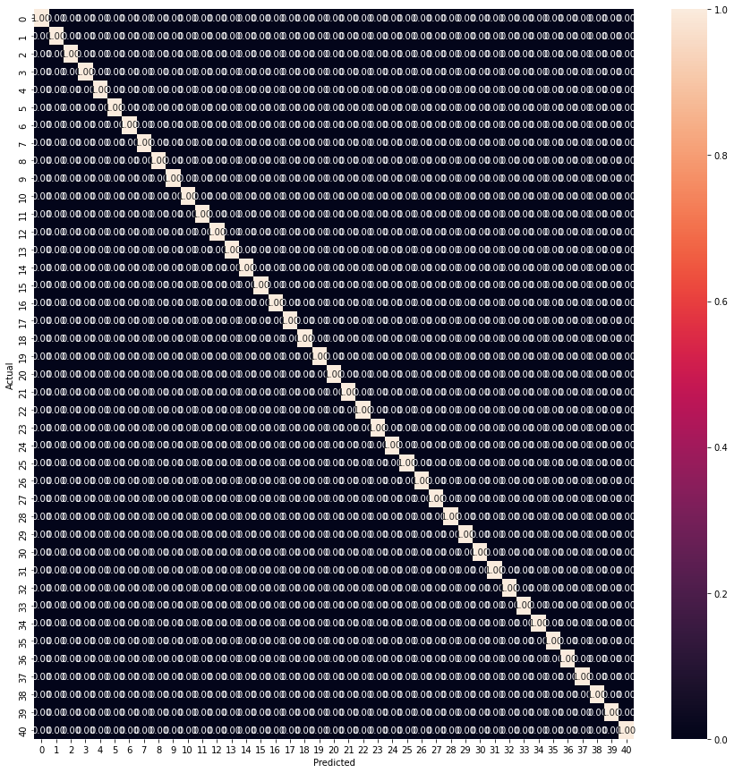
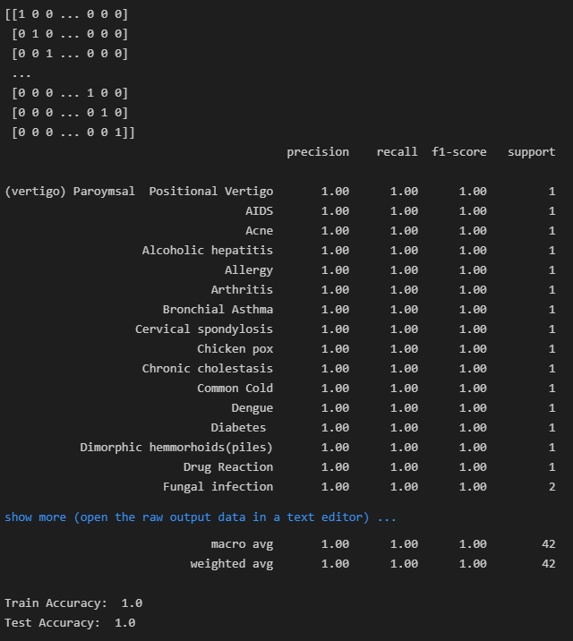
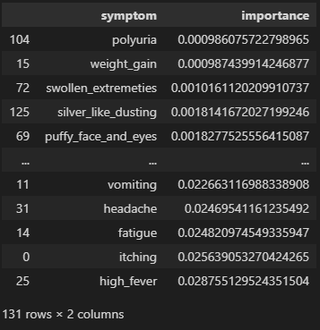
Training
Confusion Matrix + Feature Importance RF

Slide 20

Neural Network Training
Split
Encoding
Early Stopping
Future Tuning

Slide 21
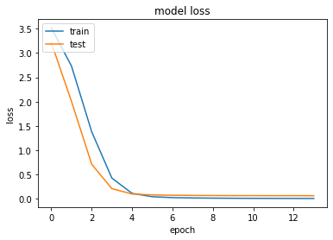
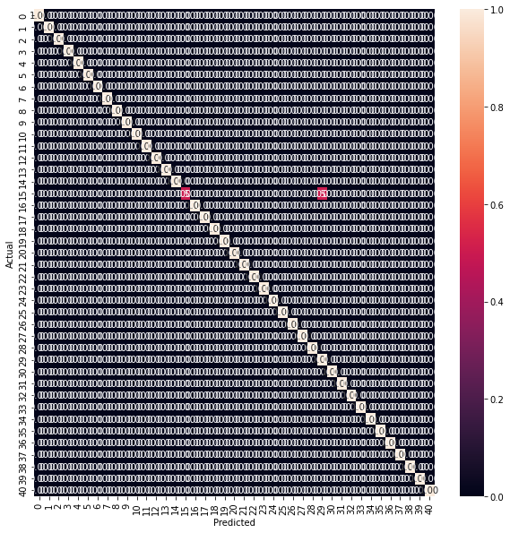
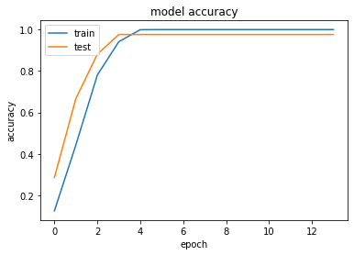
Neural Networks Training
Confusion Matrix + Accuracy + Loss

Slide 22
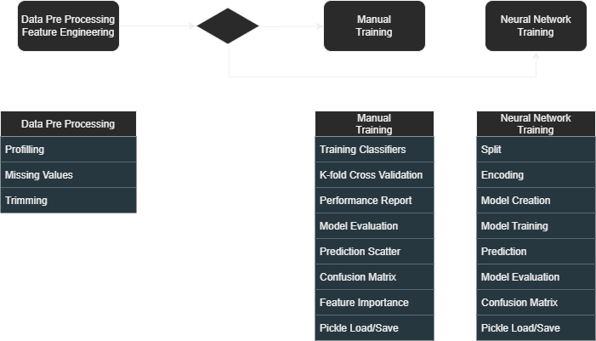
Disease Prediction WorkFlow

Slide 23
Machine Learning
Grupo 52
Dados e Aprendizagem Automática
Universidade do Minho,Mestrado em Engenharia Informática

