Slide 1

Term Project Progress Update
Portfol.io: Enhancing candidate evaluation
through LLM-powered MAS
Luis Manuel Postigo
Auburn University, Samuel Ginn College of Engineering. Auburn, AL.

Slide 2
1. Project Scope and Objectives Refinement
Why KIF over JSON?
KIF supports semantic interoperability, logical assertions, and abstract knowledge representation—critical for intelligent agent reasoning. JSON is too syntactic for this depth.
Negotiation Model:
Introduced a two-phase strategy:
Task Assignment: Uses Contract Net Protocol (CNP)—agents bid on tasks based on specialization and availability.
Final Recommendation: Uses Abstract Argumentation Framework (AAF) where agents argue for/against candidates. Conflicts are resolved using grounded semantics to ensure strong, consensus-based decisions.
Refined Objectives:
Multi-agent system for applicant evaluation (skills, resume, education, portfolio).
CNP for dynamic task distribution.
LLM-powered portfolio scraping to verify skills.
Abstract argumentation for final candidate decision.
Explainable, transparent recommendations.
Term Project Progress Update
Portfol.io: Enhancing candidate evaluation through LLM-powered MAS

Slide 3
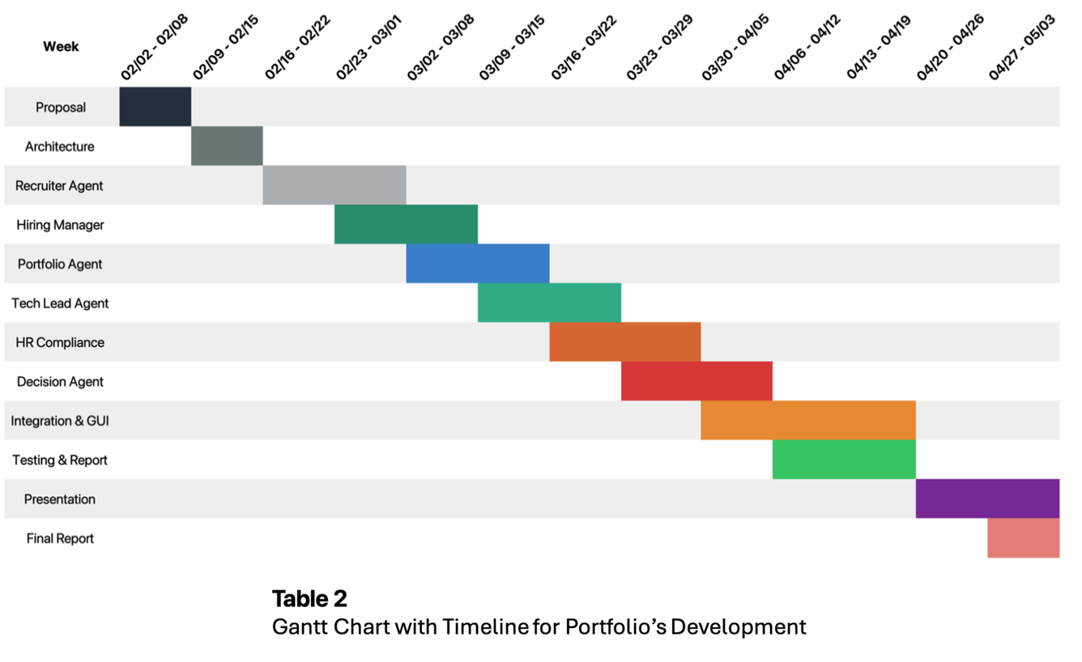
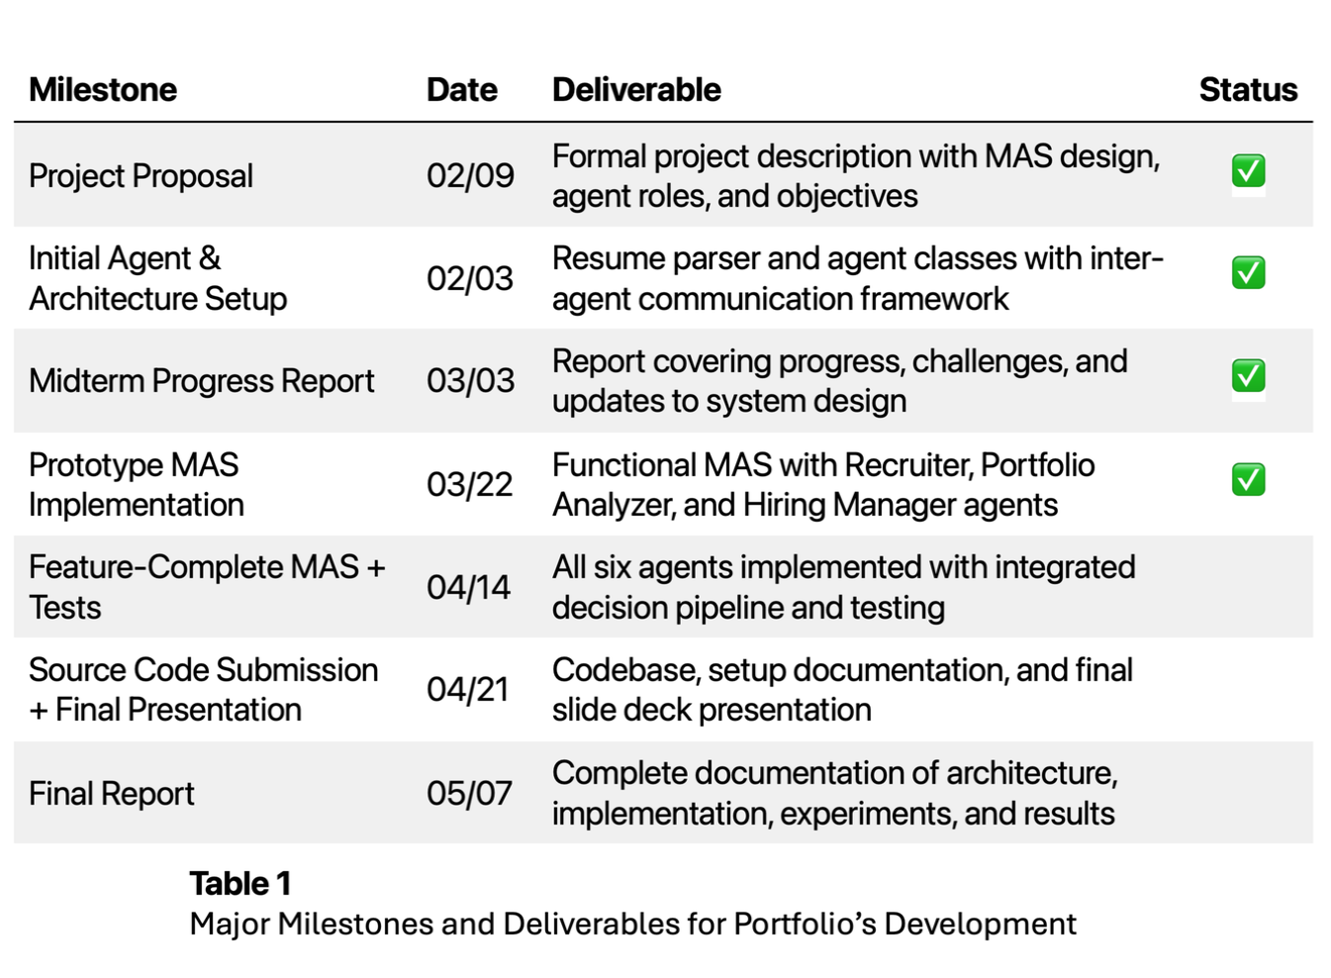
2. Detailed Implementation Plan
Major Milestones and Deliverables
Gantt Chart – Project Schedule
Term Project Progress Update
Portfol.io: Enhancing candidate evaluation through LLM-powered MAS

Slide 4
3. Implementation Framework Identification
Framework Components:
Python: Core language for modular agents.
FastAPI: Lightweight APIs for agent communication.
RabbitMQ: Async messaging between agents.
LangChain: Manages prompt chaining, structured outputs, memory.
Why This Stack?
Scalable, modular, async-friendly.
Supports interpretable agents with structured communication.
Agents use LLMs to reason over KIF inputs and produce formal outputs.
Agent Architecture:
Agents are Python classes.
Common methods: analyze_input(), generate_output(), communicate_with().
Shared modules for tasks like resume parsing and skill matching.
Term Project Progress Update
Portfol.io: Enhancing candidate evaluation through LLM-powered MAS

Slide 5
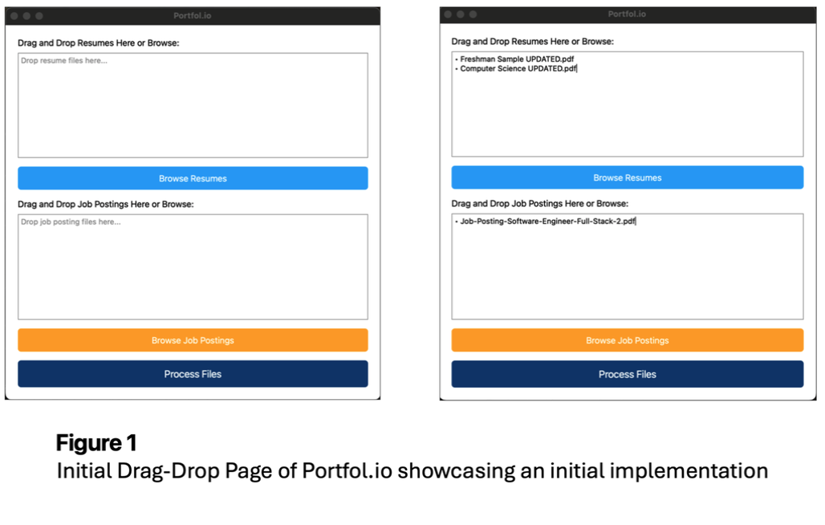
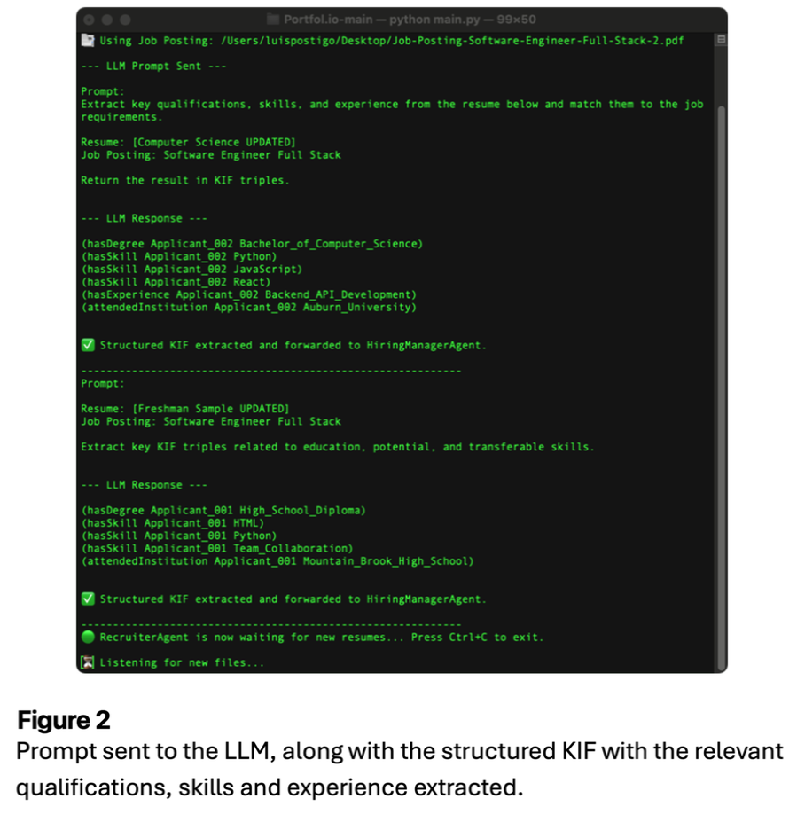
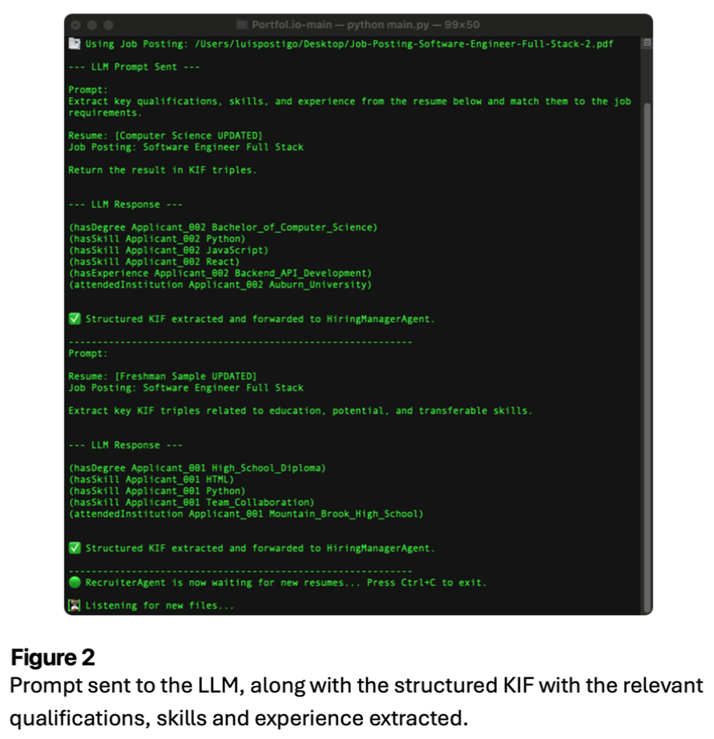
4. Preliminary Implementation of Main Architecture
Integration of LLM-powered conversational agents within the system.
Brief demonstration or proof-of-concept showcasing the initial functionality.
Basic implementation of the main architecture of our multi-agent system.
Term Project Progress Update
Portfol.io: Enhancing candidate evaluation through LLM-powered MAS

