Slide 1

Term Project Progress Update
Portfol.io: Enhancing candidate evaluation
through LLM-powered MAS
Luis Manuel Postigo
Auburn University, Samuel Ginn College of Engineering. Auburn, AL.

Slide 2




0.1 Updated Architecture Flow
MAS
Evaluate
[Job Posting]
Yes
Pre-processed
No
Queue to temp file
Any new jobs exist?
[Resume]
Technologies used:
Second Term Project Progress Update
Portfol.io: Enhancing candidate evaluation through LLM-powered MAS

Slide 3
0.2 Advantages of using RabbitMQ
High resources / Server
Recruiter
Hiring manager
Portfolio Analyzer
Concept | What does it do? | Example
RabbitMQ | How agents communicate (transport layer) | Sends messages to a queue
MCP | What agents understand (context format) | Standardized agent instructions
Technical Lead
HR Compliance
t
Low resources
Recruiter
Hiring manager
Portfolio Analyzer
Technical Lead
Technologies used:
HR Compliance
t
Figure 1
Dynamic agent allocation (queue management) for different hardware configurations.
Second Term Project Progress Update
Portfol.io: Enhancing candidate evaluation through LLM-powered MAS

Slide 4

0.3 Change of plans on agent-to-agent communication
Locally!
{
"Job Description & Responsibilities":
"Required & Preferred Skills":
"Experience Levels & Qualifications":
"Soft Skills & Team Fit":
"Project or Portfolio Expectations":
"Industry or Domain-Specific Requirements":
"Location & Work Type (Remote/Onsite/Hybrid)":
"Company & Cultural Fit":
"Salary & Compensation Expectations":
}
;; Job Posting Information
(job "Software Engineer")
(company "Tech Startup Inc.")
(location "Remote")
;; Job Responsibilities
(responsibility "Software Engineer" "Develop, evaluate, implement, and maintain software solutions.")
(responsibility "Software Engineer" "Perform software analysis, code reviews, and system risk analysis.")
…
…
Convert JSON
to KIF
One of the best advantages of this proposal, includes the ability to visualize the justification for a particular decision, the thought process behind a response to a debate request, etc.
Second Term Project Progress Update
Portfol.io: Enhancing candidate evaluation through LLM-powered MAS

Slide 5
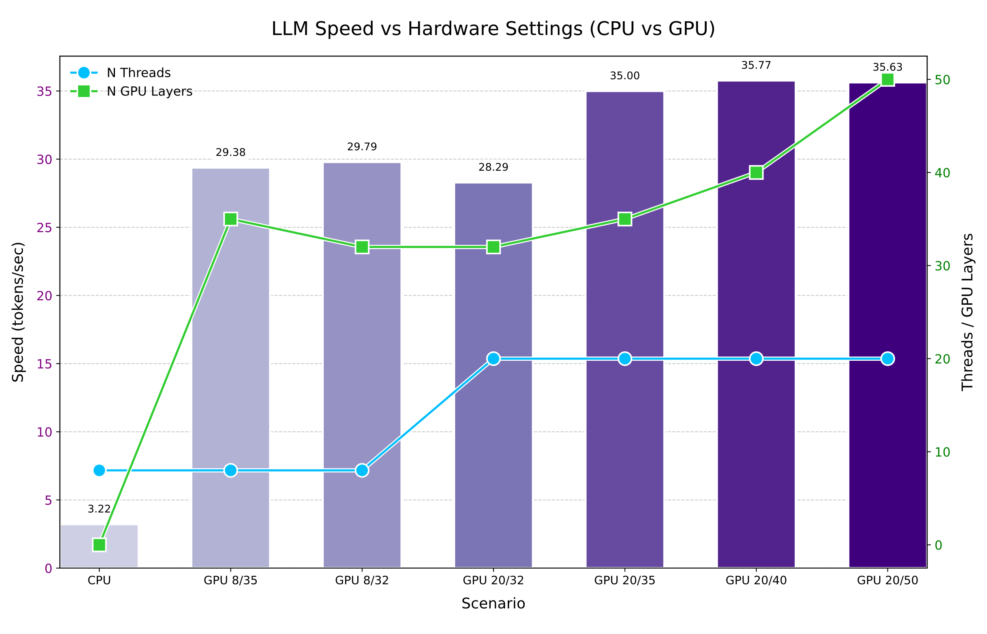
0.4 Optimizing the model’s performance
7B parameters (low).
Is run locally.
A more finetuned prompt engineering.
Note: The number of tokens/sec will vary on every use, a more complex task will reduce speed.
Figure 2
Mistral-7b-instruct-v01-q4_k_m - LLM Speed vs Hardware Settings
Second Term Project Progress Update
Portfol.io: Enhancing candidate evaluation through LLM-powered MAS

Slide 6
0.5 Pre-Processing [Extracting information from resume]
Extract the following details from the resume below:
1. Full candidate name (if available)
2. GitHub link (if available)
3. Personal portfolio or website link (if available)
4. Skills (comma-separated list)
5. Work experience summary
6. Key projects mentioned
7. Candidate summary (1-2 sentences)
--- Resume ---
{text}
⚠️ IMPORTANT: Only return a **valid JSON object**.
⚠️ Do NOT include any extra text, explanations, "---", "[Result]", or anything outside of the JSON.
⚠️ Your response must start directly with '{{' and end with '}}'.
Here is the required JSON format:
{{
"name": "...",
"github": "...",
"portfolio": "...",
"skills": "...",
"experience": "...",
"projects": "...",
"summary": "..."
}}
Itemized Requirements
Limitations (Do not’s)
Response Format
Second Term Project Progress Update
Portfol.io: Enhancing candidate evaluation through LLM-powered MAS

Slide 7
1. Recruiter Agent
You are a recruiter evaluating a candidate for the following job:
--- Job Posting ---
Title: {job_posting.get("title")}
Description: {job_posting.get("description")}
Requirements: {job_posting.get("requirements")}
--- Applicant Resume ---
Skills: {applicant_info.get("skills")}
Experience: {applicant_info.get("experience")}
Projects: {applicant_info.get("projects")}
Summary: {applicant_info.get("summary")}
Your task:
- Evaluate the candidate **briefly**, focusing on skill match, experience relevance, project quality, and fit.
- Follow the exact format shown below: 5 numbered points plus a final explicit recommendation.
- Item 5 must be a "Fit Score" from 0 to 10, where 0 = poor fit, 10 = ideal fit.
- Always conclude with "Final recommendation: **Yes**" or "**No**".
Example 1:
1. **Skills Match**: Candidate meets core skills (Python, SQL), strong React experience.
2. **Experience Match**: Solid backend and API development background.
3. **Projects Quality**: Delivered several high-impact internal tools.
4. **Overall Assessment**: Candidate is a strong backend prospect.
5. **Fit Score**: 8/10
Final recommendation: **Yes** --- Example 2:
1. **Skills Match**: Basic familiarity with JavaScript, lacks SQL or backend frameworks.
2. **Experience Match**: Mainly academic; no real-world production experience.
3. **Projects Quality**: Limited scope; only class projects, no major impact demonstrated.
4. **Overall Assessment**: Candidate is underqualified for this role currently.
5. **Fit Score**: 3/10
Final recommendation: **No** --- Now, following the same style and brevity, write your evaluation below:
Context
Instructions
Sample Response
Second Term Project Progress Update
Portfol.io: Enhancing candidate evaluation through LLM-powered MAS

Slide 8
2. Hiring Manager Agent
You are a Hiring Manager evaluating a candidate.
--- Job Posting ---
Title: {job_posting.get("title")}
Description: {job_posting.get("description")}
Requirements: {job_posting.get("requirements")}
--- Applicant Resume ---
Skills: {applicant_info.get("skills")}
Experience: {applicant_info.get("experience")}
Projects: {applicant_info.get("projects")}
Summary: {applicant_info.get("summary")}
Your task:
- Evaluate the candidate carefully based on the provided resume and job requirements.
- Follow the format below strictly: 5 numbered points + a final explicit recommendation (Yes or No).
- Item 5 must be a "Fit Score" from 0 to 10, where 0 is a very poor fit and 10 is an ideal fit.
- You must always include a final "Final recommendation: **Yes**" or "**No**" at the end.
Example 1:
1. **Career Progression**: Steady growth from junior to mid-level roles across internships and full-time positions.
2. **Job Level Fit**: Matches mid-level software engineer role based on skills and experience.
3. **Soft Skills**: Demonstrated leadership, collaboration, and initiative in team projects.
4. **Overall Assessment**: Candidate shows a strong background, technical depth, and good culture fit.
5. **Fit Score**: 9/10
Final recommendation: **Yes** --- Example 2:
1. **Career Progression**: Limited progression; mainly academic projects, no professional experience.
2. **Job Level Fit**: Partial match; candidate lacks experience in distributed systems and APIs.
3. **Soft Skills**: Limited evidence of leadership or communication skills.
4. **Overall Assessment**: Candidate has potential but lacks practical experience for the position.
5. **Fit Score**: 4/10
Final recommendation: **No** --- Now, following the same style and level of detail, write your evaluation below:
Context
Instructions
Sample Response
Second Term Project Progress Update
Portfol.io: Enhancing candidate evaluation through LLM-powered MAS

Slide 9
2.1 Hiring Manager Agent Debate Mode
Recommends applicant?
Yes/No
Recommends applicant?
Yes/No
The maximum number of responses is dynamically determined based on current GPU usage.
There is a final evaluator, which determines the debate winner.
An improved prompt should allow the model to surrender if their arguments can no longer be sustained.
Pushes MCP_context onto the hiring manager agent
Recruiter
Hiring manager
If there is a disagreement, a 3-round debate will be triggered
Second Term Project Progress Update
Portfol.io: Enhancing candidate evaluation through LLM-powered MAS

Slide 10
3. Portfolio Agent
What are the current issues?
LLM-specific approaches limit the ability of the model to correctly relate text and code. The current model being used (DeepSeek Coder 1.3) is able to correctly fix code, but it is very bad explaining it.
The GitHub scraper has been developed. A file-to-file summary takes about ~40 minutes for a profile with 12 projects. Which is of course not ideal.
All the remaining agents, HR and technical lead agent (which should debate with the Portfolio Agent) have been developed. Even though the technical lead agent still faces the same issues.
Term Project Progress Update
Portfol.io: Enhancing candidate evaluation through LLM-powered MAS

Slide 11
4. Pending work
Reduce running-time on the portfolio evaluator. The current approach is focused on not viewing all the scripts on the project directory. But rather analyze the README, and based on that, determine which scripts should be revised.
Implementation of the GUI for all the remaining agents. This includes the final summary page, which should include a spider plot, and a diagram showing the progression of evaluation through each agent.
Estimating an average run-time for each applicant for a specific job application.
Term Project Progress Update
Portfol.io: Enhancing candidate evaluation through LLM-powered MAS

