Slide 1
CLIPCAP
CLIP Prefix for Image Captioning
Luis Eduardo Robles Jiménez

Slide 2
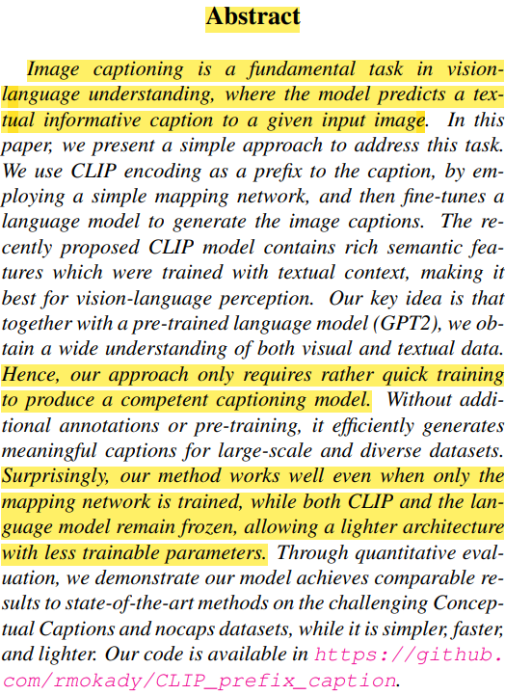
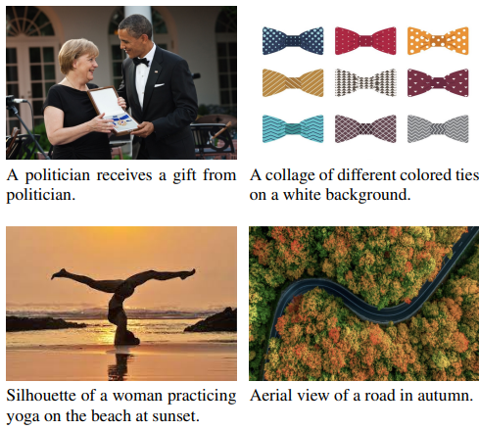
Abstract

Slide 3
Introduction
Challenges of the task
“This task poses two main challenges”
Semantic Understanding
Large number of ways to describe an image
Challenges of the approaches
“[...] models are resource hungry”
Extensive training time, large number of trainable parameters and massive datasets are needed.
A lightweight model is preferable to update the model routinely with the new data.
The idea
In this paper, we leverage powerful vision-language pretrained models to simplify the captioning process.
CLIP
GPT-2

Slide 4
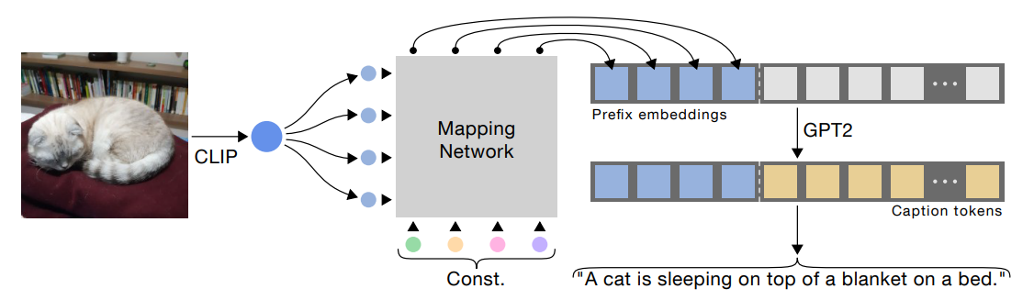
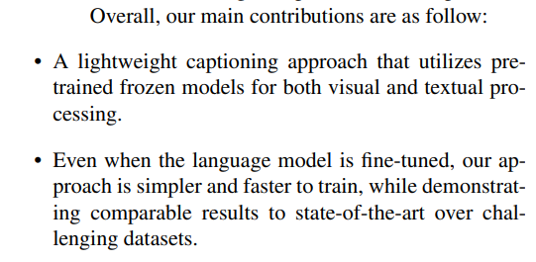
Introduction
Contributions

Slide 5
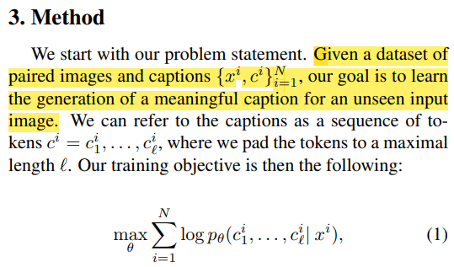
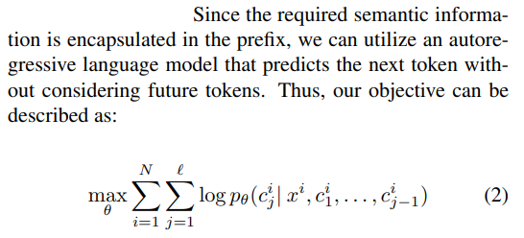
Method

Slide 6
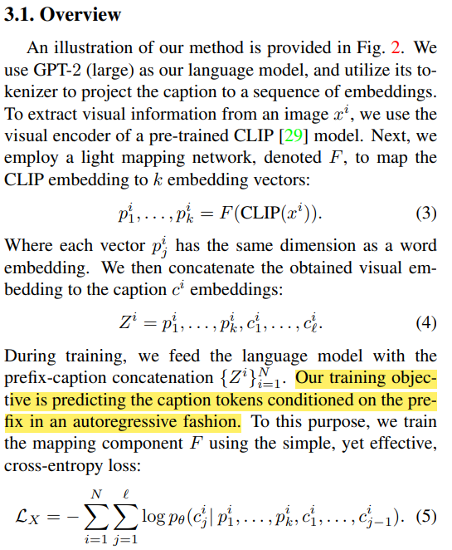
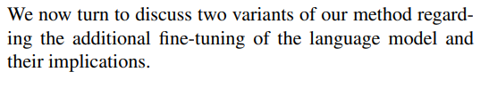
Method

Slide 7
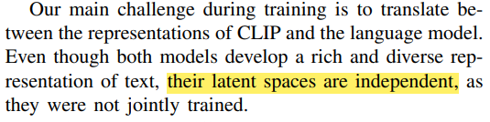
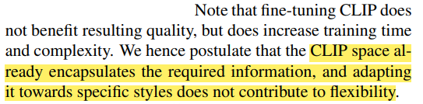
Method
3.2 Language Model Fine-Tuning
Fine-Tuning
The style of captioning may not be natural for the pre-trained language model.
Provides flexibility.
More trainable parameters.
Simple architecture.
No Fine-Tuning
Even lighter model.
Complex architecture.

Slide 8
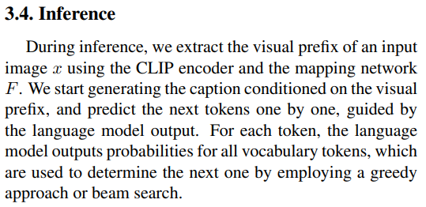
Method

Slide 9
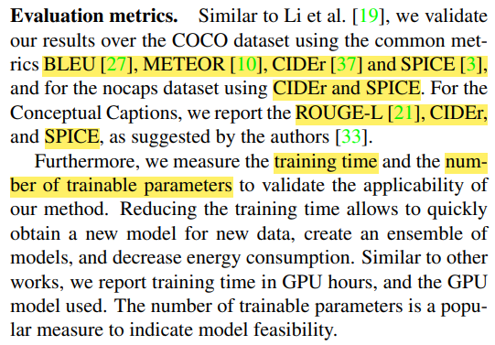
Results

Slide 10
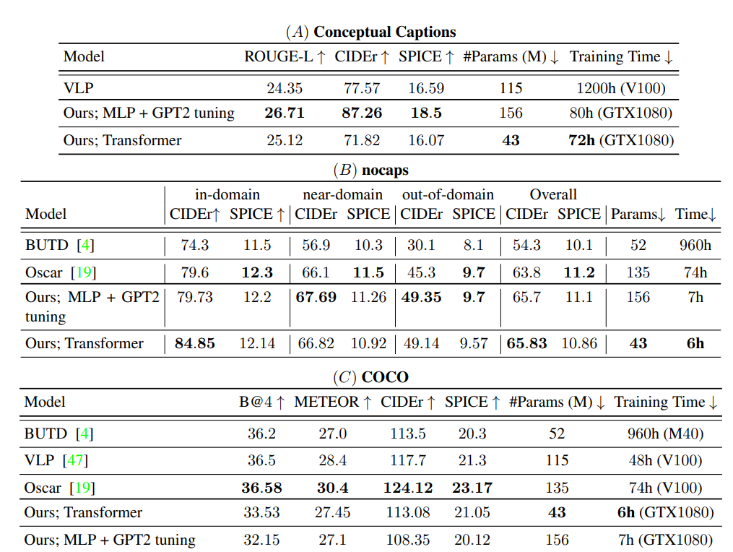
Results

Slide 11
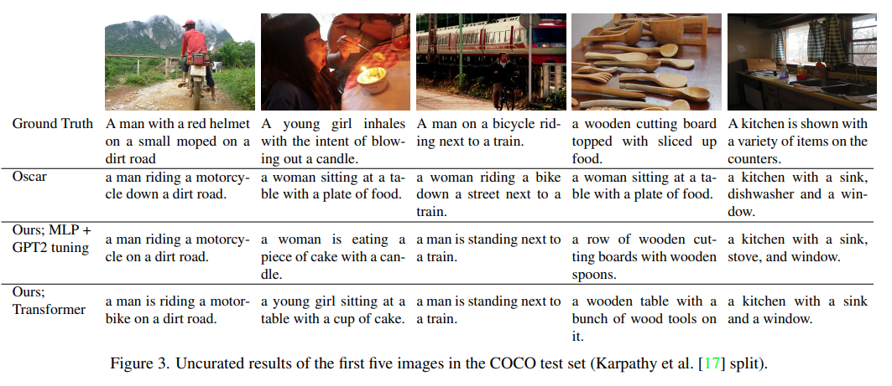
Results

Slide 12
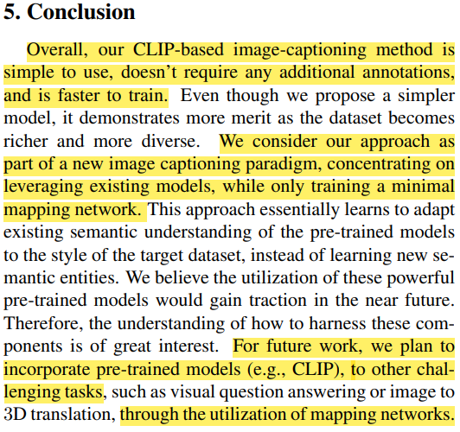
Conclusion

Slide 13
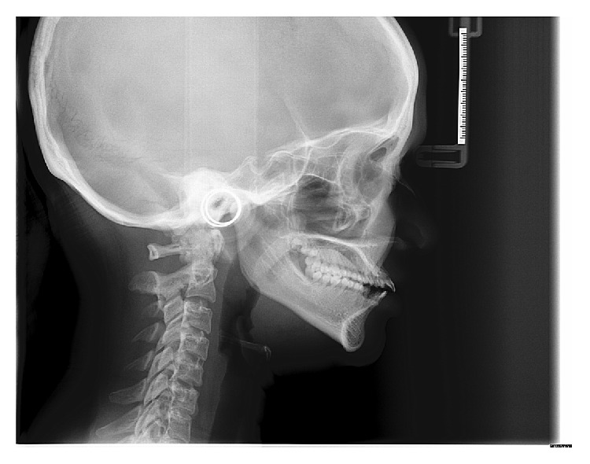
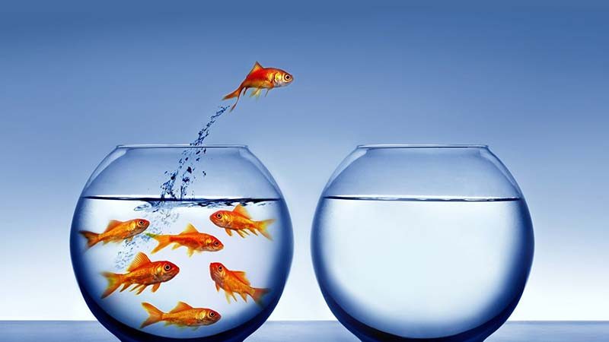
Own conclusion
Lateral cephalogram of the patient.

