Slide 1
PolliNet Architecture

Slide 2
Metting decisions
Aug 26th 2019:
Start with one flower and one pollinator, one task at a time.
Zero the Hight difference.
Use the model to infer distance.
Rotate and control Hight until pollinator finds flower.

Slide 3
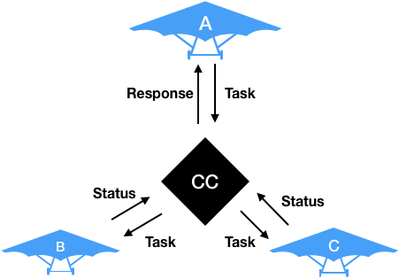

Slide 4
Scout Code | Description | Pollinators code | Description | Control Computer(CC) | Description
Image recognition model and Task report. | Recognizes flowers, computes their coordinates and sends a new task* to the CC. | Task Response | Listen to tasks from the CC, receives a Task and goes to the coordinates to perform | Task Queue | Maintain a queue of Task received from Scout drone.
Autonomous navigation** | TBD | Status Updates | CC must know if pollinators are busy or available ? | Status | Which pollinator is busy/available?
Control Computer time out response | If CC does not respond to Tasks return to home coordinates. | CC time out response | If pollinator does not receive a task in 5 min return home. | Send Pollinators to a Task | Given a Task send closest available pollinator
Displacement limit rules*** | Drone must not go more than x meter in any direction from home coordinates. | Pollination action (video) | Once at the Task coordinates, use on-board video to pollinate | Graphical 2D plot of target coordinates | Where are the flowers at****
* A Task is data that contains (LAT, LONG, HIGHT) ** Randomized Rule Base Navigation or Video data navigation *** x will be determined by hardware limitations. **** Not a critical requirement.

Slide 5
Randomized Rule Base Nav? Another Idea ?

Slide 6
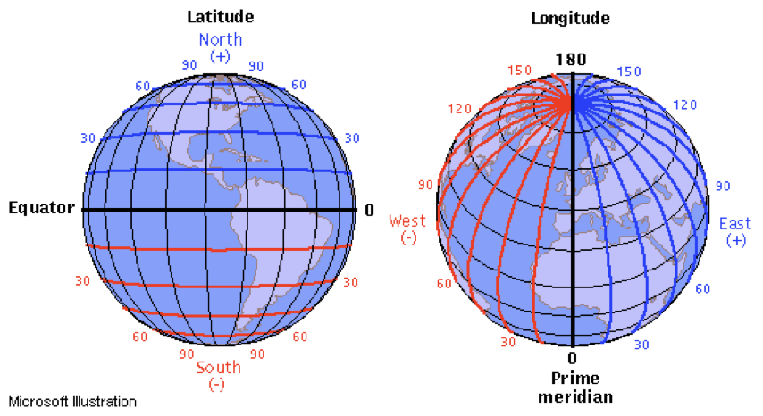
Challenge (Precision) 20 meters change in LAT is about 0.00018 degree change.

Slide 7
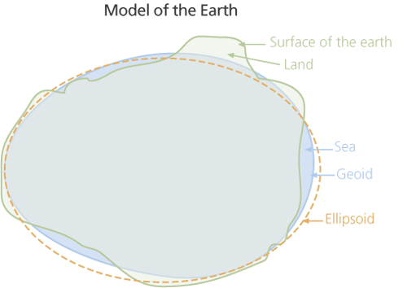
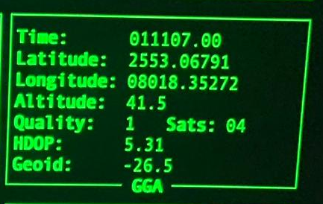
The GPS uses height (h) above the reference ellipsoid that approximates the earth's surface
The traditional, orthometric height (H) is the height above an imaginary surface called the geoid, which is determined by the earth's gravity and approximated by MSL. The signed difference between the two heights—the difference between the ellipsoid and geoid—is the geoid height (N).
Altitude: Meters above mean sea level.

Slide 8
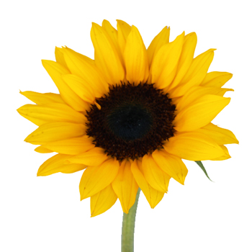
Challenge (Coordinates)
Sunflowers are in average 6 to 10 feet tall.
The black center averages 1 to 2 inches in diameter = radius of full flower 2(di/2) = diameter.
𝜃
Δy
𝜃
H
Δx = Δy /tan(𝜃)
Depends if drone is facing N,S,W,E :
If North or South : TASK = (LAT +- Δx, LONG, H - Δy )
If East or West : TASK = (LAT, LONG +- Δx, H - Δy )

Slide 9
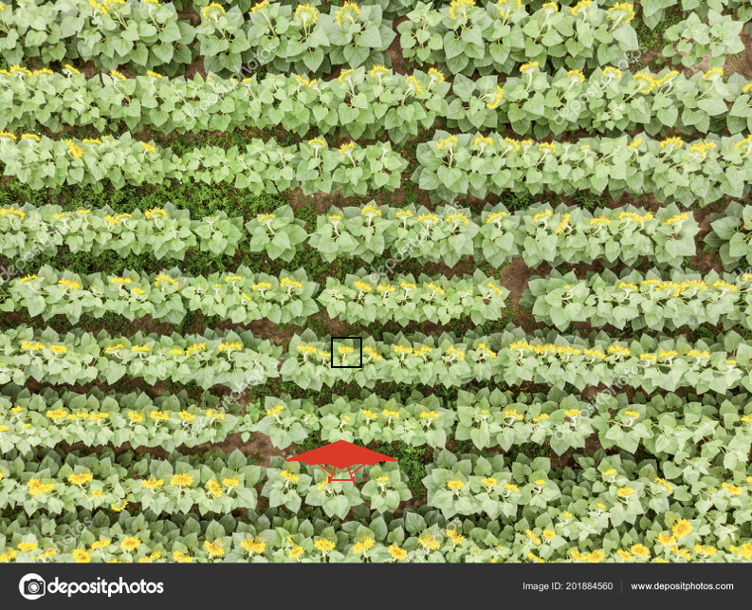
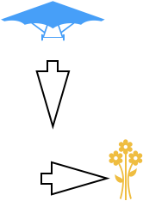
Challenge (Pollination)
Video Control Nav

Slide 10
More challenges a priori ?

Slide 11
Condition of Success for Software
10% Review:
1. CV Model recognizes flowers.
2. Scout drone onboard PI can communicate with CC.
3. Successful Test of drone and CC communicating Task data (without drone).
30% Review: (Need a flying drone at this time).
1. Scout drone can explore autonomously.
2. Scout drone return home if CC communication fails.
3. Scout follows displacement limit rules.
50% Review:
1. Pollinators onboard PI can communicate with CC.
2. Pollinator seeds Status to CC.
3. Pollinator recognizes if CC timed out.
70% Review: (Pollinator drone flying at this time).
1. Pollinators goes to the Task coordinates.
2. Pollinator can pollinate (Video guided nav).
3. Pollinator recognizes if CC timed out and returns home.
100% Review:
1. Integration Test (Go out and test if everything works)

