Slide 1
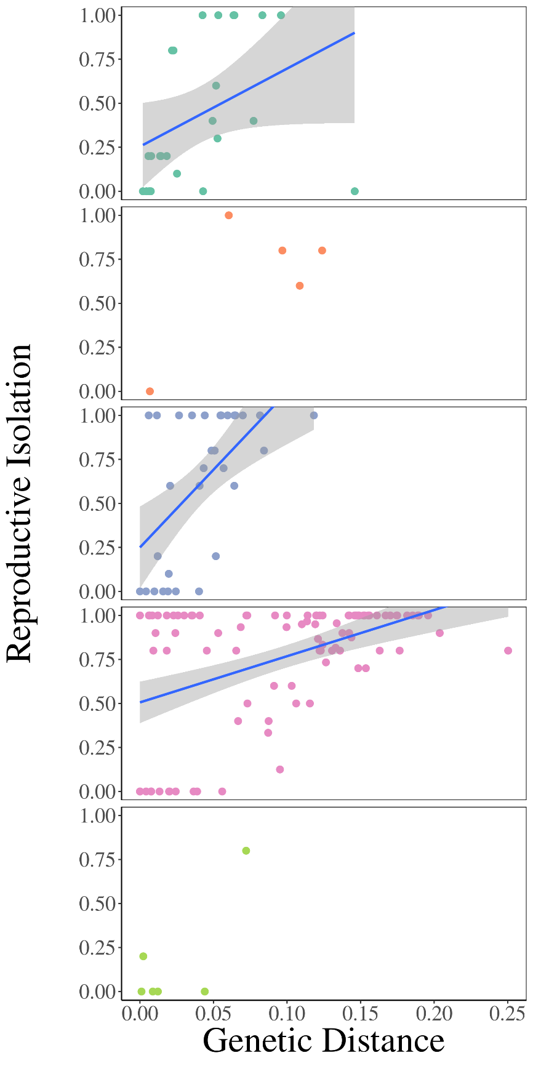




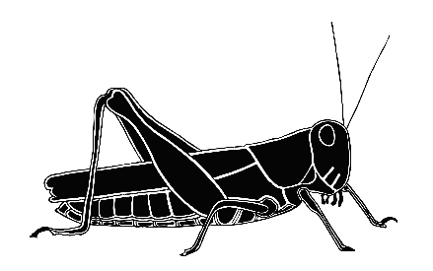
A
R²=0.15
F_{(1,22)}=3.96
p=0.0593
B
R²=0.45
F_{(1,3)}=2.46
p=0.2147
C
R²=0.33
F_{(1,30)}=14.96
p=0.0005
D
R²=0.22
F_{(1,92)}=25.64
p=2.1x10⁻⁶
E
R²=0.58
F_{(1,4)}=5.43
p=0.0802

