Slide 1
From C# 7.3 to 12
Overview of new features

Slide 2
Modifying .csproj files
In .NET Core it is possible to directly modify the .csproj file by double clicking on the corresponding project from Visual Studio.
Although we rarely do this for existing repos, it can be very useful when setting up a new project/solution, or to modify settings in an existing project.

Slide 3
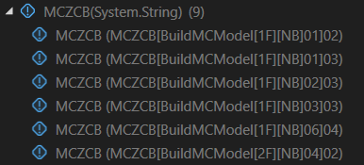
Running tests individually
Now it is possible to run a single test from a .csv file without having to modify it.

Slide 4
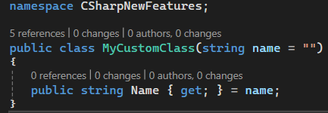
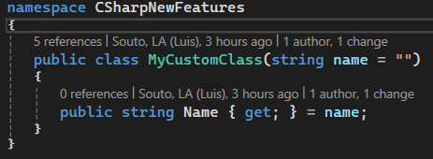
File-scoped namespaces
Since C# 10
If we only define one namespace inside a .cs file (which is what we always do) we can use file-scope namespaces to reduce indentation.
Before C# 10

Slide 5
Implicit usings
By default, every .cs file uses the following namespaces:
System
System.Collections.Generic
System.IO
System.Linq
System.Net.Http
System.Threading
System.Threading.Tasks

Slide 6

var vs new()
Since C# 9.0 class initialization can be simplified

Slide 7

Collection initialization
Initialization of collections such as lists and arrays can be simplified.

Slide 8

Concatenation of collections
Now it is possible to use the spread element “..” to concatenate lists/arrays.

Slide 9
What is an Expression in C#
An expression in C# is a sequence of operators and operands that evaluates to a single value.
Examples: Arithmetic, logical, and method call expressions.
Alternative definition: anything that can be at the right of an equal sign.
Expression in C# (Read more)

Slide 10
Switch Expressions
Switch expressions are a more concise and readable alternative to traditional switch statements.
They evaluate a single expression and return a value based on the match.
Switch Expressions (Read more)

Slide 11
Records in C#
Records are a reference type that provide built-in functionality for encapsulating data.
They are used for immutable data models.
Example: public record Person(string FirstName, string LastName);
Records in C# (Read more)

Slide 12
Primary Constructors in C#
Primary constructors allow a class to define its fields and properties directly in the constructor signature.
This makes the code cleaner and more concise.
Primary Constructors (Read more)

Slide 13
Null Coalescing (??=) Operator in C#
The null coalescing operator (??=) assigns a value to a variable only if it is null.
This is useful for default initialization.
Example: name ??= "Default Name";
Null Coalescing Operator (Read more)

Slide 14
Null Handling in C#
C# provides various ways to handle null values safely:
- Null conditional operator (?.)
- Null coalescing operator (??)
- Null-forgiving operator (!)
These operators help to avoid null reference exceptions.

Slide 15
Default Implementation in Interfaces
Interfaces in C# can now provide default method implementations.
This allows developers to add new methods to interfaces without breaking existing implementations.
Default Implementation in Interfaces (Read more)

Slide 16
Generic Math Support in C#
C# 10 and later versions provide generic math support, enabling the use of generic types in mathematical operations.
With generic math, you can write type-agnostic code that works with numeric types, such as int, double, or float, while maintaining type safety.
Generic Math support (Read more)

