Slide 1
From C# 7.3 to 12
Introduction of new features

Slide 2
How to access .csproj files

Slide 3
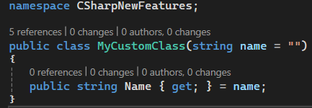
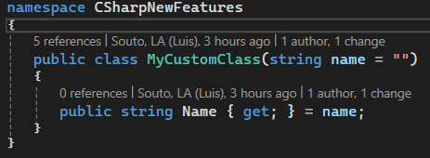
File-scoped namespaces
Since C# 10
If we only define one namespace inside a .cs file (which is what we always do) we can use file-scope namespaces to reduce indentation.
Before C# 10

Slide 4
Implicit usings
By default, every .cs file uses the following namespaces:
System
System.Collections.Generic
System.IO
System.Linq
System.Net.Http
System.Threading
System.Threading.Tasks

Slide 5

var vs new()
Since C# 9.0 class initialization can be simplified

Slide 6

Collection initialization
Initialization of collections such as lists and arrays can be simplified.

Slide 7

Concatenation of collections
Now it is possible to use the spread element “..” to concatenate lists/arrays.

