Slide 1
From C# 7.3 to 12
Overview of new features

Slide 2
Modifying .csproj files
In .NET Core it is possible to directly modify the .csproj file by double clicking on the corresponding project from Visual Studio.
Although we rarely do this for existing repos, it can be very useful when setting up a new project/solution, or to modify settings in an existing project.

Slide 3
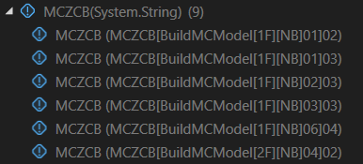
Running tests individually
Now it is possible to run a single test from a .csv file without having to modify it.

Slide 4
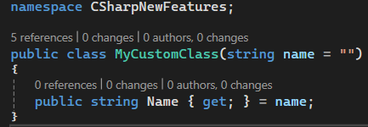
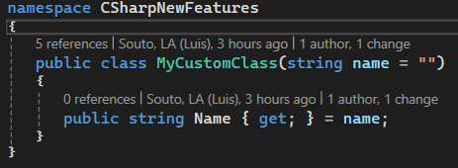
File-scoped namespaces
Since C# 10
If we only define one namespace inside a .cs file (which is what we always do) we can use file-scope namespaces to reduce indentation.
Before C# 10

Slide 5
Implicit usings
By default, every .cs file uses the following namespaces:
System
System.Collections.Generic
System.IO
System.Linq
System.Net.Http
System.Threading
System.Threading.Tasks

Slide 6

var vs new()
Since C# 9.0 class initialization can be simplified

Slide 7

Collection initialization
Initialization of collections such as lists and arrays can be simplified.

Slide 8

Concatenation of collections
Now it is possible to use the spread element “..” to concatenate lists/arrays.

