Slide 1
Sistemas de Informação II
1. Data Warehousing e OLAP
Viriato M. Marques
DEIS – Departamento de Engenharia Informática e de Sistemas
ISEC – Instituto Superior de Engenharia de Coimbra

Slide 2
2. Data Warehousing and OLAP
Based on
Data Mining
Concepts and Techniques
Adaptation and suplemental material for SQL Server
Jiawei Han and Micheline Kamber, Morgam Kaufman, 2006
Department of Computer Science, University of Illinois at Urbana-Champaign
Viriato M. Marques
Department of Computer Science, ISEC, Coimbra Portugal
&
Delivering Business Intelligence with Microsoft SQL Server 2005
Brian Larson, McGraw Hill, 2006

Slide 3
2. Data Warehousing and OLAP
Data generalization
A process which abstracts a large set of task-relevant data in a database from a low conceptual levels to higher ones.
Approaches:
Data cube approach (OLAP approach/data warehouses)
Attribute-oriented Induction approach (AOI/data-mining)
1
2
3
4
Conceptual levels
5

Slide 4
2.1.1 Data Mining
Data-Mining
Consists of a series of algorithms that are applied over datasets
The algorithms generate models that perform tasks such as
Classification of new (unknown) items
Aggregation of items according to their common features
Generate association rules between items
Preview future values of an item
Detect sequential patterns
Detect outliers
(to detail in other presentations)

Slide 5
2.1.2 Data Warehousing (DW)
Data Warehousing
Defined in many different ways, but not rigorously.
A decision support database that is maintained separately from the organization’s operational database
Support information processing by providing a solid platform of consolidated, historical data for analysis.
“A data warehouse is a subject-oriented, integrated, time-variant, and nonvolatile collection of data in support of management’s decision-making process.”—W. H. Inmon
Data warehousing:
The process of constructing and using data warehouses

Slide 6
2.1.2 Data Warehousing (DW)
Organized around major subjects, such as customer, product, sales
Focusing on the modeling and analysis of data for decision makers, not on daily operations or transaction processing
Provide a simple and concise view around particular subject issues by excluding data that are not useful in the decision support process

Slide 7
2.1.2 Data Warehousing (DW)
Constructed by integrating multiple, heteroge-neous data sources
relational databases, flat files, on-line transaction records
Data cleaning and data integration techniques are applied.
Ensure consistency in naming conventions, encoding structures, attribute measures, etc. among different data sources
E.g., Hotel price: currency, tax, breakfast covered, etc.
When data is moved to the warehouse, it is converted.

Slide 8
2.1.2 Data Warehousing (DW)
The time horizon for the data warehouse is significantly longer than that of operational systems
Operational database: current value data
Data warehouse data: provide information from a historical perspective (e.g., past 5-10 years)
Every key structure in the data warehouse
Contains an element of time, explicitly or implicitly
But the key of operational data may or may not contain “time element”

Slide 9
2.1.2 Data Warehousing (DW)
A physically separate store of data transformed from the operational environment
Operational update of data does not occur in the data warehouse environment
Does not require transaction processing, recovery, and concurrency control mechanisms
Requires only two operations in data accessing:
initial loading of data and access of data

Slide 10
2.1.2 Data Warehousing (DW)
OLTP (on-line transaction processing)
Major task of traditional relational DBMS
Day-to-day operations: purchasing, inventory, banking, manufacturing, payroll, registration, accounting, etc.
OLAP (on-line analytical processing)
Major task of data warehouse system
Data analysis and decision making
Distinct features (OLTP vs. OLAP):
User and system orientation: customer vs. market
Data contents: current, detailed vs. historical, consolidated
Database design: ER + application vs. star + subject
View: current, local vs. evolutionary, integrated
Access patterns: update vs. read-only but complex queries

Slide 11
2.1.2 Data Warehousing (DW)

Slide 12
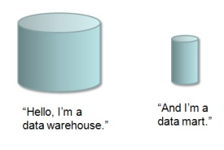
2.2 DW Modeling: Cubes and OLAP
A data warehouse is based on a multidimensional data model which views data in the form of a data cube with 2, 3 or more dimensions (over 3 dimensions can’t be graphically represented…)
In data warehousing literature, an n-D base cube is called a base cuboid.
The top most 0-D cuboid, which holds the highest-level of summarization, is called the apex cuboid. The lattice of cuboids forms a data cube.
A datamart can be tought as a “small” datawarehouse, a “component” of a larger datawarehouse

Slide 13
2.2 DW Modeling: Cubes and OLAP
all
0-D(apex) cuboid
time
item
location
supplier
1-D cuboids
time,location
item,location
location,supplier
2-D cuboids
time,supplier
item,supplier
time,location,supplier
3-D cuboids
time,item,supplier
item,location,supplier
4-D(base) cuboid
time, item, location, supplier

Slide 14
2.2 DW Modeling: Cubes and OLAP
A data warehouse is based on a multidimensional data model which views data in the form of a data cube
A data cube, such as sales, allows data to be modeled and viewed in multiple dimensions
Dimension tables, such as item (item_ID, brand_ID, type_ID), or time(day, week, month, quarter, year)
Fact tables contains measures (such as dollars_sold) and keys to each of the related dimension tables
Dimension tables also define hierarchies (example: brand_ID includes all the itens of a given brand)…
… and contain other attributes such as item_Name, brand_Name…

Slide 15
2.2 DW Modeling: Cubes and OLAP
A measure can be:
Additive: if it can be added along all the dimensions
Examples: item sales, sales amounts…
Non-Additive: if it doesn’t make sense to add it along any dimension
Examples: unit price, age… (averages can make sense!)
Semi-Additive: if it can be added along some dimensions but not all (may be of type final_value=last)
Example: inventory - can’t be added along the time dimension (the final inventory is equal to the last one); can be added along the items dimension (3 Audi’s + 2 BMW + 4 Chevys = Total number of cars)

Slide 16
2.2 DW Modeling: Cubes and OLAP
Each row of a fact table contains the maximum detail data (granularity) needed to compute the aggregate value for the most detailed dimension
This ensures that aggregates for higher levels of abstraction can also be computed, according to the hierarchies defined into the dimension tables
Example: each row of fact table = “sales by product per day” allows to compute “sales by product per day”. This ensures that it is also possible to compute “sales by brand per month” (i.e. an aggregation by a higher level of abstraction)
The PK of a Fact Table is, in general, the concatenation of the IDs that define the maximum detail measure level
Each item of this PK is a FK to the dimension tables

Slide 17
2.2 DW Modeling: Cubes and OLAP
Modeling a datamart:
Star schema: A fact table in the middle connected to a set of dimension tables
Snowflake schema: A refinement of star schema where some dimensional hierarchy is normalized into a set of smaller dimension tables, forming a shape similar to snowflake
Fact constellations: Multiple fact tables share dimension tables, viewed as a collection of stars, therefore called galaxy schema or fact constellation

Slide 18
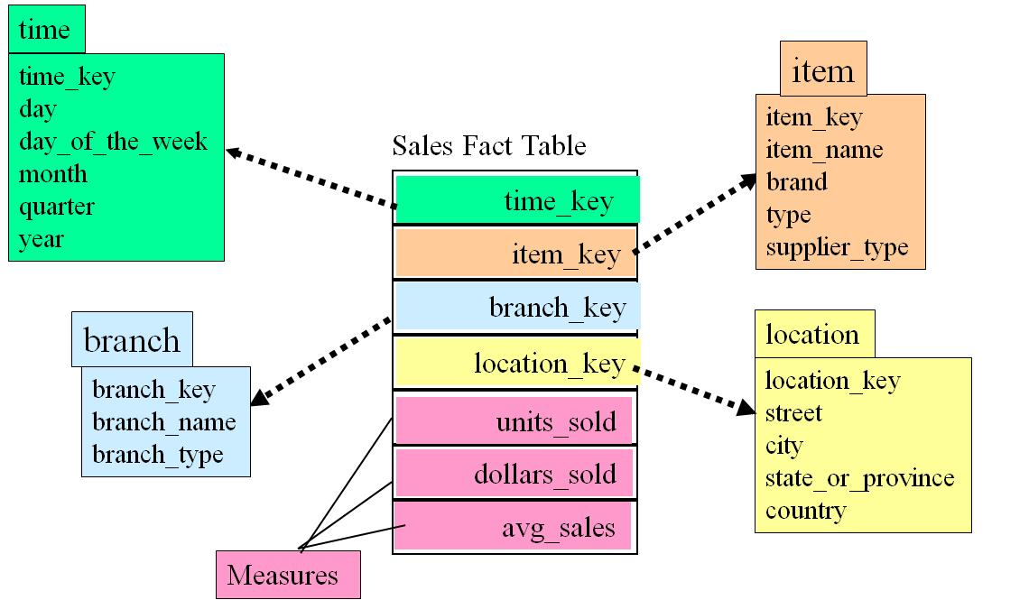
2.2 DW Modeling: Cubes and OLAP
Example of Star Schema

Slide 19
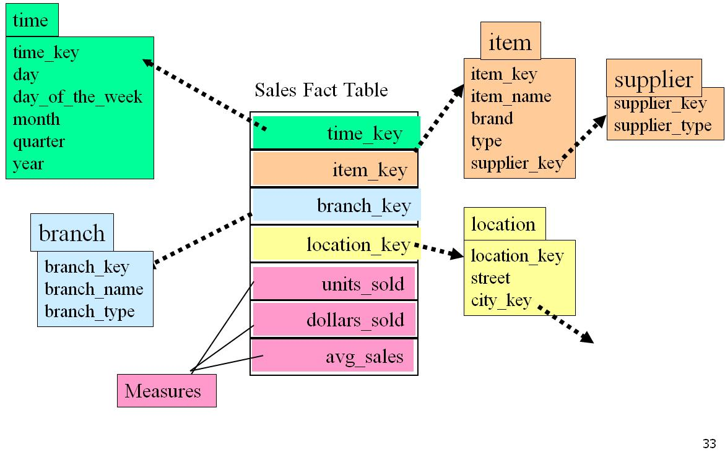
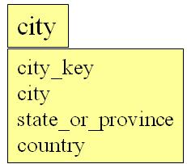
2.2 DW Modeling: Cubes and OLAP
Example of Snowflake Schema

Slide 20
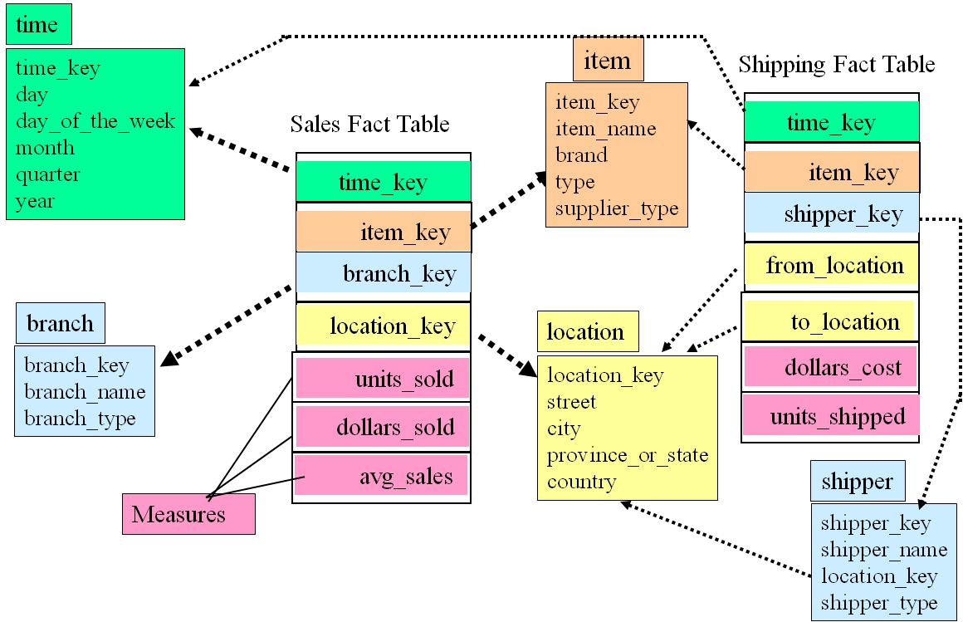
2.2 DW Modeling: Cubes and OLAP
Example of Fact Constelation

Slide 21
2.2 DW Modeling: Cubes and OLAP
Sales volume as a function of product, month, and region
Dimensions: Product, Location, Time
Hierarchical summarization paths
Region
Industry Region Year
Category Country Quarter
Product City Month Week
Office Day
Product
Month
Dimensions and their Hierarchies

Slide 22
2.2 DW Modeling: Cubes and OLAP
Date
Total annual sales
of TV in U.S.A.
1Qtr
2Qtr
3Qtr
4Qtr
sum
Product
TV
PC
U.S.A
VCR
sum
Canada
Country
Mexico
sum
All, All, All

Slide 23
2.2 DW Modeling: Cubes and OLAP
OLAP Operations:
Roll up: summarize data
by climbing up hierarchy or by dimension reduction
Drill down: reverse of roll-up
from higher level summary to lower level summary or detailed data, or introducing new dimensions
Slice and dice: project and select
Pivot (rotate)
reorient the cube, visualization, 3D to series of 2D planes
Other operations:
drill across: involving (across) more than one fact table
drill through: through the bottom level of the cube to its back-end relational tables (using SQL)

Slide 24
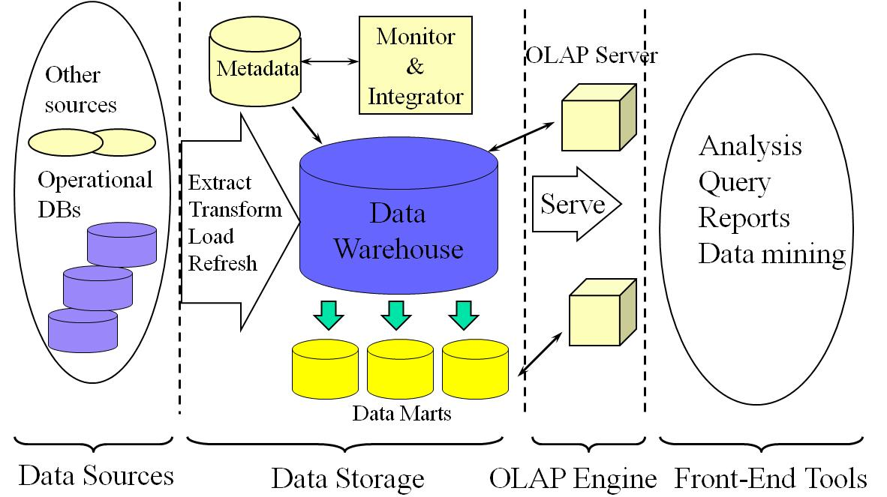
2.3 DW Architecture

Slide 25
2.3 DW Architecture
Enterprise warehouse
collects all of the information about subjects spanning the entire organization
Data Mart
a subset of corporate-wide data that is of value to a specific groups of users.
Its scope is confined to specific, selected groups, such as marketing data mart

Slide 26
2.3 DW Architecture
ETL – Extract, Transform and Load
Data extraction
get data from multiple, heterogeneous, and external sources
Data cleaning
detect errors in the data and rectify them when possible
Data Transformation
convert data from legacy or host format to warehouse format
Load
sort, summarize, consolidate, compute views, check integrity, and build indicies and partitions
Refresh
propagate the updates from the data sources to the warehouse

Slide 27
2.3 DW Architecture
Relational OLAP (ROLAP)
Use relational or extended-relational DBMS to store and manage warehouse data and OLAP middle ware
Include optimization of DBMS backend, implementation of aggregation navigation logic, and additional tools and services
Greater scalability
Multidimensional OLAP (MOLAP)
Sparse array-based multidimensional storage engine
Fast indexing to pre-computed summarized data
Hybrid OLAP (HOLAP) (e.g., Microsoft SQLServer)
Flexibility, e.g., low level: relational, high-level: array
Specialized SQL servers (e.g., Redbricks)
Specialized support for SQL queries over star/snowflake schemas

Slide 28
2.4 DW Usage
Three kinds of data warehouse applications
Information processing
supports querying, basic statistical analysis, and reporting using crosstabs, tables, charts and graphs
Analytical processing
multidimensional analysis of data warehouse data
supports basic OLAP operations, slice-dice, drilling, pivoting
Data mining
knowledge discovery from hidden patterns
supports associations, constructing analytical models, performing classification and prediction, and presenting the mining results using visualization tools

Slide 29

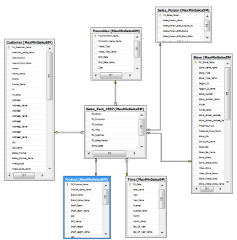
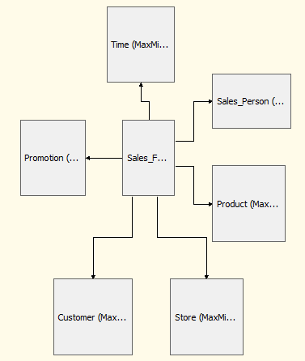

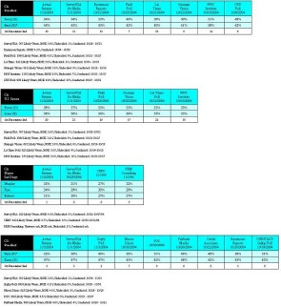

2.5 OLAP Implementation – SQL Server
OLTP’s
Data Source Views(.dsv)
BI Studio
DW (datasource)
Manag.Studio
Cubes
BI Studio
Reports
BI Studio
SQL Server, Oracle, DB2…
ETL
Analysis Services
csv, Excel…
DW
Relational Tables
Management Studio
Update: Manual or Scheduled execution
Integration Services Project
GUI + T-SQL
DSVs
A view over the DW
Indexes, calc.fields
Update: background process
BI Studio
Analysis Services Project
GUI + T-SQL / data tranform.functions
Cubes
Sums / calcs over DSV data, according to DIMs
Update: values computed when queried and then stored
BI Studio
Analysis Services Project
GUI + DMX
Reports
Cubes data
BI Studio
Update: when queried
Reporting Project
GUI+ DMX

Slide 30
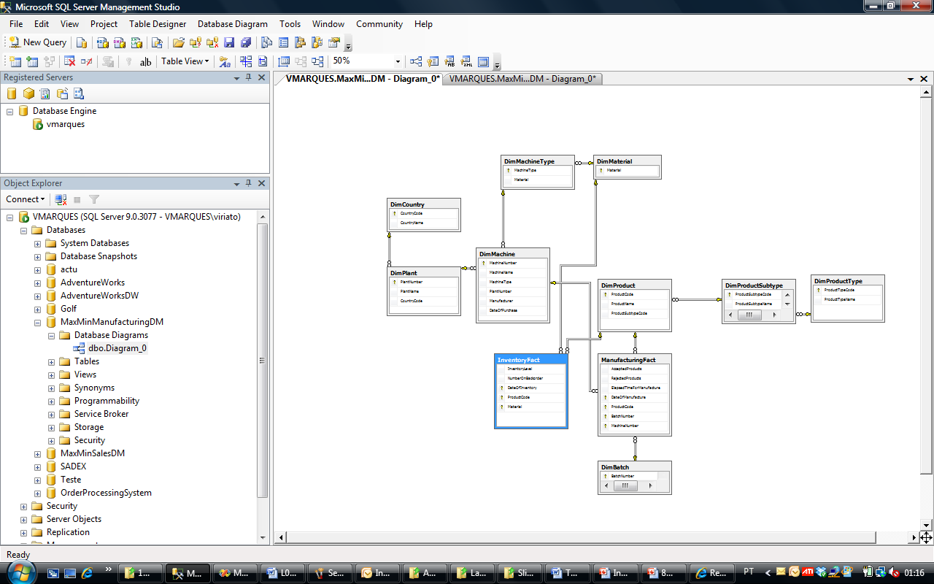
2.5 OLAP Implementation – SQL Server
Management Studio – MaxMinManufacturing datamart

Slide 31
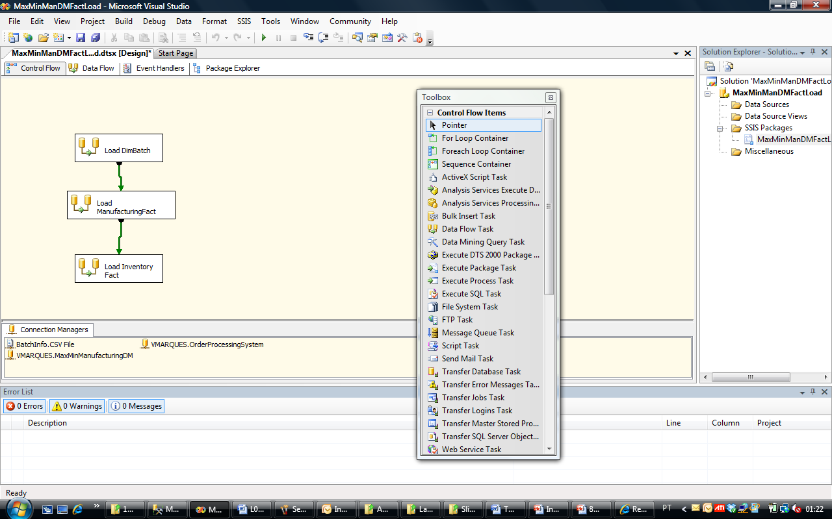
2.5 OLAP Implementation – SQL Server
BI Studio – Integration Services Project: OLTP->DW

Slide 32
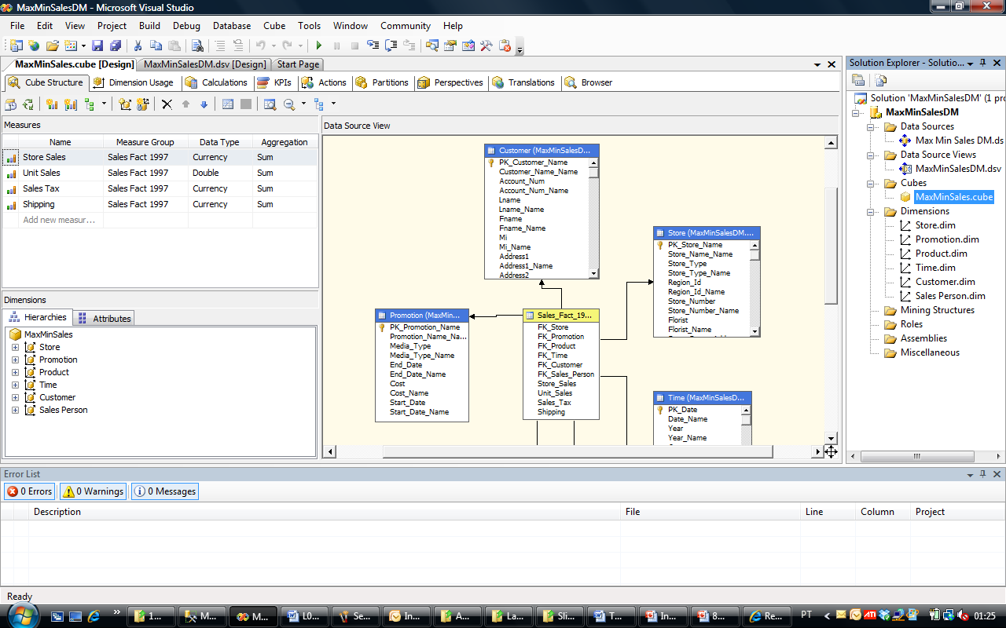
2.5 OLAP Implementation – SQL Server
BI Studio – Analysis Services Project: DSV & Cube

Slide 33
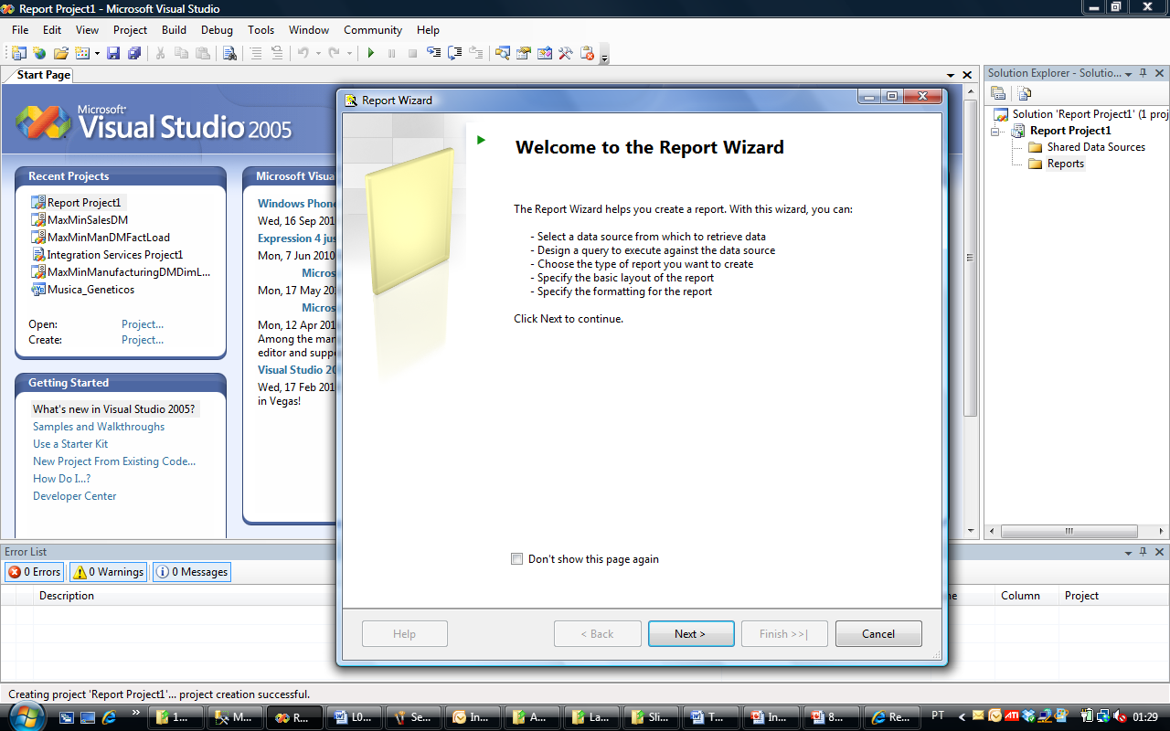
2.5 OLAP Implementation – SQL Server
BI Studio – Reporting Project

Slide 34
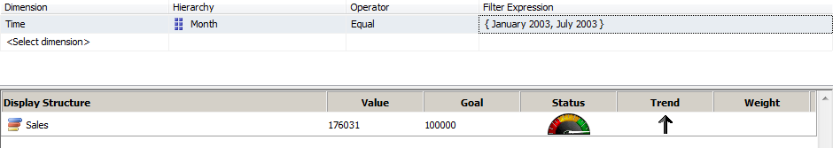
2.5 OLAP Implementation – SQL Server
KPI’s – Key Performance Indicators
A KPI is an organization performance measure
Generally a KPI assumes a graphical form such as a gauge, an arrow or a face (smiling / crying)
A KPI is dynamic, i.e. its appearance is automatically updated according to cube value changes
Boards of KPI’s can be created as an excellent support for Balanced Scorecards management methodology

Slide 35
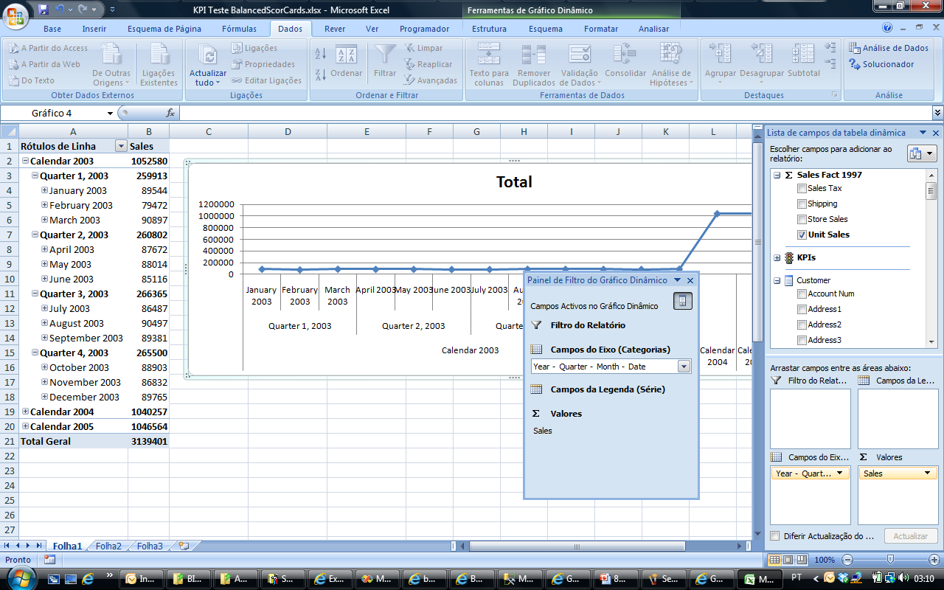
2.5 OLAP Implementation – SQL Server
Excel Dynamic Tables and Charts
Excel is the preferred interface for BI dynamic analysis (for most people)
A connection with a DB or OLAP server is established using Data -> From other sources
Pivot tables and dynamic charts with drill down and filtering capabilities can then be easily implemented by simple drag and drop operations

Slide 36
2.6 Data-mining - SQL Server
SQL Server includes data-mining capabilities
Mining takes place on DW structures, cubes or directly over OLTP relational tables
Data mining algorithms are accessed by BI Studio, Analysis Services Projects
The algorithms include:
Classification: Decision Trees, Neural Networks, Naïve Bayes
Association Analysis
Clustering: Microsoft clustering, Sequential Clustering
Microsoft Time Series
Linear Regression

Slide 37
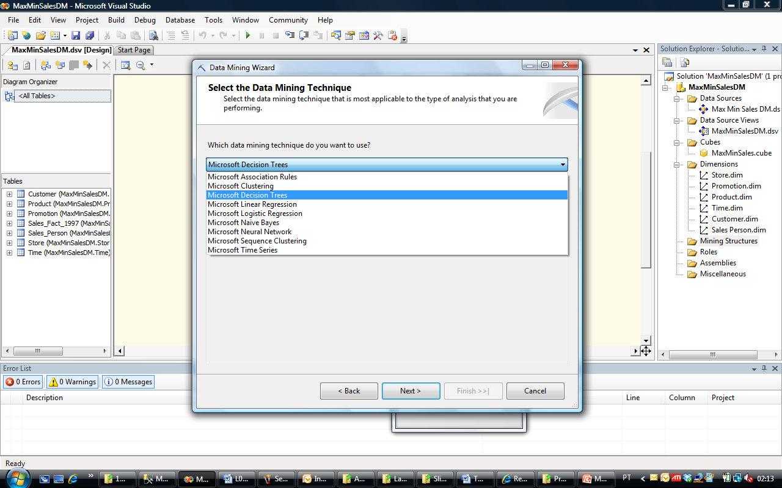
2.6 Data-mining - SQL Server
BI Studio – Analysis Services: data-mining algorithms

Slide 38
8.7 Summary
Data generalization: OLAP and Data-Mining
Data warehousing: A multi-dimensional model of a data warehouse
Star schema, snowflake schema, fact constellations
A data cube consists of dimensions & measures
OLAP operations: drilling, rolling, slicing, dicing and pivoting
Data warehouse architecture
OLAP servers: ROLAP, MOLAP, HOLAP
Efficient computation of data cubes
Partial vs. full vs. no materialization
Indexing OALP data: Bitmap index and join index
OLAP query processing

Slide 39
References (for these slides)
Jiawei Han & Micheline Kamber. Data Mining Concepts and Techniques. Morgan Kaufman 2nd edition, 2006
(slides based on the originals for this book)
Brian Larson. Delivering Business Intelligence with Microsoft SQL Server 2005, McGraw Hill, 2006
(slides complemented with information from this book)

Slide 40
References (see book 1)
S. Agarwal, R. Agrawal, P. M. Deshpande, A. Gupta, J. F. Naughton, R. Ramakrishnan, and S. Sarawagi. On the computation of multidimensional aggregates. VLDB’96
D. Agrawal, A. E. Abbadi, A. Singh, and T. Yurek. Efficient view maintenance in data warehouses. SIGMOD’97
R. Agrawal, A. Gupta, and S. Sarawagi. Modeling multidimensional databases. ICDE’97
S. Chaudhuri and U. Dayal. An overview of data warehousing and OLAP technology. ACM SIGMOD Record, 26:65-74, 1997
E. F. Codd, S. B. Codd, and C. T. Salley. Beyond decision support. Computer World, 27, July 1993.
J. Gray, et al. Data cube: A relational aggregation operator generalizing group-by, cross-tab and sub-totals. Data Mining and Knowledge Discovery, 1:29-54, 1997.
A. Gupta and I. S. Mumick. Materialized Views: Techniques, Implementations, and Applications. MIT Press, 1999.
J. Han. Towards on-line analytical mining in large databases. ACM SIGMOD Record, 27:97-107, 1998.
V. Harinarayan, A. Rajaraman, and J. D. Ullman. Implementing data cubes efficiently. SIGMOD’96

Slide 41
References (see book 1)
C. Imhoff, N. Galemmo, and J. G. Geiger. Mastering Data Warehouse Design: Relational and Dimensional Techniques. John Wiley, 2003
W. H. Inmon. Building the Data Warehouse. John Wiley, 1996
R. Kimball and M. Ross. The Data Warehouse Toolkit: The Complete Guide to Dimensional Modeling. 2ed. John Wiley, 2002
P. O'Neil and D. Quass. Improved query performance with variant indexes. SIGMOD'97
Microsoft. OLEDB for OLAP programmer's reference version 1.0. In http://www.microsoft.com/data/oledb/olap, 1998
A. Shoshani. OLAP and statistical databases: Similarities and differences. PODS’00.
S. Sarawagi and M. Stonebraker. Efficient organization of large multidimensional arrays. ICDE'94
OLAP council. MDAPI specification version 2.0. In http://www.olapcouncil.org/research/apily.htm, 1998
E. Thomsen. OLAP Solutions: Building Multidimensional Information Systems. John Wiley, 1997
P. Valduriez. Join indices. ACM Trans. Database Systems, 12:218-246, 1987.
J. Widom. Research problems in data warehousing. CIKM’95.

Slide 42

2. Data Warehouses
Data Warehouses
FIM
Warehouse

