Slide 1

MANAGING PROJECTS
Chapter 14
VIDEO CASES
Case 1 Mastering the Hype Cycle: How to Adopt the Right Innovation at the Right Time
Case 2: NASA: Project Management Challenges
Instructional Video 1: Software Project Management in 15 Minutes

Slide 2
CHAPTER 14: MANAGING PROJECTS
Learning Objectives
What are the objectives of project management and why is it so essential in developing information systems?
What methods can be used for selecting and evaluating information systems projects and aligning them with the firm’s business goals?
How can firms assess the business value of information systems projects?
What are the principal risk factors in information systems projects?
What strategies are useful for managing project risk and system implementation?
© Prentice Hall 2011
Notes:
This chapter discusses the role and importance of managing projects. Have students describe why project management is important to information systems projects. Have some students worked on projects (not necessarily IT projects) at work which were poorly managed? How many have worked on well managed projects? What were the really significant factors that made for a “well managed” (or “poorly managed”) project?

Slide 3
CHAPTER 14: MANAGING PROJECTS
“Opening Happiness” with a New Project Management System
Problem: Coke Bottling’s existing project management software unable to deliver needed reports, projects running over budget, past schedule
Solutions: Microsoft Office Enterprise Project Management (EPM) Solution, integrated with existing network and software, to allow online, centralized project management
Demonstrates use of information systems and accurate data to manage projects effectively
Illustrates need for organizational and management change to ensure success of new technology
© Prentice Hall 2011
Notes:
This slide discusses the chapter opening case that looks at the project management difficulties faced by Coke Bottling and the project management software solution it implemented. Ask students what techniques Coke Bottling used to manage the organizational change required to implement the solution (For training employees and help implementing the system, Coke Bottling hired Project Solutions Group, a consulting and training firm in Marlborough, Massachusetts. To ensure enterprise-wide implementation of its new EPM solution, Coke Bottling created a new project management office to bring consistency and structure to all the firm’s projects.) In other words, a significant amount of organizational and management change was required to make the new system functional.

Slide 4
CHAPTER 14: MANAGING PROJECTS
The Importance of Project Management
Runaway projects and system failure
Runaway projects: 30% - 40% IT projects
  Exceed schedule, budget
  Fail to perform as specified
Types of system failure
  Fail to capture essential business requirements
  Fail to provide organizational benefits
  Complicated, poorly organized user interface
  Inaccurate or inconsistent data
© Prentice Hall 2011
Notes:
This slide emphasizes the high risk of failure for most IT projects and details the main ways a system can be considered to have “failed.” Some studies have shown that only 29% of all technology investments are completed on time, on budget, and with all features and functions specified, and nearly 40% suffer some kind of failure mode. Ask students what is meant by “Fail to provide organizational benefits” and provide an example.

Slide 5
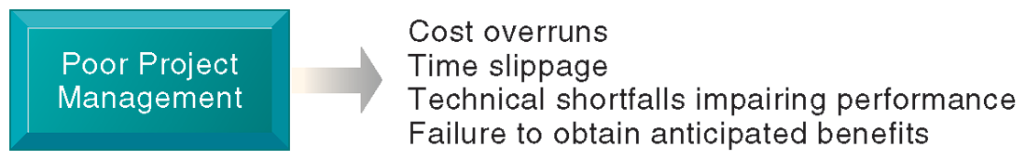
CHAPTER 14: MANAGING PROJECTS
The Importance of Project Management
CONSEQUENCES OF POOR PROJECT MANAGEMENT
FIGURE 14-1
Without proper management, a systems development project takes longer to complete and most often exceeds the allocated budget. The resulting information system most likely is technically inferior and may not be able to demonstrate any benefits to the organization.
© Prentice Hall 2011
Notes:
This graphic illustrates the main consequences when an information project is not properly managed. Have any students encountered an information system that was too difficult to use or that didn’t work as intended? Have any students experienced a poorly managed project?

Slide 6
CHAPTER 14: MANAGING PROJECTS
The Importance of Project Management
Project management
  Activities include planning work, assessing risk, estimating resources required, organizing the work, assigning tasks, controlling project execution, reporting progress, analyzing results
  Five major variables
    Scope
    Time
    Cost
    Quality
    Risk
© Prentice Hall 2011
Notes:
This slide introduces the main activities involved in project management, and lists the five major variables that project management must deal with. Ask students to describe what “scope” means. You can also ask students what project management activities concern the five variables. For example, to control scope, project managers define what work is included in the project. To manage the time spent on the project, project management estimates the time to complete each task and schedules the tasks for optimal efficiency.

Slide 7
CHAPTER 14: MANAGING PROJECTS
Selecting Projects
Management structure for information systems projects
  Hierarchy in large firms
    Corporate strategic planning group
      Responsible for firm’s strategic plan
    Information systems steering committee
      Reviews and approves plans for systems in all divisions
    Project management group
      Responsible for overseeing specific projects
    Project team
      Responsible for individual systems project
© Prentice Hall 2011
Notes:
In all but the smallest of firms, there is a considerable organizational apparatus involved in projects, which is one reason why they can be so difficult to manage. In a textbook situation, the corporate planning group decides which general capabilities and functionalities are needed to achieve the firm’s overall strategy. Then, an IT steering committee considers the matter and alternative ways to achieve what senior managers want and comes up with one or several projects. This committee assigns a project leader, who, in turn, selects a project team. The team develops the project and reports back up the line as progress is made.

Slide 8
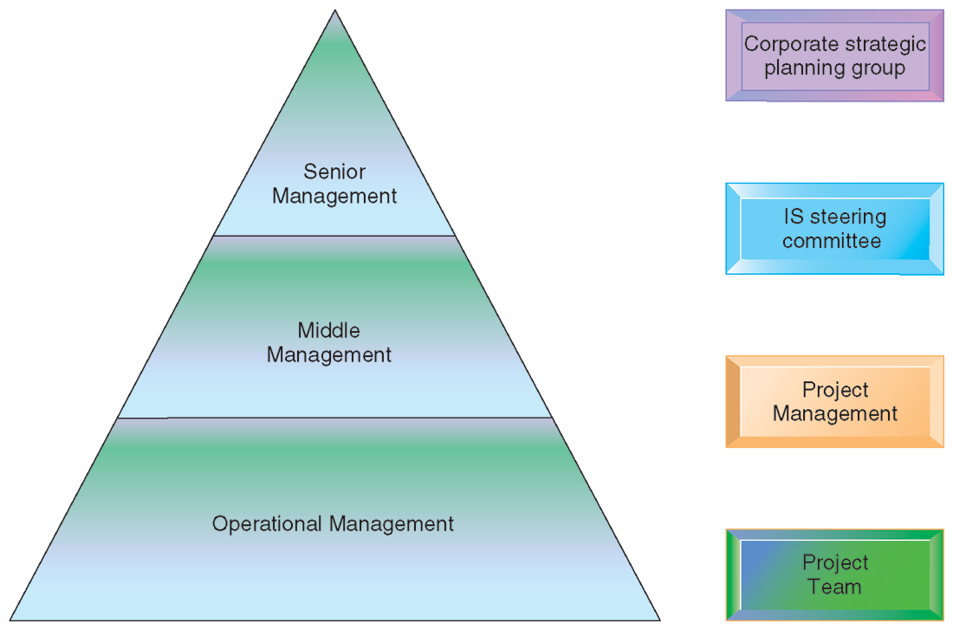
CHAPTER 14: MANAGING PROJECTS
The Importance of Project Management
MANAGEMENT CONTROL OF SYSTEMS PROJECTS
Each level of management in the hierarchy is responsible for specific aspects of systems projects, and this structure helps give priority to the most important systems projects for the organization.
FIGURE 14-2
© Prentice Hall 2011
Notes:
This graphic illustrates what management levels the four main groups are at. Have the students describe the types of decision making (structured, unstructured, etc.) that each of the four groups would be involved in.

Slide 9
CHAPTER 14: MANAGING PROJECTS
Selecting Projects
Information systems plan:
  Identifies systems projects that will deliver most business value, links development to business plan
  Road map indicating direction of systems development, includes:
    Purpose of plan
    Strategic business plan rationale
    Current systems/situation
    New developments to consider
    Management strategy
    Implementation plan
    Budget
© Prentice Hall 2011
Notes:
This slide emphasizes the importance of making sure systems projects will support the firm’s overall business goals. A key document in ensuring this is the information systems plan. What management decisions are involved in the management strategy? (Hardware acquisition; telecommunications; centralization of authority, data, and hardware; required organizational change.)

Slide 10
CHAPTER 14: MANAGING PROJECTS
Selecting Projects
In order to plan effectively, firms need to inventory and document existing software, hardware, systems
To develop effective information systems plan, organization must have clear understanding of both long-term and short-term information requirements
Strategic analysis or critical success factors (CSF) approach
  Sees information requirements as determined by a small number of critical success factors
  Auto industry CSFs might include styling, quality, cost
© Prentice Hall 2011
Notes:
This slide continues the look at the steps a firm should take in selecting the right systems projects to pursue. Ask students why it is important to inventory existing hardware and software. Ask students to give an example of a long-term information requirement versus a short-term information requirement. The slide also introduces CSFs as a way to evaluate information requirements of a firm. The book also describes other methodologies such as the balanced score card method which can also be useful for understanding what projects should be developed.

Slide 11
CHAPTER 14: MANAGING PROJECTS
Selecting Projects
Critical success factors
  Principal method:
    Interviews with 3-4 top managers to identify goals and resulting CSFs
    Personal CSFs aggregated into small number of firm CSFs
    Systems built to deliver information on CSFs
  Suitable for top management, building DSS and ESS
  Disadvantages:
    No clear methods for aggregation of CSFs into firm CSFs
    Confusion between individual and organizational CSFs
    Bias towards top managers
© Prentice Hall 2011
Notes:
This slide discusses using the Critical Success Factors method as a way to select information systems projects. Give an example of a business, for example, a hospital, a law firm, a university, ask students to give examples of personal and firm CSFs. The text gives the example of the auto industry, whose firm CSFs might include styling, quality, and cost to meet the goals of increasing market share and raising profits.

Slide 12
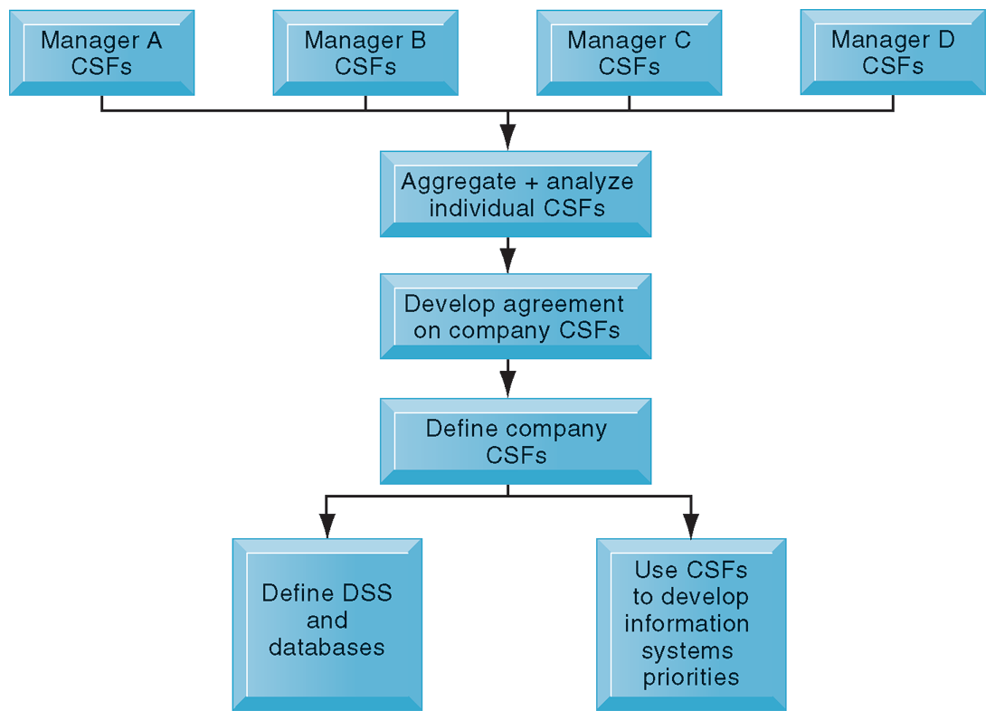
CHAPTER 14: MANAGING PROJECTS
Selecting Projects
USING CSFs TO DEVELOP SYSTEMS
The CSF approach relies on interviews with key managers to identify their CSFs. Individual CSFs are aggregated to develop CSFs for the entire firm. Systems can then be built to deliver information on
these CSFs.
FIGURE 14-3
© Prentice Hall 2011
Notes:
This graphic illustrates the steps used when applying a CSF method to selecting information systems projects to build. Notice that the CSFs can also contribute to the design of databases used for DSS as well as develop priorities between different information systems.

Slide 13
CHAPTER 14: MANAGING PROJECTS
Selecting Projects
Portfolio analysis
  Used to evaluate alternative system projects
  Inventories all of the organization’s information systems projects and assets
  Each system has profile of risk and benefit
    High-benefit, low risk
    High-benefit, high risk
    Low-benefit, low risk
    Low-benefit, high risk
  To improve return on portfolio, balance risk and return from systems investments
© Prentice Hall 2011
Notes:
This slide discusses portfolio analysis, a method used to evaluate alternative systems projects according to their levels of risk and benefit. In portfolio analysis, you seek to have a balance between types of systems, based on the level of risk you can afford, similar to a financial portfolio. Ask students what kinds of systems projects would be riskier than others. How could you determine the relative benefit of an information system?

Slide 14
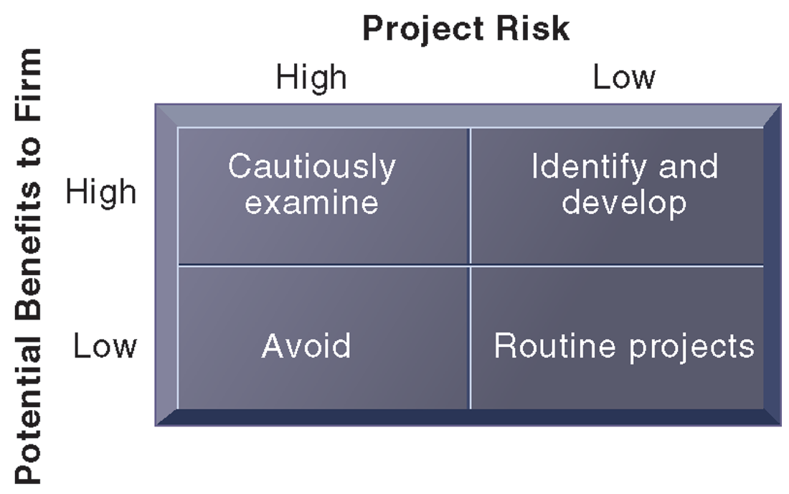
CHAPTER 14: MANAGING PROJECTS
Selecting Projects
A SYSTEM PORTFOLIO
Companies should examine their portfolio of projects in terms of potential benefits and likely risks. Certain kinds of projects should be avoided altogether and others developed rapidly. There is no ideal mix. Companies in different industries have different profiles.
FIGURE 14-4
© Prentice Hall 2011
Notes:
This graphic illustrates the priorities a firm should give to information systems with different levels of risk and benefit. The only projects to avoid are high-risk, low benefit projects. The emphasis given to any of the other three categories depends upon the individual firm. What types of influences on or within a firm might alter the firm’s emphasis on one category (e.g. high-benefit, high-risk) over another?

Slide 15
CHAPTER 14: MANAGING PROJECTS
Selecting Projects
Scoring models
  Used to evaluate alternative system projects, especially when many criteria exist
  Assigns weights to various features of system and calculates weighted totals
CRITERIA | WEIGHT | SYSTEM A % | SYSTEM A SCORE | SYSTEM B % | SYSTEM B SCORE
Online order entry | 4 | 67 | 268 | 73 | 292
Customer credit check | 3 | 66 | 198 | 59 | 177
Inventory check | 4 | 72 | 288 | 81 | 324
Warehouse receiving | 2 | 71 | 142 | 75 | 150
ETC
GRAND TOTALS |  |  | 3128 |  | 3300
© Prentice Hall 2011
Notes:
This slide discusses another method used for selecting systems projects, scoring models. This method is useful when there are many criteria involved in the evaluation and decision. The table shows a short excerpt of an example scoring model for an ERP project that compares systems from two different vendors, A and B. Ask students which of the criteria are the most important to the firm (online order entry, inventory check). Columns 3 and 5 show the percentage to which each alternative ERP system fulfills the criteria. Each system’s score is calculated by multiplying the percentage of requirements met for each function by the weight attached to that function. ERP System B has the highest total score. It is important to note that qualitative judgments affect the scoring model, so a good practice is to cycle through the scoring model several times, changing the criteria and weights, to see how sensitive the outcome is to reasonable changes in criteria

Slide 16
CHAPTER 14: MANAGING PROJECTS
Establishing the Business Value of Information Systems
Information system costs and benefits
  Tangible benefits:
    Can be quantified and assigned monetary value
    Systems that displace labor and save space:
      Transaction and clerical systems
  Intangible benefits:
    Cannot be immediately quantified but may lead to quantifiable gains in the long run
      E.g., more efficient customer service, enhanced decision making
    Systems that influence decision making:
      ESS, DSS, collaborative work systems
© Prentice Hall 2011
Notes:
In portfolio analysis, systems are compared along the lines of risk and benefit. This slide examines the ways a project’s benefits can be identified and quantified or evaluated. In addition to direct costs (costs for hardware, services, personnel, etc.) there are tangible benefits and intangible benefits. Ask students to provide examples of tangible and intangible benefits. Note that Chapter 5 introduced the total cost of ownership (TCO) method for evaluating the cost of information systems projects. The TCO method does include expenditures beyond the initial cost of purchasing and installing hardware and software, but does not typically deal with benefits, cost categories such as complexity costs, or “soft” and strategic factors discussed later.

Slide 17
CHAPTER 14: MANAGING PROJECTS
Establishing the Business Value of Information Systems
Capital budgeting for information systems
  Capital budgeting models:
    Measure value of investing in long-term capital investment projects
    Rely on measures the firm’s
      Cash outflows
        Expenditures for hardware, software, labor
      Cash inflows
        Increased sales
        Reduced costs
    There are various capital budgeting models used for IT projects: Payback method, accounting rate of return on investment, net present value, internal rate of return (IRR)
© Prentice Hall 2011
Notes:
This slide introduces the practice of using financial analysis to determine what the return on investment is for an information systems project. Ask students why using these capital budgeting methods may be more accurate in understanding the value of an information system rather than a TCO approach. At the same time, what are some of the pitfalls of using only an ROI approach to investing in IT? While costs might be relatively easy to establish, benefits are not so easy to identify, especially in a quantitative manner.

Slide 18
CHAPTER 14: MANAGING PROJECTS
Establishing the Business Value of Information Systems
Real options pricing models (ROPM)
  Can be used when future revenue streams of IT projects are uncertain and up-front costs are high
  Use concept of options valuation borrowed from financial industry
  Gives managers flexibility to stage IT investment or test the waters with small pilot projects or prototypes to gain more knowledge about risks before investing in entire implementation
Limitations of financial models
  Do not take into account social and organizational dimensions that may affect costs and benefits
© Prentice Hall 2011
Notes:
This slide discusses one financial method to evaluate IT projects, real options pricing models, which is based on the idea that initial expenditures can be seen as purchasing options for further IT project development. It is useful in situations in which the future revenue streams for a project are unclear. Ask students to describe what options valuation is. (“An option is essentially the right, but not the obligation, to act at some future date. A typical call option, for instance, is a financial option in which a person buys the right (but not the obligation) to purchase an underlying asset (usually a stock) at a fixed price (strike price) on or before a given date.”) What does this mean in terms of information systems projects? (“An initial expenditure on technology creates the right, but not the obligation, to obtain the benefits associated with further development and deployment of the technology as long as management has the freedom to cancel, defer, restart, or expand the project.” A person’s educational decisions are a good example. Students go to college (make an investment) with the hope that when they obtain a degree they will be in a good position (a better position) to find a job that pays a respectable salary. This is options decision making: a college degree sets up the holder for a variety of new options upon graduation. And maybe an immediate payoff.
This method and other financial accounting methods do not take into account all of the factors that can affect costs and benefits. Ask the students to describe some of the factors that may affect revenues or costs (costs from organizational disruptions: cost to train end users, productivity costs due to users’ learning curves for a new system, time managers need to spend overseeing new system-related changes) as well as some of the benefits that may not be addressed by financial methods (more timely decisions from a new system, enhanced employee learning and expertise).

Slide 19
CHAPTER 14: MANAGING PROJECTS
Managing Project Risk
Dimensions of project risk
  Level of project risk influenced by:
    Project size
      Indicated by cost, time, number of organizational units affected
      Organizational complexity also an issue
    Project structure
      Structured, defined requirements run lower risk
    Experience with technology
© Prentice Hall 2011
Notes:
This slide discusses a second major factor in evaluating projects, risk. (Remember that portfolio analysis ranks systems according to two criteria, benefit and risk.) Most managers don’t like to think about risk and most make no attempt to measure it. Most managers are optimists and think about benefits. As we all know from the recent financial meltdown, financial managers did not seriously consider risk, and they might have been fired if they did. A great many systems projects failed which could have been avoided if managers had a better understanding of project risk.
What is meant by risk? Ask students how the size of a project affects its risk. What does organizational complexity mean in this context? Which of these components are organizational versus technical. Can all of them be countered through better project management?

Slide 20
CHAPTER 14: MANAGING PROJECTS
Managing Project Risk
Change management
  Required for successful system building
  New information systems have powerful behavioral and organizational impact
    Changes in how information is used often lead to new distributions of authority and power
    Internal organizational change breeds resistance and opposition
© Prentice Hall 2011
Notes:
This slide emphasizes that introduction or alteration of an information system has a powerful behavioral and organizational impact. Change management is required to counter resistance and opposition. Ask students for examples of behavioral and organizational impacts that a new information system might have. What types of changes should an analyst look for in assessing the impact of a new system?

Slide 21
CHAPTER 14: MANAGING PROJECTS
Managing Project Risk
Implementation
  All organizational activities working toward adoption, management, and routinization of an innovation
Change agent: One role of systems analyst
  Redefines the configurations, interactions, job activities, and power relationships of organizational groups
  Catalyst for entire change process
  Responsible for ensuring that all parties involved accept changes created by new system
© Prentice Hall 2011
Notes:
This slide introduces the concept of implementation and the role of the systems analyst as a change agent, a key role in change management efforts. Ask students what types of activities a change agent would engage in to encourage the adoption of a new information system throughout the enterprise. Why don’t employees and managers simply adopt new systems without question?

Slide 22
CHAPTER 14: MANAGING PROJECTS
Managing Project Risk
Role of end users
  With high levels of user involvement
    System more likely to conform to requirements
    Users more likely to accept system
User-designer communication gap:
  Users and information systems specialists
    Different backgrounds, interests, and priorities
    Different loyalties, priorities, vocabularies
    Different concerns regarding a new system
© Prentice Hall 2011
Notes:
Two important factors in successful implementation are user involvement and management support. This slide discusses the role of users and the effects of the user-designer communications gap. Ask students to provide examples of user concerns and designer concerns regarding an information system. What are the goals of these two groups?

Slide 23
CHAPTER 14: MANAGING PROJECTS
Managing Project Risk
Management support and commitment
    Positive perception by both users and technical staff
    Ensures sufficient funding and resources
    Enforcement of required organizational changes
© Prentice Hall 2011
Notes:
This slide discusses a second major factor in successful implementation, management support. It is particularly important to note that if management gives high priority to a project then the project will more likely be treated the same way by users. In what ways can management show support for a project? Which of these are most likely to influence users and technical staff? Why would managers sometimes not show enthusiastic support for a project? (Sometimes, personal, political, and organizational culture differences reduce support for some projects).

Slide 24
CHAPTER 14: MANAGING PROJECTS
Managing Project Risk
Very high failure rate among enterprise application and BPR projects (up to 70% for BPR)
  Poor implementation and change management practices
    Employee’s concerns about change
    Resistance by key managers
    Changing job functions, career paths, recruitment practices
Mergers and acquisitions
  Similarly high failure rate of integration projects
  Merging of systems of two companies requires:
    Considerable organizational change
    Complex systems projects
© Prentice Hall 2011
Notes:
This slide emphasizes the high failure rate for large-scale enterprise and business process re-design projects and the importance of implementation and change management. To some extent, the failure rate has declined in recent years as the major vendor firms stabilized their offerings, making the technology less of a risk. In turn, large corporations have developed a deep experience base with large scale systems. Nevertheless, large scale system implementations almost invariably run over budget, and are behind schedule.
Ask students to recall what implementation means. Ask students why both employees and managers become concerned about changes to functions and career paths.

Slide 25
CHAPTER 14: MANAGING PROJECTS
Managing Project Risk
Controlling risk factors
  First step in managing project risk involves identifying nature and level of risk of project
  Each project can then be managed with tools and risk-management approaches geared to level of risk
  Managing technical complexity
    Internal integration tools
      Project leaders with technical and administrative experience
      Highly experienced team members
      Frequent team meetings
      Securing of technical experience outside firm if necessary
© Prentice Hall 2011
Notes:
The next slides discuss various project management, requirements gathering, and planning methodologies that can be used to counter different types of implementation problems. First, technical complexity can be managed by using internal integration tools. Why are these called “internal integration” tools?

Slide 26
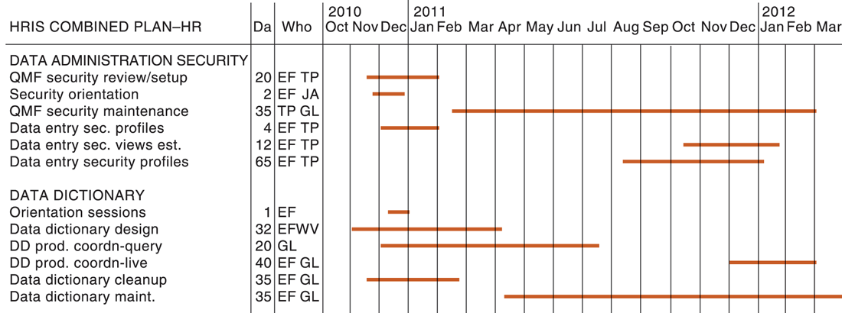
CHAPTER 14: MANAGING PROJECTS
Managing Project Risk
A GANTT CHART
FIGURE 14-5
The Gantt Chart in this figure shows the task, person-days, and initials of each responsible person, as well as the start and finish dates for each task. The resource summary provides a good manager with the total person-days for each month and for each person working on the project to manage the project successfully. The project described here is a data administration project.
© Prentice Hall 2011
Notes:
This slide and the next two show the top, middle, and bottom portions of a Gantt Chart. The orange lines show the beginning, duration, and end of each task. Organizing a project in this way can allow a manager to see what is or should be worked on at any given time

Slide 27
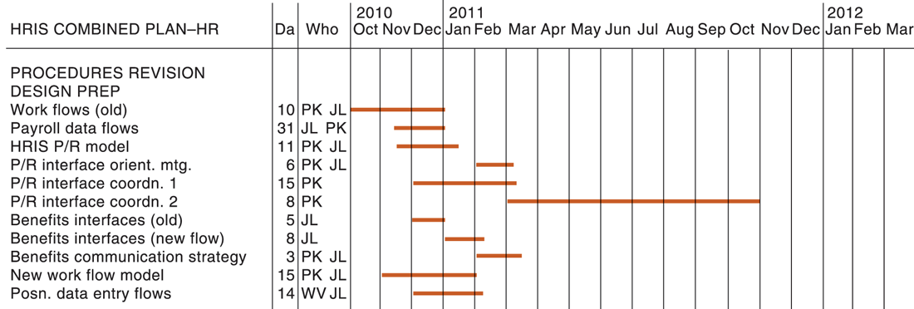
CHAPTER 14: MANAGING PROJECTS
Managing Project Risk
A GANTT CHART (cont.)
FIGURE 14-5
The Gantt chart in this figure shows the task, person-days, and initials of each responsible person, as well as the start and finish dates for each task. The resource summary provides a good manager with the total person-days for each month and for each person working on the project to manage the project successfully. The project described here is a data administration project.
© Prentice Hall 2011
Notes:
This slide shows the middle of the Figure 14-5 Gantt chart.

Slide 28
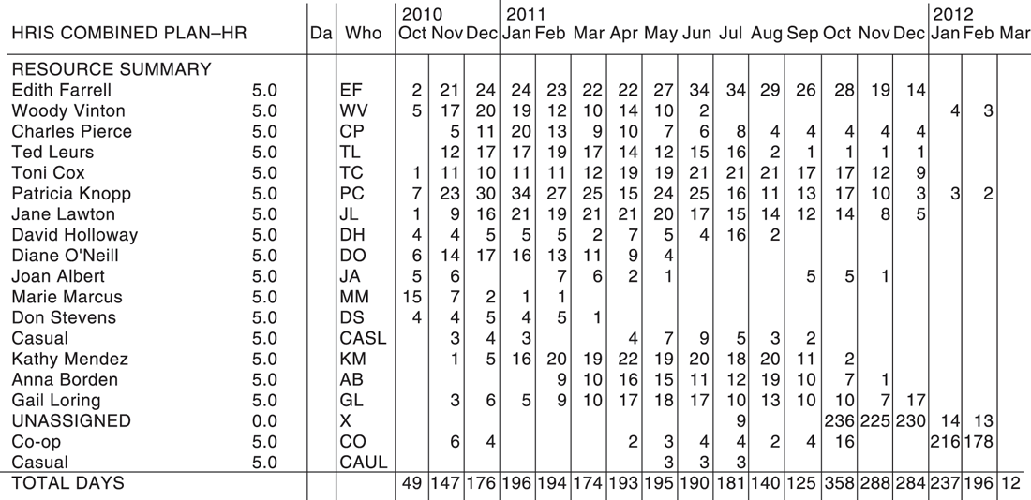
CHAPTER 14: MANAGING PROJECTS
Managing Project Risk
A GANTT CHART (cont.)
© Prentice Hall 2011
Notes:
This slide shows the Resource Summary section at the bottom of the Figure 14-5 Gantt Chart. Here you can see total numbers of human work days across the bottom of the chart.

Slide 29
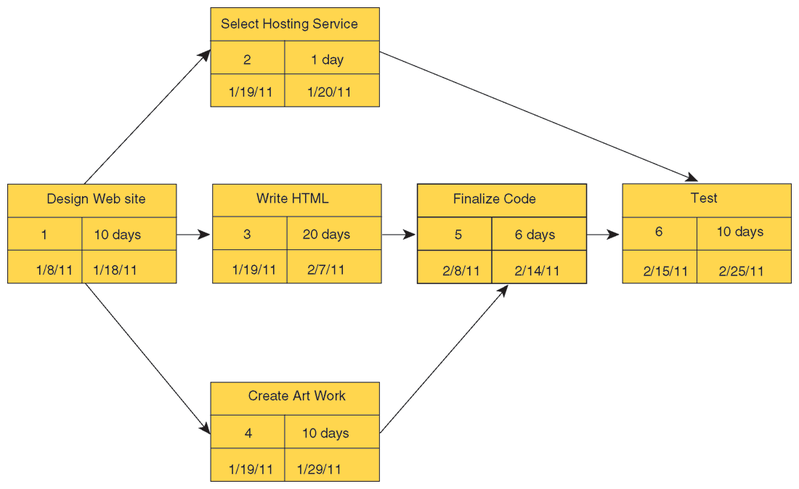
CHAPTER 14: MANAGING PROJECTS
Managing Project Risk
A PERT CHART
FIGURE 14-6
This is a simplified PERT Chart for creating a small Web site. It shows the ordering of project tasks and the relationship of a task with preceding and succeeding tasks.
© Prentice Hall 2011
Notes:
This graphic is a simplified PERT Chart, which shows the dependencies between project tasks. Ask students to define what “dependencies” means and to point out the dependencies in this chart. Why are dependencies important to consider when managing a project?

Slide 30
CHAPTER 14: MANAGING PROJECTS
Managing Project Risk
Increasing user involvement and overcoming user resistance
  External integration tools consist of ways to link work of implementation team to users at all organizational levels
    Active involvement of users
    Implementation team’s responsiveness to users
  User resistance to organizational change
    Users may believe change is detrimental to their interests
    Counterimplementation: Deliberate strategy to thwart implementation of an information system or an innovation in an organization
      E.g., increased error rates, disruptions, turnover, sabotage
© Prentice Hall 2011
Notes:
This slide discusses a third type of tool to meet implementation challenges, external integration tools. It discusses the forms that user resistance may take. Ask students if they have ever witnessed user resistance to an information system at their work places.

Slide 31
CHAPTER 14: MANAGING PROJECTS
Managing Project Risk
Strategies to overcome user resistance
  User participation
  User education and training
  Management edicts and policies
  Incentives for cooperation
  Improvement of end-user interface
  Resolution of organizational problems prior to introduction of new system
© Prentice Hall 2011
Notes:
This slide discusses methods to counter user resistance. Ask students why simply declaring a system “mandatory” may not be the best approach to effect user participation.

Slide 32
CHAPTER 14: MANAGING PROJECTS
Managing Project Risk
Designing for the organization
  Information system projects must address ways in which organization changes with new system
    Procedural changes
    Job functions
    Organizational structure
    Power relationships
    Work structure
  Ergonomics: Interaction of people and machines in work environment
    Design of jobs
    Health issues
    End-user interfaces
© Prentice Hall 2011
Notes:
This slide discusses the ways in which a new information system can impact an organization. Table 14-5 in the text lists the organizational factors in systems planning and implementation. Ask students to identify some of these. (Employee participation and involvement, job design, standards and performance monitoring, ergonomics, employee grievance resolution procedures, health and safety, government regulatory compliance.)

Slide 33
CHAPTER 14: MANAGING PROJECTS
Managing Project Risk
DST SYSTEMS SCORES WITH SCRUM AND APPLICATION LIFE CYCLE MANAGEMENT
What were some of the problems with DST Systems’ old software development environment?
How did Scrum development help solve some of those problems?
What other adjustments did DST make to be able to use Scrum more effectively in its software projects?
What management, organization, and technology issues had to be addressed?
© Prentice Hall 2011
Notes:
This slide presents discussion questions regarding the chapter case on software firm DST Systems which had trouble managing its projects because it had a high level of technical complexity. DST needed more powerful tools for planning and control as well as buy-in from end users. They implemented Scrum, a framework for agile software development in which projects progress via a series of iterations called sprints, which are no more than a month long, ending with a review to the product owner and interested stakeholders.

Slide 34
CHAPTER 14: MANAGING PROJECTS
Managing Project Risk
Organizational impact analysis
  How system will affect organizational structure, attitudes, decision making, operations
Sociotechnical design
  Addresses human and organizational issues
    Separate sets of technical and social design solutions
    Final design is solution that best meets both technical and social objectives
© Prentice Hall 2011
Notes:
This slide discusses the use of using an organizational impact analysis to anticipate how an upcoming system will affect an organization. It also discusses the use of sociotechnical design, a method to address human and organizational practices into information systems projects.

Slide 35
CHAPTER 14: MANAGING PROJECTS
Managing Project Risk
Project management software
  Can automate many aspects of project management
  Capabilities for
    Defining, ordering, editing tasks
    Assigning resources to tasks
    Tracking progress
  Microsoft Project 2010
    Most widely used project management software
    PERT, Gantt Charts, critical path analysis
  Increase in SaaS, open-source project management software
© Prentice Hall 2011
Notes:
This slide discusses commercial software that is available to assist in managing projects, the most popular of which is Microsoft Project. There are also numerous online project management tools available over the Internet, from time-tracking tools to groupware. Ask students if they have ever used any project management software.

Slide 36
CHAPTER 14: MANAGING PROJECTS
Managing Project Risk
MOTOROLA TURNS TO PROJECT PORTFOLIO MANAGEMENT
What are some of the challenges Motorola faces as a business? Why is project management so critical at this company?
What features of HP PPM were most useful to Motorola?
What management, organization, and technology factors had to be addressed before Motorola could implement and successfully use HP PPM?
Evaluate the business impact of adopting HP PPM at Motorola.
© Prentice Hall 2011
Notes:
This slide presents discussion questions regarding the chapter case on Motorola, which after multiple mergers and acquisitions, had thousands of information systems. Motorola needed to better manage its systems and projects, establish which projects and processes were the most valuable, least efficient, or redundant. HP’s Project and Portfolio Management Center software allowed managers to compare proposals, projects, and operational activities against budgets and resource capacity levels.

Slide 37
CHAPTER 14: MANAGING PROJECTS
© Prentice Hall 2011

