Slide 1

MANAGING GLOBAL SYSTEMS
Chapter 15
VIDEO CASES
Case 1 Daum Runs Oracle Apps on Linux
Case 2: Monsanto Uses Cisco and Microsoft to Manage Globally

Slide 2
CHAPTER 15: MANAGING GLOBAL SYSTEMS
Learning Objectives
What major factors are driving the internationalization of business?
What are the alternative strategies for developing global businesses?
How can information systems support different global business strategies?
What are the challenges posed by global information systems and management solutions for these challenges?
What are the issues and technical alternatives to be considered when developing international information systems?
© Prentice Hall 2011
Notes:
This chapter discusses the use and influence of information technology in developing a global business strategy. You could ask students to give an example of a global company and describe what it is that makes that company global. What are the advantages that a global firm has over an equivalent national firm?

Slide 3
CHAPTER 15: MANAGING GLOBAL SYSTEMS
3M: Sticky Film And Scratchy Things That Sell Around The World
Problem: 3M’s many divisions and thousands of local operations use separate information systems, managers unable to access timely data
Solution: SAP’s Business Suite Applications to replace all legacy software around the world, rolling out the enterprise software in phased and modular stages
Demonstrates: The need for global firms to have international systems for monitoring the business
Illustrates: The use of enterprise software suite to minimize integration problems
© Prentice Hall 2011
Notes:
This slide discusses the chapter opening case that looks at the global company 3M and its needs for globally integrated information systems.
Note that the cost of implementing new information systems on such a scale is enormous, in this case between $35 to $75 million. Given the obvious need for integration, would 3M face any organizational opposition? Ask students to imagine what kind of opposition 3M might face, and ask students what kind of efforts 3M is making to help the new systems be accepted organizationally.

Slide 4
CHAPTER 15: MANAGING GLOBAL SYSTEMS
The Growth of International Information Systems
Global economic system and global world order driven by advanced networks and information systems
Growth of international trade has radically altered domestic economies around the globe
For example, production of many high-end electronic products parceled out to multiple countries
  E.g., Hewlett-Packard laptop computer
© Prentice Hall 2011
Notes:
This slide emphasizes the role of advanced networks and information systems in enabling the growth of global economic systems and global world order. Ask students why networks and IT advances make globalization more feasible. The text uses the example of HP’s path to market to illustrate what globalization means for an international firm, illustrated in the next slide.

Slide 5
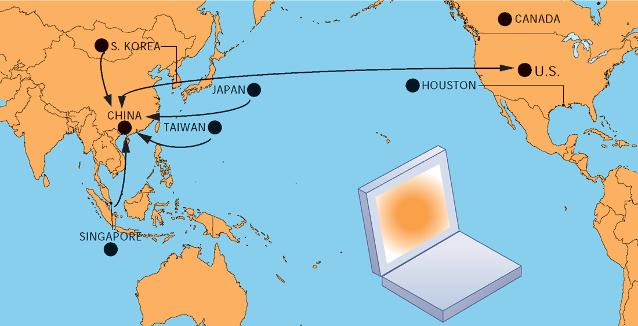
CHAPTER 15: MANAGING GLOBAL SYSTEMS
The Growth of International Information Systems
AN HP LAPTOP’S PATH TO MARKET
FIGURE 15-1
HP and other electronics companies assign distribution and production of their products to a number of different countries.
© Prentice Hall 2011
Notes:
This slide illustrates the path to market of an HP laptop. The concept and design came from a design team in the U.S., and engineering design was done in Taiwan. Graphics processors were designed in Canada and manufactured in Taiwan. Taiwan and South Korea manufactured LCD screens and memory chips. The hard drive was made in Japan. Other components came from China, Japan, Singapore, South Korea, and the U.S., and the laptop was assembled in China. Ask students what their impressions are of this path to market. Ask them where the advantage lies in having this work accomplished piecemeal across the world.

Slide 6
CHAPTER 15: MANAGING GLOBAL SYSTEMS
The Growth of International Information Systems
Strategy when building international systems
  Understand global environment
    Business drivers pushing your industry toward global competition
    Inhibitors creating management challenges
  Develop corporate strategy for competition
    How firm should respond to global competition
  Develop organization structure and division of labor
    Where will production, marketing, sales, etc., be located
  Consider management issues
    Design of business procedures, reengineering, managing change
  Consider technology platform
© Prentice Hall 2011
Notes:
This slide discusses the strategy a firm should take in order to make a successful move toward globalization. Why would understanding the business drivers be the top consideration? Why is considering the technology platform the last consideration?

Slide 7
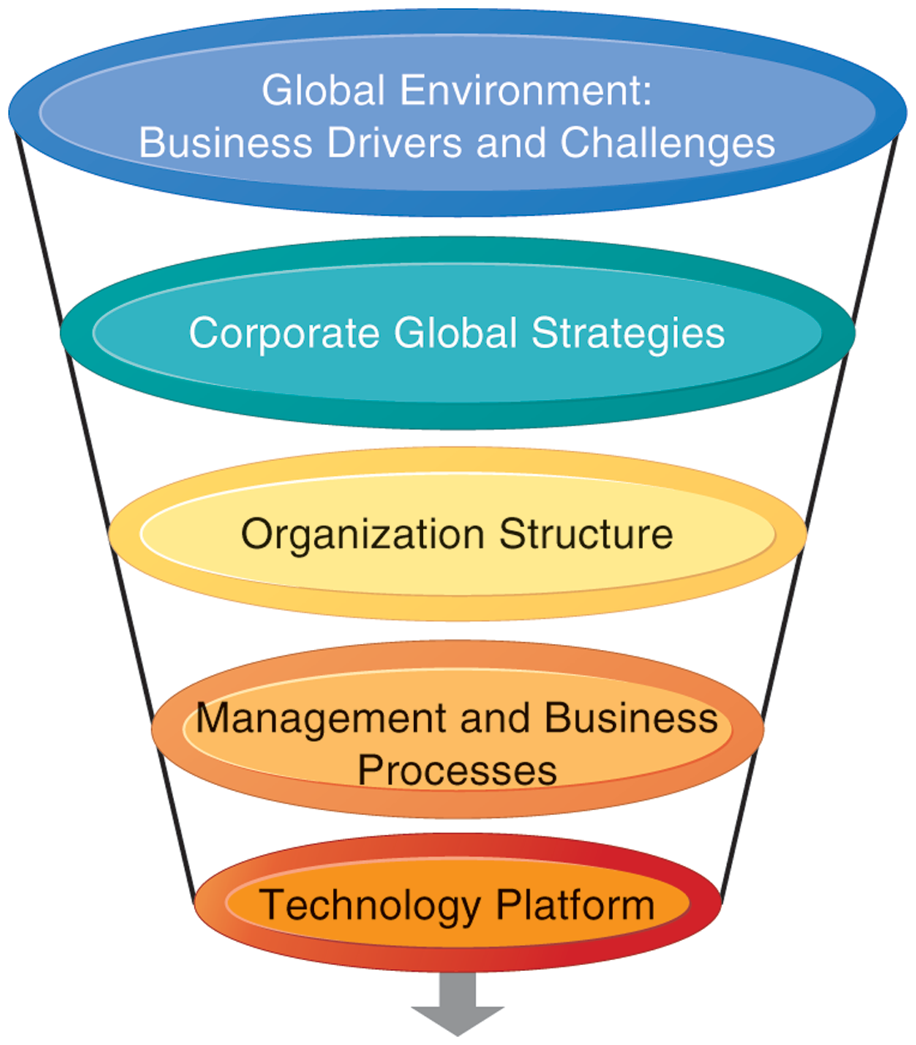
CHAPTER 15: MANAGING GLOBAL SYSTEMS
The Growth of International Information Systems
INTERNATIONAL INFORMATION SYSTEMS ARCHITECTURE
The major dimensions for developing an international information systems architecture are the global environment, the corporate global strategies, the structure of the organization, the management and business processes, and the technology platform.
FIGURE 15-2
© Prentice Hall 2011
Notes:
This graphic illustrates the strategy for developing an international system. There are a variety of choices when determining a corporate global strategy. For example, you could sell to the glove from a domestic base, or organize production and distribution around the world. Determining a global strategy means deciding what portions of the business are located globally. What would be the biggest factors in making this decision?

Slide 8
CHAPTER 15: MANAGING GLOBAL SYSTEMS
The Growth of International Information Systems
Global business drivers:
  General cultural factors lead toward internationalization and result in specific business globalization factors
GENERAL CULTURAL FACTORS | SPECIFIC BUSINESS FACTORS
Global communication and transportation technologies Development of global culture Emergence of global social norms Political stability Global knowledge base | Global markets Global production and operations Global coordination Global workforce Global economies of scale
© Prentice Hall 2011
Notes:
The first strategic consideration in building an international system is to examine the global environment in terms of business drivers and challenges. This slide and the next two examine business drivers and challenges that lead industries toward global markets and competition. Ask students what global culture is and how this influences internationalization. Ask students to explain what the global knowledge base is, and how this has changed over the past half-century. Can all industries benefit equally from globalization? Why or why not?

Slide 9
CHAPTER 15: MANAGING GLOBAL SYSTEMS
The Growth of International Information Systems
Challenges and obstacles to global business systems
  General cultural challenges
    Cultural particularism
      Regionalism, nationalism, language differences
    Social expectations:
      Brand-name expectations, work hours
    Political laws
      Transborder data flow
      Transborder data and privacy laws, commercial regulations
© Prentice Hall 2011
Notes:
This slide continues the discussion of the environmental factors driving a business or industry to globalization. There are both general, cultural challenges in internationalization as well as specific challenges; this slide looks at the general challenges. Ask students to define particularism and to provide an example of it. How would particularism, regionalism, nationalism, affect the success of a business trying to globalize? What is transborder data flow? With the use of the Internet, how is transborder data flow an issue?

Slide 10
CHAPTER 15: MANAGING GLOBAL SYSTEMS
The Growth of International Information Systems
Challenges to global business systems (cont.)
  Specific challenges
    Standards
      Different EDI, e-mail, telecommunication standards
    Reliability
      Phone networks not uniformly reliable
    Speed
      Different data transfer speeds, many slower than U.S.
    Personnel
      Shortages of skilled consultants
© Prentice Hall 2011
Notes:
This slide continues the discussion of the challenges to internationalization and looks at specific challenges that firms face. One challenge discussed in the text is different accounting standards. How can accounting standards be different from country to country? Ask students how an accounting standard can pose difficulties to developing a global information system. Ask students to define EDI (discussed in an earlier chapter).

Slide 11
CHAPTER 15: MANAGING GLOBAL SYSTEMS
The Growth of International Information Systems
State of the art
  Most companies have inherited patchwork international systems using 1960s-era batch-oriented reporting, manual entry of data from one legacy system to another, and little online control and communication
  Significant difficulties in building appropriate international architectures
    Planning a system appropriate to firm’s global strategy
    Structuring organization of systems and business units
    Solving implementation issues
    Choosing right technical platform
© Prentice Hall 2011
Notes:
This slide describes the reality of global information systems in use in typical businesses today. Few businesses that have begun to internationalize have top-of-the-line systems and face powerful competition from those companies that do have truly international systems.

Slide 12
CHAPTER 15: MANAGING GLOBAL SYSTEMS
Organizing International Information Systems
Global strategies and business organization
  Three main kinds of organizational structure
    Centralized: In the home country
    Decentralized/dispersed: To local foreign units
    Coordinated: All units participate as equals
  Four main global strategies
    Domestic exporter
    Multinational
    Franchisers
    Transnational
© Prentice Hall 2011
Notes:
This slide discusses the general ways in business activities can be organized and the four main business strategies used by global companies.
Ask students to describe each of the strategies (domestic exporter, multinational, franchiser, transnational) and to provide an example.

Slide 13
CHAPTER 15: MANAGING GLOBAL SYSTEMS
Organizing International Information Systems
GLOBAL BUSINESS AND STRATEGY
BUSINESS FUNCTION | DOMESTIC EXPORTER | MULTINATIONAL | FRANCHISER | TRANSNATIONAL
Production | Centralized | Dispersed | Coordinated | Coordinated
Finance/ Accounting | Centralized | Centralized | Centralized | Coordinated
Sales/ Marketing | Mixed | Dispersed | Coordinated | Coordinated
Human Resources | Centralized | Centralized | Coordinated | Coordinated
Strategic Management | Centralized | Centralized | Centralized | Coordinated
© Prentice Hall 2011
Notes:
This table shows how each of the four main global business strategies handle the organization of business functions (production, finance, sales, human resources, management). Of these four strategies, the transnational is the truly international form, taking the globe, not the home country, as a frame of reference. However, it is important to note that few companies have attained a truly transnational organization.
Ask students what the social effects, if any, might be if more and more companies become transnational, without reference to an origin country.

Slide 14
CHAPTER 15: MANAGING GLOBAL SYSTEMS
Organizing International Information Systems
Global systems to fit the strategy
  Configuration, management, and development of systems tend to follow global strategy chosen
  Four main types of systems configuration
    Centralized: Systems development and operation occur totally at domestic home base
    Duplicated: Development occurs at home base but operations are handed over to autonomous units in foreign locations
    Decentralized: Each foreign unit designs own solutions and systems
    Networked: Development and operations occur in coordinated fashion across all units
© Prentice Hall 2011

Slide 15
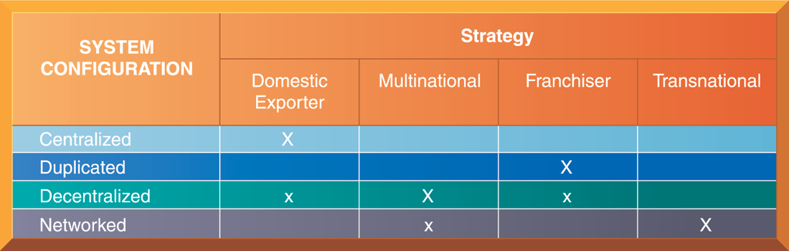
CHAPTER 15: MANAGING GLOBAL SYSTEMS
Organizing International Information Systems
GLOBAL STRATEGY AND SYSTEMS CONFIGURATIONS
FIGURE 15-3
The large Xs show the dominant patterns, and the small Xs show the emerging patterns. For instance, domestic exporters rely predominantly on centralized systems, but there is continual pressure and some development of decentralized systems in local marketing regions.
© Prentice Hall 2011
Notes:
This table shows which system configurations are typically used when a firm employs one of the four global strategies. The large Xs show the dominant patterns while the small Xs show the emerging pattern. The transnational has the most ambitious form of systems development, using a singular global environment. This structure is most visible in financial services companies, where the homogeneity of the product (money, money instruments) seems to overcome cultural barriers.

Slide 16
CHAPTER 15: MANAGING GLOBAL SYSTEMS
Organizing International Information Systems
To develop a global company and information systems support structure:
  Organize value-adding activities along lines of comparative advantage
    E.g., Locate functions where they can best be performed, for least cost and maximum impact
  Develop and operate systems units at each level of corporate activity—regional, national, and international
  Establish at world headquarters:
    Single office responsible for development of international systems
    Global CIO position
© Prentice Hall 2011
Notes:
This slide discusses how a firm should organize itself for doing business on an international scale and offers three main principles to follow when developing a global company and information systems support structure. Ask students to explain the second principal. (For local needs, there should be host country systems units; regional systems units should handle systems development across national boundaries but within major geographic regions; transnational systems should create linkages across and between regional systems.) What types of systems would serve local over regional needs?

Slide 17
CHAPTER 15: MANAGING GLOBAL SYSTEMS
Managing Global Systems
Principle management challenges in developing global systems
  Agreeing on common user requirements
  Introducing changes in business processes
  Coordinating application development
  Coordinating software releases
  Encouraging local users to support global systems
© Prentice Hall 2011
Notes:
Even if the right strategy is developed for a global systems, there are still many management problems that are encountered when developing and building a global information system. Note that these are the same types of challenges faced when building local systems – on an international scale, the challenges become increasingly complex. Ask students to describe how a user-designer communications gap might become more complex or heightened when building an international system. What other types of factors are at play when building an international system that make this a more complicated process than building a local system?

Slide 18
CHAPTER 15: MANAGING GLOBAL SYSTEMS
Managing Global Systems
Typical scenario: Disorganization on a global scale
  Traditional multinational consumer-goods company based in U.S. and operating in Europe would like to expand into Asian markets
  World headquarters and strategic management in U.S.
    Only centrally coordinated system is financial controls and reporting
  Separate regional, national production and marketing centers
  Foreign divisions have separate IT systems
  E-mail systems are incompatible
  Each production facility uses different ERP system, different hardware and database platforms, etc.
© Prentice Hall 2011
Notes:
This slide describes a common scenario of a multinational company and the challenges it faces in trying to develop a transnational information system as it expands into Asian markets. What types of implementation problems can the company expect when it begins development? Can resistance be expected even from the IT departments in different countries? The text describes some likely reactions (the foreign divisions will resist efforts to agree on common user requirements, U.S. systems groups will not easily accept guidance from anyone recommending a transnational strategy, etc.)

Slide 19
CHAPTER 15: MANAGING GLOBAL SYSTEMS
Managing Global Systems
Global systems strategy
  Share only core systems
    Core systems support functionality critical to firm
  Partially coordinate systems that share some key elements
    Do not have to be totally common across national boundaries
    Local variation desirable
  Peripheral systems
    Need to suit local requirements only
© Prentice Hall 2011
Notes:
This slide looks at the basic framework of a solution to implementing a transnational information system. Ask students what types of systems might be considered “core systems.” What types of systems might fall into the partially coordinated category? The peripheral systems category?

Slide 20
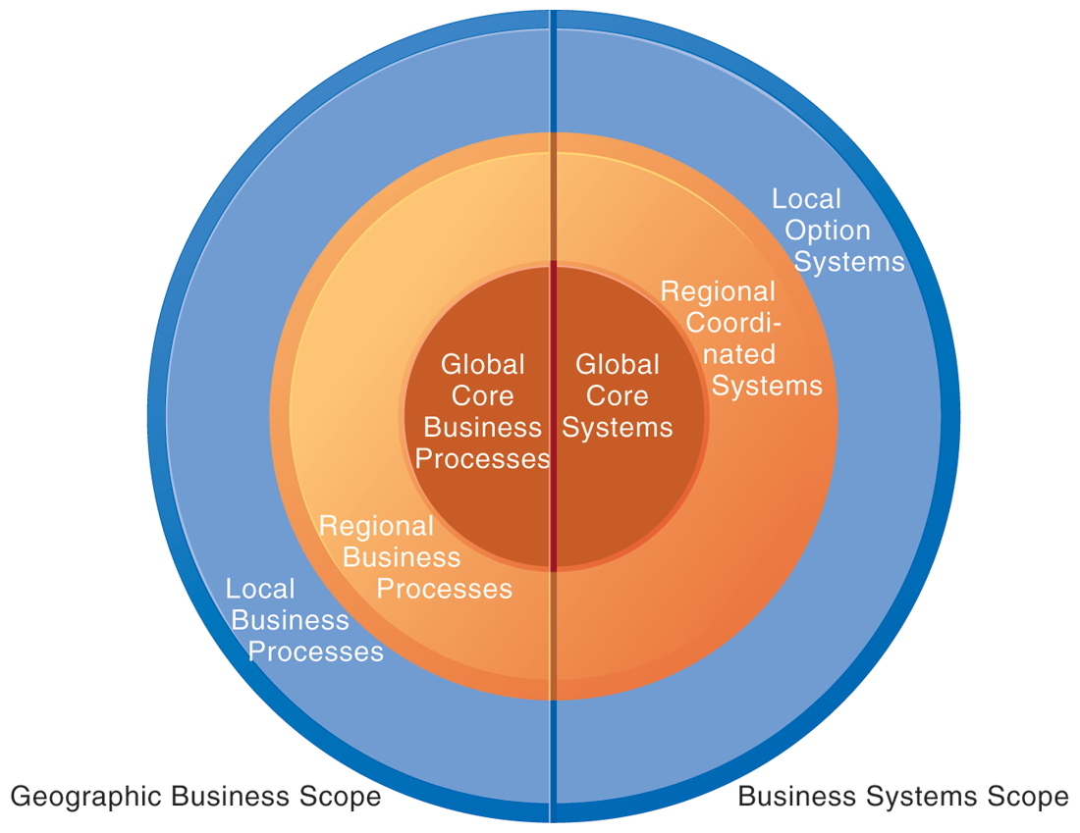
CHAPTER 15: MANAGING GLOBAL SYSTEMS
Managing Global Systems
LOCAL, REGIONAL, AND GLOBAL SYSTEMS
Agency and other coordination costs increase as the firm moves from local option systems toward regional and global systems. However, transaction costs of participating in global markets probably decrease as firms develop global systems. A sensible strategy is to reduce agency costs by developing only a few core global systems that are vital for global operations, leaving other systems in the hands of regional and local units.
FIGURE 15-4
© Prentice Hall 2011
Notes:
This graphic illustrates the scope of the three different categories of system (global, regional, local). Give the student an example industry, say, sports apparel manufacturing, and ask students to describe what local, regional, and global business processes might be. Use Nike as an example– a U.S. firm for design, marketing, sales and distribution where all the products are made in off-shore factories.

Slide 21
CHAPTER 15: MANAGING GLOBAL SYSTEMS
Managing Global Systems
Define core business processes
Identify core systems to coordinate centrally
Choose an approach
  Piecemeal and grand design approaches tend to fail
  Evolve transnational applications incrementally from existing applications
Make benefits clear
  Global flexibility
  Gains in efficiency
  Global markets and larger customer base unleash new economies of scale at production facilities
  Optimizing corporate funds over much larger capital base
© Prentice Hall 2011
Notes:
This slide outlines the steps in creating a successful global systems solution appropriate to the firm’s goals and strategies. Ask students how a firm would determine its core business processes (conduct business process analysis). Emphasize that the second step is to define the core systems identified as the transnational systems, and these should be kept to a minimum. Emphasize that it is crucial for senior managers at headquarters and in foreign divisions to understand the benefits. Ask students how a larger customer base unleashes economies of scale. What does optimizing funds over a larger capital base mean?

Slide 22
CHAPTER 15: MANAGING GLOBAL SYSTEMS
Managing Global Systems
The management solution: Implementation
  Agreeing on common user requirements
    Short list of core business processes
    Develop common language, understanding of common elements and unique local qualities
  Introducing changes in business processes
    Success depends on legitimacy, authority, ability to involve users in change design process
  Coordinating applications development
    Coordinate change through incremental steps
    Reduce set of transnational systems to bare minimum
© Prentice Hall 2011
Notes:
This slide reconsiders the management challenges introduced on Slide 17 (Table 15-4 in the text). What is meant by “developing a common language to discuss the business” and why is this important? Ask students to define legitimacy. Emphasize that, at the global level, there is far too much complexity to implement full-scale, world-wide application changes.

Slide 23
CHAPTER 15: MANAGING GLOBAL SYSTEMS
Managing Global Systems
FONTERRA: MANAGING THE WORLD’S MILK TRADE
Describe the various capabilities of SAP GTS. How does using this software help Fonterra manage its export trade? What quantifiable benefits does this system provide?
How would you characterize Fonterra’s global business strategy and structure (review Table 15-3)? What kind of a global business is it? Has Fonterra’s structure and strategy shaped its uses of SAP GTS? Would a transnational company choose a different solution?
What influence does the global business environment have on firms like Fonterra, and how does that influence their choice of systems?
© Prentice Hall 2011
Notes:
This slide presents discussion questions regarding the chapter case examining Fonterra, the world’s leading exporter of dairy products and a cooperative of New Zealand dairy farmers. The firm uses SAP Global Trade Services (GTS) to automate import/export processes and standardize trade processes across their entire enterprise, lowering the cost and reducing risk of doing business internationally.

Slide 24
CHAPTER 15: MANAGING GLOBAL SYSTEMS
Managing Global Systems
The management solution (cont.)
  Coordinating software releases
    Institute procedures to ensure all operating units update at the same time
  Encouraging local users to support global systems
    Cooptation: Bringing the opposition into design and implementation process without giving up control over direction and nature of the change
      Permit each country unit to develop one transnational application
      Develop new transnational centers of excellence
© Prentice Hall 2011
Notes:
This slide continues the discussion of solutions to the management challenges. What types of difficulties might there be in having all units update software at the same time? Why does the text suggest that, as much as possible, raw power– commanding people-- should be avoided, when dealing with user resistance?

Slide 25
CHAPTER 15: MANAGING GLOBAL SYSTEMS
Technology Issues and Opportunities for Global Value Chains
Technology challenges of global systems
  Computing platforms and systems integration
    How new core systems will fit in with existing suite of applications developed around globe by different divisions
    Standardization: Data standards, interfaces, software, etc.
  Connectivity
    Internet does not guarantee any level of service
    Many firms use private networks and VPNs
    Low penetration of PCs, outdated infrastructures in developing countries
© Prentice Hall 2011
Notes:
The slide and the next emphasize the types of technological, rather than organizational, challenges faced when building a global system. It is important to note that all units having the same hardware and operating software does not guarantee integration, data standardization must also be enforced. For example, technical accounting terms, such as the beginning and end of the fiscal year, must be standardized.

Slide 26
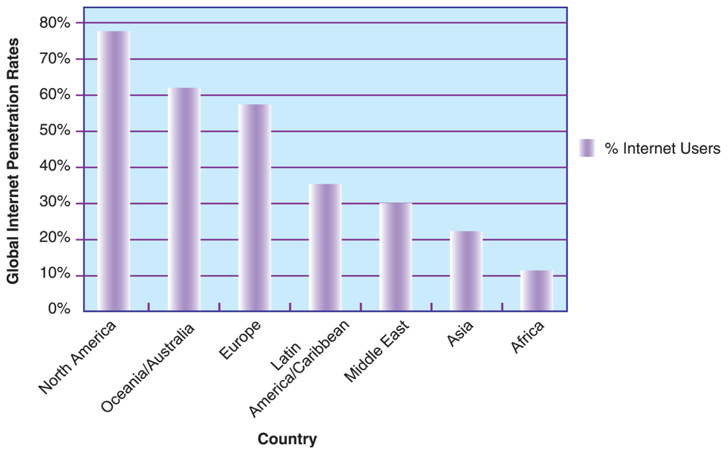
CHAPTER 15: MANAGING GLOBAL SYSTEMS
Technology Issues and Opportunities for Global Value Chains
INTERNET PENETRATION BY REGION
FIGURE 15-5
The percentage of the total population using the Internet in developing countries is much smaller than in the United States and Europe, but the fastest growth is in Asia.
© Prentice Hall 2011
Notes:
This graph shows the percentage of population using the Internet, by region. It illustrates the lower penetration of Internet usage in developing countries.

Slide 27
CHAPTER 15: MANAGING GLOBAL SYSTEMS
Technology Issues and Opportunities for Global Value Chains
Technology challenges of global systems (cont.)
  Software
    Integrating new systems with old
    Human interface design issues, languages
    Software localization: converting software to operate in second language
    Most important software applications:
      TPS and MIS
      Increasingly, SCM and enterprise systems to standardize business processes
      Applications that enhance productivity of international teams
© Prentice Hall 2011
Notes:
This slide continues the discussion of technology challenges in building global systems. Ask students why MIS and TPS are typically the most important applications.

Slide 28
CHAPTER 15: MANAGING GLOBAL SYSTEMS
Managing Global Systems
HOW CELL PHONES SUPPORT ECONOMIC DEVELOPMENT
What strategies are cell phone companies using to ‘close the digital divide’ and market phones to the poorest segment of the world’s population?
Why do economists predict that widespread cell phone usage in developing countries would have an unprecedented effect on the growth of those countries?
What are some examples of how cell phones might increase quality of life for residents of developing countries?
Do you believe that cell phones will proliferate widely through Africa and Asia? Why or why not?
© Prentice Hall 2011
Notes:
Cell phones present a partial solution to the problem of connectivity for international firms. This slide presents discussion questions on the chapter case examining the booming use of cell phones in the developing world and its effect on economic development. For example, in Niger, the growth of mobile phone coverage reduced the staple millet’s price differences across markets by 15 percent between 2001 and 2007, with a greater impact on markets isolated by distance and poor-quality roads. Cell phones allowed traders to respond to surpluses and shortages in the market, making better decisions about price and delivery. As a result, trader profits rose and prices fell.

Slide 29
CHAPTER 15: MANAGING GLOBAL SYSTEMS
© Prentice Hall 2011

