Slide 1

Capstone PROJECT DATA SCIENCE
WHERE TO OPEN A JAPANESE RESTAURANT IN MADRID, SPAIN– LUIS VIADERO BARANDICA

Slide 2

What’s the business?
Madrid is a highly diversed European capital, in terms of culture, business and lifestyle.
Over the past decade, Japanese gastronomy has strengthened its position among foodies. Nevertheless, this business market is somehow exploded in the city, as the offer is highly concentrated within the city center.
Spanish population loves it, and there’s a great acceptance to all this kind of restaurants ideas. Thus, an analysis was performed in order to decide whereas (if posible) would be the best place to open a brand-new Japanese restaurant across the Community of Madrid.

Slide 3
What’s the CONTEXT?
WHERE TO OPEN A RESTAURANT IS ALWAYS A HARD PROBLEM FOR EVERY ENTREPREUNER,
ESPECIALLY IN BIG CITY, HOW TO FIND AN IDEAL PLACE WHICH NOT TOO CLOSE TO MANY COMPETITORS AND, AT THE SAME TIME, NOT TOO FAR FROM EVERYBODY.
IN THIS ANALYSIS WE WILL COVER ON THIS PROBLEM, WITH THE FOCUS ON OUR CORE TOPIC - JAPANESE RESTAURANT

Slide 4
BUSINESS DATA ANALYSIS PROCESS
DATA REQUIREMENTS
In order to solve this need, we will need the following data:
Methodology & Results
Basically, we will need three data skills in order to explode at a minimum level the potential of the previous data:
- Web scraping (Wikipedia and Foursquare) and data analysis.
- K-means Clustering algorithm was selected due to its friendly use and implementation, and because it performs pretty good as well against noise and deviations.
- Also, folium visualizations were used in order to validate some of the ideas extracted from the model.
Conclusion
Given the insights of our cluster analysis, along with the information of our data (EDA) and the domain knowledge from a Madrid citizen point of view, this section Will discuss where to open the new restaurant.
- Madrid district data from Wikipedia.
- Geospatial data from Geocoder package.
- Venue related data from Foursquare API.

Slide 5
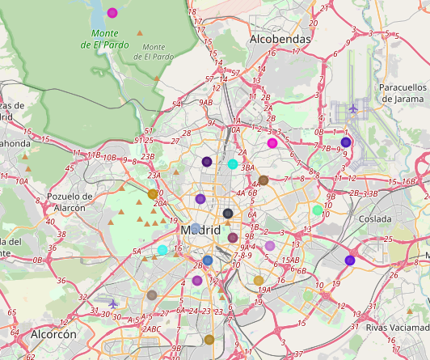
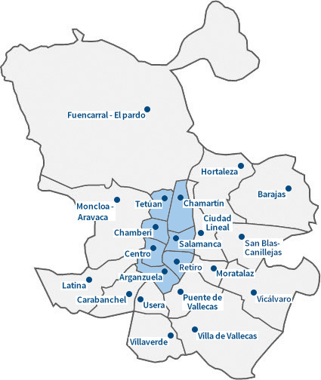
DISTRICTS OF MADRID

Slide 6
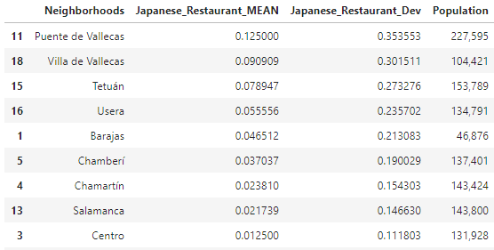
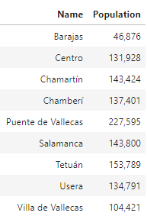
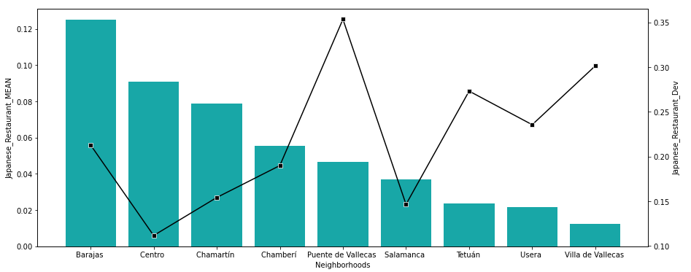
EDA to diagnos japanese congestion
Attractive area
Not that attractive

Slide 7
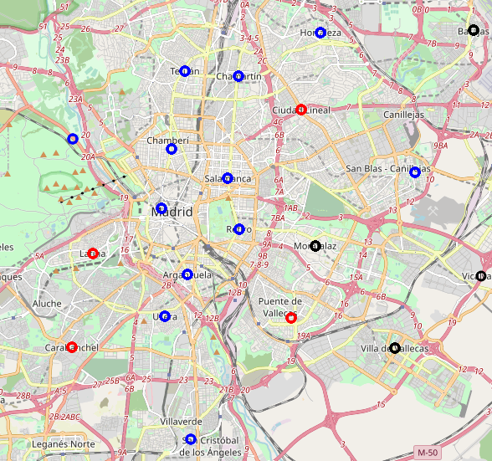
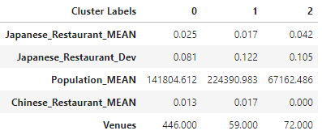
K-means CLUSTERING

Slide 8
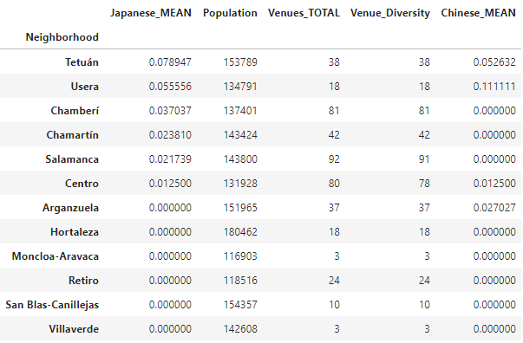
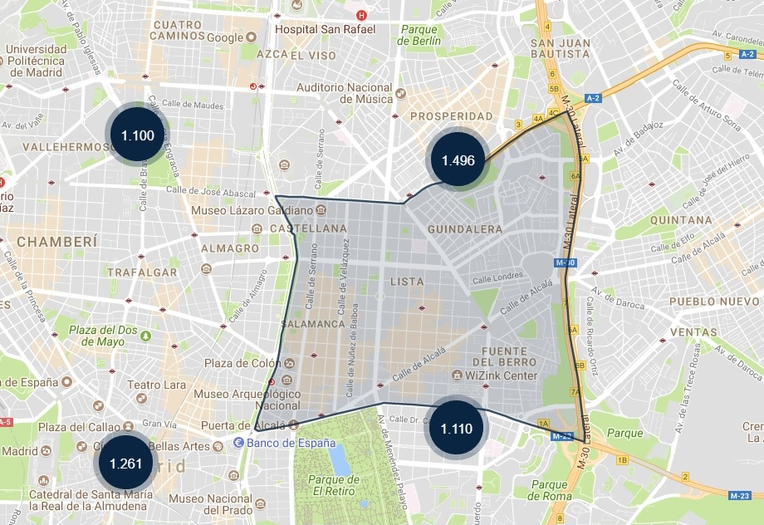
Cluster 0
District Seleciton
District of Salamanca and Chamberí would be ideal locations to launch this new project.
District’s information

Slide 9
CONCLUSION
WHERE SHOULD WE OPEN A NEW JAPANESE RESTAURANT AND WHY, GIVEN THE RESULTS FROM THE ANALYSIS:
We took into consideration different aspects that might influence the entrepreneur’s decision of opening a new not-Spanish restaurant. Thus, we looked at the diversity to the district, as well as the presence of other gastronomies coming from Asia (Chinese restaurants, Cantonese restaurants, noodle Houses, Korean Restaurants, etc.)
Also, we looked at their population, and the near by district’s population as they form potential customers. This is the reason why we discarded Barajas district since the beginning, even though it had a high presence of the previous points.
Finally, we discovered our ideal cluster (cluster 0) and digging deeper to select the final district. The final decision was highly influenced by domain knowledge of the geolocations of these districts in the city of Madrid; Salamanca’s district is a highly active area in the city (day and night) and one of the highest GDPpc in the city, the same happens with Chamberí district. All in all, let’s give a try…

