Slide 1

Online Retailer Recommender System
Business Cases for Data Science
GRUPO C
Catarina Moreira nº20201034
Luísa Barral nº20201045
Madalena Valério nº20200657
Yu Song nº20200572
1

Slide 2

What are we going to talk about today?
Business Cases for Data Science
Business Understanding
Data Understanding
Modelling
Evaluation
Deployment
2
2
1

Slide 3
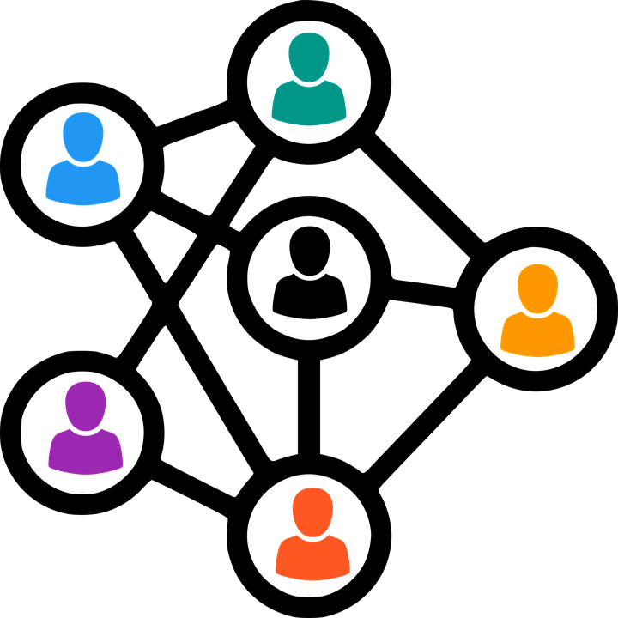
Importance of recommender systems
Business Cases for Data Science
Business Understanding
At Netflix, 2/3 of the movies watched are recommended
At Google, news recommendations improved click-through rate by 38%
For Amazon, 35% of sales come from recommendations
3

Slide 4

Business Cases for Data Science
Data Understanding
4

Slide 5
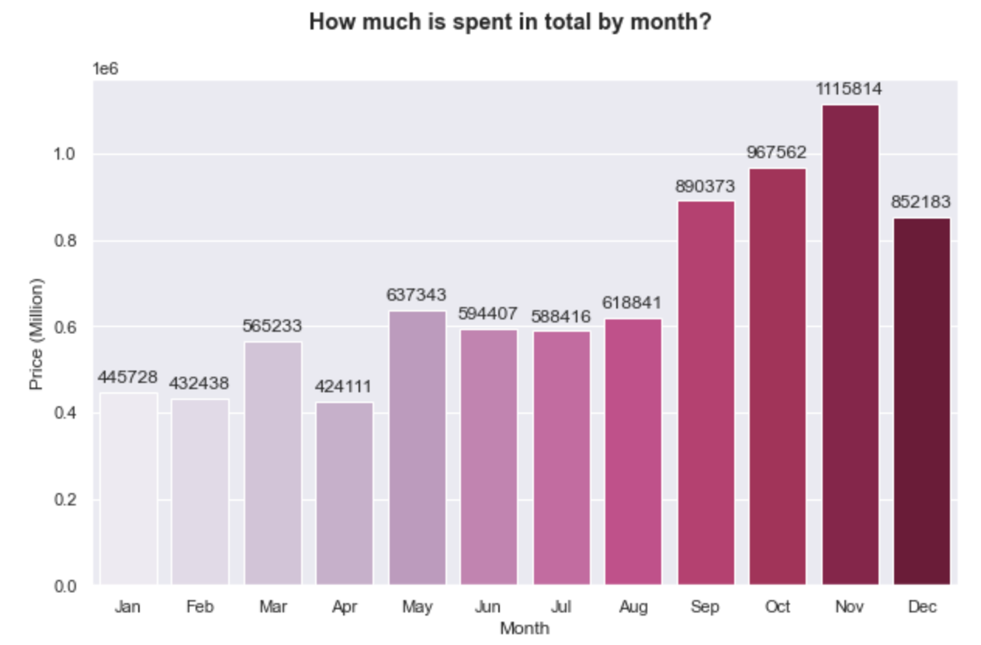
How much is spent in total by month?
Business Cases for Data Science
5

Slide 6
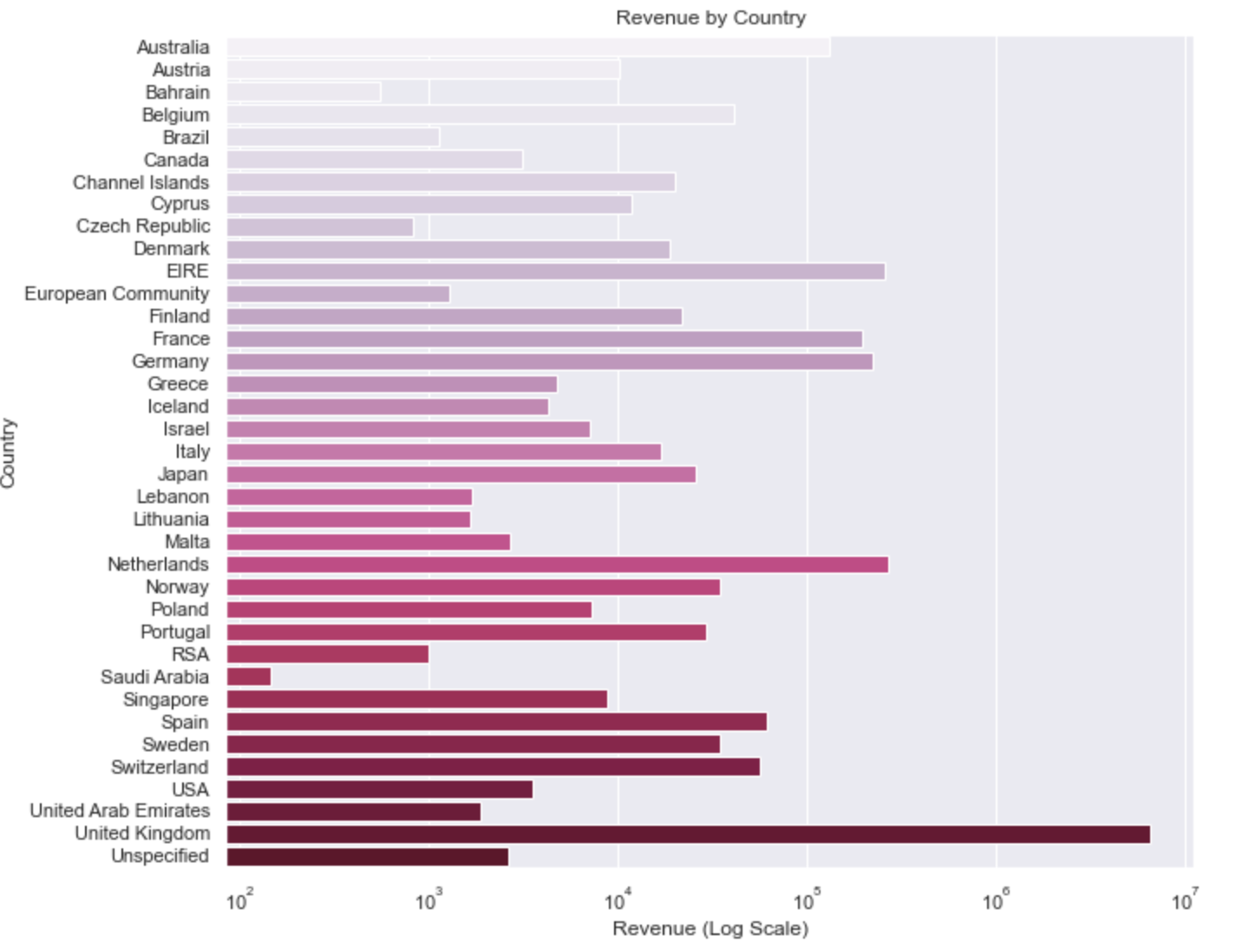
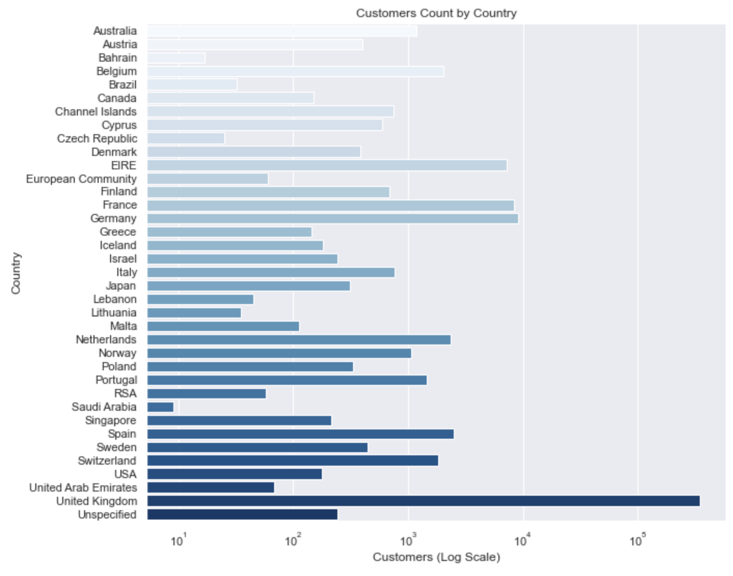
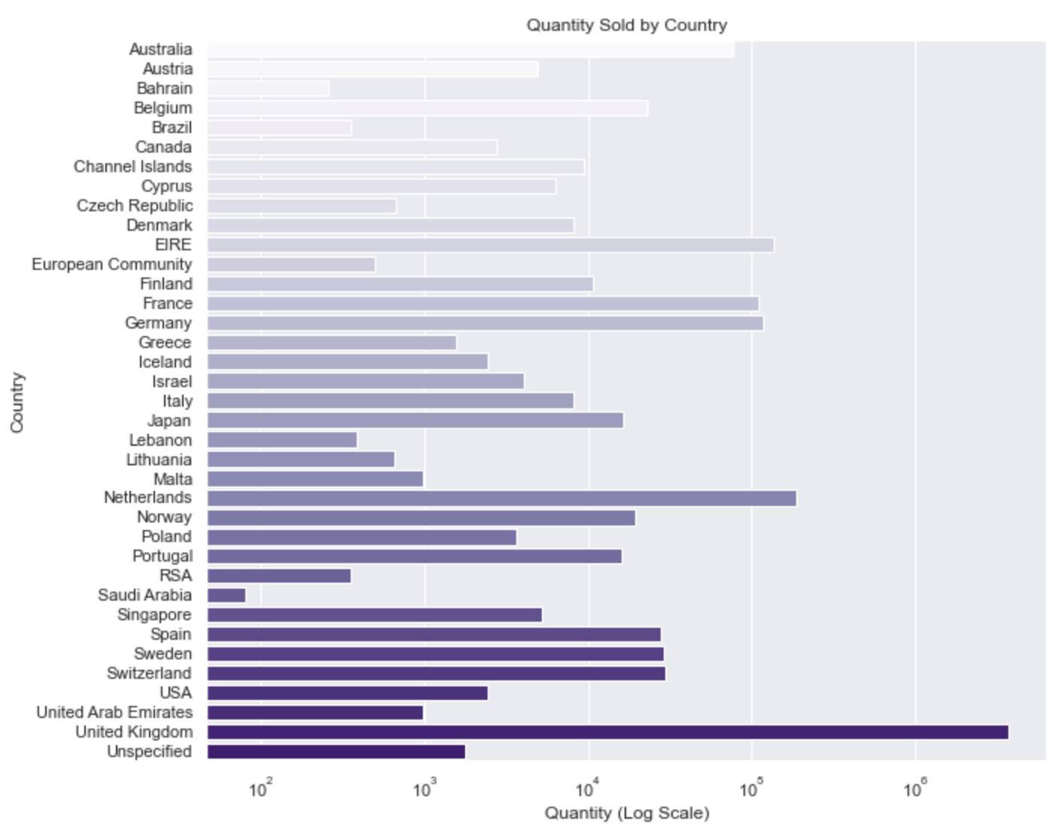
Business Cases for Data Science
Revenue by Country
Customers Count by Country
Quantity Sold by Country
6

Slide 7
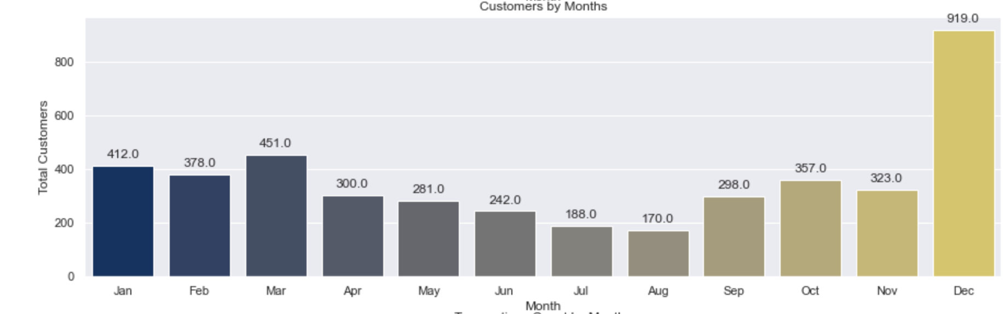
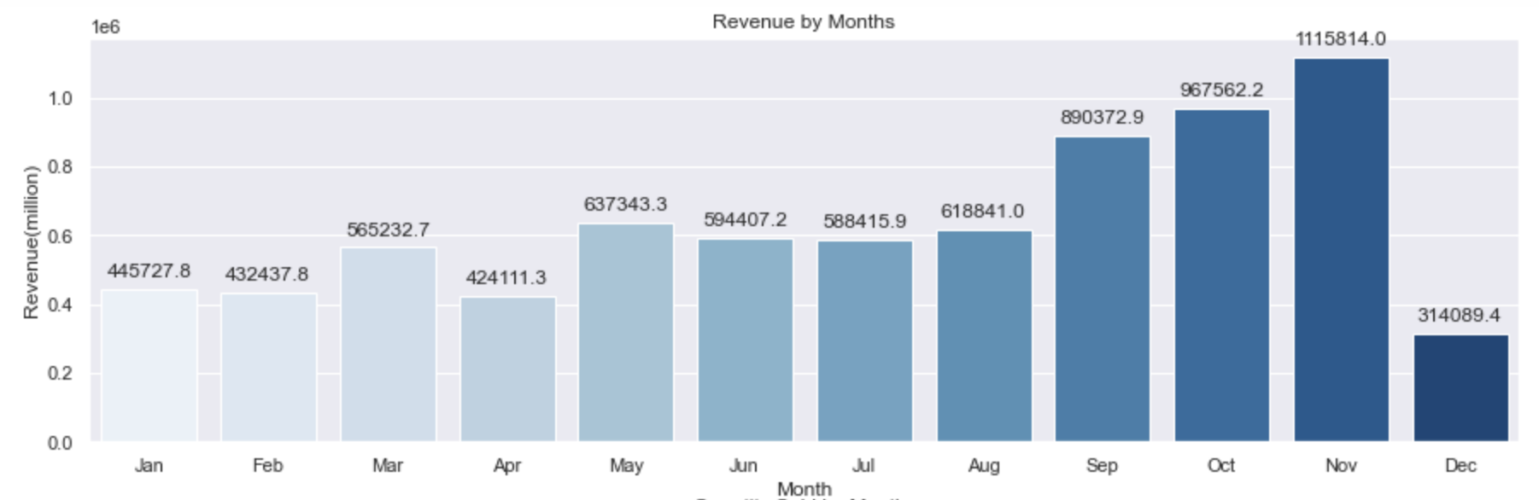
Business Cases for Data Science
Which Months have most Customers?
Which Month has the highest Revenue?

Slide 8

Modeling
Implicit Collaborative Filtering
Two different approaches using ALS
We took in consideration the dates. Training our dataset based on dates that are previous to our Test dataset
We ignored the dates. We trained our model based on all the data we had, regardless or the time of the event

Slide 9
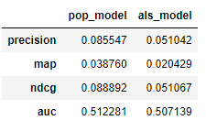
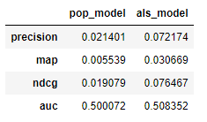
Business Cases for Data Science
1st Application of the ALS
2nd Application of the ALS
Evaluation @10
Evaluation @10
Our Model has Mean AUC of 0.857, while Popular Item benchmark had lower AUC of 0.783
Best Model
6

Slide 10
Business Cases for Data Science
Customer 1
Items Purchased
Items Recommended
Pack of 60 Pink Paisley Cake Cases | Pack Of 12 Blue Paisley Tissues | Set of 72 Pink Heart Paper Doilies
60 Teatime Fairy Cake Cases | Set Of 9 Black Skull Balloons | Multi Hearts Stickers
Pack Of 72 Skull Cake Cases | 60 Cake Cases Dolly Girl Design | 72 Cake Cases Vintage Christmas
72 Sweetheart Fairy Cake Cases | Pack Of 12 Hearts Design Tissues | Sweeties Stickers
60 Cake Cases Vintage Christmas | Pack Of 12 Suki Tissues | Doughnut Lip Gloss
Pack Of 12 London Tissues | Pack of 12 Woodland Tissues | Ice Cream Sundae Lip Gloss
Pack Of 12 Skull Tissues | Set Of 72 Skull Paper Doilies | Ice Cream Pen Lip Gloss
Pack Of 12 Circus Parade Tissues
Wrap I Love London
Skulls And Crossbones Wrap
Large Heart Measuring Spoons
Ice Cream Bubbles
Pack of 12 Red Retrospot tissues
Pack Of 60 Spaceboy Cake Cases
Pack Of 60 Dinosaur Cake Cases
Pink Fairy Cake Childrens Apron
Set 20 Napkins Fairy Cakes Design

Slide 11
Business Cases for Data Science
Customer 2
Items Purchased
Items Recommended
Mirrored Disco Ball | No Junk Mail Metal Sign | Garden Metal Sign | Vinyl Record Frame Silver
Bathroom Metal Sign | Doormat Union Flag | Laundry 15C Metal Sign | Queen Of The Skies Passport Cover
Kitchen Metal Sign | Please One Person Metal Sign | Pottering In The Shed Metal Sign | First Class Passport Cover
Toilet Metal Sign | Union Jack Flag Passport Cover | Home Sweet Home Metal Sign | Tropical Passport Cover
Metal Sign Take It Or Leave It | Area Patrolled Metal Sign | Beware Of The Cat Metal Sign | Silver Record Cover Frame
I’m On Holiday Metal Sign | Do Not Touch My Stuff Door Hanger | Metal Sign Neighbourhood Witch
Traditional Wooden Catch Cup Game | Keep Out Boys Door Hanger | House Wrecking Metal Sign
Ice Cream Pen Lip Gloss
Metal Sign Empire Tea
Man Flu Metal Sign
Airline Lounge Metal Sign
You’re Confusing Me Metal Sign
Airline Bag Vintage Tokyo 78
Glamorous Mug
Travel Card Wallet Union Jack
Red Flock Love Heart Photo Frame
Grow Your Own Plant In A Can

Slide 12
Business Cases for Data Science
Cold Start Problems
World War 2 Gliders Asstd Design
Popcorn Holder
Charlotte Bag Suki Design
Mini Paint Set Vintage
Pack of 60 Pink Paisley Cake Cases
Pack of 72 Retrospot Cake Cases
Assorted Colour Bird Ornament
Fairy Cake Flannel Assorted Colour
Girls Alphabet Iron On Patches
Jumbo Bag Red Retrospot

Slide 13
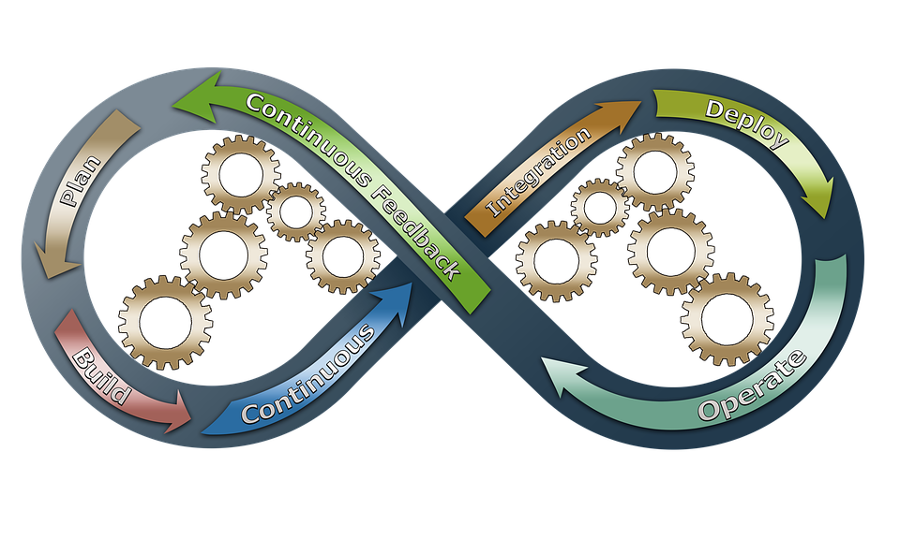
Deployment
Build a Flask App, with a search bar, where:
Given a Customer ID we recommend some similar items to the previous purchases
If an incorrect customer ID or a new customer is inserted in the search bar will be recommended our top 10 sold products

Slide 14
Thank You!
Business Cases for Data Science
Do you have any questions?
GRUPO C
Catarina Moreira nº20201034
Luisa Barral nº20201045
Madalena Valério nº20200657
Yu Song nº20200572

