Slide 1
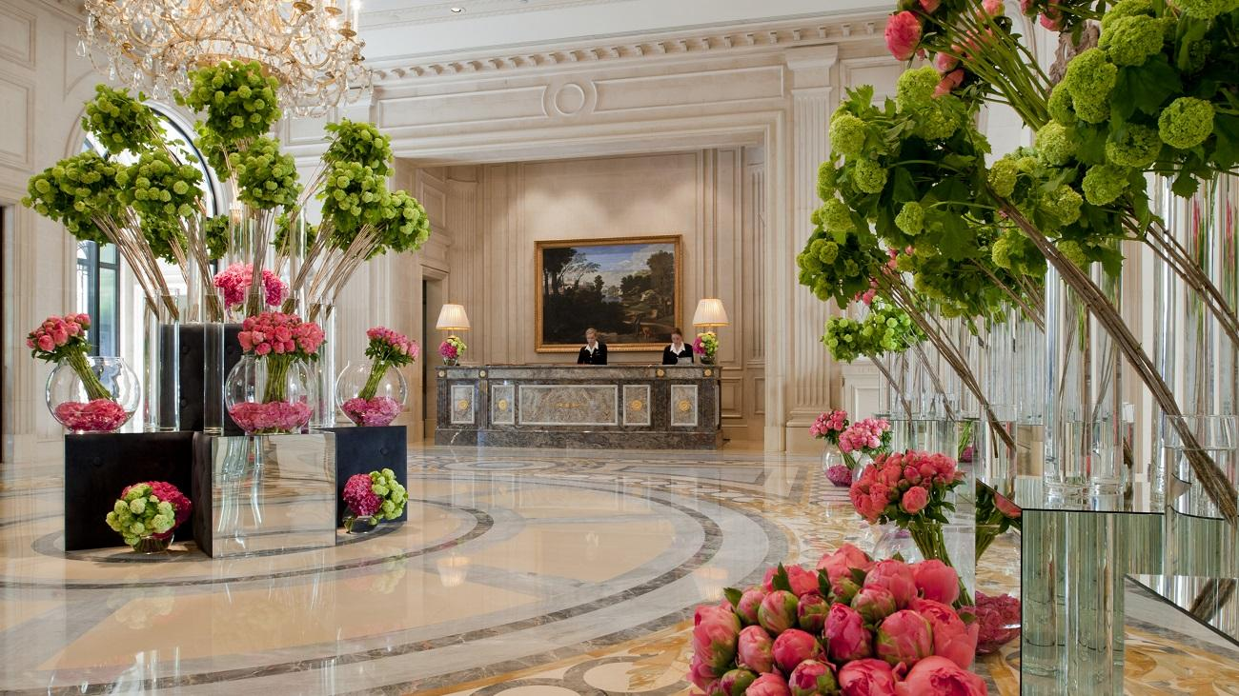
Predictive Analysis
Predict Hotel Cancellations
Group C
Catarina Moreira nº 20201034
Luisa Barral nº 20201045
Madalena Valério nº 20200657
Yu Song nº 20200572

Slide 2






Business Problem
Aggressive overbooking policy generates costs.
Less aggressive overbooking policy
results in having inventory not sold
40% Cancellation rate by reservation value, in Europe
Very often reservations have the option of free cancellation
Online Travel Agencies (OTA) negative aspects such as high commissions and competition among other hotels
“Deal-seeking” customers that tend to make multiple reservations for the same trip
Non-optimized occupancy, loss of revenue

Slide 3



Business Solutions
Control of occupation rate by predicting the canceled reservations, decreasing it by 20%
Provide various marketing strategies in order to avoid possible cancellations.​
Discover which are the most important features in predicting a cancelation

Slide 4
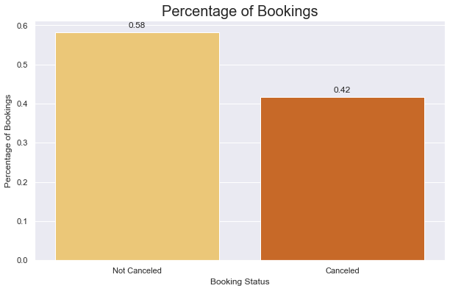
42% of Bookings Canceled

Slide 5
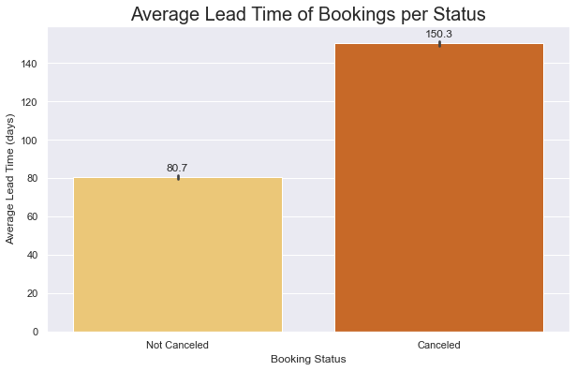
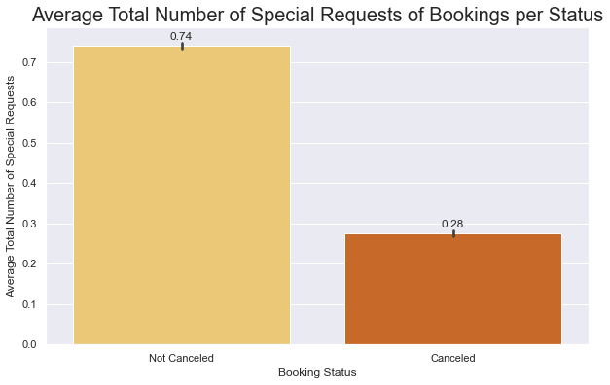
Customers that Cancel, book Hotel longer in advance
They also make less Special Requests

Slide 6
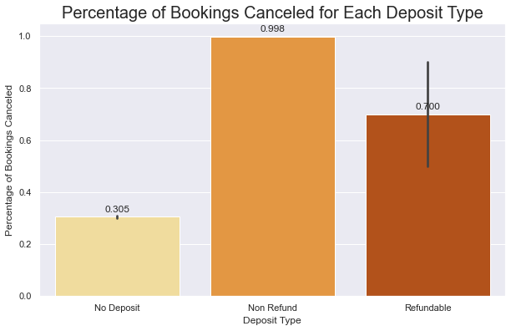
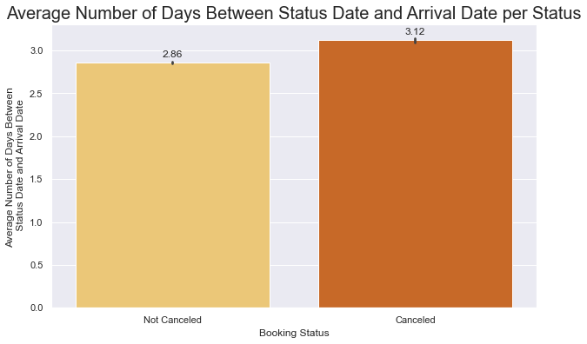
99.8% Non-Refundable Deposit Bookings are Canceled
On Average
Customers stay 3 nights in Hotel
Customers Cancel 3 days before Arrival Date

Slide 7
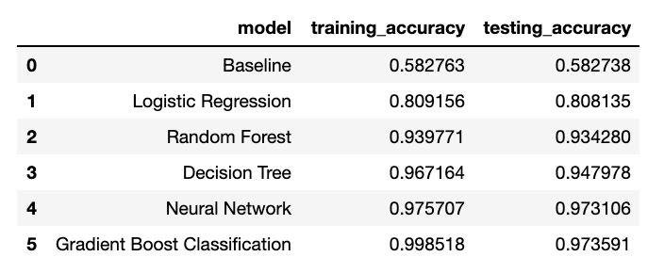
Modeling
6 Different Models:
Logistic Regression
Random Forest
Decision Tree
Gradient Boost Classifier
Neural Networks

Slide 8
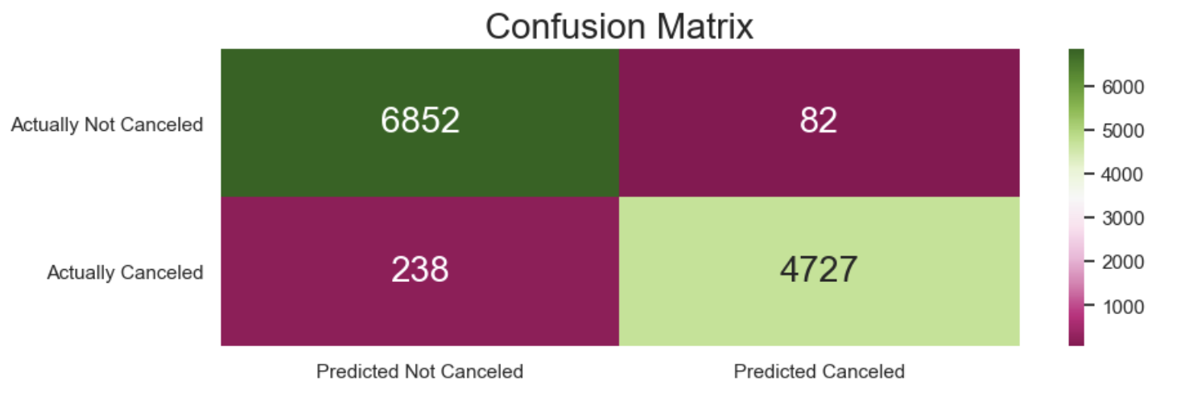
Neural Network Evaluation
How often is the classifier correct ?
97,0% of the times (Accuracy)
How often is a Canceled booking correctly classified ? 95,0% of the times
How often is a Not Canceled booking correctly classified ? 98,0% of the times

Slide 9

Marketing Strategies to Cancellations
Contact our predicted customers before they canceled.
By emailing them with vouchers to our restaurants, bars and SPA. The customers who clicks ‘Accept Vouchers’ would have lower chances of cancellations compared to those who doesn’t.

Slide 10

Marketing Strategies to Cancellations
Contact our predicted customers before they canceled.
For those ‘No response’ booking clients, 3-5 days before check-in, we could email them again with more attractive vouchers or even better deals, for example discount of room prices for stricter policies or even prepayment for high discount depends on occupancy rate.

Slide 11

Marketing Strategies to Cancellations
Contact our predicted customers before they canceled.
For the rest booking still with no response close to check-in date, we could consider overbooking based on the occupancy rate and seasoning demand.

Slide 12

Marketing Strategies to Cancellations
Create a customer loop to avoid OTA,
For example, membership system.
We can create our own booking system on our website at the same time. So we could cultivate our members loyaty for stricker cancellation policies with attracting privileges. This could also lower the rate of “Deal-seeking” customers

Slide 13
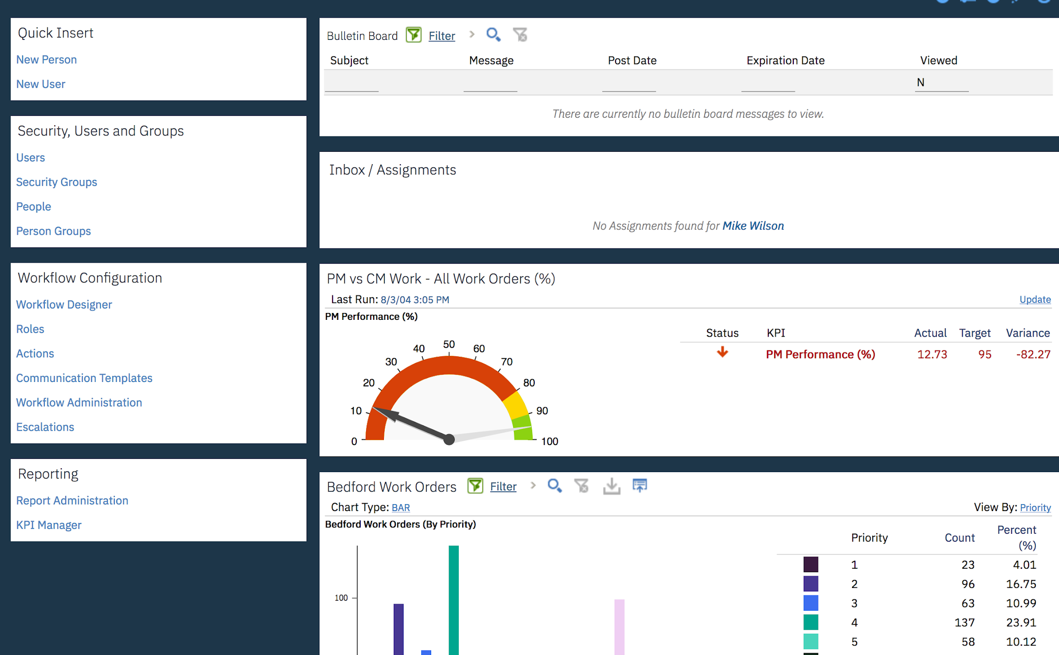
Deployment
Use of multi pipeline for Continuous Training.
Develop an app to integrate and, if needed, retraining the model everytime it decreases performance
Creation of an integration user as well as an API key which is going to be used in Maximo APM
Maximo APM for maintenance

Slide 14




Conclusion
Neural Network is able to predict booking cancellations with 97% accuracy
In 0,53% of the times the hotel might not have a room available and has a risk of overbooking
The number of special requests, the deposit type policies, the number of days until arrival and if a person has previous cancelations are some of the variables that we should pay special attention when trying to prevent cancelations

Slide 15
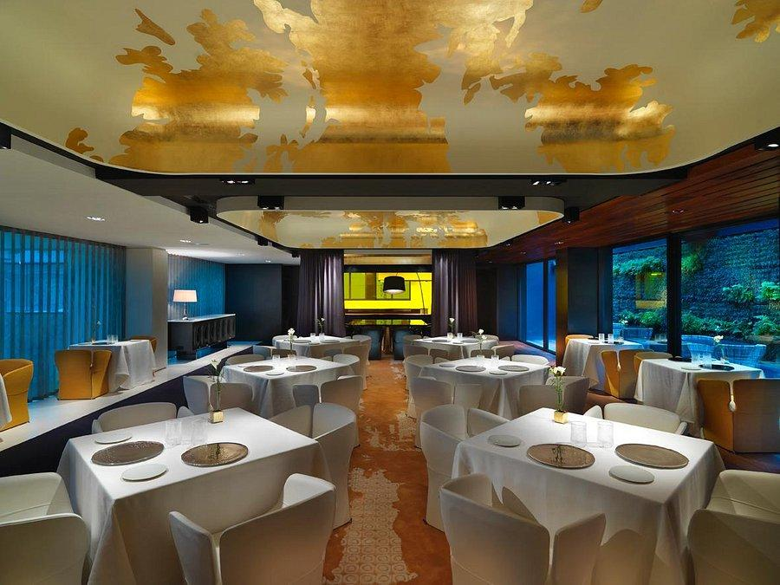
Thank you !
Group C
Catarina Moreira nº 20201034
Luisa Barral nº 20201045
Madalena Valério nº 20200657
Yu Song nº 20200572

