Slide 1

PFAFF RUNNER
step by step to a better world

Slide 2
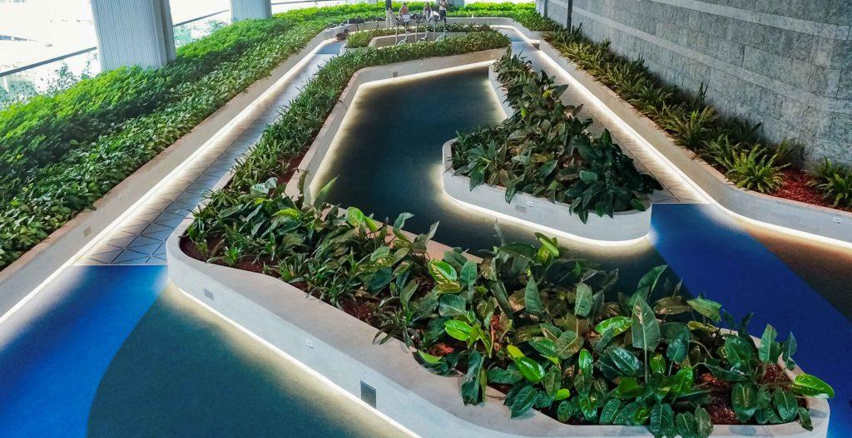

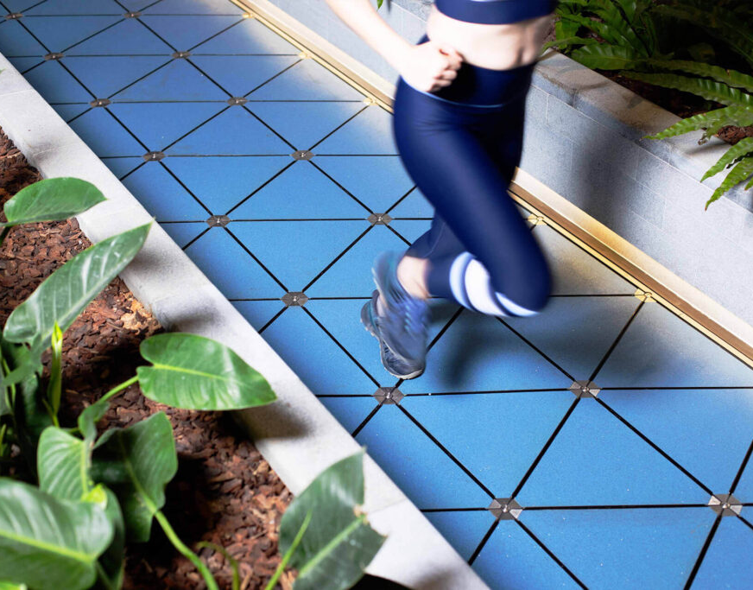
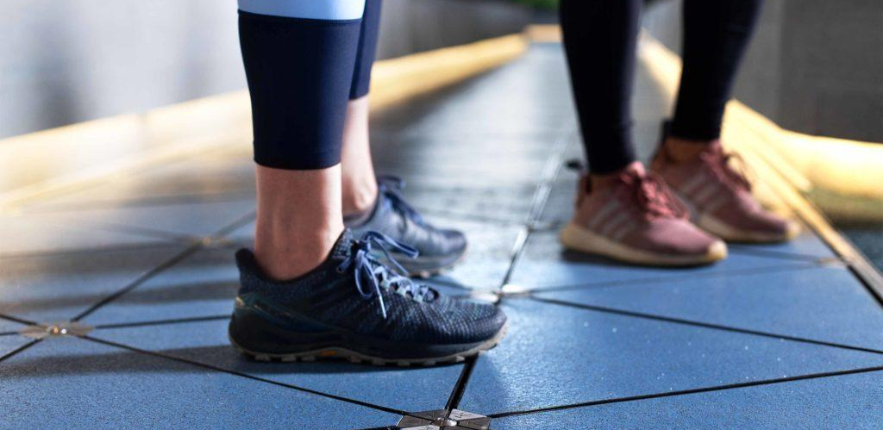
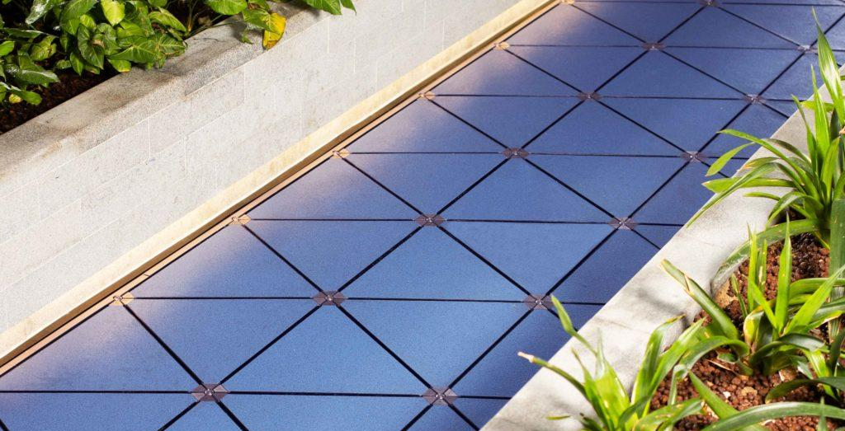

https://www.pavegen.com/en/case-studies/the-quayside-0
Outdoor running or walking track
Energy is generated by stepping on the kinetic plates and instantly used to power lights, load e-scooter, e-bikes and smartphones.
11 steps to go

Slide 3
Pfaffquartier running as a good example
people from all over Lautre will come to the track
relieve stress while generating energy
10 steps to go

Slide 4
Pfaff Runner helps you
saving energy
doing sports
living healthy
9 steps to go

Slide 5

PFAFF RUNNER APP

Slide 6



Step by step to a healthier lifestyle
real-time tracking of your steps and generated energy
7 steps to go

Slide 7
Step by step to the top of the leaderboard
compete with your friends
climb the leaderboard to the top
6 steps to go

Slide 8
Step by step to awesome rewards
earn EnergyPoints for every few step you make
spend them for awesome rewards
earn trophies for generating energy and completing challenges
5 steps to go

Slide 9
Step by step to a great community
check how much energy you and the whole community has generated
reach the daily goal as a community to earn bonus EnergyPoints
4 steps to go

Slide 10
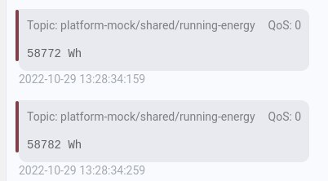
Platform Mock Integration
gameboard integration in the app
generated energy published to the platform
3 steps to go

Slide 11
with 250 steps or 1 kWh you can …
100km e-biking
1 dishwasher cycle
cook 35 cups of coffee
watching 15h on a LED-TV
1 washing machine cycle at 60°
2 steps to go
https://www.vattenfall.de/infowelt-energie/strom-von-fussgaengern-produziert
Notes:
https://www.vattenfall.de/infowelt-energie/strom-von-fussgaengern-produziert

Slide 12
Join us now and become a
PFAFF RUNNER
_ _ _
it’s as simple as one step

Slide 13

Thank you
hacking.exe Lea - Luis - Marvin - Sascha - Till
ASTOC/Mess 2018

