Slide 1


Montreal´s bike sharing system analysis

Slide 2
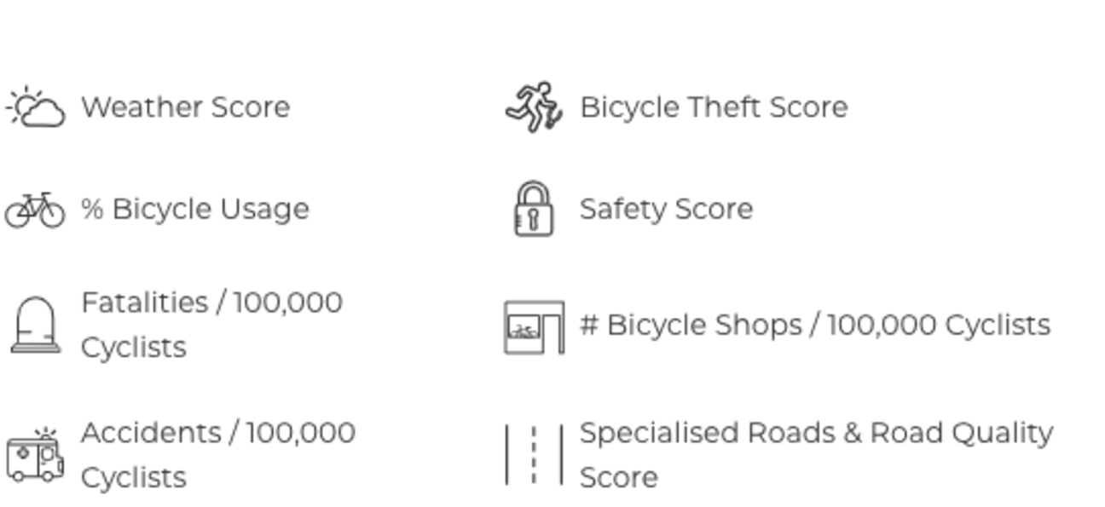
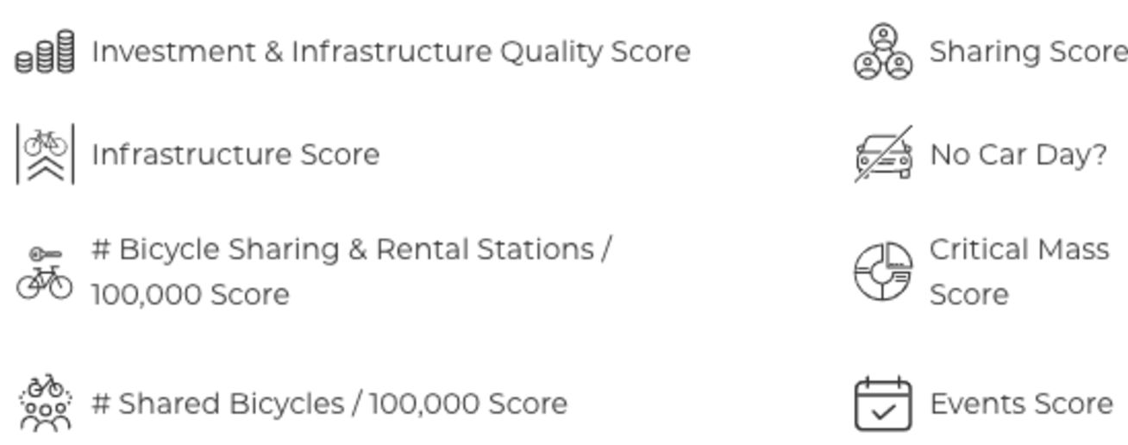
Montreal has been ranked #1 cycling city in North America and #18 worldwide according to COYA in 2019.
They study different factors to determine if a city is good for cycling overall.

Slide 3
Quick View

Slide 4
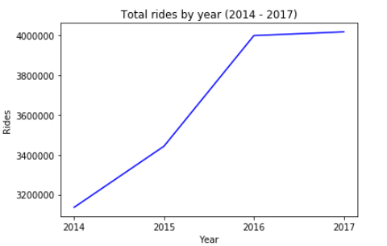
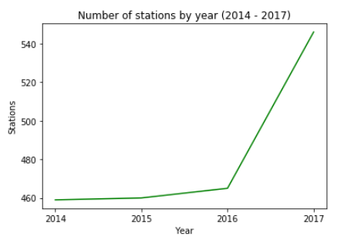
Rides and stations
The number of rides has grown in 2014 and 2015, but in 2016 has remained almost constant.
In 2014 and 2015, almost no stations were built, but in 2016 they created 81 new ones.
We can see with this simple analysis that more rides does not imply the necessity of more biki stations, because with

Slide 5
User analysis

Slide 6
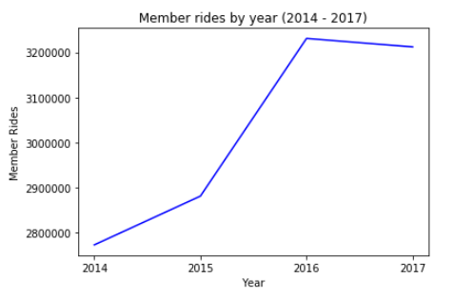
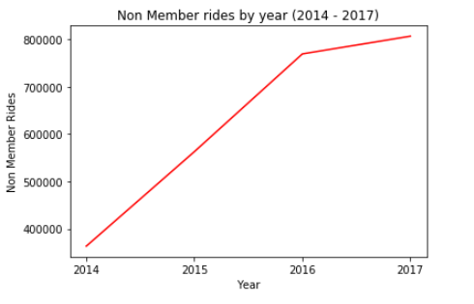
Total rides - Membership

Slide 7

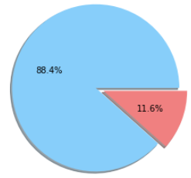
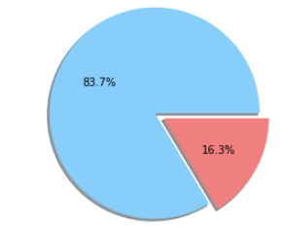
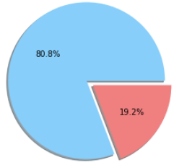
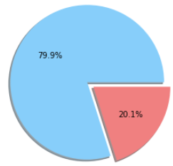
Total rides - Membership
Member
Non-Member
2014
2015
2016
2017
There is a constant growth of non-member use of the bixi system. From 11,6% in 2014 to a 20.1% in 2017.
From 2014 to 2017 there has been a total of 12.096.519 member rides and 2.502.442 non-member rides

Slide 8
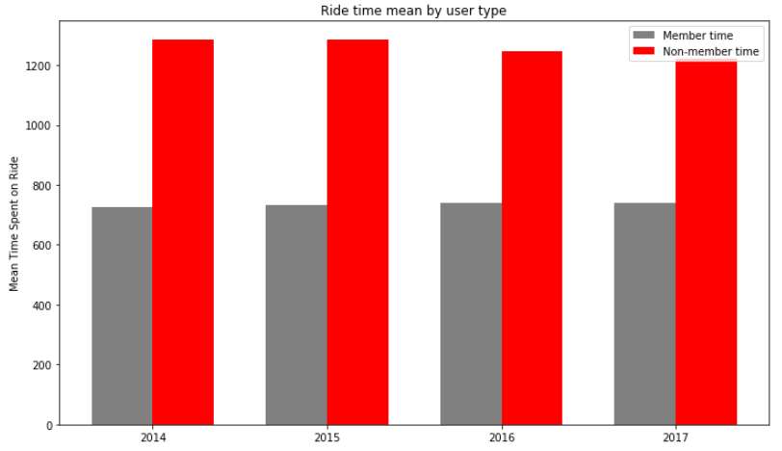
Time spent - Membership
Non-member rides are twice longer than member rides.
The time of the ride does not really change over the years
A campaign focused on longer rides could generate membership conversion.

Slide 9
Stations

Slide 10
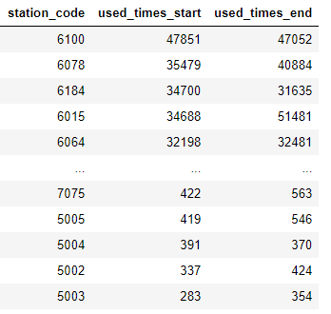
Stations
As we have seen before, the number of new stations between 2014 and 2015 remained almost constant.
It was in 2016 where, probably because of the raise of the rides, bixi built 81 new stations over the city.
We can see the specific use of each station.

Slide 11
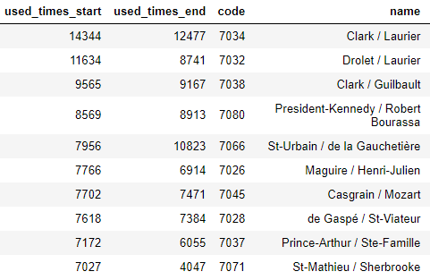
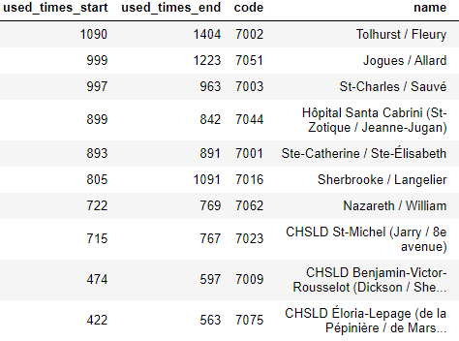
Stations
Here we can see the most and least used new stations built in 2016.
Top 10 most used new stations
Top 10 least used new stations

Slide 12
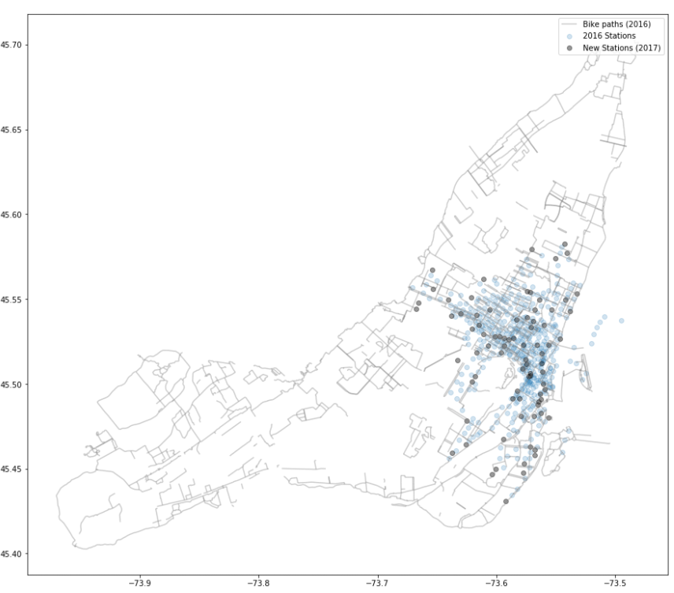
New Stations location
This graph shows the different bike paths availables in Montreal in 2019.
The new stations built from 2016 to 2017 were located all over the center of the city, well integrated between all already available stations.
There was no remarkable expansion out of the already built stations.

Slide 13
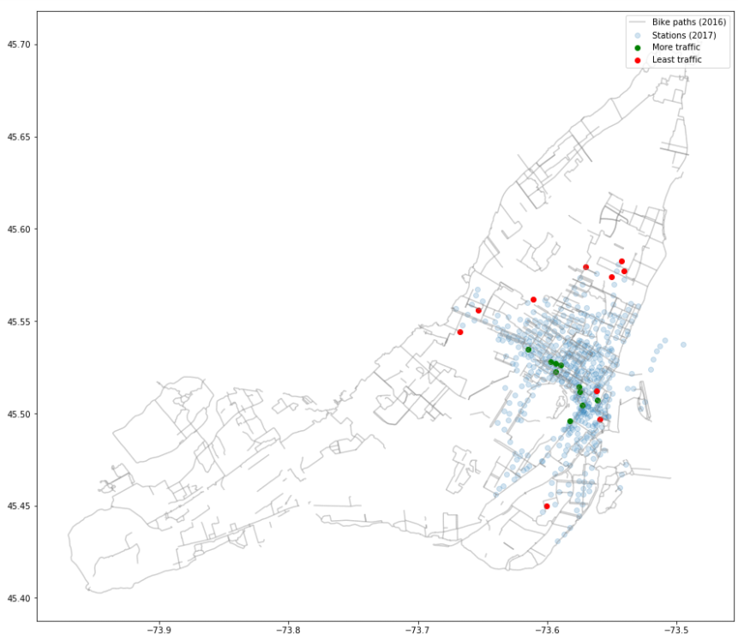
New Stations usage
Here we can see that the top most used stations are all near each other, concentrated in the center of the city.
Almost all least used stations are located far away from the most used ones, at the periphery of the bike system range.

Slide 14
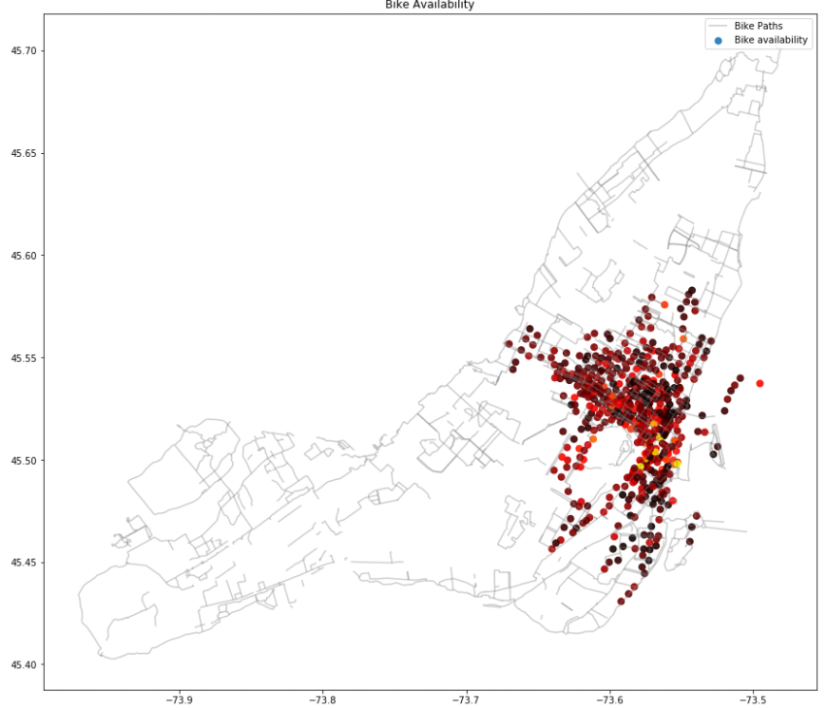
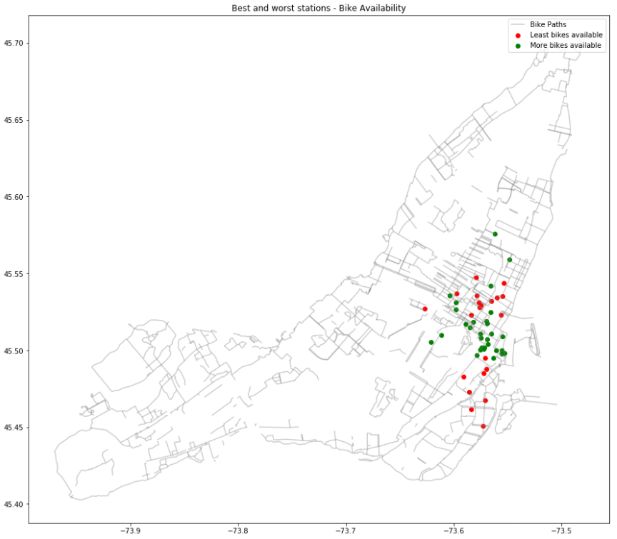
Bike availability

Slide 15
Paths

Slide 16
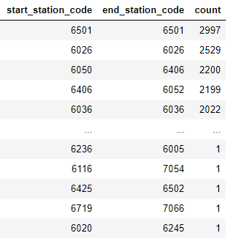
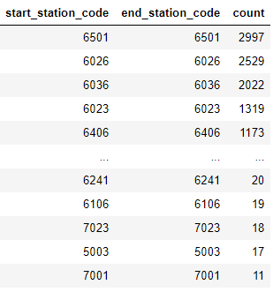
Ride paths
Most common paths
Paths with same start and end station
We can see the most common start-end points rides in the system. This analysis give us information about the path itself and the usage of each station.
As a curious point, many of the common rides has the same station as the start and end point.

