Slide 1


PGI (Performance Grading Index)
District Score & Grade Prediction (2018–2020)
Submitted by:
Ksh Sandip Singha ADTU/2022-26/BCS/028
Ph Angamba Singha ADTU/2022-26/BCS/053
K Premila Singha ADTU/2022-26/BCS/070
Meklin Chakma ADTU/2022-26/BCS(B)/006
SUPERVISOR:
Dr. Arpita Nath Boruah
Assistant Professor

Slide 2

PROBLEM STATEMENT
The Problem: A Gap in Diagnostic and Predictive Insight Current PGI evaluations are essential but often fall short of providing the necessary depth for proactive governance.
We aim to close the gap between data collection and policy formulation.
Existing PGI evaluations lack predictive and diagnostic insights.
No systematic use of AI or advanced analytics to forecast educational trends.
Difficulty in identifying the precise drivers of educational excellence or deficiency.
Policy responses are often reactive rather than anticipatory.

Slide 3
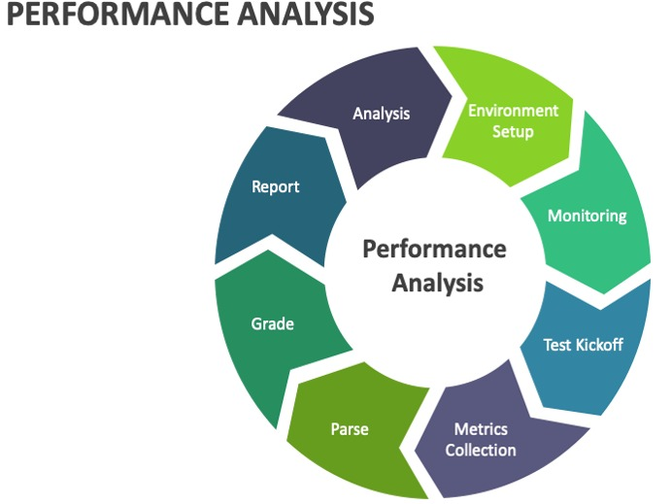
Introduction to PGI Analysis
This presentation focuses on predicting District Grades for 2018–23 using Machine Learning classifiers. We will explore various models and their performance on the dataset.
3rd
Objective
To predict district performance grades using machine learning techniques
4th
Models Used
Decision Tree, Random Forest, Gradient Boosting, XGBoost, and Stacking
1st
Overview
This project focuses on predicting district PGI grades (2018–2023) using machine learning models ,
It analyzes trends and evaluates model performance on the dataset
Dataset
District-wise PGI data collected over six years (2018–2023)
Includes multiple performance indicators
2nd
5th
Data Preparation
Data cleaned, encoded, and preprocessed for model training

Slide 4
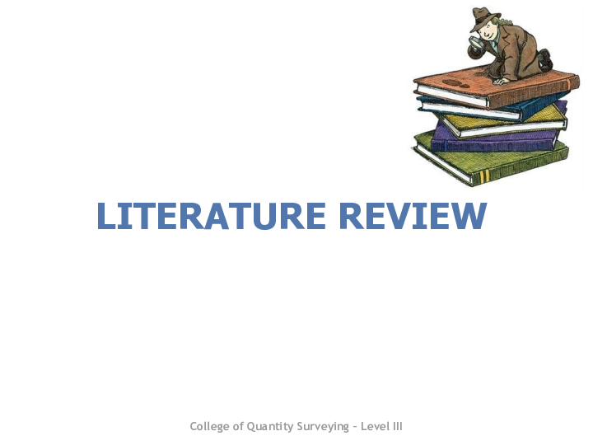
LITERATURE REVIEW
The Performance Grading Index (PGI) developed by the Ministry of Education provides a structured framework to evaluate district education performance across domains such as Outcomes, Teaching Quality, Infrastructure, Safety, Digital Learning, and Governance.
Existing PGI reports focus mainly on descriptive analysis and grade comparisons, with very limited use of predictive machine-learning methods.
In education analytics, Decision Tree, Random Forest, Gradient Boosting, XGBoost, and Stacking are commonly used classifiers due to their accuracy, ability to handle mixed data, and interpretability through feature importance.
Good evaluation practices include using accuracy with confusion matrix, checking class distribution, and ensuring proper preprocessing (imputation, scaling, and encoding).
Research gap: Very few studies attempt to predict PGI Grades using ML. This project addresses that gap by comparing multiple classifiers and analyzing their performance on district-level data.

Slide 5
Dataset Description
Our dataset comprises approximately 4000+ rows, with 'Grade' as the primary target variable. Several feature columns contribute to the prediction model.
Total Rows
~4000+
Target Variable
Grade
Feature Columns
Overall District Score, Outcome, ECT, IF&SE, SS&CP, DL, GP
GRADE | LABEL ENCODED
Akanshi | 1
Prachesta-1 | 2
Prachesta-2 | 3
Prachesta-3 | 4
Uttam | 5
Ati-uttam | 6

Slide 6
Category Score Description Table
Category | Full Form / Meaning | Max Score | Purpose / Description
Overall | District Score 2018-19 – Overall | –
Category 1 | Outcome | 290
Category 2 | ECT | 90
Category 3 | IF&SE | 51
Category 4 | SS&CP | 35
Category 5 | DL | 50
Category 6 | GP | 84
Total performance score of the district combining all categories.
Measures achievement of key targets/results in the district.
Evaluates effectiveness/
compliance/teaching quality (specific area of performance).
Assesses Infrastructure Facilities & School Environment.
Measures Student Support & Community Participation initiatives.
Evaluates Digital Learning or Distance Learning initiatives
Measures Governance & Planning quality in the district.
Insight:
Encoding ensures machine learning models can process categorical data effectively.

Slide 7
DATA PREPROCESSING
Dataset Integration
Encoding Resolution
Column Standardization
Feature Selection
Loaded multiple yearly datasets and merged into a single unified dataset for comprehensive analysis.
Handled encoding issues systematically using UTF-8 with latin1 fallback to ensure data integrity
Cleaned and standardized column names, renamed inconsistent columns (e.g., IF&SE → IFSE), removed unnecessary fields.
Selected only relevant features for modeling and added Year column for time-based analysis.

Slide 8
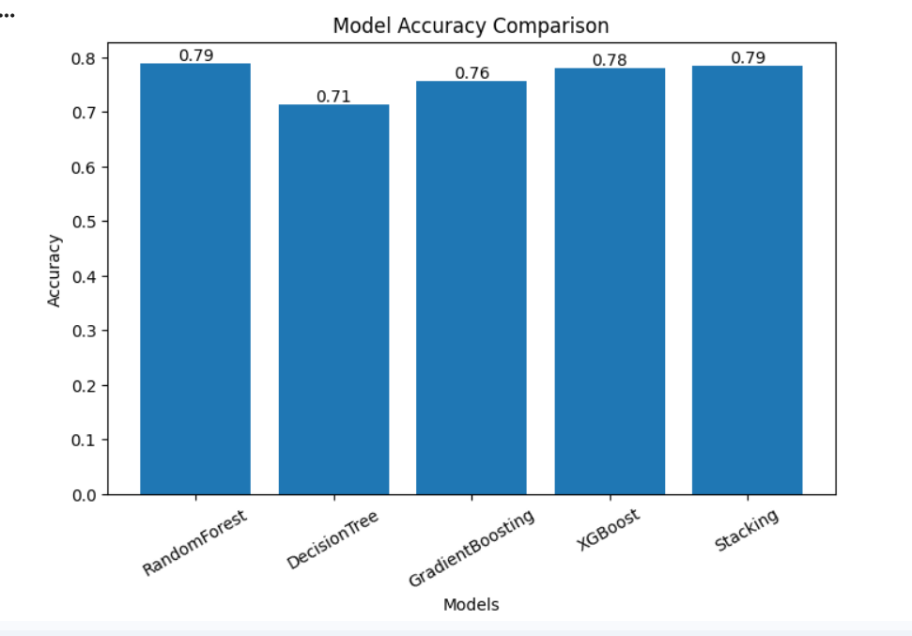
Model Accuracy Comparision
Key Insights:
*Best Performance: Random Forest and Stacking achieved the highest accuracy (79%)
*XGBoost also performed very well (78%) → Shows strong predictive capability
*Decision Tree had the lowest accuracy (71%) → Indicates it may not capture complex patterns effectively
*Ensemble Methods (RF, GB, XGBoost, Stacking) performed better than a single model → Combining models improves accuracy
Fig:2018-23

Slide 9
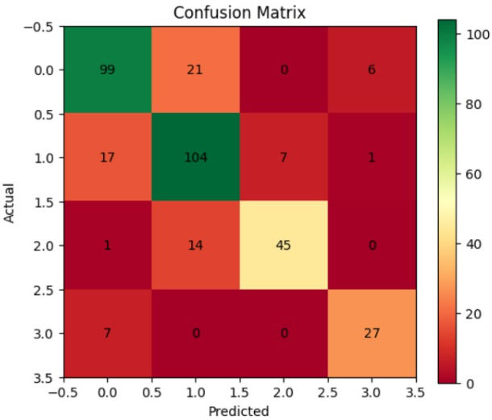
Correlation Heatmap Insights
The correlation heatmap reveals strong relationships between certain features and the target variable, 'Grade'. This is crucial for understanding feature importance in our predictive models.
Key Insight:
The model performs well overall with a high number of correct predictions
Errors mainly occur between similar or neighboring grades
🔹 What it Shows
The confusion matrix compares actual vs predicted grades
Diagonal values represent correct predictions
Off-diagonal values represent misclassifications
🔹 Key Observations
High values on the diagonal (e.g., 99, 104, 45, 27) indicate good model accuracy
Most predictions are correctly classified into their respective grades
Some confusion exists between nearby grades (e.g., grade 0 & 1, 1 & 2)
Fig: Heatmaps of the year 2018-23

Slide 10
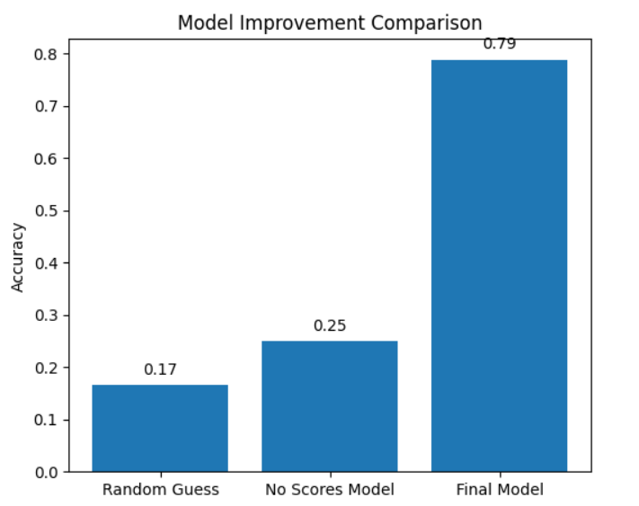
Model Improvement Comparison
Model Improvement Insights:
Random Guess accuracy is very low (17%)
Basic model improves accuracy to 25%
Final model achieves high accuracy (79%)
Key sight:
Initially, the model performs poorly when guessing randomly. As we introduce basic learning, accuracy improves slightly. Finally, with proper data processing and advanced models, accuracy increases significantly to 79%, showing the effectiveness of our approach.
Fig: Model accuracy of 2018-23

Slide 11
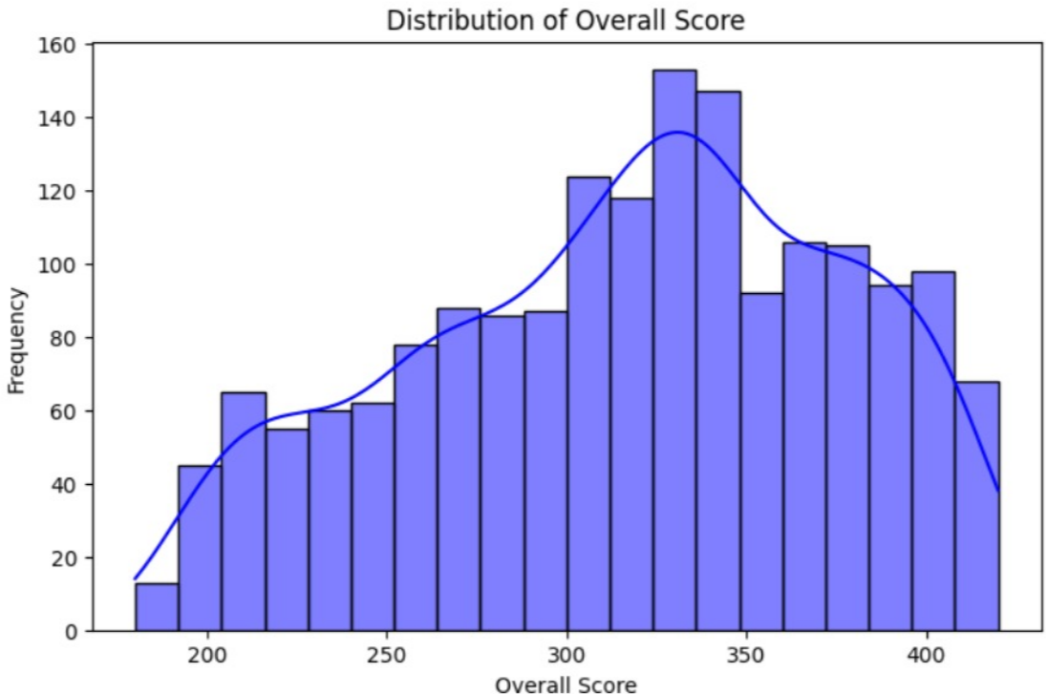
DISTRIBUTION PLOT
Description :
The histogram shows the distribution of Overall Scores across districts.
Most values lie between 280 and 380, indicating moderate to high performance
The peak of the graph is around 320–350, where most districts are concentrated.
The distribution appears slightly right-skewed, with fewer districts having very high scores
Key Insights:
Majority of districts have average performance levels
Very low scores (<200) are rare
A gradual decline is observed after the peak, showing fewer high-performing districts.
The smooth curve (KDE) highlights the overall trend of the data
Fig: Distribution plot of 2018-23

Slide 12
Machine Learning Pipeline
Our machine learning pipeline involves several critical steps to prepare the data and ensure robust model training. Each step is designed to handle data imperfections and optimise model performance.
01
02
Median Imputation
Standard Scaling
Handling missing values by replacing them with the median.
Normalising feature scales to prevent dominance by larger values.
03
04
Column Transformer
Label Encoding
Applying different transformations to different columns.
Converting categorical labels into numerical format.
05
06
Train-Test Split
Model Pipelines
Dividing data into 80% for training and 20% for testing.
Creating integrated pipelines for each machine learning model.

Slide 13
Classifiers Used
We employed a range of machine learning classifiers, each with distinct characteristics, to predict the district grades. This diverse selection allows for a comprehensive evaluation of predictive performance.
Decision Tree
Simple rule-based model for classification.
Random Forest
Ensemble of multiple decision trees (bagging technique).
Gradient Boosting
Sequential boosting model that builds trees iteratively.
XGBoost
Advanced, regularised boosting algorithm for performance.
Stacking Classifier
Combines predictions from multiple models with a meta-learner (logistic regression).

Slide 14
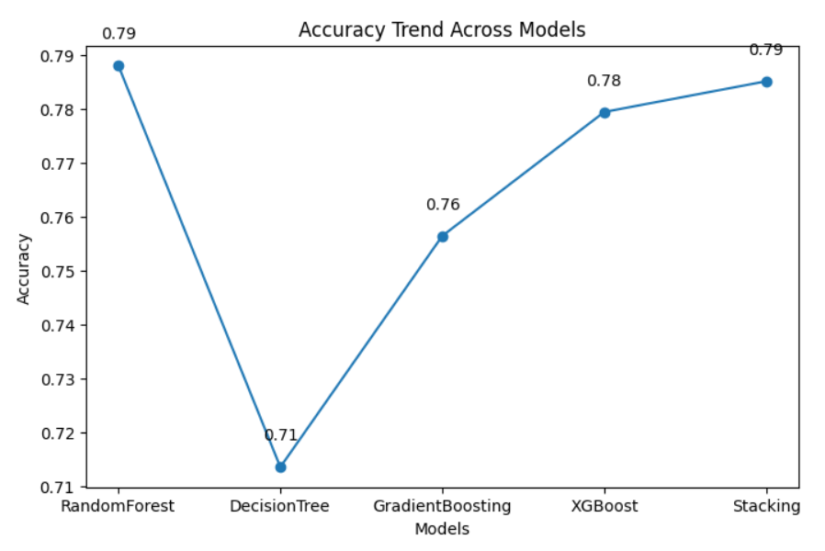
Model Accuracies
Evaluating the performance of each classifier, Random Forest emerged as the top performer with the highest accuracy score.
Models | Accuracy
Random Forest | 78.8%
Decision Tree | 71.5%
Gradient Boosting | 75.6%
XGBoost | 77.9%
Stacking | 78.8%
Fig: Accuracy trend Across Models
Key Observations
Accuracy drops at Decision Tree (71%)
Then steadily increases with advanced models
Gradient Boosting → 76%, XGBoost → 78%
Highest accuracy achieved by Random Forest & Stacking (~79%)
Insight
Advanced and ensemble models improve accuracy
There is a clear upward trend after using boosting and stacking techniques

Slide 15

Code Snippets Explained
Understanding the underlying code for preprocessing and model execution is key to appreciating the pipeline's functionality.
Preprocessing Code
Model Code
Data Loading: Reads CSV files with encoding handling (utf-8 / latin1 fallback)
Column Cleaning: Removes unwanted characters (ï»¿, \n, spaces)
Standardizes column names
Column Renaming: Dynamically maps inconsistent column names
(e.g., "if&se" → "IFSE")
Column Selection: Keeps only required features
Feature Addition: Adds Year column manually
Model Training
Data split into training and testing sets
Multiple models used (Random Forest, Gradient Boosting, XGBoost)
Model Execution
model.fit() trains the model
model.predict() generates predictions
Feature Engineering
Lag features used for time-based prediction
Evaluation Metrics
Accuracy score
Classification report
Confusion matrix

Slide 16


Conclusion & Future Work
Our analysis demonstrates the effectiveness of various ML models in predicting district grades, with Random Forest achieving the highest accuracy. However, there are avenues for further enhancement.
Top Performer
Model Consistency
Random Forest achieved the highest accuracy of 79%.
All evaluated models performed consistently well.
Key Inspects:
Model performance is consistent across different techniques
Accuracy is limited by dataset size and quality
Future Plans:
Train and optimize the model using VS Code environment
Integrate AI to provide smart suggestions
Recommend policies and scholarships for underperforming districts/states
Develop a full-stack application
Interactive dashboard for data visualization and insights
Use cross-validation to make the evaluation more reliable.

Slide 17



