Slide 1
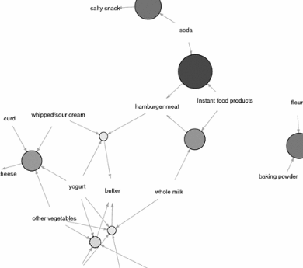

Course: Data Mining | Research Paper Review
DOI: 10.1007/s10791-025-09644-9
An Association rule-base approach for frequent item mining of multistage access data
Author: Silong Wu
Source: Discover Computing, Vol. 28, Article 139
Year: 2025
An efficient method for mining frequent patterns in multi-stage access data using improved Apriori algorithms with weighted support functions
Financial Shared Service Center, Guangdong Power Grid Corporation, Guangzhou, China
Submitted by:
Ph Angamba Singha ADTU/2022-26/BCS/053
Ksh Sandip Singha ADTU/2022-26/BCS/028
Mamoni Sheikh ADTU/2022-26/BCS/068

Slide 2
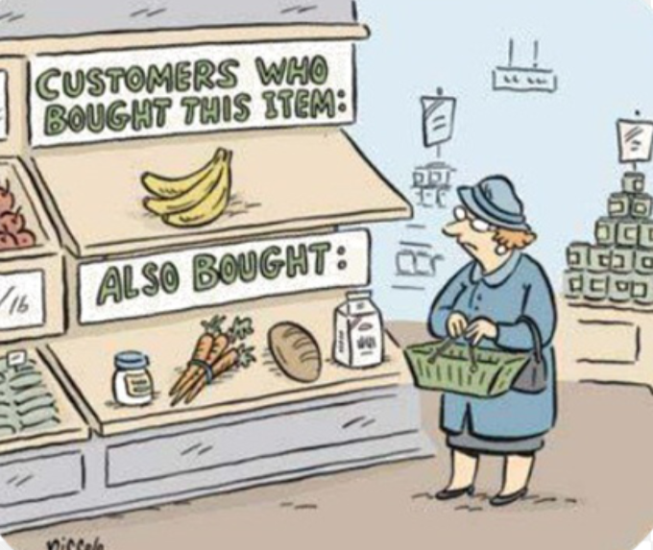
The Challenge of Traditional Apriori Algorithms
Multiple Database Scans
Fixed Support Thresholds
Traditional Apriori algorithms require multiple scans of the database to generate candidate itemsets, significantly reducing efficiency when processing large-scale datasets.
Simple support threshold settings fail to consider the importance and differences of different itemsets in practical business applications, affecting mining accuracy.
These limitations become particularly problematic when dealing with multi-stage access data in e-commerce, social networks, and financial systems where efficiency and accuracy are critical.

Slide 3






Our Solution: Improved Apriori with Weighted Support
Single Database Scan
No Candidate Generation
Weighted Support Function
Matrix compression through clustering reduces multi-stage database access to one scan
Frequent itemsets generated directly without intermediate candidates
Different weights assigned to itemsets reflect real-world importance
By applying clustering analysis and Boolean vector operations, our method achieves significant efficiency improvements while maintaining high accuracy through weighted support calculations.

Slide 4
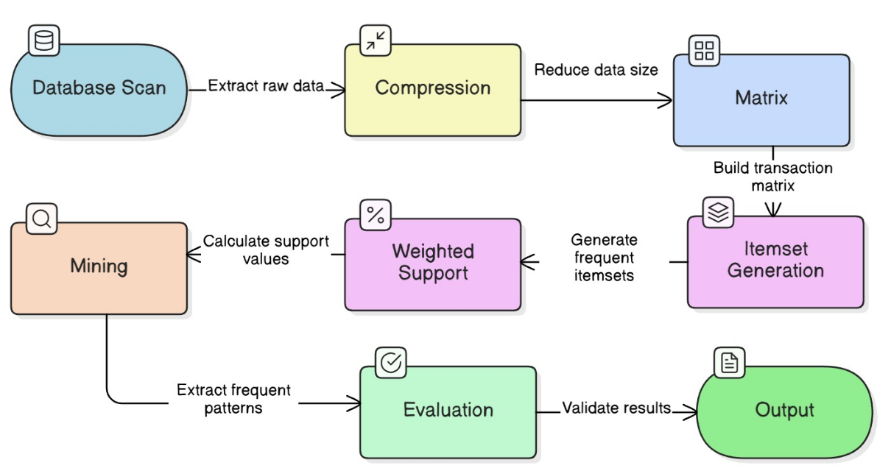
Architecture High level Diagram(HLD)

Slide 5
Algorithm Workflow
1
2
3
4
5
Data Preprocessing
Weighted Support
K-Means Clustering
Frequent Item Generation
Association Rules
Scan DB → build vertical Boolean matrix R. Cluster identical transactions to compress matrix size.
Assign each item a weight wⱼ. Weighted support wS(X) = W(X) × S(X), where W(X) = max weight in itemset.
Divide items into K clusters using distance g = 1/SC. Items near centroid may belong to multiple clusters.
Generate weighted frequent 1-, 2-, ... k-itemsets using Boolean AND on matrix rows. No candidate itemsets.
Mine rules X⇒Y where weighted confidence wC ≥ minimum threshold. Output strong association rules.

Slide 6
Experimental Setup
Dataset Description
Comparison Methods
Shortcomings
Multi-stage access database from electronic library system (September 2010-August 2022) containing identity authentication, data request, transmission, and query stages.
DBSCAN clustering (Kawtar et al.)
CLS-MMS mining (Subrata et al.)
Fuzzy association rules (Sanz et al.)
Privacy-preserving methods (Menon et al.)
Depth first + Breadth first
(Magdy et al.)
Efficiency is lower
Accuracy is lower
Accuracy is lower
Efficiency is lower
Accuracy is lower
Dataset is relatively small (15 e-books); scaling to millions of items and transactions is unproven.
15 e-books with highest access times selected for analysis. Statistical attributes included MAC number, title, publisher, publication date, and visit counts.

Slide 7
Performance Evaluation Results
0.9896
8
123s
Average Pearson Coefficient
Frequent Items Mined
Small Dataset Runtime
Indicates high mining accuracy, with values close to 1 showing strong correlation
At 1.2% minimum support expectation, demonstrating effective pattern discovery
Computational complexity of 123 seconds on small datasets with 45MB memory usage
Our method consistently outperformed comparison methods across all evaluation metrics, particularly showing superior performance on large-scale datasets where computational complexity reached 867 seconds with 384MB memory usage while maintaining 8.0 runtime performance score.

Slide 8



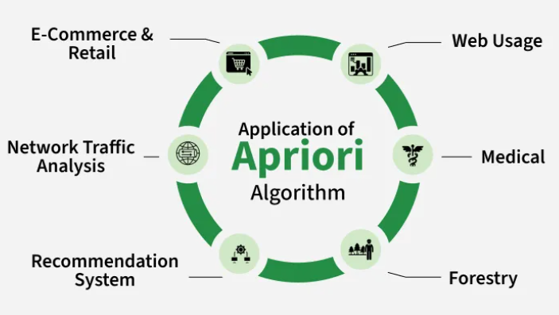
Applications and Future Directions
E-Commerce
Network Security
Personalized Services
Understand user behavior across browsing, cart addition, and payment stages to optimize product recommendations and marketing strategies
Identify abnormal access patterns and detect potential network attacks through multi-stage behavior analysis
Improve user experience through behavior pattern mining and optimized advertising strategies
Future Research Areas
Algorithm Optimization: Explore strategies to further improve large-scale data processing efficiency and accuracy
Technology Integration: Combine association rules with clustering, classification, and other techniques for deeper analysis
Deep Learning Applications: Apply deep learning to parse multi-stage access data and reveal complex user behavior patterns

Slide 9
REFERENCES
1. Lazzari F, Baldini W, Bassi G, Contu A, Dorigo M, Fantechi R., et al. Fpga-based real-time data processing for accelerating reconstruction at lhcb. J Instrum. 2022; 17(4): C04011.1–C04011.8.
2. Ordentlich O, Polyanskiy Y. Strong data processing constant is achieved by binary inputs. IEEE Trans Inform Theory. 2022;68(3):1480–1.
3. Khan S, Shaheen M. Wisdom mining: future of data mining. Rec Pat Eng. 2023;17(1):2–11.
4. Darmont J, Novikov B, Wrembel R, Bellatreche L. Data processing in modern distributed architectures. Inform Syst. 2022;104(Feb): 101936.1–101936.3.
5. Yamamoto A, Tada K, Chibat G, Endo T. Verification of the multi-group generation capability of frendy nuclear data processing code for recent nuclear data through comparison of one-group reaction rates. Trans Am Nucl Soc. 2021;124:544–7.
6. Balynsky M, Chiang H, Gutierrez D, Kozhevnikov A, Filimonov Y, Khitun A. Quantum computing without quantum computers: database search and data processing using classical wave superposition. J Appl Phys. 2021;130(16): 164903.1–164903.12.
7. Kawtar S, Damien J, Roger G, Barthélémy Steck, Jean-Marie H, Louis A, et al. A data mining approach for improved interpretation of ert inverted sections using the dbscan clustering algorithm. Geophys J Intern. 2021;225(2):1304–18.
8. Datta S, Mali K, Ghosh U, Bose S, Ghosh S. Rare correlated coherent association rule mining with CLS-MMS. Comput J. 2023;66(2):342–59.
9. Sanz J, Sesma-Sara M, Bustince H. A fuzzy association rule-based classifier for imbalanced classification problems. Inform Sci. 2021;577(4):265–79.
10. Menon S, Ghoshal A, Sarkar S. Modifying transactional databases to hide sensitive association rules. Inform Syst Res. 2022;33(1):152–78.
11. Magdy M, Ghaleb FFM, Mohamed DAEA, Zakaria W. Cc-ifim: an efficient approach for incremental frequent itemset mining based on closed candidates. J Supercomput. 2023;79(7):7877–99.
12. Wang PP, Meng Y. Simulation of mining frequent pattern association rules of multi-segment support data. Comput Simul. 2021;38(5):282–6.
13. Logeswaran K, Suresh P. High utility itemset mining using genetic algorithm assimilated with off policy reinforcement learning to adaptively calibrate crossover operation. Comput Intell. 2021;38(5):1596–615.
14. Aryabarzan N, Minaei-Bidgoli B. Neclatclosed: a vertical algorithm for mining frequent closed itemsets. Exp Syst Appl. 2021;174(Jul.): 114738.1–114738.11.
15. Luna JM, Fournier-Viger P, Ventura S. Frequent itemset mining: a 25 years review. Wiley Interdiscip Rev Data Min Knowl Discov. 2019;9(6): e1329.
16. Trasierras AM, Luna JM, Fournier-Viger P, Ventura S. Data heterogeneity’s impact on the performance of frequent itemset

Slide 10
THANK YOU
① Proposed an improved Apriori algorithm using Boolean matrices and K-Means clustering ② Introduced weighted support to handle real-world item importance differences ③ Single database scan — directly generates frequent itemsets without candidates ④ Achieved average Pearson coefficient of 0.9896 — highest among 6 compared methods

