Slide 1

EduCMS
Educational Content Management System
COP 4331 — Object-Oriented Software Development
University of Central Florida | Spring 2026 | April 16, 2026
MongoDB
Express
React
Flutter
Node.js
TypeScript
Notes:
1

Slide 2
OUR TEAM
Team Members
Luiz Gomes
Giovana Medeiros Castro
Joe Ervin
L
G
J
@LuizGomes56
@gimcastro
@joe-ervin05
Backend architecture, API type system,
authentication, CRUD controllers
Frontend Questions page, mobile account page, diagrams, documentation
Database schemas, frontend pages
(topics, questions, auth), mobile forgot password
Maria Colmenares
Jashua Sauri Colon
Tales Dias
M
J
T
@macolmenares18
@JYSCN
@tales888
Frontend dashboard, wireframes,
mobile dashboard, presentation
Frontend setup, routing,
email verification, mobile app
Mobile app, Class Diagram
Notes:
2

Slide 3
PROJECT OVERVIEW
What is EduCMS?
A full-stack educational platform where instructors create and manage question banks organized by topic — and students browse, answer questions, and track their progress.
🎓
Teacher Dashboard
🔒
Secure Auth
Create topics and build question banks with MCQ, True/False, and short answer formats
JWT authentication, bcrypt password hashing, email verification, and password reset
📱
Web + Mobile
⚡
Type-Safe API
React web app and Flutter mobile app both powered by the same Express backend API
Backend types exported directly to frontend via SwaggerDocs — zero manual type duplication
Notes:
3

Slide 4
TECHNOLOGIES
Technology Stack
Database
MongoDB
Remote MongoDB instance — schemas for users, topics, questions, and auth codes
Backend
Node.js + Express 5 + TypeScript
REST API with Zod validation, JWT auth, bcrypt, Docker Compose, AWS SES email
Web Frontend
React 19 + TypeScript + Vite + Tailwind v4
Full CMS dashboard — login, register, topics, questions, account, password reset
Mobile
Flutter (Dart)
Native Android/iOS app — login, register, dashboard, topics, questions, navigation drawer
Auth
JWT + bcrypt + AWS SES
Stateless token auth, secure password hashing, email verification and password reset
DevOps
Docker + Docker Compose
One-command setup: docker compose up --build starts MongoDB, backend, and frontend
Notes:
4

Slide 5
SYSTEM DESIGN
Architecture
React
Web App
/api/*
Express Backend
MongoDB
Port 3000
Remote cluster
localhost:80
Zod Validation
→
users
JWT Auth
topics
Flutter
Mobile App
Controllers
questions
/api/*
Mongoose ODM
auth
Android / iOS / Chrome
🐳 All three services run together with docker compose up --build
Notes:
5

Slide 6
BACKEND
API Routes
All request bodies are validated automatically by Zod middleware before reaching any controller.
POST
/api/users/register
Create teacher account
POST
/api/users/login
Login → JWT token
GET
/api/users/dashboard
Stats + topic breakdown
🔒
POST
/api/users/forgot_password
Send password reset email (AWS SES)
POST
/api/topics/create
Create a topic
🔒
GET
/api/topics/all
All topics with question counts
🔒
PUT
/api/topics/update
Update topic name/description
🔒
DELETE
/api/topics/delete
Delete a topic
🔒
POST
/api/questions/create
Create MCQ / TF / FRQ question
🔒
POST
/api/questions/check
Check if answer is correct
🔒
Notes:
6

Slide 7
WEB APPLICATION
Web App — React + TypeScript
Dashboard
Topics
Stats cards (topics, questions this week) + topic breakdown table with FRQ/MCQ/TF counts and points
Create, view, edit, and delete topics. Each topic shows name, description, question count, and timestamps
Questions
Account
Full question bank — create MCQ (single/multi answer), True/False, and FRQ (number or text) with Zod validation
View and update display name and email. Shows email verification status and account creation date
Password Reset
Docs Page
Email-based reset flow: enter email → receive 6-digit code via AWS SES → enter code + new password
In-app API documentation viewer — displays backend route documentation for the development team
Notes:
7

Slide 8
MOBILE APPLICATION
https://youtu.be/aB4OxZaYg_0
Mobile App — Flutter
Login & Register
Technical Details
Full auth flow — email/password with error handling and loading states
▸ SharedPreferences for JWT token storage
Dashboard
Stat cards (total topics, questions last week) + topic breakdown table with FRQ/MCQ/TF/Points columns
▸ http package for API calls
Topics
▸ Bearer token on all protected routes
View all topics with question counts — create, edit, and delete
▸ Base URL: 10.0.2.2:3000 (emulator)
or localhost:3000 (Chrome)
Questions
Full question bank — browse, filter, and interact with all question types
▸ AppTheme — dark zinc/purple palette
▸ AppDrawer widget on every screen
Account
View stored profile info (name, email, JWT token)
▸ Pull-to-refresh on dashboard
App Drawer
▸ Error + empty states handled
Slide-out navigation to all screens + logout — consistent across every page
Notes:
8

Slide 9
QUALITY ASSURANCE
Testing & CI/CD
Integration Test Cases
GitHub Actions CI Pipeline
Jest + Node.js fetch — tests/tests.test.ts
.github/workflows/APITest.yml
Login — non-existent user
404 user does not exist
1. Checkout code
Register — new user
200 user registered
2. Set up .env from GitHub Secrets
3. docker compose up MongoDB + backend
Register — duplicate email
409/500 existing user
4. npm install and build backend
5. npm install and build frontend
Register — invalid input
400 validation error
6. Run Jest tests
7. docker compose down
Login — invalid input
400 invalid email/password
Login — valid credentials
200 + JWT token in cookie
Test Coverage
Topics CRUD
Create, read, update, delete
Questions CRUD
MCQ, TF, FRQ all types
User auth routes
6 tests
Answer check — MCQ
Correct/incorrect validated
Topics routes
4 tests
Answer check — FRQ numeric
Tolerance range checked
Questions routes
6 tests
Mobile — API test
Dart HTTP integration test
Answer check (MCQ/TF/FRQ)
3 tests
Mobile — Login widget test
Flutter widget render & input
Mobile tests
2 tests
Notes:
9

Slide 10
RETROSPECTIVE
Project Retrospective
✅ What Went Well
⚠️ What Didn't Go Well
✓ End-to-end type safety — backend types flow directly into the frontend with zero duplication
✓ Docker setup worked cleanly — one command to spin up the entire stack
✗ Android emulator performance was very slow — switched to Chrome for Flutter testing
✓ Zod middleware validates every request before it hits any controller
✗ CORS configuration needed multiple iterations to work correctly across web, emulator, and Chrome
✓ GitHub Actions CI runs tests automatically on every pull request to main
✓ JWT + bcrypt auth fully implemented including email verification and password reset via AWS SES
✓ Both web and mobile apps successfully connect to and consume the shared backend
Notes:
10

Slide 11
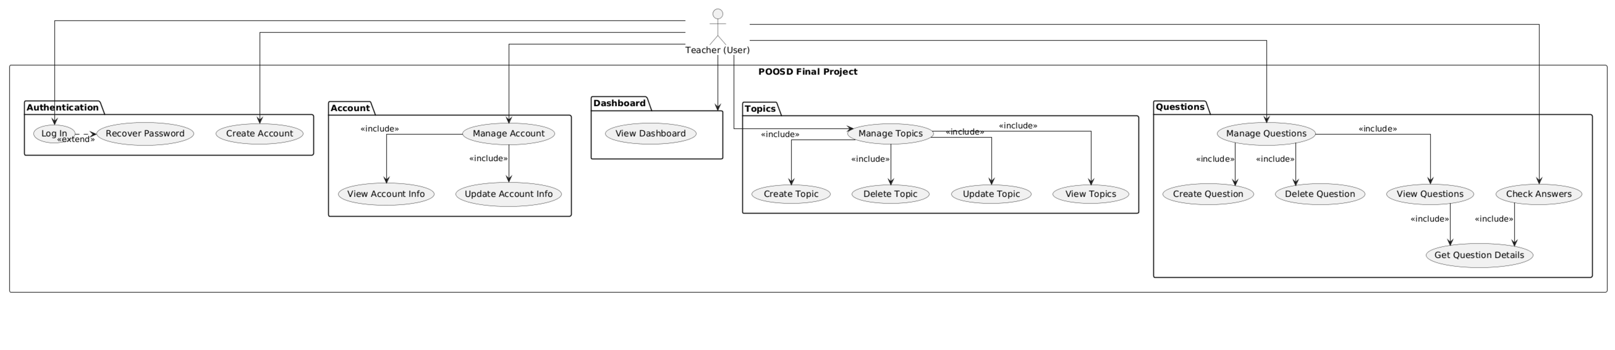
DOCUMENTATION
System Diagrams
Use Case Diagram
Shows interactions between Teacher and Student roles with the system — account management, topic/question CRUD, answer checking, and email verification.
Notes:
11

Slide 12
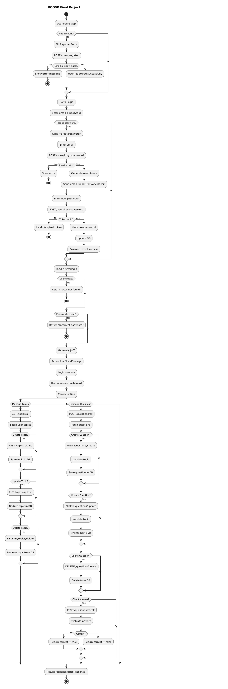
DOCUMENTATION
System Diagrams
Activity Diagram
Main system flow from login through topic management and question handling. Covers both teacher and student paths through the application.
Notes:
11

Slide 13
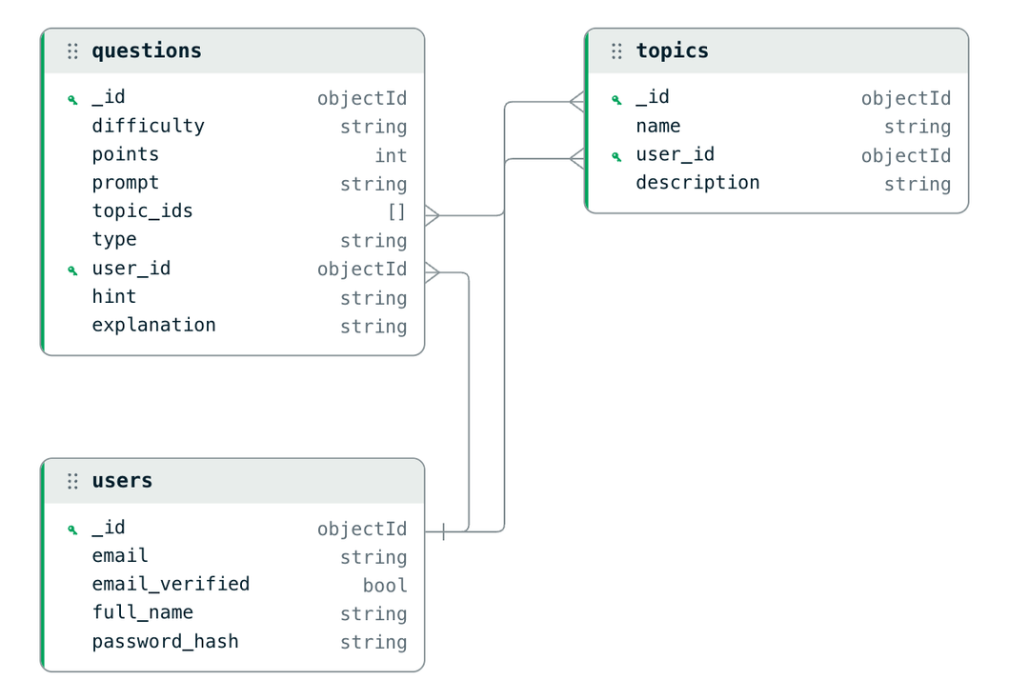
DOCUMENTATION
System Diagrams
ERD
Entity-relationship diagram generated from MongoDB showing users, topics, questions, choices, FRQ schemas, and auth codes and their relationships.
Notes:
12

Slide 14
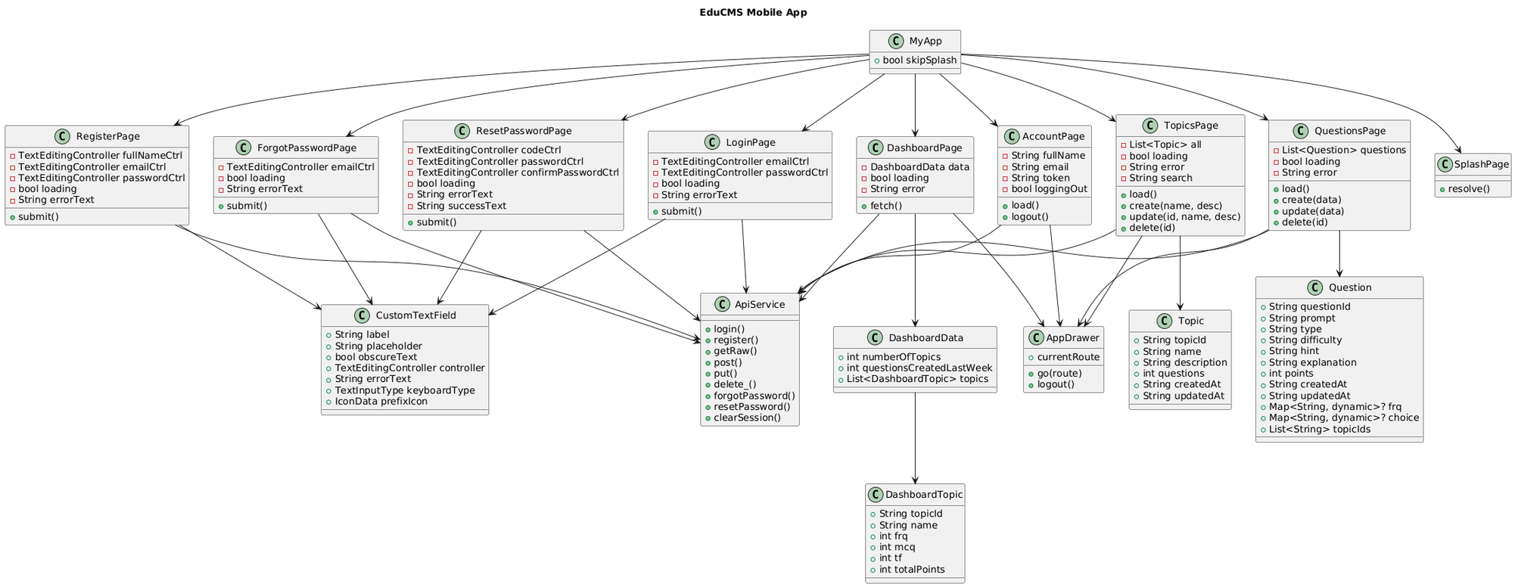
DOCUMENTATION
System Diagrams
Class Diagram (Flutter)
Flutter mobile app class structure — pages, widgets, services, and models. Covers DashboardPage, ApiService, AppDrawer, and data model classes.
Notes:
12

Slide 15
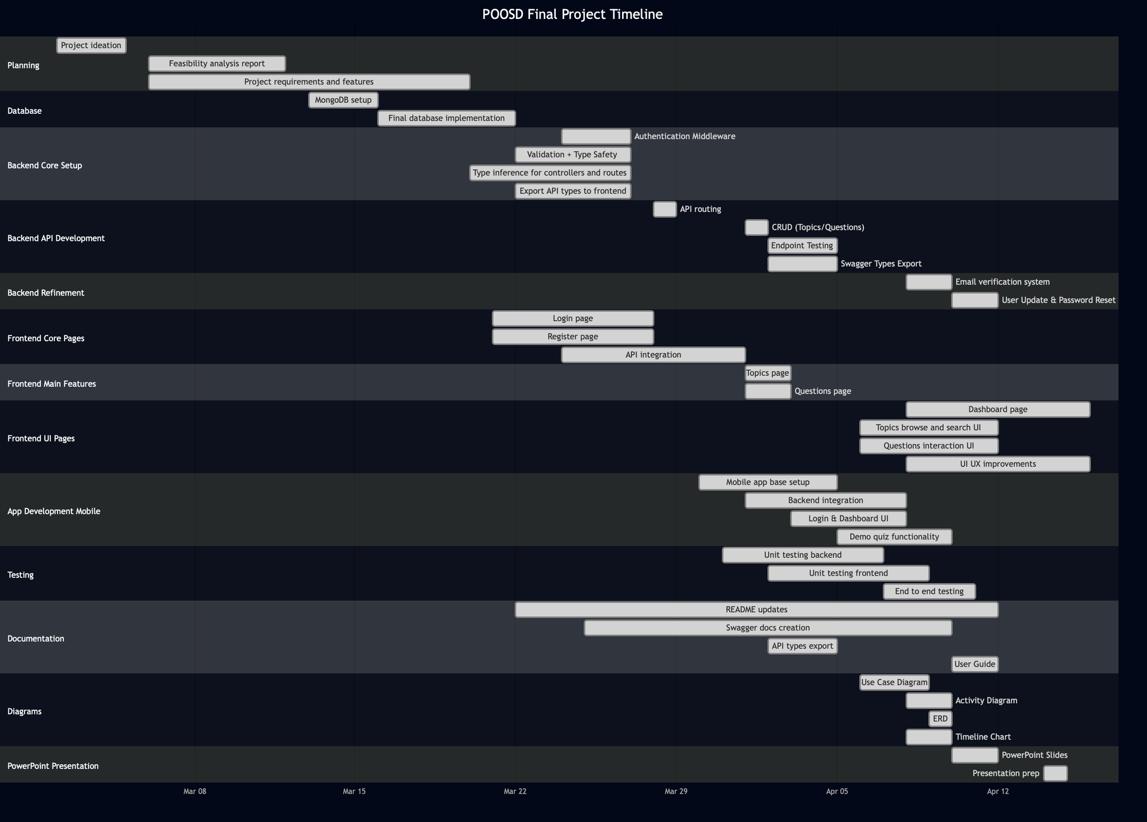
PLANNING
Gantt Chart
Project Timeline
Notes:
13

Slide 16
Thank You
Questions?
github.com/LuizGomes56/poosd_final_project
COP 4331 · UCF Spring 2026 · April 16, 2026
Notes:
14

