Slide 1
TIL6022 TIL Programming | Python
Wouter Schakel
September 16th 2024

Slide 2
Today
Algorithms
Lecture (from 8:45 till ~10:30)
Bin Packing
Enums
Least Squares
Lab Session (from ~10:30 till 12:30)

Slide 3
Bin Packing

Slide 4
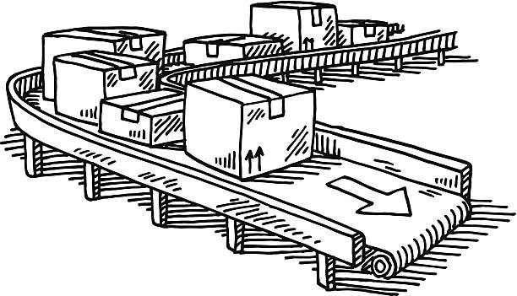

Bin Packing
Pack items in boxes (bins)
Weight
Dimensions
Shape
Strength
We assume only weight is relevant
Goal: minimize number of boxes required

Slide 5
Bin Packing
Items come ‘one at a time’
Each box has a capacity
Limited number of open boxes (closed boxed are not re-opened)
Items are packed using a heuristic:
Procedure to obtain a solution
Not guaranteed to be optimal

Slide 6
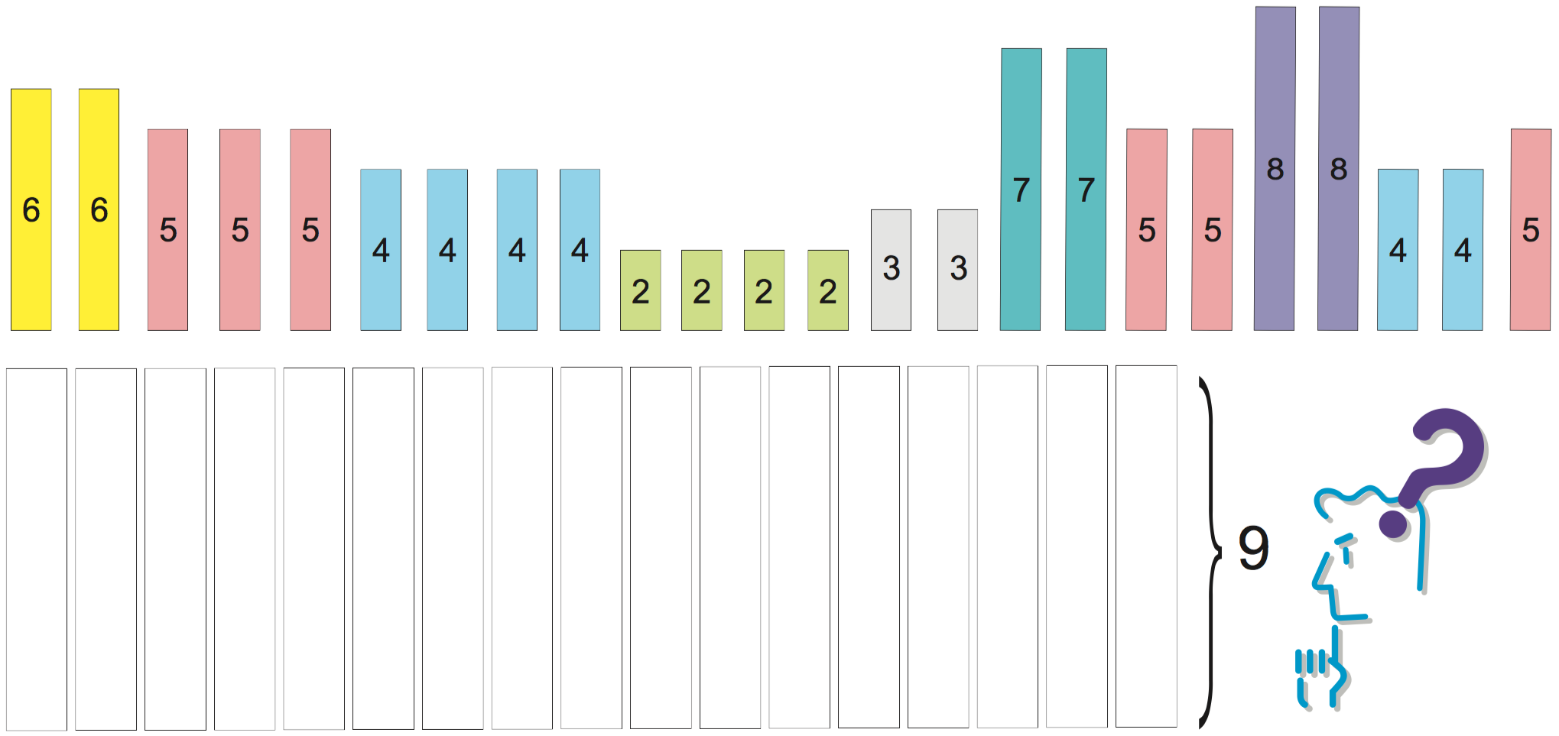
Bin Packing
Come up with a heuristic for packing
Assume infinite space for open boxes
One item at a time

Slide 7

Heuristics
Next Fit
1 open box at any time
If item does not fit, new box
Previous box is closed

Slide 8
Heuristics
Next k Fit
k open boxes at any time
Place in 1st box it fits in
If item does not fit, new box
Oldest is closed

Slide 9
Heuristics
First Fit
All boxes open
Place in 1st box it fits in
If item does not fit, new box

Slide 10
Heuristics
Best Fit
All boxes open
Place in fullest box it fits in
If item does not fit, new box

Slide 11
Heuristics
Offline vs. Online
Online
One item at a time
Offline
All items available
Partial heuristic: take largest remaining item
Challenge: how to implement offline algorithms?

Slide 12
Enums

Slide 13
Enums
A special kind of Class
Confined list of unique and constant values
Values defined at Class-level
No other instances can be created
Enum
MyEnum
MyEnum2

Slide 14
Enums
Examples
Traffic light colors
RED, AMBER, GREEN
Smurfs
SMURFETTE, PAPA_SMURF, CLUMSY_SMURF, BRAINY_SMURF, …
Line types
CONTINUOS, DASHED, DASH_DOT, DOTTED, DOUBLE, …

Slide 15
Least squares

Slide 16

Least squares
For n data points (x, y)
Linear approximation y = a + b∙x
$$a=\frac{n\sum{\left(xy\right)}−\sum{x}\sum{y}}{n\sum{\left(x^{2}\right)}−{\left(\sum{x}\right)}^{2}}$$
$$b=\frac{\sum{y}−a\sum{x}}{n}$$

Slide 17
Lab session: data smoothing filter

Slide 18
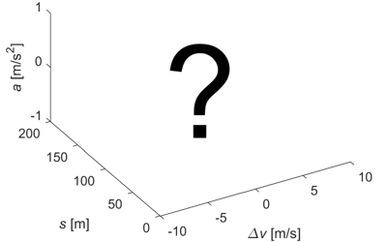
Data smoothing filter
Acceleration behaviour while driving
Depending on:
Speed difference with leader ∆v
Distance to leader s

Slide 19
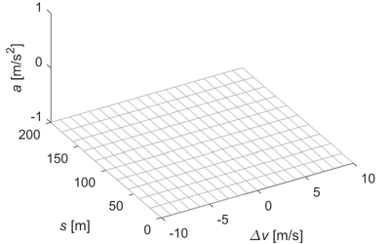
Data smoothing filter
Numerical approach:
We define a grid
At each point we calculate a value
?

Slide 20
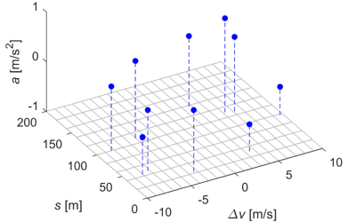

Data smoothing filter
Suppose we have 10 measurements
At each point:
Calculate weighted mean
Weight ω ~ proximity
$$\overline{A}=\frac{\sum_{i}{\left(ω_{i}A_{i}\right)}}{\sum_{i}{ω_{i}}}$$

Slide 21
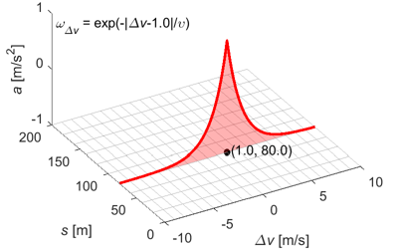
Data smoothing filter
Exponential weight function ω
Width determined by υ
ω [-]

Slide 22
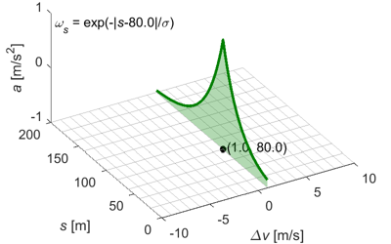
Data smoothing filter
Similar in the other dimension
Width determined by σ
ω [-]

Slide 23
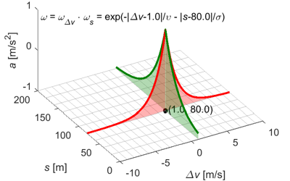
Data smoothing filter
We multiply weights of both dimensions
This 3D function is a kernel
ω [-]

Slide 24
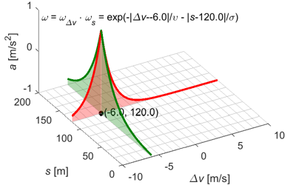
Data smoothing filter
For another point, the kernel is moved
ω [-]

Slide 25
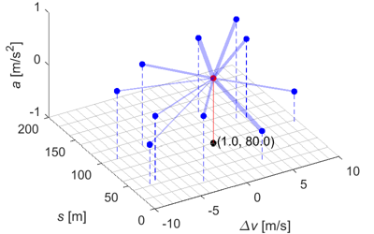
Data smoothing filter
Calculation at one point
Thickness of transparent lines indicates weight

Slide 26
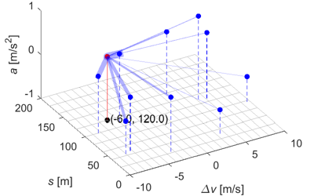
Data smoothing filter
And for the other point

Slide 27
Data smoothing filter
Data is provided
Goal: 2D pseudo-colour plot
Colour indicates the 3rd dimension (acceleration)
Plotting code is provided

Slide 28

Data smoothing filter
Measurement data A, ΔV, S (arrays)
At each point (Δv, s), you calculate a weighted sum over measurements A
The weight ω of each value in A depends on the corresponding values in ΔV, S. (1.0 and 80.0 in the example)
ω [-]
$$\overline{A}=\frac{\sum_{i}{\left(ω_{i}A_{i}\right)}}{\sum_{i}{ω_{i}}}$$

Slide 29
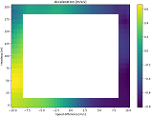
Data smoothing filter
The solution should look like this
But high resolution
And with the middle part included
The filtering is <10 lines of code!

Slide 30
Lab session
Open Jupyter Notebook file ‘3.lab_session.ipynb’
Also download ‘cf_data.csv’
Print as pdf
Hand in on Brightspace
Deadline: September 17th, 23:59

