Slide 1

Pavan T
Sudhakar R
https://github.com/sudhakar3697/PWA-Sample

Slide 2

Internet IP WWW

Slide 3
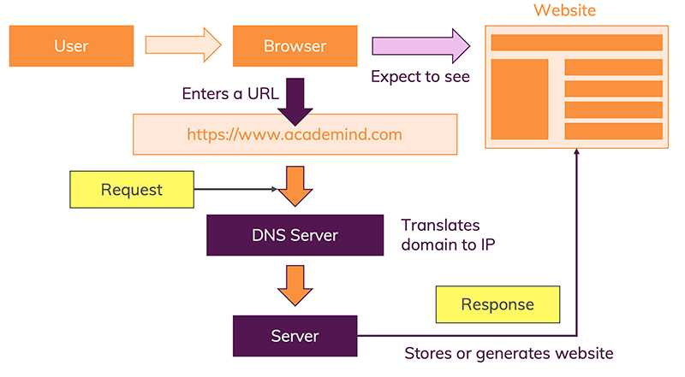
WWW & Browser
Client-Server
HTTP/HTTPS
DNS
Search Engine
https://xxxx.com 😜

Slide 4


Web page/site/app

Slide 5
Browser | Rendering engine (transforms HTML & other resources of a web page into an interactive visual representation on a user's device) | JavaScript engine (executes JavaScript code)
Chromium Google Chrome Opera Brave | Blink | V8
Firefox | Gecko | SpiderMonkey
Internet Explorer | Trident | Chakra
Edge | EdgeHTML -> Blink | Chakra -> V8
Safari | WebKit | JavaScriptCore
WHATWG
W3C
ECMAScript
…
Node.js
Electron
React Native (Hermes) created by Facebook

Slide 6
Agenda
What?
Why?
How?
Oh?
Demo

Slide 7

What?
Progressive Web Apps (PWAs) are simply web apps that are progressively enhanced with native app-like features on supporting platforms and browser engines, such as launch-from-home screen installation, offline support, and push notifications.- MSDN.
Website++

Slide 8
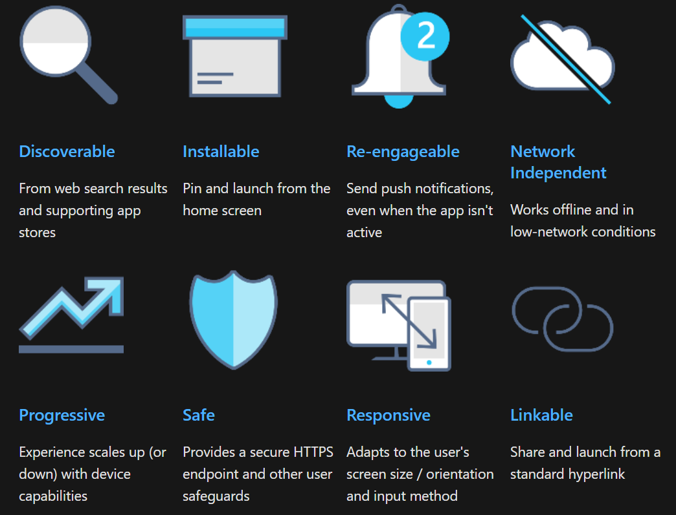

Slide 9
Why?
Fast, efficient and portable
Easy to develop & maintain
Cross-platform & native feel
Google Play Store, Microsoft Store, etc.

Slide 10
HTTPS
Service workers & other PWA tech will only work with web resources served over a secure connection.
Web app manifest
A JSON file describing key info about your web app (such as icons, language, and URL entry point)
Cross-browser compatibility
Ensure your PWA works in different browsers and environments
Responsive design
Employ fluid layouts and flexible images with CSS grid and/or flexbox, media queries, and responsive images to adapt your UX to your user's device.
Deep linking
Route each page of your site to a unique URL so existing users can help you engage an even broader audience through social media sharing.
Best practices
Use code quality to optimize the efficiency, robustness, safety, and accessibility of your app.
Service workers
acts as network proxies b/w your server & client app in order to provide offline support, resource caching, push notifications, background data sync, page load perf optimizations.
How?

Slide 11


Good to know about
Architecture of an app
SSR
CSR
Hybrid
TWA
App shell (loading minimal UI ASAP, Cache)
WASM
Tailor your PWA for Windows
Lighthouse (Test)

Slide 12

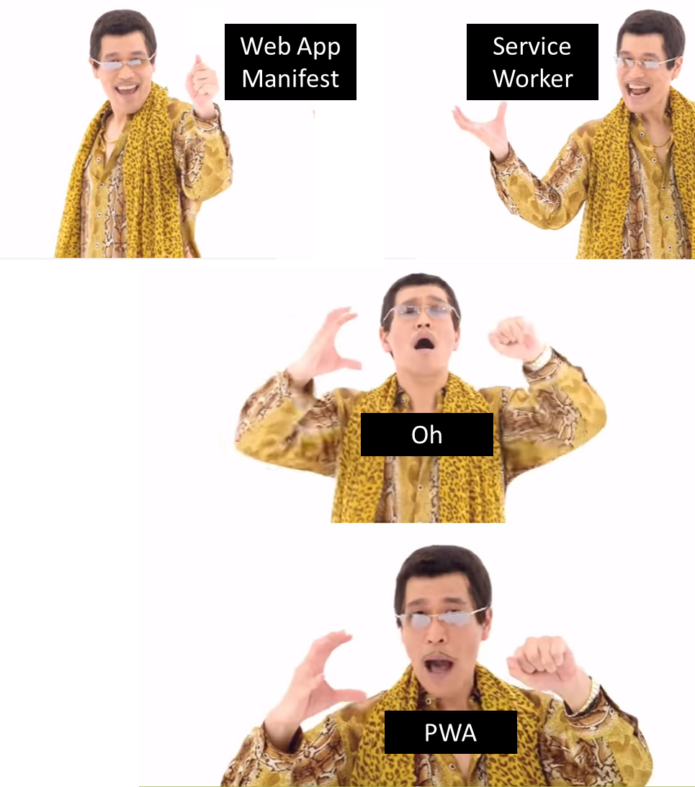
1. Android
2. IOS
3. Windows
4. Linux
5. MAC
5 Platforms
PWA

Slide 13

















Oh?

Slide 14
Demo
https://www.pwabuilder.com
From scratch

Slide 15

#chromedevsummit2019
Native APIs
https://youtu.be/JKVZMqpiY7w?list=PLNYkxOF6rcIDA1uGhqy45bqlul0VcvKMr
https://fugu-journal.web.app
https://fugu-edit.web.app
https://goo.gle/fugu-api-tracker
https://webwewant.fyi/

Slide 16
References
https://docs.microsoft.com/en-us/microsoft-edge/progressive-web-apps
https://developer.mozilla.org/en-US/docs/Web/Progressive_web_apps
https://developers.google.com/web/progressive-web-apps

Slide 17
Thank you

