Slide 1
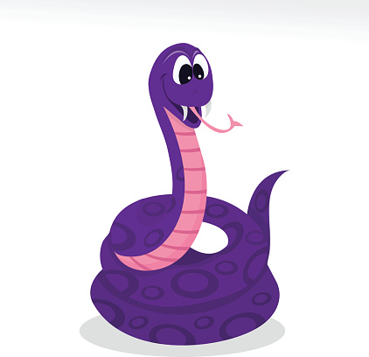
Snake 208_ Algorithm Dr.Islam Tharwat
Team Members :
- Hagar Mekhemer Ismail : 202000737
- Rodeen Mustafa : 202002557
- Lujain Mohamed El-said : 202002670
- Toqa Tamer : 202001985
- Ranim Mustafa : 202000515

Slide 2
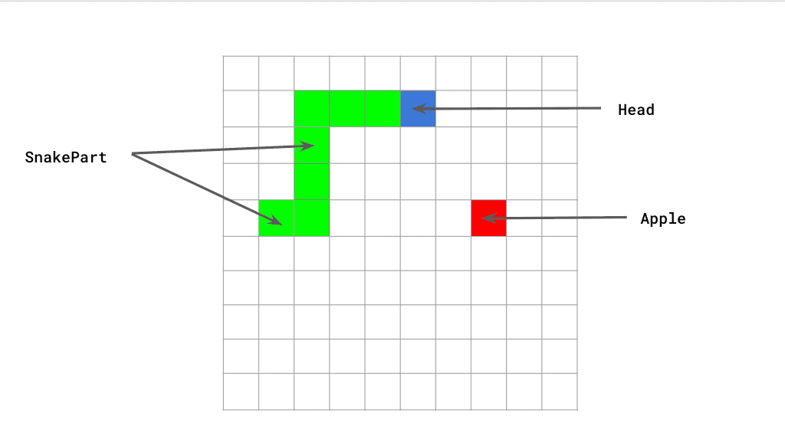
pygame → consists of computer graphics to be used in python.
Breadth-First Search , Depth- First Search
The snake can move in 4 directions: up, down, left, and right.
Every time the snake eats, its length increases.
The food should appear at random empty positions.
Algorithm to win the game, eat the last piece while there is no other place for the food to appear. The algorithm should automate the snake movement as no human being should affect the snake.

Slide 3
Simple process
start
Initial game
Moving
The snake find food ?
Get food and continue ... Till there is no other place for the food to appear
yes
End “win”
Continue moving till get food.
Or dead
no

Slide 4
We used 3 files
One of them includes the shape that will appear when running the algorithm
Width , height , number of rows , colors , frame , initial length , etc.
One of them to includes the main → screen , grid , game
initializing the Pygame library. Then it sets up a game surface with dimensions of WIDTH and HEIGHT “The screen for this program”.
On of them includes → building the squares , moving “left, right, up, down” , generating food , eating food , hitting the wall , the BFS algorithm , etc.
A helper function to find the neighbors of a given position.
A distance function that takes 2 argument (position 1 , position 2 ) as calculating the absolute value of each coordinate, then it calculates the difference in those coordinates and returns that as a positive number.
mainloop is set to true which means that this script will run continuously until it's stopped.

Slide 5
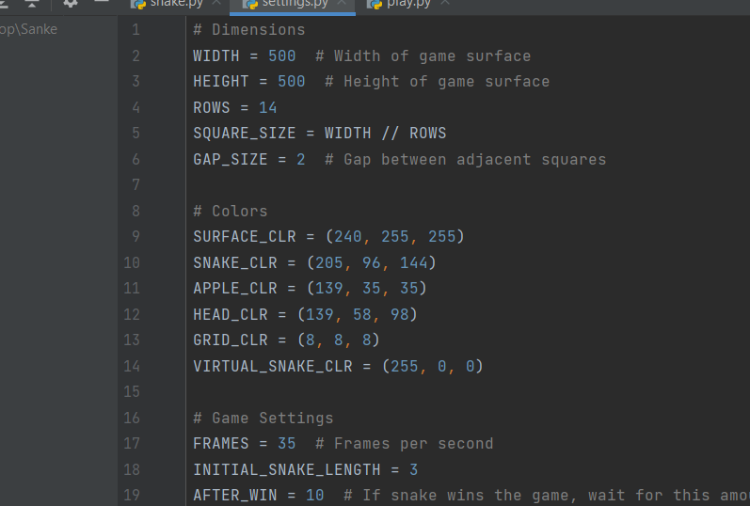
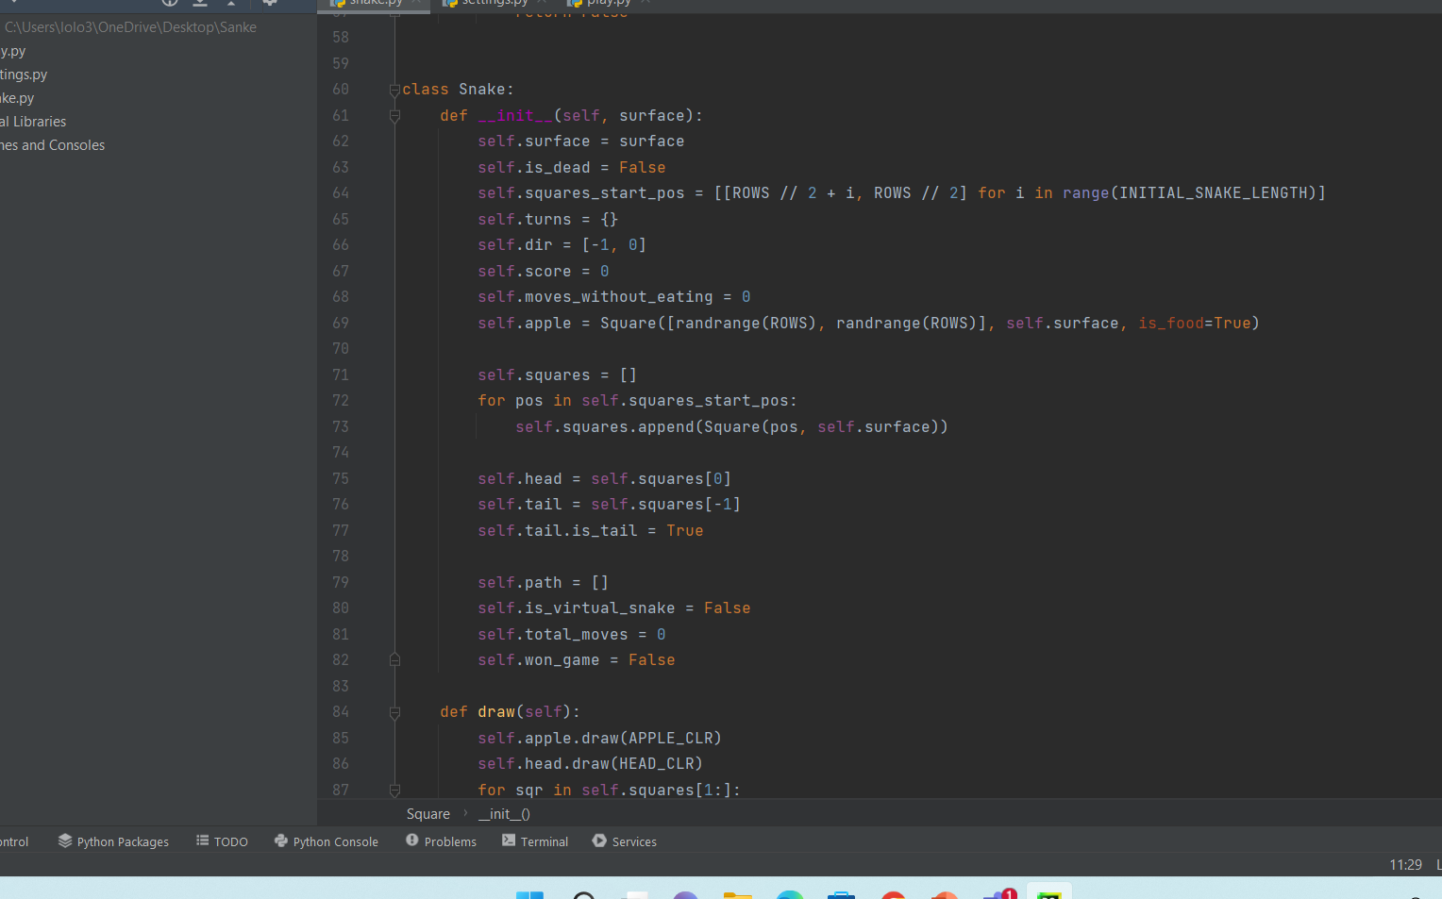
Parts from the code

Slide 6
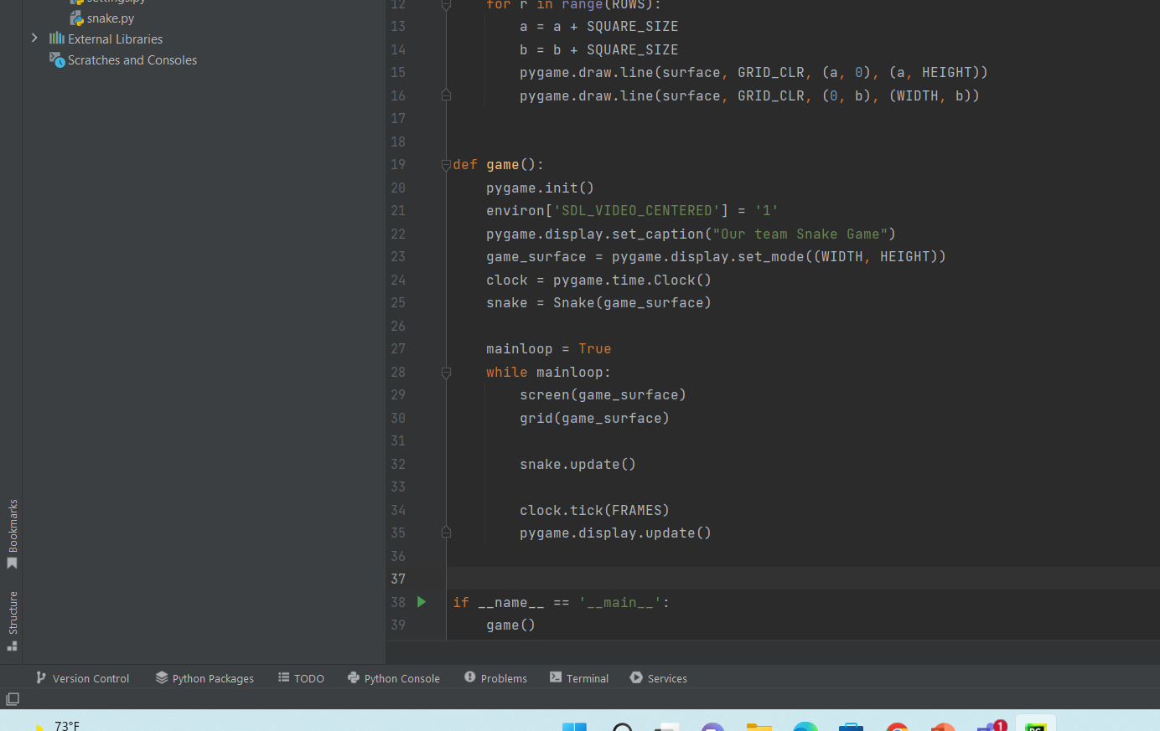
Continue ..

Slide 7
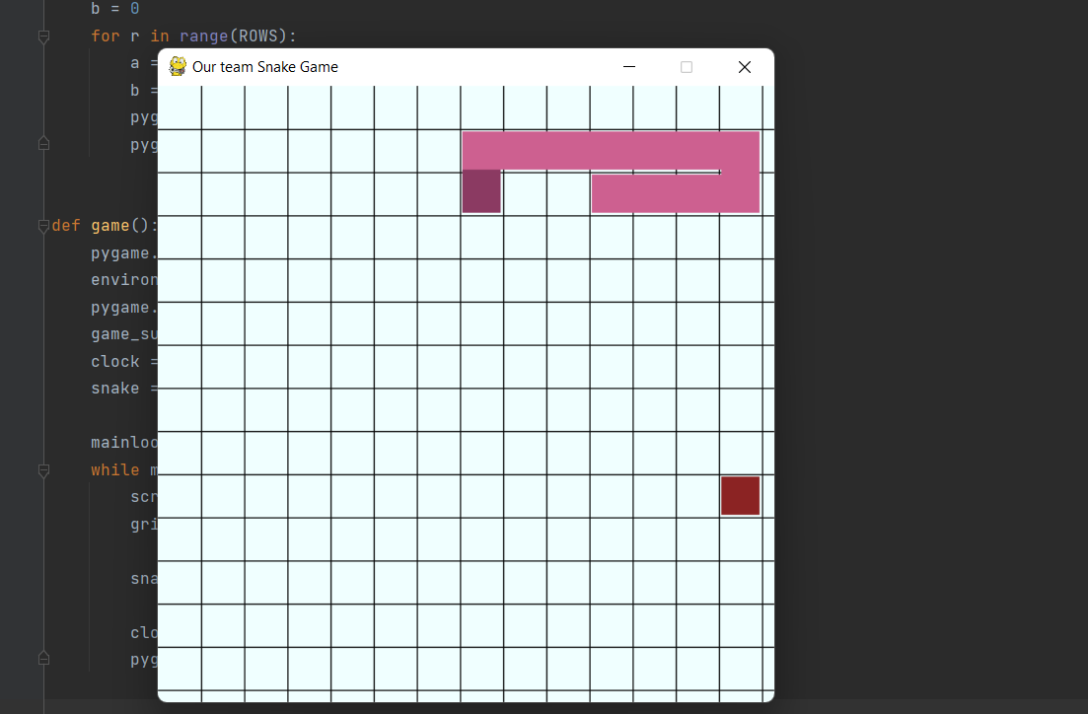
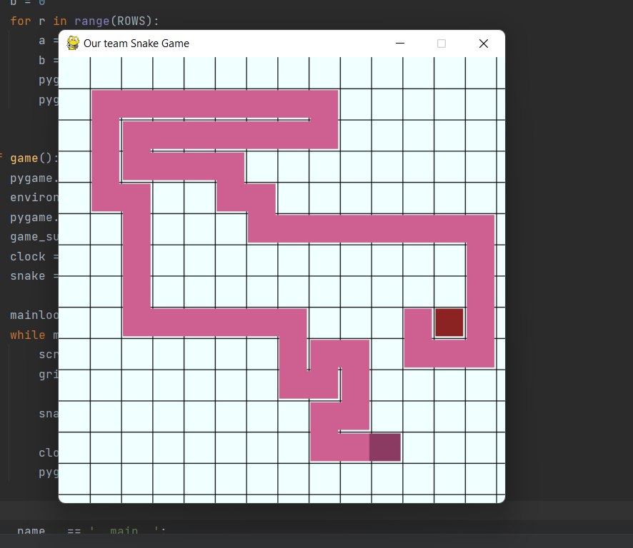

Slide 8
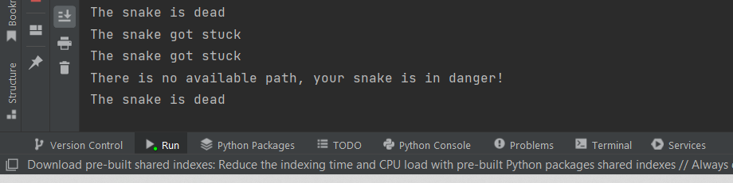
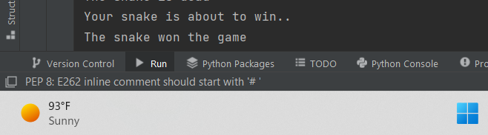
When playing the game

Slide 9

Have a nice Day ISA 💜💜️

