Slide 1

Student Course Registration Prerequisite Checking System
207- Final project

Slide 2


Team members :
Hagar Mekhemer Ismail_202000737
RodeenMustafa_202002557
Toqa Tamer _202001985
Lujain Mohamed Elsaid_202002670

Slide 3
This program will input the university course list with their prerequisites ONCE at the start of program by reading this information from a file. Then, whenever a student is willing to register a number of courses, he/she will enter the courses they studied and the ones they want to register in. The system will allow or disallow the student from registering the course based on stored course prerequisites.
-- The courses that we had :
101Introduction to Programming
207Fundamental of Data Structures & Algorithms
311Computer Architecture
217Advanced Computer Programming & Concepts
404Database Systems
313Software Engineering
415Compiler Design
304Analysis and Design of Algorithms
419Theory of Computing
315Operating Systems

Slide 4

Functions
- We create a struct node - a class for tree - a function to add nodes to Tree – a function to print full Tree
Searching function ….etc. and we used some other functions and built our int main(){
And the notepad the we put the codes for the courses

Slide 5
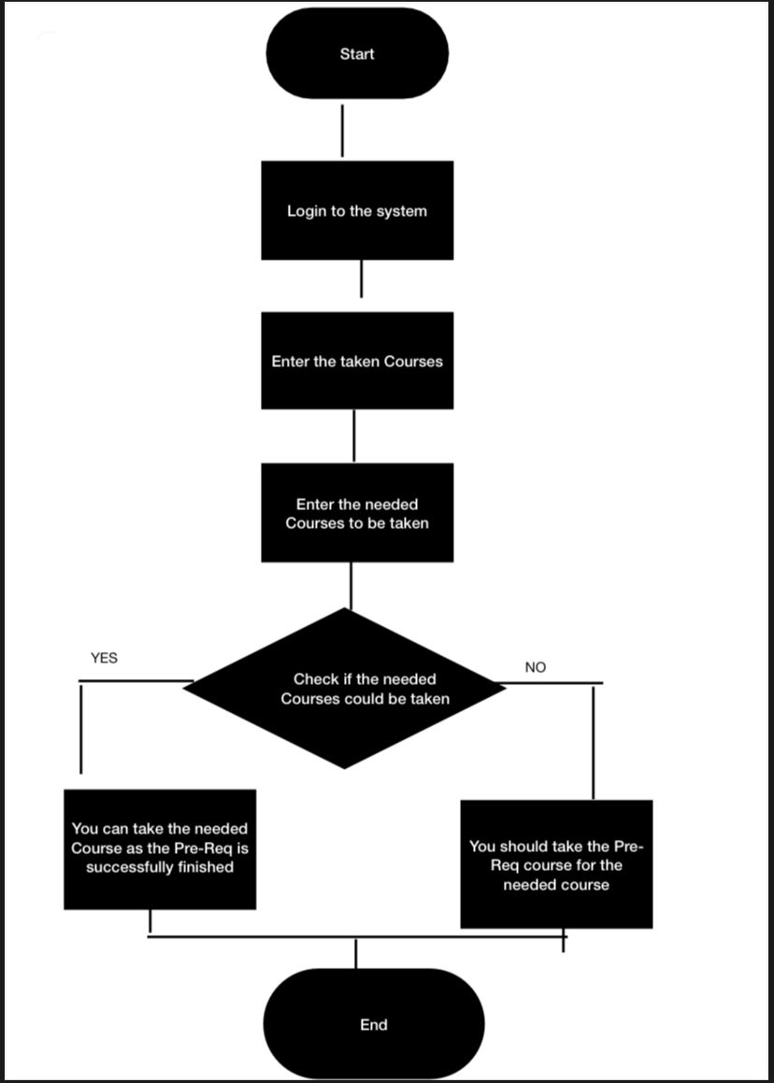
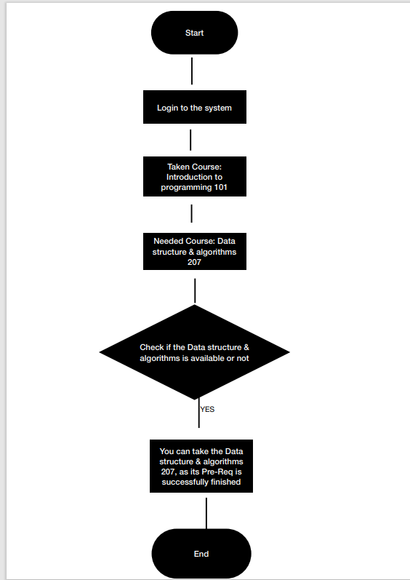

Slide 6
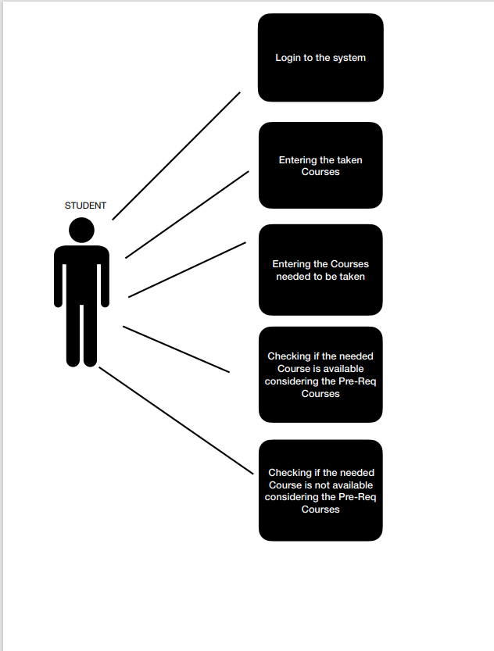

Slide 7
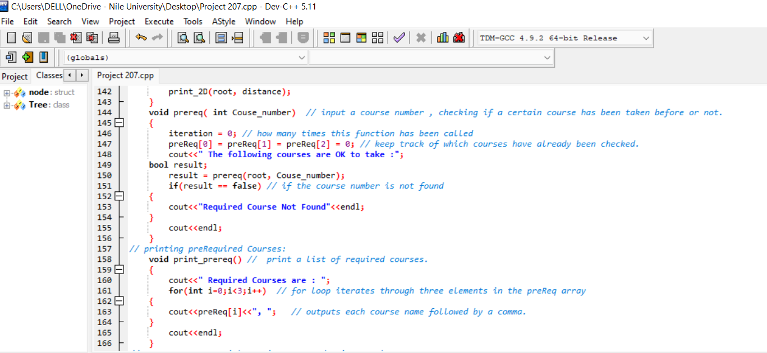

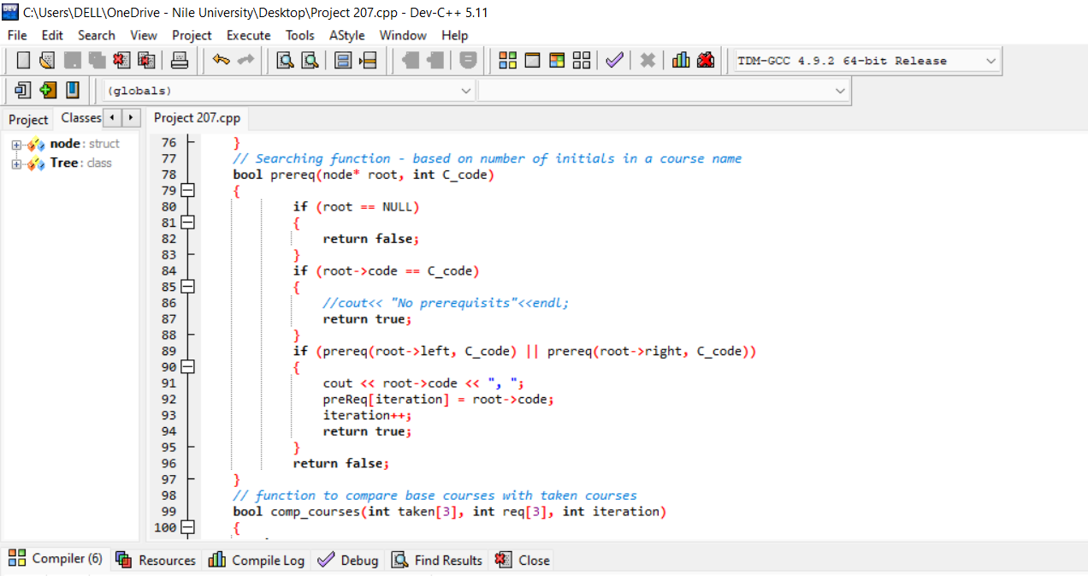
Some parts of code

Slide 8
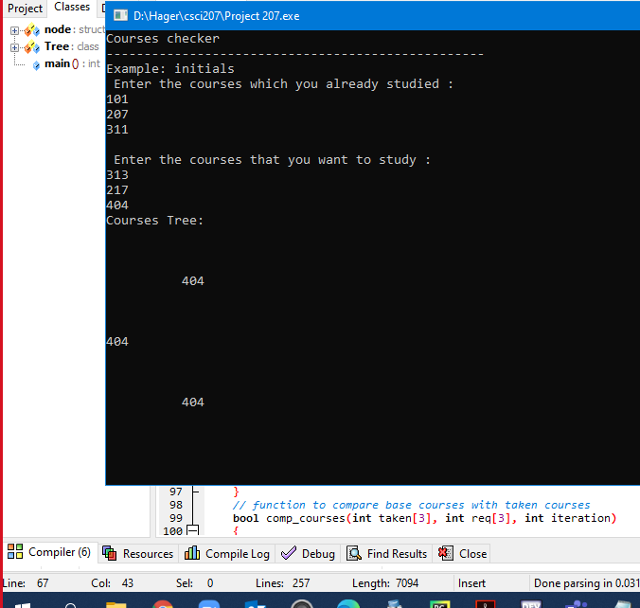
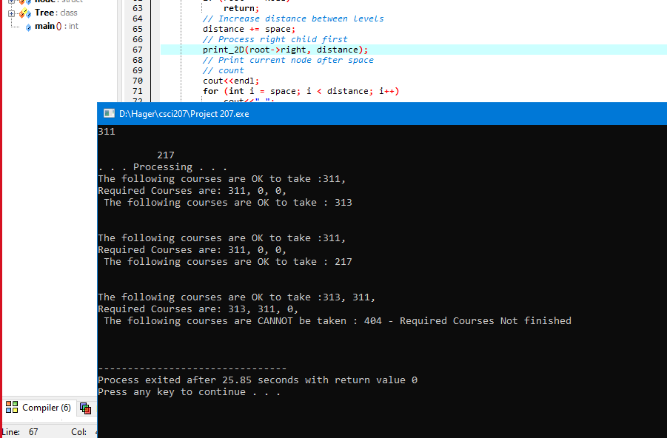

Sample run
Sample Run

Slide 9


Eng. Asmaa, have a nice day :))

