Slide 1
SMART EYESIGHT
AIIP/S
Yanilette Lopez Duprey
Emanuel Rivera Castro
Joaquin Pockels Balaguer

Slide 2
Presentation
Introduction
SRS
Introduction
Interfaces
Constraints And Dependencies
SDD
Introduction
STD
Introduction
Methods for test
Equipment for test
Black box example
White box example
Integration example
SPMP
Introduction
Project Responsibilities
Member Roles
Budget
Salary

Slide 3
Problem
Current registration system have a lot of problems.
Search engine.
Validation.
Specific course statement fees.

Slide 4
The SRS
SRS means Software Requirements Specifications
Is a complete description of the behavior of a system to be developed.
Is divided in three fundamental parts:
Introduction
Overall Description(For the Client)
Specific Requirements(For the developers)

Slide 5
Objectives
Extracts relevant features from an incoming stream of images by using traditional features extraction algorithms and statistical methods
Train a probabilistic neural network using the relevant features obtained from UAV incoming images
Identify provided images based on its neural network training
Provide feedback to mayor project's interconnected inverse file query system.

Slide 6
Objectives (cont.)
Designed as an extensible software for CUDA code conversion
Designed as an independent system or module
Interconnection structure of the Smart Eyesight application with the main proposed system is to be established and validated with the consent of developers of the dependent sub-systems and the client himself

Slide 7
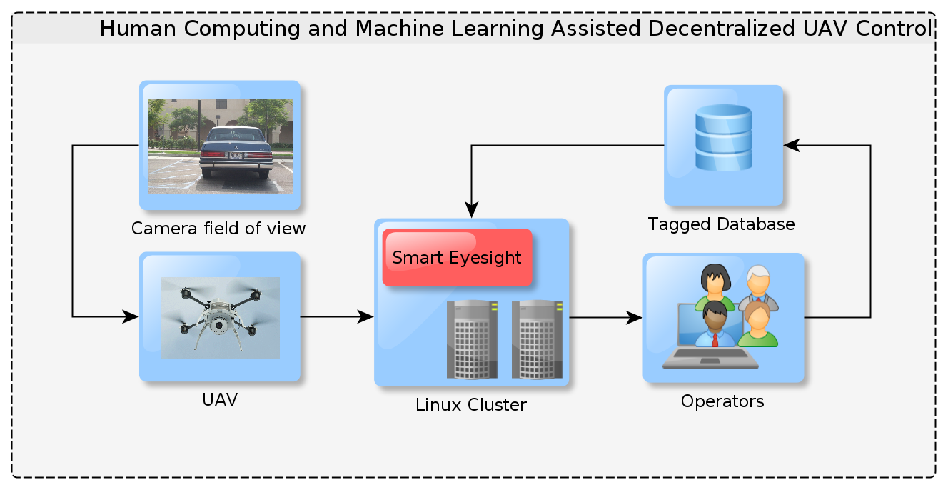
Product Perspective

Slide 8
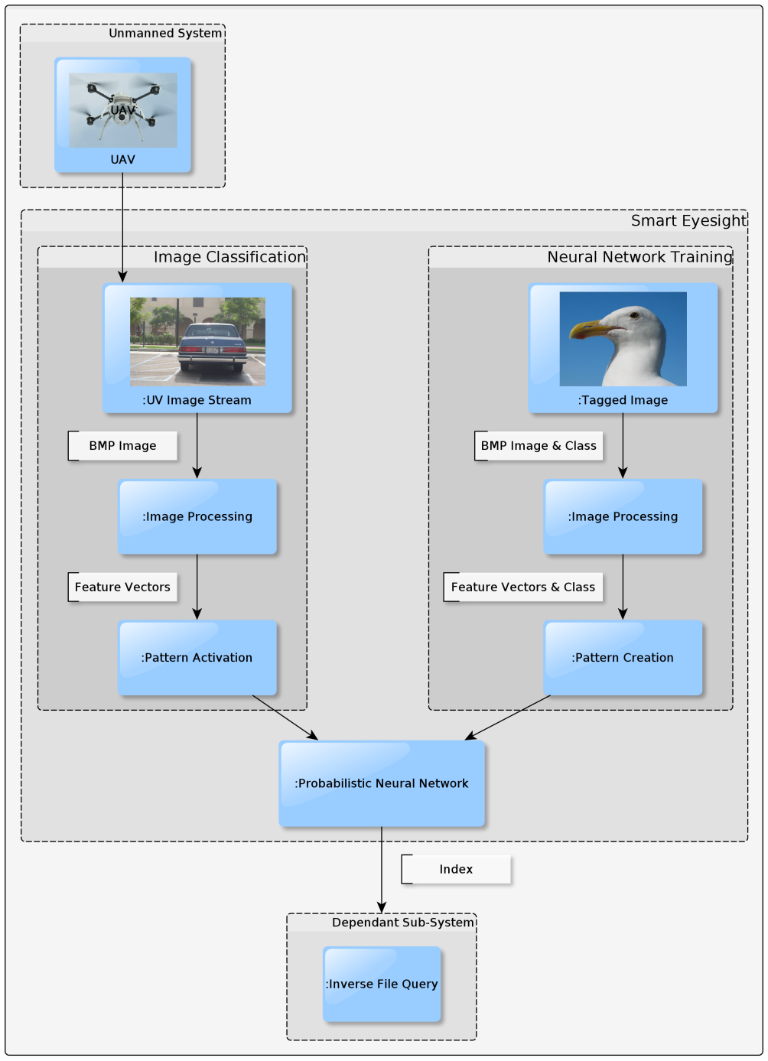
Smart eyesight perspective

Slide 9
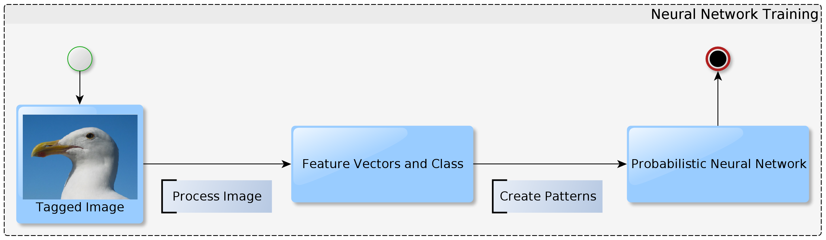
Neural Network Training

Slide 10
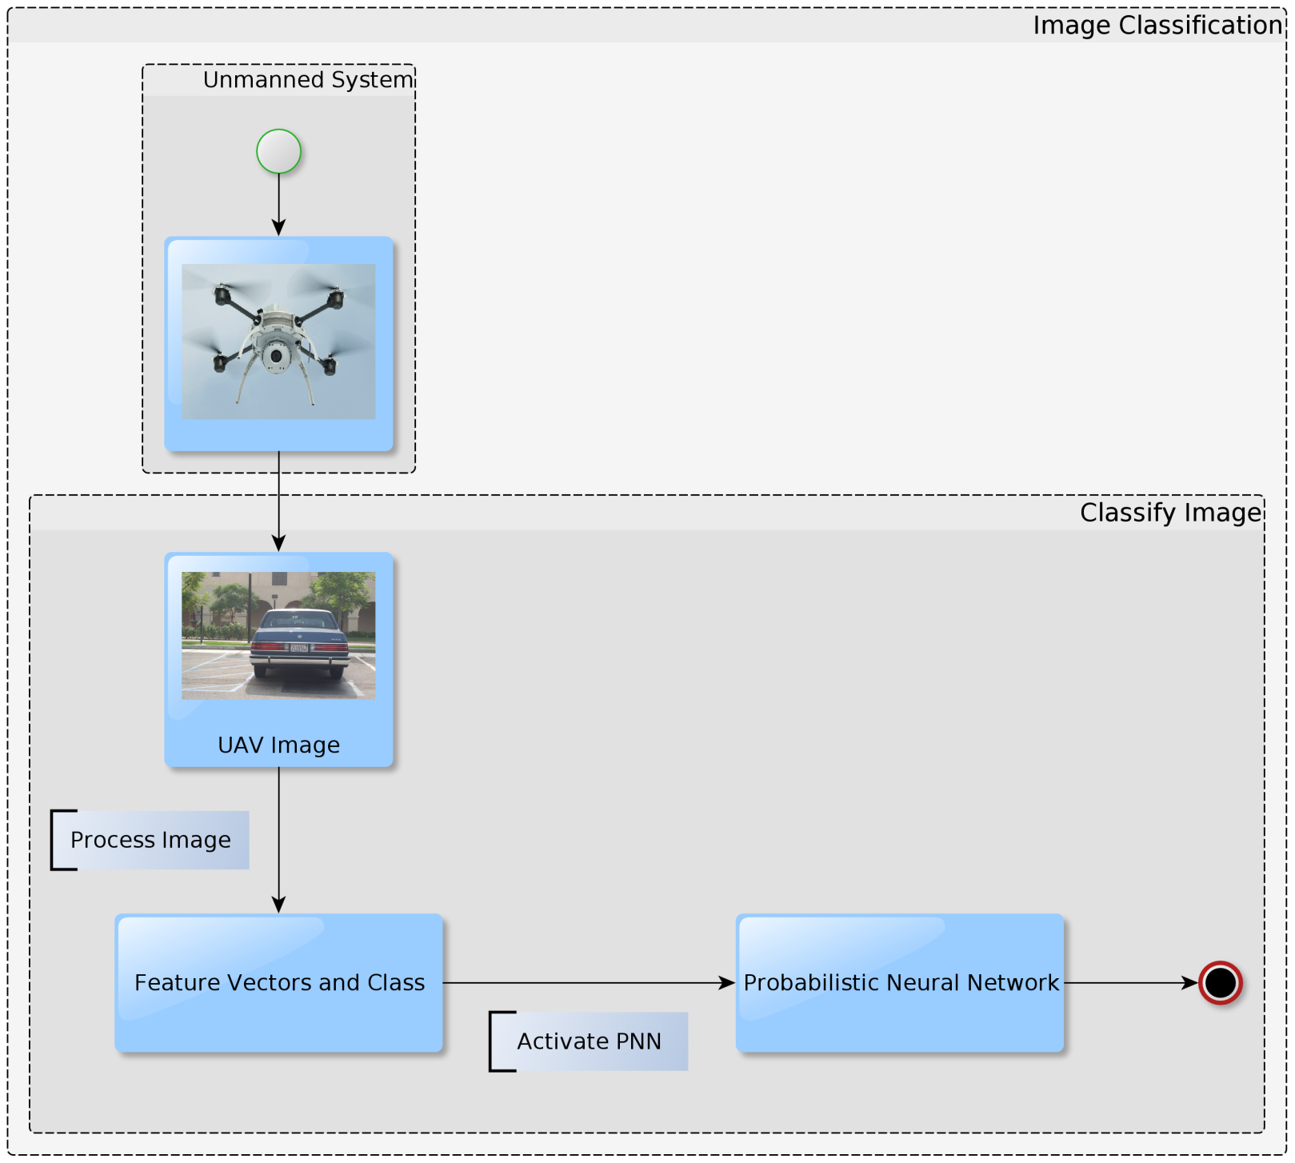
Image Classification

Slide 11
Hardware interface
Computer with basic peripherals(monitor, mouse, keyboard).
Peripheral that allows internet connection.
Any tablet or smart phone capable of web browsing with 233MHz processor.

Slide 12
Software Interfaces
Every operation will use the internet in some way.
Need a web browser and an OS.
Receives credentials and validate with the DBMS.

Slide 13
Communication Interfaces
Will be running on the PUPR server.
Easier and accurate update
Every user will communicate with the server.
TCP/IP for managing.

Slide 14
User cases

Slide 15
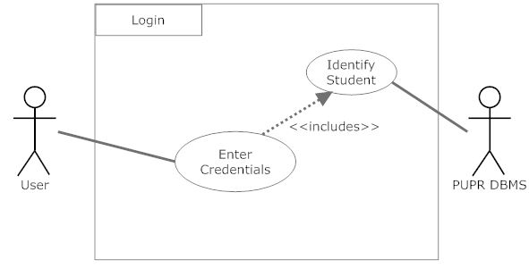
User cases

Slide 16
User cases

Slide 17
User cases

Slide 18
User cases

Slide 19
User cases

Slide 20
User cases

Slide 21
User cases

Slide 22
User Characteristics
Skills for the user are not high.
Experience in navigating the web.
Detailed enough for inexperience users.

Slide 23
Constraints
Hardware and Software limitations
Processor: 233 MHz
Memory: 64 MB RAM
OS: None (user can use any OS that can support Mozilla Firefox and/or Google Chrome)
Web browser: Mozilla Firefox or Google Chrome
Internet connection with at least a speed of 5.6 kbps
Languages needed for implementation
PHP (version 4.0)
MySQL
Security
HTTPS with Encrypted SSL and TSL connection features.
Others
Depends on the database that the institution uses.

Slide 24
Assumptions and Dependencies
Users belong to the PUPR and have an account already created on the CTE in the PUPR campus, otherwise they will not be able to access AE.
The PUPR DBMS use MySQL.

Slide 25
The SDD
SDD Means Software Design Description.
It represents or model a system with a precise information for planning, analysis, and implementation.
It can be divided in:
Introduction
System overview
Architectural design
Detail system specifications

Slide 26
Deployment Diagram

Slide 27
Decomposition Block Diagram

Slide 28
main Activity Diagram

Slide 29
Class Diagram

Slide 30
Enroll Activity Diagram

Slide 31
Display Course sub-activity Diagram

Slide 32
The STD
STD Means Software Test Document.
Is description of the methodology to be used for testing each function.
In can be divided in:
Introduction
Test Plan
Test Design Specification
Test Description

Slide 33
Methods for Testing
Unit Test
Black Box
White Box
Integration Test
Bottom-up
Top-down
Sandwich
Big Bang

Slide 34
Equipment for tests
Astra-Enroller web page (Internet)
PUPR Database
Astra-Enroller server

Slide 35
Black box example
Test design specification identifier
Test if the function displays the user’s curriculum when the user clicks view curriculum button and loads the user’s transcript.
Function to be tested
View Curriculum
Method to be use
Unit Testing: Black Box
Conditions for the test
5000 users will click on the View Curriculum button.

Slide 36
Black box example

Slide 37
White box example
Test design specification identifier
Test if the function login the user to his account. (Validation of credential)
Function to be tested
Login
Method to be use
White Box
Conditions for the test
User writes his valid credentials (username and password).
User writes his valid username but not the valid password.
User writes his valid password but not the valid username.
User writes not valid credentials (username and password).
User writes his valid credentials with Uppercase or lowercase (username and
password)

Slide 38
White box example

Slide 39
Integration example
Test design specification identifier
Test if the function gets the Astra-Enroller webpage when the user write the url.
Function to be tested
Homepage
Method to be use
Integration: Sandwich
Conditions for the test
Using different web browsers (Mozilla Firefox, Opera).
Using different OS (Windows XP, Mac OS X).
Using different devices. (PC, Laptop, tables, smartphones)

Slide 40
Integration example

Slide 41
The SPMP
SPMP means Software Project Management Plan.
It establish in a clear form the details and specifications of how a system would be administrated.
Is divided in five sections
Introduction
Project Organization
Managerial Process
Technical Process
Work Packages, Schedule and Budget

Slide 42
Project Responsibilities
Document Type | Project Manager (s) | Assigned Member(s)
SRS | Gabriel and Emanuel | Gabriel, Emanuel, Joaquín, Francisco and Luis
SDD | Joaquin | Joaquin
STD | Emanuel | Emanuel
SPMP | Francisco and Gabriel | Francisco, Gabriel and Luis

Slide 43
Project Responsibilities
 | SRS
Title | Section | Works on
Purpose | 1.1 | Luis
Scope | 1.2 | Francisco and Gabriel
Definitions, Acronyms and Abbreviations | 1.3 | All
References | 1.4 | All
Overview | 1.5 | Joaquin and Emanuel
Product Perspective | 2.1 | Luis
Product Functions | 2.2 | Joaquin and Gabriel
User Classes Characteristics | 2.3 | Emanuel
Constraints | 2.4 | Emanuel
Assumptions and dependencies | 2.5 | Francisco
External interface | 3.1 | Luis
Product Functions | 3.2 | Joaquin and Gabriel
Performance Requirements | 3.3 | Emanuel
Logic Requirements of Database | 3.4 | Emanuel
Design restrictions | 3.5 | Emanuel
Software System Requirements | 3.6 | Francisco

Slide 44
Project Responsibilities
 | SDD
Title | Section | Works on
Introduction | 1 | Emanuel
Everything else | 2-6 | Joaquin
 | STD
Title | Section | Works on
ALL | ALL | Emanuel
 | SPMP
Title | Section | Works on
Introduction | 1 | Luis
Project Organization | 2 | Gabriel
Managerial Process | 3 | Francisco
Technical Process | 4
Methods, Tools, and Techniques | 4.1 | Gabriel
Software Documentation | 4.2 | Luis
Project Support Functions | 4.3 | Francisco
Work Packages, Schedule, and Budget | 5
Work Packages | 5.1 | Gabriel
Dependencies | 5.2 | Flagged
Resource Requirements | 5.3 | Francisco
Budget and Resource Allocation | 5.4 | Luis
Schedule | 5.5 | Gabriel

Slide 45
Members Roles
Member Full Name | Title(s)
Gabriel E. Nieves Rodríguez | Co-Founder, Computer Engineer, Project Manager, Graphics Designer
Francisco O. Ramos Bravo | Co-Founder, Computer Engineer, Project Manager, Editor & Chief and Translator
Joaquín Pockels Balaguer | Co-Founder, Computer Engineer, Project Manager and Function Specialist
Emanuel Rivera Castro | Co-Founder, Computer Engineer, Project Manager, Editor and Translator
Luis Ayala Silva | Computer Engineer

Slide 46
Budget
Items | Quantity | Amount | Total
Pens Package | 2 | $4.99 | $9.98
Record Note Book | 1 | $19.99 | $19.99
Laptops | 5 | $900.00 | $4,500.00
Gasoline | 5 | $500.00 | $2,500.00
Paper Block | 2 | $23.95 | $47.90
Adobe Photoshop CS5 | 1 | $679.99 | $679.99
Office 2010 Professional | 1 | $408.99 | $408.99
Microsoft Project 2010 | 1 | $499.80 | $499.80
Smart Draw 2010 | 1 | $208.04 | $208.04
TOTAL |  |  | $8,874.69

Slide 47
Salary
Personal | Months | Amount(Per Month) | Total
Gabriel Nieves | 3 | $2,400.00 | $7,200.00
Francisco Ramos | 3 | $1,920.00 | $5,760.00
Emanuel Rivera | 3 | $1,920.00 | $5,760.00
Joaquin Pockels | 3 | $1,920.00 | $5,760.00
Luis Ayala | 3 | $1,920.00 | $5,760.00
Total |  |  | $30,240.00

Slide 48
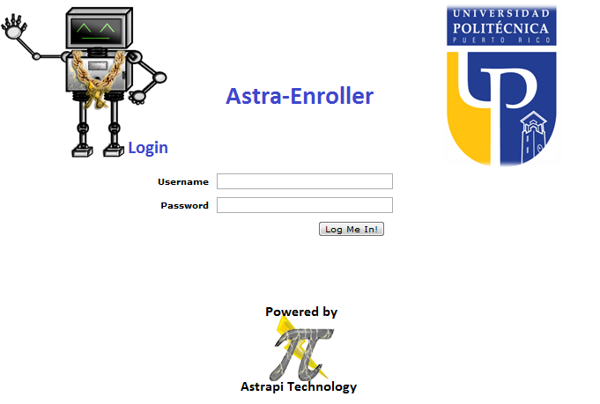
User Interface Example

Slide 49
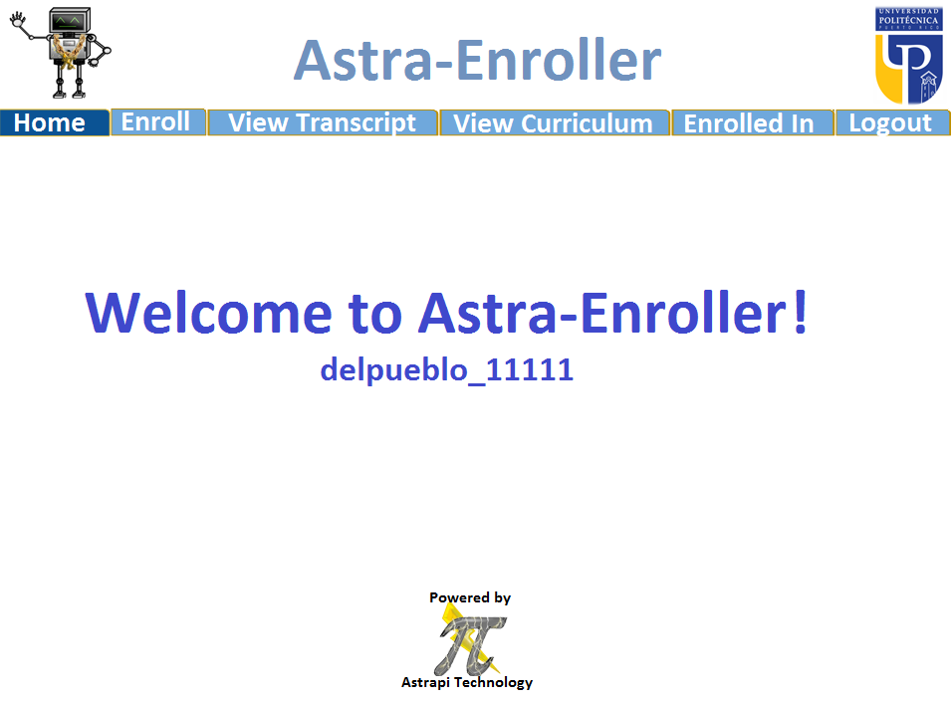
User Interface Example

Slide 50
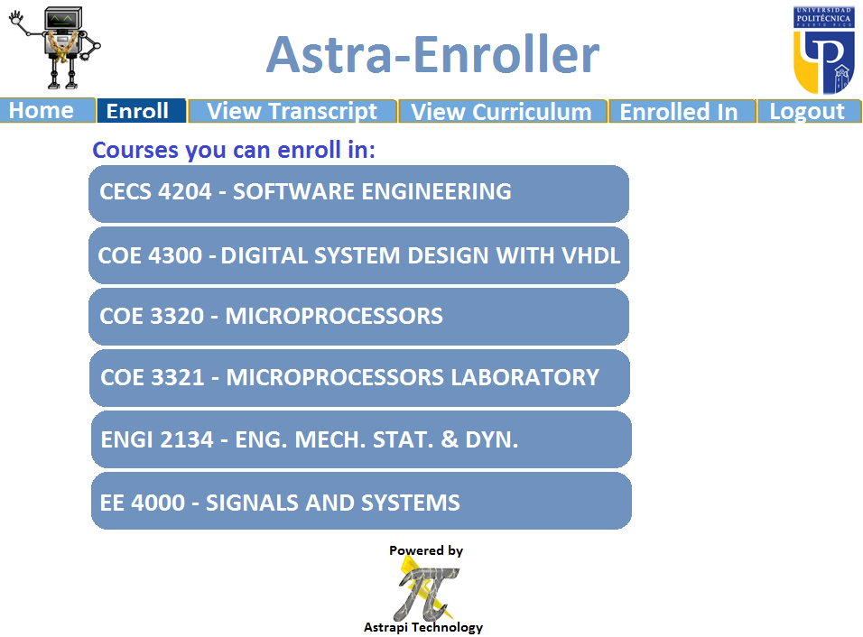
User Interface Example

Slide 51
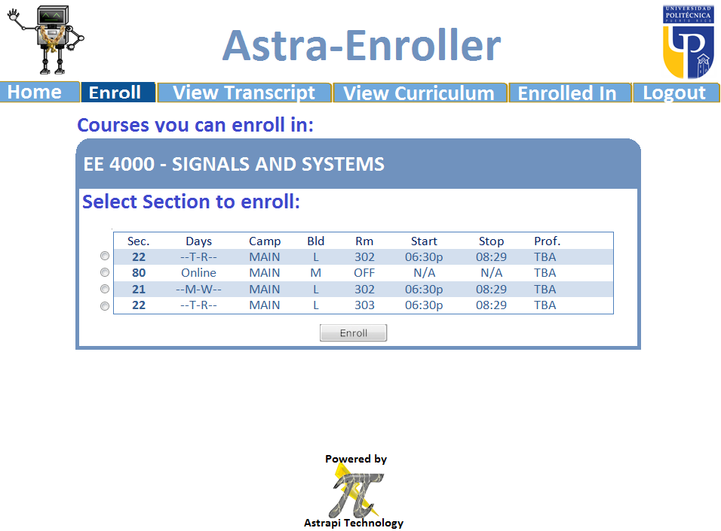
User Interface Example

Slide 52

User Interface Example

Slide 53
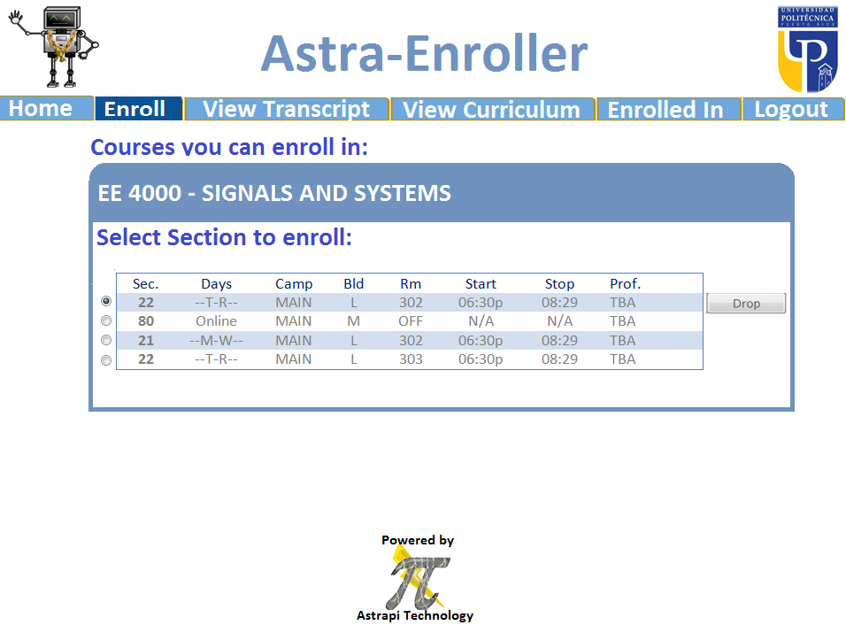
User Interface Example

Slide 54
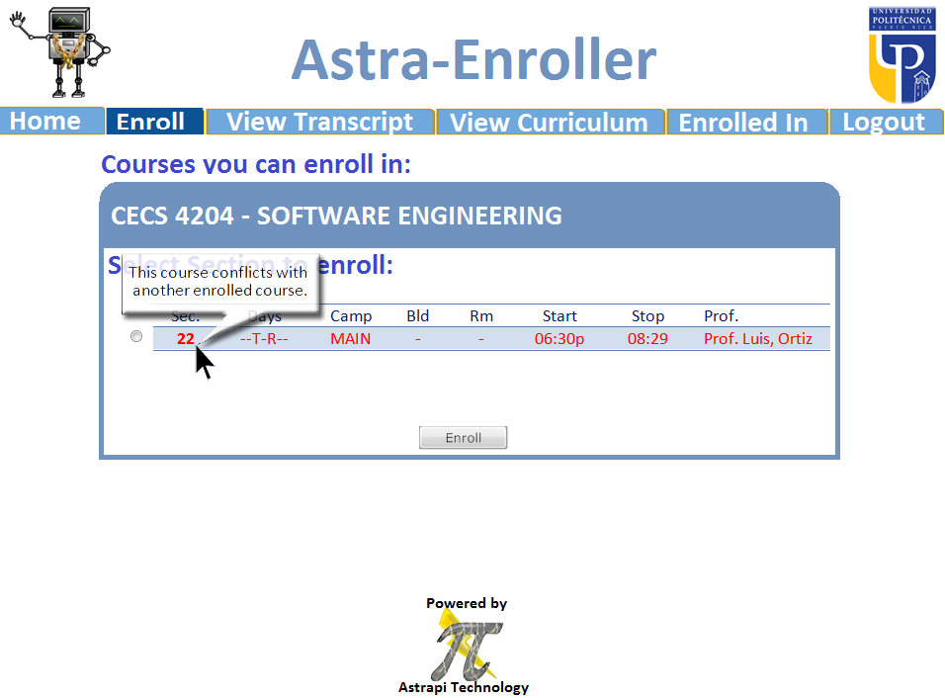
User Interface Example

Slide 55
Thanks for your Attention

