Slide 1
EP Factor Backtesting for Quantitative Financial Investment
Nov 7, 2024
Group Members: Lu Junning, Zhang Yuhan, Ma Shichang, You Huimei, Sun Kexin

Slide 2
Content
01
Introduction
02
Data Import
03
Data Preprocess
04
Stock Selection Strategy
05
Picture and Indicators

Slide 3
Part 1: Introduction
Goal: Build a single-factor stock selection strategy.
Steps:
Obtain A-share data
The daily data for A-shares are from the Tushare financial API, covering the period from January 1, 2014, to December 1, 2023.
Factor identification
The factor we focus on is Earnings-to-Price ratio (EP), which is the inverse of the P/E ratio (1/PE_TTM).
Data preprocessing
Delete extreme values, Standardization and Industry market value Zero-centered.
Reasons: The distribution of factor may vary significantly across different industries and market values; If multiple factors are used, this ensures comparability between factors.

Slide 4
Part 1: Introduction (cont.)
Stock ranking and grouping
Stocks are ranked by their factor values and divided into decile-based groups.
Portfolio Construction
The bottom 30 stocks are selected within each group.
Rebalancing
On the designated rebalancing dates, recalculate factor rankings and adjust the portfolio. The first trading day of each month is chosen as the rebalancing date.
Performance Monitoring
Track the portfolio's returns over time and plot a benchmark return graph (compared to the CSI 500 return rate).
Calculate the factor Information Coefficient (IC) value, Sharpe ratio and annual return.

Slide 5
Part 1: Introduction (cont.)
Why are we doing this?
Beginner-Friendly
A basic, adaptable quantitative trading strategy.
Self-Coded Advantage
We code from scratch (using numpy, pandas, sklearn packages) without relying on existing related packages.
Allows for tailored adjustments that better align with real-world needs.
Reduces the risk of strategy leakage; for instance, running a strategy on an online platform using their framework can expose it to potential security risks.

Slide 6
Part 2: Data Import
Download data from Tushare
Call the Tushare data interface.
token = 'f558cbc6b24ed78c2104e209a8a8986b33ec66b7c55bcfa2f46bc108’
# Set the Token for Tushare. This ensures that all subsequent API requests are properly authorized with the provided credentials.
ts.set_token(token)
# Create an API instance called pro. This instance will be used for interacting with the Tushare API, allowing us to make various data requests, such as retrieving stock data.
pro = ts.pro_api()
Notes:
‌‌API（‌Application Programming Interface，应用程序编程接口）是一组预先定义的函数或方法，允许软件应用或组件之间相互通信和交互。‌ API定义了不同软件应用或组件之间如何相互沟通和交互的方法，它相当于一个中间件，允许开发者访问和使用某些功能或数据，而无需了解背后的详细实现。‌

Slide 7
Part 2: Data Import (cont.)
Download data from Tushare
Retrieve relevant data for all listed stocks within a specified date range from the Tushare API and organize it into a Pandas DataFrame for subsequent analysis and use.
# Define the access_data function to store the listed stocks’ data.
def access_data(start_date, end_date, pro):
code_list = pro.stock_basic(exchange='', list_status='L', fields='ts_code’)
code_list = code_list['ts_code'].tolist()
result = [] # Fetch each stock’s financial data from 2014.1.1 to 2024.1.5.
for stockid in code_list:
stock_data = pro.stk_factor_pro(ts_code = stockid, start_date = '20140101', end_date = '20240105', fields='ts_code, trade_date, close, turnover_rate, turnover_rate_f,volume_ratio, pe, pe_ttm, pb, ps, ps_ttm, dv_ratio, dv_ttm, total_share, float_share, free_share, total_mv,circ_mv')
result.append(stock_data)
# The result list is converted into a Pandas DataFrame.
result_df = pd.DataFrame(result, columns=['ts_code', 'trade_date', 'close', 'turnover_rate', 'turnover_rate_f', 'volume_ratio', 'pe', 'pe_ttm', 'pb', 'ps', 'ps_ttm', 'dv_ratio', 'dv_ttm', 'total_share', 'float_share', 'free_share', 'total_mv', 'circ_mv’])
return result_df
Notes:
‌‌API（‌Application Programming Interface，应用程序编程接口）是一组预先定义的函数或方法，允许软件应用或组件之间相互通信和交互。‌ API定义了不同软件应用或组件之间如何相互沟通和交互的方法，它相当于一个中间件，允许开发者访问和使用某些功能或数据，而无需了解背后的详细实现。‌

Slide 8
Part 2: Data Import (cont.)
Download data from Tushare
Save the retrieved data in a parquet file. # Call the access_data function, and ten_years_data stores the listed stocks’ data from 2014.1.1 to 2023.12.1.
ten_years_data = access_data(start_date='20140101', end_date='20231201', pro=pro)
# Save DataFrame to Parquet File.
ten_years_data.to_parquet('ten_years.parquet’)
Why Parquet not CSV?
Compared to the simple CSV format, Parquet has significant advantages in storing and processing large datasets:
(1) Storage Efficiency: Parquet requires much less cloud storage compared to CSV.
(2) Query Performance: Parquet offers significantly faster query speeds than CSV, especially when handling large datasets.
(3) Cost Savings: Using Parquet can greatly reduce storage and data scanning costs.
Notes:
Parquet与CSV的比较
与简单的CSV格式相比，Parquet在存储和处理大数据集时具有明显优势：
（1）存储效率：Parquet在云存储上的需求比CSV小得多。
（2）查询性能：Parquet的查询速度远高于CSV，特别是在处理大数据时。
（3）成本节约：使用Parquet可以大幅降低存储和数据扫描成本。

Slide 9
Part 2: Data Import (cont.)
Data import
ImportData class: to facilitate the importation of stock data from stored Parquet and CSV files, compute the earnings-to-price ratio (EP factor), and output the processed data in a convenient format.
class ImportData():
__init__ method: An instance of the ImportData class is created.
It reads stock data from a Parquet file named ten_years.parquet using Pandas‘ read_parquet method and stores it in the self.stock_data attribute.
It reads industry data from a CSV file named industry.csv using Pandas‘ read_csv method and stores it in the self.industry attribute.
def __init__(self):
self.stock_data = pd.read_parquet('ten_years.parquet')
self.industry = pd.read_csv('industry.csv')
……

Slide 10
Part 2: Data Import (cont.)
Data import
factor_calculation method: calculates the earnings-to-price ratio (EP factor) for the stocks.
……
def factor_calculation(self):
df = self.stock_data.merge(self.industry, on='ts_code', how='left')
stock = df[['ts_code', 'trade_date', 'close', 'pe_ttm', 'industry’]]
# Calculate the earnings-to-price ratio (EP): ep = 1 / pe_ttm, where pe_ttm is the trailing twelve months price-to-earnings ratio.
stock['ep'] = 1/stock['pe_ttm']
# Refer to the professional single factor research report, fill any missing values in the pe_ttm and ep columns with zeros.
stock[['pe_ttm', 'ep']] = stock[['pe_ttm', 'ep']].fillna(value = 0, method=None, axis=None, inplace=False) return stock
……

Slide 11
Part 2: Data Import (cont.)
Data import
data_output method: calls factor_calculation method to obtain the processed data and formats it for analysis, and reorganizes the data according to trade_date and ts_code.
……
def data_output(self):
data = self.factor_calculation()
# Convert the trade_date column from string format to datetime format using the apply method.
data['trade_date'] = data.trade_date.apply(str).apply(parse)
# Set multi-indexes on the DataFrame with trade_date in the first place and ts_code in the second place, which enhances data organization for future analysis.
data = data.set_index(['trade_date', 'ts_code'])
# Sort the DataFrame by the two indexes trade_date and ts_code to ensure the data is well-ordered.
data = data.sort_index()
return data
……

Slide 12
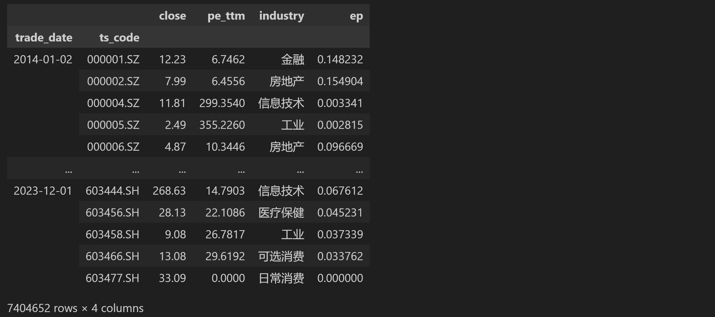
Part 2: Data Import (cont.)
Data import
Now stock_data is a Pandas DataFrame, and it includes trade_date：交易日期, ts_code：股票代码, close：收盘价, pe_ttm：滚动市盈率, industry：行业, ep：盈利价格比率（EP factor）。
stock_data = ImportData().data_output()
stock_data

Slide 13
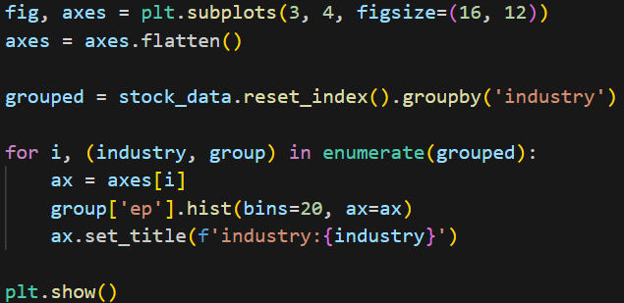
Part 3: Data Preprocess — Visualization
Code Explanation:
Create a grid of subplots with 3 rows and 4 columns, making a total of 12 subplots
Group by the 'industry' column
For each industry group, display a histogram of ‘ep’ column
Display the entire figure with all the subplots

Slide 14
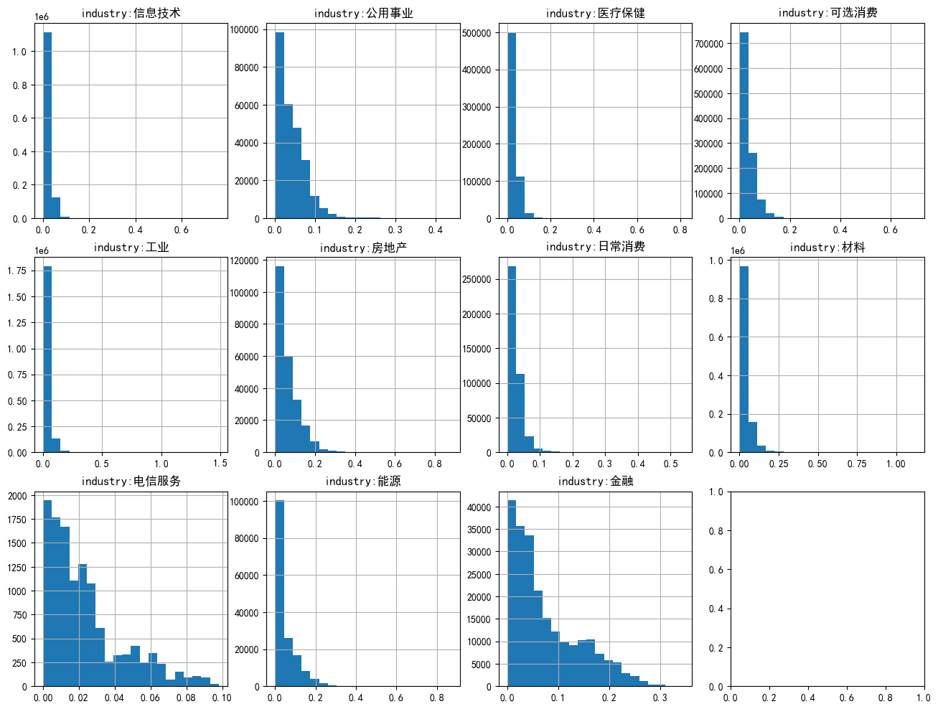
Part 3: Data Preprocess — Visualization (cont.)

Slide 15
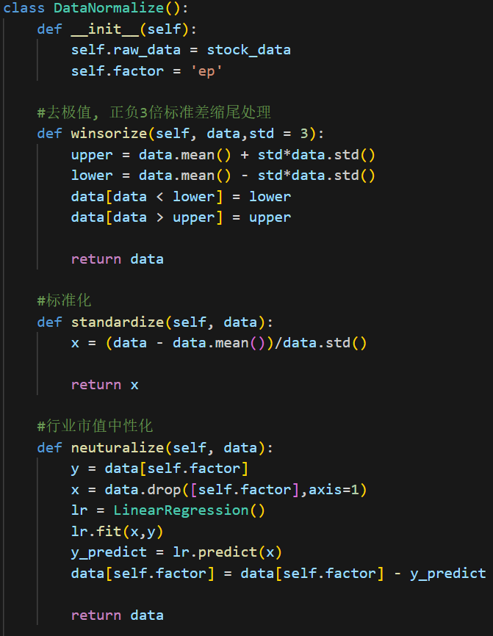
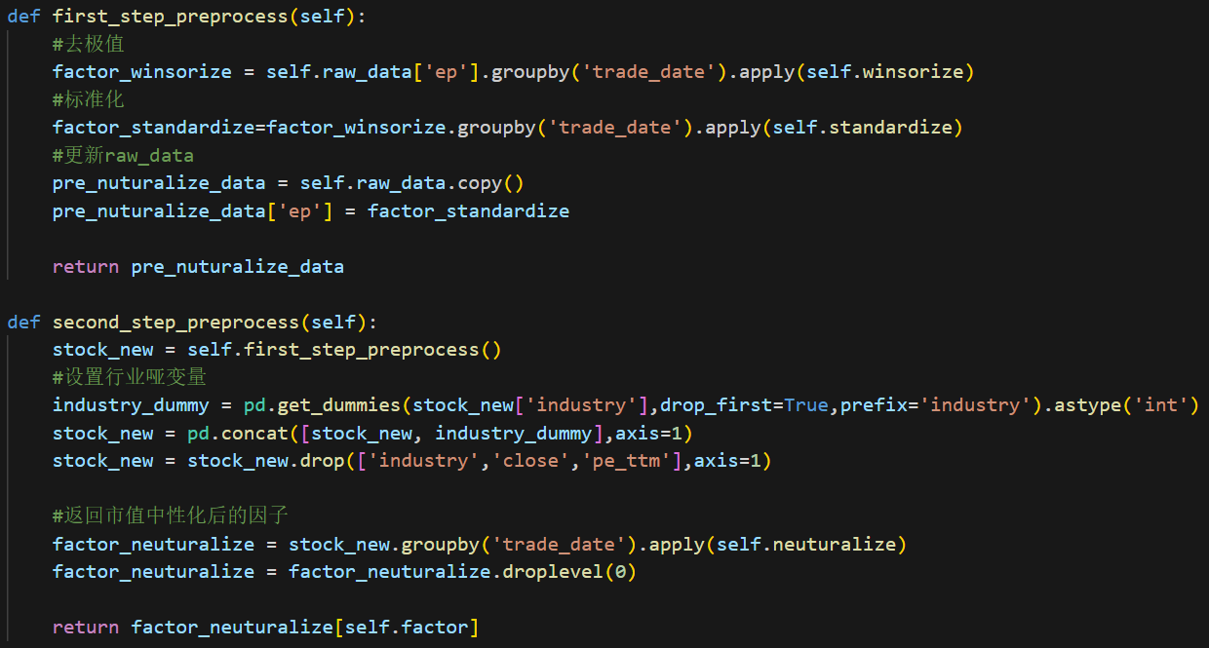
Part 3: Data Preprocess — Define key class
Neutralization：

Slide 16
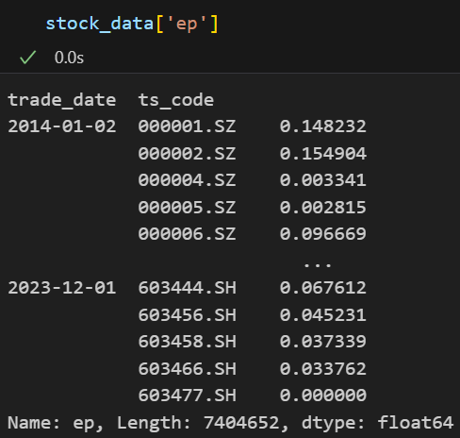
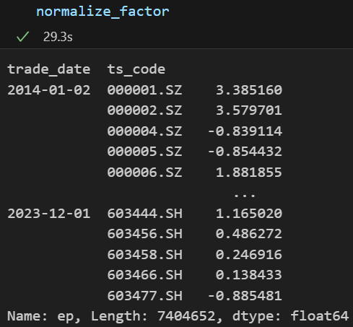
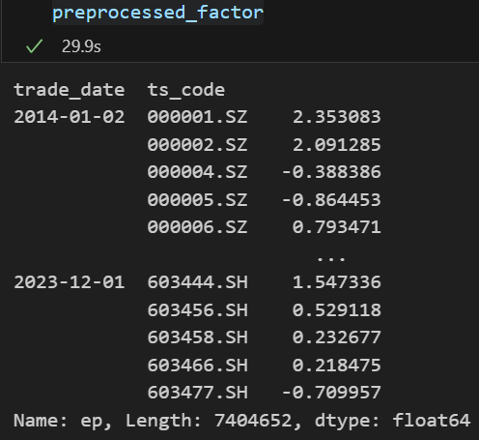
Part 3: Data Preprocess —Key outcome
Raw data
Normalize
Neuturalize

Slide 17
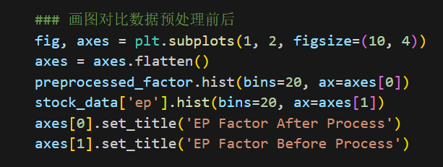
Part 3: Data Preprocess — Comparison
Code Explanation:
Create a grid of subplots with 1 rows and 2 columns, making a total of 2 subplots
For processed ‘ep’, display a histogram
For non_processed ‘ep’, display a histogram

Slide 18
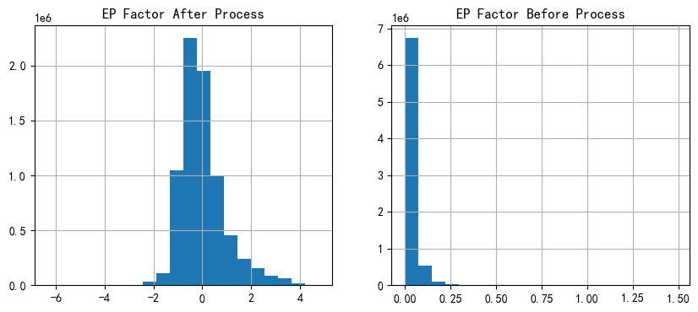
Part 3: Data Preprocess — Comparison (cont.)
Comparison:
More smooth and centralized after data preprocess

Slide 19
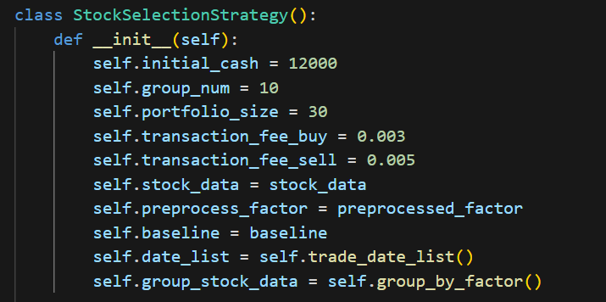
Part 4: Stock Selection Strategy
Basic ideas
Sort the stocks by preprocessed EP value and divide them into 10 groups.
For each group, we choose 30 stocks with the lowest EP value. (We build ten portfolios and compare there performance)
On the first trading date of each month, we re-sort the ep value and adjust the portfolios.
Time period 20140101-20231201
Taken the CSI 500 as the baseline model.
Factor preprocessing is conducted using groupby by trading day to prevent time overlap.
Conditions setting:

Slide 20
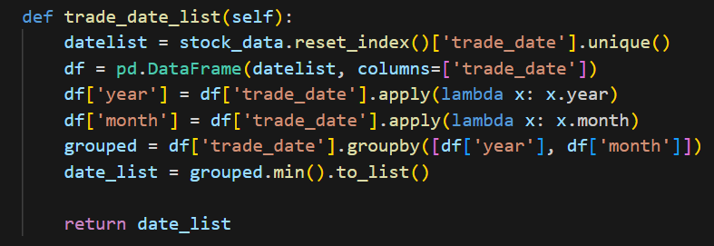
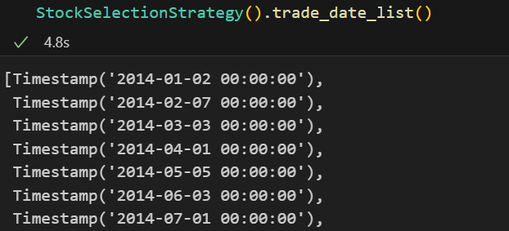
Part 4: Stock Selection Strategy (cont.)
Count the rebalancing days
The first trading date per month

Slide 21
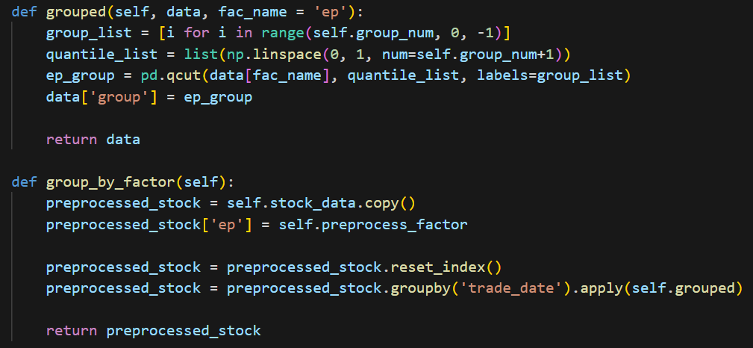
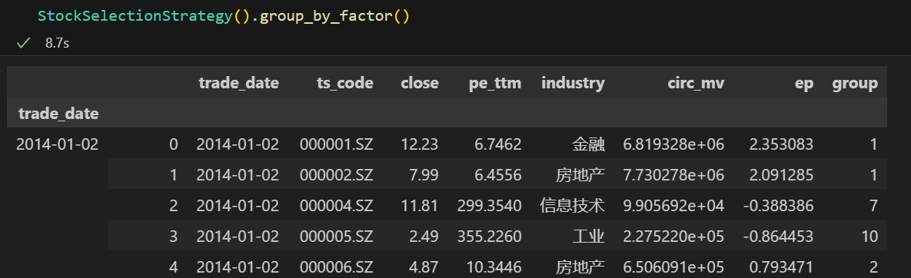
Part 4: Stock Selection Strategy (cont.)
Divide the stocks into 10 groups
Define the ‘grouped’ function; Groupby date and apply(grouped); Prevent time overlap

Slide 22
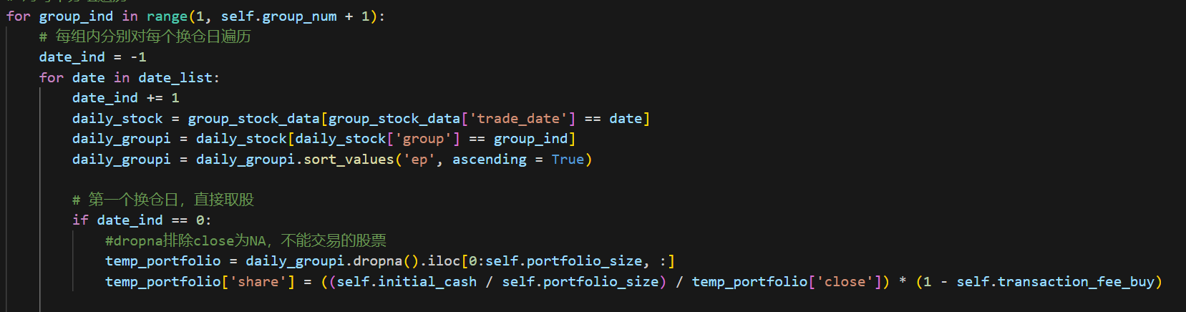
Part 4: Stock Selection Strategy (cont.)
First rebalancing date: Choose 30 stocks with the lowest EP value.
Use initial_cash = 12000 to buy the stocks and calculate the share of stocks
Consider the transaction fee to buy

Slide 23
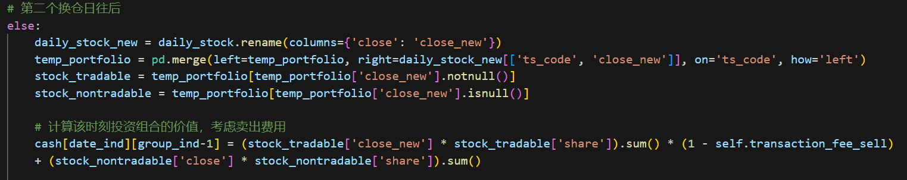
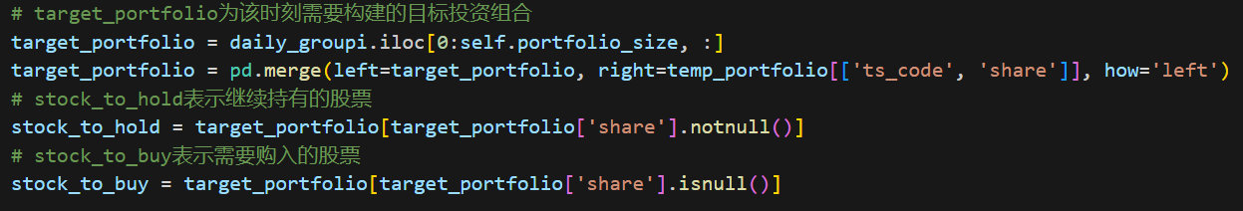
Part 4: Stock Selection Strategy (cont.)
Remaining rebalancing date
Identify the tradable and non-tradable stocks
Calculate the value of current portfolio (Transaction fee to sell is included)
The value of non-tradable stocks + The value of tradable stocks
According to the new rank of EP, determined which stocks to hold and which stocks to buy

Slide 24
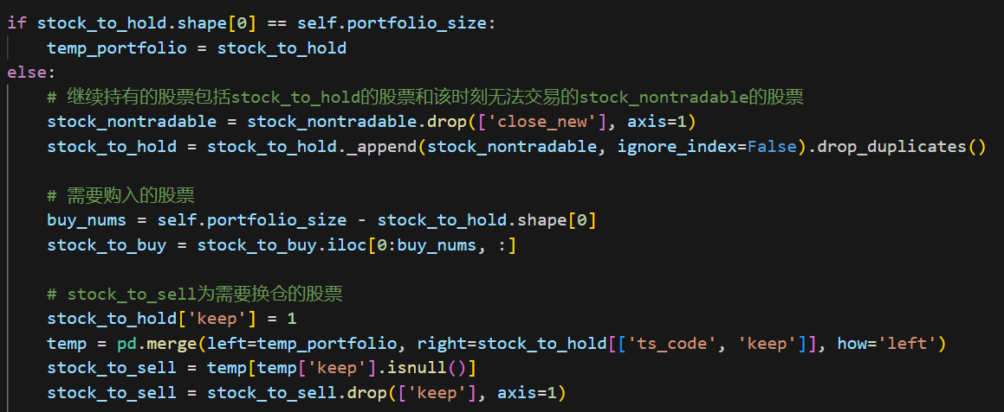
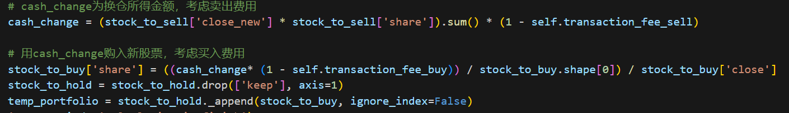
Part 4: Stock Selection Strategy (cont.)
Determine stocks to sell
Sell target stocks and buy targets stock.
We have finish our portfolio adjustment for this day.

Slide 25
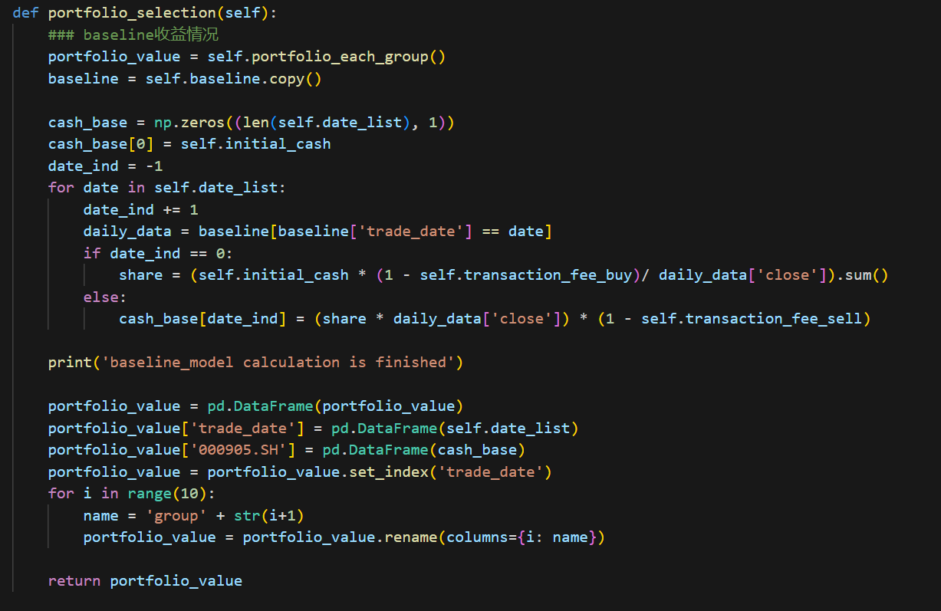
Part 4: Stock Selection Strategy (cont.)
Calculate the value of baseline model CSI500
We just use initial cash to invest CSI500 and keep it for ten years

Slide 26
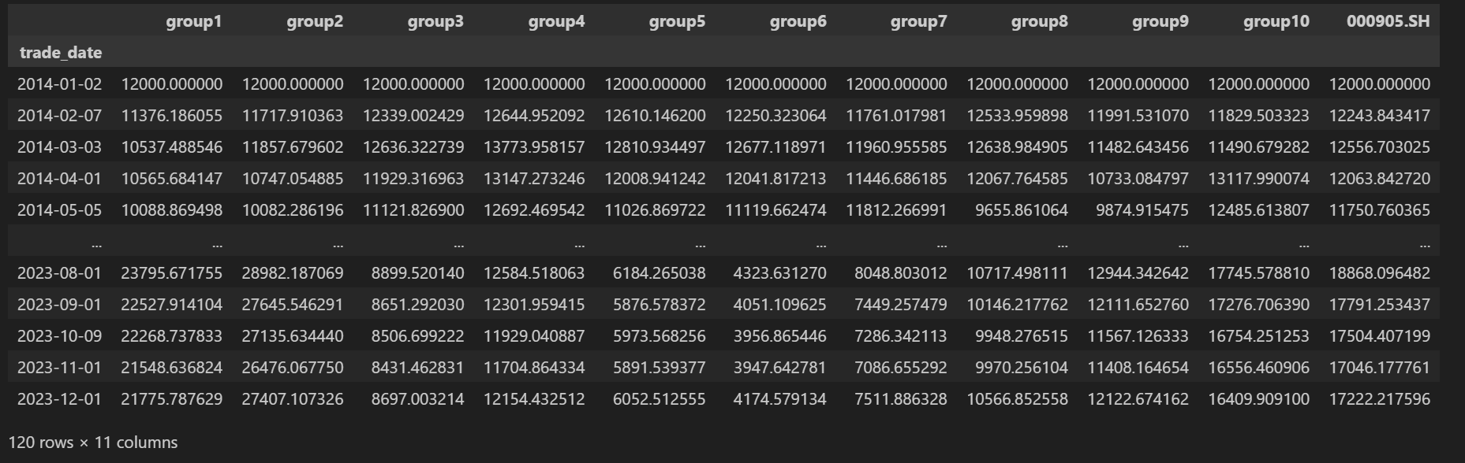
Part 4: Stock Selection Strategy (cont.)

Slide 27
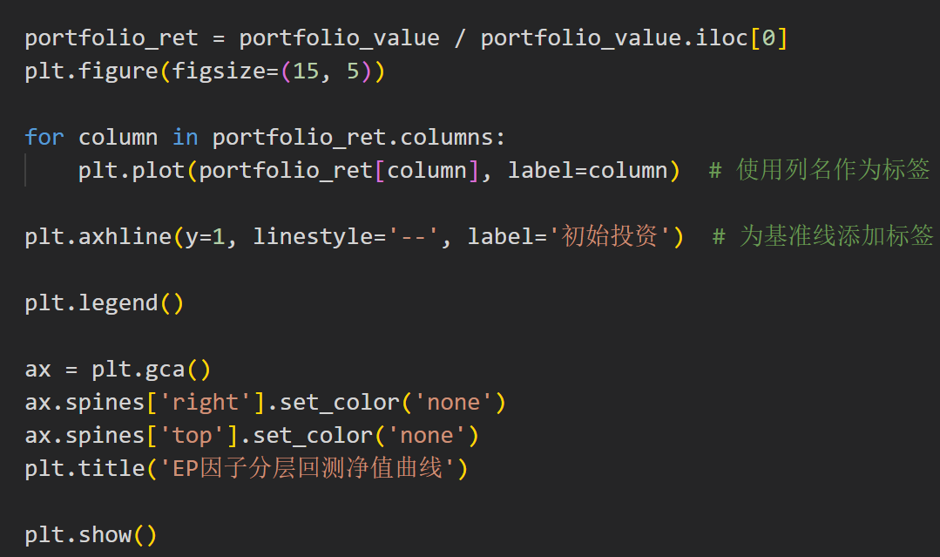
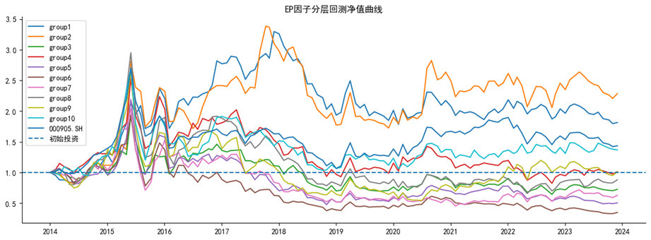
Part 5: Picture and Indicators
Net value of EP factor hierarchical portfolio backtesting.
How much one yuan on January 2, 2014, which is the first trading day, turns into eventually.

Slide 28
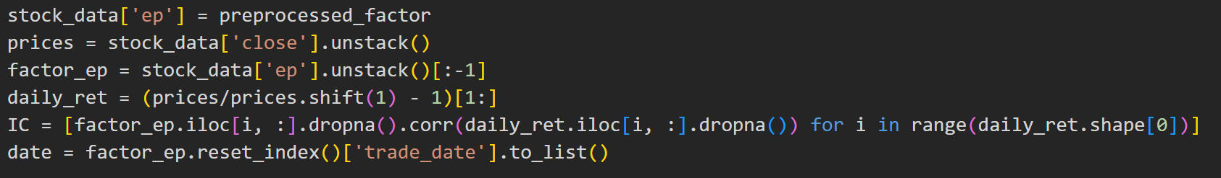
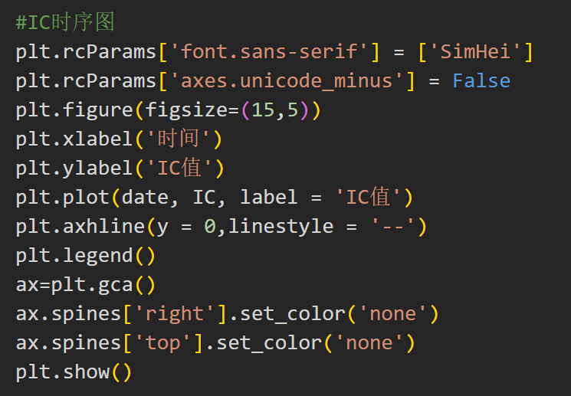
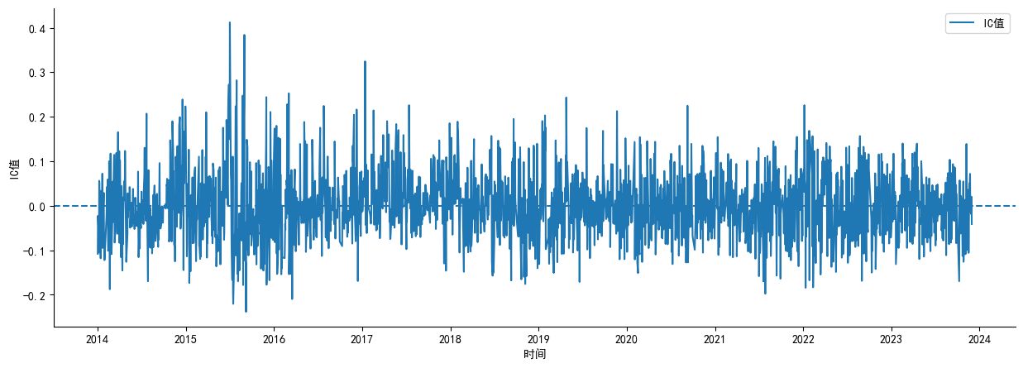
Part 5: Picture and Indicators (cont.)
Calculate the IC value
The correlation coefficient between the factor sequence on the current day and the return rate sequence on the next day
Plotting IC Timing Diagrams

Slide 29
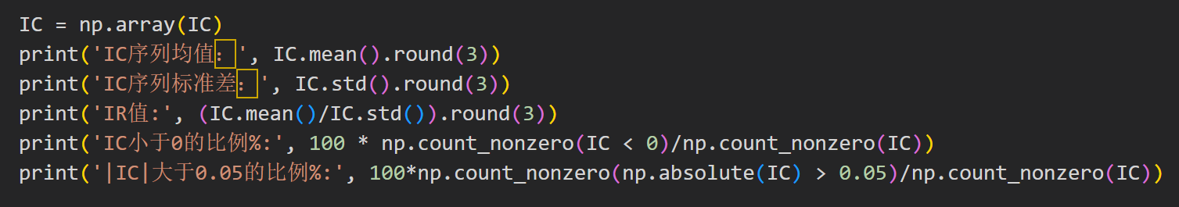
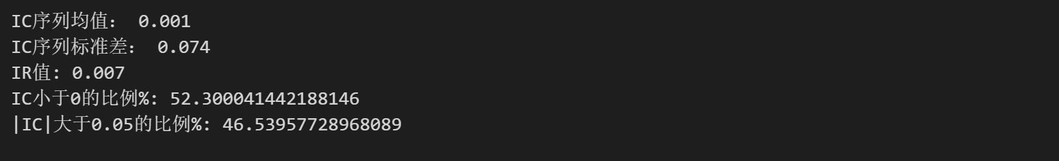
Part 5: Picture and Indicators (cont.)
Statistical Characteristics of IC Values

Slide 30
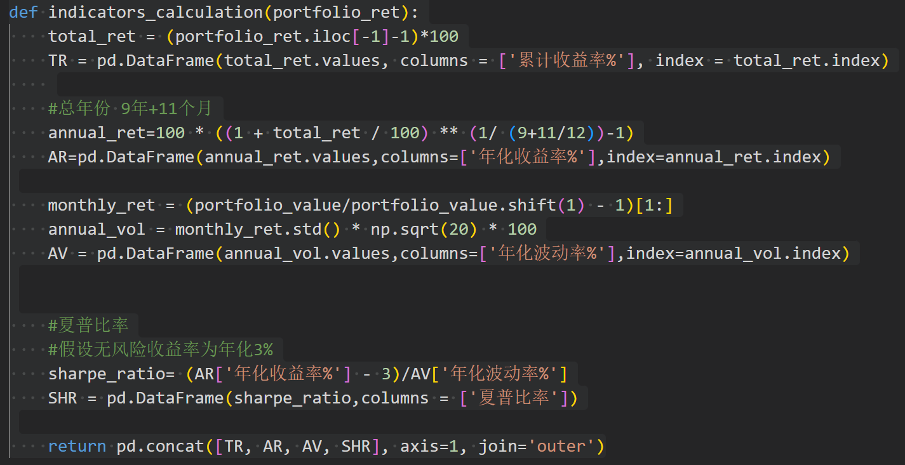
Part 5: Picture and Indicators (cont.)
Calculating Cumulative Returns, Annualized Returns, Sharpe Ratio Indicators

Slide 31
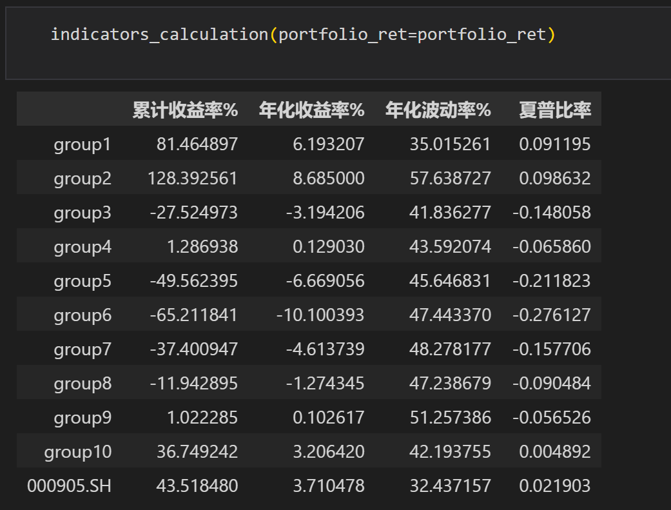
Part 5: Picture and Indicators (cont.)

Slide 32

Thanks !
Notes:
补充estimate equation 1，前面有涉及到的也需补充

