Slide 1
Data service integration workflow for investigation of differential miRNA-protein networks of suicide completors
Lukáš Peter Filipčík
l.filipcik@student.maastrichtuniversity.nl
https://github.com/LukeKrishna
Supervised by:
Dr. Friederike Ehrhart
Notes:
Welcome to my presentation, my name is Lukas P. Filipcik and today I’ll be talking to you about my bachelour thesis where I developed a Workflow for analysing miRNA-protein networks in suicide, as supervised by Dr. Friederike Ehrhart and Dr. Chad Ellington.
One book-keeping note at the beginning: the structure will be as typical academic presentation, with few modifications: methods is replaced with the workflow, and I will discuss the results as they are being presented, so we don’t have to keep them in mind

Slide 2
Suicide
WHO Global Imperative (World Health Organisation, 2014)
Est. 800 000 deaths every year
Second leading cause of death 15-34
Numerous comorbidities
  Major Depressive Disorder
  Alcoholism or Substance Abuse (Beautrais et al., 1996)
  Socio-economical circumstances (Chang et al., 2013)
  Family history of suicide (Jordan and McIntosh, 2011)
Notes:
Suicide is a devastating condition that is world-spreading, being significant across the wealth spectrum. It’s prevalency has lead the WHO to declare it world health imperative.
It is estimated that it kills 800 000 people a year, with as many as 20 as many suicide attempts – which also are a great burden on both individual and societal wellbeing

Slide 3
miRNA
Subclass of ncRNA
Control of translation at mRNA level
Approx. 60% of human genes can be targeted
Mental disorders have been shown to have a link with miRNA disregulation (Zhou et al., 2018)
  Potential for complex regulatory network interaction (Dwivedi et al., 2015)
Notes:
Why study such a complex behaviour from the perspective of miRNAs?

Slide 4
Dataset
Published in 2012 by Maussion et al.
N = 8, miRNA = 757 (Exiqion miCURY v10.0)
Prefrontal cortex
French Canadian
History of Major Depressive Disorder
TrkB-T1 levels pre-screening

Slide 5
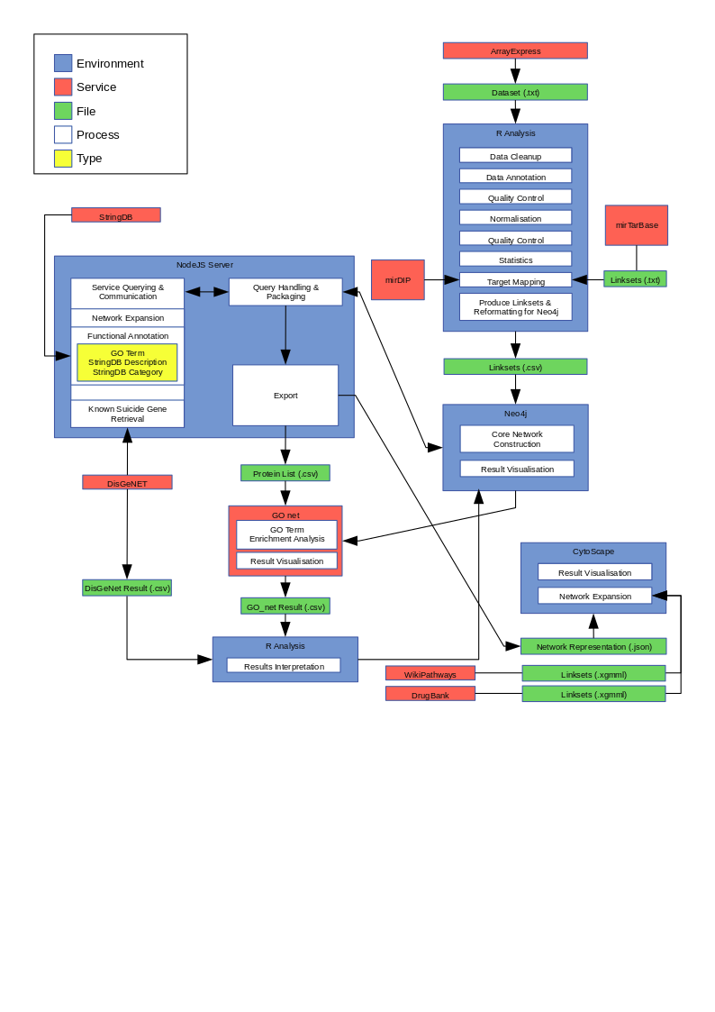
Workflow
Notes:
At the end: I will show you an example of how the workflow might be applied, however the somewhat-cyclical nature of it means that the analyses can be performed ad infinitum, thus only an example of each step will be shown

Slide 6
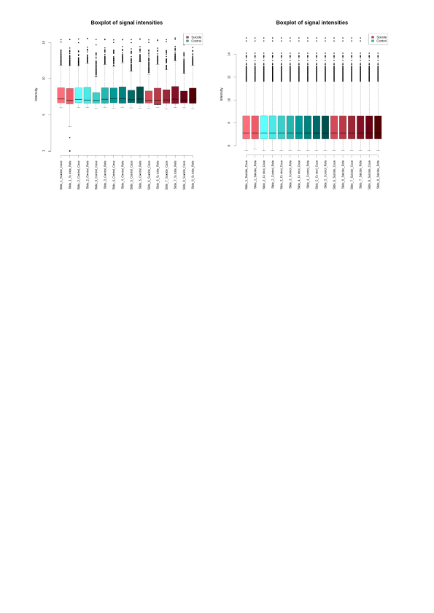
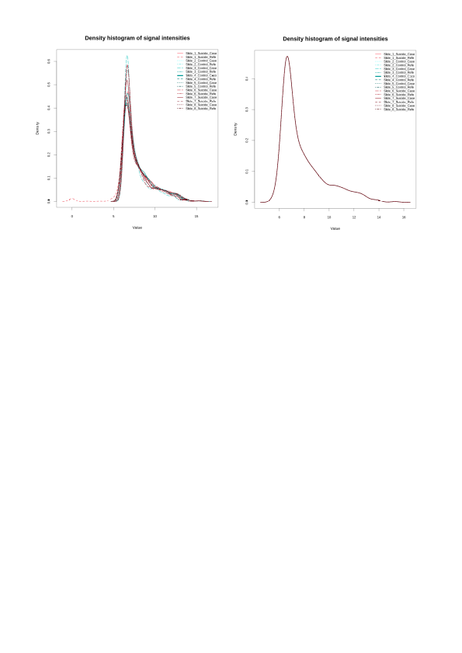
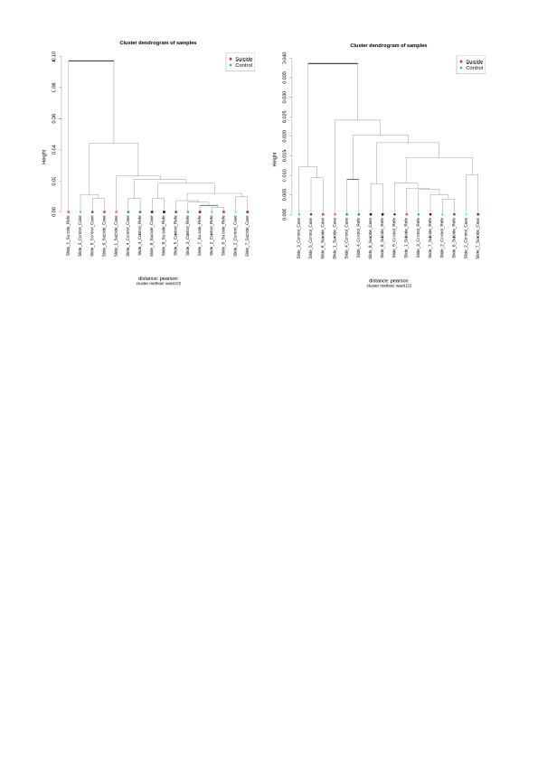
Results – QC

Slide 7
Results – Stats
 | miRNA | P-Value | FC | log2FC
1 | hsa-miR-330-3p | 0.007215 | 0.845035 | -0.242917
2 | hsa-miR-637 | 0.045382 | 0.583333 | -0.777608
3 | hsa-miR-642a-5p | 0.027177 | 0.673364 | -0.570542
4 | hsa-miR-605-5p | 0.005295 | 0.825107 | -0.277346
5 | hsa-miR-520a-3p | 0.012208 | 0.941829 | -0.086463
6 | kshv-miR-K12-6-3p | 0.032906 | 0.491080 | -1.025969
7 | hsa-miR-185-3p | 0.008723 | 0.322683 | -1.631810
8 | hsa-miR-491-3p | 0.034026 | 0.774905 | -0.367909
9 | hsa-miR-888-3p | 0.021477 | 1.267472 | 0.341954
10 | hsa-miR-148b-3p | 0.044473 | 0.854279 | -0.227221
11 | hsa-miR-582-3p | 0.027006 | 1.087597 | 0.121145
12 | hsa-miR-485-3p | 0.037992 | 1.174738 | 0.232339
13 | hsa-miR-887-3p | 0.007593 | 1.325122 | 0.406125
14 | hcmv-miR-UL148D | 0.012400 | 0.691684 | -0.531815
15 | hsa-miR-551b-3p | 0.044446 | 1.382286 | 0.467056
16 | hsa-miR-373-5p | 0.015026 | 0.923100 | -0.115441
17 | hsa-miR-520g-3p | 0.040200 | 1.099721 | 0.137138
18 | hsa-miR-588 | 0.049768 | 0.948378 | -0.076466
19 | hsa-miR-106b-3p | 0.002214 | 0.886168 | -0.174347
20 | hsa-miR-612 | 0.002967 | 0.917646 | -0.123991
21 | hsa-miR-937-3p | 0.003339 | 0.817970 | -0.289881
 | miRNA | P-Value | FC | log2FC
1 | hsa-miR-330-3p | 0.007215 | 0.845035 | -0.242917
2 | hsa-miR-605-5p | 0.005295 | 0.825107 | -0.277346
3 | hsa-miR-185-3p | 0.008723 | 0.322683 | -1.631810
4 | hsa-miR-887-3p | 0.007593 | 1.325122 | 0.406125
5 | hsa-miR-106b-3p | 0.002214 | 0.886168 | -0.174347
6 | hsa-miR-612 | 0.002967 | 0.917646 | -0.123991
7 | hsa-miR-937-3p | 0.003339 | 0.817970 | -0.289881

Slide 8
Results – Target Mapping
mirDIP
#miRNA = 18
#Targets = 5141
#Links = 8735
Constraint = Very High Confidence
miRTarBase
#miRNA = 19
#Targets = 2415
#Links = 3860

Slide 9
Results – Core Network
COUNT(r) | miRNA
12 | hsa-miR-330-3p
8 | hsa-miR-148b-3p
7 | hsa-miR-520a-3p
6 | hsa-miR-520g-3p
4 | hsa-miR-485-3p
4 | hsa-miR-491-3p
3 | hsa-miR-582-3p
3 | hsa-miR-612
2 | hsa-miR-605-5p
2 | hsa-miR-637
1 | hsa-miR-588
1 | hsa-miR-373-5p
1 | hsa-miR-642a-5p
1 | hsa-miR-185-3p
Neo4J
Core Network
  #Nodes: 6,422
  #Relationships: 11,916

Slide 10
Results – GO Term Enrichment
GO_term_ID | GO_term_def | P | N of Genes | Implicated Genes
GO:0048668 | collateral sprouting | 0.00708 | 7 | 1
GO:0098696 | regulation of neurotransmitter receptor localization to postsynaptic specialization membrane | 0.00708 | 7 | 1
GO:0006198 | cAMP catabolic process | 0.00080 | 8 | 1
GO:0035871 | protein K11-linked deubiquitination | 0.00284 | 8 | 1
GO:1900122 | positive regulation of receptor binding | 0.00284 | 8 | 1
GO:0099550 | trans-synaptic signaling, modulating synaptic transmission | 0.00317 | 9 | 1
GO:0099566 | regulation of postsynaptic cytosolic calcium ion concentration | 0.00043 | 10 | 1
GO:0045722 | positive regulation of gluconeogenesis | 0.00132 | 10 | 1
GO:0009214 | cyclic nucleotide catabolic process | 0.00327 | 10 | 1
GO:1902683 | regulation of receptor localization to synapse | 0.00646 | 11 | 1
Relevant GO Term Groupings
Neuronal death (8)
Neuronal differentation & development (25)
Neurogenesis (9)
Neuron migration and guidance (10)
Neurotransmitters (10)
Synapse (48)

Slide 11
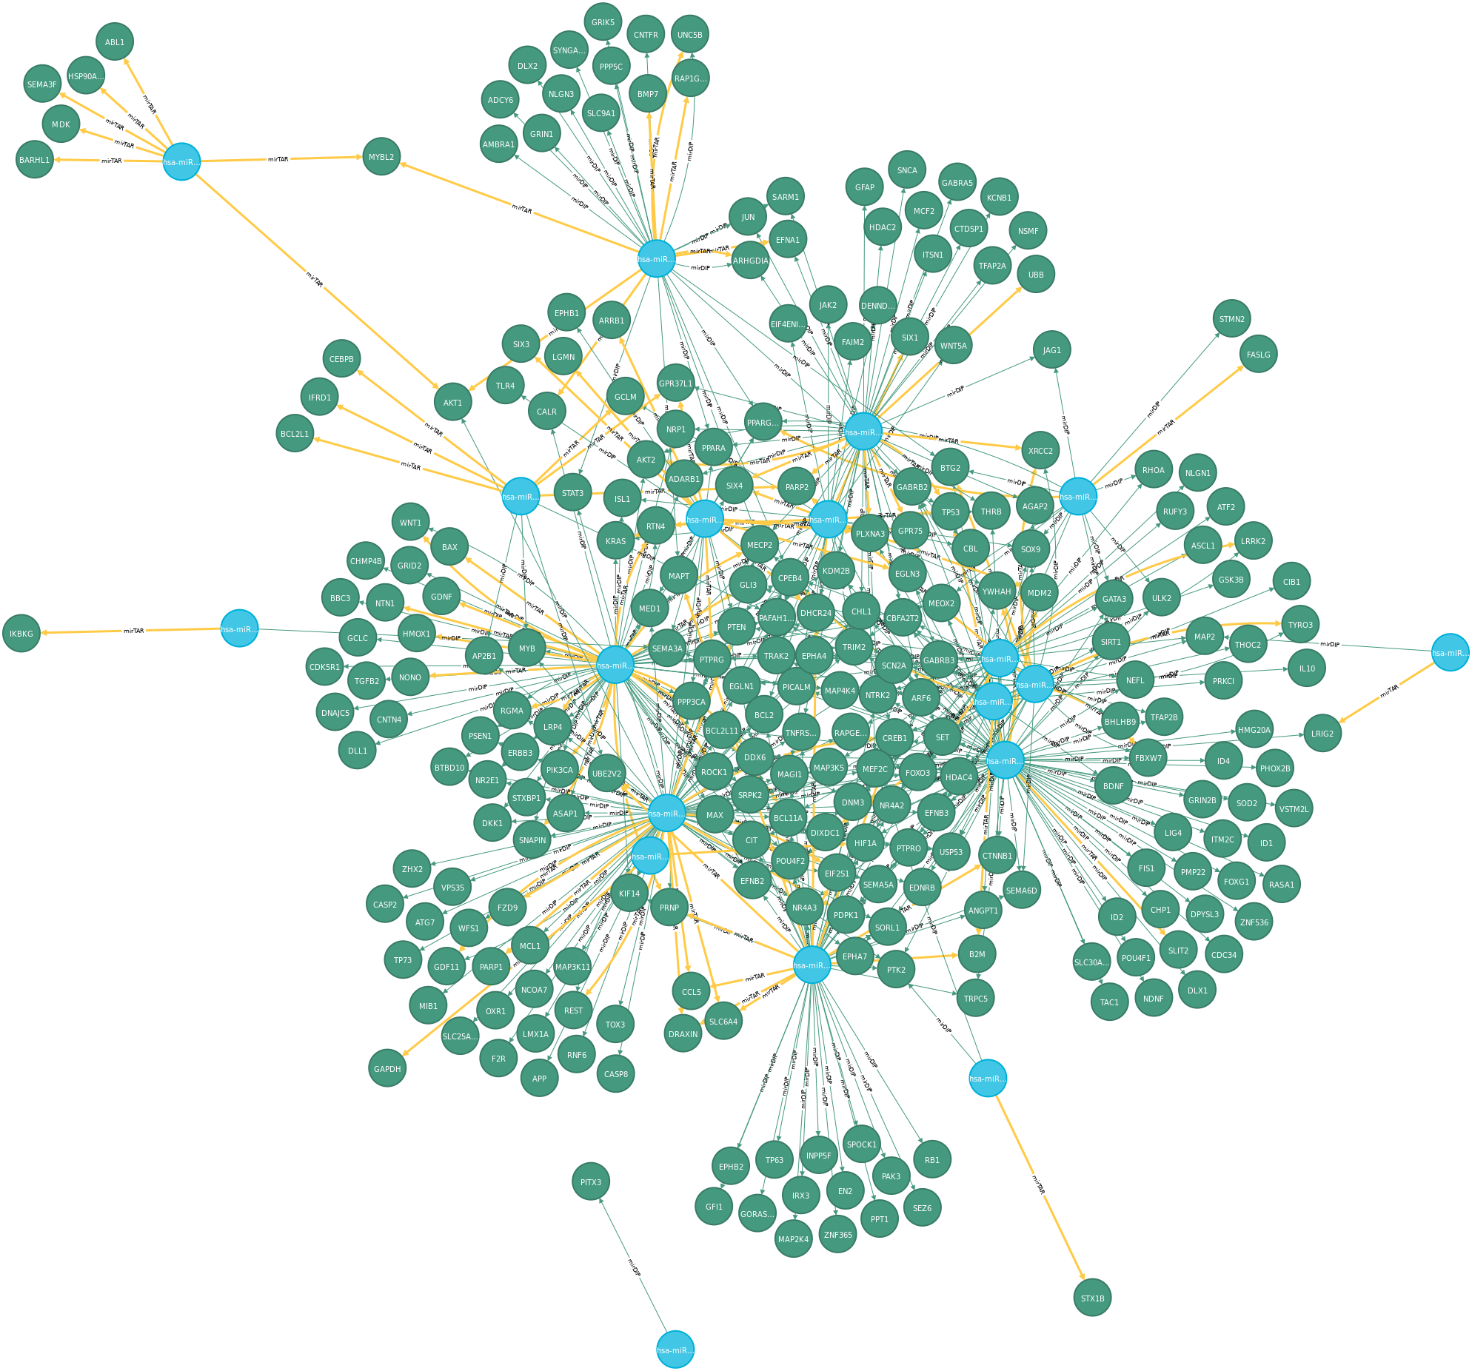
Results – Neuronal death subset
CytoScape → WikiPathways
  Alzheimer disease pathways
  Dopamingergic neurogenesis
  Serotonin receptor signaling, serotonin transporter activity, serotonin and anxiety related events
  GABA receptor signaling
  Monoamine transport
  BDNF-TrkB Signaling

Slide 12
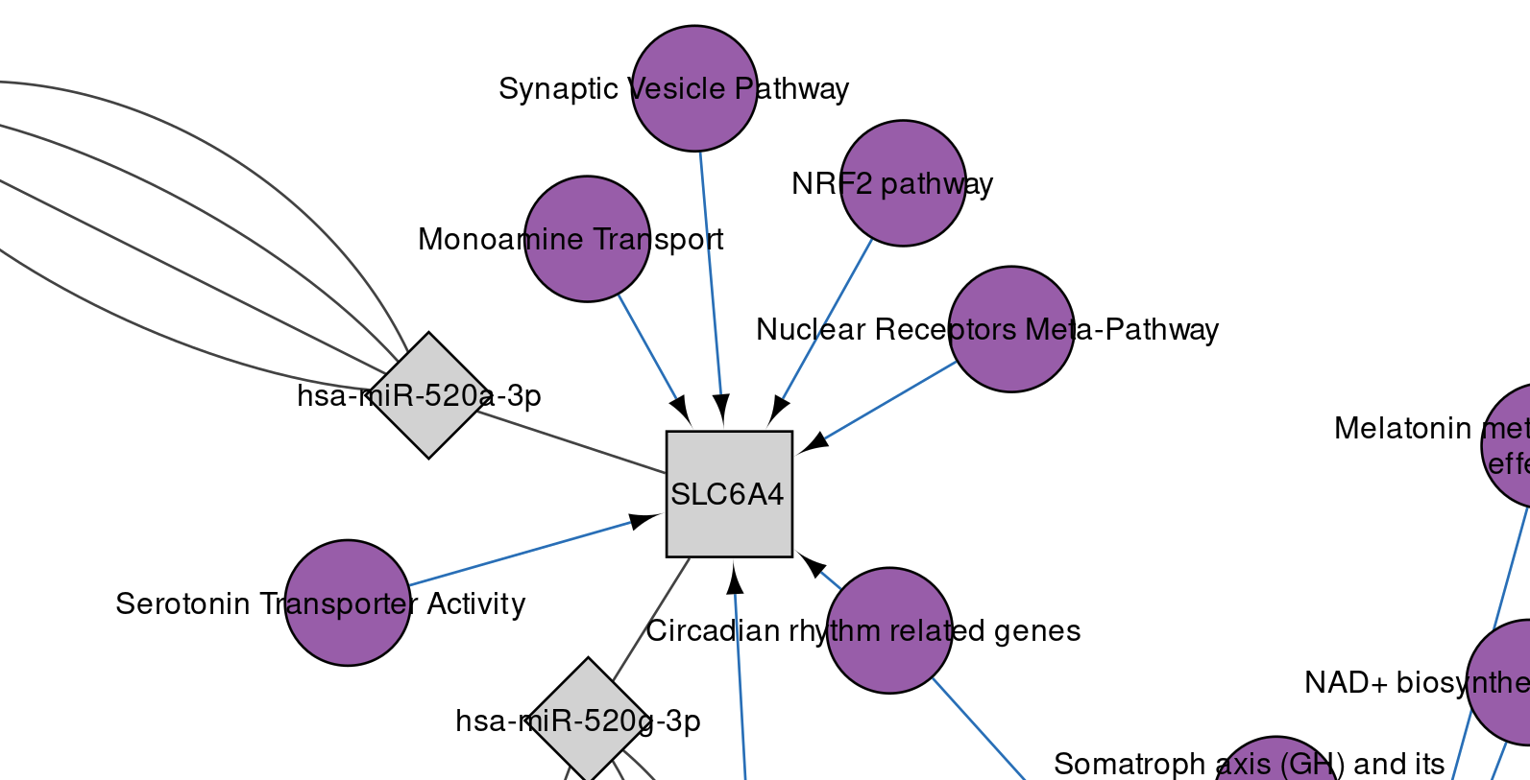
Results – Neuronal death subset

Slide 13
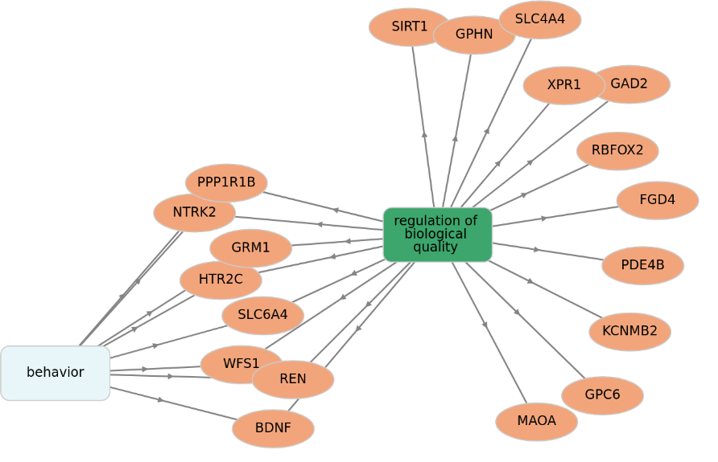
Results – GO of Implicated Genes
 | GO_term_ID | GO_term_def | P | N of Genes | Implicated Genes
1 | GO:0007610 | behavior | 6E-10 | 252 | 7
2 | GO:0007626 | locomotory behavior | 0.00024 | 86 | 2
3 | GO:0002209 | behavioral defense response | 0.00092 | 19 | 0
4 | GO:0001662 | behavioral fear response | 0.00178 | 18 | 0
5 | GO:0008344 | adult locomotory behavior | 0.00322 | 37 | 0
6 | GO:0007632 | visual behavior | 0.00407 | 27 | 1
7 | GO:0090647 | modulation of age-related behavioral decline | 0.00708 | 7 | 0
8 | GO:0001967 | suckling behavior | 0.00733 | 9 | 0

Slide 14
Conclusion
The workflow managed to both recreate previously published results, and to provide new insights into the condition
The worflow is condition-independent, but in current state requires programming knowledge
For further development greater integration between environments, involvement of more services to draw upon, and increasing the ease-of-use for non-programmers would be beneficial

Slide 15
Acknowledgments
I would like to express heartfelt thanks to Assistant Professor Dr. Friederike Ehrhart and Dr. Chad Ellington for supervising me on this journey, as well as helpful advice and insights shared.
Furthermore I would like to thank BiGCaT department at UM for support, especially to Assistant Professor Dr. Martina Kutmon for helping me understand CytoScape and Ammar Ammar for helping me problem solve in R.

Slide 16
References
World Health Organization. (2014a). Preventing suicide: A global imperative. World Health Organization.
Beautrais, A. L., Joyce, P. R., & Mulder, R. T. (1996). Fergusson. DM, Deavoll BJ, Nightingale SK. Prevalence and comorbidity of mental disorders in person making serious attempts: a case control study. Am J Psychiatry, 153(8), 1009-14.
Chang, S. S., Stuckler, D., Yip, P., & Gunnell, D. (2013). Impact of 2008 global economic crisis on suicide: time trend study in 54 countries. Bmj, 347, f5239.
Jordan, J. R., & McIntosh, J. L. (Eds.). (2011). Grief after suicide: Understanding the consequences and caring for the survivors. Routledge.
Zhou, Y., Lutz, P. E., Ibrahim, E. C., Courtet, P., Tzavara, E., Turecki, G., & Belzeaux, R. (2018). Suicide and suicide behaviors: A review of transcriptomics and multiomics studies in psychiatric disorders. Journal of neuroscience research.
Dwivedi, Y., Roy, B., Lugli, G., Rizavi, H., Zhang, H., & Smalheiser, N. R. (2015). Chronic corticosterone-mediated dysregulation of microRNA network in prefrontal cortex of rats: relevance to depression pathophysiology. Translational psychiatry, 5(11), e682-e682.
Maussion, G., Yang, J., Yerko, V., Barker, P., Mechawar, N., Ernst, C., & Turecki, G. (2012). Regulation of a truncated form of tropomyosin-related kinase B (TrkB) by Hsa-miR-185* in frontal cortex of suicide completers. PloS one, 7(6).

