Slide 1
Intermediate Presentation:
A Bioinformatic Investigation of miRNA-mediated Changes in Brains of Succesful Suicide Completers
Lukáš Peter Filipčík
l.filipcik@student.maastrichtuniversity.nl
Supervised by:
Friederike Ehrhart

Slide 2
Suicide
WHO Global Imperative (World Health Organisation, 2014)
Est. 800 000 deaths every year
Second leading cause of death 15-34
Numerous comorbidities
  Major Depressive Disorder
  Alcoholism or Substance Abuse (Beautrais et al., 1996)
  Socio-economical circumstances (Chang et al., 2013)
  Family history of suicide (Jordan and McIntosh, 2011)

Slide 3
miRNA
Subclass of ncRNA
Control of translation at mRNA level
Approx. 60% of human genes can be targeted
Mental disorders have been shown to have a link with miRNA disregulation (Zhou et al., 2018)
  Potential for complex regulatory network interaction (Dwivedi et al., 2015)

Slide 4
Dataset
Published in 2012 by Maussion et al.
N = 8, miRNA = 757 (Exiqion miCURY v10.0)
Prefrontal cortex
French Canadian
History of MDD
TrkB-T1 levels pre-screening

Slide 5
Methods
Completed:
  Quality Control
  Statistical Analysis
  Validated Target Mapping and Predicted Target Mapping
  Network Construction
Ongoing:
  Network Expansion by Inclusion of Available Resources
  Network Analysis

Slide 6
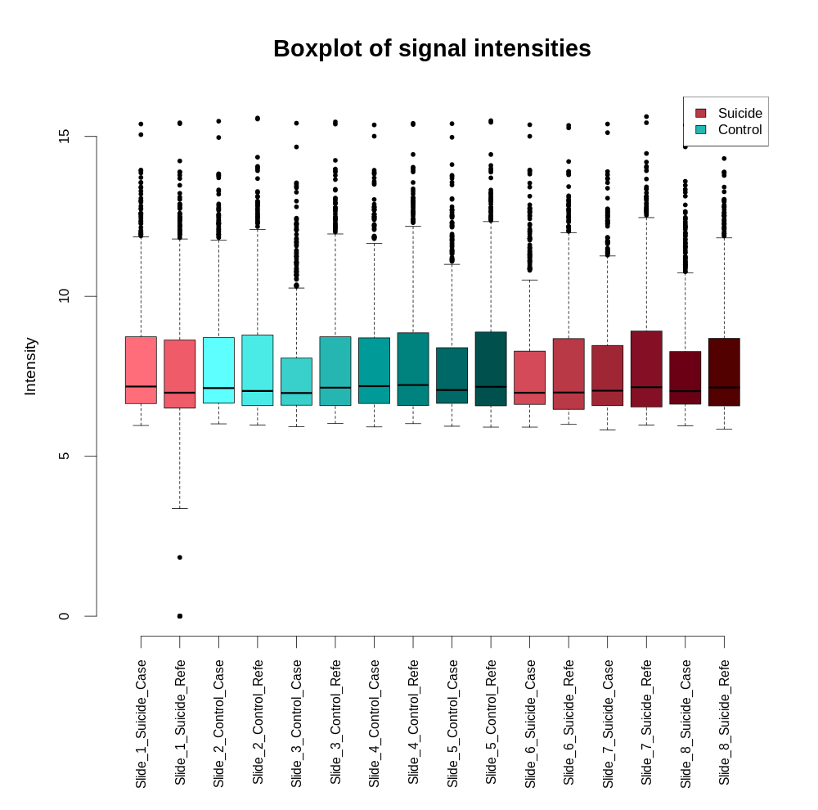
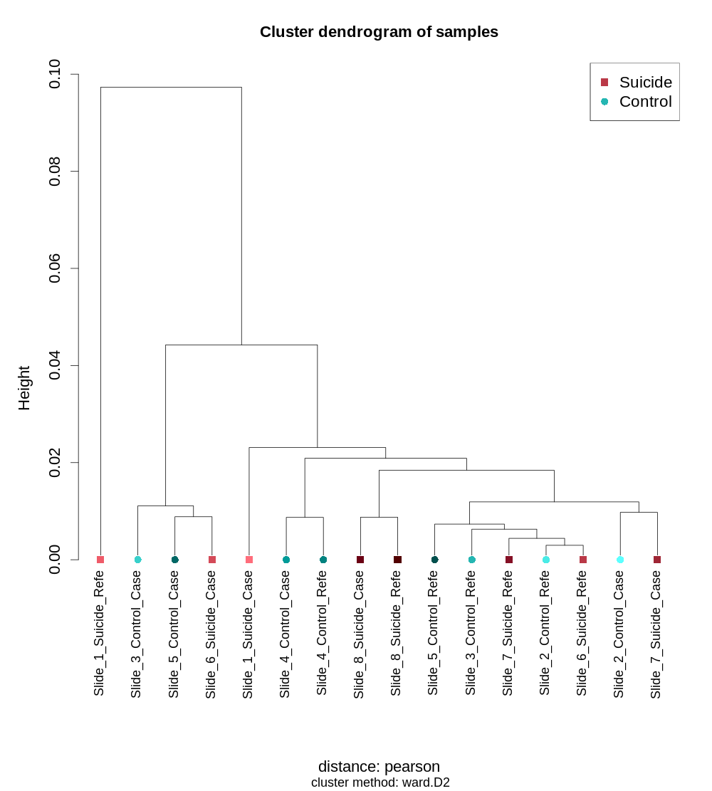
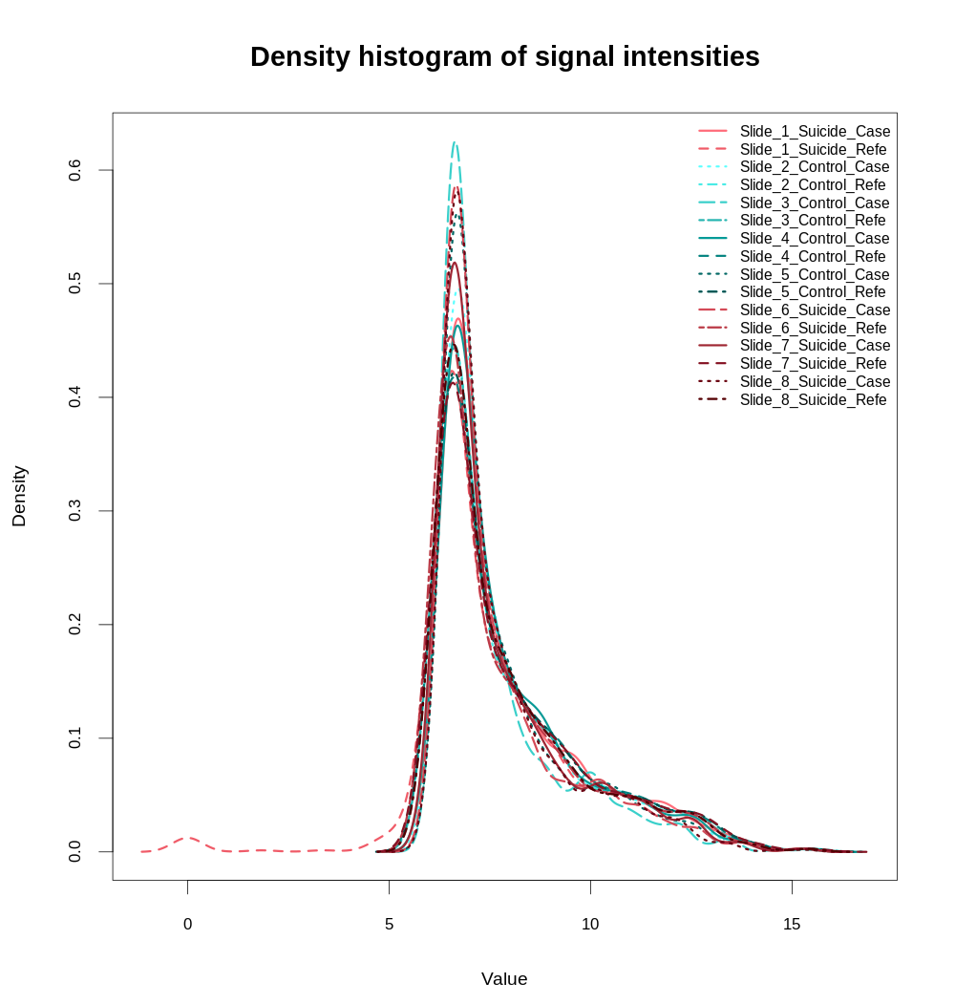
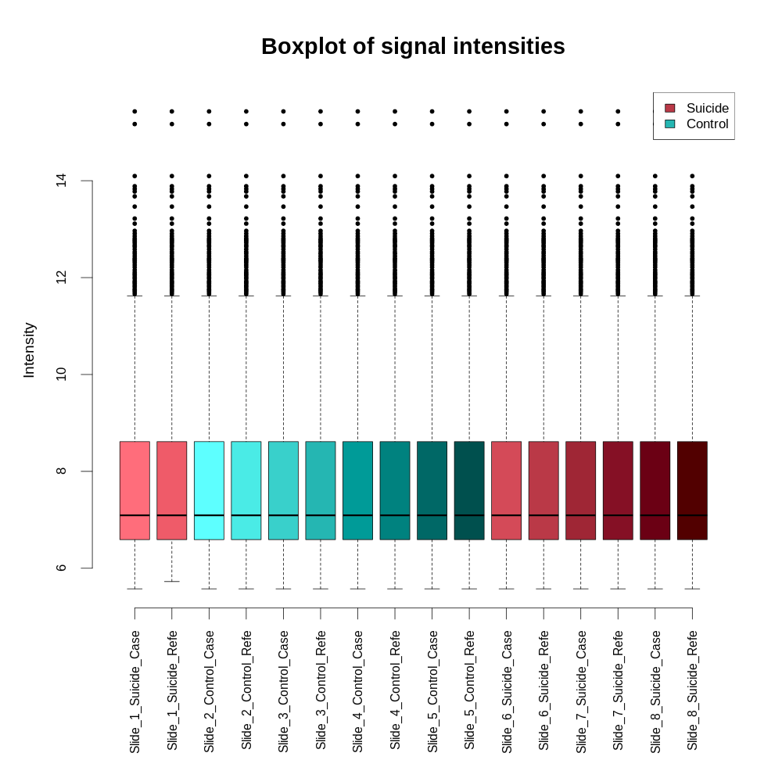
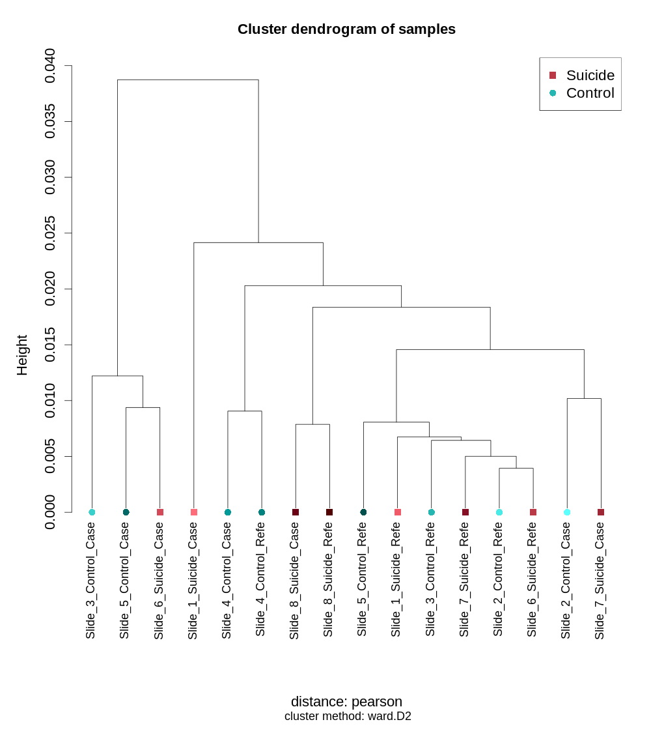
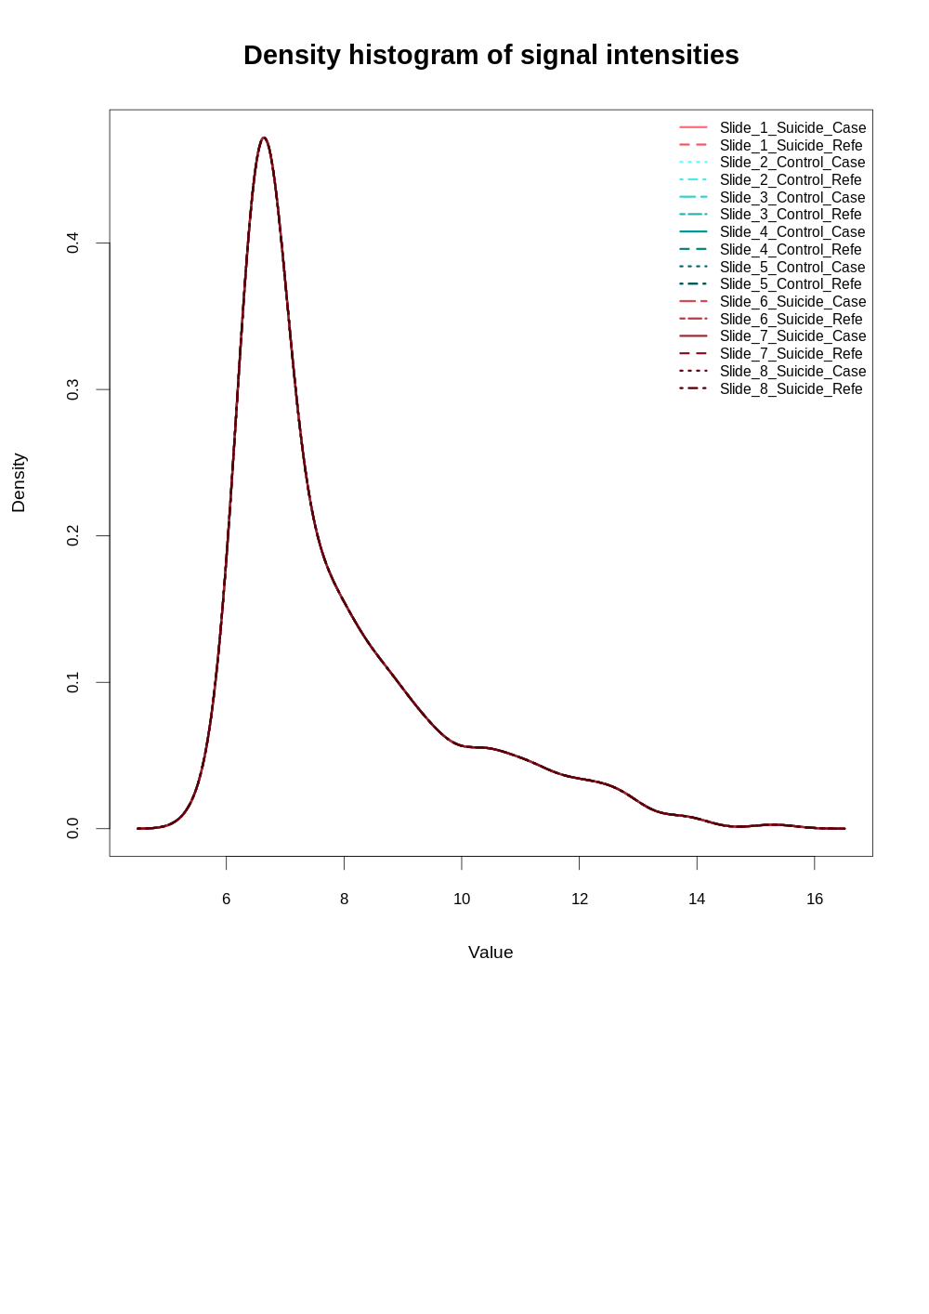
Preliminary Results – QC and Norm
Before Normalisation
After Normalisation

Slide 7
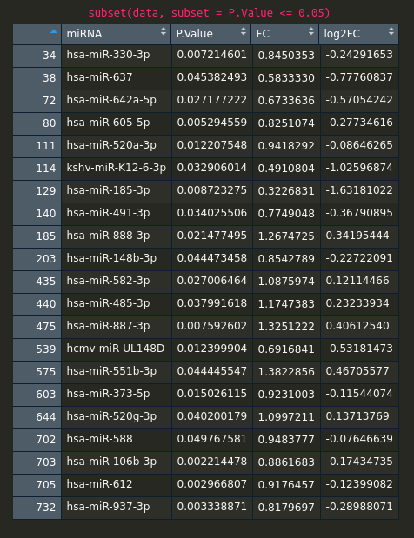
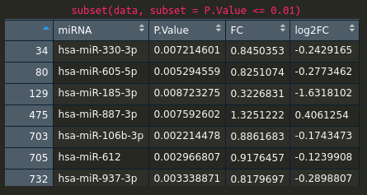
Preliminary Results -
Statistics

Slide 8
Preliminary Results – Validated Target Mapping
miRTarBase
#miRNA = 19
#Targets = 2415
#Links = 3860

Slide 9
Preliminary Results – Predicted Target Mapping
mirDIP
#miRNA = 18
#Targets = 5141
#Links = 8735
Constraint = Very High Confidence

Slide 10
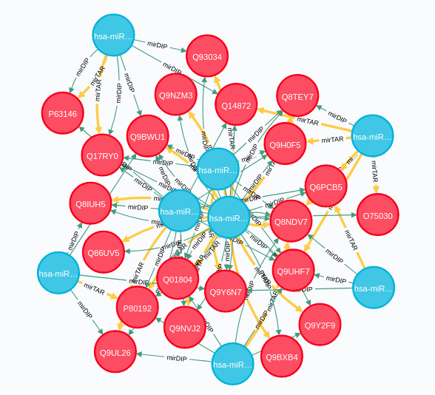
Preliminary Results – Network Construction
Neo4J
Core Network
  #Nodes: 6,422
  #Relationships: 11,916

Slide 11
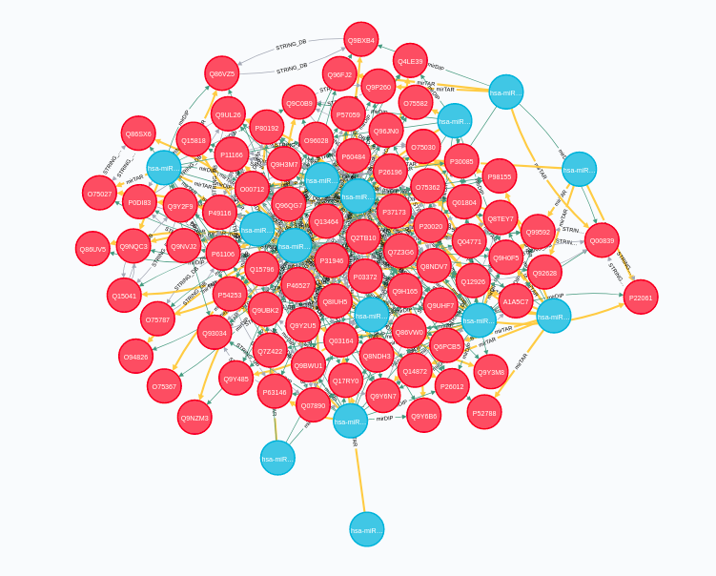
Preliminary Results – Network Expansion
Inclusion of Data from Available Resources
  STRING-DB (DONE)
    # Nodes: 19,481
    # Relationships: 789,180
    Functional Annotation
  Potential More Inclusions
    IntAct
    GeneMania
    WikiPathways
    DisGeNet

Slide 12
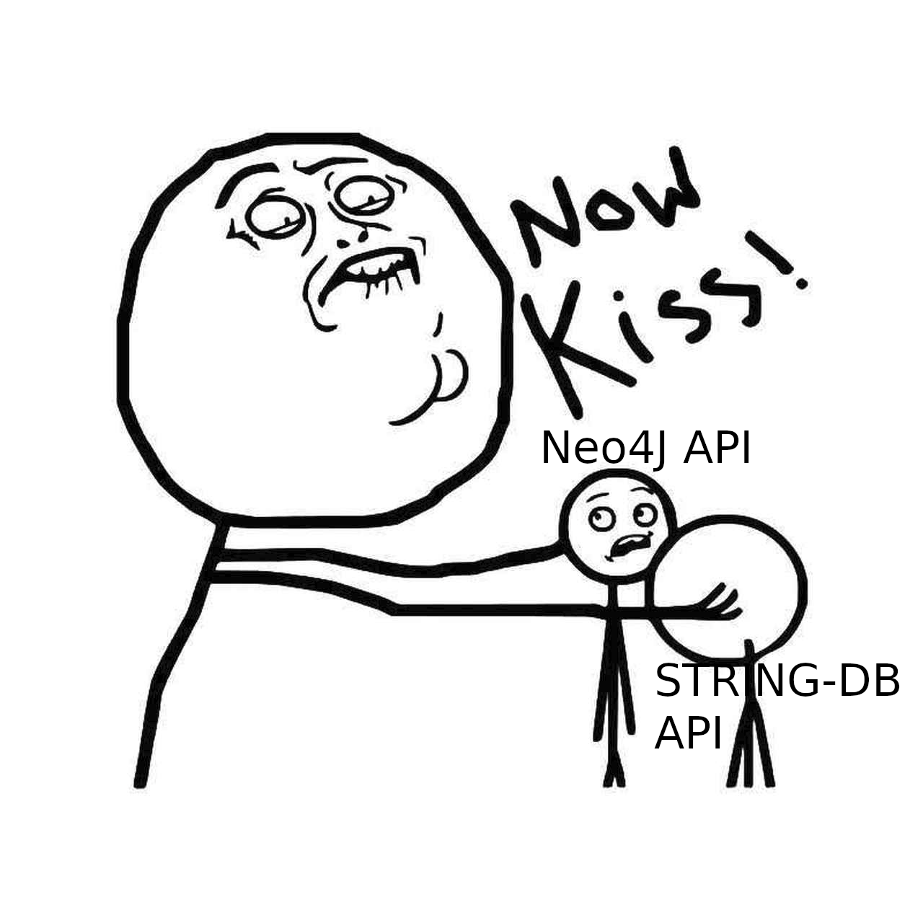

Slide 13
Preliminary Results – Network Analysis
Certain disregulated proteins involved in:
  Neuron membrane action
  Brain development
Use of Neo4J Network Plugins?
Use of STRING-DB API network enrichment analysis?
Visualisation using D3?
Suggestions?

Slide 14
Thank You for Your Attention
Questions or Suggestions are most welcome!

Slide 15
References
World Health Organization. (2014a). Preventing suicide: A global imperative. World Health Organization.
Beautrais, A. L., Joyce, P. R., & Mulder, R. T. (1996). Fergusson. DM, Deavoll BJ, Nightingale SK. Prevalence and comorbidity of mental disorders in person making serious attempts: a case control study. Am J Psychiatry, 153(8), 1009-14.
Chang, S. S., Stuckler, D., Yip, P., & Gunnell, D. (2013). Impact of 2008 global economic crisis on suicide: time trend study in 54 countries. Bmj, 347, f5239.
Jordan, J. R., & McIntosh, J. L. (Eds.). (2011). Grief after suicide: Understanding the consequences and caring for the survivors. Routledge.
Zhou, Y., Lutz, P. E., Ibrahim, E. C., Courtet, P., Tzavara, E., Turecki, G., & Belzeaux, R. (2018). Suicide and suicide behaviors: A review of transcriptomics and multiomics studies in psychiatric disorders. Journal of neuroscience research.
Dwivedi, Y., Roy, B., Lugli, G., Rizavi, H., Zhang, H., & Smalheiser, N. R. (2015). Chronic corticosterone-mediated dysregulation of microRNA network in prefrontal cortex of rats: relevance to depression pathophysiology. Translational psychiatry, 5(11), e682-e682.
Maussion, G., Yang, J., Yerko, V., Barker, P., Mechawar, N., Ernst, C., & Turecki, G. (2012). Regulation of a truncated form of tropomyosin-related kinase B (TrkB) by Hsa-miR-185* in frontal cortex of suicide completers. PloS one, 7(6).

