Slide 1
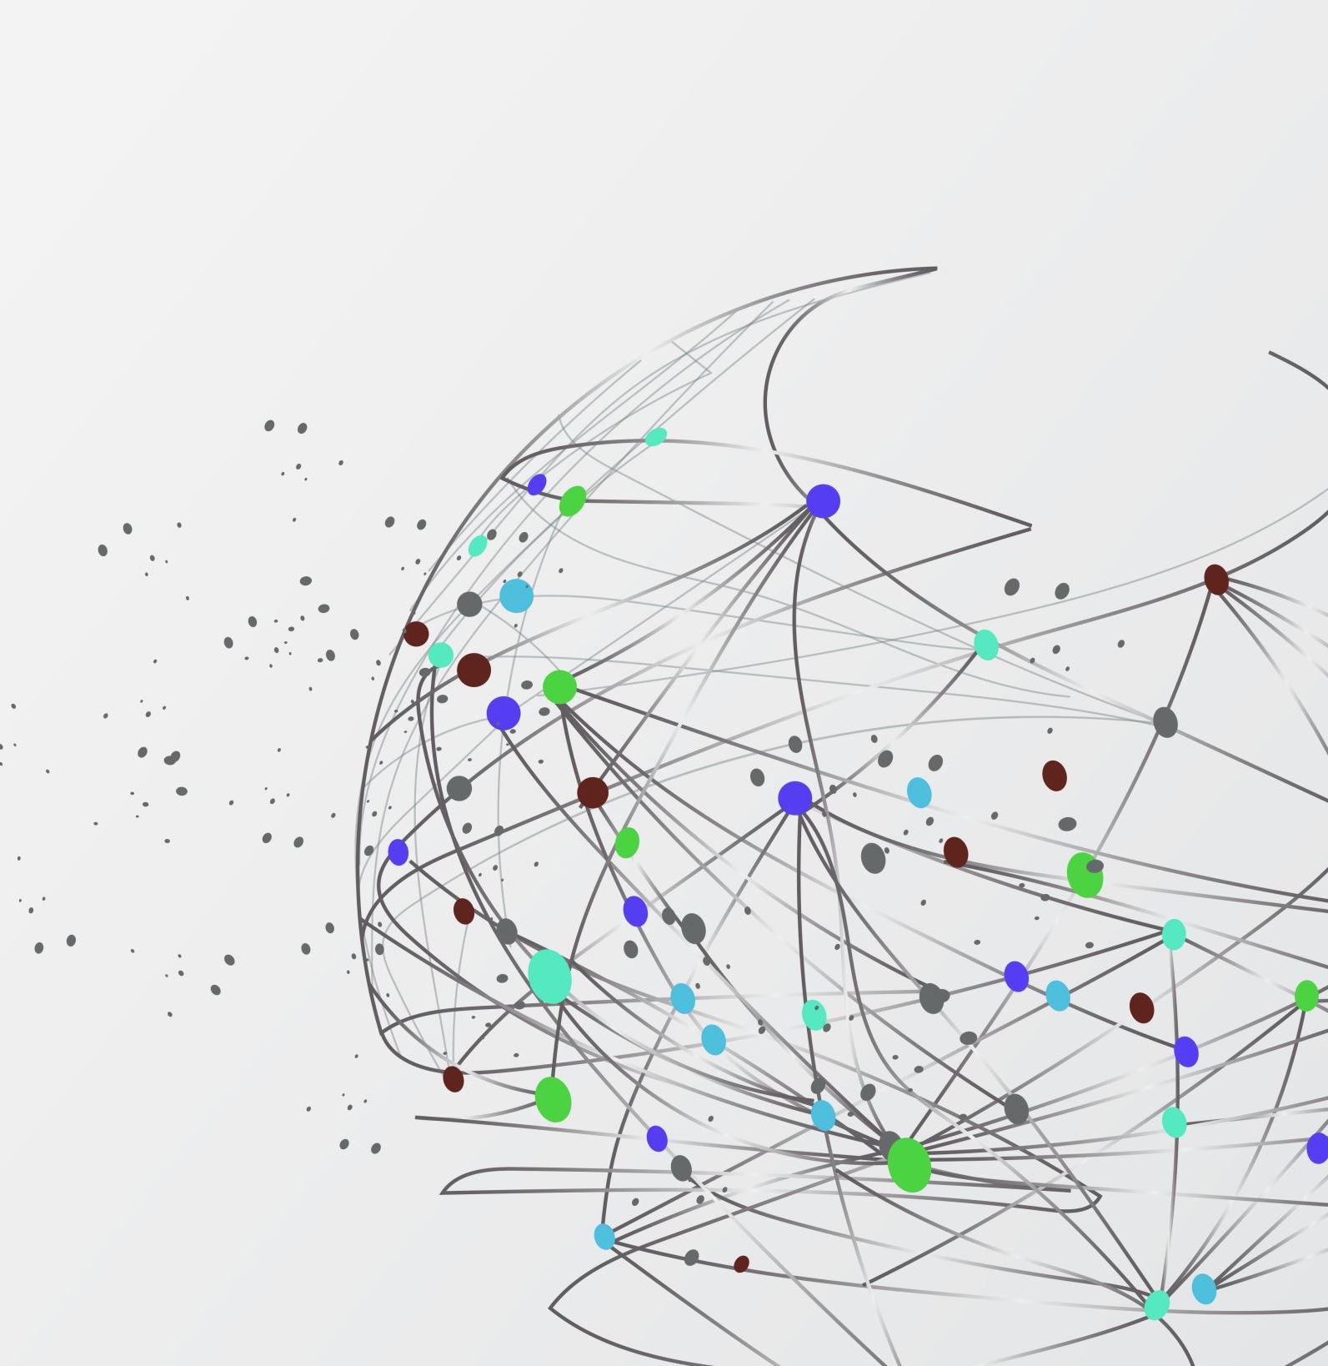
Getting more productive with the Terminal

Slide 2
Glossary
Terminal: The program that runs the shell (CLI) Mac: ‘Terminal App’, ‘iTerm’, … Windows: ‘cmd’, ‘PowerShell’
Shell: The program that executes the commands Examples: ‘zsh’, ‘bash’, ’PowerShell’, …

Slide 3
rm –rf folder/
Anatomy of a command
git fetch --prune
Command
Options
Parameter
Command
Options

Slide 4
Exercise Time
https://github.com/LukGer/workshop
Notes:
https://github.com/LukGer/workshop

