Slide 1
Streamlit en Windows
Oct 2026
LAVF

Slide 2
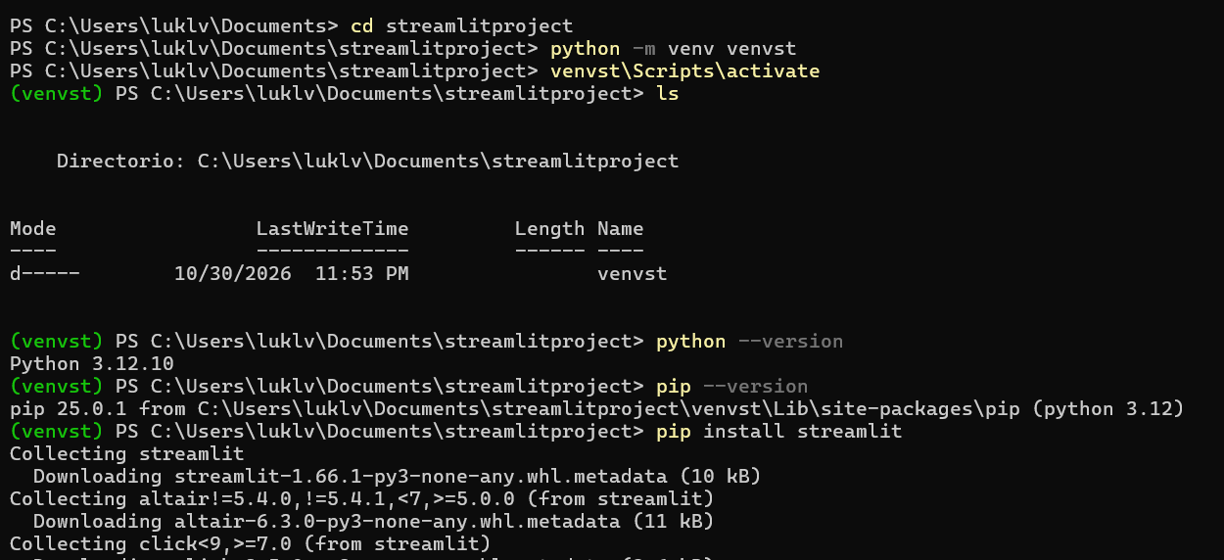

Slide 3
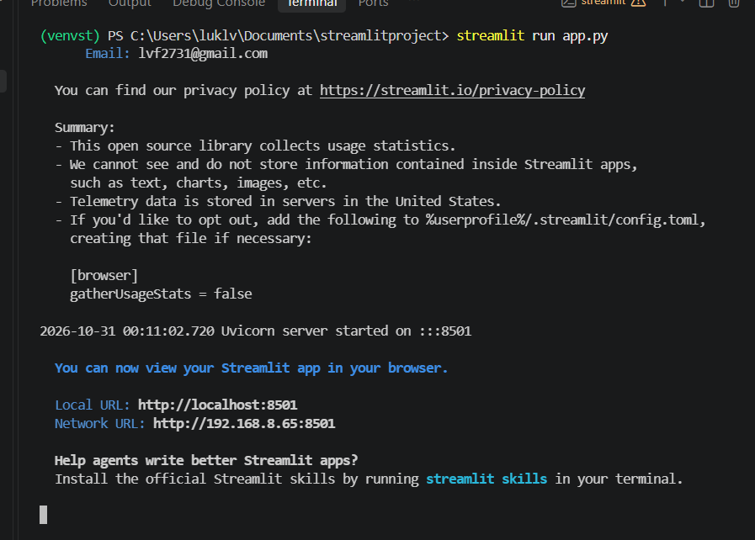

Slide 4
Caching overview
Streamlit runs your script from top to bottom at every user interaction or code change. This execution model makes development super easy. But it comes with two major challenges:
Long-running functions run again and again, which slows down your app.
Objects get recreated again and again, which makes it hard to persist them across reruns or sessions.
But don't worry! Streamlit lets you tackle both issues with its built-in caching mechanism. Caching stores the results of slow function calls, so they only need to run once. This makes your app much faster and helps with persisting objects across reruns. By default, cached values are available to all users of your app. If you need to save results that should only be accessible within a session, pass scope="session" to the caching decorator, or use Session State instead. Session-scoped cached values are removed when the session disconnects.

Slide 5
Usage
Let's look at an example of using st.cache_data. Suppose your app loads the Uber ride-sharing dataset – a CSV file of 50 MB – from the internet into a DataFrame:
def load_data(url):
df = pd.read_csv(url) # 👈 Download the data
return df
df = load_data("https://github.com/plotly/datasets/raw/master/uber-rides-data1.csv")
st.dataframe(df)
st.button("Rerun")

Slide 6
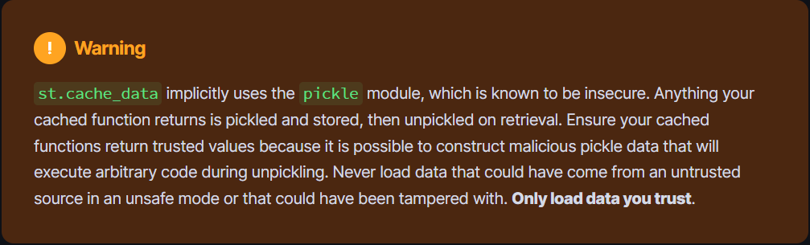
Adding a decorator
Running the load_data function takes 2 to 30 seconds, depending on your internet connection. (Tip: if you are on a slow connection, use this 5 MB dataset instead). Without caching, the download is rerun each time the app is loaded or with user interaction. Try it yourself by clicking the button we added! Not a great experience… 😕
Now let's add the @st.cache_data decorator on load_data:

Slide 7
Behavior
How does this work? Let's go through the behavior of st.cache_data step by step:
On the first run, Streamlit recognizes that it has never called the load_data function with the specified parameter value (the URL of the CSV file) So it runs the function and downloads the data.
Now our caching mechanism becomes active: the returned DataFrame is serialized (converted to bytes) via pickle and stored in the cache (together with the value of the url parameter).
On the next run, Streamlit checks the cache for an entry of load_data with the specific url. There is one! So it retrieves the cached object, deserializes it to a DataFrame, and returns it instead of re-running the function and downloading the data again.
This process of serializing and deserializing the cached object creates a copy of our original DataFrame. While this copying behavior may seem unnecessary, it's what we want when caching data objects since it effectively prevents mutation and concurrency issues. Read the section “Mutation and concurrency issues" below to understand this in more detail.

Slide 8
Deciding which caching decorator to use
The sections above showed many common examples for each caching decorator. But there are edge cases for which it's less trivial to decide which caching decorator to use. Eventually, it all comes down to the difference between “data" and “resource":
Data are serializable objects (objects that can be converted to bytes via pickle) that you could easily save to disk. Imagine all the types you would usually store in a database or on a file system – basic types like str, int, and float, but also arrays, DataFrames, images, or combinations of these types (lists, tuples, dicts, and so on).
Resources are unserializable objects that you usually would not save to disk or a database. They are often more complex, non-permanent objects like database connections, ML models, file handles, threads, etc.
From the types listed above, it should be obvious that most objects in Python are “data." That's also why st.cache_data is the correct command for almost all use cases. st.cache_resource is a more exotic command that you should only use in specific situations.
Or if you're lazy and don't want to think too much, look up your use case or return type in the table below 😉: cachingDecoratos_streamlit.xlsx

Slide 9
Advanced usage
Controlling cache size and duration
If your app runs for a long time and constantly caches functions, you might run into two problems:
The app runs out of memory because the cache is too large.
Objects in the cache become stale, e.g. because you cached old data from a database.
You can combat these problems with the ttl and max_entries parameters, which are available for both caching decorators.
The ttl (time-to-live) parameter
ttl sets a time to live on a cached function. If that time is up and you call the function again, the app will discard any old, cached values, and the function will be rerun. The newly computed value will then be stored in the cache. This behavior is useful for preventing stale data (problem 2) and the cache from growing too large (problem 1). Especially when pulling data from a database or API, you should always set a ttl so you are not using old data. Here's an example:

Slide 10
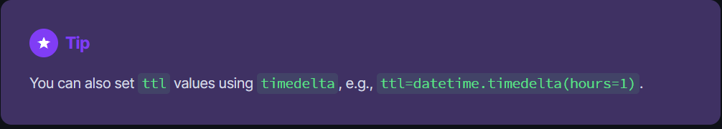
Example
@st.cache_data(ttl=3600) # 👈 Cache data for 1 hour (=3600 seconds)def get_api_data(): data = api.get(...) return data
You can also set ttl values using timedelta, e.g., ttl=datetime.timedelta(hours=1).

Slide 11


