Slide 1

Learning how to play Pokemon Trading Card Game using Monte Carlo methods
Luka Filipovic
CS 798 Final Project
University of Waterloo, Canada

Slide 2
About Pokemon Trading Card Game
Pokemon Trading Card Game is a 2-player Card game, played using collectible Pokemon Trading Card Game cards
Each player builds a deck of 60 cards
There are 3 types of cards – Pokemon Cards, Trainer Cards, and Energy Cards
Game consists of a playing field visible to everyone, and players also hold cards in their hands, which are only visible to them.

Slide 3
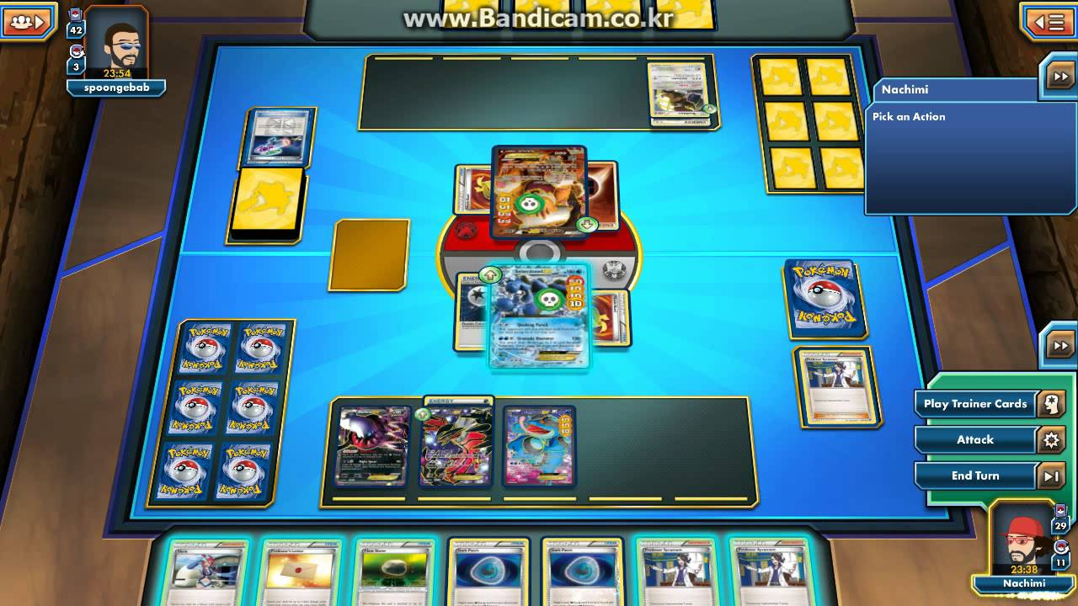

Slide 4
Playing Field
Playing field consists of an active Pokemon slot, 5 Bench Pokemon slots, deck slot, and 6 Prize card slots.
Players play by taking turns. Each player begins his/her turn by drawing a card from the deck, then playing some cards from the hand, and finally (optionally) attacking at the end of the turn.
Player wins by either taking all prize cards, knocking out all Pokemon on opponent’s side of the field, or when an opponent is required to draw, but has no remaining cards in the deck.

Slide 5
Pokemon cards
Pokemon cards are divided into basic Pokemon and evolved Pokemon.
At the beginning of the game, players put a basic Pokemon card from their hand to the active slot on the field
Players can put a basic Pokemon to an empty bench slot at any time during their turn. They can also evolve their Pokemon by placing a matching evolution from their hand to the required Pokemon on the field, but this can be done only once per turn for a specific Pokemon, and can’t be done on the first turn.
Pokemon cards have HP (Hit Points), and attacks. Attacks have energy cost. Only active Pokemon can attack. When Pokemon attacks, first we check whether the Pokemon has sufficient Energy on him to satisfy the Energy cost. If it does, then it does corresponding Damage (and possible additional effects) to the Defending (opponent’s active) Pokemon.
If a Pokemon has more damage on it than it has HP, it gets knocked out. Player removes that Pokemon from the field. Opponent takes one of his/her Prize cards. Then the player promotes one of his benched Pokemon to the active position.

Slide 6
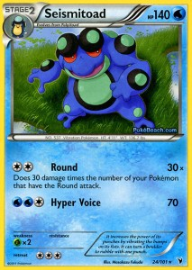
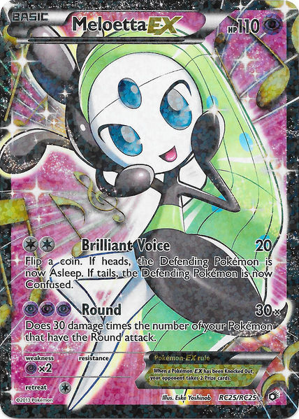
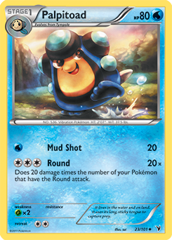
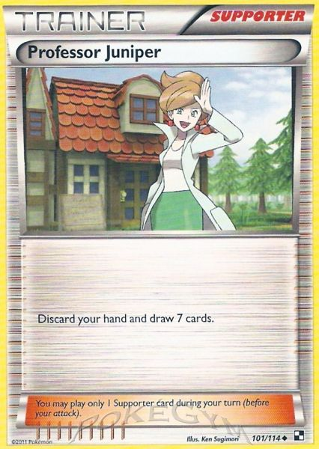
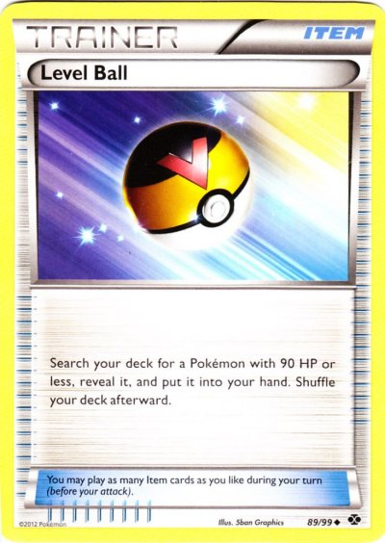
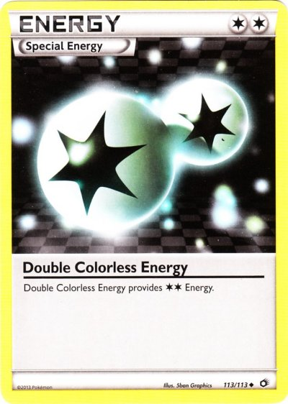

Slide 7
Trainer/Energy Cards
Players can play Trainer cards at any time during their turn.
There is a special type of trainer cards, called “Supporter” Trainer card. Only one Supporter can be played during the turn, while other types can be played any number of times.
Energy cards can be played once a turn. When played, the player attaches an energy card to one of his/her Pokemon on the field.

Slide 8
“Round” Pokemon deck
My project will try to use Monte Carlo methods in order to play a specific Pokemon deck, which is named “Round”.
The goal of this deck is to attack with Seismitoad using Round attack, while having as many other Pokemon with the Round attack on the field as possible.
There are 13 cards in the deck. We assign to each card a number (ID) from 0 to 12. For the complete deck-list and explanation of each card, please refer to the final paper.

Slide 9
Monte Carlo approach
Playing a card can be represented by a function play (id, arg1, arg2).
Id represents card ID (in our hand) which we play, while arg1,arg2 denote arguments which are related to the effect of the card (for example which Pokemon to evolve, where to attach energy, etc).
If we call play with ID = -1, we attack and end the turn.

Slide 10
Algorithm will run an instance of the game. We input cards that we draw. Then, the program will output a list of possible moves.
It will also provide “Damage” estimate for each move, which is calculated by randomly simulating some specified number of games for that move, for the next 3 turns, and outputting how much damage we dealt during that simulation.
Choosing the move with the highest “Damage” associated to it gives us a Monte Carlo based algorithm which plays the game.

Slide 11
Simulating opponent’s moves
Since “Round” deck strategy isn’t highly dependent on opponent’s play, we simplify our opponent’s moves.
We assign to our opponent “threat” level before starting simulation, which is simply an approximation of our opponent’s side of the field, indicating how much damage opponent can threaten with in his current position.
In the simulation, our opponent will deal damage to us which is proportional to his/her threat level.

Slide 12
Limitations of this approach
Simulating on the fly is very time consuming – our algorithm can only do around 10 game simulations for every move in order to be responsive (returns moves with “Damage” estimations in a couple of seconds).
This makes it impossible to play a game in real time while still guaranteeing that the moves we play are being close to optimal.

Slide 13
Different possible approaches: Constructing a Decision Network
Instead of simulating random games on the fly, we could construct a decision network and train it.
Nodes in this network represent current state of the game – state of the playing field, current cards in the hand, remaining cards in the deck, prize cards, opponent’s hand size, deck size, prize card count.
Arcs correspond to possible moves.

Slide 14
The number of all possible states of the game exceeds 10^(12), which would make the corresponding network be Terabytes in size.
States are hence approximated. For example, instead of a separate state for every combination of cards remaining in the deck, we give an approximation – i.e. there are 0-4, 5-9, 10+ energies left in deck, etc.
There are no arcs in this case– state is computed every time before making a move, and each state has corresponding values for every move that can be made, which correlate to how good that given move is.
Values are obtained by training this state-value table - doing a lot of random Monte Carlo simulations, and updating values of moves taken in the simulation according to the outcome.

Slide 15
What’s the purpose of this project?
Current Pokemon Trading Card Game Online platform doesn’t allow players to play against a skilled computer AI, the current one uses weak decks and is extremely easy to beat.
Players preparing for tournaments usually rely on intuition and past experiences to build decks. With the help of some computer simulations, perhaps it’s possible to get a better understanding of how certain decks measure up to other strong decks being used in pro-play.
Having fun!

Slide 16
http://www.pokemon.com/us/pokemon-tcg/play-online/ - access to Pokemon Trading Card Game online, and tutorials on how to play
https://www.youtube.com/watch?v=qDYwlPeEfpI - “Round” deck explained (and played), slightly different (stronger) version
“The State of Solving Large Incomplete-Information Games, and Application to Poker”, Toumas Sandholm

