Slide 1
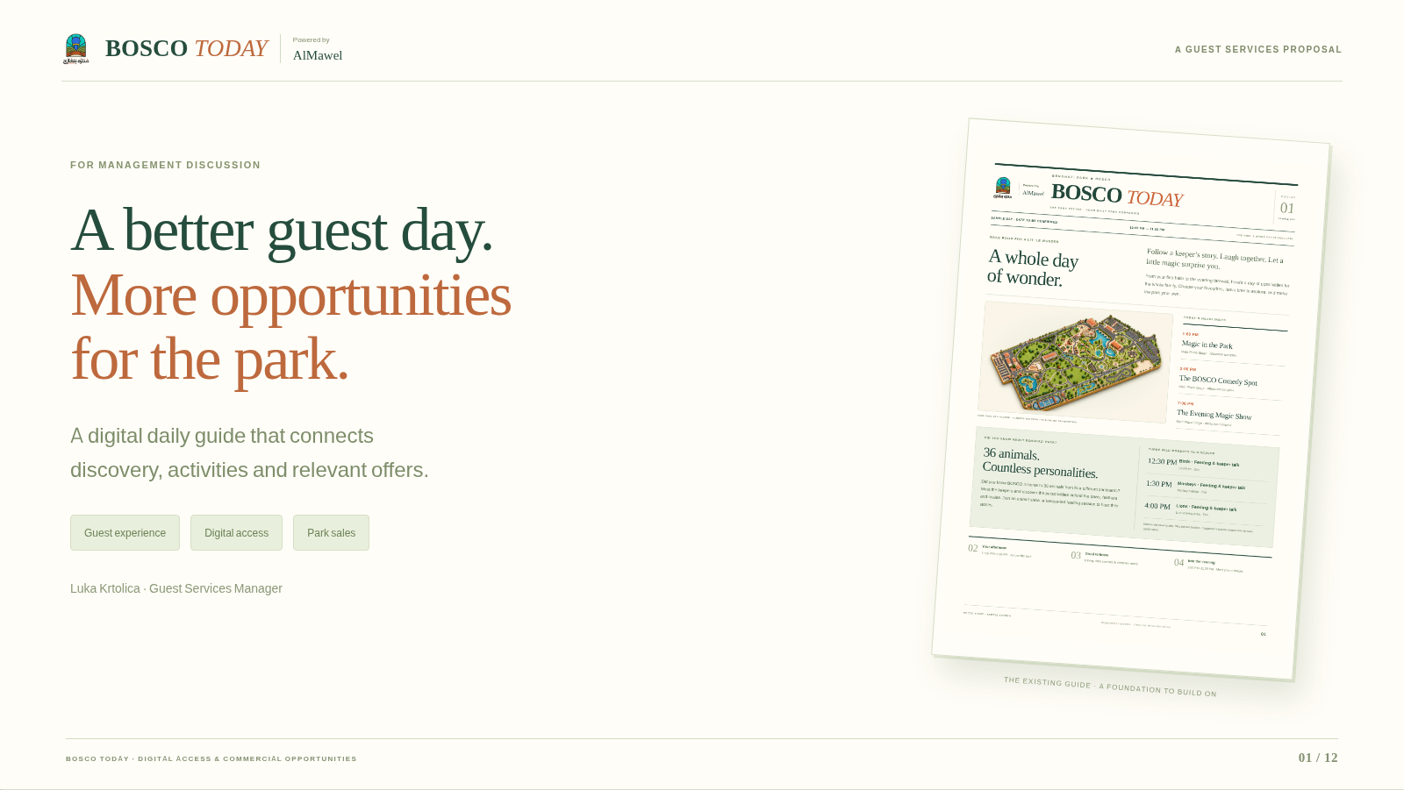
Notes:
Static backup of the browser presentation. The page-turning effect is available in the website version.
BOSCO
TODAY
Powered by
AlMawel
A GUEST SERVICES PROPOSAL
FOR MANAGEMENT DISCUSSION
A better guest day.
More opportunities
for the park.
A digital daily guide that connects
discovery, activities and relevant offers.
Guest experience
Digital access
Park sales
Luka Krtolica · Guest Services Manager
THE EXISTING GUIDE · A FOUNDATION TO BUILD ON
BOSCO TODAY · DIGITAL ACCESS & COMMERCIAL OPPORTUNITIES

Slide 2
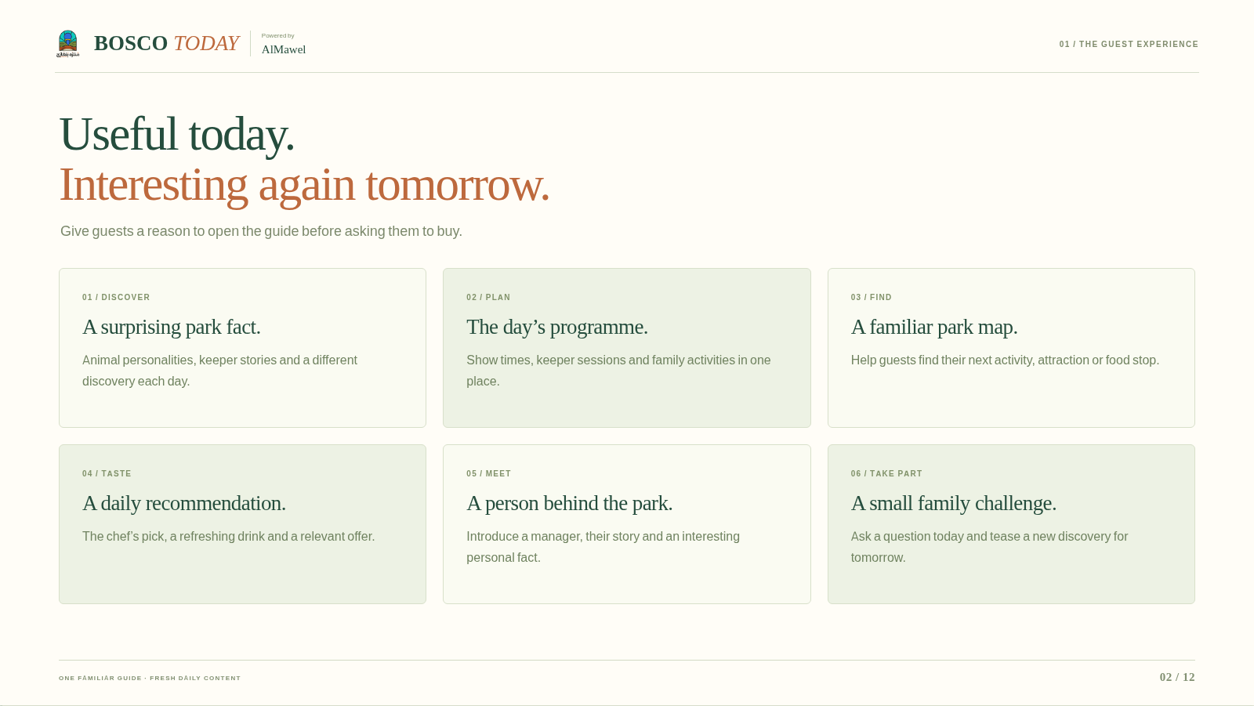
Notes:
Static backup of the browser presentation. The page-turning effect is available in the website version.
BOSCO
TODAY
Powered by
AlMawel
01 / THE GUEST EXPERIENCE
Useful today.
Interesting again tomorrow.
Give guests a reason to open the guide before asking them to buy.
01 / DISCOVER
A surprising park fact.
Animal personalities, keeper stories and a different discovery each day.
02 / PLAN
The day’s programme.
Show times, keeper sessions and family activities in one place.
03 / FIND
A familiar park map.
Help guests find their next activity, attraction or food stop.
04 / TASTE
A daily recommendation.
The chef’s pick, a refreshing drink and a relevant offer.
05 / MEET
A person behind the park.
Introduce a manager, their story and an interesting personal fact.
06 / TAKE PART
A small family challenge.
Ask a question today and tease a new discovery for tomorrow.
ONE FAMILIAR GUIDE · FRESH DAILY CONTENT

Slide 3
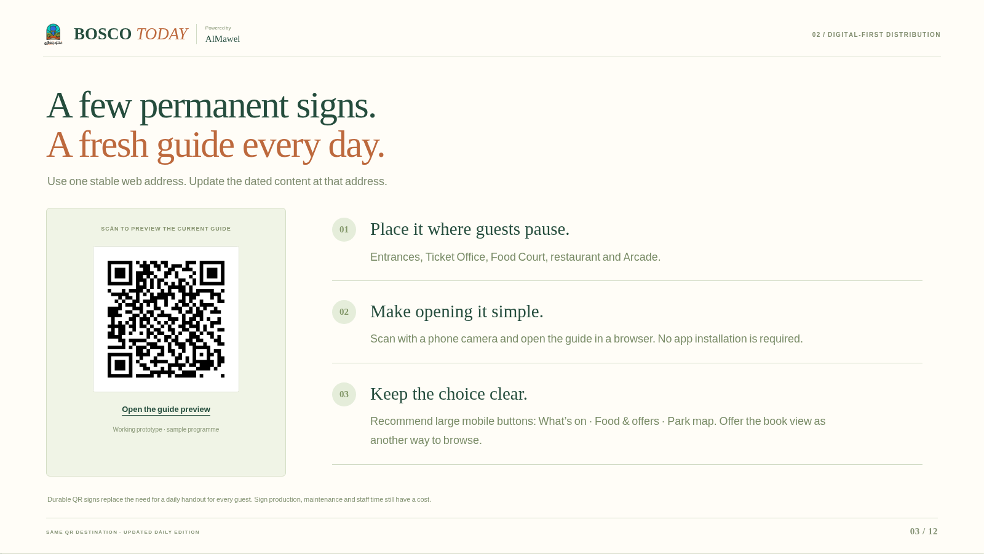
Notes:
Static backup of the browser presentation. The page-turning effect is available in the website version.
BOSCO
TODAY
Powered by
AlMawel
02 / DIGITAL-FIRST DISTRIBUTION
A few permanent signs.
A fresh guide every day.
Use one stable web address. Update the dated content at that address.
SCAN TO PREVIEW THE CURRENT GUIDE
Open the guide preview
Working prototype · sample programme
01
Place it where guests pause.
Entrances, Ticket Office, Food Court, restaurant and Arcade.
02
Make opening it simple.
Scan with a phone camera and open the guide in a browser. No app installation is required.
03
Keep the choice clear.
Recommend large mobile buttons: What’s on · Food & offers · Park map. Offer the book view as another way to browse.
Durable QR signs replace the need for a daily handout for every guest. Sign production, maintenance and staff time still have a cost.
SAME QR DESTINATION · UPDATED DAILY EDITION

Slide 4
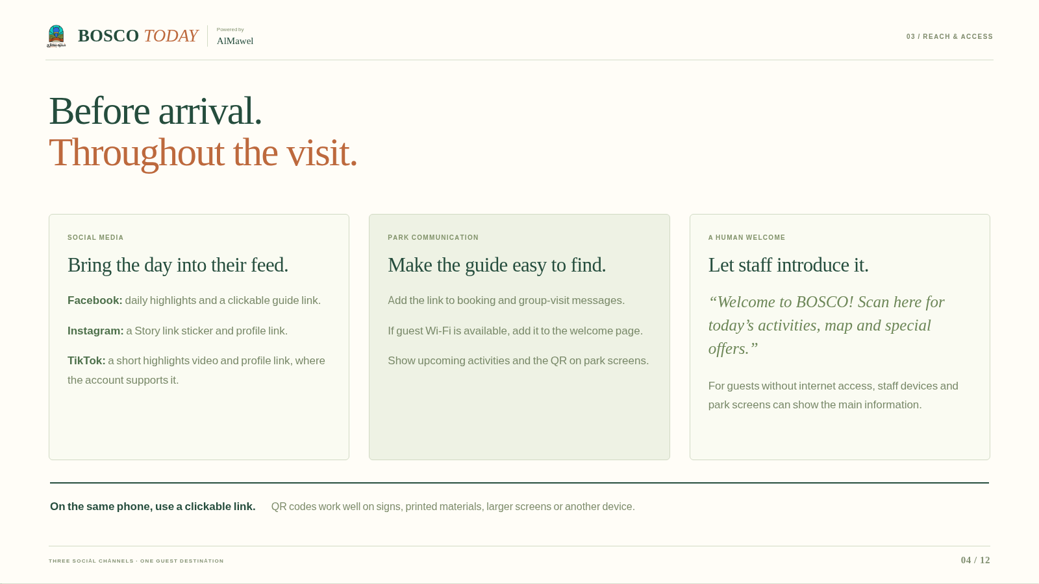
Notes:
Static backup of the browser presentation. The page-turning effect is available in the website version.
BOSCO
TODAY
Powered by
AlMawel
03 / REACH & ACCESS
Before arrival.
Throughout the visit.
SOCIAL MEDIA
Bring the day into their feed.
Facebook:
daily highlights and a clickable guide link.
Instagram:
a Story link sticker and profile link.
TikTok:
a short highlights video and profile link, where the account supports it.
PARK COMMUNICATION
Make the guide easy to find.
Add the link to booking and group-visit messages.
If guest Wi-Fi is available, add it to the welcome page.
Show upcoming activities and the QR on park screens.
A HUMAN WELCOME
Let staff introduce it.
“Welcome to BOSCO! Scan here for today’s activities, map and special offers.”
For guests without internet access, staff devices and park screens can show the main information.
On the same phone, use a clickable link.
QR codes work well on signs, printed materials, larger screens or another device.
THREE SOCIAL CHANNELS · ONE GUEST DESTINATION

Slide 5
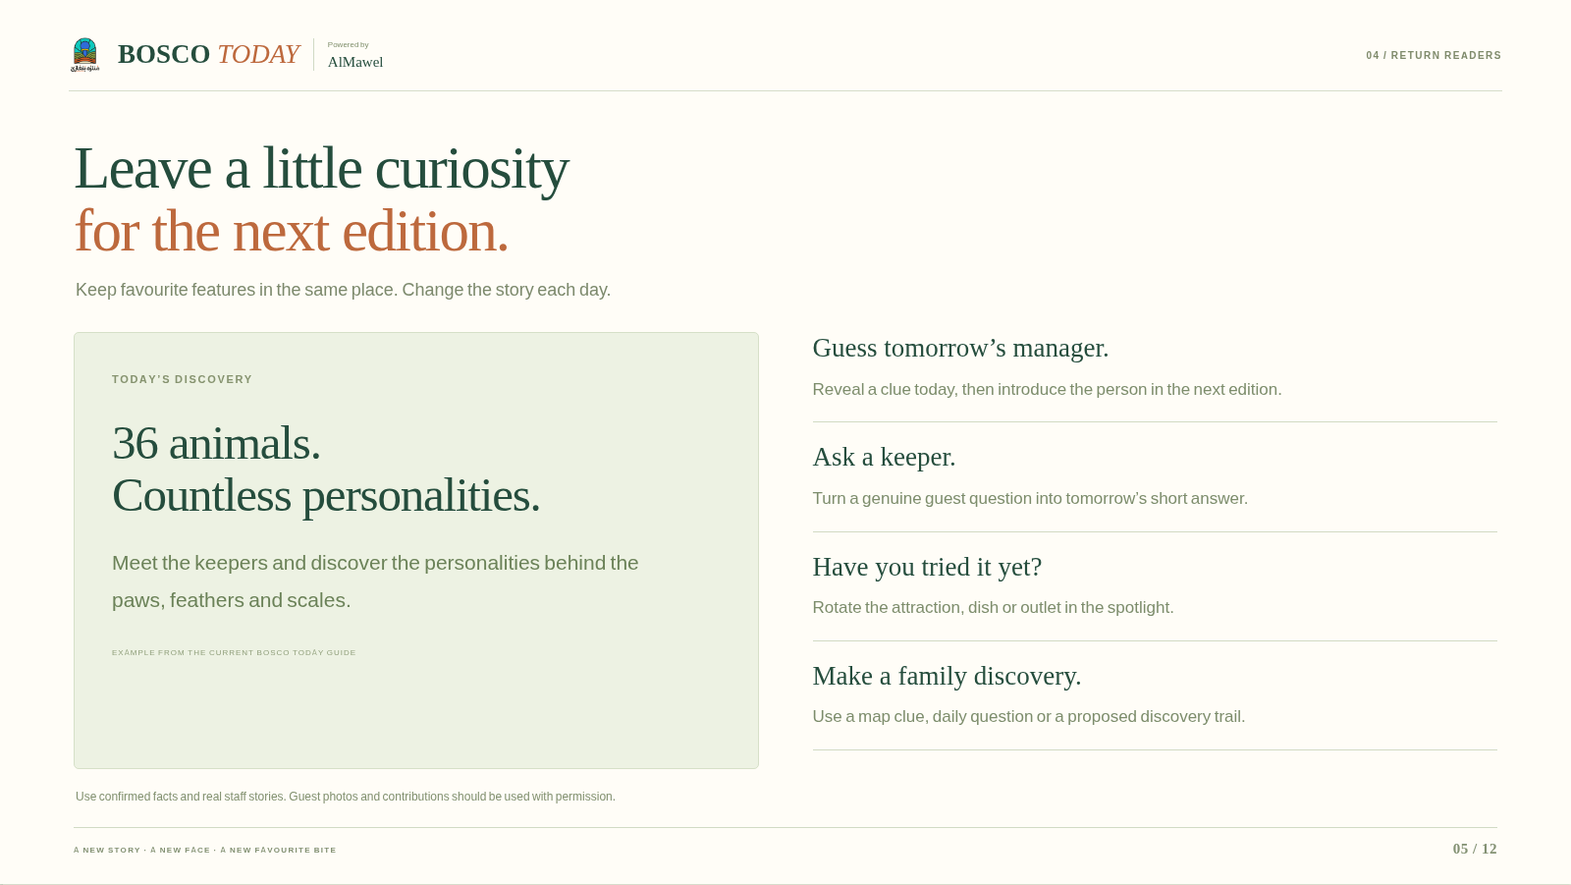
Notes:
Static backup of the browser presentation. The page-turning effect is available in the website version.
BOSCO
TODAY
Powered by
AlMawel
04 / RETURN READERS
Leave a little curiosity
for the next edition.
Keep favourite features in the same place. Change the story each day.
TODAY’S DISCOVERY
36 animals.
Countless personalities.
Meet the keepers and discover the personalities behind the paws, feathers and scales.
EXAMPLE FROM THE CURRENT BOSCO TODAY GUIDE
Guess tomorrow’s manager.
Reveal a clue today, then introduce the person in the next edition.
Ask a keeper.
Turn a genuine guest question into tomorrow’s short answer.
Have you tried it yet?
Rotate the attraction, dish or outlet in the spotlight.
Make a family discovery.
Use a map clue, daily question or a proposed discovery trail.
Use confirmed facts and real staff stories. Guest photos and contributions should be used with permission.
A NEW STORY · A NEW FACE · A NEW FAVOURITE BITE

Slide 6
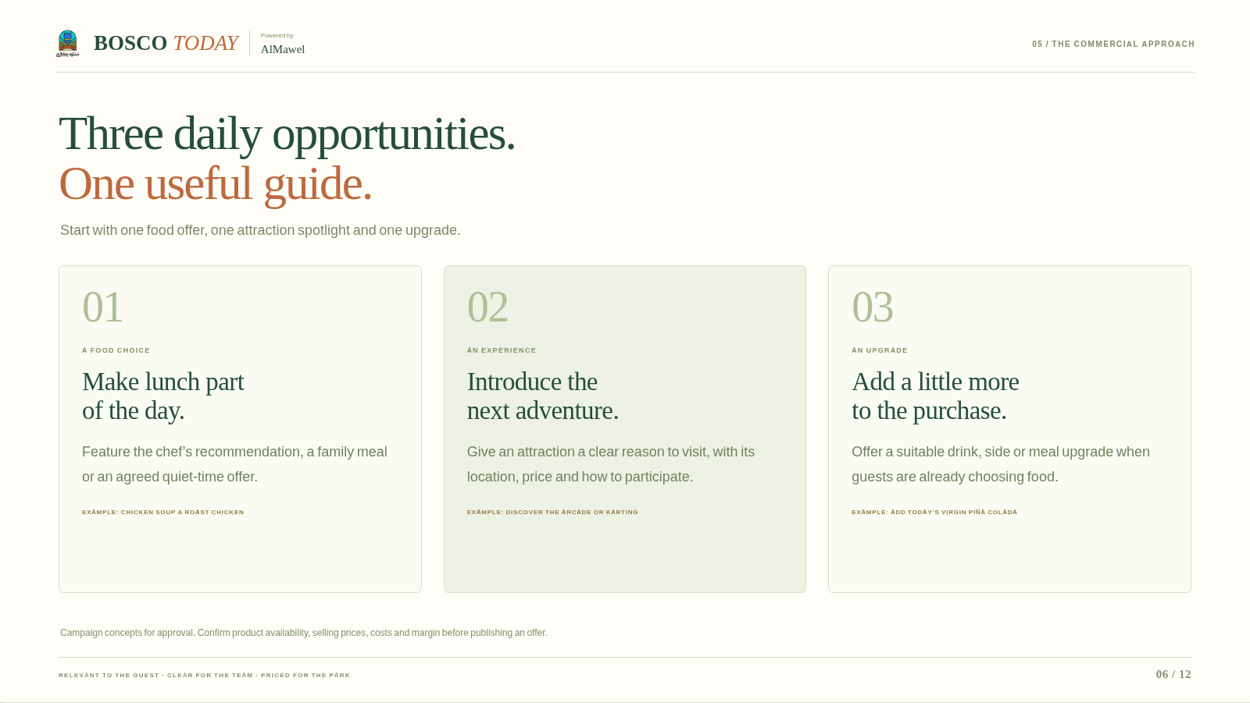
Notes:
Static backup of the browser presentation. The page-turning effect is available in the website version.
BOSCO
TODAY
Powered by
AlMawel
05 / THE COMMERCIAL APPROACH
Three daily opportunities.
One useful guide.
Start with one food offer, one attraction spotlight and one upgrade.
01
A FOOD CHOICE
Make lunch part
of the day.
Feature the chef’s recommendation, a family meal or an agreed quiet-time offer.
EXAMPLE: CHICKEN SOUP & ROAST CHICKEN
02
AN EXPERIENCE
Introduce the
next adventure.
Give an attraction a clear reason to visit, with its location, price and how to participate.
EXAMPLE: DISCOVER THE ARCADE OR KARTING
03
AN UPGRADE
Add a little more
to the purchase.
Offer a suitable drink, side or meal upgrade when guests are already choosing food.
EXAMPLE: ADD TODAY’S VIRGIN PIÑA COLADA
Campaign concepts for approval. Confirm product availability, selling prices, costs and margin before publishing an offer.
RELEVANT TO THE GUEST · CLEAR FOR THE TEAM · PRICED FOR THE PARK

Slide 7
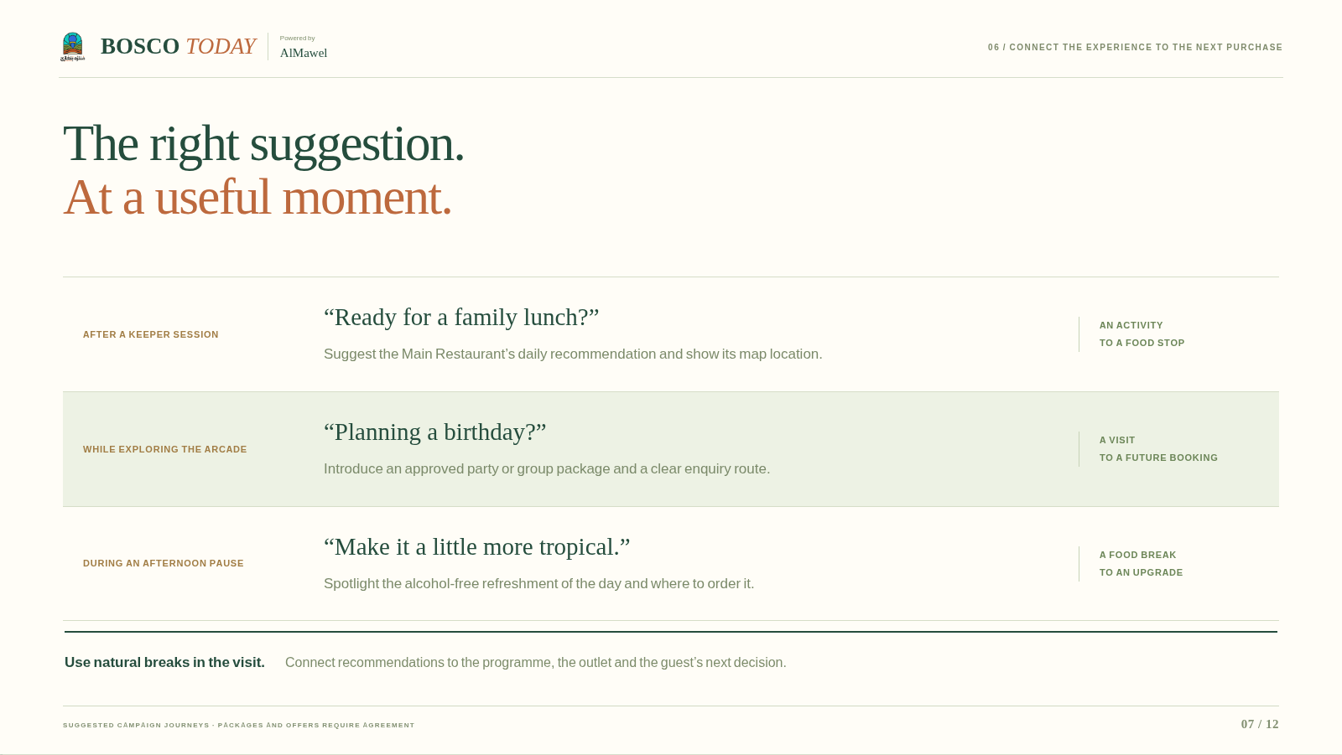
Notes:
Static backup of the browser presentation. The page-turning effect is available in the website version.
BOSCO
TODAY
Powered by
AlMawel
06 / CONNECT THE EXPERIENCE TO THE NEXT PURCHASE
The right suggestion.
At a useful moment.
AFTER A KEEPER SESSION
“Ready for a family lunch?”
Suggest the Main Restaurant’s daily recommendation and show its map location.
AN ACTIVITY
TO A FOOD STOP
WHILE EXPLORING THE ARCADE
“Planning a birthday?”
Introduce an approved party or group package and a clear enquiry route.
A VISIT
TO A FUTURE BOOKING
DURING AN AFTERNOON PAUSE
“Make it a little more tropical.”
Spotlight the alcohol-free refreshment of the day and where to order it.
A FOOD BREAK
TO AN UPGRADE
Use natural breaks in the visit.
Connect recommendations to the programme, the outlet and the guest’s next decision.
SUGGESTED CAMPAIGN JOURNEYS · PACKAGES AND OFFERS REQUIRE AGREEMENT

Slide 8
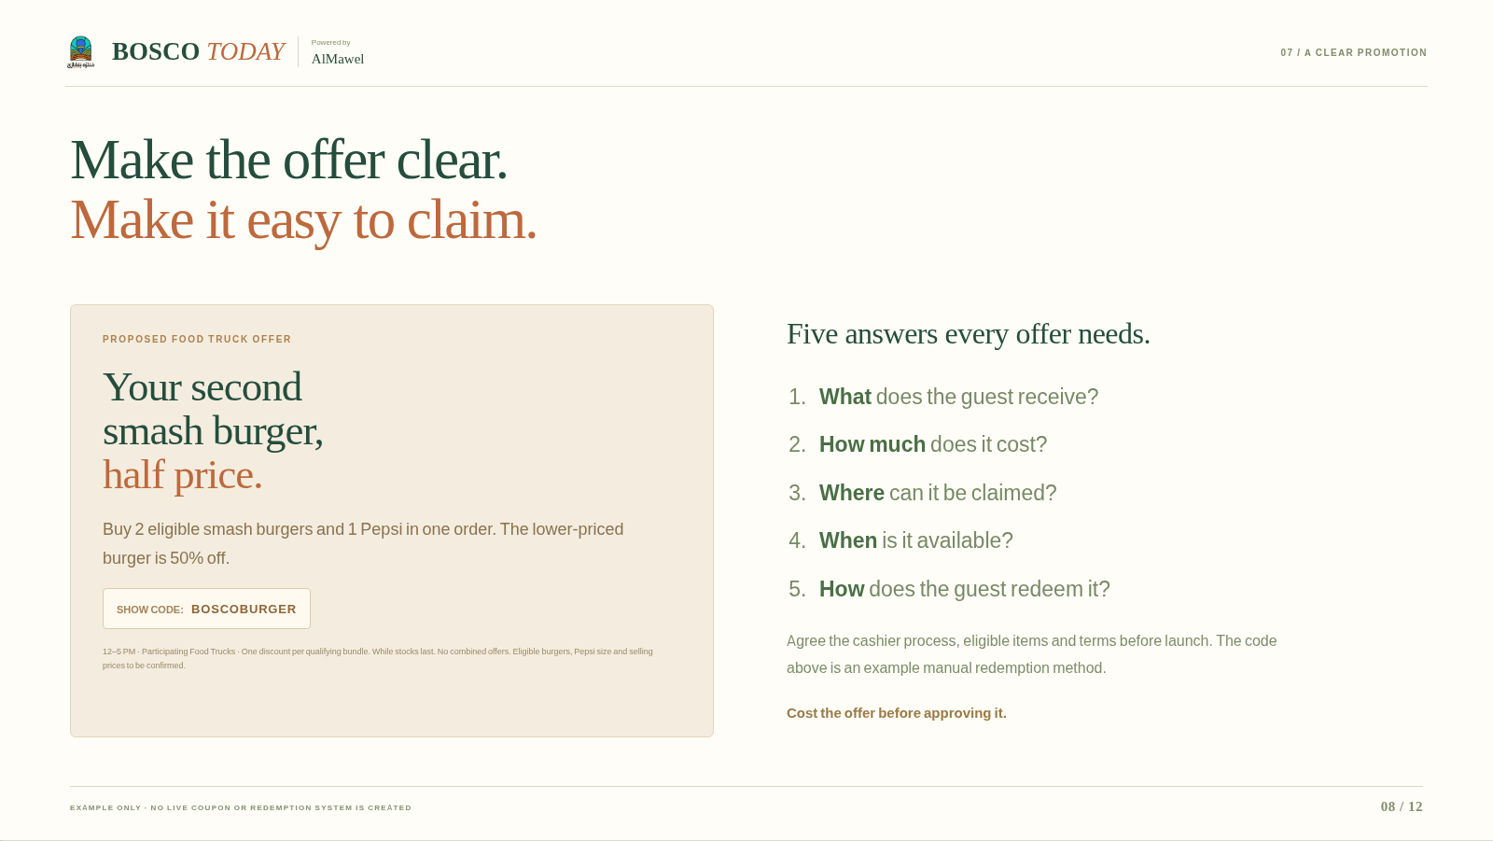
Notes:
Static backup of the browser presentation. The page-turning effect is available in the website version.
BOSCO
TODAY
Powered by
AlMawel
07 / A CLEAR PROMOTION
Make the offer clear.
Make it easy to claim.
PROPOSED FOOD TRUCK OFFER
Your second
smash burger,
half price.
Buy 2 eligible smash burgers and 1 Pepsi in one order. The lower-priced burger is 50% off.
SHOW CODE:
BOSCOBURGER
12–5 PM · Participating Food Trucks · One discount per qualifying bundle. While stocks last. No combined offers. Eligible burgers, Pepsi size and selling prices to be confirmed.
Five answers every offer needs.
What
does the guest receive?
How much
does it cost?
Where
can it be claimed?
When
is it available?
How
does the guest redeem it?
Agree the cashier process, eligible items and terms before launch. The code above is an example manual redemption method.
Cost the offer before approving it.
EXAMPLE ONLY · NO LIVE COUPON OR REDEMPTION SYSTEM IS CREATED

Slide 9
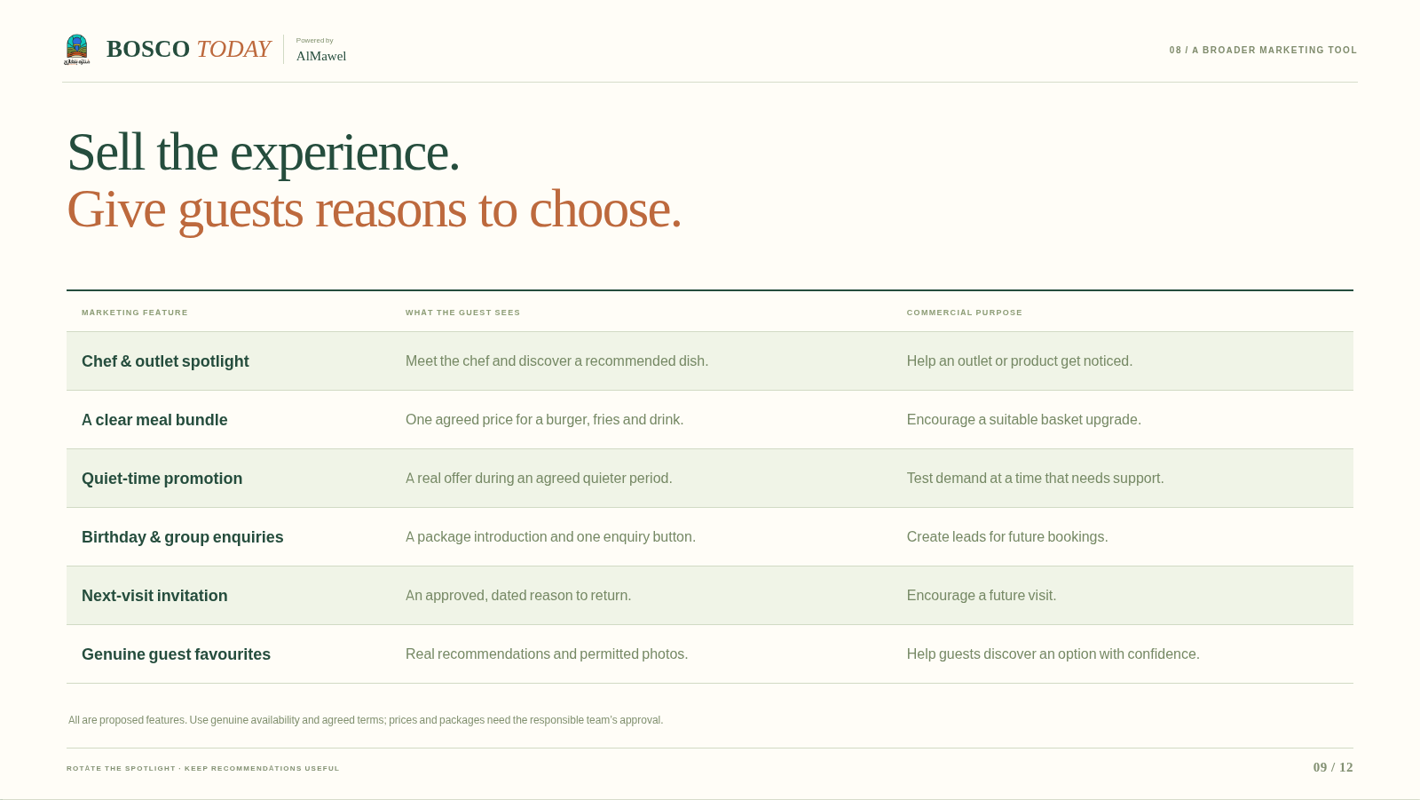
Notes:
Static backup of the browser presentation. The page-turning effect is available in the website version.
BOSCO
TODAY
Powered by
AlMawel
08 / A BROADER MARKETING TOOL
Sell the experience.
Give guests reasons to choose.
MARKETING FEATURE
WHAT THE GUEST SEES
COMMERCIAL PURPOSE
Chef & outlet spotlight
Meet the chef and discover a recommended dish.
Help an outlet or product get noticed.
A clear meal bundle
One agreed price for a burger, fries and drink.
Encourage a suitable basket upgrade.
Quiet-time promotion
A real offer during an agreed quieter period.
Test demand at a time that needs support.
Birthday & group enquiries
A package introduction and one enquiry button.
Create leads for future bookings.
Next-visit invitation
An approved, dated reason to return.
Encourage a future visit.
Genuine guest favourites
Real recommendations and permitted photos.
Help guests discover an option with confidence.
All are proposed features. Use genuine availability and agreed terms; prices and packages need the responsible team’s approval.
ROTATE THE SPOTLIGHT · KEEP RECOMMENDATIONS USEFUL

Slide 10
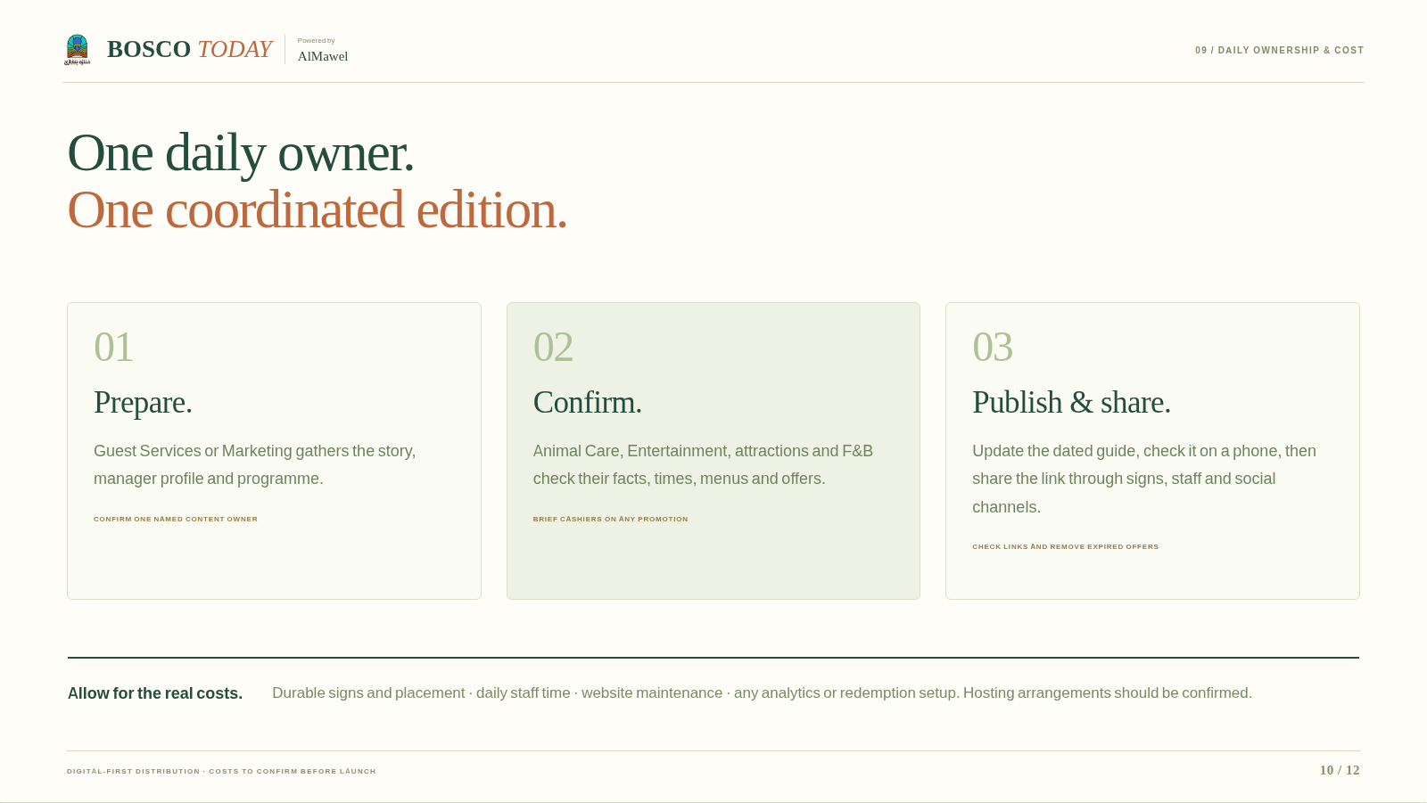
Notes:
Static backup of the browser presentation. The page-turning effect is available in the website version.
BOSCO
TODAY
Powered by
AlMawel
09 / DAILY OWNERSHIP & COST
One daily owner.
One coordinated edition.
01
Prepare.
Guest Services or Marketing gathers the story, manager profile and programme.
CONFIRM ONE NAMED CONTENT OWNER
02
Confirm.
Animal Care, Entertainment, attractions and F&B check their facts, times, menus and offers.
BRIEF CASHIERS ON ANY PROMOTION
03
Publish & share.
Update the dated guide, check it on a phone, then share the link through signs, staff and social channels.
CHECK LINKS AND REMOVE EXPIRED OFFERS
Allow for the real costs.
Durable signs and placement · daily staff time · website maintenance · any analytics or redemption setup. Hosting arrangements should be confirmed.
DIGITAL-FIRST DISTRIBUTION · COSTS TO CONFIRM BEFORE LAUNCH

Slide 11
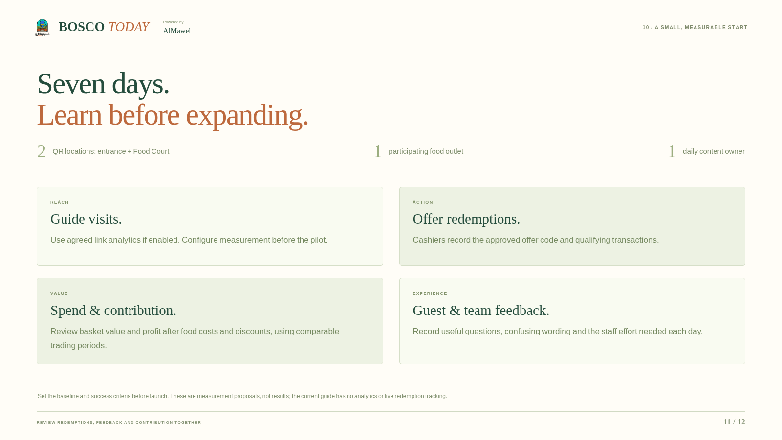
Notes:
Static backup of the browser presentation. The page-turning effect is available in the website version.
BOSCO
TODAY
Powered by
AlMawel
10 / A SMALL, MEASURABLE START
Seven days.
Learn before expanding.
2
QR locations: entrance + Food Court
1
participating food outlet
1
daily content owner
REACH
Guide visits.
Use agreed link analytics if enabled. Configure measurement before the pilot.
ACTION
Offer redemptions.
Cashiers record the approved offer code and qualifying transactions.
VALUE
Spend & contribution.
Review basket value and profit after food costs and discounts, using comparable trading periods.
EXPERIENCE
Guest & team feedback.
Record useful questions, confusing wording and the staff effort needed each day.
Set the baseline and success criteria before launch. These are measurement proposals, not results; the current guide has no analytics or live redemption tracking.
REVIEW REDEMPTIONS, FEEDBACK AND CONTRIBUTION TOGETHER

Slide 12
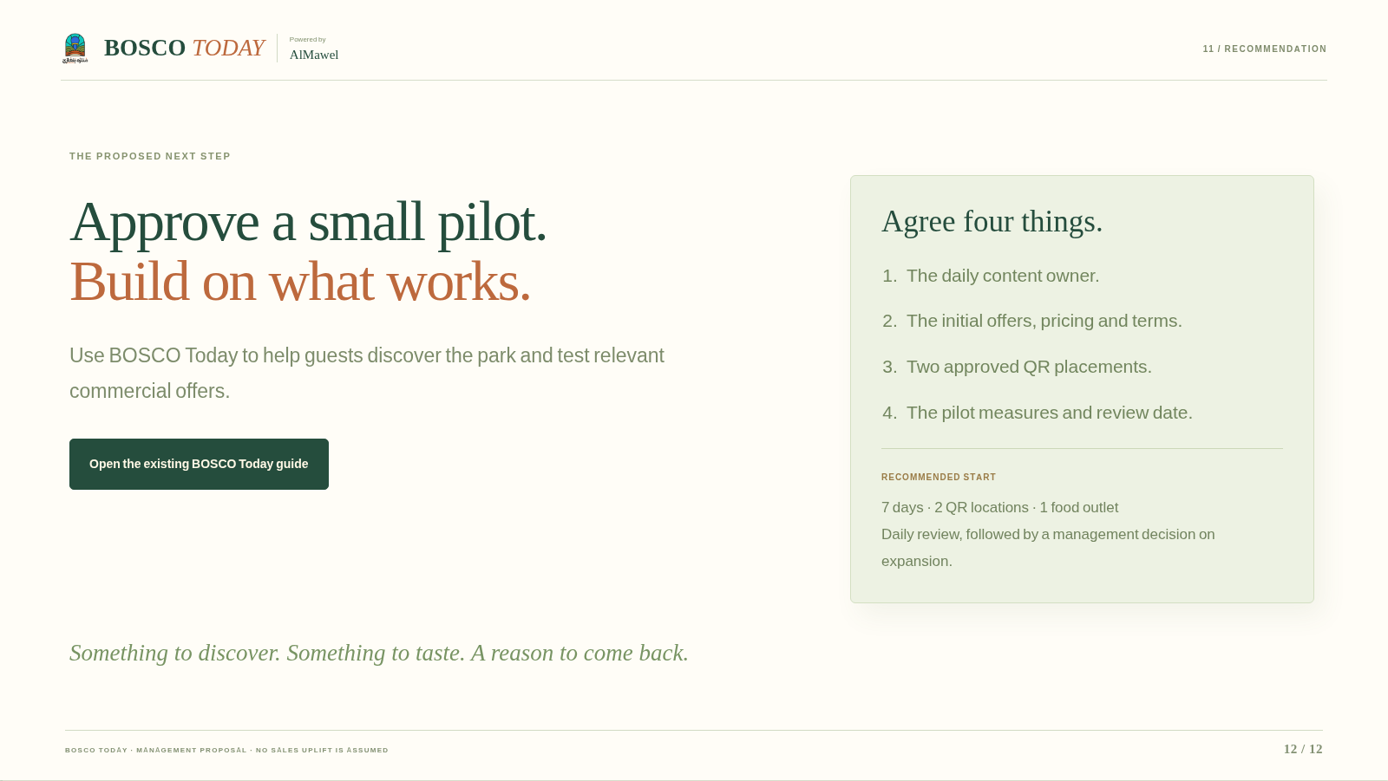
Notes:
Static backup of the browser presentation. The page-turning effect is available in the website version.
BOSCO
TODAY
Powered by
AlMawel
11 / RECOMMENDATION
THE PROPOSED NEXT STEP
Approve a small pilot.
Build on what works.
Use BOSCO Today to help guests discover the park and test relevant commercial offers.
Open the existing BOSCO Today guide
Agree four things.
The daily content owner.
The initial offers, pricing and terms.
Two approved QR placements.
The pilot measures and review date.
RECOMMENDED START
7 days · 2 QR locations · 1 food outlet
Daily review, followed by a management decision on expansion.
Something to discover. Something to taste. A reason to come back.
BOSCO TODAY · MANAGEMENT PROPOSAL · NO SALES UPLIFT IS ASSUMED

