Slide 1
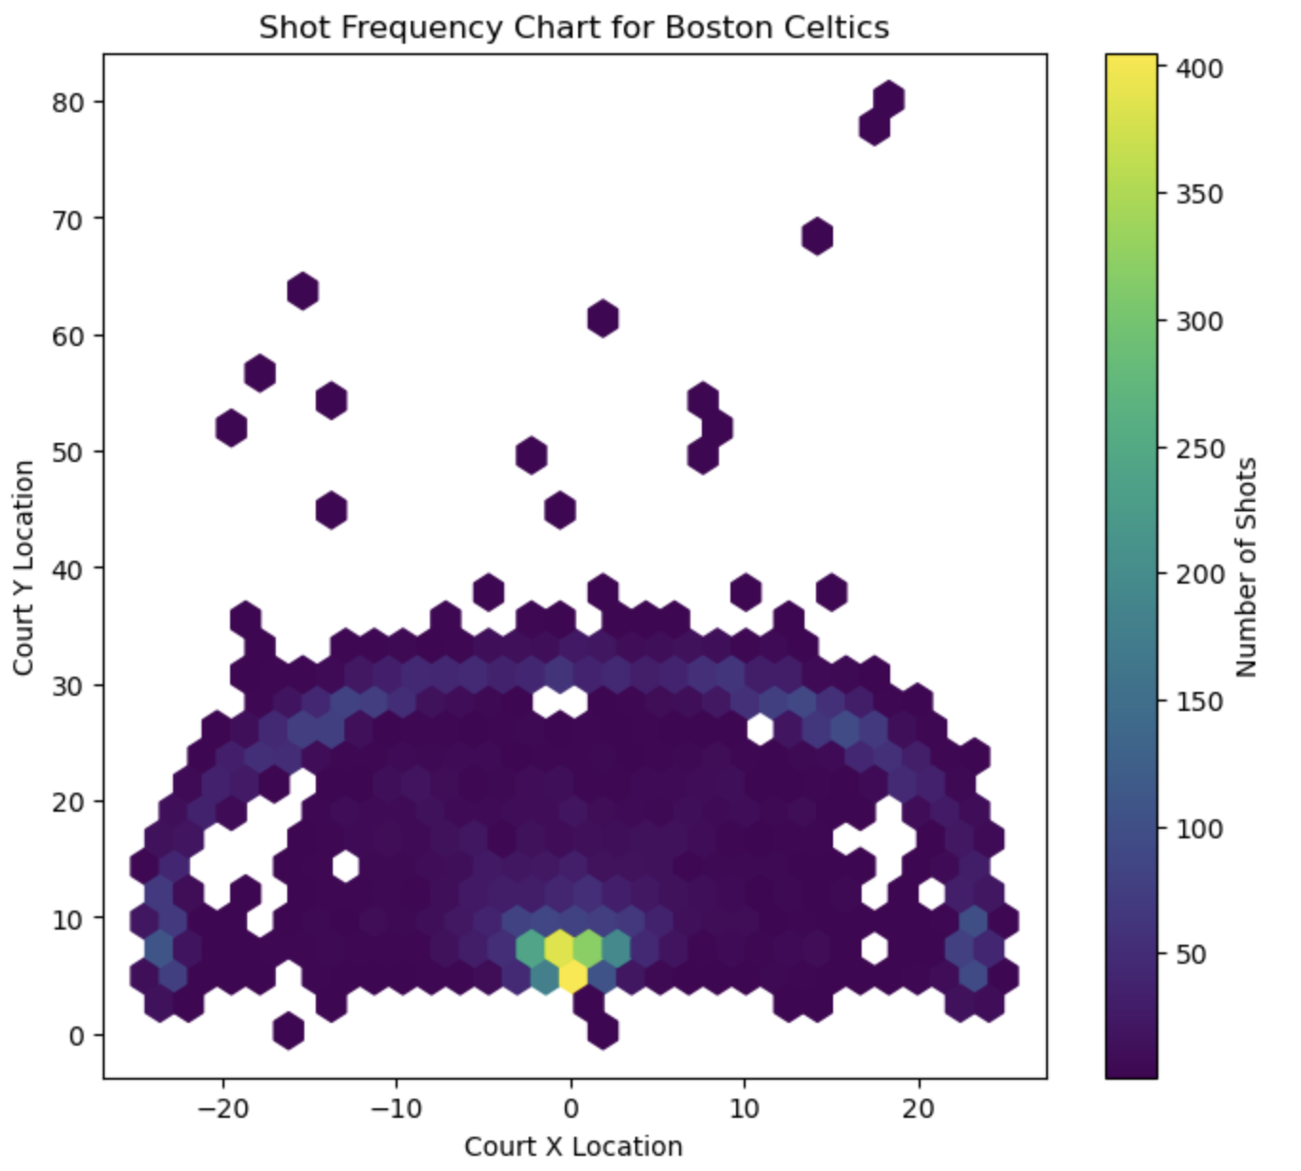
Sports strategy optimization
Kevin, luka, nate, eric, sahat
Cmse 202 section 4

Slide 2
What we’re looking for
What key team performance metrics can an NBA team focus on to maximize their chance to win the most games?

Slide 3
What we’re looking at
Stats from NBA that influences winning % -
Shot types (2p, 3p, layups, etc.) – shot chart
Turnover %
True shooting %
Team adjusted offensive/defensive ratings
Height/Wingspan

Slide 4
Our Process
Get data from official NBA API
Setup Github and organize
Create graphs and charts
Run regressions and create a model that is a good indicator of what creates wins/losses
Train/test model with data
Make a correlation matrix
Analyze results

Slide 5

Our variables
Offensive Rating(ORTG)
Points per 100 possessions
Defensive Rating(DRTG)
Points allowed per 100 possessions
The lower the rating, the better the defense is
True Shooting Percentage
Turnover%
The % of a teams possesions that end in a turnover

Slide 6
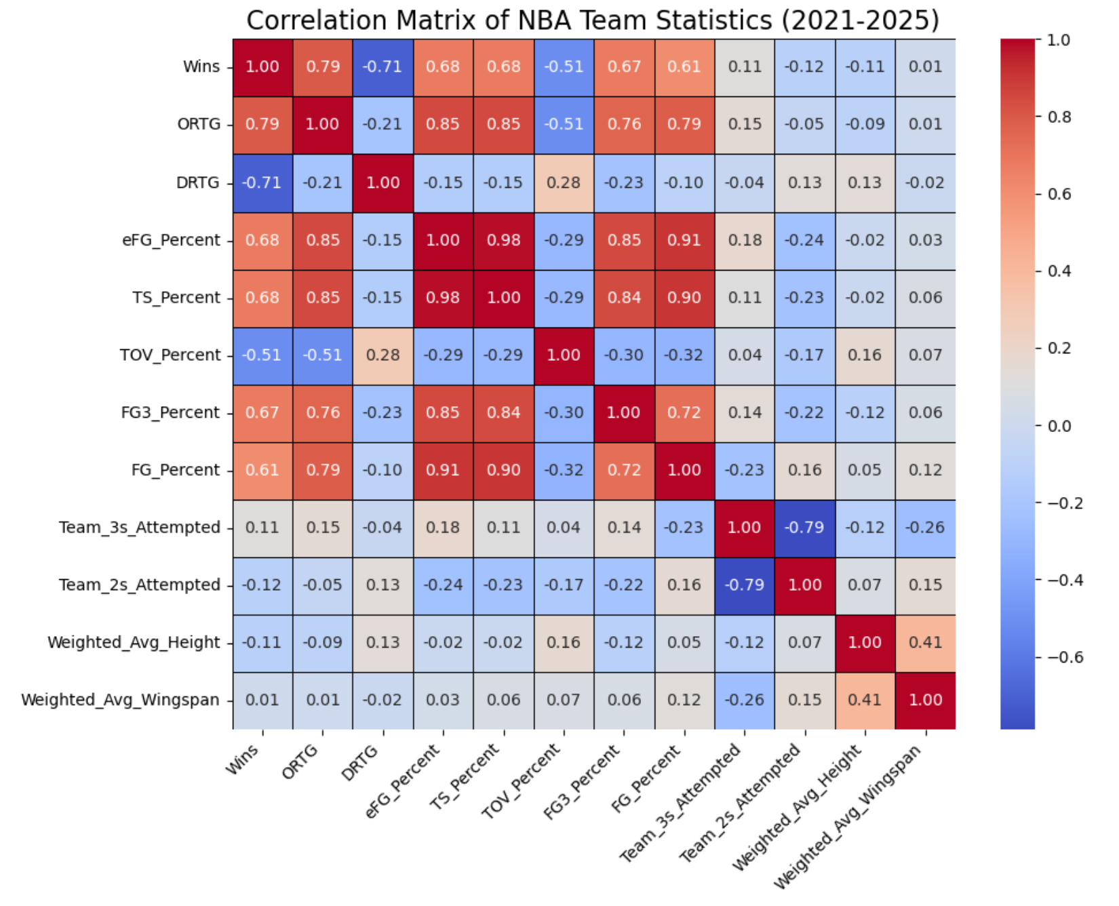
Correlation matrix with team data:
Notable Pairwise Correlations
Wins/ORTG 0.79
Wins/DRTG -0.71
Wins/Height -0.11

Slide 7
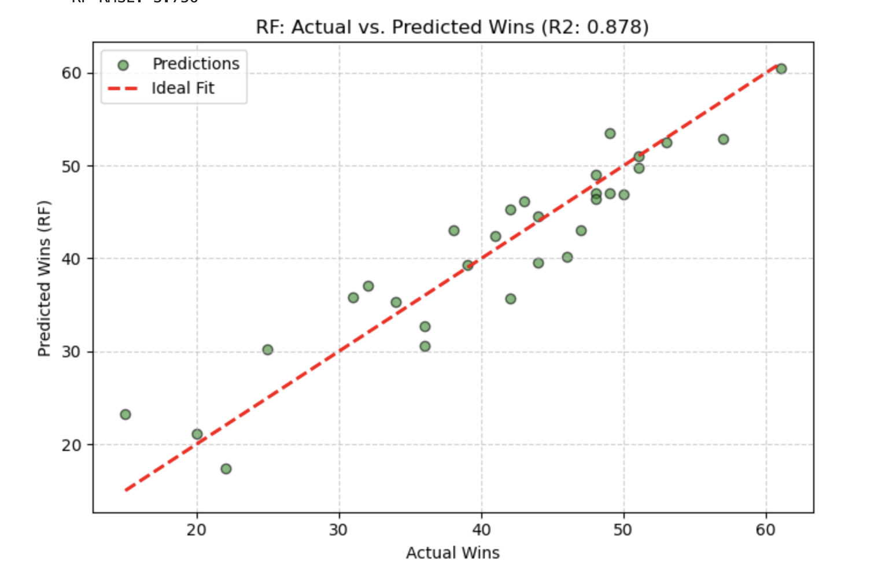
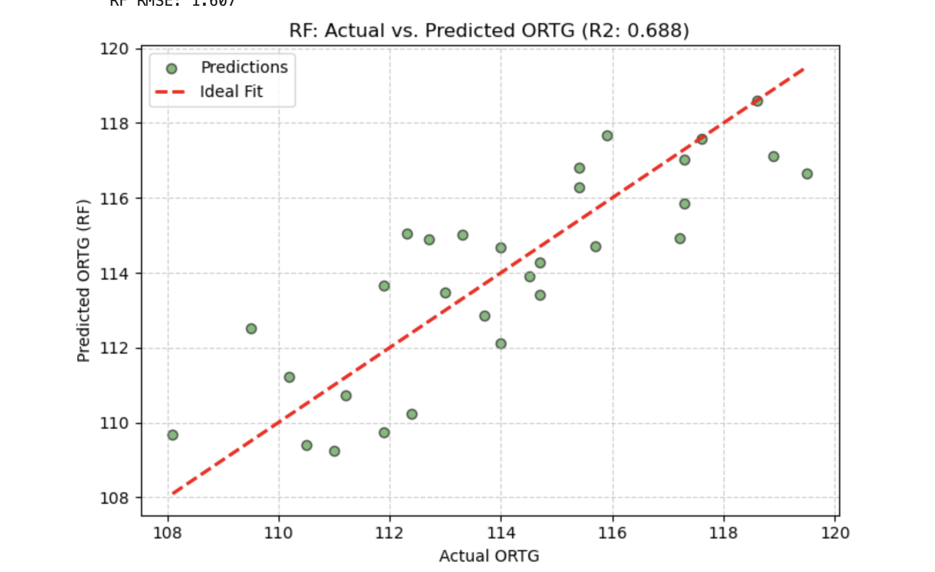
Random forest Predicting Offensive Rating and Wins
Why random forest?
Random forest excels at handling non-linear relationships

Slide 8
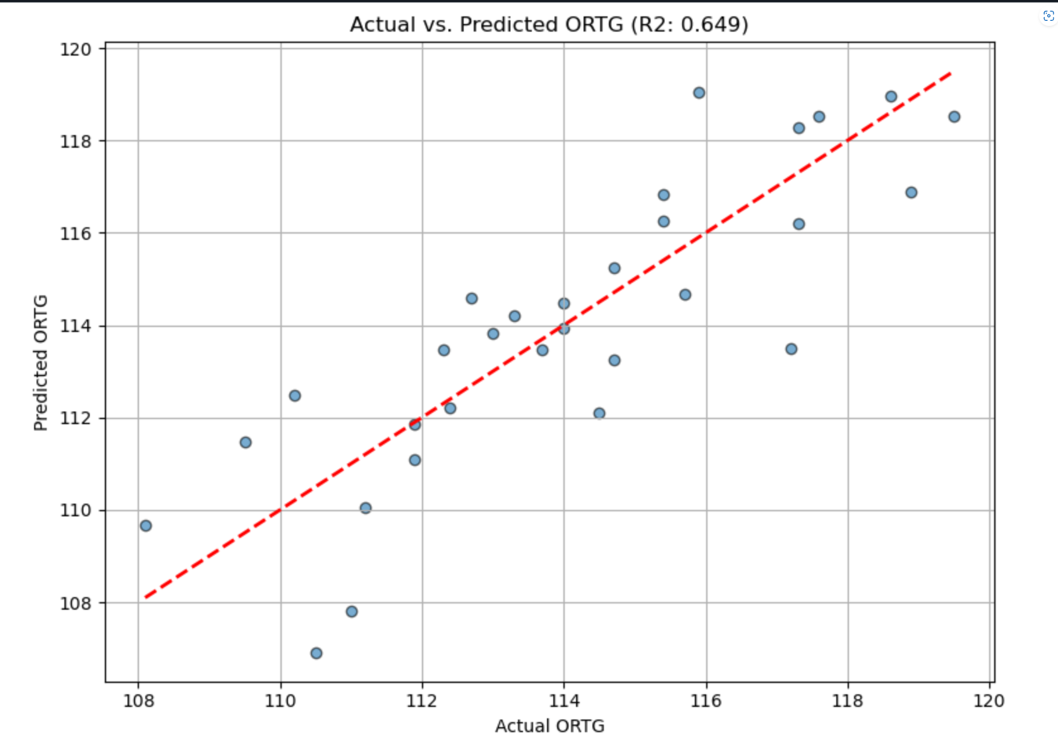
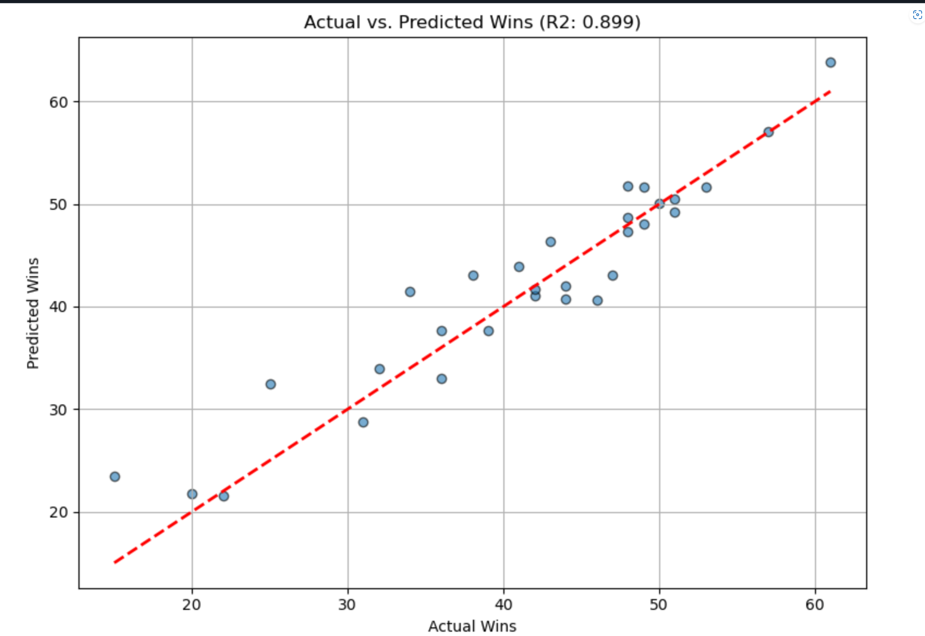
Linear Regression Predicting Offensive Rating and Wins

Slide 9
Difficulties and Complications
Importing the Python shap module and utilizing its methods for SHAP analysis was more complicated than the other parts, as this went beyond the material taught in class.
Finding data beyond the NBA.com API
Basketball changes over time, so it's hard to get a good sample size

Slide 10
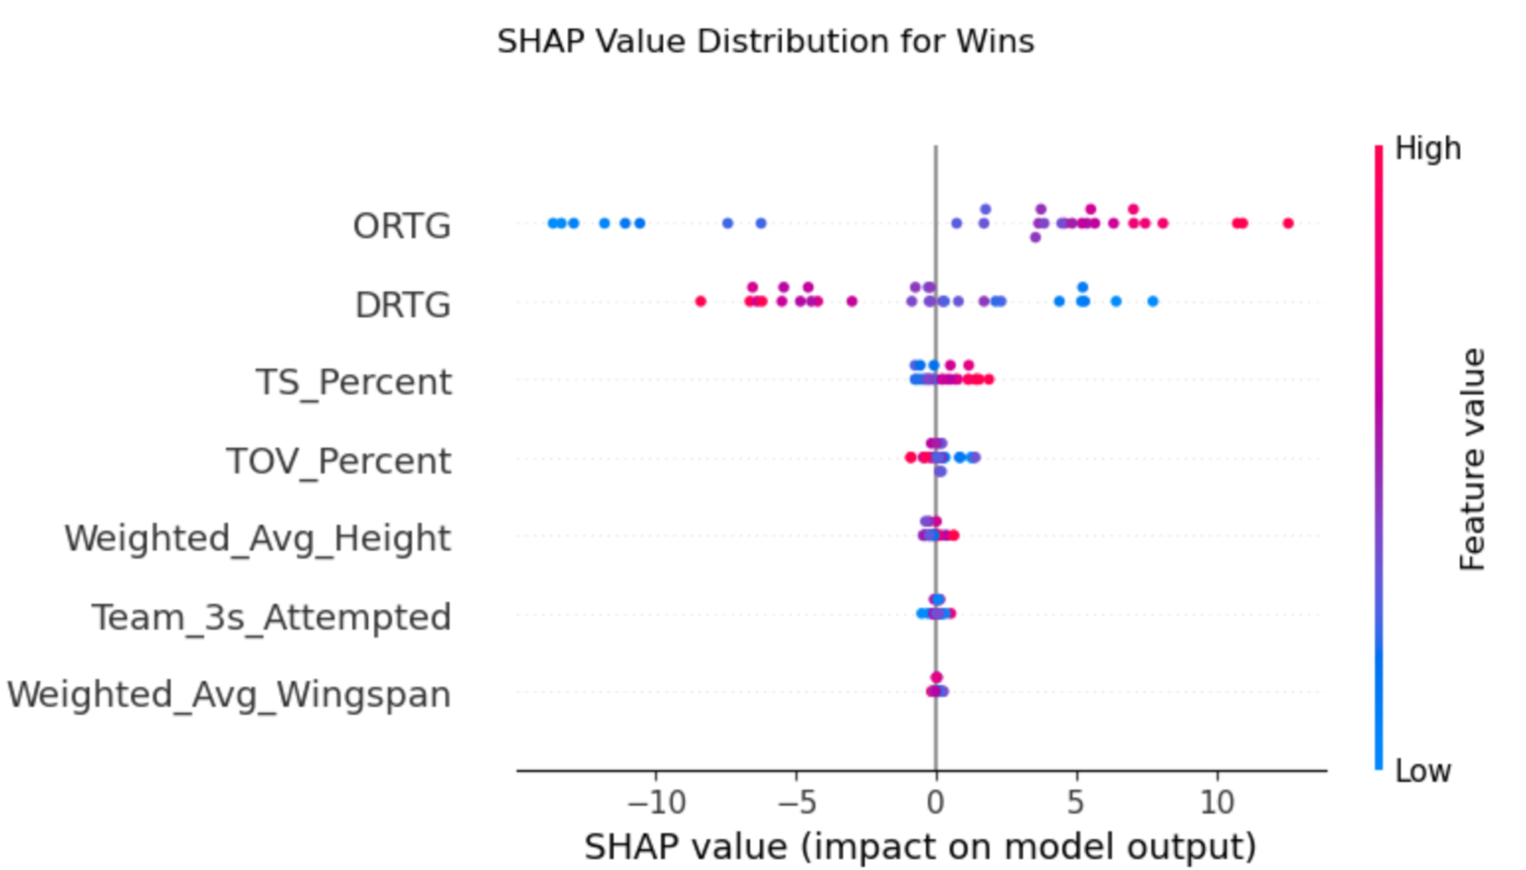
Factors predicting Wins
The wider the spread in SHAP (SHapley Additive exPlanation) values, the more important the factor is when predicting wins:
Offensive rating is the strongest predictor for wins:

Slide 11
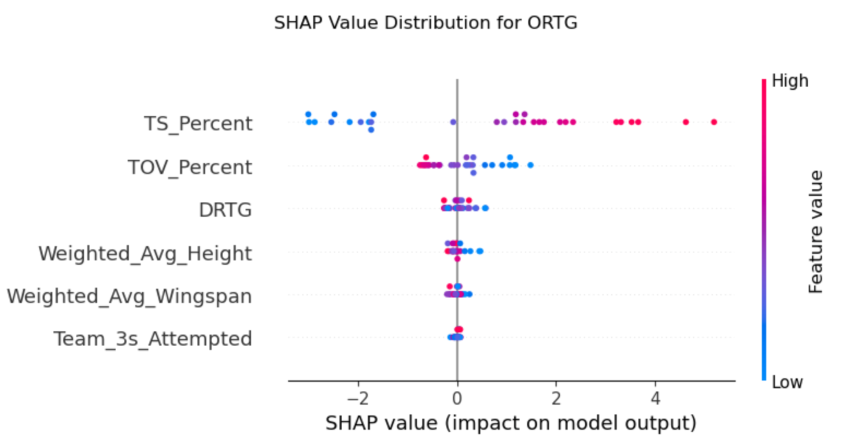
Factors Predicting Offensive Rating

Slide 12
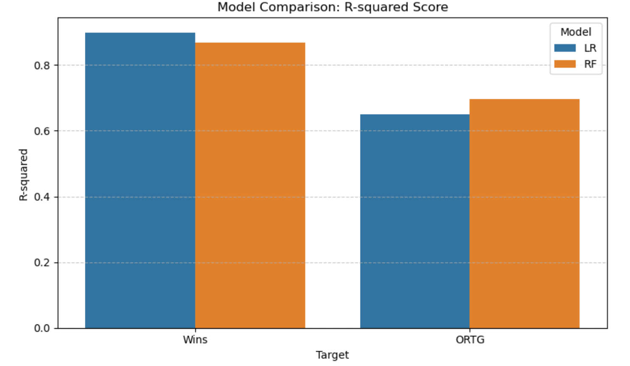
Results: Linear Regression (LR) and Random Forest (RF) Model Comparison

Slide 13
Conclusion
Offensive efficiency should be prioritized over defense.
This can be achieved by increasing shooting efficiency (high TS%) and minimizing turnovers (low TOV%).
Other interesting finding: greater average height has a slightly negative correlation to wins and offensive rating for a team.

