Slide 1
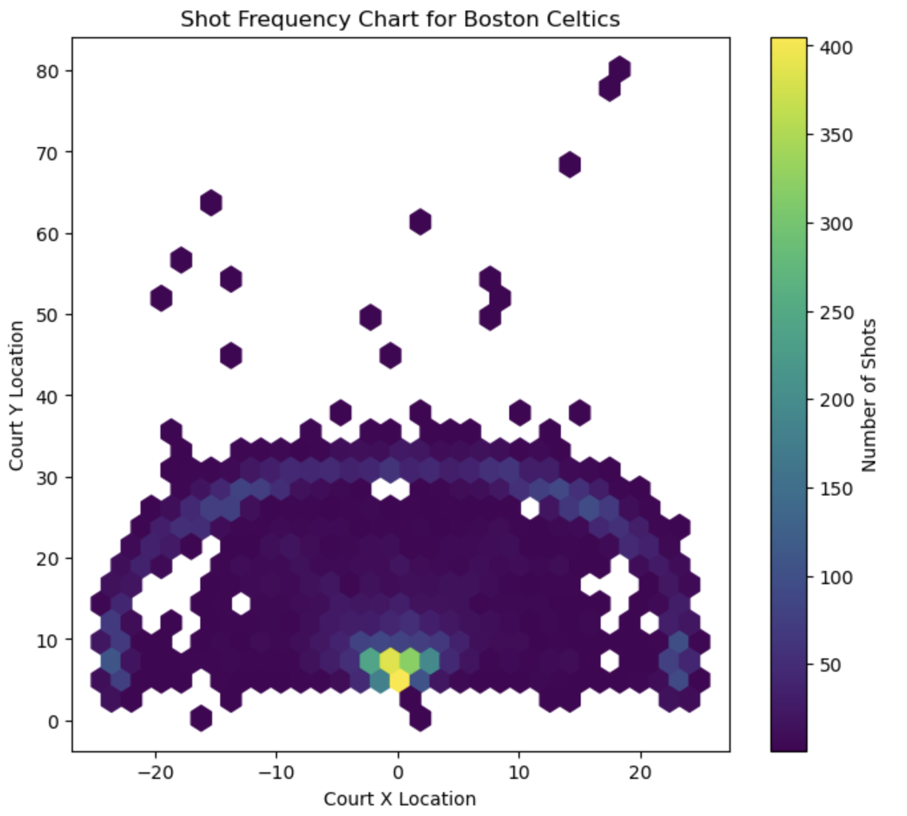
Group 8- sports analysis
Kevin, luka, nate, eric, sahat

Slide 2
What we’re looking for
What key team performance metrics can an NBA team focus on to maximize their chance to win the most games?

Slide 3
What we’re looking at
Stats from NBA that influences winning % -
Shot types (2p, 3p, layups, etc.) – shot chart
Turnover %
True shooting %
Team adjusted offensive/defensive ratings
Height/Wingspan

Slide 4
Our Process
Get data from official NBA API
Setup Github and organize
Create graphs and charts
Run regressions and create a model that is a good indicator of what creates wins/losses
Train/test model with data
Make a correlation matrix
Analyze results

Slide 5
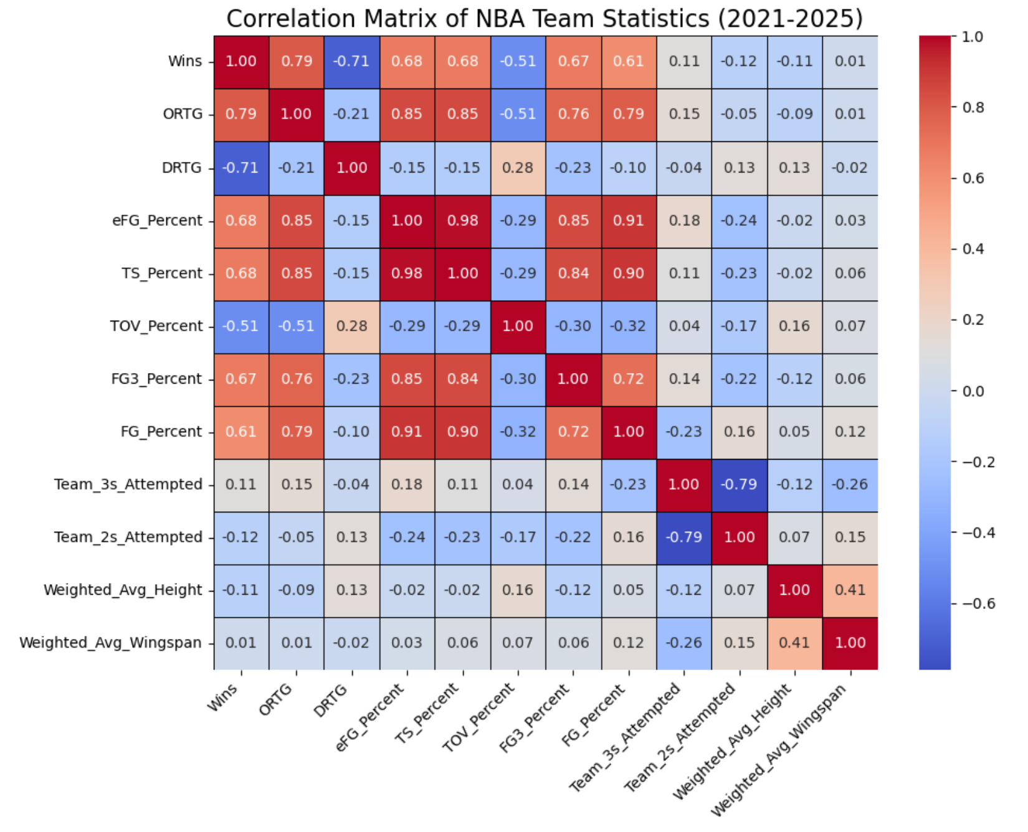
Correlation matrix with team data:
Notable Pairwise Correlations
Wins/ORTG 0.79
Wins/DRTG -0.71
Wins/Height -0.11

Slide 6
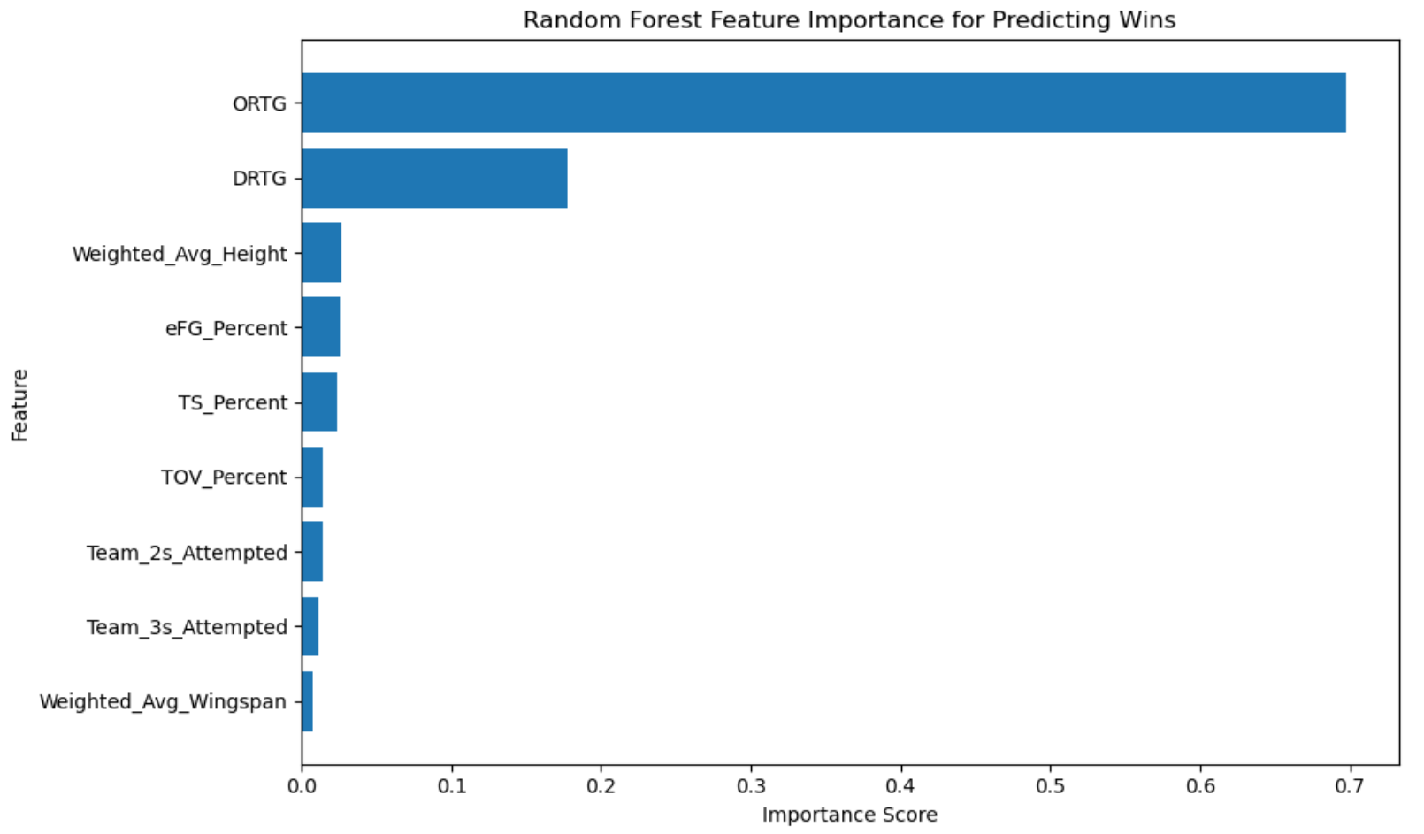
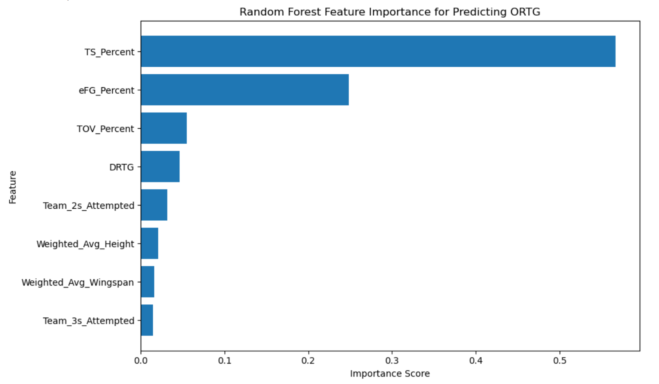
Random forest Predicting Offensive Rating and Wins

Slide 7
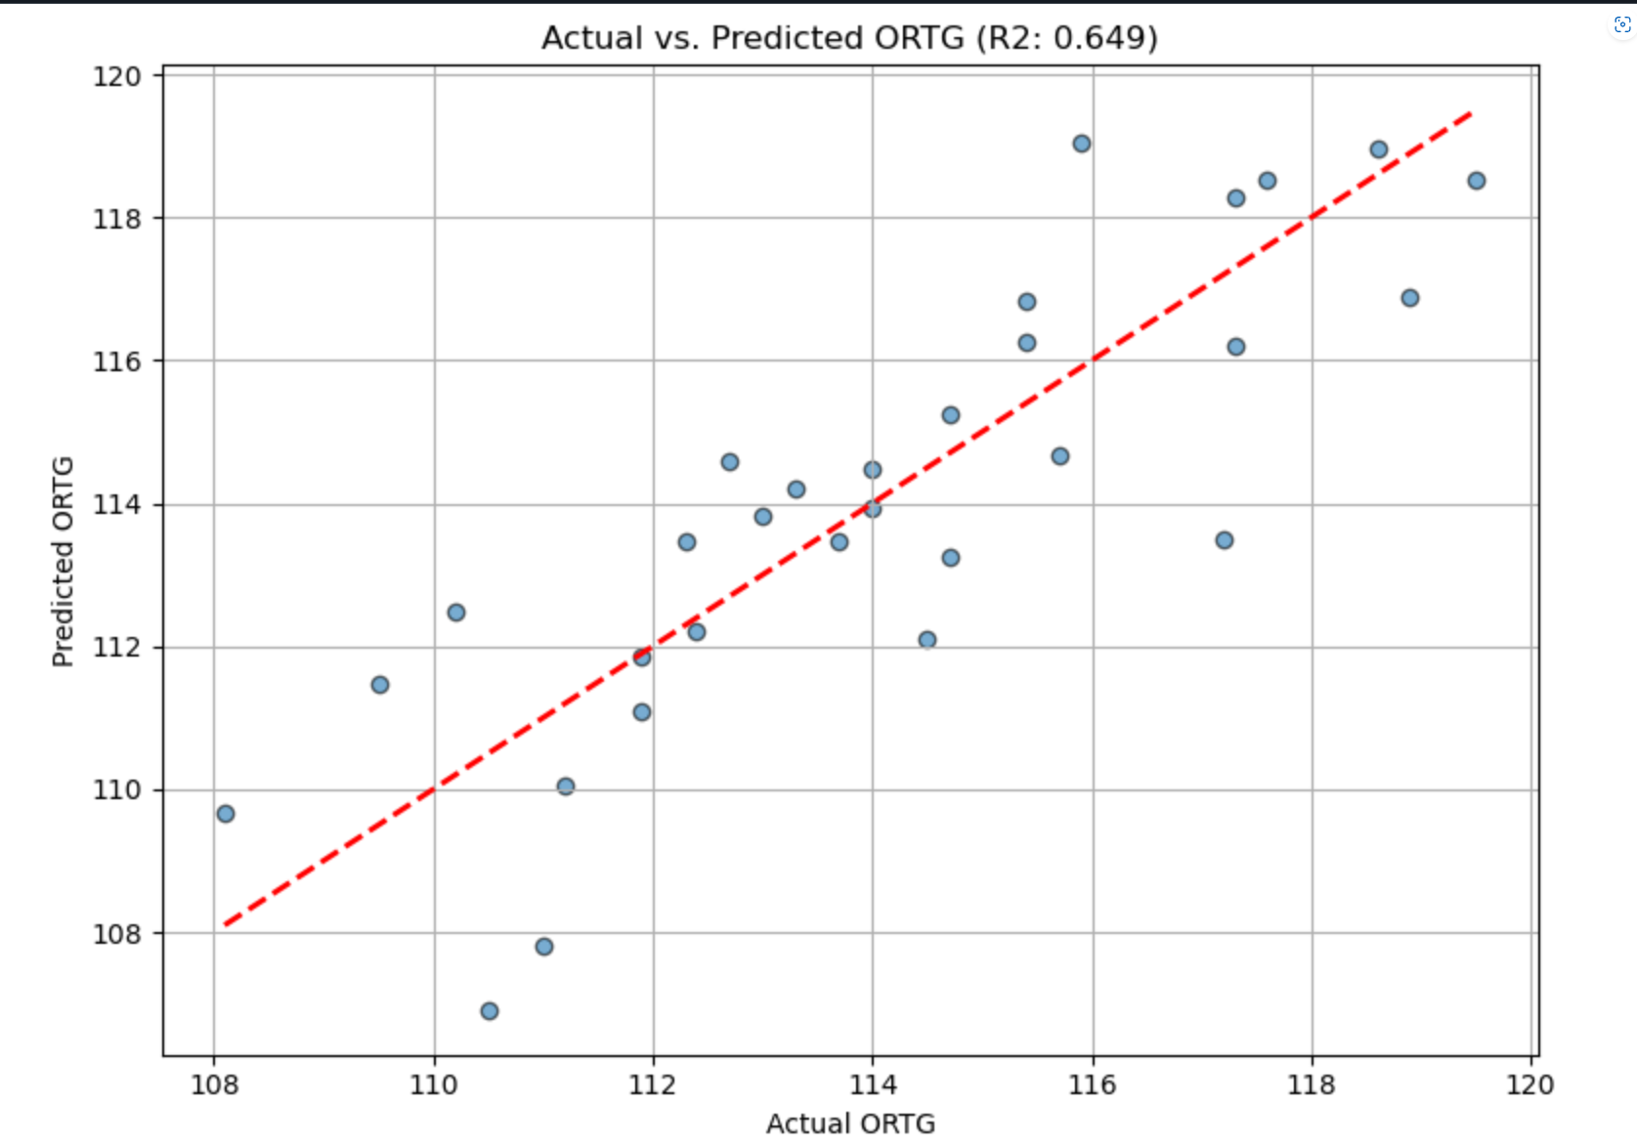
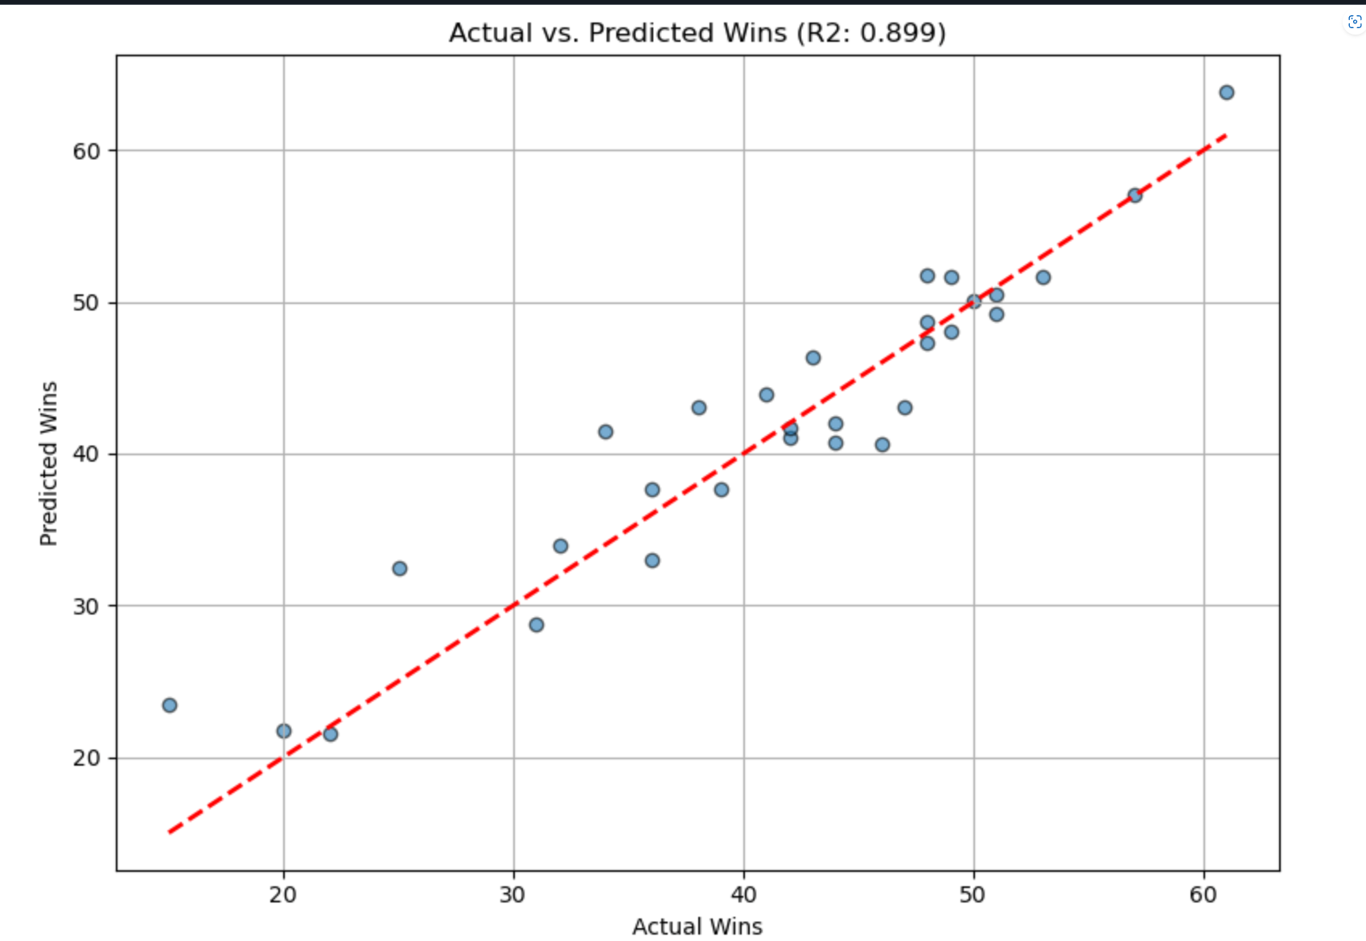
Linear Regression Predicting Offensive Rating and Wins

Slide 8
Difficulties and Complications
Importing the Python shap module and utilizing its methods for SHAP analysis was more complicated than the other parts, as this went beyond the material taught in class.

Slide 9
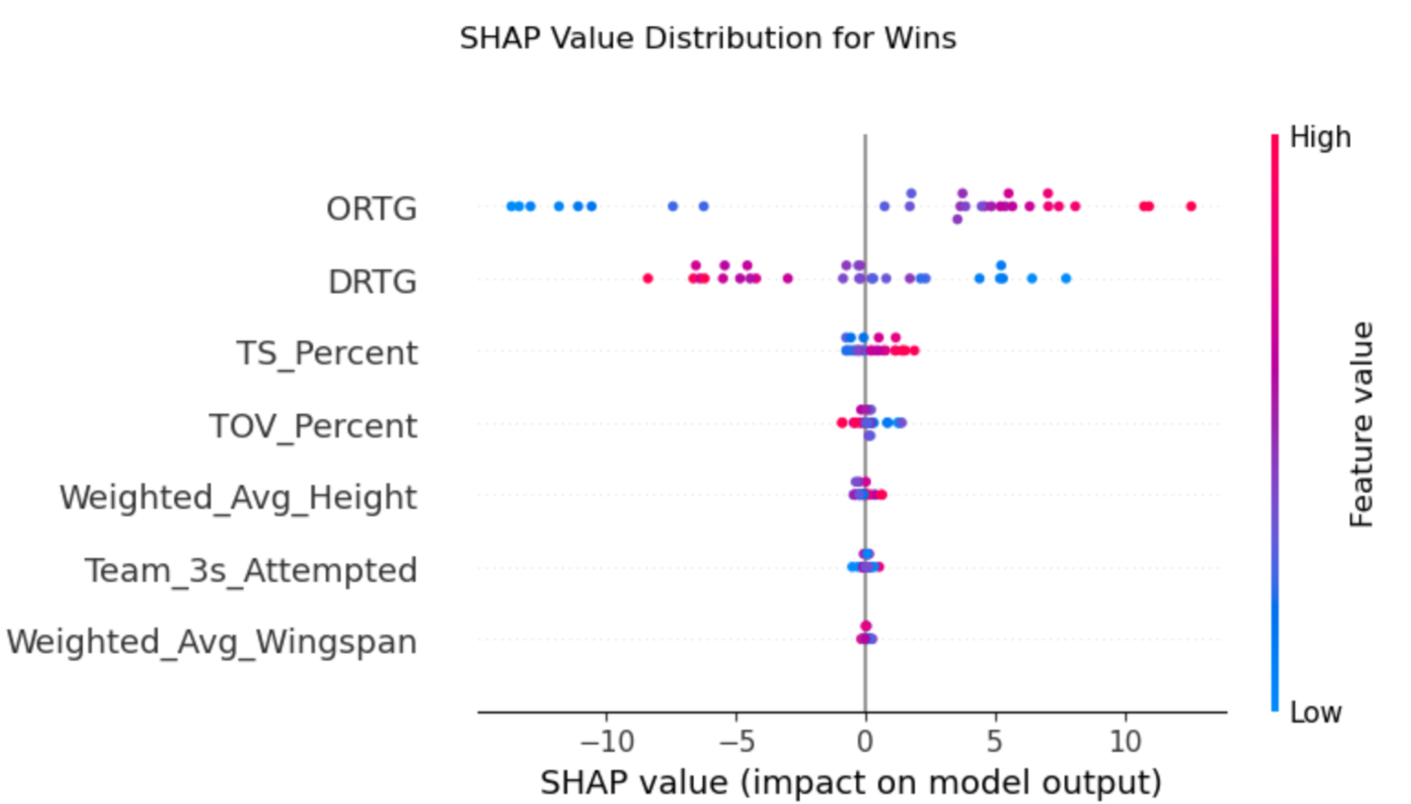
Factors predicting Wins
The wider the spread in SHAP (SHapley Additive exPlanation) values, the more important the factor is when predicting wins:
Offensive rating is the strongest predictor for wins:

Slide 10
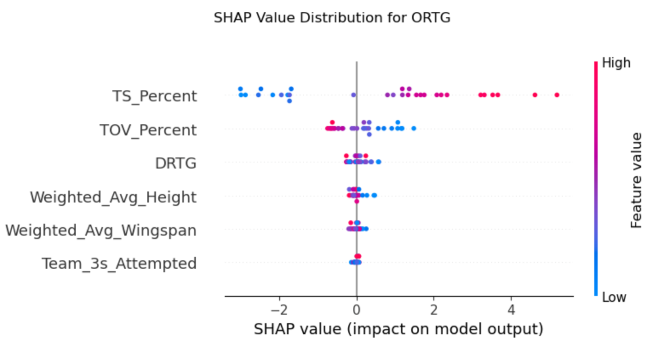
Factors Predicting Offensive Rating

Slide 11
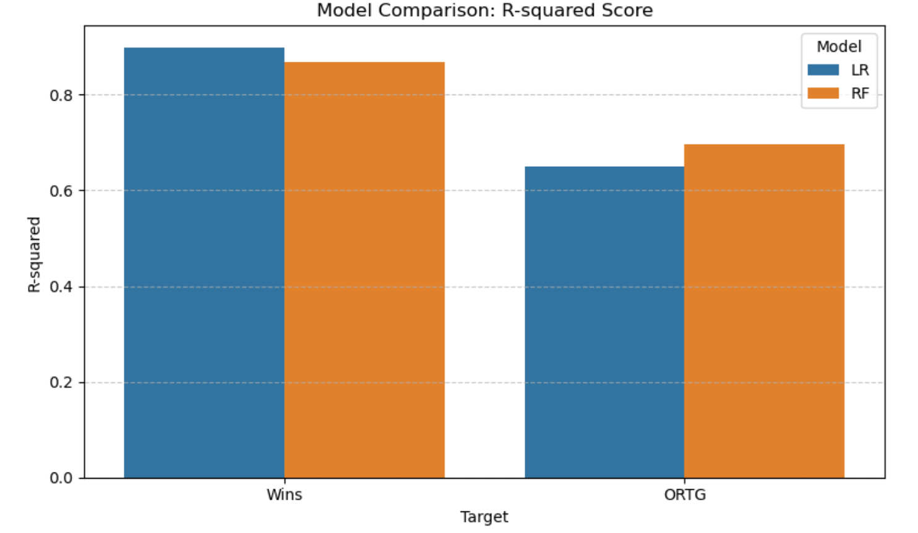
Results: Linear Regression and Random Forest Model Comparison

Slide 12
Conclusion
Offensive efficiency should be prioritized over defense.
This can be achieved by increasing shooting efficiency (high TS%) and minimizing turnovers (low TOV%).
Other interesting finding: greater average height has a slightly negative correlation to wins and offensive rating for a team.

